Slide 1
Modeling Pathways with the π-Calculus:
Concurrent Processes Come Alive
Aviv Regev
Joint work with Udi Shapiro, Bill Silverman and Naama Barkai

Slide 2
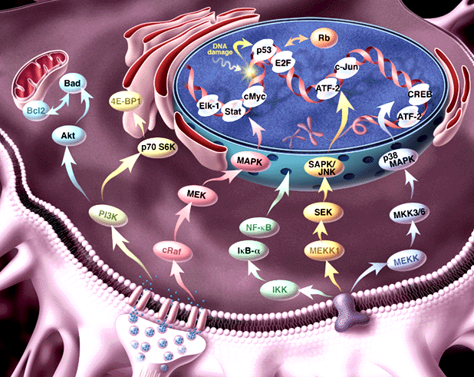
Pathway informatics:
From molecule to process
Genome, transcriptosome, proteome
Regulation of expression; Signal Transduction; Metabolism

Slide 3
Our goal:
A formal representation language for molecular processes
Information about
  Dynamics
  Molecular structure
  Biochemical detail of interaction
The Power to
  simulate
  analyze
  compare
Formal semantics

Slide 4
Biochemical networks are complex
Concurrent, compositional
Mobile (dynamic wiring)
Modular, hierarchical
… but similar to concurrent computation

Slide 5
Molecules as processes
Represent a structure by its potential behavior: by the process in which it can participate
Example: An enzyme as the enzymatic reaction process, in which it may participate

Slide 6
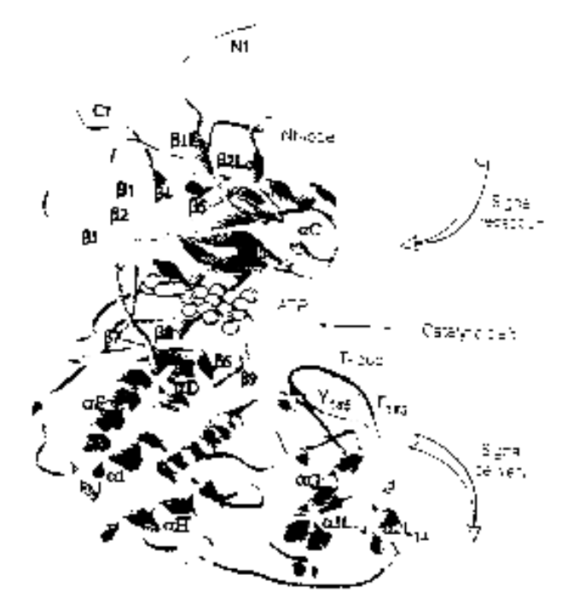
Example: ERK1 Ser/Thr kinase
Structure
Process
NH₂
Binding MP1 molecules
Nt lobe
Regulatory T-loop:
Change conformation
Kinase site:
Phosphorylate Ser/Thr residues
(PXT/SP motifs)
ATP binding site:
Bind ATP, and use it for phsophorylation
p-Y
Catalytic core
p-T
Ct lobe
Binding to substrates
COOH

Slide 7
The π-calculus
(Milner, Walker and Parrow 1989)
A program specifies a network of interacting processes
Processes are defined by their potential communication activities
Communication occurs on complementary channels, identified by names
Communication content: Change of channel names (mobility)
Stochastic version (Priami 1995) : Channels are assigned rates

Slide 8
Processes
P – Process
P|Q – Two parallel processes
ERK1
SYSTEM ::= … | ERK1 | ERK1 | … | MEK1 | MEK1 | …
ERK1 ::= (new internal_channels)
(Nt_LOBE |CATALYTIC_CORE |Ct_LOBE)
Domains, molecules, systems ~ Processes

Slide 9
Global communication channels
x ? [y] –Input into y on channel name x?
x ! [z] – Output z on channel co-named x!
MEK1
ERK1
T_LOOP (tyr )::=
tyr ? [tyr].T_LOOP(tyr)
KINASE_ACTIVE_SITE::=
tyr ! [p-tyr] . KINASE_ACTIVE_SITE
Y
Complementary molecular structures ~
Global channel names and co-names

Slide 10
Communication and global mobility
Ready to send p-tyr
on tyr !
Ready to receive on tyr ?
MEK1
ERK1
tyr ! [p-tyr] . KINASE_ACTIVE_SITE + … | … + tyr ? [tyr] . T_LOOP
Y
Actions consumed
alternatives discarded
p-tyr replaces tyr
KINASE_ACTIVE_SITE | T_LOOP {p-tyr / tyr}
pY
Molecular interaction and modification ~
Communication and change of channel names

Slide 11
Local restricted channels
(new x) P – Local channel x, in process P
ERK1
ERK1 ::= (new backbone)
(Nt_LOBE |CATALYTIC_CORE |Ct_LOBE)
Compartments (molecule,complex,subcellular)
~ Local channels as unique identifiers

Slide 12
Communication and scope extrusion
(new x) (y ! [x]) – Extrusion of local channel x
MP1
(new backbone) mp1_erk ! [backbone] . mp1_mek ! [backbone] . … |
mp1_erk ? [cross_backbone] . cross_backbone ? […] |
mp1_mek ? [cross_backbone] . cross_backbone ! […]
MEK1
ERK1
Complex formation ~ Exporting local channels

Slide 13
Stochastic π-calculus
(Priami, 1995, Regev, Priami et al 2000)
Every channel x attached with a base rate r
A global (external) clock is maintained
The clock is advanced and a communication is selected according to a race condition
Modification of the race condition and actual rate calculation according to biochemical principles (Regev, Priami et al., 2000)
BioPSI simulation system

Slide 14
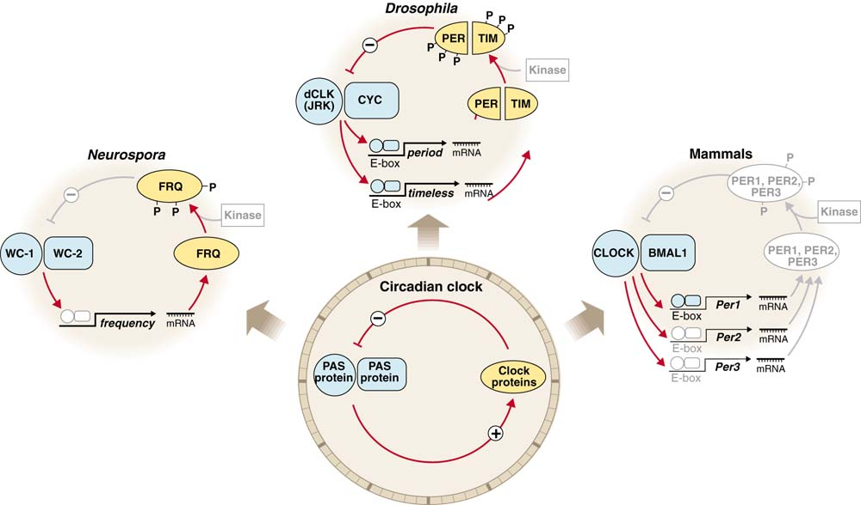
Circadian clocks: Implementations
J. Dunlap, Science (1998) 280 1548-9

Slide 15
The circadian clock machinery
(Barkai and Leibler, Nature 2000)
A
R
degradation
A
R
degradation
UTR_{A}
UTR_{R}
translation
translation
A_RNA
R_RNA
transcription
transcription
P_{A}
P_{R}
A_GENE
R_GENE
Differential rates: Very fast, fast and slow

Slide 16
The machinery in π-calculus: “A” molecules
A_GENE::= PROMOTED_A + BASAL_A
PROMOTED_A::= pA ? {e}.ACTIVATED_TRANSCRIPTION_A(e)
BASAL_A::= bA ? [].( A_GENE | A_RNA)
ACTIVATED_TRANSCRIPTION_A::=
τ₁ . (ACTIVATED_TRANSCRIPTION_A | A_RNA) +
e ? [] . A_GENE
A_Gene
RNA_A::= TRANSLATION_A + DEGRADATION_mA
TRANSLATION_A::= utrA ? [] . (A_RNA | A_PROTEIN)
DEGRADATION_mA::= degmA ? [] . 0
A_RNA
A_PROTEIN::= (new e1,e2,e3)
PROMOTION_A-R + BINDING_R + DEGRADATION_A
PROMOTION_A-R ::= pA!{e2}.e2![]. A_PROTEIN +
pR!{e3}.e3![]. A_PRTOEIN
BINDING_R ::= rbs ! {e1} . BOUND_A_PRTOEIN
BOUND_A_PROTEIN::= e1 ? [].A_PROTEIN + degpA ? [].e1 ![].0
DEGRADATION_A::= degpA ? [].0
A_protein

Slide 17
The machinery in π-calculus: “R” molecules
R_GENE::= PROMOTED_R + BASAL_R
PROMOTED_R::= pR ? {e}.ACTIVATED_TRANSCRIPTION_R(e)
BASAL_R::= bR ? [].( R_GENE | R_RNA)
ACTIVATED_TRANSCRIPTION_R::=
τ₂ . (ACTIVATED_TRANSCRIPTION_R | R_RNA) +
e ? [] . R_GENE
R_Gene
RNA_R::= TRANSLATION_R + DEGRADATION_mR
TRANSLATION_R::= utrR ? [] . (R_RNA | R_PROTEIN)
DEGRADATION_mR::= degmR ? [] . 0
R_RNA
R_PROTEIN::= BINDING_A + DEGRADATION_R
BINDING_R ::= rbs ? {e} . BOUND_R_PRTOEIN
BOUND_R_PROTEIN::= e1 ? [] . A_PROTEIN + degpR ? [].e1 ![].0
DEGRADATION_R::= degpR ? [].0
R_protein

Slide 18
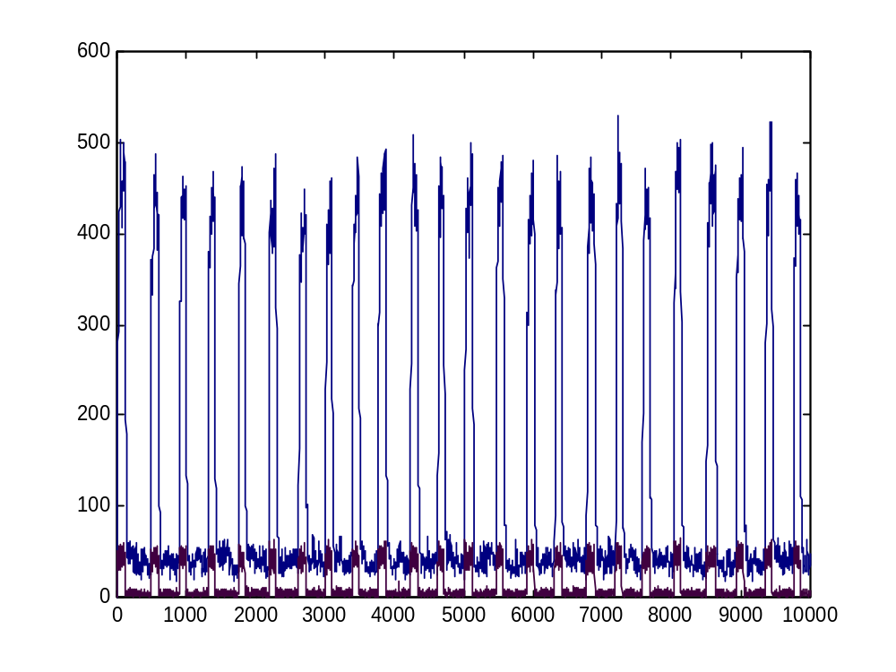
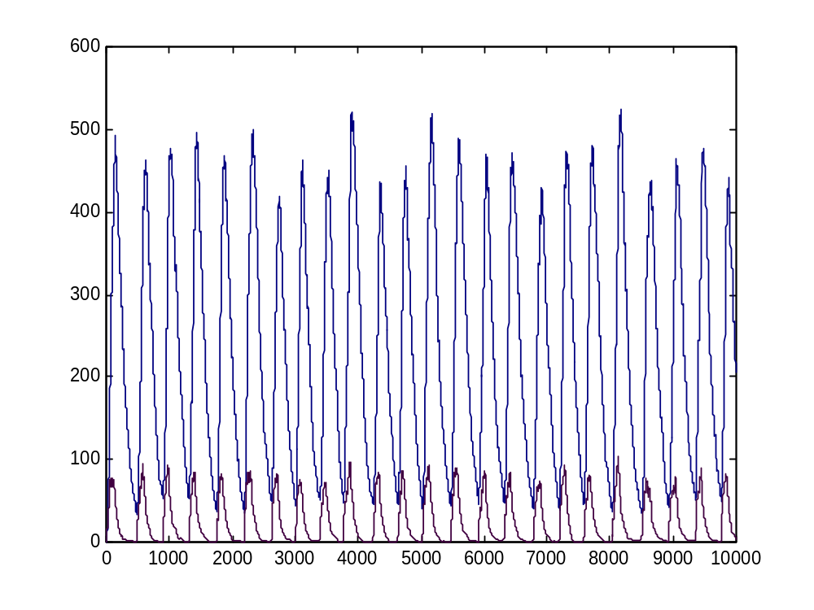
BioPSI simulation
A
R
Robust to a wide range of parameters

Slide 19
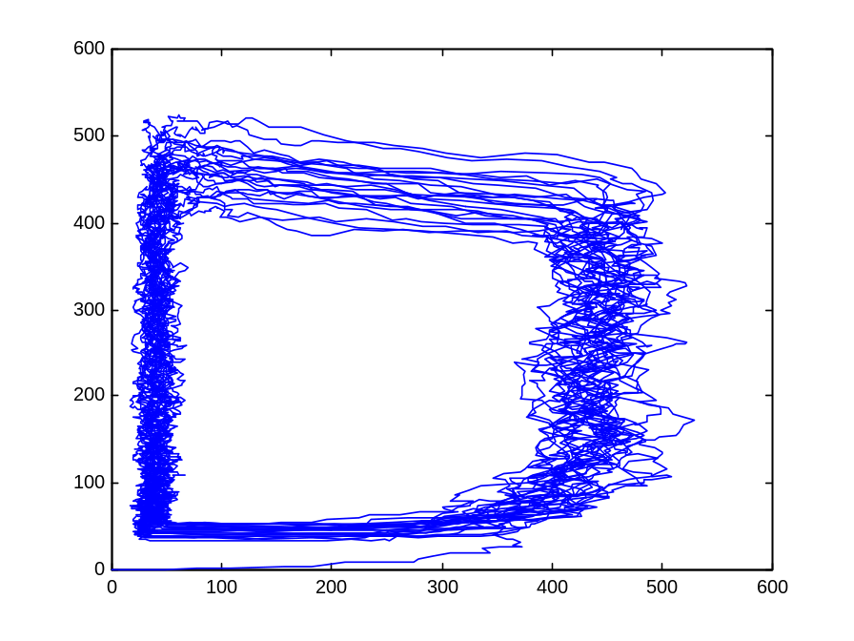
The A hysteresis module
A
ON
A
Fast
Fast
OFF
R
R
The entire population of A molecules (gene, RNA, and protein) behaves as one bi-stable module

Slide 20
Modular cell biology
? How to identify modules and prove their function?
! Semantic concept: Two processes are equivalent if can be exchanged within any context without changing observable system behavior

Slide 21
Modular cell biology
Build two representations in the π-calculus
  Implementation (how?): molecular level
  Specification (what?): functional module level
Show the equivalence of both representations
  by computer simulation
  by formal verification

Slide 22
The circadian specification
R
Counter_A
R
degradation
OFF
ON
UTR_{R}
translation
R_RNA
P_{R}
transcription
R_GENE
R (gene, RNA, protein) processes are unchanged (modular;compositional)

Slide 23
Hysteresis module
ON_H-MODULE(C_{A})::=
{C_{A}<=T1} . OFF_H-MODULE(C_{A}) +
{C_{A}>T1} .
(rbs ! {e1} . ON_DECREASE +
e1 ! [] . ON_H_MODULE +
pR ! {e2} . (e2 ! [] .0 | ON_H_MODULE) +
τ1 . ON_INCREASE)
ON_INCREASE::= {C_{A}++} . ON_H-MODULE
ON_DECREASE::= {C_{A}--} . ON_H-MODULE
ON
OFF_H-MODULE(C_{A})::=
{C_{A}>T2} . ON_H-MODULE(C_{A}) +
{C_{A}<=T2} .
(rbs ! {e1} . OFF_DECREASE +
e1 ! [] . OFF_H_MODULE +
τ2 . OFF_INCREASE )
OFF_INCREASE::= {C_{A}++} . OFF_H-MODULE
OFF_DECREASE::= {C_{A}--} . OFF_H-MODULE
OFF

Slide 24
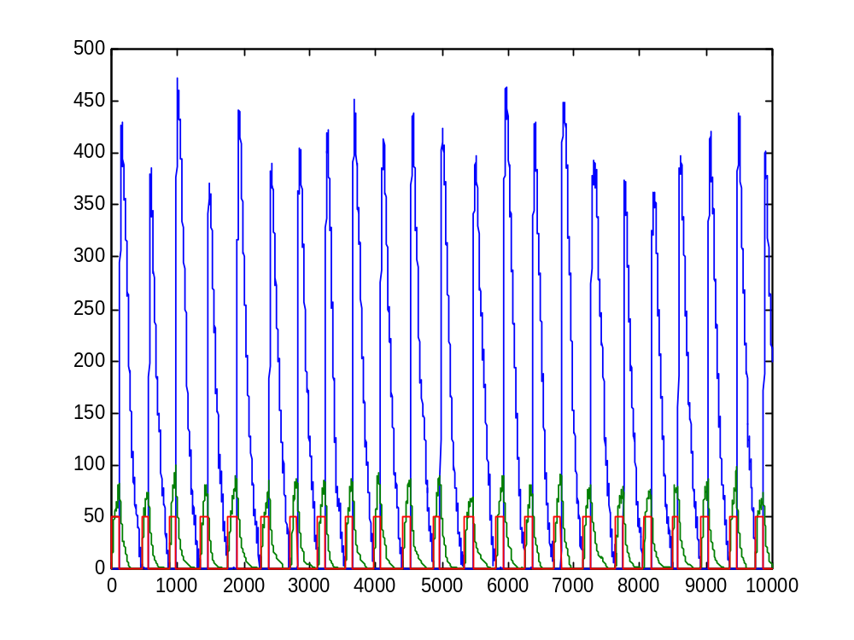
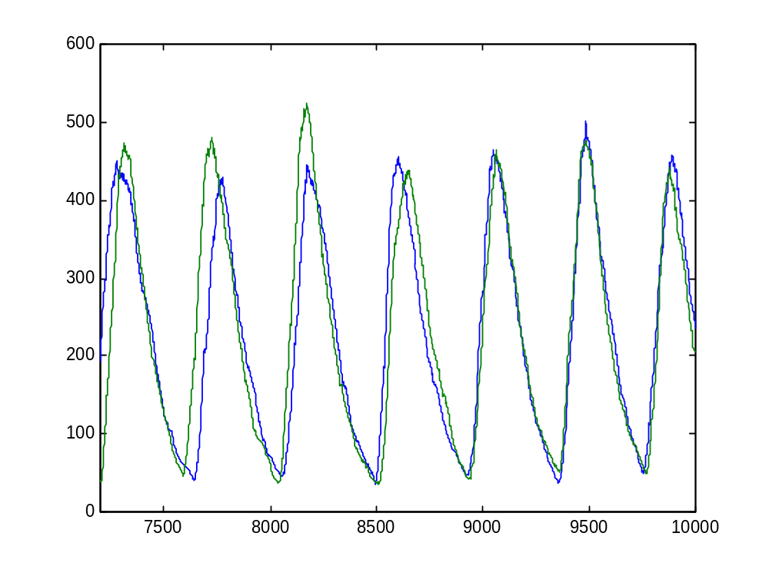
BioPSI simulation
Module, R protein and R RNA
R (module vs. molecules)

Slide 25
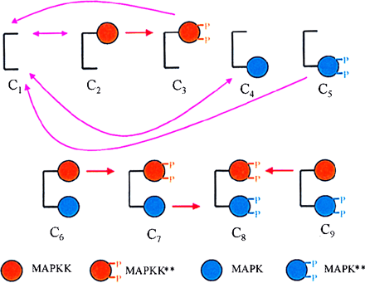
Why Pi ?
Compositional
  Molecular
  Incremental
  Preservation through transitions
  Straightforward manipulation
Modular
  Scalable
  Comparative
Levchenko et al., 2000

Slide 26
The next step:
The homology of process

Slide 27
Udi Shapiro (WIS)
Eva Jablonka (TAU)
Bill Silverman (WIS)
Aviv Regev (TAU, WIS)
Naama Barkai (WIS)
Corrado Priami (U. Verona)
Vincent Schachter (Hybrigenics)
www.wisdom.weizmann.ac.il/~aviv

