Slide 1
The pi-Calculus
Syntax and Semantics - II

Slide 2
Na + Cl ↔ Na⁺ + Cl⁻
Atoms and ions | Processes | Na, Na_plus Cl Cl_minus
Reaction capabilities (valence electrons) | Communication actions (alerts) | e1 ! [] e1 ? [] e2 ! [] e2 ? []
Reaction | Communication and state alteration | COMM
Reaction rate | Channel rate | Gillespie’s algorithm

Slide 3
Na + Cl ↔ Na⁺ + Cl⁻
-language(psifcp).
global(e1(100),e2(10)).
baserate(10).
System::= Na | Na | Cl | Cl .
Na::= e1 ! [] , Na_plus .
Na_plus::= e2 ? [] , Na .
Cl::= e1 ? [] , Cl_minus .
Cl_minus::= e2 ! [] , Cl .
nacl_1.cp

Slide 4
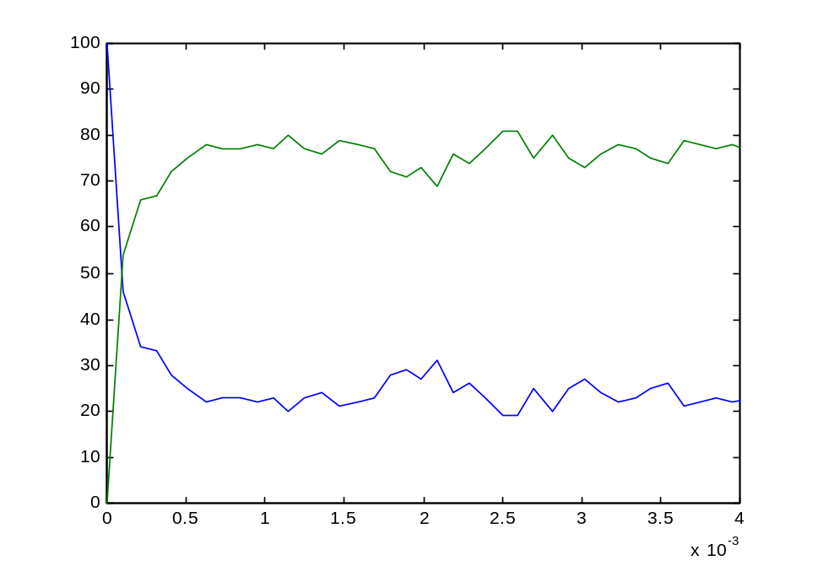
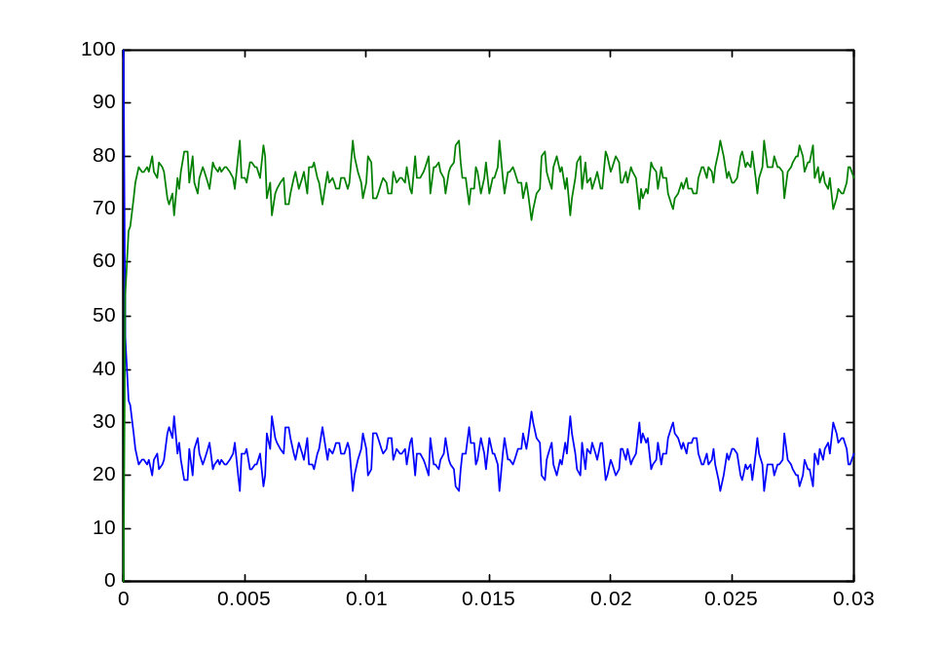
Na + Cl ↔ Na⁺ + Cl⁻
~ 70-80 Na+; 20-30 Na. Why?
nacl_1.cp

Slide 5
Na + Cl ↔ Na⁺ + Cl⁻
2nd order forward and reverse reactions, at equilibrium
-k1[Na][Cl] + k2[Na+][Cl-] = 0
10(100-[Na])² = 100[Na]²
[Na] = 100√10 / (10 + √ 10)
= 24.025...

Slide 6
Na + K + 2Cl ↔ Na⁺ + K⁺ + 2Cl⁻
One molecule (Cl) is able to interact with more than one partner (Na or K)
Each reaction has a different base rate
We will use
  A different communication channel per each partner (same as e1 and e2 for forward and reverse reactions before)

Slide 7
Na + K + 2Cl ↔ Na⁺ + K⁺ + 2Cl⁻
Several alternative reactions are offered (enabled) by the same atom at the same time, but only a single one can actually occur (Cl + Na → , Cl + K →)
We will use
  A mutual exclusive (stochastic) choice construct to choose between the different options (all offered simultaneously, but only one is selected).

Slide 8
K + Na + 2Cl ↔ K⁺ + 2Cl⁻ + Na⁺
-language(psifcp).
global(e1(100),e2(10),e3(30),e4(20)).
System::= Na | Cl | Cl | K
Na::= e1 ! [] , Na_plus .
Na_plus::= e2 ? [] , Na .
K::= e3 ! [] , K_plus .
K_plus::= e4 ? [] , K .
Cl::= e1 ? [] , Cl_minus ;
e3 ? [] , Cl_minus .
Cl_minus::= e2 ! [] , Cl ;
e4 ! [] , Cl .
knacl_2.cp

Slide 9
Guarded Homogenous* Choice
Na::= e1 ! [] , Na_plus .
Na_plus::= e2 ? [] , Na .
K::= e3 ! [] , K_plus .
K_plus::= e4 ? [] , K .
Cl::= e1 ? [] , Cl_minus ;
e3 ? [] , Cl_minus .
Cl_minus::= e2 ! [] , Cl ;
e4 ! [] , Cl .
,
;
<Communication action>
<Right hand side>
…
,
.
<Communication action>
<Right hand side>
*Homogenous: All input (output) guards
knacl_2.cp

Slide 10
Choice in Communication
Ready to send an alert on e1
Ready to send an alert on e3
Na | K | Cl
e1 ! [] , Na_plus | e3 ! [] , K_plus |
e1 ? [] , Cl_minus ; e3 ? [] , Cl_minus .
Ready to receive an alert on e1
Ready to receive an alert on e3
COMM+PAR+STRUCT:
Alternatives discarded;
Probabilistic choice
Na_plus | K |
Cl_minus
Na | K _plus |
Cl_minus
knacl_2.cp

Slide 11
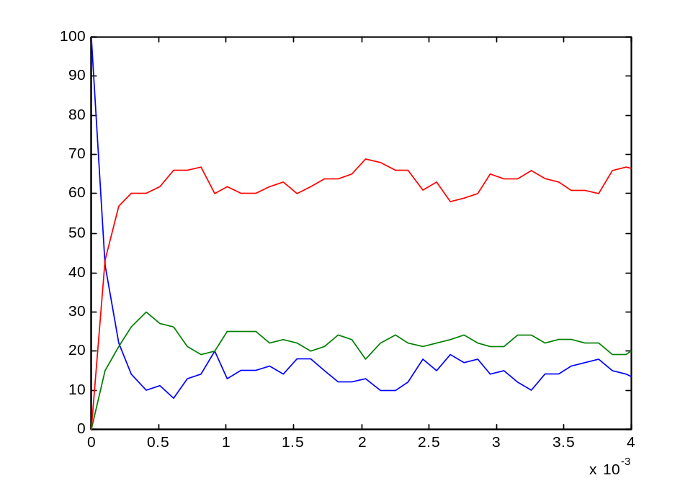
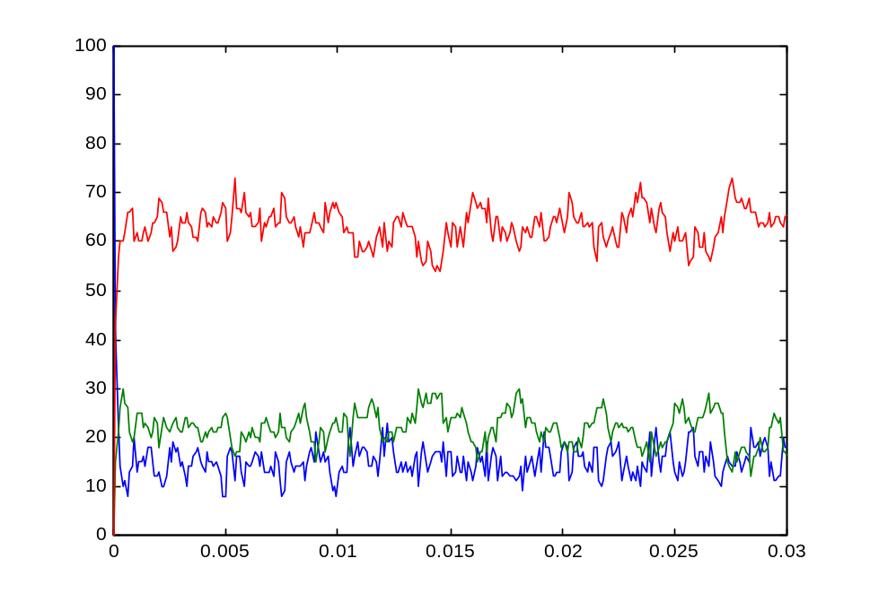
Na + K + 2Cl ↔ Na⁺ + K⁺ + 2Cl⁻
100,100,100
knacl_2.cp

Slide 12
Na + K + 2Cl ↔ Na⁺ + K⁺ + 2Cl⁻
Multiple reaction capabilities | Choice | e1 ! [] , … ; e2 ! [] , … .
Alternative reactions | Mutual exclusive, probabilistic choice; discarding of alternative communication | COMM (PAR and STRUCT)

Slide 13
Mg + 2Cl ↔ MgCl₂
Cl | : | Mg | : | Cl
One atom (Mg) sharing electrons with two other (Cl) atoms
Represent as two consecutive interactions
Intermediate state: Mg⁺
At Mg+ state can either
  Return to Mg state
  Proceed to Mg⁺² state

Slide 14
Mg + 2Cl ↔ MgCl₂
Intermediate states can be represented as
  Explicit processes
  Implicit local processes
  Implicit, sequential guards

Slide 15
Mg + 2Cl ↔ MgCl₂
The two alternatives in an intermediate state (lose or gain an electron) are represented as mixed choice between
  Output action (lose a second electron)
  Input action (gain back an electron)

Slide 16
Mg + 2Cl ↔ MgCl₂
-language(psifcp).
global(e1(10),e2(100),e3(50),e4(5)).
System::= Mg | Cl | Cl .
Mg::= e1 ! [] , Mg_plus .
Mg_plus::= e2 ! [] , Mg_plus2 ;
e3 ? [] , Mg .
Mg_plus2::= e4 ? [] , Mg_plus .
Cl::= e1 ? [] , Cl_minus ;
e2 ? [] , Cl_minus .
Cl_minus::= e3 ! [] , Cl ;
e4 ! [] , Cl .
mgcl2_3.cp

Slide 17
Mixed Choice
Mg::= e1 ! [] , Mg_plus .
Mg_plus::= e2 ! [] , Mg_plus2 ;
e3 ? [] , Mg .
Mg_plus2::= e4 ? [] , Mg_plus .
Cl::= e1 ? [] , Cl_minus ;
e2 ? [] , Cl_minus .
Cl_minus::= e3 ! [] , Cl ;
e4 ! [] , Cl .
,
;
<Communication action>
<Right hand side>
…
,
.
<Communication action>
<Right hand side>
mgcl2_3.cp

Slide 18
Intermediate States
Mg | Cl | Cl
e1 ! [] , Mg_plus |
e1 ? [] , Cl_minus ; e2 ? [] , Cl_minus |
e1 ? [] , Cl_minus ; e2 ? [] , Cl_minus
e3
Mg_plus | Cl_minus | Cl
e1
e2 ! [] , Mg_plus2 ; e3 ? [] , Mg |
e3 ! [] , Cl ; e4 ! [] , Cl |
e1 ? [] , Cl_minus ; e2 ? [] , Cl_minus .
e2
Mg_plus2 | Cl_minus | Cl_minus
mgcl2_3.cp

Slide 19
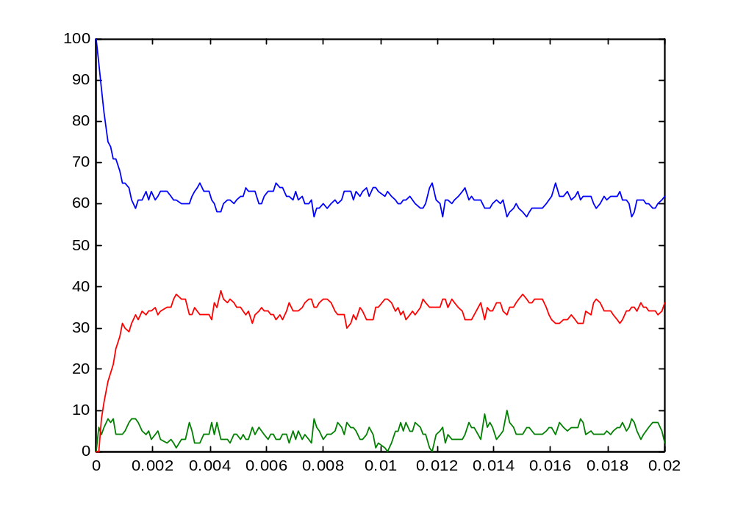
Mg + 2Cl ↔ MgCl₂
Mg
Mg⁺²
Mg⁺
100, 100
mgcl2_3.cp

Slide 20
Mg + 2Cl ↔ MgCl₂
-language(psifcp).
global(e1(10),e2(100),e3(50),e4(5)).
System::= Mg | Cl | Cl .
Mg::=
e1 ! [] , << e2 ! [] , Mg_plus2 ;
e3 ? [] , Mg >> .
Mg_plus2::=
e4 ? [] , << e2 ! [] , Mg_plus2 ;
e3 ? [] , Mg >> .
Cl::= e1 ? [] , e3 ! [] , Cl ;
e2 ? [] , e4 ! [] , Cl .
mgcl2_4.cp

Slide 21
Implicit representation of intermediate states: Local Processes
Mg::=
e1 ! [] , << e2 ! [] , Mg_plus2 ;
e3 ? [] , Mg >> .
Mg_plus2::=
e3 ? [] , << e2 ! [] , Mg_plus2 ;
e3 ? [] , Mg >> .
Cl::= e1 ? [] , e3 ! [] , Cl ;
e2 ? [] , e4 ! [] , Cl .
<< <right hand side> >>
New (process)
scope
mgcl2_4.cp

Slide 22
Implicit representation of states: Sequential Guards
Mg::=
e1 ! [] , << e2 ! [] , Mg_plus2 ;
e3 ? [] , Mg >> .
Mg_plus2::=
e3 ? [] , << e2 ! [] , Mg_plus2 ;
e3 ? [] , Mg >> .
Cl::= e1 ? [] , e3 ! [] , Cl ;
e2 ? [] , e4 ! [] , Cl .
,
,
,
;
<Communication>
…
<Communication>
<Right hand side>
…
,
,
,
.
<Communication>
…
<Communication>
<Right hand side>
mgcl2_4.cp

Slide 23
Mg + 2Cl ↔ MgCl₂
Alternative reverse capabilities (electron donor and acceptor) | Mixed Choice | e1 ? [] , … ; e2 ! [] , … .
Reaction intermediates | Explicit or implicit intermediate states (processes, local processes or sequential guards) | Mg_plus << >> e1 ? [ ] , e2 ? [ ] , …
Implicit representations are sometimes more difficult to trace

Slide 24
Exercise #2 – Question 1
Write pi-calculus programs for the following reactions
  Al + 3Cl ↔ AlCl₃ ((Al⁺³ + 3Cl⁻) ionic bond)
  H₂ + Cl₂ ↔ 2HCl (covalent bond)

Slide 25
Ionic and Covalent Bonds
In ionic bonds electrons are gained and lost. The attraction between positive and negative charge results in an ionic bond
 | Na | ·
 | ..
: | Cl | ·
 | ..
 | ..
: | Na⁺ | :
 | ..
 | ..
: | Cl⁻ | :
 | ..
+ →
A covalent bond is a sharing of a pair of electrons, so that both atoms have filled octets
→ |  |  |  |  | ←
H | · |  |  | · | Cl
H | : | Cl
..
 | :
..
..
 | :
..

Slide 26
H + Cl ↔ HCl
So far, in ionic bonds, the reverse reaction did not necessarily occur b/w the same two atoms that participated in the forward one.
In a covalent bond, a molecule is formed, and the two products are specifically bonded

Slide 27
H + Cl ↔ HCl
We will represent specific bonding and unbonding by using local, private channels
In the forward reaction, when a bond is formed, a private channels is established between the two atoms:
  A private channel is declared in one of the atoms
  The channel is sent as a message, to be received by the other atoms
This channel will be used for the reverse reaction
Later, we will see an alternative approach to this problem

Slide 28
H + Cl ↔ HCl
-language(psifcp).
global(e1(100)).
System::= H | H | Cl | Cl
H::= << electron(10) .
e1 ! {electron} , H_plus .
H_plus::= electron ? [] , H >> .
Cl::=
e1 ? {e} , e ! [] , Cl .
hcl_5.cp

Slide 29
Local Channel Declaration
H::= << electron(10) .
e1 ! {electron} , H_plus .
H_plus::= electron ? [] , H >> .
Cl::=
e1 ? {e} , e ! [] , Cl .
<Process>
::=
<< channel(rate) .
<right hand side> .
<local process definition> >>
.
Channel scope
hcl_5.cp

Slide 30
Channel tuples: Messages and channel declarations
H::= << electron(10) .
e1 ! {electron} , H_plus .
H_plus::= electron ? [] , H >> .
Cl::=
e1 ? {e} , e ! [] , Cl .
e1 ? {channel₁ , … , channel_{n}} – input (receive) action
e1 ! {channel₁ , … , channel_{n}} – output (send) action
<< channel₁ , … , channel_{n} . <right hand side> . <local process> >>
hcl_5.cp

Slide 31
Channel tuples: Channel Typing (Sorts)
A channel’s sort (type): The kind of message that the channel sends and receives, e.g.
Channel types are determined at run time. Due to mobility static analysis is problematic.
BioPSI typing is flat (not recursive). This is not generally true for pi-calculus.
a ! [] (a’s type is nil alert)
b ? {x1,x2,x3} (b’s type is a tuple of size 3)
a ? {b} | b ! {c}

Slide 32
Channel tuples: Channel Typing (Sorts)
A type mismatch will cause a run-time error.
It is the programmer’s responsibility to make sure that there are no type mismatches
a ! [] | a ? {y}

Slide 33
Communication: Local channel mobility
H | Cl
<< electron(10) . e1 ! {electron} , H_plus >> |
e1 ? {e} , e ! [] , Cl
e1
electron
{electron/e}
electron ? [] , H | electron ! [] , Cl
The same (private, local) electron channel
hcl_5.cp

Slide 34
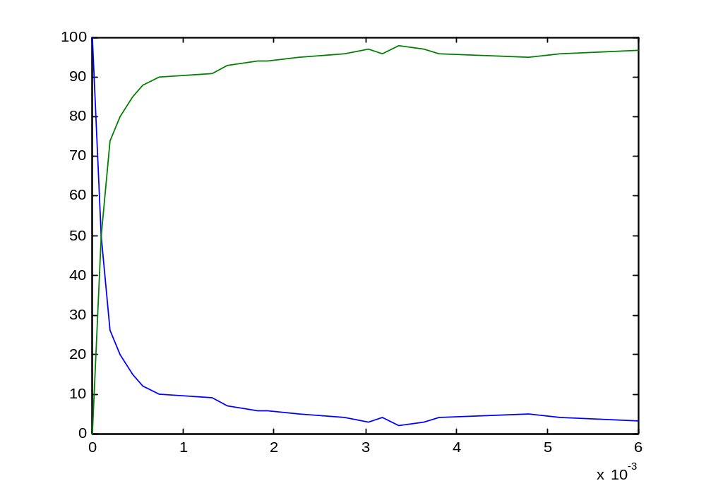
H + Cl ↔ HCl
H_plus
H
hcl_5.cp

Slide 35
H + Cl ↔ HCl
-language(psifcp).
global(e1(100)).
System::= H | H | Cl | Cl
H+electron(10)::=
e1 ! {electron} , H_plus(electron).
H_plus(e)::= e ? [] , H .
Cl::= e1 ? {electron} , Cl_minus(electron). Cl_minus(e)::= e ! [] , Cl .
hcl_6.cp

Slide 36
Local Channel Declaration - Alternative
H+electron(10)::=
e1 ! {electron} , H_plus(electron).
H_plus(e)::= e ? [] , H .
Cl::= e1 ? {e} , Cl_minus(e).
Cl_minus(e)::= e ! [] , Cl .
.
<Process>+channel(rate)
::=
<right hand side>
.
<Process>+(ch₁(r₁),…, ch_{n}(r_{n}))
::=
<right hand side>
Channel(s) scope
hcl_6.cp

Slide 37
Channel tuples: Parameters
H+electron(10)::=
e1 ! {electron} , H_plus(electron).
H_plus(e)::= e ? [] , H .
Cl::= e1 ? {e} , Cl_minus(e).
Cl_minus(e)::= e ! [] , Cl .
<Process>(channel₁, … ,channel_{n}) – declaration or call
hcl_6.cp

Slide 38
Communication: Local channel mobility
H | Cl
e1 ! {electron} , H_plus(electron) |
e1 ? {e} , Cl_minus(e).
e1
electron
{electron/e}
electron ? [] , H | electron ! [] , Cl
The same (private, local) electron channel
hcl_6.cp

Slide 39
H + Cl ↔ HCl
Molecular identity | Local scopes for channels (and processes) | H::= << electron. … >> H+electron::= …
Creation of molecule | Communication and mobility of local channel names (scope extrusion) | e1 ? {e} , e ! [] , … e1 ? {e} , Cl_minus(e)
hcl_5.cp

Slide 40
Exercise #2 - Question 2 Transition States
High energy activated complexes of the reactants that must be formed if reaction is to lead to products.
Have only a transitory existence
Once formed, they must lead to products or lose excess energy and return to reactants
Activated
complex
A + B ↔ (AB)‡
(AB)‡ → C + D
A + B → C + D
Elementary bimolecular process

Slide 41
Exercise #2 - Question 2
Write a pi-calculus program representing this mechanism and its reverse (together)
A+B ↔ (AB)‡ → C+D
C+D ↔ (CD)‡ → A+B
A+B ↔ C+D
Assume:
  C is derived from A
  D is derived from B
  (CD)‡ and (AB)‡ should be defined implicitly
Hint: private channels for both reactions of an activated complex

Slide 42
H + H ↔ H₂
A symmetric interaction: the same atom serves both “roles”, in a symmetrical interaction with identical atoms
We will represent this by mixed choice, using the same channel once for input and once for output
This works since choice is mutually exclusive
Rate calculation is modified for symmetric interaction

Slide 43
H + H ↔ H₂
-language(psifcp).
global(e(10),e1(10)).
System::= H | H .
H+electron(0.1)::=
e1 ! {electron} , H_BoundH(electron) ;
e1 ? {e2} , H_BoundH(e2) ;
e ! {electron} , H_Bound(electron) . H_BoundH(el)::= el ? [] , H ;
el ! [] , H.
H_Bound(el)::= el ? [] , H .
h2_7.cp

Slide 44
Mixed choice on the same channel: Symmetric Communication
H+electron(0.1)::=
e1 ! {electron} , H_BoundH(electron) ;
e1 ? {e2} , H_BoundH(e2) ;
e ! {electron} , H_Bound(electron) .
H_BoundH(el)::= el ? [] , H ;
el ! [] , H.
H_Bound(el)::= el ? [] , H .
Rate calculation for symmetric interactions:
<baserate>*<#sends>*<#receives-1>/2
c_{μ}=2k_{μ}
h2_7.cp

Slide 45
Symmetric Communication
H | H
H
e1 ! {electron} , H_BoundH(electron) ;
e1 ? {e2} , H_BoundH(e2) ;
e ! {electron} , H_Bound(electron) |
e1 ! {electron} , H_BoundH(electron) ;
e1 ? {e2} , H_BoundH(e2) ;
e ! {electron} , H_Bound(electron)
H
e1
{electron/e2}
H_BoundH(electron) | H_BoundH(electron)
h2_7.cp

Slide 46
Symmetric Communication
H_BoundH(electron) | H_BoundH(electron)
electron ? [] , H ;
electron ! [] , H |
electron ? [] , H ;
electron ! [] , H
electron
H | H
h2_7.cp

Slide 47
Channel Typing: Asymmetric and symmetric channels
Symmetric (“homodimerization”) and asymmetric (“bimolecular”) channels are distinguished by their rate calculation
The same channel (name) cannot be used for both types of communication
BioPSI identifies them at run time (due to mobility). An ambiguity would cause a run-time error.
It is the programmer’s responsibility to ensure correct use.

Slide 48
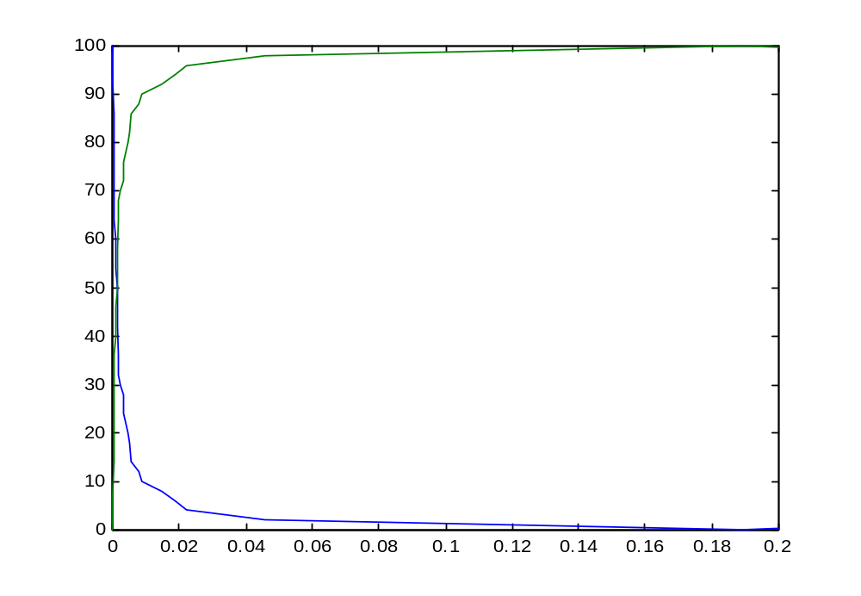
H + H ↔ H₂
H_BoundH
H
h2_7.cp

Slide 49
H + H ↔ H₂
Symmetric interaction | Mixed choice on the same channel (special rate calculation) | H_BoundH(el)::= el ? [ ] , H ; el ! [ ] , H.
h2_7.cp

Slide 50
Exercise #2 – Question 1
Write pi-calculus programs for the following reactions
  Al + 3Cl → AlCl₃ ((Al⁺³ + 3Cl⁻) ionic bond)
  H₂ + Cl₂ → 2HCl (covalent bond)
Hint: Each H₂ (Cl₂) molecule is initialized as two H_BoundH processes with the same private channel.

Slide 51
O + O ↔ O₂ ?
Symmetric interaction, sharing two electrons (double bond)
Naive suggestion: Two consecutive symmetric interactions (analogous to the MgCl₂ case)

Slide 52
O + O ↔ O₂ ?
-language(psifcp).
global(e1(100),e2(100)).
System::= O | O | O | O | O . O+electron1(10)::=
e1 ! {electron1} , O_Bound1(electron1) ;
e1 ? {electron1} , O_Bound1(electron1) .
O_Bound1(el1)+electron2(0.1)::=
el1 ! [] , O ;
el1 ? [] , O ;
e2 ! {electron2} , O_Bound2(el1,electron2) ;
e2 ? {electron2} , O_Bound2(el1,electron2) .
O_Bound2(el1,el2)::=
el2 ! [] , O_Bound1(el1) ;
el2 ? [] , O_Bound1(el1) .
O2_8.cp

Slide 53
O + O ↔ O₂ ?
Binding first electron
O+electron1(10)::=
e1 ! {electron1} , O_Bound1(electron1) ;
e1 ? {electron1} , O_Bound1(electron1) .
O_Bound1(el1)+electron2(0.1)::=
el1 ! [] , O ;
el1 ? [] , O ;
e2 ! {electron2} , O_Bound2(el1,electron2) ;
e2 ? {electron2} , O_Bound2(el1,electron2).
O_Bound2(el1,el2)::=
el2 ! [] , O_Bound1(el1) ;
el2 ? [] , O_Bound1(el1) .
Binding second electron
O2_8.cp

Slide 54
O + O ↔ O₂ ?
An O process may share its two electrons with a single other O process (leading to O₂) or with two other O processes (leading to O_{n}). This is incorrect.
Note, that Lewis’ Octet Theory does not handle O₂ well.
We will solve this by limiting O’s capability for symmetric interaction
O2_8.cp

Slide 55
Solution 1: Single channel for double bond
Symmetric interaction (double bond)
global(e(10),ee(2)).
O+electron(0.1)::=
ee ! {electron} ,O_Double_Bound(electron) ;
ee ? {electron} , O_Double_Bound(electron) ;
e ? {electron} , O_Bound1(electron) . O_Double_Bound(el)::=
el ! [] , O ;
el ? [] , O .
O_Bound1(el)::=
el ! [] , O ;
e ? {electron1}, O_Bound2(el,electron1) . O_Bound2(el,electron1)::=
electron1 ! [] , O_Bound1(el) ;
el ! [] , O_Bound1(electron1) .
Asymmetric interaction (two single bonds)
Creation of a double bond as an atomic interaction
o2_9.cp

Slide 56
Solution 2: Restricting the second electron
New tuple definition
global(e(10),e1(2)).
O+(electron(0.1),e2(infinite))::=
e1 ! {electron,e2} , O_Bound1_O(electron,e2);
e1 ? {electron,e2} , O_Bound1_O(electron,e2) ;
e ? {electron} , O_Bound1(electron) .
O_Bound1_O(el,e)::=
e ! [] , O_Double_Bound(el);
e ? [] , O_Double_Bound(el).
O_Double_Bound(el)::=
el ! [] , O ;
el ? [] , O .
Creation of a double bond as two interactions: The second is restricted and infinite in rate

Slide 57
Infinite channels
All actions on inifinite channels occur instantaneously:
  As soon as they are enabled
  Before the clock is advanced and a new (non-inifinte) action is selected
Are primarily used for encoding purposes

Slide 58
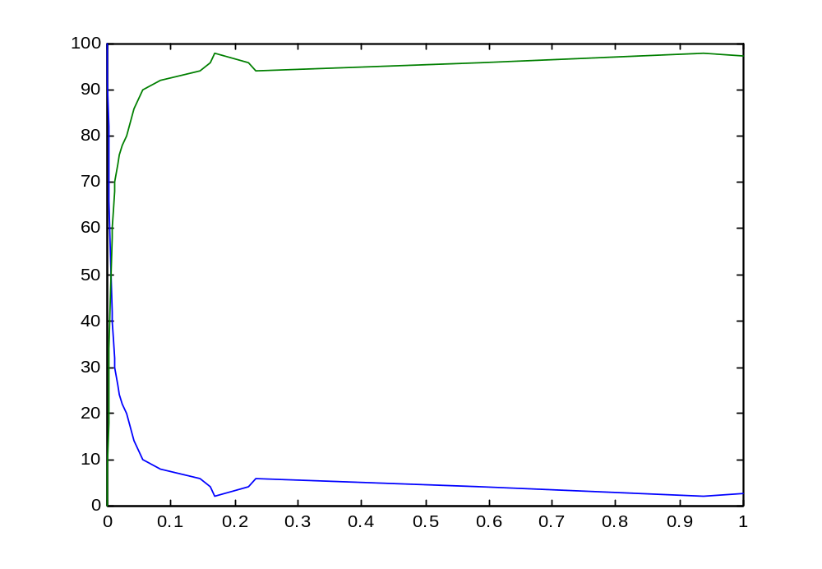
O + O ↔ O₂
O_Double_Bound
O
o2_9.cp

Slide 59
O + O ↔ O₂
Multiple bonds | Limiting symmetric interactions | Atomic interactions for multiple bonds (ee channel)
 |  | Using a restricted channel for second bond, with infinite rate (O+e2(infinite))

Slide 60
Lattices, molecules and networks
Ionic compounds | Ionic | Lattice | Global channels
Molecular covalent compounds | Covalent | Discrete molecular units | Global and local channels
Network covalent compounds | Covalent | Network | Global and local channels (“On”*)
* A real network covalent compounds is e.g. SiO₂

Slide 61
H + O ↔ H₂O + O₂ + H₂
Building a complex system by “mix and match”
We already have all the components: single and double, symmetric and asymmetic bonds for H and O

Slide 62
H + O ↔ H₂O + O₂ + H₂
-language(psifcp).
global(e(10),ee(2)).
System::= h2_7#System | o2_9#System .

Slide 63
External Calls: Multi Module Programs
-language(psifcp).
global(e(10),ee(2)).
System::= h2_7#System | o2_9#System .
<module name> # <process name>
Global channels are shared across modules:
There mustn’t be a rate conflict between modules.

Slide 64
External Calls: Export
-language(psifcp).
global(e1(100),e2(10)).
export(System).
System::= Na | Na | Cl | Cl .
Na::= e1 ! [] , Na_plus .
Na_plus::= e2 ? [] , Na .
Cl::= e1 ? [] , Cl_minus .
Cl_minus::= e2 ! [] , Cl .
Only the System process can be called externally
@c(nacl_1)
<1> started
<1> source : /home/aviv/Course/Electron_1/nacl_1.cp – 20010413140021
<1> interpret : export([System / 2])
<1> file : /home/aviv/Course/Electron_1/nacl_1.bin – written
<1> terminated

Slide 65
Inclusion of external files: Rate parameter files
-language(psifcp).
-include(rates).
global(e(R1),ee(R2)).
System::= h2_7#System | o2_9#System .
H2o*_10.cp
R1 => 10.
R2 => 2.
rates.cp

Slide 66
Multiple Process Calls: Arithmetics and Logix Commands
System(N1)::=
<< CREATE_H(N1).
CREATE_H(C)::=
{C =< 0} , true ;
{C > 0} , {C--} | H | self >> .
Logix variables
(as parameters)
Logix ask guards
iteration
The empty process
(also 0)
Logix goal
h2_7*.cp

Slide 67
Logix Variables
A new argument which is a logix variable is initially uninstantiated
A Logix variable may have a value which is an arbitrary Logix term.
Such values may be tested by a Logix ask guard or manipulated by a Logix goal or by a Logix tell guard

Slide 68
Self Iteration
self is a reserved word in context (it may be used as a channel name as well*)
self may be used to iterate any process, including anonymous (local) processes (e.g. sequential guards, inner scopes)
It always iterates to the innermost predicate, starting with the last guard preceding the period. Use with care.
Not recommended ☺

Slide 69
Self Iteration - Examples
A::= x ? [] , self ;
y ? [] , self .
Iterate to A
Iterates to
z ? [] , self
A::= x ? [] , z ? [] , self ;
y ? [] , w ? [] , self .
Iterates to
w ? [] , self

Slide 70
H + O ↔ H₂O + O₂ + H₂
-language(psifcp).
global(e(10),ee(2)).
System(N1,N2)::=
h2_7#System(N1) | o2_9#System(N2).
h2o_10.cp

Slide 71
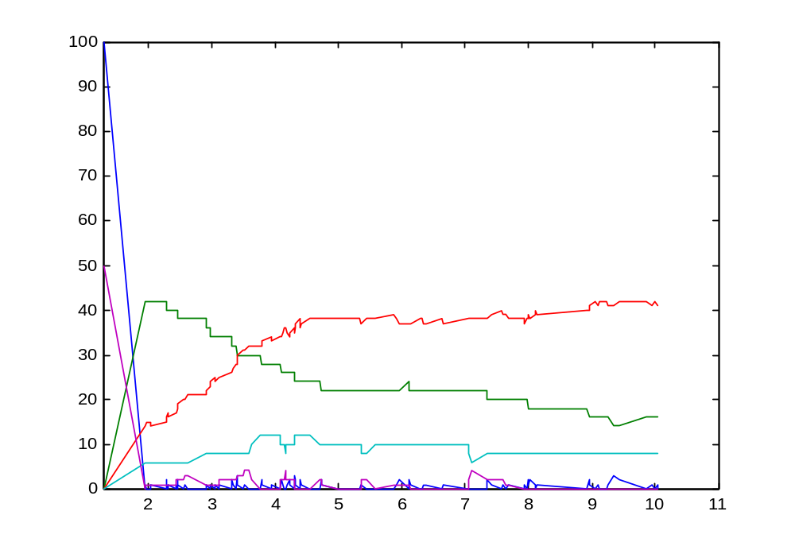
H + O ↔ H₂O + O₂ + H₂
H
O
O_Bound2
(H₂O)
H_Bound_H
(H₂)
O_Double_Bound
(O₂)
h2o_10.cp

Slide 72
Exercise #2 - Question 1
In each case:
  Represent each atom (and its related chemical species) as a separate .cp programs. For example, for H2 you have free H atom, H bound to H, and H bound to Cl
  Use a “Logix loop” to spawn of multiple processes
  Write a system program to initialize the system, based on parameters (see attached table for process quantities)
  Use a common rates file for all the rate parameters

Slide 73
Limitations
Interactions explained by more than pair-wise sharing of electrons, e.g.
  Resonance structures (benzen, ozone)
  Lattice energies of ionic compounds (MgCl₂, NaCl)
Limitations on global interactions, e.g.
  Network covalent bonds
Higher order entities., e.g.
  Radicals

Slide 74
Exercise #2 – Question 1
Write pi-calculus programs for the following reactions
  Al + 3Cl ↔ AlCl₃ ((Al⁺³ + 3Cl⁻) ionic bond)
  H₂ + Cl₂ ↔ 2HCl (covalent bond)

Slide 75
Exercise #2 - Question 2
Write a pi-calculus program representing this mechanism and its reverse (together)
A+B ↔ (AB)‡ → C+D
C+D ↔ (CD)‡ → A+B
A+B ↔ C+D
Assume:
  C is derived from A
  D is derived from B
  (CD)‡ and (AB)‡ should be defined implicitly
Hint: private channels for both reactions of an activated complex

Slide 76
Exercise #2 - Question 1+2
Reaction | Initial Quantities | Rates (forw,rev) | Time limit (scale)
Al + 3Cl ↔ AlCl₃ (Al⁺³ + 3Cl⁻) | Al=50 Cl =150 | Al ↔ Al⁺¹ (10,50) Al⁺¹ ↔ Al⁺² (100,50) Al⁺² ↔ Al⁺³ (200,10) | 0.05 (0.001)
H₂ + Cl₂ ↔ 2HCl | H₂ = Cl₂ = 100 HCL, H, Cl = 0 | 2H ↔ H₂ (20,0.5) 2Cl ↔ Cl₂ (20,0.5) H + Cl ↔ HCl (100,0.5) | 30 (0.1)
A+B ↔ C+D (with activated complexes) | A = B = 100 C = D = 0 | A+B ↔ (AB)‡ (100,20) (AB)‡ → C+D (100) C+D ↔ (CD)‡ (10,100) (CD)‡ → A+B (10) | 0.5 (0.01)

Slide 77
Exercise #2 - Questions 1+2
In each case:
  Submit code, .table and .names files, and plot change of reactants and products
  Represent each atom (and its related chemical species) as a separate .cp programs. For example, for H2 you have free H atom, H bound to H, and H bound to Cl
  Use a “Logix loop” to spawn of multiple processes
  Write a system program to initialize the system, based on parameters (see attached table for process quantities)
  Use a common rates file for all the rate parameters

Slide 78
Exercise #2 – Question 3 (bonus*)
In an ozone (O₃) molecule, a resonance structure exists, where three O atoms are sharing 3 electron pairs (see picture): 2 electron pairs are shared in “the usual way”. The third pair is shared by all three atoms.
Try to write a pi-calculus program to describe this molecule.
Even an unsuccessful (but interesting) attempt can gain points.
O
O
O

Slide 79
Supplementary Material
Milner, R. (1999) Communicating and Mobile Systems: The pi-Calculus. Cambridge University Press.
Mahan and Myers (1987) University Chemistry. 4th Edition. Addison-Wesley. Chapters 2, 6, 9
Chang R. (1991) Chemistry. McGraw-Hill. Chapters 3.1, 9, 13
Silverman W. (2001) BioPSI Appendices.
Gillespie D.T. (1976) A general method for numerically simulating the stochastic time evolution of coupled chemical reactions. Journal of Computational Physics 22: 403-434.
Gillespie D. T. (1977) Exact stochastic simulation of coupled chemical reactions. Journal of Physical Chemistry 81: 2340-2361.

