Slide 1
Notices
Instantaneous channels (with infinite rate) are a separate type of channel, distinct from the usual (rated) ones, and cannot be used for symmetric interactions
A call for a process (Remote Process Call = RPC) has the general form LogixPath#LogixGoal

Slide 2
Notices
LogixPath may be the name of a module (e.g. nacl_1) or a transformation of a UNIX path:
dir₁/dir₂/…/dir_{n}/module.bin → dir₁#dir₂#…#dir_{n}#module
LOGIX treats an alphanumeric name which begins with a lower case letter as a string, hence it does not require quotes
Any other names starting with upper case letter (except for Logix variables) require quotes
LogixGoal may be any process defined within the target module. Since BioPSI processes start with upper case letter they must be quoted

Slide 3
Unit 2: Molecules, Radicals and Functional Groups

Slide 4
Radicals and Functional Groups
Free radicals are highly reactive, typically univalent, “parts” of molecules
Organic compounds are composed of functional groups
A functional group is the the part of a molecule having a special arrangement of atoms that is largely responsible for the chemical behavior of the parent molecule
We focus on reactions involving almost exclusively organic compounds and functional groups

Slide 5
A Modular Approach to Radicals, Groups and Compounds
For a reaction of the type
A+B → C
We will
  Represent A, B as processes
  Upon interaction
    A, B processes will be terminated
    A new process, C, will be spawned
Example: O + H → O₂ + H₂ + H₂O

Slide 6
A Modular Approach to Radicals, Groups and Compounds
For reverse unimolecular reaction
C → A + B
Before, we had two counterparts (Bound_A and Bound_B) which unbound from each other
Now, we have a single reactant process C
In the pi-calculus we are limited to pair wise interactions

Slide 7
A Modular Approach to Radicals, Groups and Compounds
We will add a Timer process that will offer the complementary communication required by the pi-calculus.
We will use a single instance of this process to ensure a correct rate calculation

Slide 8
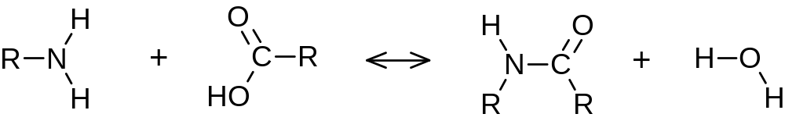
Condensation and hydrolysis
Amine
Carboxyl
Amide
eRN
eRC
amine
hydrolysis
eRN
eRC
R(eRN)
R(eRC)
R(eRN)
R(eRC)
NH2(eRN)
COOH(eRC)
Amide(eRN,eRC)

Slide 9
RNH₂ + RCOOH ↔ RNHCOR + H₂O
-language(psifcp).
global(amine(10),hydrolysis(1)).
R_Amine+eRN::= NH2(eRN) | R(eRN) .
R_Carboxyl+eRC::= R(eRC) | COOH(eRC) .
NH2(eRN)::=
amine ? {eRC1} , Amide(eRN,eRC1) | H2O .
Amide(eRN,eRC)::=
hydrolysis ? [] , COOH(eRC) | NH2(eRN) .
COOH(eRC)::= amine ! {eRC} , true .
R(e)::= e ! [] , self .
H2O::= hydrolysis ! [] , true .
condensation_peptide_1.cp

Slide 10
Unit 3: Programming and Tracing Polymers, Compartments and other Quantitative Aspects

Slide 11
Chain Reaction and Polymerization
Multi-step reaction mechanisms in which certain steps may be repeated indefinitely.
Typically involve three types of steps
  Intiation reaction
  Chain propagation reaction(s)
  Chain termination reaction
Occur in flames, explosions, atmosphetic and life processes, and are important for the creation of synthetic polymers

Slide 12
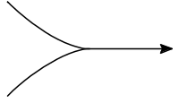
Polymerization
Seeds
Monomers
Y
Y
A
A
A
A
A
A
A
A
A
Y
Initiation
Propagation
Y
A*
A
Y
A
A*
Y
A
A
A*
A
A
Y
A
A
A*
Termination
Y
A
A
A
A
A
A
Y
Y
A
A
A*
Polymer

Slide 13
Synthetic polymers: Polyethylene
Initiation
Y + CH2=CH2 → Y-CH2-CH2*
Propagation
Y-(CH2-CH2)_{n}- CH2-CH2* + CH2=CH2 → Y-(CH2-CH2)_{n+1}-CH2-CH2*
Termination
Y-(CH2-CH2)_{n}- CH2-CH2* +
Y-(CH2-CH2)_{m}- CH2-CH2* →
Y-(CH2-CH2)_{m+n+2}-Y

Slide 14
Polyethylene - Initiation
alkene_Y
polyCC
polyCC_L
polyCC_R
Y + CH2=CH2 → Y----CH2-CH2*
Y+polyCC
Ethylene
Bound_Y
(polyCC)
EthylR
(polyCC_L)+ polyCC_R

Slide 15
Polyethylene - Propagation
pCC
pCC_L
pCC_R
pCC_L
pCC_R
pCC_L
+pCC_R
Y-------------(CH2-CH2)------------(CH2-CH2)------------CH2-CH2* + CH2=CH2
→
Y-(CH2-CH2)₂-------- CH2-CH2 -------CH2-CH2*
Bound_Y
(pCC)
EthylP
(pCC_L, pCC_R)
EthylP
(pCC_L , pCC_R)
EthylR
(pCC_L) +pCC_R
Ethylene
alkene_R
pCC_R
pCC_L
pCC_R
pCC_L
+pCC_R
EthylP
(pCC_L, pCC_R)
EthylR
(pCC_L) +pCC_R

Slide 16
Polyethylene - Termination
pCC_L
pCC_L
Y-(CH2-CH2)_{n}---- CH2-CH2* + Y-(CH2-CH2)_{m}---- CH2-CH2*
→
Y-(CH2-CH2)_{n}- CH2-CH2 ------CH2-CH2 -(CH2-CH2)_{m}- Y
EthylR
(pCC_L) +pCC_R
EthylR
(pCC_L) +pCC_R
poly_R*
pCC_L
pCC_R
pCC_R
pCC_L
EthylP_term
(pCC_L, pCC_R)
EthylP_term
(pCC_L, pCC_R)
* poly_R is a symmetric channel
(either pCC_R or pCC_R could end up as the shared channel)

Slide 17
Polyethylene
-language(psifcp).
global(dummy, alkene_Y(1), alkene_R(10), poly_R(1)).
System(N1,N2)::=
CREATE_Y(N1) | CREATE_Ethylene(N2) .
CREATE_Y(C)::=
{C =< 0} , true ;
{C > 0} , {C--} | Y | self .
CREATE_Ethylene(C)::=
{C =< 0} , true ;
{C > 0} , {C--} | Ethylene | self .
Polyethylene_1.cp

Slide 18
Polyethylene
Y+polyCC::=
alkene_Y ! {polyCC} , Y_bound(polyCC) .
Y_bound(polyCC)::= dummy ? [] , true .
Ethylene::=
alkene_Y ? {polyCC_L} , EthylR(polyCC_L) ;
alkene_R ? {polyCC_L} , EthylR(polyCC_L) . EthylR(polyCC_L)+polyCC_R::=
alkene_R ! {polyCC_R} , EthylP(polyCC_L, polyCC_R) ;
poly_R ! {polyCC_R} , EthylP_term(polyCC_L, polyCC_R);
poly_R ? {polyCC_R’} , EthylP_term(polyCC_L, polyCC_R’). EthylP(polyCC_L, polyCC_R)::=
dummy ? [] , true .
EthylP_term(polyCC_L, polyCC_R)::=
dummy ? [] , true .
Polyethylene_1.cp

Slide 19
Initiation
Y+polyCC | Ethylene
alkene_Y ! {polyCC} , Y_bound(polyCC) |
alkene_Y ? {polyCC_L} , EthylR(polyCC_L) ;
alkene_R ? {polyCC_L} , EthylR(polyCC_L) .
alkene_Y
Y_bound(polyCC) | EthylR(polyCC)+polyCC_R
Polyethylene_1.cp

Slide 20
Propagation
EthylR(polyCC)+polyCC_R | Ethylene
alkene_R ! {polyCC_R} , EthylP(polyCC, polyCC_R) ; … | alkene_Y ? {polyCC_L} , EthylR(polyCC_L) ;
alkene_R ? {polyCC_L} , EthylR(polyCC_L) .
alkene_R
EthylP(polyCC,polyCC_R) | EthylR(polyCC_R)+polyCC_R
Polyethylene_1.cp

Slide 21
Termination
EthylR(polyCC_R)+polyCC_R | EthylR(polyCC_R)+polyCC_R
alkene_R ! {polyCC_R} , EthylP(polyCC_R, polyCC_R) ;
poly_R ! {polyCC_R} , EthylP_term(polyCC_R, polyCC_R);
poly_R ? {polyCC_R} , EthylP_term(polyCC_R, polyCC_R) |
alkene_R ! {polyCC_R} , EthylP(polyCC_R, polyCC_R) ;
poly_R ! {polyCC_R} , EthylP_term(polyCC_R, polyCC_R);
poly_R ? {polyCC_R} , EthylP_term(polyCC_R, polyCC_R).
poly_R
EthylP_term(polyCC_R, polyCC_R)|EthylR(polyCC_R, polyCC_R)
Polyethylene_1.cp

Slide 22
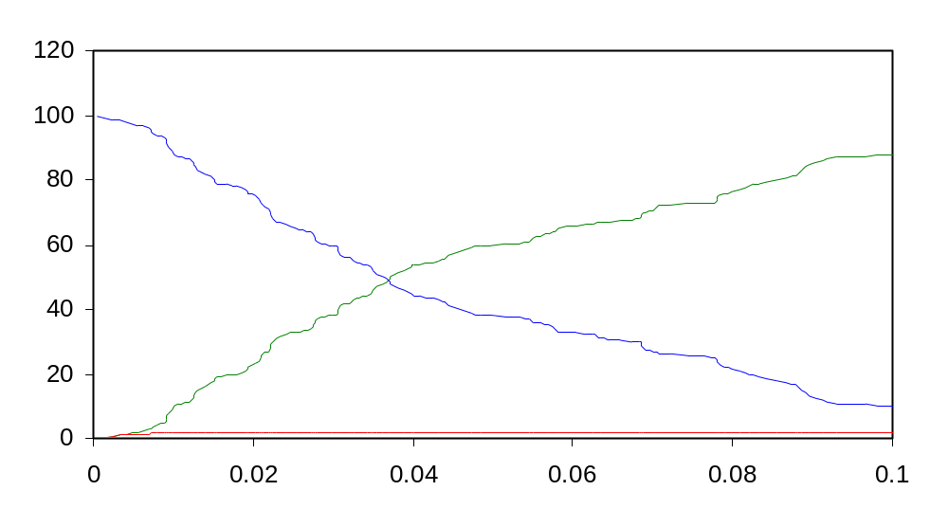
Polyethylene
(100 Ethylene ; 2 Y seeds)
EthylP
EthylR
Ethylene
Polyethylene_1.cp

Slide 23
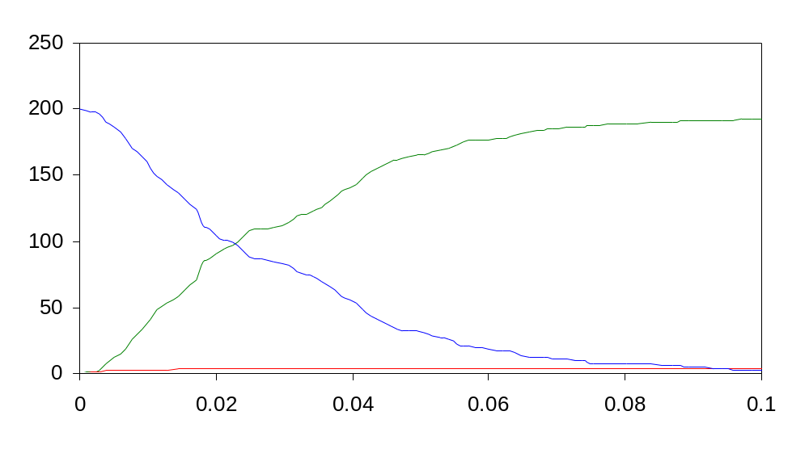
Polyethylene
(200 Ethylene, 4 Y seeds)
EthylP
EthylR
Ethylene

Slide 24
What Else Would We Like to Trace?
What is the length of each molecule?
What is the position of each of the monomers inside the polymer?
How can we follow the process of polymerization?

Slide 25
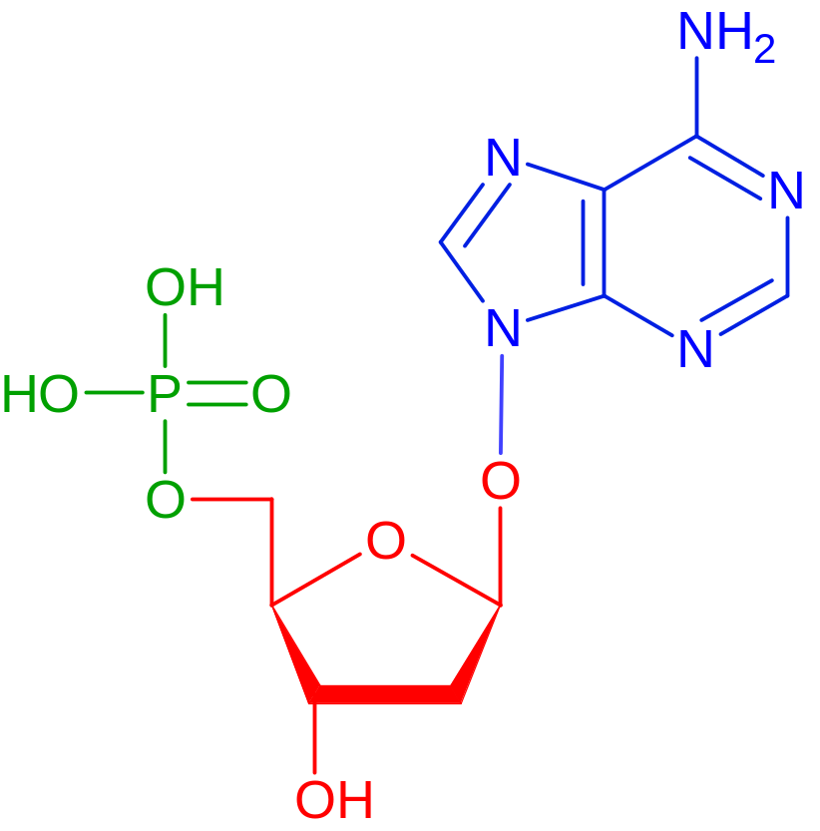
Nucleic Acids
Base*
Phosphate
5’
Base
P
Sugar
5’
Phosphoester
bond
3’
3’
Sugar
(pentose = 5 C)
Adenine (here)*; Guanine, Thymine, Cytosine, Uracil

Slide 26
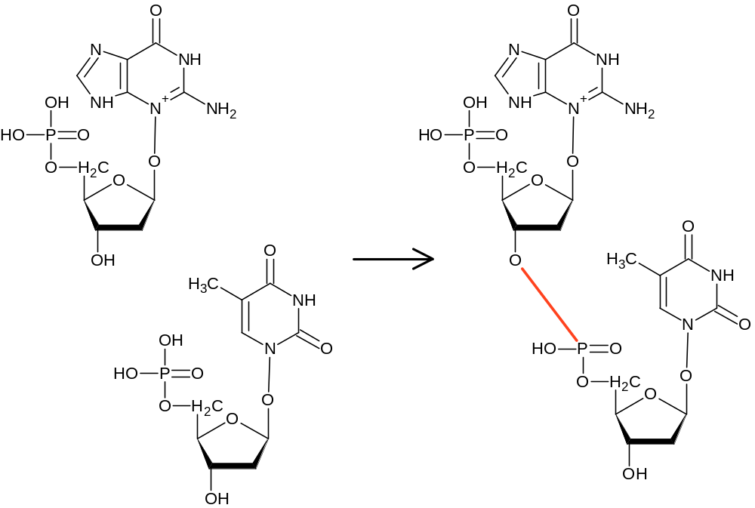
Phosphodiester Bonds and Nucleic Acid Polymerization
3’
5’
Phosphodiester
bond

Slide 27
Nucleic Acid Polymerization is Directional
Polymerization proceeds in the 5’→3’ direction:
The 5’ phosphate of a free nucleotide binds to the 3’ growing end of an existing chain
In cells this process requires a complex machinery (as we will learn later on)
For now, we will focus on the chain propagation mechanism.

Slide 28
Phosphodiester Bonds and Nucleic Acid Polymerization
5’
P
Seed
Free nucleotides
3’
5’
5’
P
P
3’
3’
5’
5’
P
Polymerized nucleotides
P
3’
3’
5’
P
5’
P
3’
3’
5’
P
Growing end
3’

Slide 29
Nucleic Acid Polymerization
-language(psifcp).
global(hydroxyl_P(1)).
System(N1,N2)::=
<< CREATE_Nucleotide(N1) |
CREATE_Seed_Nucleotide(N2).
CREATE_Nucleotide(C)::=
{C =< 0} , true ;
{C > 0} , {C--} | Nucleotide | self .
CREATE_Seed_Nucleotide(C)::=
{C =< 0} , true ;
{C > 0} , {C--} | Seed_Nucleotide | self
>> .
phosphodiester_sugar_phosphate_7a.cp

Slide 30
Nucleic Acid Polymerization
Seed_Nucleotide::=
<< hydroxyl_P ? {pd_ester} , Seed_Bound(pd_ester) .
Seed_Bound(pd_ester)::=
pd_ester ! [] , Seed_Nucleotide >> .
Nucleotide+pde(0.001)::=
<< hydroxyl_P ! {pde} , Nucleotide_5_Bound(pde) .
Nucleotide_5_Bound(pde)::=
pde ? [] , Nucleotide ;
hydroxyl_P ? {pd_ester} ,
Nucleotide_5_3_Bound(pde,pd_ester).
Nucleotide_3_Bound(pd_ester)::=
pd_ester ! [] , Nucleotide .
Nucleotide_5_3_Bound(pde,pd_ester)::=
pde ? [] , Nucleotide_3_Bound(pd_ester) ;
pd_ester ! [] , Nucleotide_5_Bound(pde) >> .
phosphodiester_sugar_phosphate_7a.cp

Slide 31
Initiation
5’
P
3’
pde
5’
P
Seed_Nucleotide | Nucleotide+pde
3’
hydroxyl_P ? {pd_ester} , Seed_Bound(pd_ester) |
hydroxyl_P ! {pde} , Nucleotide_5_Bound(pde)
hydroxyl_P
pde
Seed_Bound(pde) | Nucleotide_5_Bound(pde)
pde ! [] , Seed_Nucleotide | pde ? [] , Nucleotide ; …
phosphodiester_sugar_phosphate_7a.cp

Slide 32
Elongation
5’
P
3’
pde
5’
P
3’
pde
Nucleotide_5_Bound(pde) | Nucleotide+pde
5’
P
pde ? [] , Nucleotide ;
hydroxyl_P ? {pd_ester} , Nucleotide_5_3_Bound(pde,pd_ester) |
hydroxyl_P ! {pde} , Nucleotide_5_Bound(pde)
3’
pde
hydroxyl_P
Nucleotide_5_3_Bound(pde, pde) | Nucleotide_5_Bound(pde)
pde ? [] , Nucleotide_3_Bound(pde) ;
pde ! [] , Nucleotide_5_Bound(pde) |
pde ? [] , Nucleotide ;
hydroxyl_P ? {pd_ester} , Nucleotide_5_3_Bound(pde,pd_ester)
phosphodiester_sugar_phosphate_7a.cp

Slide 33
Cleavage
5’
P
3’
pde
Nucleotide_5_3_Bound(pde, pde) |
Nucleotide_5_3_Bound(pde,pde)
5’
P
3’
pde
pde ? [] , Nucleotide_3_Bound(pde) ;
pde ! [] , Nucleotide_5_Bound(pde) |
pde ? [] , Nucleotide_3_Bound(pde) ;
pde ! [] , Nucleotide_5_Bound(pde)
5’
P
3’
pde
5’
P
3’
pde
5’
5’
P
P
Nucleotide_5_Bound(pde) |
Nucleotide_3_Bound(pde)
3’
pde
3’
pde
5’
5’
P
P
3’
3’
phosphodiester_sugar_phosphate_7a.cp

Slide 34
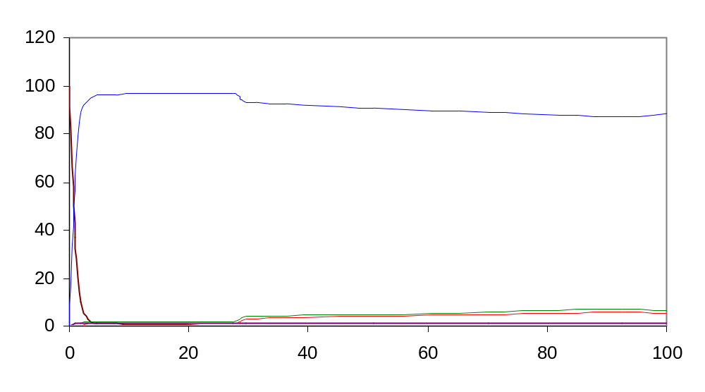
Phosphodiester bonds and nucleic acid polymerization
5’
P
1 Bound Seed + 5 “3_Bound”
= 6 “5_Bound” = 6 polypeptides
3’
5’
P
3’
5’
P
3’
P
5’
3’
5’
P
3’
phosphodiester_sugar_phosphate_7a.cp

Slide 35
What Else Would We Like to Trace?
What is the length of each molecule?
What is the position of each of the monomers inside the polymer?
How can we follow the process of polymerization?
Which chains are formed by cleavage?

Slide 36
Exercise 4 – Question 1
Does the nucleic acid program ensure directionality? Explain your answer

Slide 37
Exercise 4 – Question 2
A similar directional polymer is formed from monomer amino acids by the creation of a peptide bond. Each amino acid has two functional groups: an amine group and a carboxyl group. The two can form an amide (peptide) bond (See previous lesson). The resulting polymer is a polypeptide.

Slide 38
Exercise 4 – Question 2
Based on the nucleic acid example, write a program for the formation and cleavage of such “polypeptides”
Assume:
  The polypeptide is initiated from a Seed
  It is created in a directional fashion
  COOH (in seed or end of existing polymer) ←NH2(in incoming monomer): The NH2 group in each amino acid is “enabled” before the COOH group
  You should distinguish between Seed, free amino acids, COOH-bound, NH2-bound and COOH AND NH2 bound monomers.

Slide 39
Exercise 4 – Question 2
Run # | Initial Quantities | Rates | Time limit (scale)
1 | 2 seeds, 200 AAs | Propagation rate= 1 (polymerization and initition at same rate, use same channel) Cleavage rate = 0.005 | 100 (0.1)
2 | 2 seeds, 100 AAs | Propagation rate =1 Cleavage rate = 0.0005 | 100(0.1)
In addition to the standard (code, record, .table, .names, plot)
also determine how many individual chains you have at the
end of the run

Slide 40
Quantitative Options
Representing each molecule as a separate process can be costly
In some cases we do not wish to represent each molecule as a separate process, but would rather represent only molecular species as distinct processes
In other cases we would like to follow other quantitative aspects. E.g the location of a nucleotide in a polymer.

Slide 41
Quantitative Options
We will use Logix variables as counters to account for the number of molecules we have in each species
We will use this counters as message multipliers to ensure the correct rate calculation
We can also use counters in processes to represent location (in polymer) or other relevant quantitative properties

Slide 42
Variables
Variables are denoted by alphanumeric strings, beginning with an upper case alphabetic character
The string may contain an underscore character (_) or be a single underscore character.
We may use variables as parameters and in messages (we can mix in one tuple channels and variables)
May be used in various arithmetic and logic operations (e.g. summation, comparison)
We’ve all ready seen some examples in the spawning loop (e.g. {R++} or {R>0} )

Slide 43
Variables
We are using Logix variables, which can be assigned a value only once. Hence, every operation (e.g. R++) creates a new variable, which is assigned the new value
The new variable is local to the process in which the operation was performed, and is distinct from all other variables in other processes (that appear to have the same name)

Slide 44
Na + Cl → Na⁺ + Cl⁻
Each process: One chemical species (4 process in the system at all times)
A counter is maintained in every process.
The counter is initialized according to the starting quantities
Following each communication the reactant process decrements its own counter and alerts the relevant product process to increment its counter
The counter is used as a message multiplier

Slide 45
Na + Cl → Na⁺ + Cl⁻
language(psifcp).
global(e1(90),e2(10)).
-baserate(infinite).
System(N1,N2,N3,N4)+(e3,e4)::=
<< Na | Cl | Na_plus | Cl_minus .
Na::= e1 ! N1 * [] , {N1--} , e3 ! [] , Na ;
e3 ? [] , {N1++} , Na .
Na_plus::= e2 ? N3 * [] , {N3--} , e3 ! [] , Na_plus ;
e3 ? [] , {N3++} , Na_plus .
Cl::= e1 ? N2 * [] , {N2--} , e4 ! [] , Cl ;
e4 ? [] , {N2++} , Cl .
Cl_minus::= e2 ! N4 * [] , {N4--} , e4 ! [] , Cl_minus;
e4 ? [] , {N4++} , Cl_minus
>> .
<channel> ! <multiplier> * <message>
<channel> ? <multiplier> * <message>
nacl_1b.cp

