Slide 1
Unit 7: Signal Transduction

Slide 2
Multi-Step Regulation of Gene Expression
nucleus
cytosol
Degraded mRNA
mRNA degradation control
DNA
Primary RNA transcript
mRNA
mRNA
Transcription
control
RNA
processing
control
RNA
transport
control
mRNA translation control
Protein
protein activity control
Active Protein
Protein
degradation control
Degraded Proteinn

Slide 3
Signal Transduction Pathways
Pathways of molecular interactions that provide communication between the
cell membrane and intracellular endpoints, leading to some change in the cell

Slide 4
Major themes in ST
The “internal complexity” of each interaction
The combinatorial nature of each component molecule (may receive and send multiple signals)
The integration of pathways and networks

Slide 5
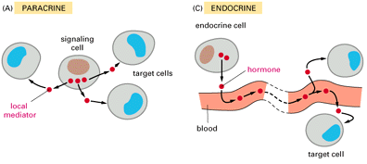
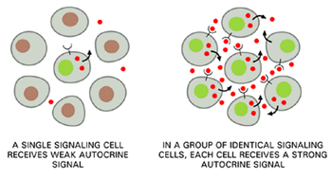
Signal source
A signaling cell produces a particular particular type of signal molecule
This is detected in another target cell, by means of a receptor protein, which recognizes and responds specifically to its ligand
We distinguish between Endocrine, paracrine and autocrine signaling. The latter often occurs in a population of homogenous cells.
Each cell responds to a limited set of signals, and in a specific way

Slide 6
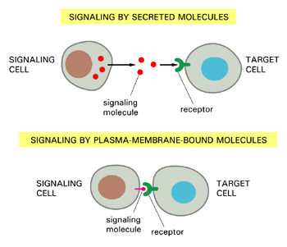
Signaling Molecule
The signal molecule is often secreted from the signaling cell to the extracellular space
In some cases the signaling molecule is bound to the cell surface of the signaling cell. Sometimes, a signal in both cells will be initiated by such an event.

Slide 7
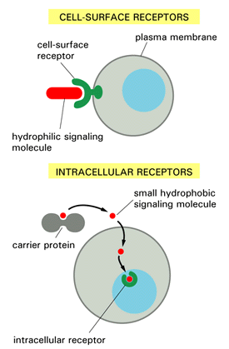

Receptors
Cell surface receptors detect hydrophilic ligands that do not enter the cell
Alternatively, a small hydrophobic ligand (e.g. steroids) may cross the membrane, and bind to an intracellular receptor
Cells may also be linked through a gap junction, sharing small intracellular signaling molecules
GAP JUNCTIONS

Slide 8
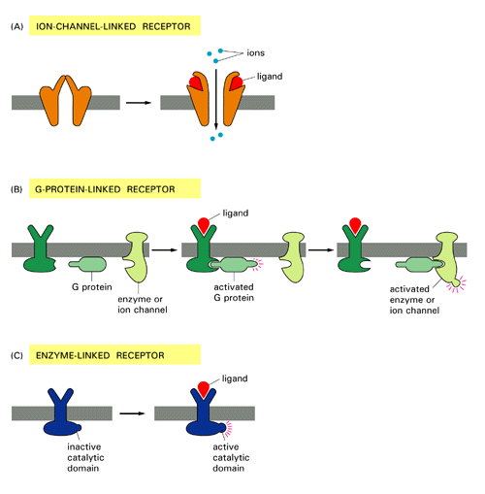
Cell Surface Receptors
Ion channel linked: Binding of ligand causes channel to open or close
G-protein linked:
Binding of ligand activates a G-protein which will activate a separate enzyme or ion channel
Enzyme linked receptor: Binding of ligand activates an enzyme domain on the receptor itself or on an associated molecule

Slide 9
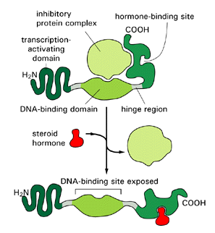
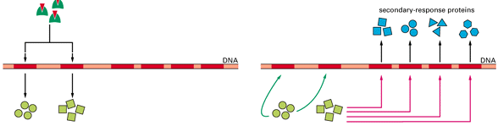
Intracellular receptors
Small hydrophobic signaling molecules, such as steroids, can cross the cell membrane (e.g. estrogen, vitamin D, thyroid hormone, retinoic acid) and bind to intracellular receptors
The hormone-receptor complex has an exposed DNA binding site and can activate transcription directly (or, more typically as a homo- or hetero-dimer)
This usually initiates a cascade of transcription events
PRIMARY RESPONSE
SECONDARY RESPONSE
Shut off primary response genes
Turn on secondary response genes

Slide 10
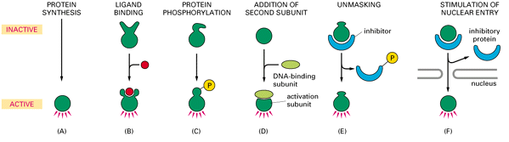
Regulating proteins
Change in conformation by ligand binding. Only bound protein can bind DNA
Only dimer complex of two proteins can bind DNA
In order to bind DNA, the protein must first be translocated to the nucleus
How much protein is created?
Transcription, splicing, degradation, translation
Change in conformation by protein phosphorylation. Only phospho-protein can bind DNA
Binding site is revealed only after removal of an inhibitor

Slide 11
Molecular Interactions
Protein-protein interactions
  Binding or unbinding (formation or breaking of complex)
  Covalent modification:
  phosphorylation (tyr, thr, ser)
  Conformation changes
  Translocation
  Targeting for degradation
Small molecule regulated events
  Binding or unbinding, resulting in conformation change: Steroid ligand, nucleotide binding
  Production of second messengers (e.g. Ca+2)

Slide 12
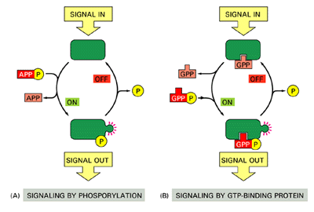
Covalent and non-covalent association of phosphate groups
The association (or absence) of a phosphate group with a protein may affect its capability to interact or its activity
  Activate an enzymatic domain by conformation change
  Enable or disable binding by structural change in binding site
  Affect binding/unbinding of complex and release of “active form” of a G-protein
Both the covalent and non-covalent modifications are reversible, and so are their effects.

Slide 13
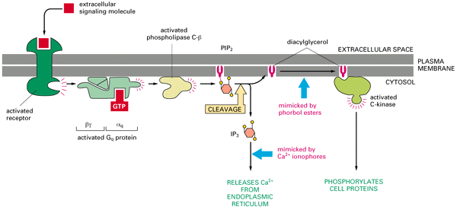
Second messengers
In many pathways, enzymes are activated which catalyze the formation of a large quantity of small molecules
These second messengers broadcast the signal by diffusing widely to act on target proteins in various parts of the cell
This may often result in the release of other second messengers
Activated enzyme: PLC
Ligand – GPCR interaction
2nd messenger: IP₃
Release of Ca+2, another also 2nd messenger
Target: Ca+2 channels in ER

Slide 14
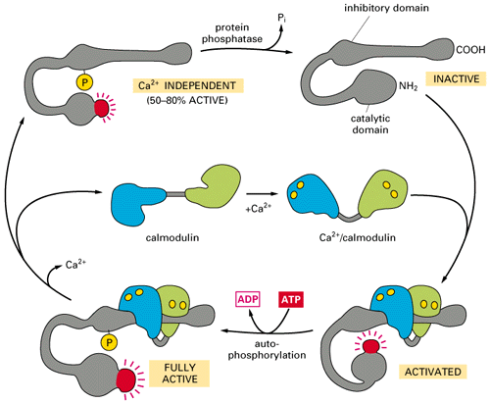
Multi-state regulation of a single protein
Calmodulin-dependent kinase II (CaM Kinase II):
Four different activity states based on a combination of protein binding, ion binding and phosphorylation state

Slide 15
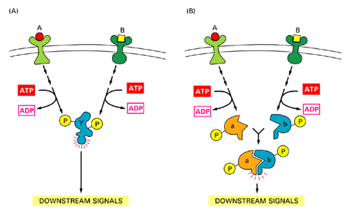
Integration of Signals
The signals from several different sources may be integrated though a single shared protein (A) or protein complex (B)

Slide 16
Insulation by complex formation
The same signaling molecule may participate in more than one pathway
In such cases, it is sometimes insulated from some of its potential inputs and outputs and sequestered (with specific up- and downstream counterparts) by a specific scaffold molecule

Slide 17
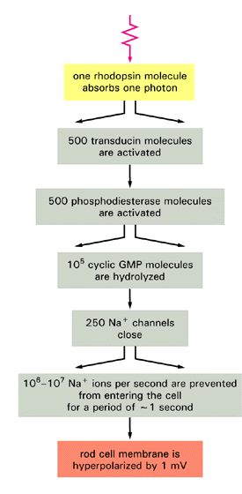
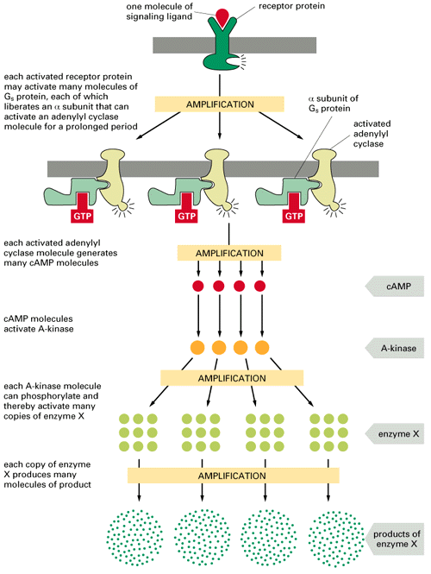
Amplification
1
ligand-receptor
1 receptor activates multiple G proteins
500
G-protein
500
enzymes
Each enzyme Y produces many second messangers, each messanger activates 1 enzyme Y
10⁵
(2nd messanger)
250
(ion channels)
10⁵-10⁷
(ions)

Slide 18
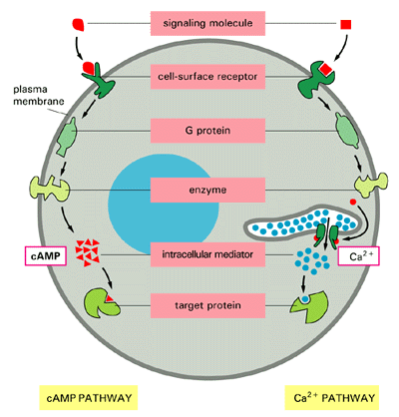
Intracellular target
Determining the “end” of a signaling pathway is often difficult
For example, after transcription, a phosphatase may be synthesized that dephosphorylates one of the enzymes in the pathway
One approach is to consider an event that is “biochemically different” (e.g. transcription, metabolism) as the intracellular target

Slide 19
Intracellular Endpoint
Three major molecular targets
  Regulation of gene expression (e.g. activate a transcription factor and translocate it to the nucleus)
  Changes in the cytoskeleton (e.g. induce movement or reorganization of cell structure)
  Affect metabolic pathways
Many critical processes can occur in response to external signals, without any new synthesis of RNA or proteins. The most well known one is “cell suicide”, termed apoptosis

Slide 20
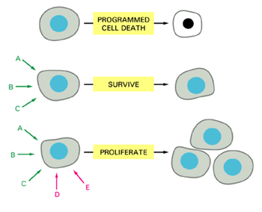
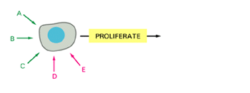
Change in the cell
An animal cell depends on multiple extracellular signals
Multiple signals are required to survive, additional to divide and still others to differentiate
When deprived of appropriate signals most cells undergo apoptosis
DIFFERENTIATE
F
G

Slide 21
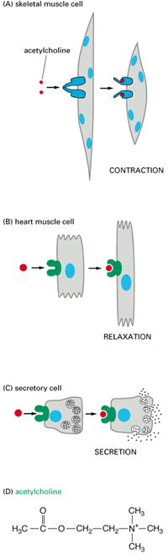
Change in the cell
The same signal molecule can induce different responses in different target cells, which express different receptors or signaling molecules
For example, the neurotransmitter acetylcholine induces contraction in skeletal muscle cells, relaxation in heart muscle cells and secretion in salivary gland cells

Slide 22
RTK
RTK
G protein receptors
Cytokine receptors
DNA damage, stress sensors
G_{β}
G_{α}
SHC
GRB2
G_{γ}
RAB
RhoA
RAC/Cdc42
C-ABL
Multiple connections: feedback, cross talk
SOS
Ca⁺²
GCK
PAK
HPK
RAS
GAP
PYK2
Modular
at domain, component and pathway level
?
PKA
RAF
MOS
TLP2
MEKK1,2,3,4
MAPKKK5
MLK/DLK
ASK1
MAPKKK
MKK1/2
MKK4/7
MKK3/6
MAPKK
PP2A
MAPK
ERK1/2
JNK1/2/3
P38 α/β/γ/δ
Rsk,
MAPKAP’s
TFs, cytoskeletal proteins
Kinases, TFs
Cell division, Differentiation
Inflammation, Apoptosis
Pathway architecture fulfills various functions in the transmission and processing of signals: relay, amplification, switch, insulation etc.

Slide 23
Two Views of Signaling
The biochemical view: What are the specific biochemical events that mediate signals?
The logical view: Is a signal activatory or inhibitory?

Slide 24
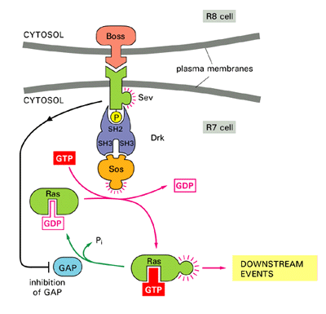
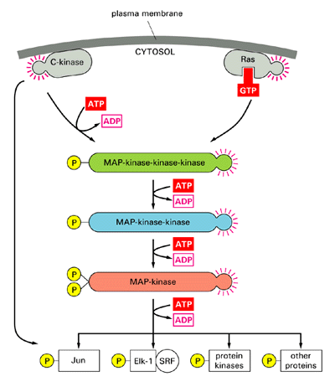
The RTK-MAPK pathway
Drosophila R7 development

Slide 25
The RTK-MAPK pathway
GF
GF
RTK receptor
RTK
RTK
Adaptor proteins
SHC
GRB2
SOS
Ras Activation
RAS
MKP1
PP2A
GAP
MAPK cascade
RAF
MKK1
ERK1
IEP
MP1
IEP
J
F
IEG
This is only one path in mammalian mitogenic signaling initiated from an RTK. In fact, additional signals are intiated at the RTK. Similar pathways were found in eukaryotic organisms as diverse as yeast, drosophila, mouse and humans

Slide 26
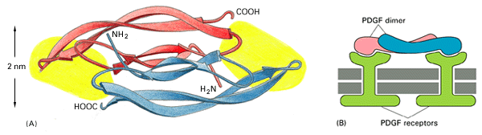
Receptor-Ligand Binding
Ligand
Receptor-Ligand complex
A dimeric ligand protein is formed by di-sulfide bonds between two identical protein monomers
The ligand has two identical receptor binding sites and can cross link two adjacent receptors upon their binding
This initiates the intracellular signaling process
We assume that ligand-receptor binding is irreversible

Slide 27
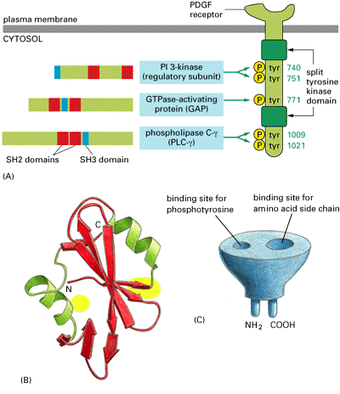
Receptor Activation
The cytoplasmic domain of the receptor has intrinsic kinase activity
Upon dimerization each receptor cross phosphorylates a specific tyrosine residue on its counterpart, which fully activates its kinase
Then, each kinase autophosphorylates additional tyrosine residues on it own cytoplasmic part

Slide 28
Ligand
global(ligand_bind,dummy).
LIGAND::=
<< ligand .
FREE_BD | FREE_BD .
FREE_BD::=
ligand_bind ! {ligand} , BOUND_BD .
BOUND_BD::=
dummy ? [] , true >> .

Slide 29
Receptor (Extracellular part)
global(ligand_bind,tyr,p_tyr,met,atp,dummy).
RTK(env)::=
<< backbone_extra, backbone_intra1, backbone_intra2,
backbone_intra3, tyr1162, atp_bs,sh2_tyr,sh2_tyr1 .
EXTRACELLULAR | TRANSMEMBRANAL | INTRACELLULAR .
EXTRACELLULAR::=
ligand_bind ? {lig} , backbone_extra ! {lig} ,
BOUND_EXTRACELLULAR .
BOUND_EXTRACELLULAR::=
dummy ? [] , true .

Slide 30
Ligand-Receptor binding
GF
GF
RTK
RTK
LIGAND | RTK(mem) | RTK(mem)
FREE_BD(ligand) | FREE_BD(ligand) |
EXTRACELLULAR | EXTRACELLULAR
ligand_bind ! {ligand} , BOUND_BD |
ligand_bind ! {ligand} , BOUND_BD |
ligand_bind ? {lig} , backbone_extra ! {lig} ,
BOUND_EXTRACELLULAR |
ligand_bind ? {lig} , backbone_extra ! {lig} ,
BOUND_EXTRACELLULAR
*
BOUND_BD | BOUND_BD |
backbone_extra ! {ligand} , BOUND_EXTRACELLULAR |
backbone_extra ! {ligand} , BOUND_EXTRACELLULAR

Slide 31
Receptor (Transmembranal)
TRANSMEMBRANAL::=
<< cross_receptor .
backbone_extra ? {cross_lig} ,
<< cross_lig ! {tyr1162, cross_receptor} ,
cross_receptor ? {cross_tyr} ,
backbone_intra1 ! {cross_tyr} , RTK_DIMERIZED ;
cross_lig ? {cross_tyr, cross_rec} , cross_rec ! {tyr1162} ,
backbone_intra1 ! {cross_tyr} , RTK_DIMERIZED >> .
RTK_DIMERIZED:-
dummy ? [] | true >> .

Slide 32
Receptor dimerization
GF
GF
RTK
RTK
backbone_extra ! {ligand} , BOUND_EXTRACELLULAR |
backbone_extra ! {ligand} , BOUND_EXTRACELLULAR |
backbone_extra ? {cross_lig} , … |
backbone_extra ? {cross_lig} , … |
Communication within receptors
*
BOUND_EXTRACELLULAR | BOUND_EXTRACELLULAR |
ligand ! {tyr1162, cross_receptor} , … ;
ligand ? {cross_tyr, cross_rec} , … |
ligand ! {tyr1162, cross_receptor} , … ;
ligand ? {cross_tyr, cross_rec} , … |
Communication between receptors

Slide 33
Receptor dimerization
GF
GF
RTK
RTK
cross_receptor ? {cross_tyr} , backbone_intra1 ! {cross_tyr} , RTK_DIMERIZED |
cross_receptor ! {tyr1162} , backbone_intra1 ! {tyr1162} ,
RTK_DIMERIZED
Communication between receptors
backbone_intra1 ! {tyr1162} , RTK_DIMERIZED |
backbone_intra1 ! {tyr1162} , RTK_DIMERIZED

Slide 34
Receptor Activation
The cytoplasmic domain of the receptor has intrinsic kinase activity
Upon dimerization each receptor cross phosphorylates a specific tyrosine residue on its counterpart, which fully activates its kinase
Then, each kinase autophosphorylates additional tyrosine residues on it own cytoplasmic part

Slide 35
Location and Chemical complementarity
For one receptor to phosphorylate another (or itself) the two must share
  Common complex (private channel)
  Chemical complementarity (global channel)
This creates a modeling difficulty, since we cannot match two channels simultaneously
One option is to use a match construct
  First communicate on the private channel and send a global channel name (bind)
  Then, match the global channels by comparing them (react)
  If the second match does not work the counterparts unbind (similar to a competitive inhibitor)
An simpler alternative is to use only the private channels, but this may create an “illegal” situation where the kinase phosphorylates something it shouldn’t

Slide 36
Receptor (Cytoplasmic)
INTRACELLULAR::=
RTK_SH_BS(tyr,met) | RTK_KINASE_CORE .
RTK_KINASE_CORE::=
RTK_KINASE_SITE |
RTK_REGULATORY_SITE(tyr) |
RTK_ATP_BS .
We will subsequently “ignore” ATP binding to simplify the example
A phosphorylatable Tyr1162, its phosphorylation/dephosph will cause a conformation change throughout the kinase core

Slide 37
RTK Kinase – Phosphorylation – Option I
RTK_KINASE_SITE::=
CROSS_PHOSPHORYLATE + FULL_PHOSPHORYLATE .
CROSS_PHOSPHORYLATE::=
backbone_intra1 ? {cross_motif} , cross_motif ? {cross_res} ,
<< cross_res=?=tyr , cross_motif ! {p_tyr} , RTK_KINASE_SITE;
otherwise , cross_motif ! {cross_res} , RTK_KINASE_SITE >>.
FULL_PHOSPHORYLATE::=
backbone_intra3 ? [] , ACTIVE_FULL .
ACTIVE_FULL::=
backbone_intra2 ? {cross_motif} , cross_motif ? {cross_res} ,
<< cross_res=?=tyr , cross_motif ! {p_tyr} , ACTIVE_FULL ;
otherwise , cross_motif ! {cross_res} , ACTIVE_FULL >> ;
backbone_intra3 ? [] , RTK_KINASE_SITE .

Slide 38
RTK Kinase – Regulation - Option I
RTK_REGULATORY_SITE(res)::=
tyr1162 ! {res} , tyr1162 ? {res1} ,
<< res1 =?= res , RTK_REGULATORY_SITE(res1) ;
otherwise , backbone_intra3 ! [] ,
RTK_REGULATORY_SITE(res1) >> .

Slide 39
RTK Intracellular Tyr Phosphorylation Sites - Option I
RTK_SH_BS(res,side_res)::=
backbone_intra2 ! {sh2_tyr} , sh2_tyr ! {res} ,
sh2_tyr ? {resa} , RTK_SH_BS(resa, side_res) ;
res ! {sh2_tyr, sh2_tyr1, backbone_intra2, env, side_res} ,
<< sh2_tyr1 ? [] , BOUND_RTK_SH_BS ;
sh2_tyr ? {res1} , RTK_SH_BS(res,res1) >>.
BOUND_RTK_SH_BS:-
dummy ? [] , true .

Slide 40
RTK Kinase – Phosphorylation: Option II
RTK_KINASE_SITE::=
CROSS_PHOSPHORYLATE + FULL_PHOSPHORYLATE .
CROSS_PHOSPHORYLATE::=
backbone_intra1 ? {cross_motif} , cross_motif ! {p_tyr} ,
RTK_KINASE_SITE.
FULL_PHOSPHORYLATE::=
backbone_intra3 ? [] , ACTIVE_FULL .
ACTIVE_FULL::=
backbone_intra2 ? {cross_motif} , cross_motif ! {p_tyr} ,
ACTIVE_FULL ;
backbone_intra3 ? [] , RTK_KINASE_SITE .

Slide 41
RTK Kinase – Regulation - Option II
RTK_REGULATORY_SITE(res)::=
tyr1162 ? {res1} ,
<< res1 =?= res , RTK_REGULATORY_SITE(res1) ;
otherwise , backbone_intra3 ! [] ,
RTK_REGULATORY_SITE(res1) >> .

Slide 42
RTK Intracellular Tyr Phosphorylation Sites - Option II
RTK_SH_BS(res,side_res)::=
backbone_intra2 ! {sh2_tyr} , sh2_tyr ? {resa} ,
RTK_SH_BS(resa, side_res) ;
res ! {sh2_tyr, sh2_tyr1, backbone_intra2, env, side_res} ,
<< sh2_tyr1 ? [] , BOUND_RTK_SH_BS ;
sh2_tyr ? {res1} , RTK_SH_BS(res,res1) >>.
BOUND_RTK_SH_BS:-
dummy ? [] , true .

Slide 43
Receptor
(Trans-phosphorylation)
GF
GF
RTK
RTK
backbone_intra1 ! {tyr1162} , RTK_DIMERIZED |
backbone_intra1 ! {tyr1162} , RTK_DIMERIZED |
backbone_intra1 ? {cross_motif} , cross_motif ! {p_tyr} ,
RTK_KINASE_SITE |
backbone_intra1 ? {cross_motif} , cross_motif ! {p_tyr} ,
RTK_KINASE_SITE
Within receptors
*
RTK_DIMERIZED | RTK_DIMERIZED |
tyr1162 ! {p_tyr} , RTK_KINASE_SITE |
tyr1162 ! {p_tyr} , RTK_KINASE_SITE
tyr1162 ! {p_tyr} , RTK_KINASE_SITE |
tyr1162 ! {p_tyr} , RTK_KINASE_SITE |
RTK_REGULATORY_SITE(tyr) |
RTK_REGULATORY_SITE(tyr)

Slide 44
Receptor
(Trans-phosphorylation)
GF
GF
RTK
RTK
tyr1162 ! {p_tyr} , RTK_KINASE_SITE |
tyr1162 ! {p_tyr} , RTK_KINASE_SITE |
tyr1162 ? {res1} , << res1 =?= tyr, RTK_REG_SITE(res1);
otherwise , backbone_intra3 ! [] ,
RTK_REG_SITE(res1) >> |
tyr1162 ? {res1} , << res1 =?= tyr, RTK_REG_SITE(res1);
otherwise , backbone_intra3 ! [] ,
RTK_REG_SITE(res1) >> |
Between receptors
*
RTK_KINASE_SITE | RTK_KINASE_SITE |
backbone_intra3 ! [] , RTK_REG_SITE(p_tyr) |
backbone_intra3 ! [] , RTK_REG_SITE(p_tyr)
FULL_PHOSPHORYLATE | FULL_PHOSPHORYLATE |
backbone_intra3 ! [] , RTK_REG_SITE(p_tyr) |
backbone_intra3 ! [] , RTK_REG_SITE(p_tyr)

Slide 45
Receptor
(Trans-phosphorylation)
GF
GF
RTK
RTK
backbone_intra3 ? [] , ACTIVE_FULL |
backbone_intra3 ? [] , ACTIVE_FULL |
backbone_intra3 ! [] , RTK_REG_SITE(p_tyr) |
backbone_intra3 ! [] , RTK_REG_SITE(p_tyr)
within receptors
*
ACTIVE_FULL | ACTIVE_FULL |
RTK_REG_SITE(p_tyr) | RTK_REG_SITE(p_tyr)

Slide 46
Receptor
(Auto-phosphorylation)
GF
GF
RTK
RTK
ACTIVE_FULL | RTK_SH_BS(tyr,met)
backbone_intra2 ? {cross_motif} , cross_motif ! {p_tyr} , ACTIVE_FULL ; … |
backbone_intra2 ! {sh2_tyr} , sh2_tyr ? {resa} ,
RTK_SH_BS(resa, met) ; …
within receptor
sh2_tyr ! {p_tyr} , ACTIVE_FULL ; … |
sh2_tyr ? {resa} , RTK_SH_BS(resa, met) ; …
within receptor
ACTIVE_FULL | RTK_SH_BS(p_tyr, met) ; …

Slide 47
The activated receptor
The phosphorylated tyrosines can be specifically identified by SH2 and SH3 domains on other proteins, including adapter proteins
The activated receptor can then phosphorylate these bound proteins

Slide 48
Adapter proteins:
Coupling receptor and Ras activation
A series of protein-protein binding events follow, leading to the formation of a multi-protein complex at the receptor: First, the SHC adapter protein binds the receptor through an SH2 domain. The receptor can then phosphorylate it on a Tyr residues, allowing it to bind the SH2 domain of the GRB2 protein, which in parallel can bind the SH3 domain of the SOS protein

Slide 49
Binding SH2 domains
The SH2 domain is a compact module
Each SH2 domain has distinct sites for recognizing phosphotyrosine and for recognizing a particular amino acid side chain
Thus, different SH2 domains recognize pTyr in the context of different flanking amino acids

Slide 50
Simultaneous recognition in multiple sites
Correct identification of an SH2 domain requires matching of two motifs (global channels)
One approach is to combine communication with the match construct
Alternatively, we may treat each combined tyr+flanking region as an independent motif.
In this case the phosphorylating kinase should modify a more “specific” name

Slide 51
RTK Intracellular Tyrosine Phosphorylation Sites
RTK_SH_BS(res,side_res)::=
backbone_intra2 ! {sh2_tyr} , sh2_tyr ? {resa} ,
RTK_SH_BS(resa, side_res) ;
res ! {sh2_tyr, sh2_tyr1, backbone_intra2, mem, side_res} ,
<< sh2_tyr1 ? [] , BOUND_RTK_SH_BS ;
sh2_tyr ? {res1} , RTK_SH_BS(res,res1) >>.
BOUND_RTK_SH_BS:-
dummy ? [] | true .
The side-res will be checked (matched)
in the counterpart SH2 domain. This may lead to many futile interactions, and is thus incorrect

Slide 52
SHC
GF
GF
RTK
RTK
SHC
SHC(env)::=
<< shc_tyr, shc_tyr1, shc_tyr2, backbone .
SHC_SH2(env) | SHC_SH2_BS(env,tyr,glu) .
SHC_SH2(env)::=
p_tyr ? {c_sh2,c_sh2a,c_backbone,c_env, c_res1} ,
<< c_res1 =?= met , backbone ! {c_env} , c_backbone!{shc_tyr},
c_sh2a ! [] , BOUND_SHC_SH2(c_env) ;
otherwise , c_sh2 ! {c_res1} , SHC_SH2(env) >> .
BOUND_SHC_SH2(cross_env)::=
dummy ? [] , true .

Slide 53
SHC
SHC_SH2_BS(env,res,res1)::=
backbone ? {cross_env} , SHC_SH2_BS(cross_env,res,res1);
shc_tyr ? {resa} , SHC_SH2_BS(env,resa,res1);
res1 ! {shc_tyr1, shc_tyr2, env, res} ,
<< shc_tyr1 ? [] , BOUND_SHC_SH2_BS ;
shc_tyr2 ? [] , SHC_SH2_BS(env,res,res1) >> .
BOUND_SHC_SH2_BS:-
dummy ? [] , true >> .

Slide 54
SHC binding to receptor pTyr-met motif
GF
GF
RTK
RTK
SHC
RTK_SH_BS(p_tyr, met) | SHC_SH2(cyt) | SHC_SH2_BS(cyt,tyr,glu)
p_tyr ! {sh2_tyr, sh2_tyr1, backbone_intra2, mem, met} ,…;…|
p_tyr ? {c_sh2,c_sh2a,c_backbone,c_env, c_res1} , … |
SHC_SH2_BS(cyt,tyr,glu)
met=met
sh2_tyr1 ? [] , BOUND_RTK_SH_BS ;
sh2_tyr ? {res1} , RTK_SH_BS(p_tyr,res1) |
backbone ! {mem} , backbone_intra2 ! {shc_tyr},
sh2_tyr1 ! [] , BOUND_SHC_SH2(mem) |
backbone ? {cross_env} , SHC_SH2_BS(cross_env,tyr,glu);…
sh2_tyr1 ? [] , BOUND_RTK_SH_BS ;
sh2_tyr ? {res1} , RTK_SH_BS(p_tyr,res1) |
backbone_intra2 ! {shc_tyr}, sh2_tyr1 ! [] , BOUND_SHC_SH2(mem)|
SHC_SH2_BS(mem,tyr,glu)

Slide 55
SHC binding to receptor pTyr-met motif
GF
GF
RTK
RTK
The “Active_Full” sub-process of the SAME receptor
SHC
sh2_tyr1 ? [] , BOUND_RTK_SH_BS ;
sh2_tyr ? {res1} , RTK_SH_BS(p_tyr,res1) |
backbone_intra2 ! {shc_tyr}, sh2_tyr1 ! [] , BOUND_SHC_SH2(mem)|
backbone_intra2 ? {cross_motif} , cross_motif ! {p_tyr} ,
ACTIVE_FULL ;… | SHC_SH2_BS(mem,tyr,glu)
RTK “receives motif” for phosphorylation
sh2_tyr1 ? [] , BOUND_RTK_SH_BS ;
sh2_tyr ? {res1} , RTK_SH_BS(p_tyr,res1) |
sh2_tyr1 ! [] , BOUND_SHC_SH2(mem)|
shc_tyr ! {p_tyr} , ACTIVE_FULL | SHC_SH2_BS(mem,tyr,glu)
BOUND_RTK_SH_BS | BOUND_SHC_SH2(mem)|
shc_tyr ! {p_tyr} , ACTIVE_FULL |
SHC_SH2_BS(mem,tyr,glu)

Slide 56
SHC phosphorylation by RTK
GF
GF
RTK
RTK
SHC
shc_tyr ! {p_tyr} , ACTIVE_FULL |
shc_tyr ? {resa} , SHC_SH2_BS(mem,resa,glu); …
RTK phosphorylates bound SHC
ACTIVE_FULL | SHC_SH2_BS(mem,p_tyr,glu); …
… ; glu ! {shc_tyr1, shc_tyr2, mem,p_tyr} ,
<< shc_tyr1 ? [] , BOUND_SHC_SH2_BS ;
shc_tyr2 ? [] , SHC_SH2_BS(env,res,res1) >> .
To be identified by next in line (the SH2 domain of Grb2)
Note: We did a “dirty trick” here: once (in RTK pTyr) checking first on ptyr and another (in SHC pTyr) checking first on glu

Slide 57
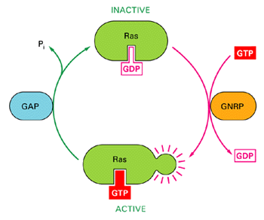
Ras Activation
By these protein-protein interactions, the SOS protein is brought close to the membrane, where is can activate Ras, that is attached to the membrane
SOS activates Ras by exchanging Ras’s GDP with GTP.
GAP inactivates it by the reverse reaction
SOS

Slide 58
Activation of the MAPK cascade
Active Ras interacts with the first kinase in the MAPK cancade, Raf.
It localizes Raf to the membrane, where it is activated by an unknown mechanism
This starts the cascade

Slide 59
Activation of the MAPK cascade
Each kinase in the cascade is activated by phosphorylation in a regulatory site, called the t-loop
When T-loop is phosphorylated, a conformation change occurs and the catalytic cleft is “opened” and active
Each kinase is bound by modifying enzymes (incoming signals) on its Nt lobe. It binds its substrate through its Ct lobe.
The three kinases may be tethered together in one complex with the MP1 scaffold protein

Slide 60
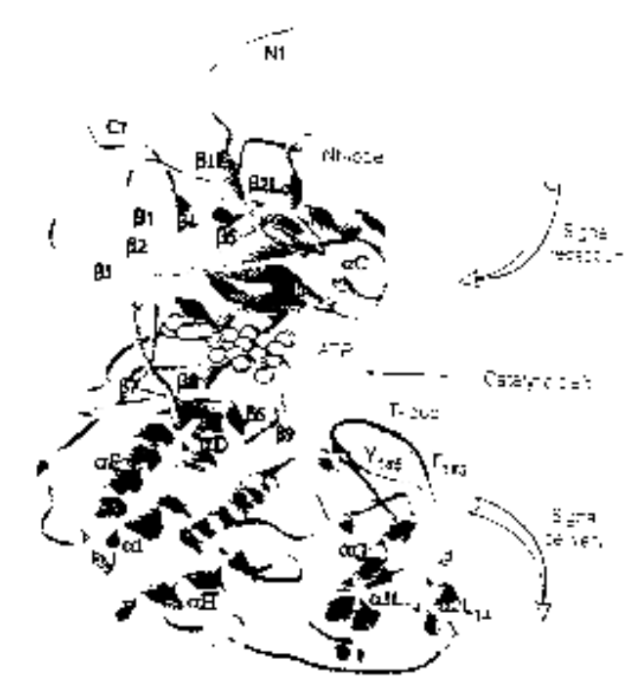
MAPK (ERK1)
Structure
Process
NH₂
Binding MP1 molecules
Nt lobe
Kinase site:
Phosphorylate Ser/Thr residues
(PXT/SP motifs)
Regulatory T-loop:
Change conformation
ATP binding site:
Bind ATP, and use it for phsophorylation
p-Y
Catalytic core
p-T
Ct lobe
Binding to substrates
COOH

Slide 61
MAPK targets
The MAPK phosphorylates and activates many different targets
For example, after phosphorylation it may translocate to the nucleus and activate transcription factors
It also phosphorylates the receptor kinase and other enzymes in the pathway in an inhibitory fashion (negative feedback)

Slide 62
References
General Introduction:
  Alberts et al. (1994) Molecular Biology of the Cell, Chapter 15
  Alberts et al. (1997) Essential Cell Biology, Chapter 15
Signal transduction:
  Krauss (2000) Biochemistry of Signal Transduction and Regulation
  Heldin and Purton (eds.) (1996) Signal Transduction
RTK-MAPK pathways
  Lewis et al. (1998) Signal transduction through MAP kinase cascades. Advances in Cancer Research 74: 49-139
  Widmann et al (1999) Mitogen activated protein kinase: Conservation of a three kinase module from yeast to human. Physiological Reviews 79:143-180
  Brunet et al (1997) Mammalian MAP kinase modules: how to transduce specific signals. Essays in Biochemistry 32: 1-16.

