Slide 1
A Lane Detection, Tracking and Recognition System for Smart Vehicles (LTRSV)
Batch No: 19CSEA010
Team Members
A.Bharathi Devi(16K61A0501)
G.Siva Jyothi (16K61A0541)
K.Ethish Kumar (17K65A0501)
Ch.Manoj Sai(16K61A0517)
Supervisor
Dr.N.Krishnaraj Ph.D
Professor

Slide 2
List of Contents
Abstract
Techniques
Modules split up
Gantt chart
Detailed design
Work progress towards proposed system
Software requirements
Algorithms
Expected outcome
Plan of action
References/Bibliography

Slide 3
Abstract
Introduce an approach to detect information about lane and vehicle for the driver assistance system, or the lane tracking and vehicle detection system. Most previous research works could only detect the lanes or vehicles separately. However, the combination of lane information and vehicle information is able to support the driver assistance system and to improve the reliability of results.
For the Lane detection,tracking and recognition system for smart vehicles (LTRSV), it must detect the frontal lanes and discover the vehicles around a test vehicle. Therefore, a vision system is utilized including two cameras, one is fixed in front side top and another one is fixed in inside the vehicle to analyze driver facial expression.

Slide 4
Techniques
To Detect lanes,vehicles and driver facial expression for LTRSV we should use these techniques
FACE DETECTION
Support Vector Machine(SVM)
LANE DETECTION
The Canny Edge Detection
Hough Transform
VEHICLE DETECTION
Haar Like Cascade Classifier

Slide 5
Module split-up
Facial recognition
Lane detection
Vehicle detection

Slide 6
Facial recognition
To detect the driver facial expression because if the driver may be feel sleepy at that time our facial expression will detect and alert the driver with voice assistant otherwise there is a chance to occur accidents, And these always keep analyze the facial expressions of the driver until he reaches the destination for facial expression detection we can use Facial Expression Recognition Using Support Vector Machine.

Slide 7
Lane detection
The results of lane edge detection play an important role in feature-based lane detection. The complicated conditions of road make the correct edge detection of lane markings become very challenging. In order to get an ideal edge of lane markings in road image, a method of lane edge detection based on Canny algorithm is proposed. Firstly according to the importance in lane markings recognition, the road image is divided into three regions. Only the regions with useful information are processed. Then by the features of gray distribution and lane markings width, some noises are removed from the image. Using the shape features of lane markings, the lane edges are detected based on Canny algorithm. Finally by use of the Hough transform technique lane detection is achieved.

Slide 8
Vehicle detection
Vehicle detection is a technology which its aim is to locate and
show the vehicle size in digital images. In this technology,
vehicles are detected in presence of other things like trees and
buildings.It has an important role in many computer vision
applications such as vehicle tracking, analyzing the traffic scene
and efficient traffic management.These Vehicle detection is
implemeted based on “Haar like cascade classifier”.

Slide 9
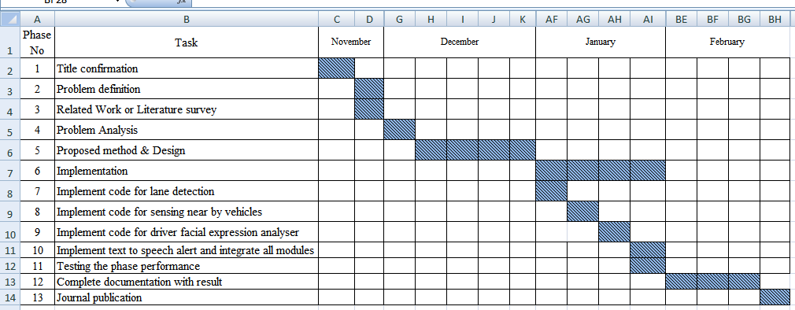
Gantt chart
For full Gantt chart:https://drive.google.com/open?id=0B5CCyMjZT9O0MVc3bjBJVUxHWmI0WnotRkR6bzlobExsaDlZ

Slide 10
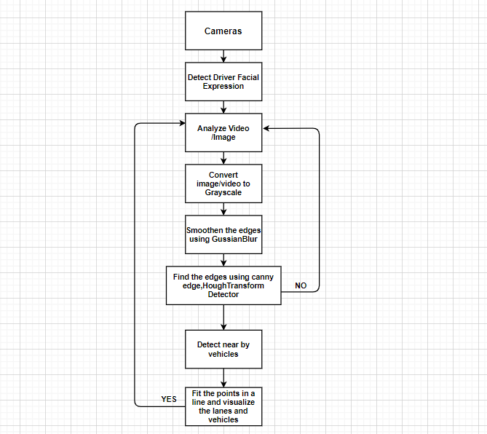
Detailed design
Data flow diagram

Slide 11
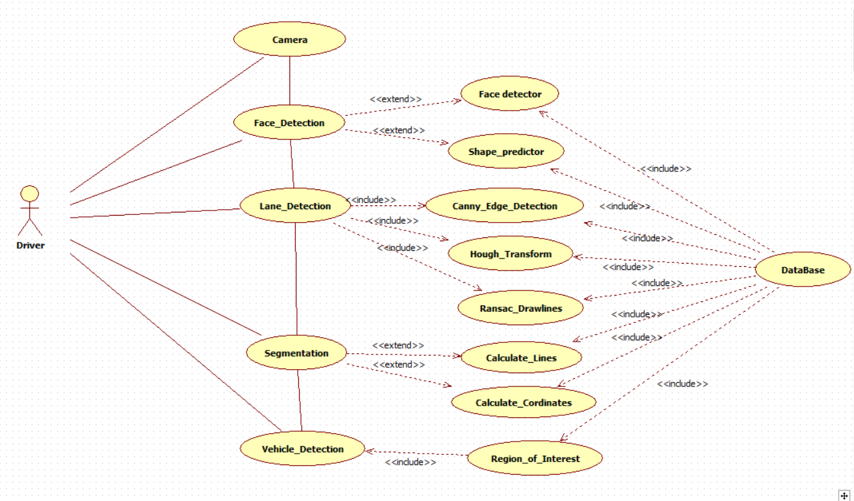
Use case diagram

Slide 12
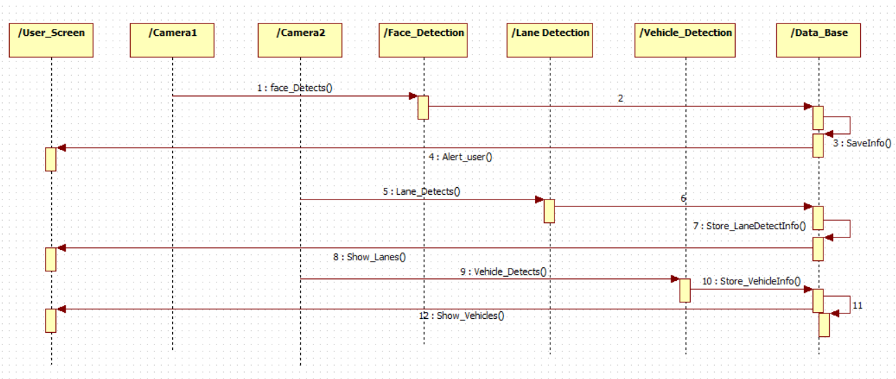
Sequence diagram

Slide 13
Work progress towards proposed system
Completed required software’s installation.
Code implementation of Module “Driver Facial Expression Analyzer” is completed.
Implemented code for “Road Lane Detection” using “Canny Edge” method.
Present we were working on “Lane Detection using Hough Transform” And Vehicle Detection.

Slide 14
Software requirements
Python3
Opencv4
Numpy
Matplotlib
Dlib

Slide 15
Algorithms
SVM algorithm: “Support Vector Machine” (SVM) is a supervised machine learning algorithm which can be used for both classification or regression challenges
Hough Transform: The ”Hough transform” is a feature abstraction technique used in computer vision. The purpose of the technique is to find imperfect instances of objects within a certain class of shapes by a voting procedure, Using the gradient direction to reduce the number of votes.

Slide 16
Algorithms(contd..)
Canny Algorithm:Canny edge detection is a technique to extract useful structural information from different vision objects and dramatically reduce the amount of data to be processed. It has been widely applied in various computer vision systems. Canny has found that the requirements for the application of edge detection on diverse vision systems are relatively similar. Thus, an edge detection solution to address these requirements can be implemented in a wide range of situations.

Slide 17
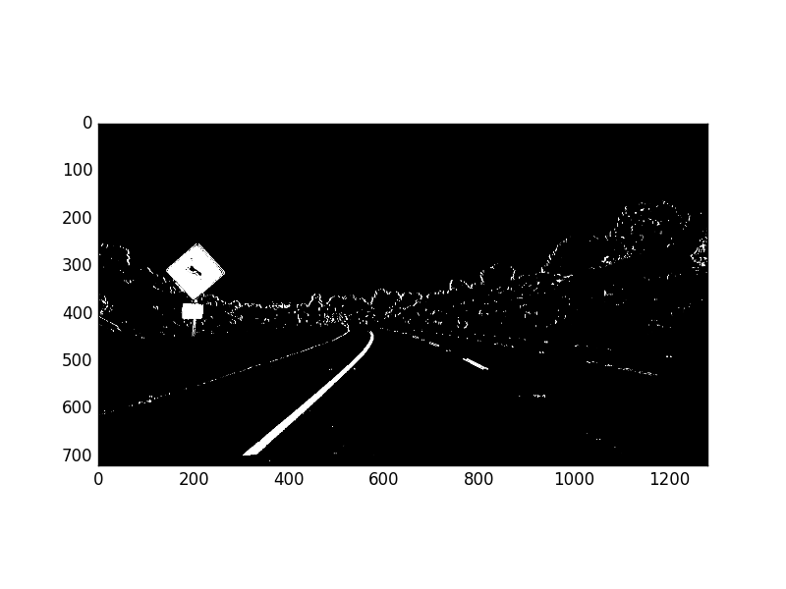
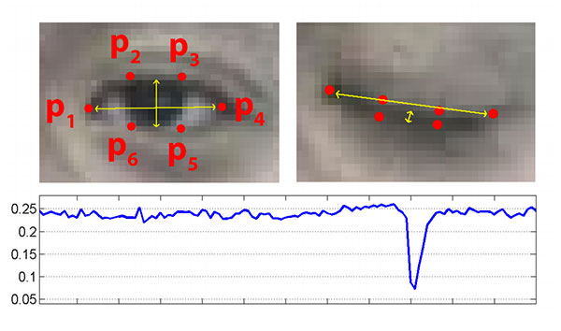
Expected outcome
To provide safety and avoid accidents by detecting road lanes
Monitor Driver facial expression and alerts driver
Detect lanes using above discussed techniques and algorithms
Detect vehicles which are passing nearby our vehicle
Driver Face Analyzer
Canny Edge Detection

Slide 18
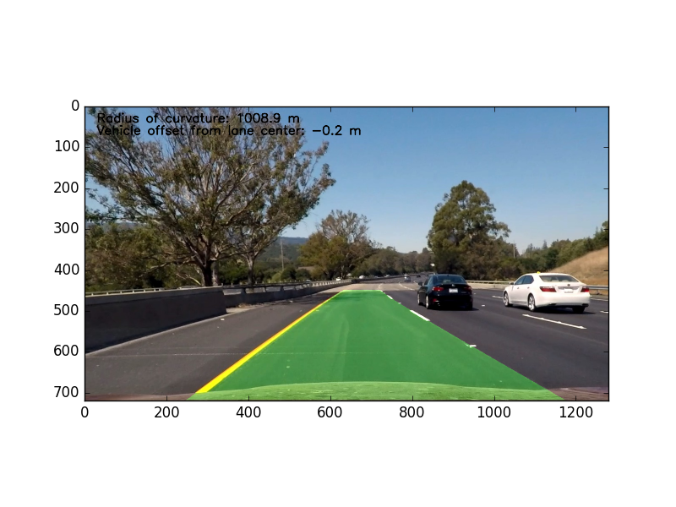
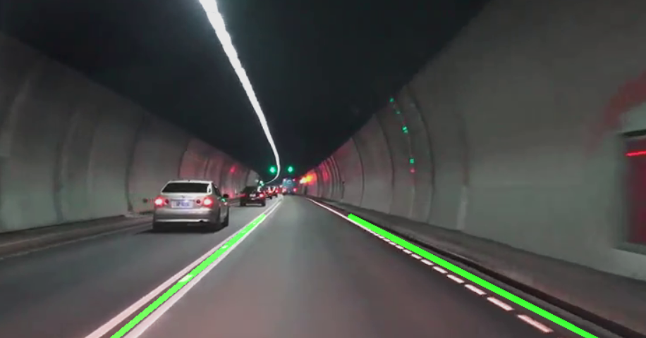
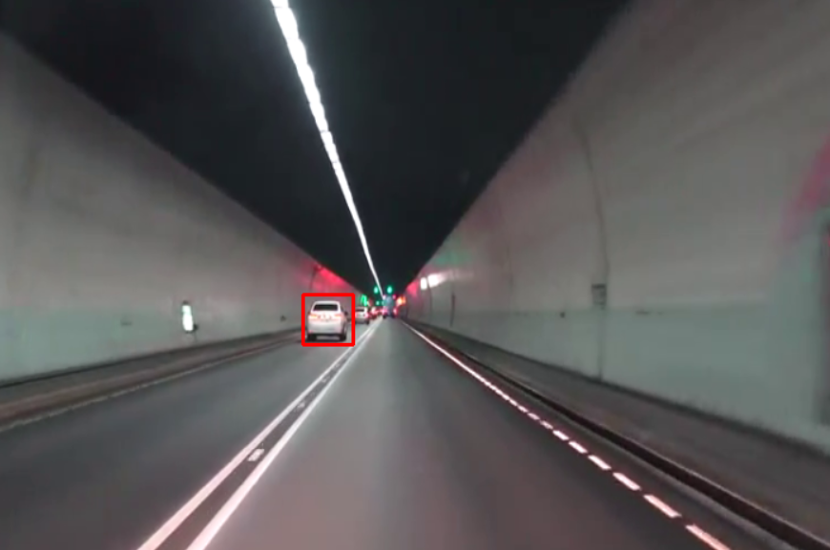
Expected outcome(contd..)
Ransac Detection
Hough Transform Detection
Vehicle Detection

Slide 19
Plan of action
Task | Starting Date | Ending Date
Problem statement | 19/11/19 | 29/11/19
Requirements identification | 23/11/19 | 27/11/19
Literature Survey | 28/11/19 | 03/12/19
Design | 5/12/19 | 13/12/19
Software Installation | 14/12/19 | 21/12/19
Implementation | 24/12/19 | 14/02/20
Testing | 15/02/20 | 29/02/20
Documentation | 01/03/20 | 07/03/20

Slide 20
References/Bibliography
[1] C. Y. Lin et al., “Real-time mark-on-windshield
warning system for intelligent vehicles,” Transactions of the Canadian Society for Mechanical Engineering, vol.36, no. 1, 2012, pp. 97-112.
[2] A. M.A. Soliman et al., “Fuzzy-skyhook control for active suspension systems applied to a full vehicle
model,” International Journal of Engineering and
Technology Innovation, vol. 2, no. 2, 2012, pp. 85-96.
[3] Y. He et al., “Color-based road detection in urban
traffic scenes,” IEEE Transaction on Intelligent
Transportation System, vol. 5, no. 4, 2004, pp. 309-318.
[4] D. J. Kang and M. H. Jung, “Road lane segmentation using dynamic programming for active safety vehicles,” Pattern Recognition Letters, vol. ,no. 16, 2003, pp.3177-3185.
[5] N. Benmansour et al., “Stereovision-based 3D lane
detection system: a model driven approach,” 11th
International IEEE Conference on Intelligent
Transportation System, Beijing, China, 2008, pp. 182-188.
[6] A. Assidiq et al., “Real time lane detection for
autonomous vehicles,” International Conference on
Computer and Communication Engineering, Kuala
Lumpur, Malaysia, 2008, pp. 82-88.
[7] M. Bahgat, “A simple implementation for unmarked road tracking,” The 14th IEEE Mediterranean Electrotechnical Conference, Ajaccio, France, 2008, pp.929-934.
[8] A. Borkar et al., “A layered approach to robust lane
detection at night,” IEEE Workshop on Computational
Intelligence in Vehicles and Vehicular Systems, Nashville ,TN, U.S., 2009, pp. 51-57.
[9] B. F. Wu et al., “A new vehicle detection with
distance estimation for lane change warning systems,”
Intelligent Vehicles Symposium, Istanbul, Turkey, 2007,pp. 698-703.

Slide 21
THANK YOU

