Slide 1

Batch No: 19CSEA010
Team Members
A.Bharathi Devi(16K61A0501)
G.Siva Jyothi (16K61A0541)
K.Ethish Kumar (17K65A0501)
Ch.Manoj Sai(16K61A0517)
Supervisor
Dr.N.Krishna Raj Ph.D
Professor

Slide 2
List of Contents
Abstract
Methodology
Modules split up
Gantt chart
Detailed design
Work progress towards proposed system
Equations and software
Algorithms/Techniques
Expected outcome
Plan of action
References/Bibliography

Slide 3
Abstract
Here, we introduce an approach to detect information about lane and vehicle for the driver assistance system, or the lane change assistant system. Most previous research works could only detect the lanes or vehicles separately.
However, the combination of lane information and vehicle information is able to support the driver assistance system, or the lane change assistant system, and to improve the reliability of results.
For the lane change assistant system (LCAS), it must detect the frontal lanes and discover the vehicles around a test vehicle. Therefore, in this study, a vision system is utilized including three cameras, two of them are under the right and left wing mirrors, the left one is equipped on the windscreen of the test vehicle.
The images from the cameras are used to detect three lanes, and detect vehicles. In the lane detection, the line detection is used.

Slide 4
The project involves detection of lane lines in an image using Python and OpenCV. OpenCV means “Open-Source Computer Vision”, which is a package that has many useful tools for analyzing images.
The Canny Edge Detection Technique
Gaussian blur
Edge Detection
Region of Interest
Hough Transform

Slide 5
Module split-up
Lane detection
This approach is to detect the line segments from the image and EDLines algorithm is used because for each image this algorithm only takes from 10ms to 20ms with an intel 2.2GHz CPU for the line detection ,which much faster than other algorithms, such as the Line Segment Detector (LSD),without the need for any further processing.Moreover, the EDLines algorithm runs even faster when it is applied to the Region Of Interest(ROI).
Vehicle detection
The vehicle detection is the main work and which is relied on the detected lane markings from the previous section the original image is filtered by horizontal edge and the received image is converted to binary using the Otsu’s thresholding. After having the binary image ,we divide the image into lane areas based on the detected lane markings and it is used to detect the vehicles.

Slide 6
Continue...
Facial recognition
To detect the driver facial expression because if the driver may be feel sleepy at that time our facial expression will detect and alert the driver with voice assistant otherwise there is a chance to occur accidents, And these always keep analyze the facial expressions of the driver until he reaches the destination for facial expression detection we can use Facial Expression Recognition Using Support Vector Machines

Slide 7
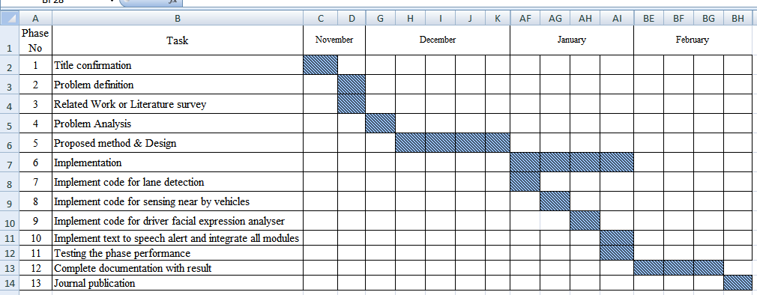
Gantt chart
For full Gantt chart:https://drive.google.com/open?id=0B5CCyMjZT9O0MVc3bjBJVUxHWmI0WnotRkR6bzlobExsaDlZ

Slide 8
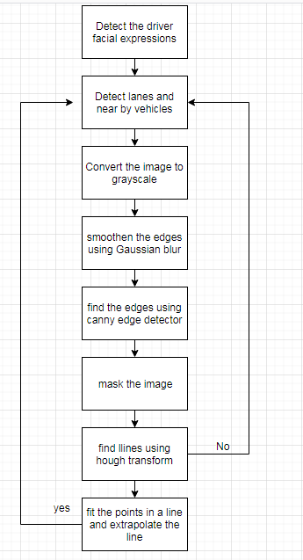
Detailed design
Dataflow diagram:

Slide 9
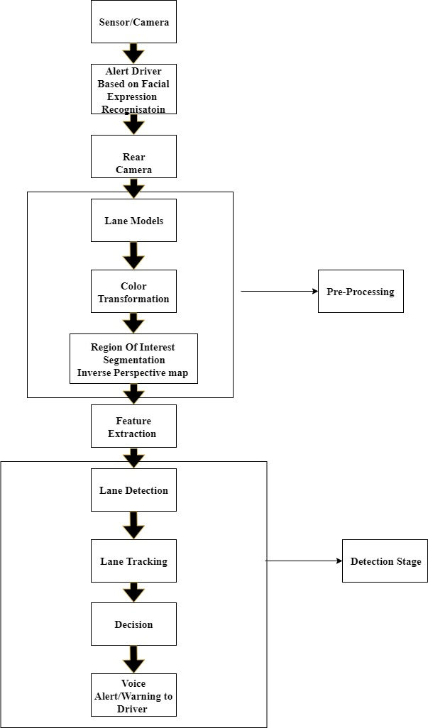
System architecture:

Slide 10
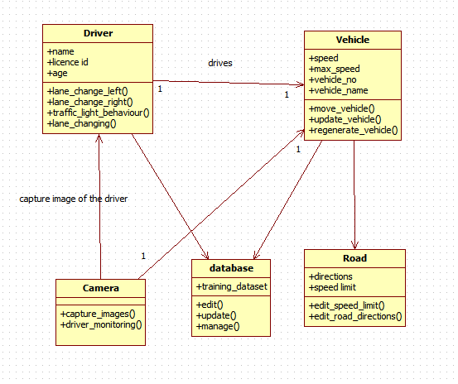
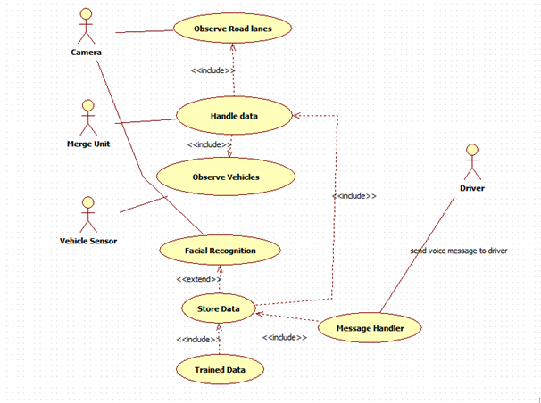
Usecase diagram
Class diagram

Slide 11
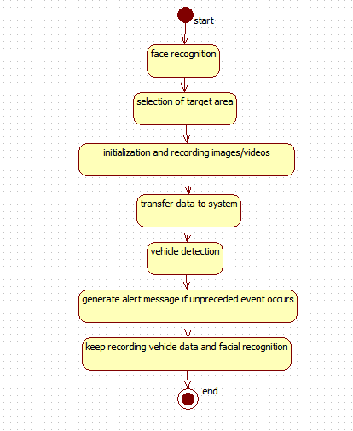
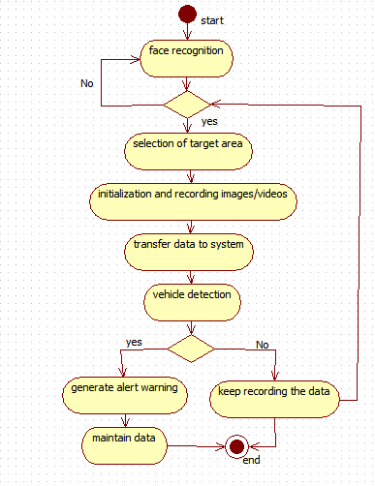
State chart diagram
Activity diagram

Slide 12
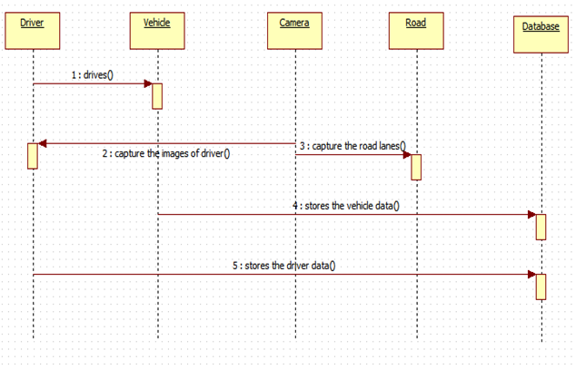
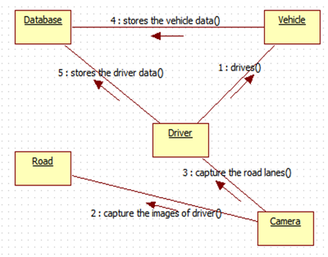
Sequence diagram
Collaboration diagram

Slide 13
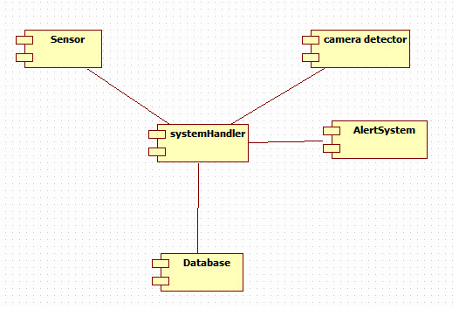
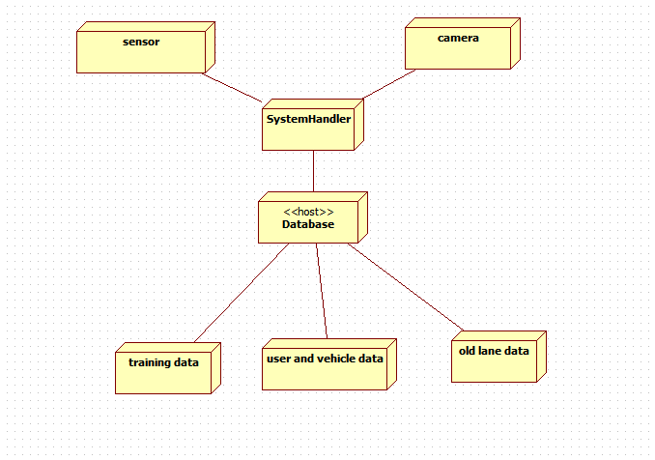
Component diagram
Deployment diagram

Slide 14

Literature Survey
Literature Survey
Study about 12 reference articles.
Study about 12 reference articles.
Literature Survey
Study about 12 reference articles.
Literature Survey
Study about 12 reference articles.
Literature Survey
Study about 12 reference articles.
Literature Survey
Study about 12 reference articles.

Slide 15
Software requirements
  Python3
  Opencv4
  Numpy
  Moviepy
  Matplotlib

Slide 16
Algorithms/Techniques
RANSAC algorithm:Random sample consensus is an iterative method to estimate parameters of a mathematical model from a set of observed data
EDLines algorithm: Detects line segments in the image and provides the result as a vector list consisting of starting and ending points. EDLines is alos a parameter-free algorithm which validates all detected lines via Helmholtz Principle.
SVM algorithm: Support Vector Machine” (SVM) is a supervised machine learning algorithm which can be used for both classification or regression challenges
Hough Transform: The Hough transform is a feature abstraction technique used in computer vision. The purpose of the technique is to find imperfect instances of objects within a certain class of shapes by a voting procedure

Slide 17
Expected outcome
To provide safety and avoid accidents by detecting road lanes
Approach to detect lanes and track multiple vehicles for lane change support around the test vehicle
Experimental results show its robustness in the cases of complex environment conditions

Slide 18
Plan of action
Detect driver facial expression
Alert Driver
Detect lanes and near by vehicles
Convert the image to gray scale
Smoothen the edges using Gaussian blur
Find the edges using Canny edge detection
Mask the image
Find lines using hough transform
Fit the points in a line and extrapolate the line

Slide 19
References/Bibliography
[1] C. Y. Lin et al., “Real-time mark-on-windshield
warning system for intelligent vehicles,” Transactions of the Canadian Society for Mechanical Engineering, vol.36, no. 1, 2012, pp. 97-112.
[2] A. M.A. Soliman et al., “Fuzzy-skyhook control for active suspension systems applied to a full vehicle
model,” International Journal of Engineering and
Technology Innovation, vol. 2, no. 2, 2012, pp. 85-96.
[3] Y. He et al., “Color-based road detection in urban
traffic scenes,” IEEE Transaction on Intelligent
Transportation System, vol. 5, no. 4, 2004, pp. 309-318.
[4] D. J. Kang and M. H. Jung, “Road lane segmentation using dynamic programming for active safety vehicles,” Pattern Recognition Letters, vol. ,no. 16, 2003, pp.3177-3185.
[5] N. Benmansour et al., “Stereovision-based 3D lane
detection system: a model driven approach,” 11th
International IEEE Conference on Intelligent
Transportation System, Beijing, China, 2008, pp. 182-188.
[6] A. Assidiq et al., “Real time lane detection for
autonomous vehicles,” International Conference on
Computer and Communication Engineering, Kuala
Lumpur, Malaysia, 2008, pp. 82-88.
[7] M. Bahgat, “A simple implementation for unmarked road tracking,” The 14th IEEE Mediterranean Electrotechnical Conference, Ajaccio, France, 2008, pp.929-934.
[8] A. Borkar et al., “A layered approach to robust lane
detection at night,” IEEE Workshop on Computational
Intelligence in Vehicles and Vehicular Systems, Nashville ,TN, U.S., 2009, pp. 51-57.
[9] B. F. Wu et al., “A new vehicle detection with
distance estimation for lane change warning systems,”
Intelligent Vehicles Symposium, Istanbul, Turkey, 2007,pp. 698-703.

