Slide 1
FREEBIEZ
Give it away, Give it away, Give it away now

Slide 2
CALLING ALL DONORS!!
+ Are you tired of the clutter in your home or business?
+ Is it a fact that you have items which aren’t useful to you but are still in good condition and could be useful to someone else?
+ Is your daily routine so jammed that you don’t have time to take care of disposing of your unwanted items?
+ Do you have interest in helping various charities get ahead, little by little?

Slide 3
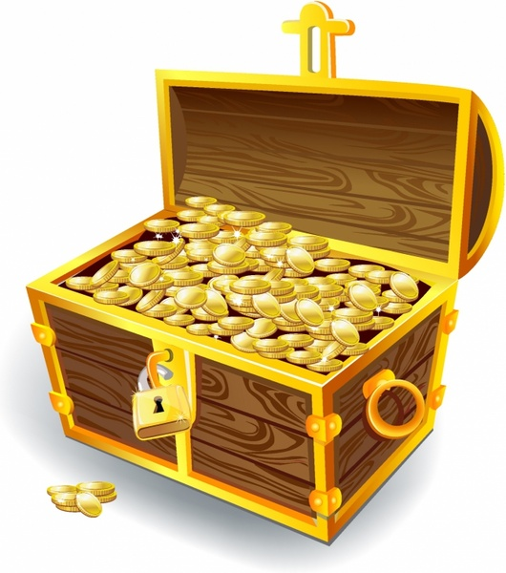
FREEBIEZ
Is the only platform dedicated to helping you pass your “once-a-treasure” on to become someone else’s.

Slide 4
WHY FREEBIEZ?
To take a load off of unloading your unwanted ”stuff”

Slide 5
As The owner of unwanted but useful products
I Want to use an application to upload images and a description of my products So That interested parties can also also use the application to collect said products easily

Slide 6
Technologies Used
HTML, CSS ,Javascript
Node.JS, Express.JS
Handlebars.JS
MySQL, Sequelize
Follows MVC format
Multer Library
Bootstrap

Slide 7
Process
* Collaborative Brainstorm Sessions for Concept Development
* Regular meetings every 2-3 days * Constant revision and improvements as achieved in the AGILE methodology * Timely check ins with the client (aka J. Wang & Assoc.)

Slide 8
Demonstration
Here is a beta test of what we have in development
Scheduled Date of Final Delivery: 20/12/20

Slide 9
Victories & Battles
Victories * Formulating a useful idea * Being resourceful with code * Incorporating Multer and learning how to manipulate images in databases * Ensuring all team members can find ways to contribute
Battles
* Three is glee, but Four is More (Group of 3)
* Chasm in knowledge and ability between team members
* End of year work/life ramp up

Slide 10

Future Development Considerations
* Including GPS/Maps to pinpoint locations * Single-User authentication- allowing advanced user access for outside registrations to secure Freebiez postings * Charity User Access- 24 hour period whereby charities have first access to posted products

Slide 11
FREEBIEZ
Links?
Github: https://github.com/SterlynKong/Freebiez

Slide 12
Thanks!
Hit Us Up!
S3 Developers Inc.
For any questions, compliments or concerns, contact freebiez2021@gmail.com

Slide 14
SlidesCarnival icons are editable shapes.
This means that you can:
Resize them without losing quality.
Change fill color and opacity.
Change line color, width and style.
Isn’t that nice? :)
Examples:

Slide 15
Diagrams and infographics

Slide 16
😉
Now you can use any emoji as an icon!
And of course it resizes without losing quality and you can change the color.
How? Follow Google instructions https://twitter.com/googledocs/status/730087240156643328
✋👆👉👍👤👦👧👨👩👪💃🏃💑❤😂😉😋😒😭👶😸🐟🍒🍔💣📌📖🔨🎃🎈🎨🏈🏰🌏🔌🔑 and many more...

