Slide 1
Challenges and Automation When Using Machine Learning Surrogates in Scientific Applications
Konstantinos Parasyris
Computer Scientist
Center for Applied Scientific Computing

Slide 2




AI/ML In the Intersection of Computer Science
How can we leverage the advances in Machine Learning to ease the software development process?
How can ML be applied to automate heuristic design?
How can we seamlessly integrate ML models into applications to improve their performance?
Copilot
Codex
….
Is Machine Learning Necessary for Cloud Resource Usage Forecasting
Autophase V2: Towards Function Level Phase Ordering Optimization
Inner Loop
Inner Loop
Prologue
Prologue
Expensive Function
Surrogate Model
Epilogue
Epilogue

Slide 3
AI/ML In the Intersection of Computer Science
How can we leverage the advances in Machine Learning to ease the software development process?
How can ML be applied to automate heuristic design?
How can we seamlessly integrate ML models into applications to improve their performance?
Copilot
Codex
….
Is Machine Learning Necessary for Cloud Resource Usage Forecasting
Autophase V2: Towards Function Level Phase Ordering Optimization
Inner Loop
Inner Loop
Prologue
Prologue
Expensive Function
Surrogate Model
Epilogue
Epilogue

Slide 4
Who Am I
Computer Scientist at LLNL
Post-doctoral researcher LLNL (2020-2021)
Post-doctoral research BSC
Ph.D. University of Thessaly, Volos, Greece
Passion for System Software Research
Compilers (LLVM, LLVM-developer)
Runtime Systems (OpenMP, OpenMP-Offload)
Approximate Computing (HPAC: https://github.com/LLNL/HPAC)
Lawrence Livermore National Laboratory (LDRD Exploratory Research)
Autonomous MultiScale (AMS: https://github.com/LLNL/AMS)
Lawrence Livermore National Laboratory (LDRD Strategic Initiative)

Slide 5
Why ML Driven Approximation For Science?
Hardware advances
Bigger complex models can approximate with high accuracy complicated functions
Implementations/algorithms utilize hardware better
Lower arithmetic precision
Software:
Scientific applications frequently use approximations to couple simulation scales:
Fine vs Coarse Grain simulation
Results indicate orders of magnitude of gains
Inner Loop
Inner Loop
Prologue
Prologue
Expensive Function
Surrogate Model
Epilogue
Epilogue

Slide 6
Limiting Factors of adopting ML in science
Scientific Applications = Large Scale Distributed Execution
HPC
No python, pip install
Low latency languages (C/C++, Fortran)
Software Complexity:
Heterogeneous Computing
GPU
CPU
Memory Layout
ML Libraries Are Complicated
Their design mainly assumes ML library is the “only” big software in the system.

Slide 7
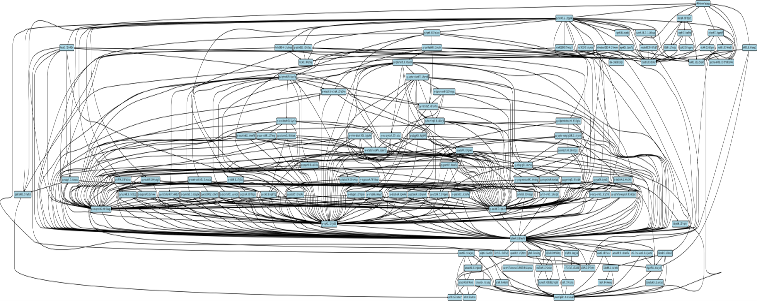
Limiting Factors of adopting ML in science
Scientific Application
ML Library
(py-torch)

Slide 8

Limiting Factors of Adopting ML in Science
Scientific Applications = Large Scale Distributed Execution
HPC
No python, pip install
Low latency languages (C/C++, Fortran)
Software Complexity:
Heterogeneous Computing
GPU
CPU
Memory Layout
ML Libraries Are Complicated
Interdisciplinary expertise:
Domain scientist (e.g. Biologist)
ML expert
Computer Scientist
Instrument application for data collection
Execute application and gather data
Analyze the data and build a DNN model
Instrument application to use trained model
Execute DNN enhanced Application
Validate Simulation Results

Slide 9
Let’s make this simple then
What do we need to make this easier:
Training Models require data:
Data assimilation
Description of what part of the application we would like to replace
Code Region
A mechanism to load a model
Provided by ML vendor tools
Inner Loop
Inner Loop
Prologue
Prologue
Expensive Function
Expensive Function
Epilogue
Epilogue

Slide 10
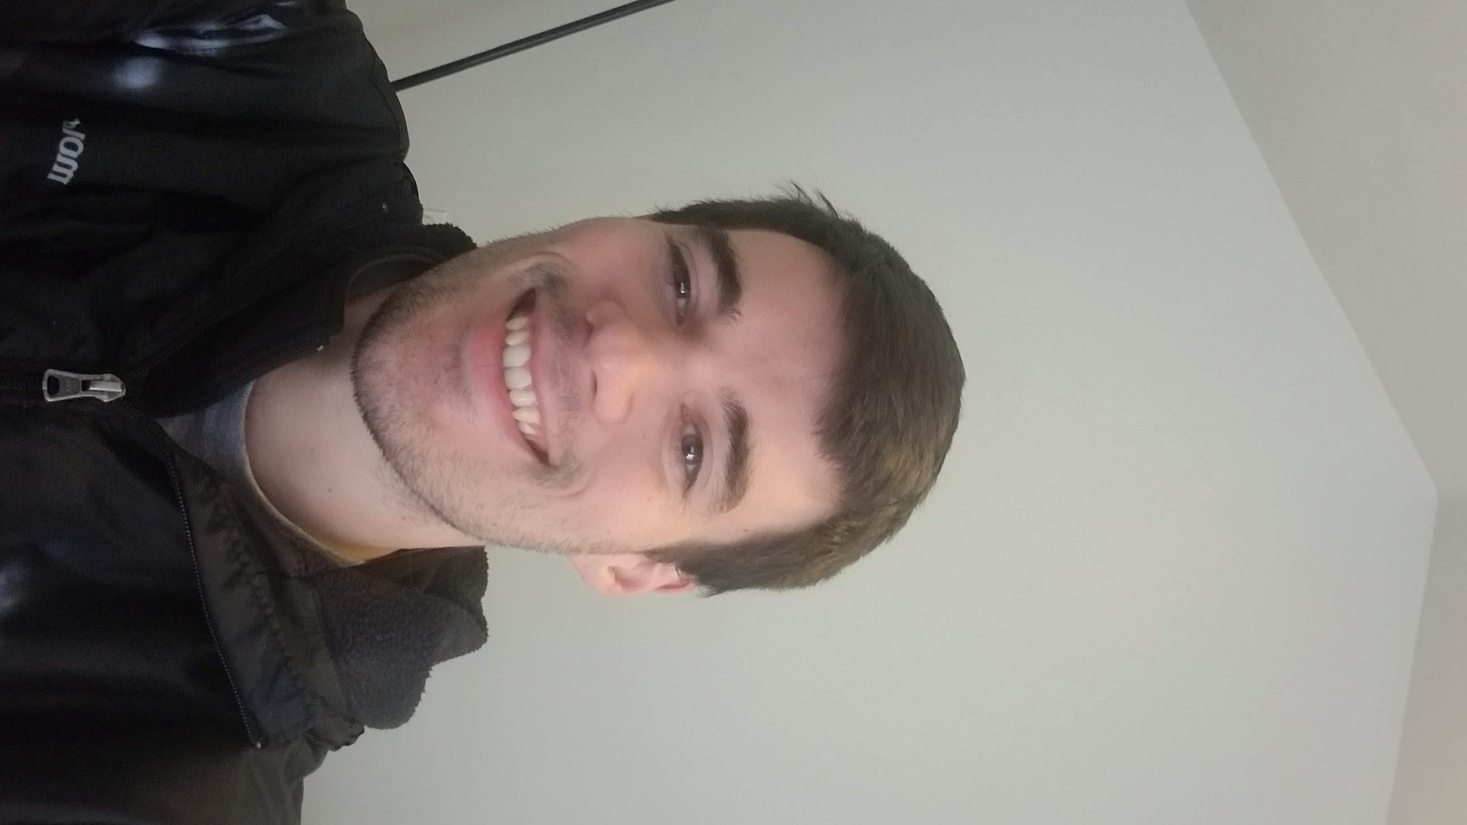
… and build an abstraction to do this.
Zane Fink
Inner Loop
void stencil(double **in, double **out, int SIZE_Y, int SIZE_X){ #pragma approx tensor functor(ifnctr: \ [i, j, 0:5] = ( ([i-1, j], [i+1, j], \ [i, j-1:j+2])) #pragma approx surrogate in(ifnctr(in)) out(out) \ model(<model-id>) db(<db-id>) for (int i = 1; i < SIZE_Y-1; i++) for ( int j = 1; j < SIZE_X-1; j++) out[i][j] = stencil_op(in[i-1][j], in[i][j-1], in[i][j], in[i][j+1], in[i+1][j]); }
Prologue
Expensive Function
Epilogue

Slide 11
… and build an abstraction to do this.
Zane Fink
Inner Loop
void stencil(double **in, double **out, int SIZE_Y, int SIZE_X){ #pragma approx tensor functor(ifnctr: \ [i, j, 0:5] = ( ([i-1, j], [i+1, j], \ [i, j-1:j+2]) ) #pragma approx surrogate in(ifnctr(in)) out(out) \ model(<model-id>) db(<db-id>) for (int i = 1; i < SIZE_Y-1; i++) for ( int j = 1; j < SIZE_X-1; j++) out[i][j] = stencil_op(in[i-1][j], in[i][j-1], in[i][j], in[i][j+1], in[i+1][j]); }
Prologue
Memory access pattern
Expensive Function
Epilogue

Slide 12
… and build an abstraction to do this.
Zane Fink
Inner Loop
void stencil(double **in, double **out, int SIZE_Y, int SIZE_X){ #pragma approx tensor functor(ifnctr: \ [i, j, 0:5] = ( ([i-1, j], [i+1, j], \ [i, j-1:j+2]) ) #pragma approx surrogate in(ifnctr(in)) out(out) \ model(<model-id>) db(<db-id>) for (int i = 1; i < SIZE_Y-1; i++) for ( int j = 1; j < SIZE_X-1; j++) out[i][j] = stencil_op(in[i-1][j], in[i][j-1], in[i][j], in[i][j+1], in[i+1][j]); }
Prologue
Memory access pattern
Expensive Function
Epilogue
Once the developer describes the code region and the data layout the runtime support of the abstraction can handle data collection and model inference.

Slide 13



… but we need more automation … How do you build a model?
Zane Fink
Generated Deep Learning Network
Inner Loop
(e.g. Time step)
Inner Loop
(e.g. Time step)
Inner Loop
(e.g. Time step)
Inner Loop
(e.g. Time step)
Inner Loop
(e.g. Time step)
DL Model
Construction
Inner Loop
(e.g. Time step)
Inner Loop
(e.g. Time step)
Inner Loop
(e.g. Time step)
Prologue
Inputs
…
Prologue
Prologue
Prologue
Prologue
Prologue
Prologue
Prologue
Expensive Function
Surrogate Model
Expensive Function
Surrogate Model
Expensive Function
Surrogate Model
Data Collection
Outputs
Surrogate Model
Epilogue
Epilogue
Epilogue
Epilogue
Epilogue
Epilogue
Epilogue
Epilogue
Human In the Loop

Slide 14
… but we need more automation … Let’s put a human to do this?
Zane Fink
Generated Deep Learning Network
Inner Loop
(e.g. Time step)
Inner Loop
(e.g. Time step)
Inner Loop
(e.g. Time step)
Inner Loop
(e.g. Time step)
Inner Loop
(e.g. Time step)
DL Model
Construction
Inner Loop
(e.g. Time step)
Inner Loop
(e.g. Time step)
Inner Loop
(e.g. Time step)
Prologue
Inputs
…
Prologue
Prologue
Prologue
Prologue
Prologue
Prologue
Prologue
Expensive Function
Surrogate Model
Expensive Function
Surrogate Model
Expensive Function
Surrogate Model
Expensive Function
Outputs
Surrogate Model
Epilogue
Epilogue
Epilogue
Epilogue
Human In the Loop
Epilogue
Epilogue
Epilogue
Epilogue

Slide 15

… but we need more automation … Nope
Zane Fink
Generated Deep Learning Network
Inner Loop
(e.g. Time step)
Inner Loop
(e.g. Time step)
Inner Loop
(e.g. Time step)
Inner Loop
(e.g. Time step)
Inner Loop
(e.g. Time step)
DL Model
Construction
Inner Loop
(e.g. Time step)
Inner Loop
(e.g. Time step)
Inner Loop
(e.g. Time step)
Prologue
Inputs
…
Prologue
Prologue
Prologue
Prologue
Prologue
Prologue
Prologue
Expensive Function
Surrogate Model
Expensive Function
Surrogate Model
Expensive Function
Surrogate Model
Expensive Function
Outputs
Surrogate Model
Epilogue
Epilogue
Epilogue
Epilogue
Human In the Loop
Epilogue
Epilogue
Epilogue
Epilogue

Slide 16
… but we need more automation … Let’s build it …
Zane Fink
Generated Deep Learning Network
Inner Loop
(e.g. Time step)
Inner Loop
(e.g. Time step)
Inner Loop
(e.g. Time step)
Inner Loop
(e.g. Time step)
Inner Loop
(e.g. Time step)
DL Model
Construction
Inner Loop
(e.g. Time step)
Inner Loop
(e.g. Time step)
Inner Loop
(e.g. Time step)
Prologue
Inputs
…
Prologue
Prologue
Prologue
Prologue
Prologue
Prologue
Prologue
Expensive Function
Surrogate Model
Expensive Function
Surrogate Model
Expensive Function
Surrogate Model
Expensive Function
Outputs
Surrogate Model
Epilogue
Epilogue
Epilogue
Epilogue
Epilogue
Bayesian Optimization Framework to search for an optimal model
Epilogue
Epilogue
Epilogue

Slide 17
We use this system to scale our research …
Applied Approach on 5 Benchmarks
Tested in total 5100 different models:
600-1500 per benchmark
Results indicate orders of magnitude of gains
… and we can outperform existing approximations

Slide 18
Particlefilter
Existing solution
Particle filter original solution is a Bayesian approximation.
The trained models outperform in terms of accuracy and performance this approximation

Slide 19
Not everything is great though MiniWeather
Original Solution
Surrogate Solution

Slide 20
What about mixed executions interleave ‘exact’ with ‘surrogate’ timesteps.
Original Solution
Surrogate Solution
Interleaved Solution

Slide 21
What about mixed executions interleave ‘exact’ with ‘surrogate’ timesteps.
Original Solution
Surrogate Solution
Interleaved Solution

Slide 22
What about mixed executions interleave ‘exact’ with ‘surrogate’ timesteps.
Original Solution
Surrogate Solution
Interleaved Solution
… but still this is not is great

Slide 23
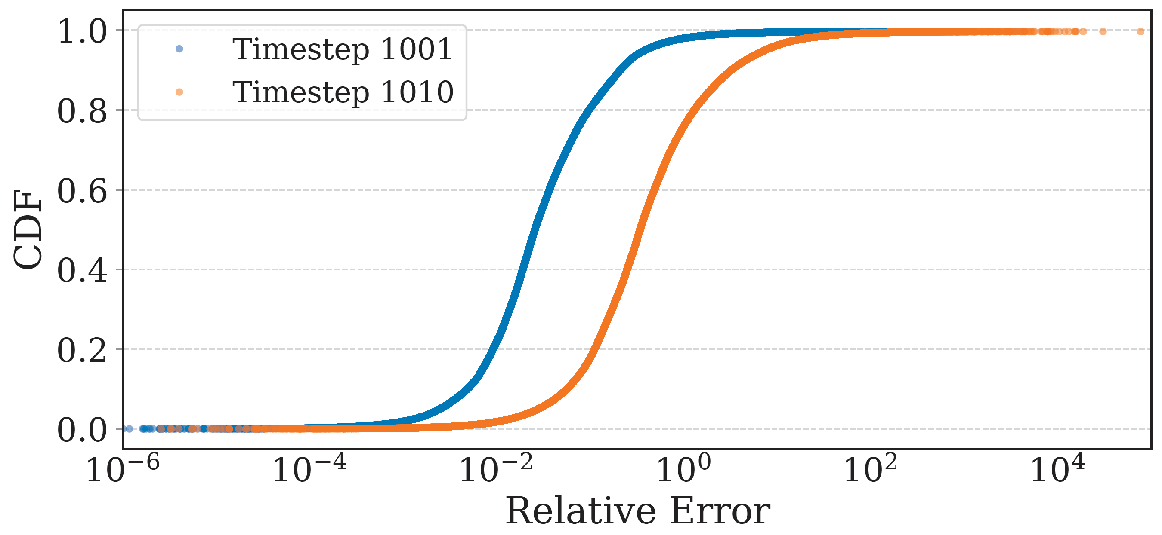
The model is ‘frequently’ precise, rarely with high error
In every time step:
We apply the model in every grid point
Those points have some error
That propagates to the models’ input in next time step.
… Error accumulates or propagates…

Slide 24
The model is ‘frequently’ precise, rarely with high error
In every time step:
We apply the model in every grid point
Those points have some error
That propagates to the models’ input in next time step.
… Error accumulates or propagates…

Slide 25
What if we interleave model invocations also in space, instead of only in time
Let’s apply the model only on the points it performs ‘well’.
How do we do this at application execution time?

Slide 26
Uncertainty Quantified ML Models
Uncertainty Quantified ML Models
We ‘expect’ that the model error will monotonically increase in respect to the ‘model std’
Model 1
Model 2
Model K
…
…
…
…
Model Error
Model std
Mean of ML Model outputs
Std of ML model outputs

Slide 27
Welcome to Autonomous MultiScale (AMS) (LDRD SI, LLNL Investment Fund)
AMS assumes such a uncertainty quantified model
AMS Software is currently being tested in really expensive solvers ( O(n⁶) ) and higher
AMS design assumes parallel distributed executions.
Interdisciplinary expertise:
Domain scientist
ML expert
Computer Scientist
Coarse Grain Simulation
Coarse Grain Simulation
Fine Grain Simulation
AMS
Coarse Grain Simulation
Coarse Grain Simulation

Slide 28

Dive into the design UQ models allow us to spatially interleave ML model invocations with existing expensive solutions
Coarse Grain Simulation
UQ
Gather
Coarse Grain Simulation
MPI Application

Slide 29
Dive into the design Slowest execution path determines execution time …
Coarse Grain Simulation
Load Balance
UQ
Distribute Inputs
SP
SP
SP
SP
SP
SP
SP
SP
SP
SP
SP
SP
Gather
Gather Outputs
Coarse Grain Simulation
MPI Application

Slide 30
Dive into the design A model will always be as good as the training data, thus always collect more
Coarse Grain Simulation
RabbitMQ Queue
AMS Stage Mechanism
UQ
Distribute Inputs
Data Flow Transform 1
…
SP
SP
SP
SP
SP
SP
Data Flow Transform K
SP
SP
SP
SP
SP
SP
Gather
Gather Outputs
Candidates
Coarse Grain Simulation
MPI Application
HPC System

Slide 31

Dive into the design
AMS Orchestrator
Coarse Grain Simulation
RabbitMQ Queue
observe
UQ
Distribute Inputs
Data Flow Transform 1
…
SP
SP
SP
SP
SP
SP
Data Flow Transform K
SP
SP
SP
SP
SP
SP
Gather
Gather Outputs
Candidates
Coarse Grain Simulation
MPI Application
HPC System

Slide 32
Dive into the design
AMS Orchestrator
Coarse Grain Simulation
RabbitMQ Queue
observe
schedule
Candidates
Database
Model
UQ
Distribute Inputs
Data Flow Transform 1
…
Training Data Selection
SP
SP
SP
SP
SP
SP
Data Flow Transform K
SP
SP
SP
SP
SP
SP
Database
Gather
Gather Outputs
Candidates
Model (Re-)Training
Coarse Grain Simulation
Model
HPC
System
MPI Application
HPC System

Slide 33
AMS Status
Building components are implemented
Integrated with 2 large HPC applications
In both we break spatial continuity of the grid
When the outputs of the model represent simulation “derivative” values things go bad …
We are running our first debug/small scale runs
No performance numbers until now

Slide 34
Conclusions
AI/ML can be an important technology for scientific applications:
Approximator for arbitrary complex functions
We need to treat as any other technology:
Use it, measure it, observe it and improve it based on our needs.
Our use case transforms every application into a ‘workflow’.
Does it need to be automatic?
Opens avenues for exciting ‘traditional’ computer science research.
Load Balancing
Scheduling heuristics
Power aware runtime policies

Slide 36
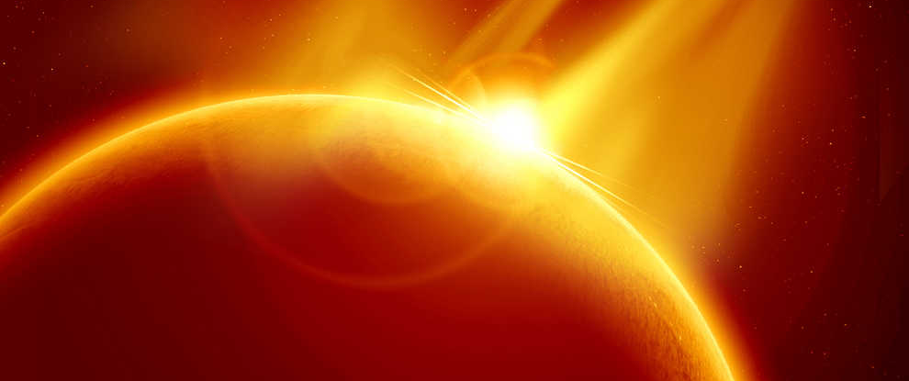
Title for full-frame image Subtitles can be used on longer titles, 24pt “Regular” (no bold)

