Slide 1
WMO Consultation on climate data homogenization
Use case from: HungaroMet, Hungarian Meteorological Service
Contact(s): Beatrix Izsák PhD (izsak.b@met.hu), Mónika Lakatos PhD (lakatos.m@met.hu), Olivér Szentes (szentes.o@met.hu), Kinga Bokros (bokros.k@met.hu)
Date: 19/11/2025

Slide 2
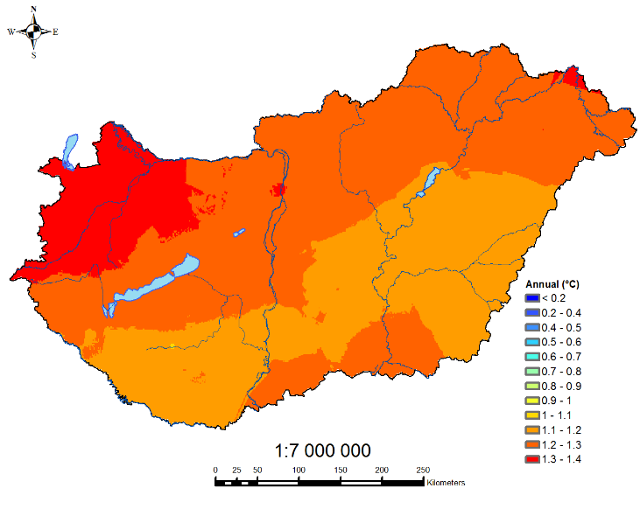
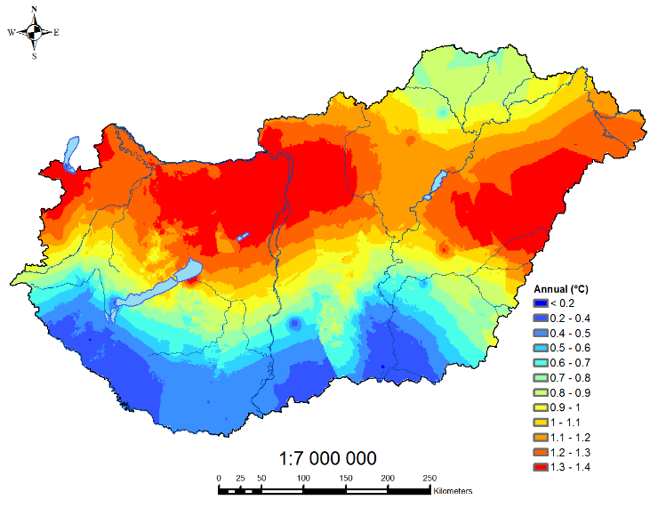
Homogenization: data processes, products and services
There is a long tradition of homogenizing meteorological data in Hungary - 1996 organization of „1st Seminar for Homogenization and Quality Control in Climatological Databases” at the headquarters Hungarian Meteorological Service – supported by WMO
The 12th Seminar for Homogenization and Quality Control in Climatological Databases and the 7th Interpolation Conference will be organized in Budapest, at HungaroMet and online, from 5 to 7 May 2026.
Homogenization mailing list: homogenisation@met.hu – Join us!
Annual mean temperature, homogenized series: Estimation of change over the total period 1901-2018 (°C)
Annual mean temperature, raw series:
Estimation of change over the total period 1901-2018 (°C)

Slide 3
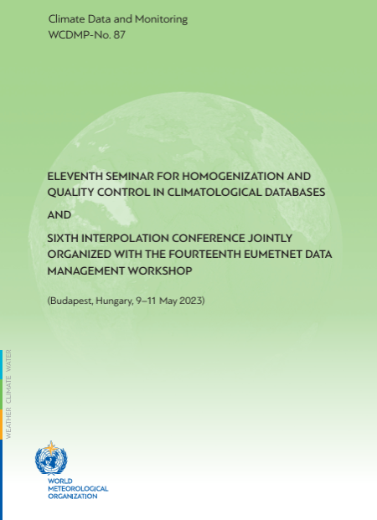
Proceedings from the earlier Seminars in WMO World Climate Data and Monitoring Programme (WCDMP) serial
1.
https://library.wmo.int/records/item/49281-proceedings-of-the-first-seminar-for-homogenization-of-surface-climatological-data?offset=19
3.
https://library.wmo.int/records/item/49272-proceedings-of-the-third-seminar-for-homogenization-and-quality-control-in-climatological-databases?offset=11
4.
https://library.wmo.int/records/item/43890-fourth-seminar-for-homogenization-and-quality-control-in-climatological-databases?offset=5
5.
https://library.wmo.int/records/item/52559-proceedings-of-the-fifth-seminar-for-homogenization-and-quality-control-in-climatological-databases?offset=3
6.
https://library.wmo.int/records/item/48629-proceedings-of-the-sixth-seminar-for-homogenization-and-quality-control-in-climatological-databases?offset=7
7.
https://library.wmo.int/records/item/50511-seventh-seminar-for-homogenization-and-quality-control-in-climatological-databases-jointly-organized-with-the-meeting-of-cost-es0601-home-action-mc-meeting?offset=1
8.
https://library.wmo.int/records/item/54705-eighth-seminar-for-homogenization-and-quality-control-in-climatological-databases-and-third-conference-on-spatial-interpolation-techniques-in-climatology-and-meteorology?offset=6
9.
https://library.wmo.int/records/item/56338-ninth-seminar-for-homogenization-and-quality-control-in-climatological-databases-and-fourth-conference-on-spatial-interpolation-techniques-in-climatology-and-meteorology?offset=2
10.
https://library.wmo.int/viewer/57355?medianame=WCDMP_No._86_Proceedings_2020_en_#page=1&viewer=picture&o=bookmarks&n=0&q=
11.
https://library.wmo.int/records/item/68452-eleventh-seminar-for-homogenization-and-quality-control-in-climatological-databases-and-sixth-interpolation-conference-jointly-organized-with-fourteenth-eumetnet-data-management-workshop?offset=4

Slide 4
Homogenization: software
MASHv3.03
(Multiple Analysis of Series for Homogenization; Szentimrey, T.)
For homogenization, quality control and missing value completion of station daily data series
https://www.met.hu/en/rolunk/rendezvenyek/homogenization_and_interpolation/software/
MASHv4.01 (Szentimrey, T.)
For homogenization in mean and standard deviation, quality control and missing value completion of station daily data series
Widely used: China, Central Eastern Europe, Ireland…

Slide 5
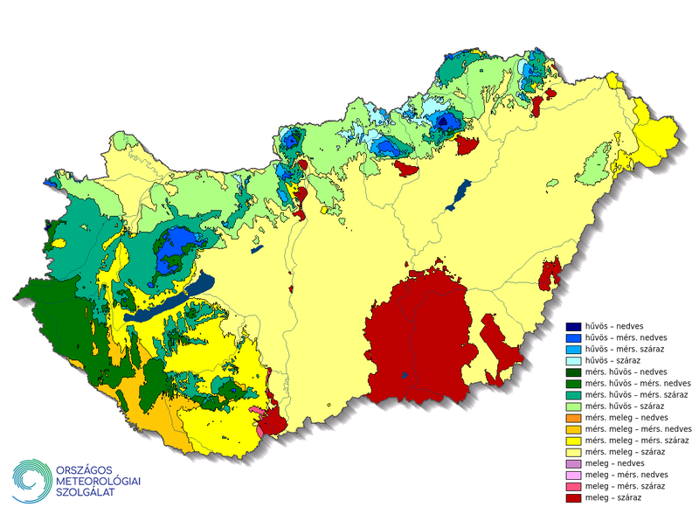
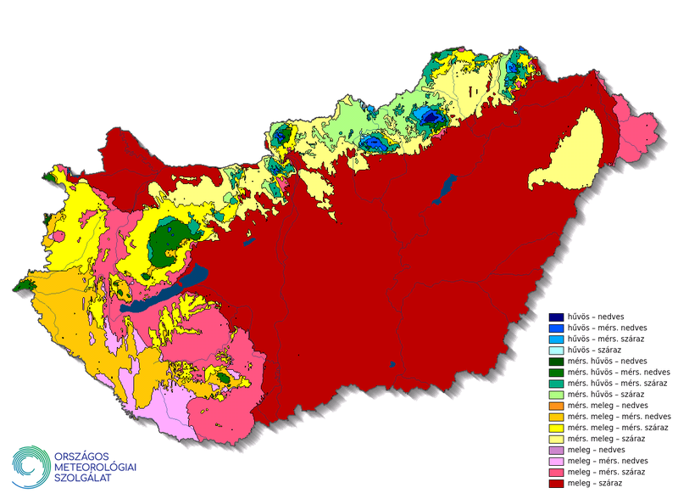
Homogenization: data processes, products and services
Climate variables we homogenize (daily data):
Temperature (Max, Min, Mean), Precipitation, daily
Wind, daily
Relative humidity, daily
Surface air pressure at instrument level, daily
Global radiation, daily
https://odp.met.hu/climate/
Yearly update for all the elements above!
Products:
Production of climate normals
Climate trends
Climate indices
Warm, Cold
Precipitation
Climate stripes
Changes in climatic zones
Projects:
CARPATCLIM - Climate of the Carpathian Region (2010-2013)
KLIMADAT-Integration of past, present, and future data
Danube-ADAPT 2025- (Enhancing Climate Data Cooperation for Evidence-based Adaptation Policy Making in the Danube Region)

Slide 6
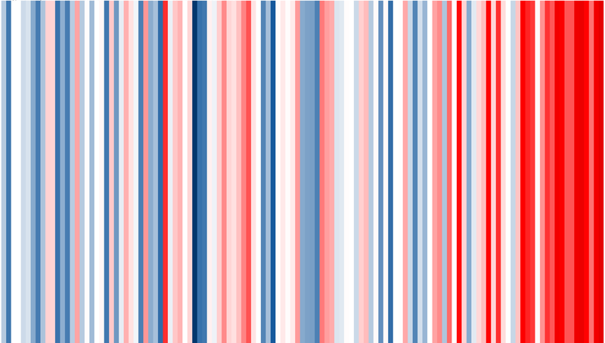
References
Szentimrey, T., 2017: Manual of homogenization software MASHv3.03. Hungarian Meteorological Service, 71.
Szentimrey, T., 2023a: Overview of mathematical background of homogenization, summary of method MASH and comments on benchmark validation, International Journal of Climatology, 1–16. https://doi.org/10.1002/joc.8207
Szentimrey, T., 2023b: Manual of homogenization software MASHv4.01, Varimax Limited Partnership, p.83.Szentimrey, T., 2023c: Development of new version MASHV4.01 for homogenization of standard deviation (extended abstract), Proceedings of the 11th Seminar for Homogenization and Quality Control in Climatological Databases and 6th Conference on Spatial Interpolation Techniques in Climatology and Meteorology (Ed. Lakatos M, Puskás M, Szentimrey T), Budapest, Hungary, 2023, WCDMP-No. 87, pp. 8-13. https://library.wmo.int/idurl/4/68452
Venema et al., 2012: Benchmarking monthly homogenization algorithms. Climate of the Past, 8, 89–115.
World Meteorological Organization (WMO), 2020: Guidelines on Homogenization, WMO-No. 1245, p. 63.
Izsák, B., Szentimrey, T., Lakatos, M., Pongrácz, R., and Szentes, O., 2020: Creation of a representative climatological database for Hungary from 1870 to 2020. Időjárás 126, 1–26. https://doi.org.10.28974/idojaras.2022.1.1
Lakatos, M., Szentimrey, T., Bihari, Z., Szalai, S., 2013: Creation of a homogenized climate database for the Carpathian region by applying the MASH procedure and the preliminary analysis of the data, Időjárás Vol. 117. No. 1, January-March 2013. pp. 143-158.
Szentes, O., Lakatos, M., Pongrácz, R., 2023: New homogenized precipitation database for Hungary from 1901. International Journal of Climatology, 1–15. https://doi.org/10.1002/joc.8097
Szentimrey,T., Bihari, Z., 2014: Manual of interpolation software MISHv1.03, Hungarian Meteorological Service, 60.

