Slide 1
ENGR 126 · VIBE CODING WITH AI
A face is not a name.
It is 512 unnamed numbers.
Today we walk the real pipeline — SCRFD, a 5-point warp, a 112×112 crop, ResNet-50 ArcFace — then we paste one prompt into an LLM and make the webcam do it.
No training. No “build FaceNet from scratch.” We wire a detector to an embedding to a gallery.

Slide 2
01 · THE CONTRACT FOR THIS HOUR
02 / 13
Understand first. Then generate. Then own the bugs.
01
The six boxes
Webcam → detect → warp → 112 crop → ArcFace → unit vector. If you cannot point at each box, you are not ready to prompt.
02
One prompt
We hand the LLM a specification, not a vibe. Stack, file names, gallery format, threshold, what “done” looks like.
03
You keep the bugs
The model will miss L2-normalization, mix BGR/RGB, or hard-code one face. That is the lab, not a failure of the lecture.
ENGR 126 · VIBE CODING WITH AI
FACE PIPELINE LAB

Slide 3
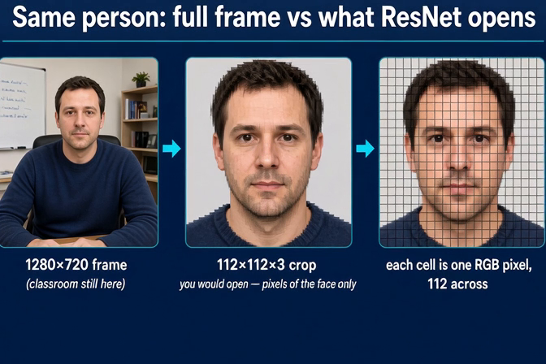
02 · THE NETWORK NEVER SEES THE CLASSROOM
03 / 13
Same person. Three different objects.
1280×720
The webcam frame still has the whiteboard, the plant, the sweater. ResNet does not open this file.
112×112×3
After detect + warp, you keep only the aligned face. 37,632 RGB values. That is the entire input.
One cell = one pixel
The grid on the right is not a style. It is the tensor shape. 112 across, 112 down, 3 channels.
Click the figure to play · 15 seconds · audio on
ENGR 126 · VIBE CODING WITH AI
FACE PIPELINE LAB

Slide 4
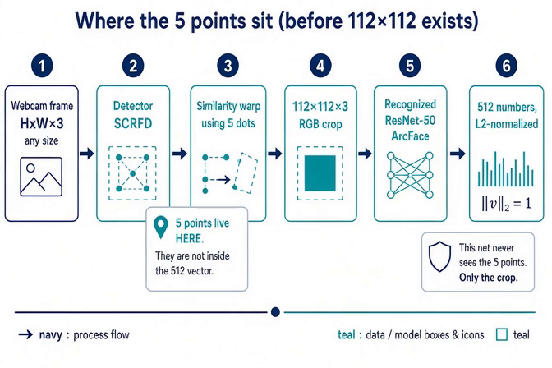
03 · THE ONLY DIAGRAM THAT MATTERS
04 / 13
Six boxes. The 5 points die at box 3.
Click the figure to play · 15 seconds · audio on
ENGR 126 · VIBE CODING WITH AI
FACE PIPELINE LAB

Slide 5
04 · LANDMARKS ARE ALIGNMENT, NOT IDENTITY
05 / 13
The five dots never enter the 512-vector.
1–2
3
4–5
Two eye centers
Nose tip
Mouth corners
SCRFD returns them in the original frame coordinates.
Anchors pitch. Without it the crop shears when you look down.
Finish the similarity transform. Five points → one 2D affine warp.
The trap this lecture exists to kill
Students keep asking an LLM to “put the landmarks in the embedding.” Do not. The recognition net (ResNet-50 ArcFace) is blind to the five points. It receives only the aligned 112×112×3 crop. The dots are scaffolding. After the warp, throw them away.
ENGR 126 · VIBE CODING WITH AI
FACE PIPELINE LAB

Slide 6
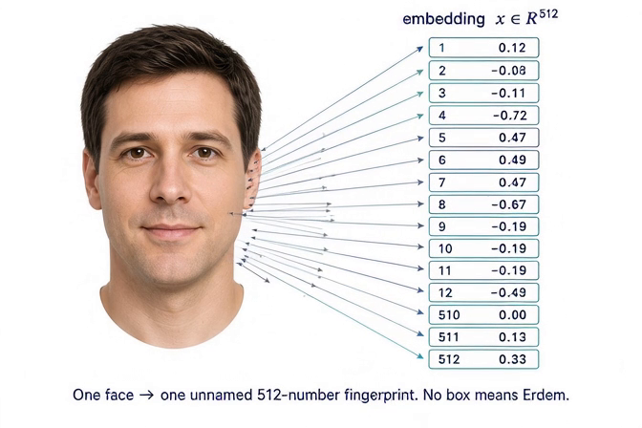
05 · ONE FACE → ONE UNNAMED FINGERPRINT
06 / 13
x ∈ R⁵¹². No slot means Erdem.
Not a caption
The vector does not contain the string “Erdem.” Names live only in the gallery you build.
Not the five points
Eyes / nose / mouth are not coordinates 1–5. Every component is a learned mix of the whole crop.
Unit length
After L2-normalization, ||x||₂ = 1. That turns “how similar” into a single dot product.
Same face, new photo
A second frame of the same person is a nearby point on the sphere — not the identical 512 numbers.
Click the figure to play · 15 seconds · audio on
ENGR 126 · VIBE CODING WITH AI
FACE PIPELINE LAB

Slide 7
06 · MATCHING IS A DOT PRODUCT
07 / 13
Because the vector is on the unit sphere, cosine is free.
NORMALIZE
SCORE
DECIDE
x ← x / ||x||₂
s(x, g) = x · g
s ≥ τ → name
else UNKNOWN
InsightFace usually already did this. Check anyway. A non-unit vector makes every threshold a lie.
Dot product of two unit vectors is cosine similarity. Range is [−1, 1]. Same person lives near the top.
Start with τ ≈ 0.40 for buffalo_l / ArcFace. Measure on your own faces. Do not copy a blog.
argmax over the gallery is the whole “AI recognized me” moment. There is no extra neural net after the embedding.
ENGR 126 · VIBE CODING WITH AI
FACE PIPELINE LAB

Slide 8
07 · NAMES LIVE IN A DICTIONARY YOU WRITE
08 / 13
Recognition is enrollment plus a loop.
ENROLL (do this once per person)
RECOGNIZE (every webcam frame)
Capture 3–5 frames of the same person.
Run each through the six-box pipeline.
Average the 512-vectors, then L2-normalize the mean.
Store { "erdem": vec } on disk (npy / json).
A single blurry selfie is a weak gallery. That is why one-shot demos flake.
Detect + warp + embed the live face.
Dot against every enrolled vector.
Keep the max score and its name.
If score < τ, draw UNKNOWN — do not invent a name.
Draw the box, the name, and the score. The score is the honest part.
ENGR 126 · VIBE CODING WITH AI
FACE PIPELINE LAB

Slide 9
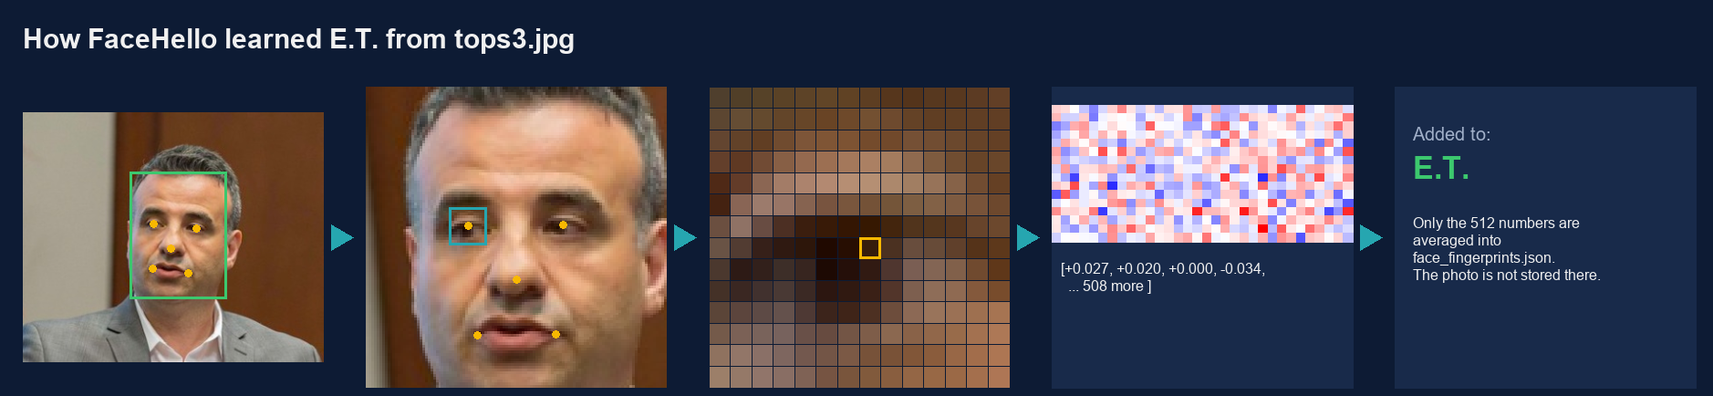
07 · ENROLLMENT, ON ONE REAL PHOTO
09 / 13
Enrollment on one real photo: tops3.jpg → E.T.
1 · Find
2 · Straighten
3 · Pixels
4 · Fingerprint
5 · Save
The detector boxes the face and marks 5 points: eyes, nose tip, mouth corners. Confidence 0.88 = sure it is a face, not whose face.
Rotate, scale and shift so the 5 dots land on the same spots for every face, then cut 112×112. The room is gone.
Zoom on the teal eye box. Each cell is one pixel = 3 numbers (R 54, G 28, B 12). The whole crop is 37,632 numbers.
ResNet-50 ArcFace squeezes the 37,632 numbers into 512. Scaled to length 1, so each is tiny (about ±0.04). Only the pattern matters.
Only the name “E.T.” and the 512 numbers are saved, not the photo. More photos get averaged for a steadier match.
ENGR 126 · VIBE CODING WITH AI
FACE PIPELINE LAB

Slide 10
08 · THE STACK THE LLM IS ALLOWED TO USE
10 / 13
Pretrained weights. No fine-tuning. No PyTorch training loop.
insightface
Gives you SCRFD + ArcFace (buffalo_l) as one FaceAnalysis object. This is the six boxes in a package.
opencv-python
Webcam, BGR frames, drawing the box / name / score. Convert BGR→RGB before the recognizer.
numpy
Embeddings, mean-of-enroll, L2-normalize, gallery as a matrix, scores = gallery @ x.
onnxruntime
Pulled in by insightface. First run downloads ~hundreds of MB of ONNX. Do that before class if you can.
ENGR 126 · VIBE CODING WITH AI
FACE PIPELINE LAB

Slide 11
09 · PASTE THIS. THEN CHANGE ONLY WHAT BREAKS.
11 / 13
The prompt is the assignment.
Write a single Python script face_lab.py that:
1. Opens the default webcam with OpenCV.
2. Uses insightface FaceAnalysis(name='buffalo_l', providers=['CPUExecutionProvider']).
3. Detects faces each frame. For each face, take the 512-d embedding.
4. L2-normalize every embedding even if the model claims it already did.
5. Has an enroll mode: press E, type a name, average 8 consecutive embeddings, save gallery.npz.
6. Has a recognize mode: cosine = gallery @ x; label UNKNOWN if max score < 0.40.
7. Draws box, name, and score on the BGR frame. Quit on Q.
8. Never puts landmarks into the embedding. Never trains a net. No extra files except gallery.npz.
Include a requirements.txt and a 10-line README that says how to enroll myself first.
ENGR 126 · VIBE CODING WITH AI
THE PROMPT

Slide 12
10 · WHAT “WORKING” LOOKS LIKE, AND WHAT THE LLM WILL GET WRONG
12 / 13
Ship the webcam loop. Then hunt these.
Done means: you walk in front of the camera, your name and a score like 0.62 appear, a classmate who is not enrolled is UNKNOWN, Q quits, gallery.npz exists on disk.
Forgot L2
BGR vs RGB
One enrollment frame
Scores jump around 10–40 instead of 0–1. Normalize both sides.
InsightFace wants RGB. OpenCV gives BGR. Faces detect; identity dies.
You smiled once. Tomorrow you don’t. Average 8 frames.
No UNKNOWN
Profile / hat / mask
Two faces, one name
argmax always returns someone. That is a classifier cosplaying as recognition.
SCRFD will miss or warp badly. That is the model, not your code.
Loop every detection. Do not take faces[0] and stop.
ENGR 126 · VIBE CODING WITH AI
FACE PIPELINE LAB

Slide 13
11 · BEFORE YOU HIT RUN
You may generate every line.
You may not outsource the six boxes.
Explain it out loud
Ask before you enroll
If you cannot say where the 5 points die, you are not done — even if the demo works.
Classmates are not a dataset. Gallery is opt-in. Delete gallery.npz at the end of lab.
Print the score
This is not a surveillance kit
A name with no number is theater. The number is the only claim the system is making.
The assignment is the pipeline. Do not point it at a hallway and call it a product.
ENGR 126 · VCU ECE

