Slide 1
ENGR-126 · VIBE CODING WITH AI
Your webcam,
512 numbers,
one comparison
How face recognition works — then we make an LLM write it in Python
detect
→
align
→
embed
→
compare
Notes:
Hook: by the end of class, every laptop in this room will put your name over your face in a live webcam window — and none of you will type the Python yourselves. First we earn it by understanding the four stages on the bottom row.

Slide 2
Today in four moves
01
02
03
04
Understand
Describe
Generate
Break it
Watch a face turn into 512 numbers, one stage at a time
Turn those stages into a prompt precise enough to get working code
The LLM writes face_id.py; we read it before we run it
Glasses, dim light, a photo on a phone — find where it fails
ENGR-126 · Face recognition by vibe coding
Notes:
Navy = the concepts half, teal = the coding half. Emphasize that step 4 is the real engineering: anyone can get a demo running; engineers find the conditions where it fails.

Slide 3
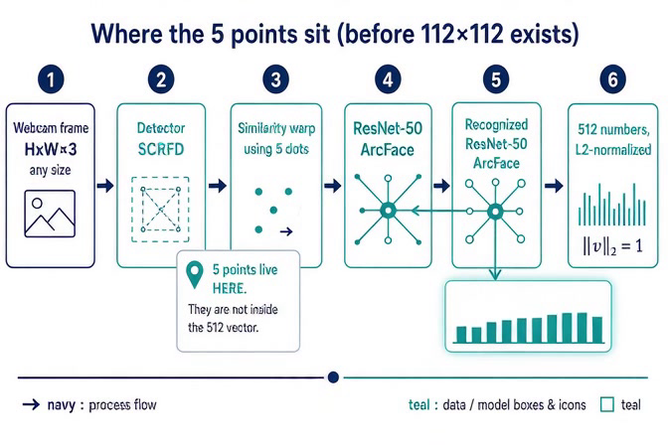
Six boxes from webcam to fingerprint
1
Webcam frame, any size
2
SCRFD finds each face and 5 key points
3
Warp the face so the 5 points line up
4
112×112×3 crop is cut out
5
ResNet-50, trained with ArcFace loss
6
512 numbers, scaled to length 1
ENGR-126 · Face recognition by vibe coding
Notes:
Let the clip play once without talking. Then walk the six boxes. Key point from the clip: the 5 points live in stages 2–3 only; the recognizer in stage 5 never sees them, only the crop. SCRFD and ArcFace ResNet-50 are exactly what the insightface "buffalo_l" model pack gives us — this is the pipeline the LLM's code will use.

Slide 4
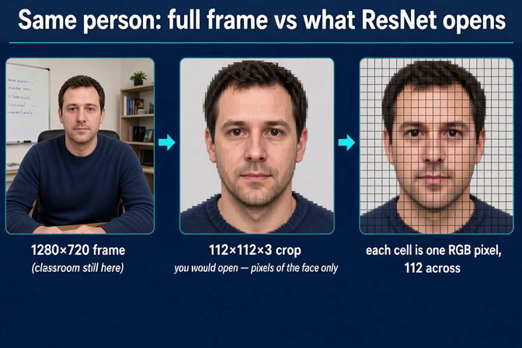
The network never sees the classroom
2,764,800
numbers in one 1280×720 color frame
37,632
numbers ResNet actually reads: 112 × 112 × 3
About 73× less data — and none of it is the whiteboard behind you.
ENGR-126 · Face recognition by vibe coding
Notes:
Math on the board: 1280 × 720 × 3 = 2,764,800; 112 × 112 × 3 = 37,632; ratio ≈ 73. Each grid cell in the clip is one pixel with three values (R, G, B). Ask: what happens if the crop accidentally includes half the bookshelf? (The detector's job is to stop that.)

Slide 5
Five dots make every face stand the same way
1
2
3
4
5
Left eye center
Right eye center
Nose tip
Left mouth corner
Right mouth corner
Similarity warp
Why it matters
Rotate, scale and shift the image — no stretching — so the 5 dots land on the same 5 pixels of every 112×112 crop.
A tilted head and a straight head now give nearly the same crop, so the network compares faces, not poses.
ENGR-126 · Face recognition by vibe coding
Notes:
Demo idea: tilt your head 20 degrees and ask what a naive crop would look like. In insightface code these five points show up as face.kps — a 5×2 array of (x, y) pixel coordinates. Students will see it in the LLM's code.

Slide 6
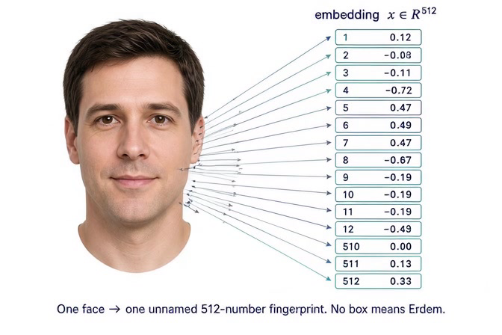
One face becomes 512 numbers
37,632 in → 512 out
Each box mixes information from the whole face. No single box means “eyes” — and no box means “Erdem.”
The name lives in your file, stored next to a vector. The network knows no one.
ENGR-126 · Face recognition by vibe coding
Notes:
The glowing regions in the clip are a teaching simplification: real embedding dimensions are not tied to one feature. Takeaway: the model was trained so that two photos of the same person land close together in 512-dimensional space. That is all it does. Recognition = our code comparing vectors.

Slide 7
Recognition is one multiply-and-add
score = a₁b₁ + a₂b₂ + … + a₅₁₂b₅₁₂
Both vectors have length 1, so this dot product is the cosine of the angle between them: np.dot(a, b)
−1 opposite
0 unrelated
THRESHOLD ≈ 0.40
+1 same
Best score above the line → print that name. Below it → “Unknown.” The 0.40 is a starting guess we will tune in lab.
ENGR-126 · Face recognition by vibe coding
Notes:
Put two tiny vectors on the board, e.g. (0.6, 0.8) and (0.8, 0.6): dot = 0.96. Then (0.6, 0.8) and (0.8, −0.6): dot = 0. Same idea in 512 dimensions. The threshold is an engineering trade-off: too high and you become "Unknown" to your own laptop; too low and your classmate unlocks as you.

Slide 8
The program has two jobs
python face_id.py enroll Erdem
python face_id.py run
Enroll — once per person
Recognize — every frame
Grab 5 frames with exactly one face
Get 5 embeddings, average them
Rescale the average back to length 1
Save name → vector in faces.npz
Detect every face in the frame
Embed each one
Dot it with every vector in faces.npz
Draw box + best name + score
ENGR-126 · Face recognition by vibe coding
Notes:
This slide IS the specification we are about to give the LLM. If students can explain these eight steps, they can write the prompt. Why average 5 frames? One frame can be blurry or mid-blink; the average is steadier. Why rescale? Averaging unit vectors gives a vector slightly shorter than 1, which would quietly shrink every score.

Slide 9
PART 2 · VIBE CODING
You describe the four stages.
The LLM types the Python.
You still own every line it writes.
Notes:
Transition. Everything on the last five slides becomes words in a prompt. The quality of the code you get back depends on how precisely you can describe the system — which is why we did the concepts first.

Slide 10

The loop you will run a dozen times
Describe
Generate
Read
Run
Paste back
what, with which library
LLM writes the file
before you run it
in the terminal
the full error
↺ then back to Generate
Paste the whole traceback
Ask “explain line 42”
“It doesn’t work” gets a guess. The last 20 lines of red text get a fix.
If you can’t say what a block does, ask before you accept it.
ENGR-126 · Face recognition by vibe coding
Notes:
After "Paste back" you return to "Generate". Also tell the LLM your OS and Python version in the first message — many install errors are platform specific.

Slide 11
The prompt we paste into the LLM
Write one Python 3.11 file, face_id.py, for a laptop webcam on [Windows / macOS].
Use insightface (model pack buffalo_l) on CPU with onnxruntime, plus OpenCV and NumPy.
Mode enroll NAME: capture 5 frames that contain exactly one face, average their normed_embedding, re-normalize to length 1, and save name → vector in faces.npz.
Mode run: for every frame, detect all faces, dot each embedding with every saved vector, and draw the box with the best name and score. If the best score is below THRESHOLD = 0.40, show “Unknown”.
Press q to quit. No network calls except the first model download. Comment every block for a beginner and list the pip install command at the top.
ENGR-126 · Face recognition by vibe coding
Notes:
Every sentence of this prompt maps to a slide we already covered: library = the pipeline slide, enroll/run = the two-jobs slide, THRESHOLD = the comparison slide. Students fill in their OS. Paste it live into the LLM and let the class watch the answer stream in. Naming the library matters: without it, LLMs often pick the older face_recognition/dlib package, which is hard to install on Windows.

Slide 12
Six lines to find before you press Enter
Look for | Why it matters
FaceAnalysis(name="buffalo_l") | SCRFD + ArcFace, the pipeline from the videos
app.prepare(ctx_id=-1) | −1 means CPU: no GPU needed on lab laptops
face.normed_embedding | Already length 1, so the dot product is the cosine
mean / np.linalg.norm(mean) | An average of unit vectors is shorter than 1
THRESHOLD = 0.40 | One named knob at the top, not a number buried in a loop
cv2.VideoCapture(0) | Camera index: try 1 if the window is black
ENGR-126 · Face recognition by vibe coding
Notes:
Have students Ctrl+F for each of these in the generated file. If one is missing, that is a question for the LLM, not a reason to panic — e.g. "Where do you re-normalize the averaged embedding?" LLMs frequently forget the re-normalization step.

Slide 13
What will go wrong first
You see | Likely cause | Try
No module named 'insightface' | Wrong environment | pip install insightface onnxruntime opencv-python
Microsoft Visual C++ 14.0 is required | Windows can’t compile the package | Install VS Build Tools, or paste the error back
Black window, or frame is None | Wrong camera or no permission | VideoCapture(1); allow camera for Terminal
Everyone is “Unknown” | Threshold too high, dark enrollment | Print the scores; re-enroll in room light
Your friend is labeled as you | Threshold too low | Raise THRESHOLD; enroll more frames
ENGR-126 · Face recognition by vibe coding
Notes:
The first run downloads the buffalo_l model pack (a few hundred MB) — do that step before class on lab machines if Wi-Fi is slow. The last two rows are not bugs; they are the threshold trade-off from the comparison slide showing up in real life.

Slide 14
Lab: break your own recognizer
Condition | Score | Named?
Straight on, room light
Glasses or hat on
Head turned about 45°
Lights dimmed
Your photo on a phone screen
A classmate (with consent)
Then decide
Pick the THRESHOLD that names you in rows 1–4 and never names your classmate. Write down why.
ENGR-126 · Face recognition by vibe coding
Notes:
Students print the raw score (ask the LLM to add it if missing). The phone-screen row is the teaching moment: the system will very likely accept a photo, because it has no liveness check. That leads straight into the next slide.

Slide 15



faces.npz is biometric data. Treat it that way.
Enroll only a yes
Keep it local
It is not a lock
Yourself, or a classmate who agreed out loud. Never a photo of someone from the internet.
Not on GitHub, Drive or Canvas. Add faces.npz to .gitignore.
A phone photo can fool it. Never use it to secure anything real.
Before you leave: delete faces.npz.
ENGR-126 · Face recognition by vibe coding
Notes:
A 512-number vector cannot be turned back into a perfect photo, but it can identify you — which is exactly what makes it sensitive. Connect to the phone-photo result: real systems add liveness detection (blink, depth, infrared). Ours does not.

Slide 16
Detect. Align.
Embed. Compare.
HOMEWORK · DUE [DATE]
Prompt the LLM to add an attendance log: write name + timestamp to attendance.csv, once per person per session.
Submit your prompts, the final file, and one bug you had to fix.
Notes:
Recap the four words. For homework, the interesting part is "once per person per session" — students will have to describe state (who has already been logged) to the LLM. Grading on the prompts and the bug story rewards understanding, not just a working script.

