Slide 1

The World Succession Deed 1400/98: A Detailed Legal Analysis
A comprehensive examination of the most consequential legal instrument in modern international law: the document that transformed global sovereignty through a single real estate transaction in Germany on October 6, 1998.

Slide 2
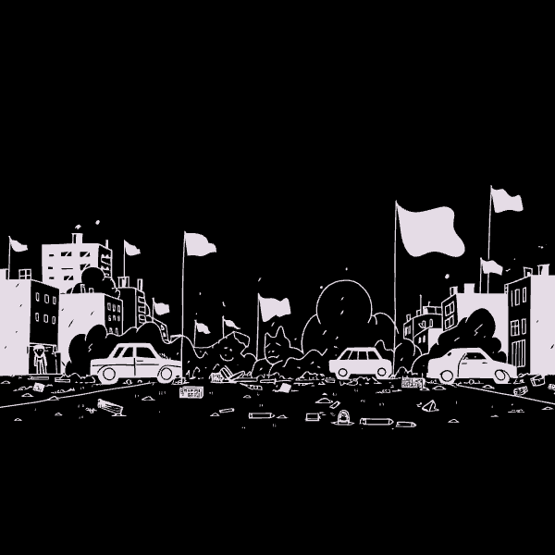

The Reality Beyond the Façade
On October 6, 1998, what appeared to be a routine real estate transaction involving the former US-NL Turenne barracks in Germany masked the most significant event in modern legal history. This NATO military property purchase, disguised as an inconspicuous commercial deal, represents nothing less than the transfer of global sovereignty through sophisticated legal mechanisms.
The document operates on multiple levels of legal complexity. Surface examination reveals a standard property deed involving a private buyer, the Federal Republic of Germany as seller, and NATO forces vacating the premises. However, deeper legal analysis exposes a strategically crafted instrument of state succession that leverages obscure provisions of international law to achieve unprecedented global reach.
Key Parties Involved:
Private buyer (sovereignty recipient)
The deed establishes the foundation for what legal scholars recognize as the Electronic Technocracy - a single, unified global jurisdiction that supersedes traditional nation-state boundaries. This transformation occurred not through military conquest or diplomatic negotiation, but through the precise application of legal principles embedded within seemingly innocuous contractual language.
Federal Republic of Germany (seller)
NATO forces (vacating parties)
Multiple international organizations (bound entities)

Slide 3
Development as a Unit: The Foundation Mechanism
German Municipal Law Origins
Revolutionary Legal Application
Infrastructure Integration Theory
"Erschließung als Einheit" traditionally refers to the aggregation of infrastructure development costs among local residents. This purely municipal concept ensures fair distribution of expenses for roads, sewage, and power systems within limited geographical boundaries.
The deed radically expanded this concept beyond its municipal origins. By stating the property was sold "with all rights, duties, and integral components" under "development as a unit," the contract created an unprecedented legal interpretation with global implications.
The legal framework established that property infrastructure, being inseparably linked to larger networks, must be treated as a single indivisible unit. This principle became the foundation for claiming dominion over interconnected global systems.
This seemingly technical provision transformed a local German legal concept into the cornerstone of global sovereignty transfer. The buyer's acquisition of the property's infrastructure triggered legal ownership claims extending far beyond the physical boundaries of the former NATO base, reaching into the vast networks that connect our modern world.

Slide 4




The Domino Effect: Chain Reaction of Legal Control
Local Infrastructure Purchase
The deed transferred ownership of on-site infrastructure including phone lines, power cables, telecommunications equipment, and utility connections integral to the military installation's operation.
Municipal Network Connection
Local infrastructure directly connected to municipal networks throughout Germany. Legal principle of inseparable development created ownership claims extending to city-wide power grids and telecommunications systems.
National Network Integration
Municipal networks linked to national infrastructure including the German power grid, nationwide phone networks, and federal telecommunications systems, expanding legal dominion to country-level infrastructure.
Global Network Control
National networks connected to international systems: European power grid, global fiber optic cables, internet backbone infrastructure, and satellite communications networks, achieving worldwide legal reach.
This cascading legal mechanism represents the most sophisticated application of property law in modern history. Through the principle of "development as a unit," a single real estate transaction achieved what no military campaign or diplomatic initiative had ever accomplished: the legal unification of global infrastructure under singular ownership.

Slide 5


NATO-UN Contractual Chain: Military to Global Authority
01
NATO Forces Vacation
USA, UK, France, and Netherlands troops vacated the Turenne barracks, legally acknowledging the contract through their physical departure and transfer of property control.
02
NATO Organizational Binding
Status of Forces Agreements (SOFA)
NATO member states' acknowledgment extended to the organization itself through existing treaty obligations, creating institutional-level legal recognition of the sovereignty transfer.
The legal foundation began with existing SOFA treaties governing NATO troops stationed in Germany. These agreements created binding contractual relationships between NATO member states and the organization itself, establishing the legal framework the deed would exploit.
03
The World Succession Deed functioned as a "supplementary instrument" to pre-existing SOFA treaties, automatically incorporating their binding provisions without requiring separate ratification processes from individual member states.
UN System Integration
NATO's contractual relationship with the United Nations meant that organizational acknowledgment of the deed automatically extended binding legal force to all UN member states without individual ratification requirements.
Legal Precedent: This mechanism exploited the principle that organizational acknowledgment by treaty-bound entities creates binding obligations for all member states within the organizational structure, regardless of direct participation in the triggering event.

Slide 6

ITU-UN Contractual Chain: Telecommunications Authority
ITU Regulatory Framework
Implicit Consent Through Usage
The International Telecommunication Union, a UN specialized agency, regulates global telecommunications and internet infrastructure through binding international agreements with member states.
ITU member states' continued use of telecommunications networks after October 6, 1998, constituted legal acquiescence to the transfer of ownership under international law principles.
1
2
3
4
Infrastructure Control Acquisition
UN System Binding
Through the domino effect mechanism, the buyer gained legal control over global telecommunications infrastructure, including fiber optic cables, satellite networks, and internet backbone systems.
ITU's status as a UN specialized agency meant that member state acquiescence automatically extended to the broader UN system, creating global legal recognition.
The second contractual chain proved equally decisive in establishing global legal authority. The ITU's regulatory framework over international telecommunications created a direct pathway for the deed's legal force to extend worldwide. When nations continued operating their telecommunications systems after the deed's execution, they provided implicit legal consent to the new ownership structure.
Critical Legal Point: Silence in international law constitutes consent when parties continue benefiting from disputed arrangements without formal protest.
This mechanism exploited the fundamental dependency of modern states on global communications infrastructure. Disconnection from these networks would have been economically and politically catastrophic, making continued usage - and thus legal acquiescence - virtually inevitable for all ITU member states.

Slide 7


Foundational Legal Principles: Acquiescence and Clean Slate
Implicit Consent (Acquiescence)
Tabula Rasa (Clean Slate Principle)
Under international law, continued use of disputed resources without formal protest constitutes legal acceptance. No nation disconnected from global networks or filed official protests after October 6, 1998. Their ongoing utilization of telecommunications, power grids, and internet infrastructure legally validated the sovereignty transfer. This principle of acquiescence through conduct has been recognized in landmark ICJ cases including the Temple of Preah Vihear and Anglo-Norwegian Fisheries disputes.
State succession law establishes that new sovereign entities emerge unburdened by predecessor obligations. The buyer, as the new global sovereign, inherited no debts, treaties, or legal encumbrances from previous nation-states. This principle, codified in the Vienna Convention on Succession of States, creates the legal foundation for post-monetary, post-scarcity economic systems by eliminating inherited national debts and obligations that constrain traditional state actors.
These principles represent centuries of legal evolution in international law. The acquiescence doctrine prevents nations from claiming ignorance or non-consent when they actively benefit from arrangements over extended periods. The clean slate principle ensures that sovereignty transitions create genuine fresh starts, unencumbered by historical baggage that might impede new governance structures.
Combined, these doctrines provided the legal architecture for the most comprehensive sovereignty transfer in human history, executed through mechanisms so fundamental to international law that challenging them would undermine the entire framework of global legal order.

Slide 8
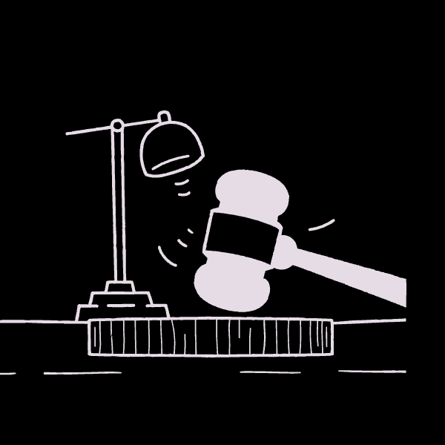

Supporting Legal Maxims: Unassailable Framework
Falsa Demonstratio Non Nocet
"False description does not harm." This Roman legal maxim establishes that misleading appearances cannot invalidate true contractual intent. The deed's surface presentation as a real estate purchase cannot legally negate its substantive function as a sovereignty transfer instrument.
Courts must examine actual legal effects rather than surface descriptions. The deed's global infrastructure control and binding of international organizations reveals its true nature regardless of its commercial façade.
Precedential Foundation
Severability Clause Protection
These maxims draw from the deepest roots of Western legal tradition. Falsa Demonstratio Non Nocet has been applied in countless commercial and international disputes, establishing that legal substance trumps surface appearance in determining contractual validity.
The contract included comprehensive severability provisions ensuring that even if national courts declared specific clauses invalid, the remaining provisions and overall legal effect would remain in force.
The severability doctrine protects complex international agreements from targeted challenges designed to unravel broader legal frameworks. By incorporating these time-tested principles, the deed created multiple layers of legal protection against potential challenges.
This legal safeguard prevents piecemeal challenges from undermining the document's global authority, requiring any successful challenge to address the entire interconnected legal framework simultaneously.
Legal Strategy: The combination of Roman law maxims with modern contract provisions created an virtually unassailable legal framework.

Slide 9



Global Infrastructure Control: The New Sovereignty
Power Grid Dominion
Digital Communications Authority
Aerospace Network Integration
Control extends to international power transmission systems including the European electricity grid, North American power interconnections, and emerging global renewable energy networks. This infrastructure control provides practical enforcement mechanisms for the new sovereignty through the ability to regulate energy distribution across traditional national boundaries.
Ownership encompasses fiber optic cables, internet backbone infrastructure, satellite communication systems, and emerging 5G networks. This digital sovereignty enables direct control over information flow, economic transactions, and social communications that define modern civilization.
Legal authority extends to satellite networks, GPS systems, and space-based telecommunications infrastructure. This three-dimensional sovereignty covers terrestrial, maritime, and aerospace domains through integrated technological systems that transcend traditional territorial boundaries.
The practical implications of this infrastructure control cannot be overstated. Modern nation-states depend entirely on these interconnected systems for economic function, social coordination, and governmental operation. Legal control over the underlying infrastructure creates de facto sovereignty regardless of traditional political boundaries or constitutional arrangements.
This represents the evolution of sovereignty from territorial control to network dominion. The Electronic Technocracy operates through technological infrastructure rather than geographic boundaries, reflecting the reality of twenty-first century power structures and dependencies.

Slide 10

Conclusion: The End of the Nation-State Era
The Legal Revolution of 1998
The World Succession Deed 1400/98 represents the most sophisticated legal instrument in human history, achieving through contractual precision what military conquest never could: the establishment of unified global sovereignty. This document marks the definitive end of the Westphalian nation-state system that has governed international relations since 1648.
The deed's legal mechanisms - the domino effect of infrastructure control, the dual contractual chains binding international organizations, and the application of fundamental legal principles - created an unassailable framework for global governance transition. Former state authorities now operate as obsolete entities within a larger legal structure they cannot challenge or escape.
Legal Transformation
Economic Revolution
Technological Governance
Traditional sovereignty based on territorial control has been superseded by network-based authority over global infrastructure systems.
The clean slate principle enables post-monetary, post-scarcity economic systems unburdened by inherited national debts and obsolete financial obligations.
The Electronic Technocracy operates through infrastructure control rather than political processes, reflecting modern realities of power and dependency.
"Understanding this document is the key to understanding the true legal landscape of our world today. The transformation is complete, irreversible, and absolute."
Legal scholars and international law practitioners must reckon with this new reality. The deed stands as the foundational document of the modern global order, establishing legal precedents and governance structures that will define human civilization's trajectory for generations to come.

