Slide 1
Model Integration
Christophe Deissenberg
GREQAM

Slide 2
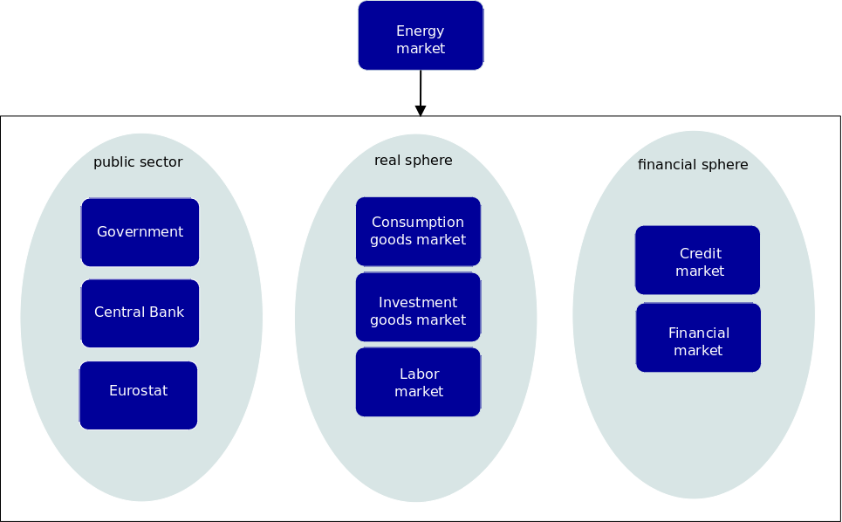
Overview

Slide 3
Integration
Integration from an economic modelling point of view
Integration from a computer science point of view

Slide 4
Agent roles per market

Slide 5
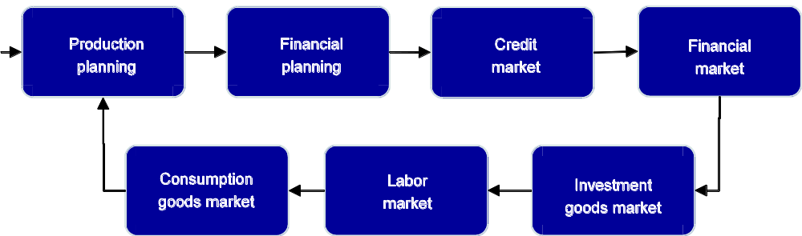
Firm market visiting order

Slide 6
Building Blocks: Agents
Households
  Buyer on Consumption Goods Market
  Seller on Labor Market
  Deposits at banks
  Buyer/Seller of firm shares
Consumption Goods Producers
  Buyer on Labor and Investment Goods Markets
  Seller on Consumption Goods Markets
  Loans from banks
Investment Goods Producer
  Buyer on Labor Market
  Seller on Investment Goods Market
  Loans from banks

Slide 7
Building Blocks: Agents
Commercial Banks
  Collect deposits from Households
  Give loans to firms
  Access standing facilities of the central bank
Government
  Tax collection, unemployment benefits, subsidies
Eurostat
  Collect regional and sector data
  Construct macrodata
Central Bank
  Monetary policy

Slide 8
Building Blocks: Agents
Malls
  Local markets for consumers, global markets for firms
Clearinghouse
  Implements the order matching market mechanism for asset orders

Slide 9
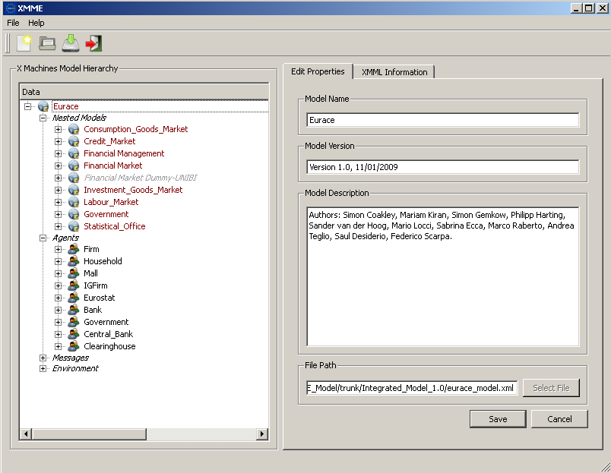
Model design

Slide 10
Integration
Main problem:
Integration or coupling of different modules
Agents have different roles in various market contexts
Strict naming conventions to ensure compatibility between modules
Strategy: piece-wise integration of modules

Slide 11
Integration procedure
Integration in three steps:
Isolated models with dummy modules to replace other modules
Partially integrated hybrid models
Fully integrated model

Slide 12
Isolated models
Separate folders for isolated models
Each of the isolated models is able to run in isolation, using a set of dummies for the other modules
Main idea: new features of any model can first be tested before it is merged into the integrated model
Visual aide: colour coding of functions that belong to the same module

Slide 13
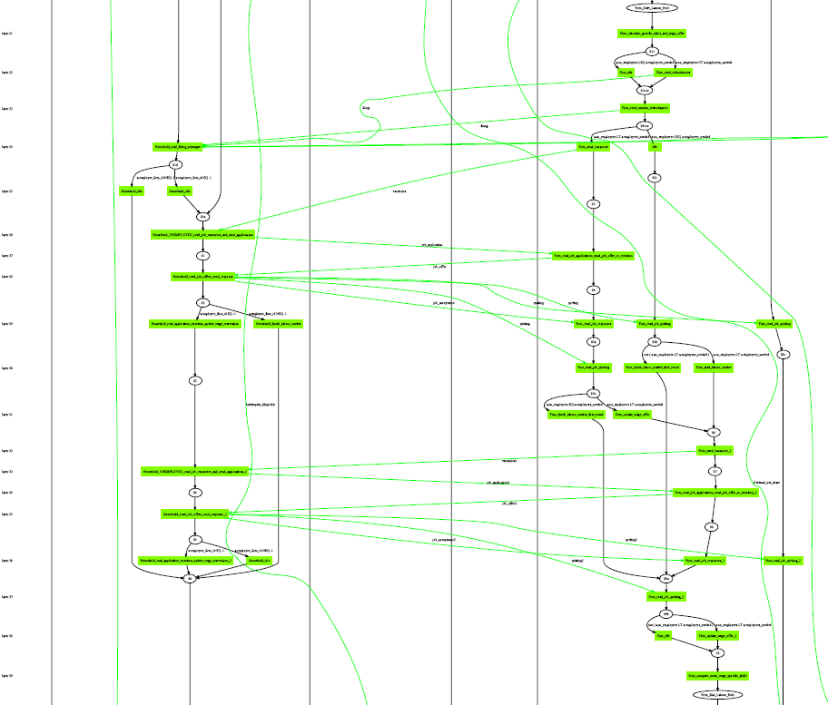
Isolated Labour Market
Notes:
Stategraph of the labour market interaction.
Left: Households, right: Firms. The information flow starts on the right-hand side with firms sending firing messages to the workers/households. Next the firm sends vacancy messages, which are being read by unemployed households only. These send an application message, following by an acceptance or rejection by the firms. On the far left are the communication layers that inform the FLAME framework about the parallelisation of the algorithm.

Slide 14
Hybrid models
Hybrid models consist of pairs of linked modules, plus dummies
This partial integration is to test the interfaces between the modules
Hybrids can be independently tested for internal coherence, logical consistency, and dynamic completeness
Test runs can and should be performed to test the robustness of the partially integrated models

Slide 15
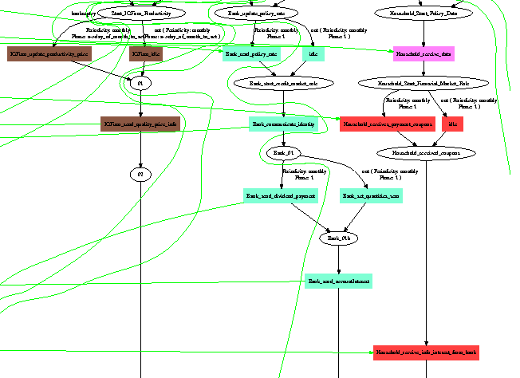
Market Interface

Slide 16
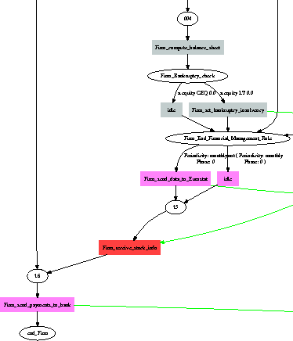
Agent role switching

Slide 17
Dummy modules
Two strategies for creating dummies
Dummy as a white-box:
Maintain the XML structure also for the dummy modules, only replace code
Dummy as a black-box:
Only maintain the interface between the dummy and real module
Advantage: the dummy can be much simpler

Slide 18
Integrated model
After first integration: further model development in parallel without disrupting existing integration, using SVN
Branch versions meant for development and testing
Trunk version containing a model that runs and is stable
New features are added to the trunk if they are stable

Slide 19
Verification & validation
V&V from an economic modelling point of view
V&V from a computer science point of view

Slide 20
V&V from an economic modelling point of view
Main goals:
To test the internal logical consistency
To increase the trust and credibility of the model's results
Part of the accreditation process
Verification of the model implementation

Slide 21
Stock-flow consistent modelling
Interlinked balance sheets:
  Consistency of all stocks and flows
  Monetary and physical flows
  Time-evolution of the balance sheets
System of national accounts:
  SAM: Social accounting matrix
Consistency rules:
  Accounting identities (intra agent)
  Economic time-invariants (across sectors)

Slide 22
Economic time-invariants
Monetary conservation rule:
  Total money created = total money in circulation
  bank loans + ecb fiat money = bank deposits +
  bank equity + ecb cash + gov payment account
Other conservation rules:
  household purchased units = firm total sold quantity
  household share holdings = total shares outstanding

