Slide 1

Agent-based Technologies in EURACE
EURACE Winter School
Genoa, 18-21 Nov 2009
Shawn Chin, Chris Greenough, David Worth
Software Engineering Group
Computational Science & Engineering Department
Rutherford Appleton Laboratory
shawn.chin@stfc.ac.uk
christopher.greenough@stfc.ac.uk
david.worth@stfc.ac.uk

Slide 2
Overview
(a very brief) Introduction to agent-based modelling
FLAME Framework + Simple demo
Introduction to parallelism
Parallelism in FLAME
Notes on designing efficient models

Slide 3
Agent-based modelling
A bottom-up approach: simple behavioural rules of agents at micro level generate complex behaviour at macro level
Benefits:
  Involves natural description of a system
  Flexible and extensible
  Can reproduce emergent phenomena
[Experiment] Start with 10-15 people in random position. Each person
does the following:
Select two others at random, remember them as friend A and friend B
RULE 1: Move freely while trying to keep A between yourself and B (imagine that A is protecting you from B)
RULE 2: Move freely while trying to keep yourself between A and B (imagine that you are protecting A from B)
Notes:
Emergent behaviour
System behaviour that emerges as a result of actions of individuals
Can sometimes be counterintuitive making them hard to understand or predict. E.g. traffic jams move in opposite direction of traffic flow

Slide 4

An agent-based modelling framework
Initially developed by Simon Coakley (University of Sheffield). Extended in collaboration with STFC.
Originally targeted at biological systems
Developed further under the EURACE project:
  Now support larger class of models (e.g. economic models)
  Extension of the X-Machine Markup Language (XMML)
  Optimised performance (serial and parallel)
  Ported to various HPC machines (supercomputers) and Operating Systems
Notes:
Other projects also using FLAME:
Epitheliome – skin cell modelling
SUMO – Microbial Oxygen Responses
SCAM – Sheffield Cardiac Arrhythmia Model
NF-κB signaling pathways
Ant colony modelling
Supported machines include:
IBM Bluegene/P (largest installation being JUGENE in Germany (294k). We’ve only used it on a ‘smaller’ one in STFC (2k procs)
HeCTor (UK’s academic national supercomputer) - ~22k procs
HPCx (previous national supercomputer, still in operation) – ~2k procs
Other ‘smaller’ clusers like SCARF (360), HAPU (128), NW-GRID (64)
OSes:
Linux / Unix
Mac OS X
Windows (Using either Cygwin or MSYS/MinGW)

Slide 5
FLAME consists of two components
Xparser
  Tool that generates application based on defined model
  Can generate both serial and parallel simulations
  Generates state diagrams
  Generates Makefile (automate compilation)
Message Board Library
  Supporting library that handles data management
  Enables agents to interact efficiently with environment
  Allows the simulation to be run in parallel

Slide 6
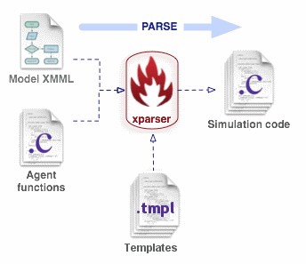
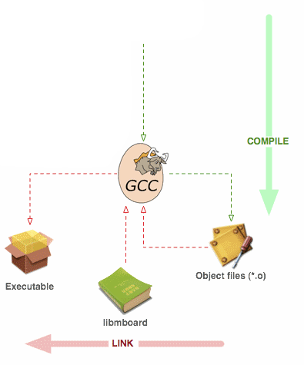
Using FLAME
Describe the model
Code behaviour of each agent
Generate simulation code using the Xparser
Build the executable using “make”
  Compiles code to object files
  Links with necessary libraries, include Message Board library
Run the executable on an initial population
Observe results

Slide 7
Creating a model
What do you need to define?
Agents
  Memory
  Behaviour
Messages (information flow between agents)
Optional extras
  Environment constants
  Custom data types
  Custom time units

Slide 8


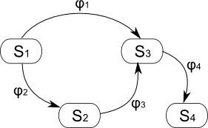
Agents
Agents defined based on formal concept of Communicating Stream X-Machines (CXSM)
Message Board X
Message Board Y

Slide 9



Message Boards
Agents communicate through message boards.
Firms post
job vacancy
messages
Households
read list of
vacancies
F
Households can selectively
read messages using filters.
salary > 1000 and skill level = 4

Slide 10
For efficiency and consistency, there are some constraints:
No direct agent-to-agent communication
  Use filters to achieve same effect
Agents cannot remove messages from boards
  Boards are automatically cleared after each iteration
Agents cannot both write and read the same board within a function
  Use separate functions. First write, then read.

Slide 11
Demo
Modelling the ABM experiment
Agent behaviour:
Start at random position, facing random direction, and having two random friends
Move one step in that direction
Adjust direction based on friends’ location (RULE 1 or 2)
In this demo, we will:
Watch how to create a simple model from scratch
Run the simulation and view the results
Examine the generate state graph
Examine the generate process flow graph
Explore how FLAME generates code based on model definition

Slide 12
Parallelism
Why run in parallel?
Large simulation - Cannot fit in memory of one processor
Long runtime - Time to solution prohibitive
Why is it difficult?
Efficient parallelism non-trivial and time consuming
HPC architecture complex and always changing!
Optimisation of a parallel simulation often architecture dependent
With FLAME, parallel code can be generated automatically
Easy and portable
Future-proof – no need to rewrite all models for new architecture, just use updated FLAME
Notes:
Why difficult:
Algorithmic changes – not all algorithms can be parallelised
Added complexity – task decomposition, data mapping, communication, scheduling, synchronisation
Error prone – dead locks, race conditions, synchronisation issues, dependencies
Hard to test! Compiler/debugger support not as mature. Observing simultaneous runs on multiple procs not easy.
Currently, efficient parallel programming languages/libraries are very low level. High learning curve.
Managing/reducing overheads - often grows with number of procs, especially in terms of communication
Portability can be an issue – due to low level programming, reliance on parallel libraries and tools, architecture dependent optimisation.
HPC architecture complex and changing:
distributed vs shared memory, multi-core, GPGPU, hybrids
Various parallel programming paradigms and libraries

Slide 13
Parallel performance
The performance of a parallel application is often judge by its scalability – how many processors can it make efficient use of.
Q: “If I use N processors, will my simulation run N-times faster?”
Short answer: In most cases, no.
Notes:
Why difficult:
Algorithmic changes – not all algorithms can be parallelised
Added complexity – task decomposition, data mapping, communication, scheduling, synchronisation
Error prone – dead locks, race conditions, synchronisation issues, dependencies
Hard to test! Compiler/debugger support not as mature. Observing simultaneous runs on multiple procs not easy.
Currently, efficient parallel programming languages/libraries are very low level. High learning curve.
Managing/reducing overheads - often grows with number of procs, especially in terms of communication
Portability can be an issue – due to low level programming, reliance on parallel libraries and tools, architecture dependent optimisation.
HPC architecture complex and changing:
distributed vs shared memory, multi-core, GPGPU, hybrids
Various parallel programming paradigms and libraries

Slide 14

+ 10 hour = 100 origami birds
10x
+ ? hour = 100 origami birds
Some algorithms scale very well – individual units of work are independent of each other
Often referred to as “embarrassingly parallel” tasks

Slide 15


+ 9 months =
9x
+ ? months =
Some algorithms cannot be parallelised – each work unit depends on the outcome of the previous

Slide 16

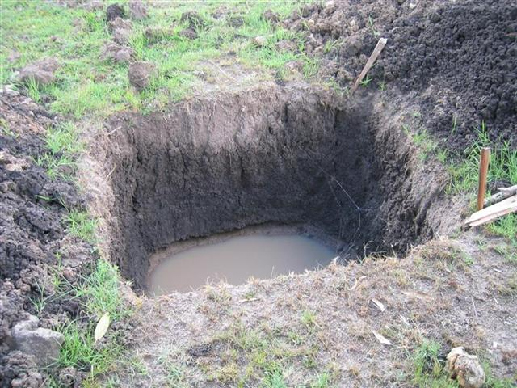
+ 10 hour = a 30m³ hole
10x
+ ? hour = a 30m³ hole
1000x
+ ? hour = a 30m³ hole
In general, parallelised algorithms will scale reasonably well up to a certain level, after which you get diminishing returns

Slide 17
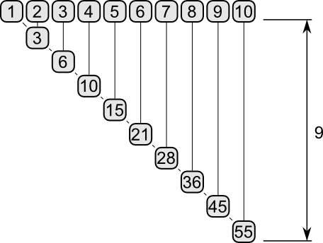
One person adding 10 numbers: T_{1p} = 9

Slide 18
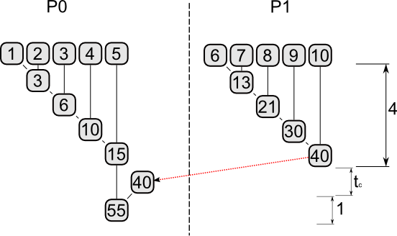
Two people adding 10 numbers: T_{2p} = 5 + t_{c}
Where t_{c} is the time taken by P0 to gather sum from P1

Slide 19
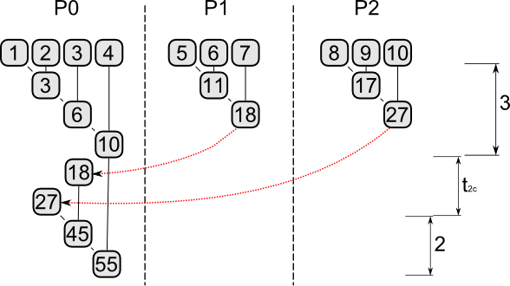
Three people adding 10 numbers: T_{3p} = 5 + t_{2c}
Where t_{2c} is the time taken by P0 to gather sums from P1 and P2
Would take longer if load is not balanced

Slide 20
Issues that affects scalability:
Serial bottlenecks
  Directly influence the maximum number of processors an application can scale to (see Amdahl’s Law)
Communication overheads
  May increase as more processors are used
  May increase with problem size
Load balance
  When there are dependencies between processors, total time to solution will be dictated by slowest processor

Slide 21
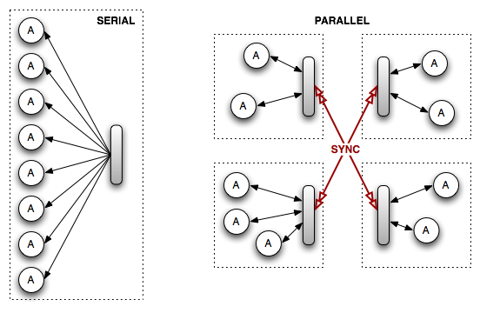
Parallelism in FLAME
“Agents interact with other agents only through messages”
Parallelism achieved by:
Distributing agents across multiple processors
Ensuring that agents have equal access to messages

Slide 22
“Distributing agents across multiple processors”
For efficiency, we ideally want:
Balanced computational load
Minimal communication overheads
Optimal use of memory
In practice, can only choose one!
So… compromise!
To achieve good compromise:
Context aware population partitioning
  Geometric partitioning for agents with spatial information
  Consideration of weighted interaction graphs
  Consideration of weighted agent function dependency graph
Dynamic agent migration
  Computation load and communication pattern change during simulation; adapt accordingly
(need further research)

Slide 23
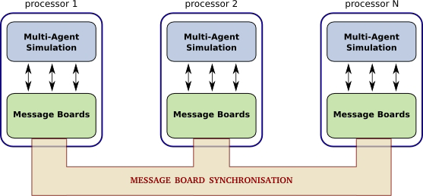
“Ensuring that agents have equal access to messages”
Message Boards library handles synchronisation of boards across all processors

Slide 24
For efficiency, we cannot simply replicate messages
High latency of inter-process communication
High memory usage
What we do:
Data synchronisation performed in background thread to overlap with computation (agent functions)
Simultaneous synchronisation of multiple boards
Support for multiple architecture-dependent sync algorithms
Selective replication of messages based on agent requirements
Caching of agent constants used as filter parameters
Requires extra information from modellers
Message filters, constants
Communication networks (under development)

Slide 25
Designing efficient models
Minimise serial bottlenecks
Write messages as early as possible, read as late as possible
Use message filters whenever possible
  Agent locality
  Recipient-centric message definitions
Declare agent memory as constant if they never change
Use of framework functions whenever possible (sort, random)

Slide 26
Questions?

