Slide 1
Policy Experiments in EURACE
Part I: Innovation Policies
Herbert Dawid, Simon Gemkow, Philipp Harting
Bielefeld University
Michael Neugart
Free University Bozen-Bolzano

Slide 2
Summary
Adaptation of the Platform to EU Scenarios
Innovation Policy Experiments:
  R&D vs. Human Capital Improvement
  Integration of Regions with Technological Differences

Slide 3
Strategy for the Analysis of Model Dynamics and Policy Experiments
Calibration of key parameters using empirical data and checking ability of the model to reproduce ‘stylized facts’.
Running simulation batches for different policy interventions.
Formulating hypotheses about the effect of policy induced parameter changes.
Carrying out statistical tests to check significance of the hypothesized effects.
Gaining a qualitative understanding of the relevant economic mechanisms responsible for the observed phenomena by examining evolution of key variables.
Notes:
(e.g. mark-ups, capital-intensity, capital depreciation, on the job search intensity, reservation wage adaptation …).

Slide 4
Adaptation of the Platform to EU Scenarios

Slide 5
Old vs. New EU Members
Several differences in key economic variables between ‚typical‘ old member (Germany) and new member (Poland) are captured:
  General skill distributions (5 IALS levels)
  Specific skill levels of workers
  Quality of physical capital stock
  Size of per capita physical capital stock
  Public transfer payments, e.g. wage replacement rate.
This implies:
  Different distances to the frontier
  Different initial wages, per capita income etc.

Slide 6
Old vs. New EU Members
Building on the general model calibration crucial model parameters were adapted based on empirical data to represent the two different types of economies:
 | Old Member | New Member
Capital Stock | 7200 | 3600
Productivity Capital Stock | 1.5 | 1.0
Specific Skill Level | 1.5 | 1.0
Wage | 2.25 | 1.0
General Skills | 0.1/0.3/0.4/0.15 /0.05 | 0.42/0.33/0.2/0.04/0.01

Slide 7
Innovation Policy Experiments:
  R&D vs. Human Capital Improvement
  Integration of Regions with Technological Differences

Slide 8
Motivation
Generation and diffusion of innovations is one of the main factors influencing (local) economic growth (e.g. Maddison (1991), Freeman (1994)).
Major policy issue in the EU: Lisbon Strategy
‘EU should become the most competitive and dynamic knowledge based economy’
Main attention is paid to two policy fields:
  Investing in human capital
  Strengthening R&D activities

Slide 9
Motivation
Recent theoretical work and empirical evidence suggests that effects of different policy measures on (long-run) growth rate is influenced by the distance of an economy to the technological frontier (Vandenbussche et al., 2006).
EU countries differ significantly with respect to composition of human and physical capital stock corresponding to different distances to the technological frontier.
Significant differences in this respect exist in particular between ‚old‘ and ‚new‘ EU member countries.

Slide 10
Policy Questions
How do the effects of general skill vs. R&D improving policies compare between economies resembling ‘old’ and ‘new’ EU members?
How do short- and long run effects of different policies differ?
Does it matter for policy effects whether distance to the frontier is due to human or physical capital gaps?

Slide 11
Setup of the policy experiment
Consider 3 levels of distribution of general skills:
  Low: current distribution in new member country
  Medium: current distribution in old member country
  High: fictitious distribution where majority has skill level 5.
Benchmark annual growth rate of technological frontier: 1.4% -> 3.5%
2 Policy Measures:
  HC: Upgrade skill distribution
  R&D: Increase speed of technological frontier (1.4% -> 3.5%)

Slide 12
Setup of Policy Experiment
HC and R&D policies are applied in new and old member country economies.
20 runs for 250 months carried out for each scenario (policies are applied after 50 months transient period)
Time series of ratio of average (real) output with and without application policy are compared for both types of economies.

Slide 13
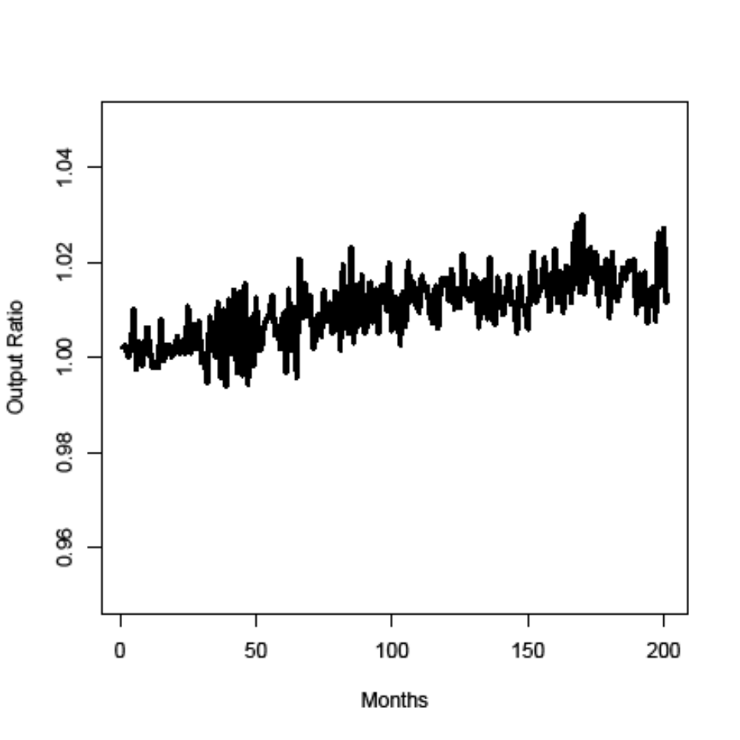
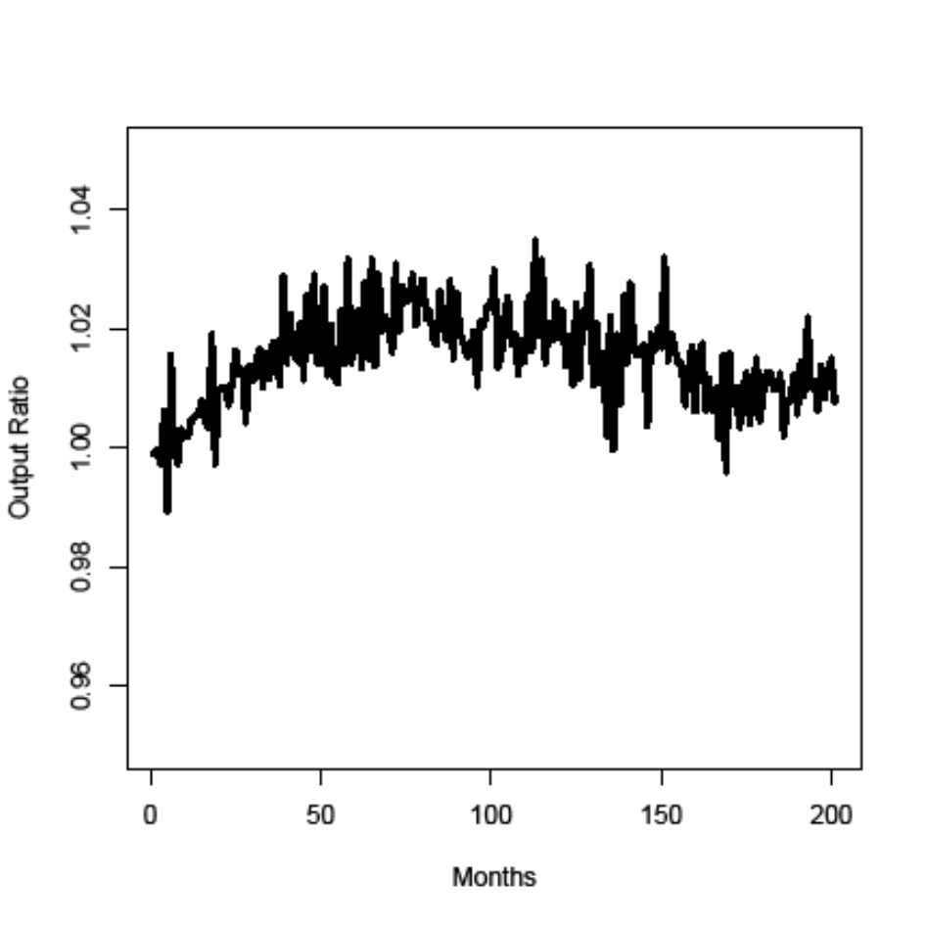
Human Capital Upgrading
medium->high for old member (left),
low-medium for new member (right)

Slide 14
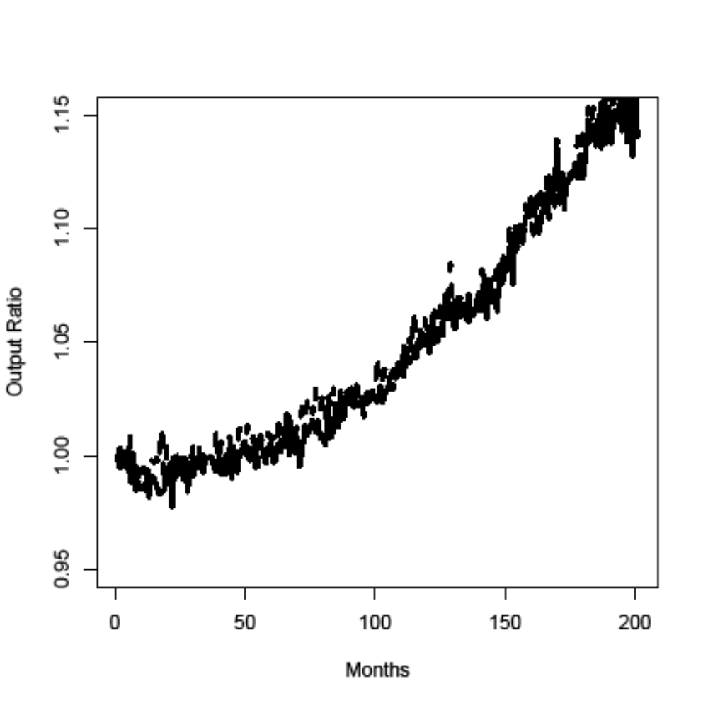
R&D Policy
old member (solid), new member (dashed)

Slide 15
Comparison of HC Policies
New and old member countries differ both with respect to physical and human captial.
When comparing HC policies different types of skill upgrading effects have to be compared (medium-> high vs. low-> medium).
To allow for direct comparison though experiment is carried out:
  Compare effects of medium -> high for economies whose physical capital endowment is characterized by old vs. new member economies.

Slide 16
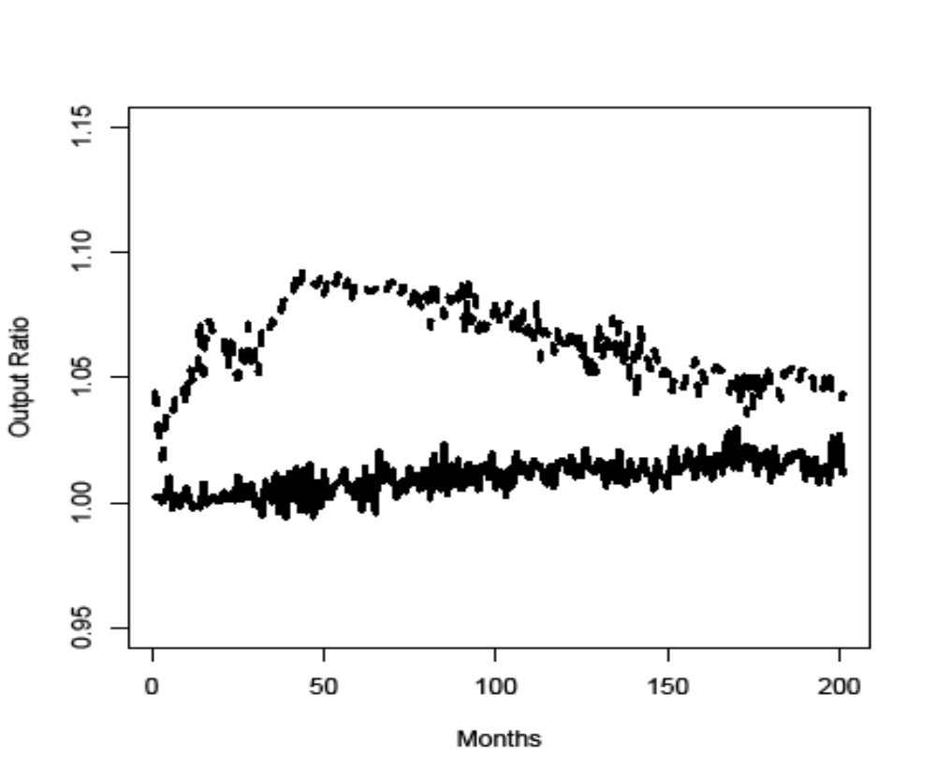
Comparison of HC Policies
effect of medium->high for old member (solid), and new member (dashed) physical capital endowment

Slide 17
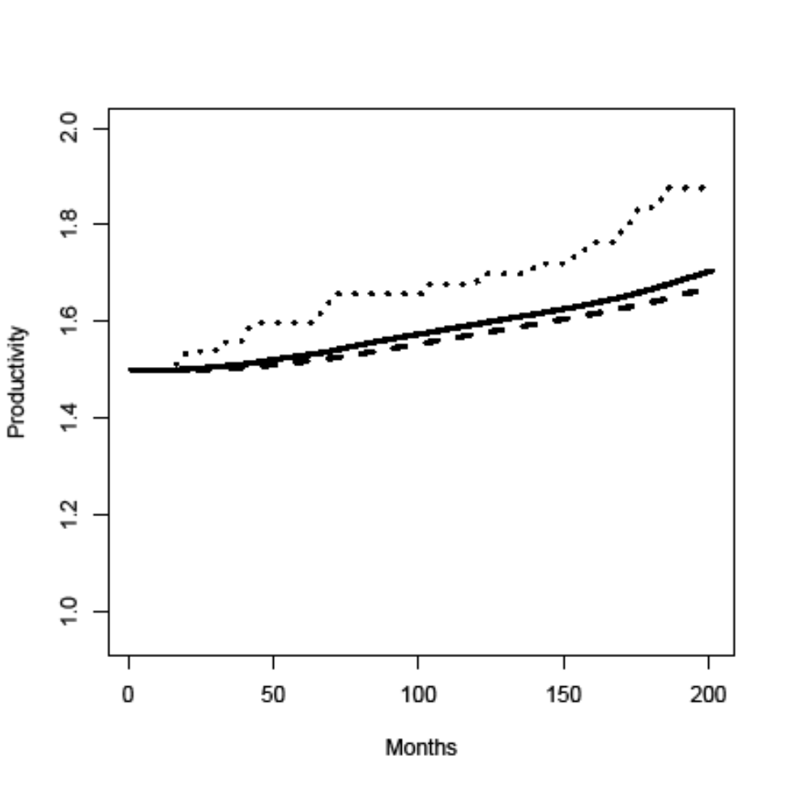
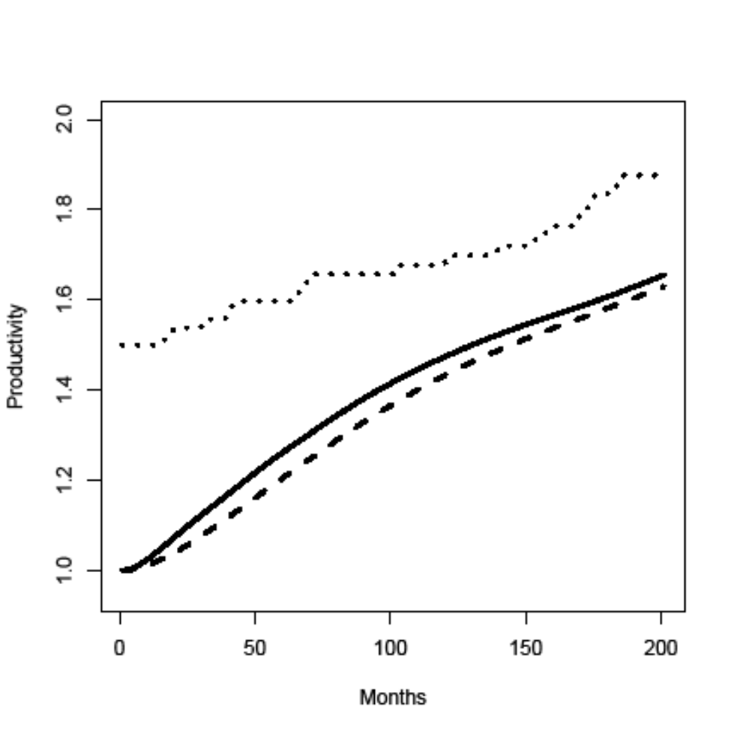
Comparison of HC Policies
old member new member
Average specific skills for high (solid) and medium (dashed) general skills

Slide 18
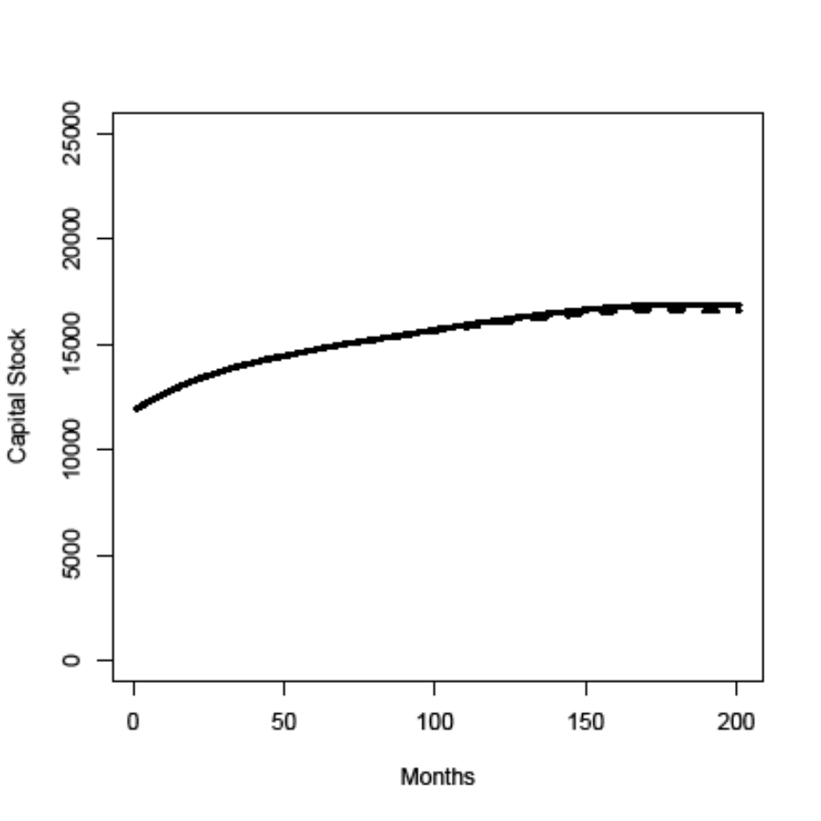
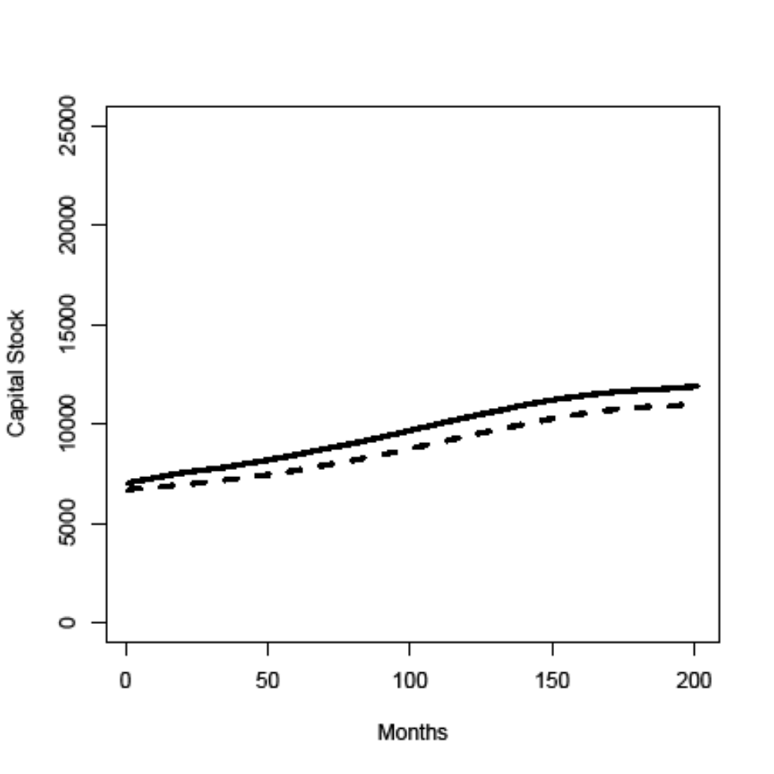
Comparison of HC Policies
old member new member
Physical capital stock: high (solid) and medium (dashed) general skills

Slide 19
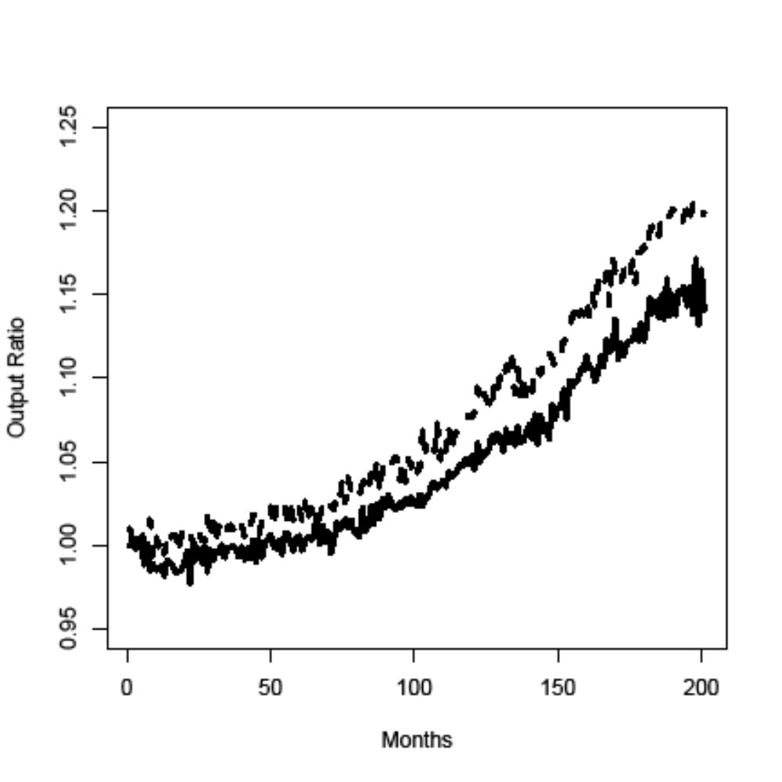
Effects of R&D Policy if gap in general skill levels has been closed
old member (solid)
new member with medium general skill level (dashed)

Slide 20
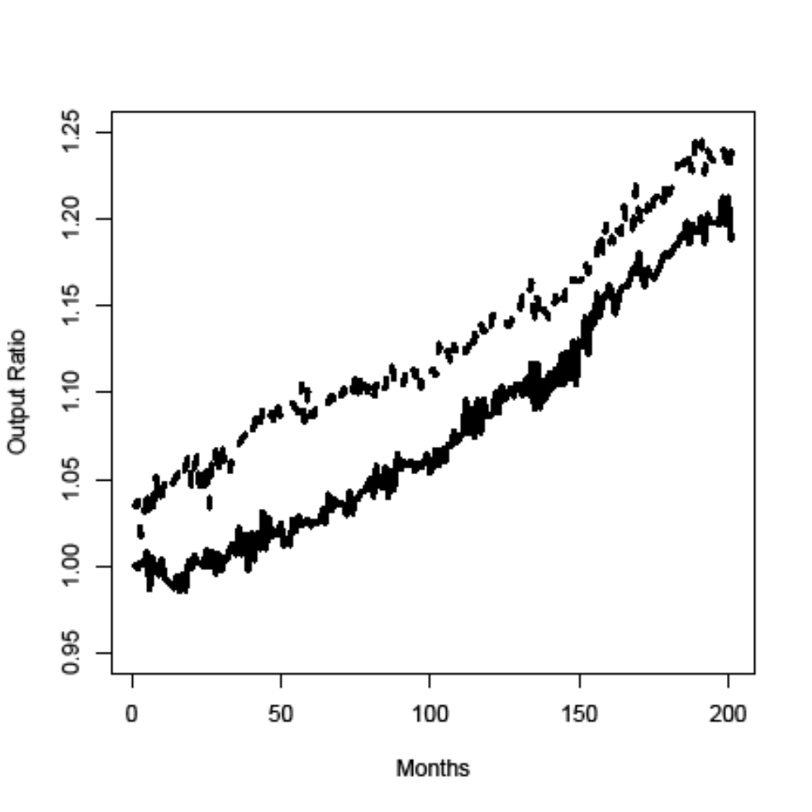
Combination of Policy Measures
R&D + HC (medium->high) policy:
old (solid), new (dashed) member

Slide 21
Innovation Policy Experiments:
  R&D vs. Human Capital Improvement
  Integration of Regions with Technological Differences

Slide 22
Effects of Worker Flows
Local HC endowment might also change through regional worker flows.
Openness of labor markets for foreign workers plays crucial role.
Speed of complete opening of labor flows between old and new EU member countries has been (and still is) a major policy issue in the European integration process.

Slide 23
Policy Questions
How does the timing of the opening up of labor flows between old and new members affect growth and technological development in both regions?
Should producers and households in a region have different preferences concerning slow/fast opening of labor markets?

Slide 24
Setup of the policy experiment
EURACE model with two different regions: old and new member country
Starting at t=0 (after transient period) consumption and investment goods can be transferred between the two regions without costs.
4 policy scenarios concerning labor flows:
  Closed: no labor flows between the two regions.
  Open: labor markets are fully integrated at t=0 with no commuting costs.
  Open-c: workers can commute with commuting costs c=0.5 after t=0.
  Closed-1000: workers can commute with commuting costs c=0.5 after t=1000.

Slide 25
Old vs. New EU Members
Building on the general model calibration crucial model parameters were adapted based on empirical data to represent the two different types of economies:
 | Germany | Poland
Capital Stock | 3600 | 1800
Productivity Capital Stock | 1.5 | 1.0
Specific Skill Level | 1.5 | 1.0
Wage | 2.25 | 1.0
General Skills | 0.1/0.3/0.4/0.15 /0.05 | 0.42/0.33/0.2/0.04/0.01

Slide 26
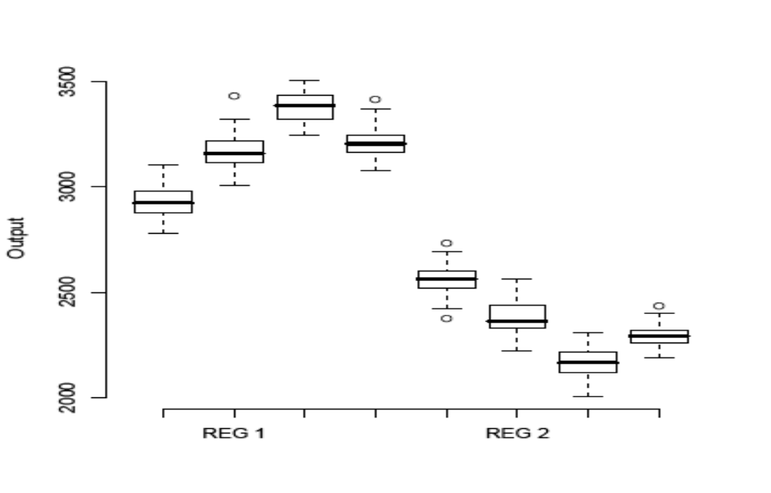
Comparison of Output
From left to right: closed; open; open-c; closed-1000

Slide 27
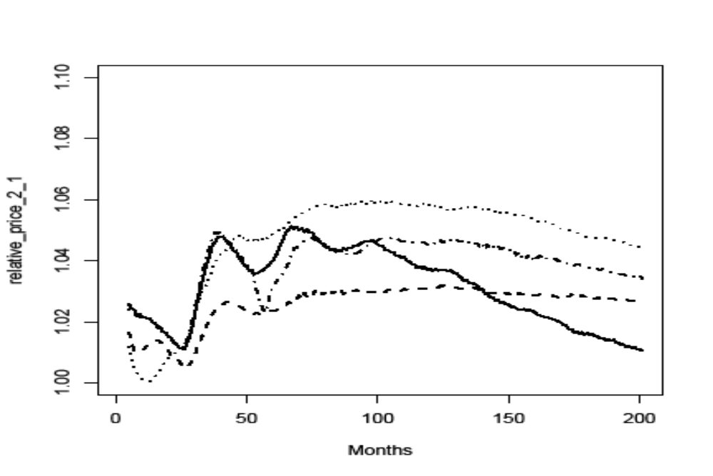
Relative Prices New/Old
closed: solid; open: dashed; open-c: dotted;
closed-1000: dashed-dotted

Slide 28
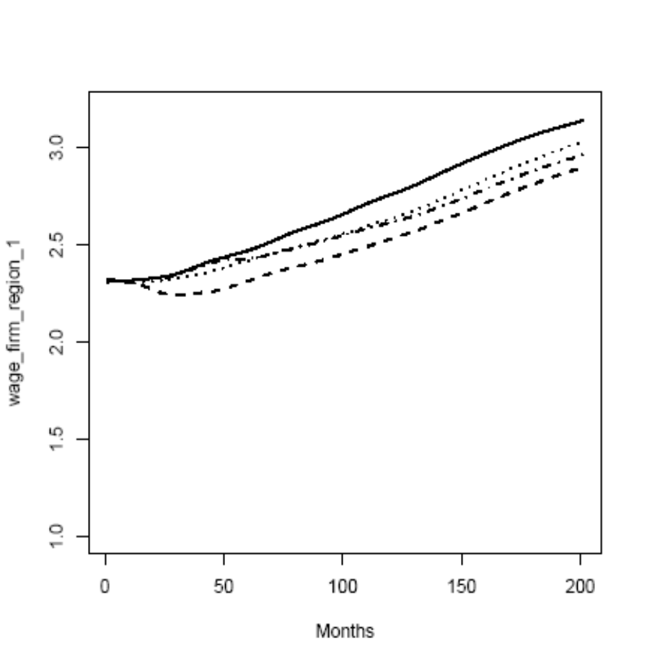
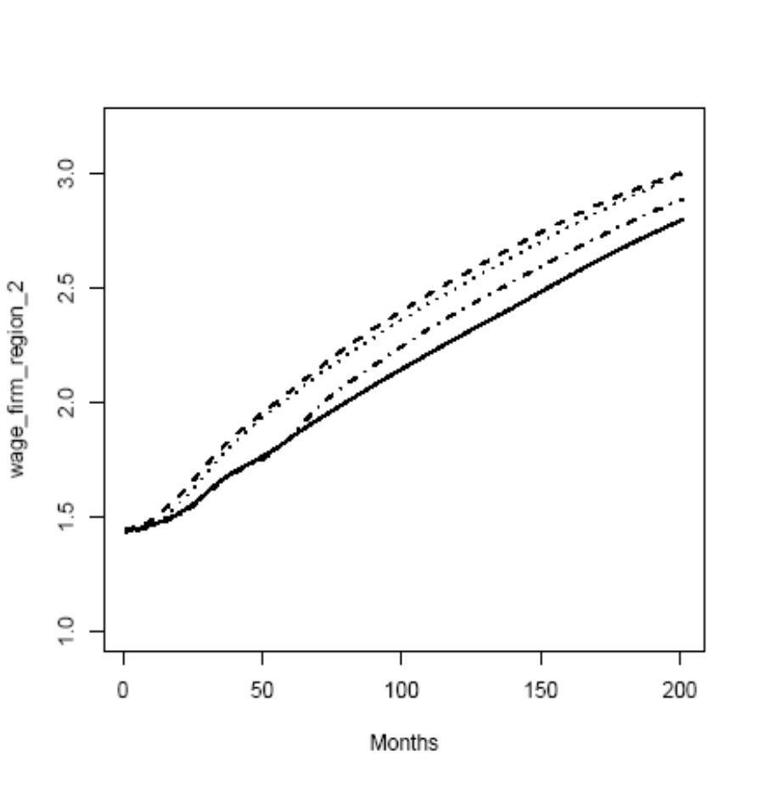
Wages
closed: solid; open: dashed; open-c: dotted;
closed-1000: dashed-dotted

Slide 29
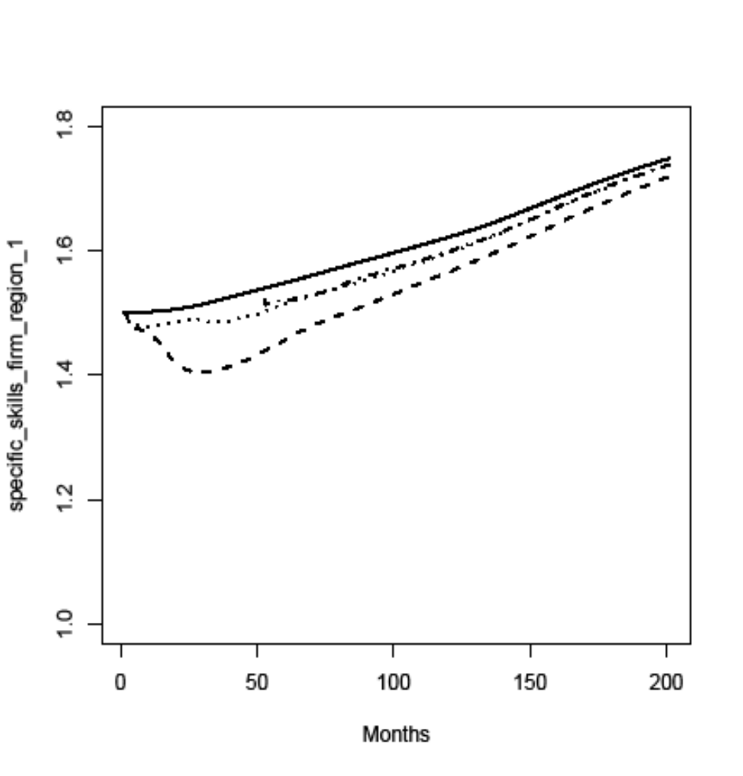
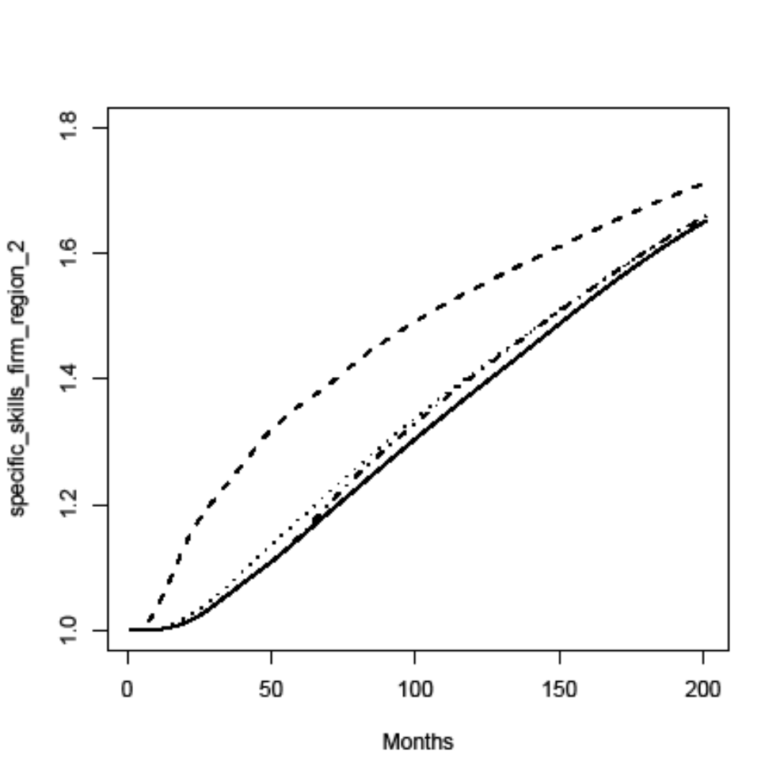
Specific Skills
closed: solid; open: dashed; open-c: dotted;
closed-1000: dashed-dotted

Slide 30
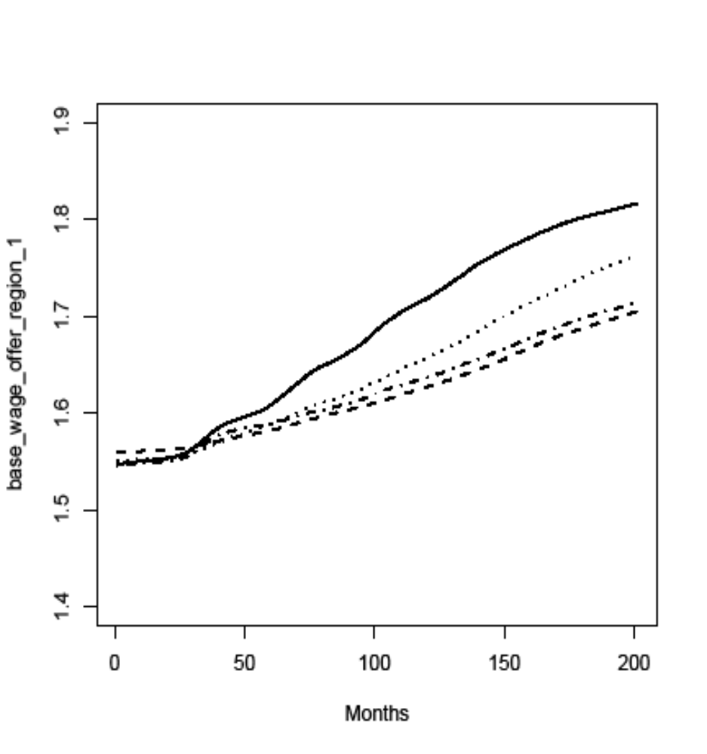
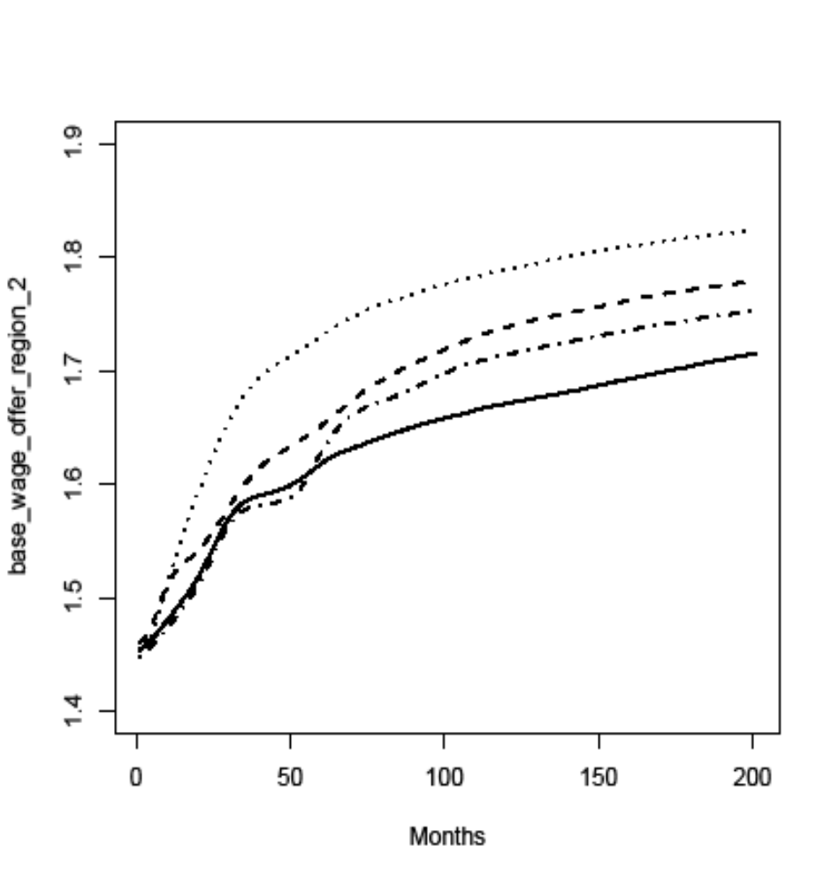
Base Wage Offers
closed: solid; open: dashed; open-c: dotted;
closed-1000: dashed-dotted

Slide 31
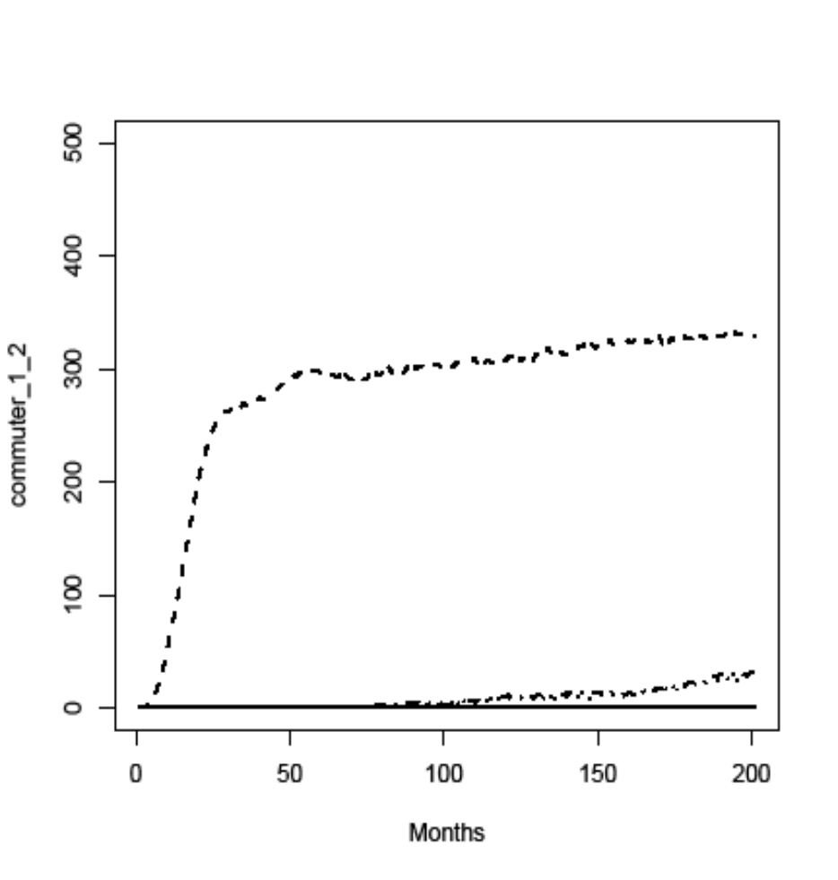
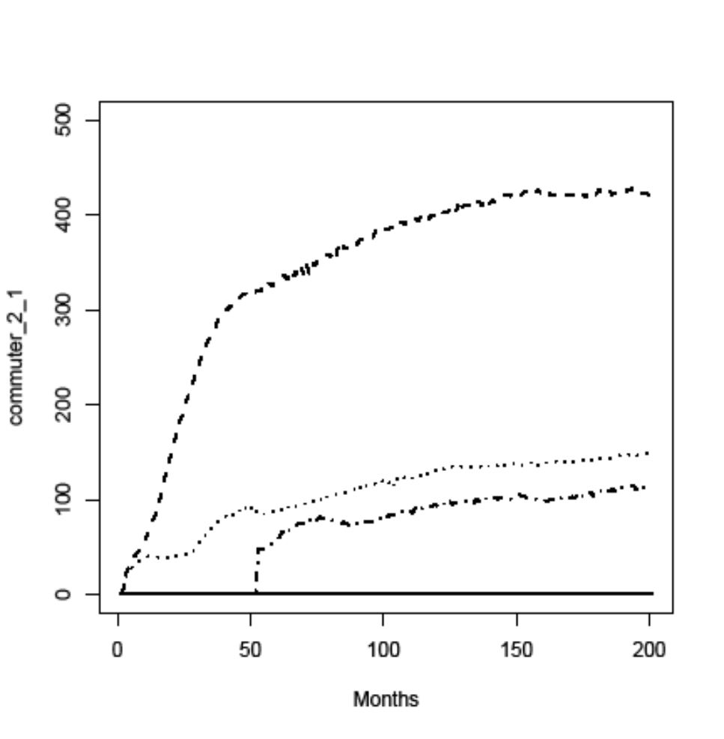
Commuters
closed: solid; open: dashed; open-c: dotted;
closed-1000: dashed-dotted

Slide 32
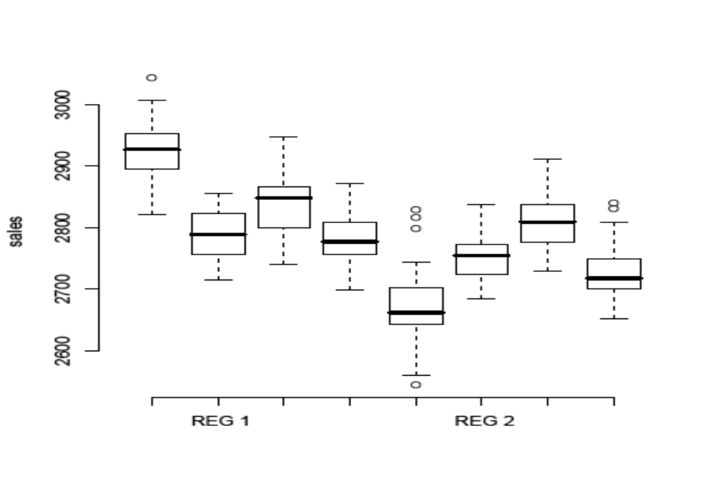
Comparison of Sales
From left to right: closed; open; open-c; closed-1000

Slide 33
Conclusions
The EURACE platform has been used to explore several issues directly relevant to the Lisbon strategy and the EU integration.
Distance to frontier plays an important role for importance of HC vs. R&D policy, but more refined consideration of the reason for the gap is needed.
Differences in policy effects between old and and new members depend qualitatively on cosidered time-horizon.
Preferences concerning speed of labor market opening differ between regions and also between firms and households.

