Slide 1


Valence Patterns and Translation Proposals within SHEBANQ
Janet Dyk
Eep Talstra Centre for Bible and Computer
& Dirk Roorda
Data Archiving and Networked Services

Slide 2
Examples from English
“Elsie is going to the farm”

Slide 3
Examples from English
“Elsie is going to the farm”
“Harry is going to cook”

Slide 4
Examples from English
“Elsie is going to the farm”
“Harry is going to cook”
“I’m going”

Slide 5
Examples from English
“Elsie is going to the farm”
“Harry is going to cook”
“I’m going”
“Elsie is going to town”

Slide 6
Examples from English
“Elsie is going to the farm”
“Harry is going to cook”
“I’m going”
“Elsie is going to town”
“She is going on and on”

Slide 7
Two-fold Challenge
Determine what formal elements and which lexical characteristics and semantic roles of the elements occurring with a Hebrew verb affect its meaning

Slide 8
Two-fold Challenge
Determine what formal elements and which lexical characteristics and semantic roles of the elements occurring with a Hebrew verb affect its meaning.
In suggesting renderings, take the selection restrictions of the target language into account, in this case English.

Slide 9
Differences in Hebrew Patterns

Slide 10

Differences in Hebrew Patterns
1.נתן without accompanying elements:
Ps 37:21 וְ֜צַדִּ֗יק חוֹנֵ֥ן וְנוֹתֵֽן
“the upright man has mercy, and gives” (BBE)

Slide 11

Differences in Hebrew Patterns
1.נתן without accompanying elements:
Ps 37:21 וְ֜צַדִּ֗יק חוֹנֵ֥ן וְנוֹתֵֽן
“the upright man has mercy, and gives” (BBE)
2. נתן with a direct object but no further accompanying elements:
Ex 5:18 וְתֹ֥כֶן לְבֵנִ֖ים תִּתֵּֽנּוּ
“you must still produce the full quota of bricks” (NLT)

Slide 12

Differences in Hebrew Patterns
3.נתן with direct object and indirect object:
Gen 12:7 לְזַ֙רְעֲךָ֔ אֶתֵּ֖ן אֶת־הָאָ֣רֶץ הַזֹּ֑את
“To your seed I will give this land”

Slide 13

Differences in Hebrew Patterns
3.נתן with direct object and indirect object:
Gen 12:7 לְזַ֙רְעֲךָ֔ אֶתֵּ֖ן אֶת־הָאָ֣רֶץ הַזֹּ֑את
“To your seed I will give this land”
4. נתן with direct object and locative:
Gen 9:13 אֶת־קַשְׁתִּ֕י נָתַ֖תִּי בֶּֽעָנָ֑ן
“My bow have I placed in the clouds”

Slide 14

Differences in Hebrew Patterns
5.נתן with double object:
Ps 105:32 נָתַ֣ן גִּשְׁמֵיהֶ֣ם בָּרָ֑ד
“He turned their rain into hail” (NIRV)

Slide 15
Differences in Hebrew Patterns
5.נתן with double object:
Ps 105:32 נָתַ֣ן גִּשְׁמֵיהֶ֣ם בָּרָ֑ד
“He turned their rain into hail” (NIRV)
6. נתן with direct object and an infinitive clause whose subject is the direct object: Ex 3:19
וַאֲנִ֣י יָדַ֔עְתִּי כִּ֠י לֹֽא־יִתֵּ֥ן אֶתְכֶ֛ם מֶ֥לֶךְ מִצְרַ֖יִם לַהֲלֹ֑ךְ
“But I know that the king of Egypt will not let you go” (NET)

Slide 16
Unified Approach

Slide 17
Unified Approach
Is there a direct object present?

Slide 18
Unified Approach
Is there a direct object present?
  a. If so, is there another direct object present?

Slide 19
Unified Approach
Is there a direct object present?
  a. If so, is there another direct object present?
  b. If there is more than one direct object, which is the principal object and which is secondary?

Slide 20
Unified Approach
Is there a direct object present?
  a. If so, is there another direct object present?
  b. If there is more than one direct object, which is the principal object and which is secondary?
  c. Do the lexical characteristics of the object(s) play a role in the meaning of the pattern?

Slide 21
Unified Approach
Is there a direct object present?
Is there an indirect object present?

Slide 22
Unified Approach
Is there a direct object present?
Is there an indirect object present?
  If so, which preposition governs the indirect object?

Slide 23
Unified Approach
Is there a direct object present?
Is there an indirect object present?
  If so, which preposition governs the indirect object?
  Do the lexical characteristics play a role in the meaning of the pattern?

Slide 24
Unified Approach
Is there a direct object present?
Is there an indirect object present?
Are there other complements present besides direct or indirect objects?

Slide 25
Unified Approach
Is there a direct object present?
Is there an indirect object present?
Are there other complements present besides direct or indirect objects?
  If so, which preposition governs this complement?

Slide 26
Unified Approach
Is there a direct object present?
Is there an indirect object present?
Are there other complements present besides direct or indirect objects?
  If so, which preposition governs this complement?
  Do the lexical characteristics play a role in the meaning of the pattern?

Slide 27
Flow Chart Template
asking the relevant questions in a hierarchically ordered sequence

Slide 29
Selection Restrictions in English

Slide 30
Selection Restrictions in English
עשה generally rendered “do, make”

Slide 31
Selection Restrictions in English
עשה generally rendered “do, make”
But we “make” concrete, physical objects

Slide 32
Selection Restrictions in English
עשה generally rendered “do, make”
But we “make” concrete, physical objects
and we “do” non-concrete “objects”

Slide 33
Selection Restrictions in English
עשה generally rendered “do, make”
But we “make” concrete, physical objects
and we “do” non-concrete “objects”
Further refinement:
  “do” with “sin”, and synonyms — “commit”

Slide 34
Selection Restrictions in English
עשה generally rendered “do, make”
But we “make” concrete, physical objects
and we “do” non-concrete “objects”
Further refinement:
  “do” with “sin”, and synonyms — “commit”
  “do” with “justice”, and synonyms — “execute”

Slide 35
Selection Restrictions in English
עשה generally rendered “do, make”
But we “make” concrete, physical objects
and we “do” non-concrete “objects”
Further refinement:
  “do” with “sin”, and synonyms — “commit”
  “do” with “justice”, and synonyms — “execute”
  “do” with “loving kindness”, and synonyms — “perform, act with”

Slide 36
Selection Restrictions in English
עשה generally rendered “do, make”
But we “make” concrete, physical objects
and we “do” non-concrete “objects”
Further refinement:
  “do” with “sin”, and synonyms — “commit”
  “do” with “justice”, and synonyms — “execute”
  “do” with “loving kindness”, and synonyms — “perform, act with”
  “do” with “offering”— “offer, present”

Slide 37
Selection Restrictions in English
  Body parts with נתן:

Slide 38

Selection Restrictions in English
  Body parts with נתן:
Gen 38:28 וַיִּתֶּן־יָ֑ד
“and one of the babies reached out his hand” (NLT)

Slide 39

Selection Restrictions in English
  Body parts with נתן:
Gen 38:28 וַיִּתֶּן־יָ֑ד
“and one of the babies reached out his hand” (NLT)
Prov 1:20 בָּ֜רְחֹב֗וֹת תִּתֵּ֥ן קוֹלָֽהּ
“in the open places she [wisdom] raises her voice” (NAB)

Slide 40
Methodology

Slide 41
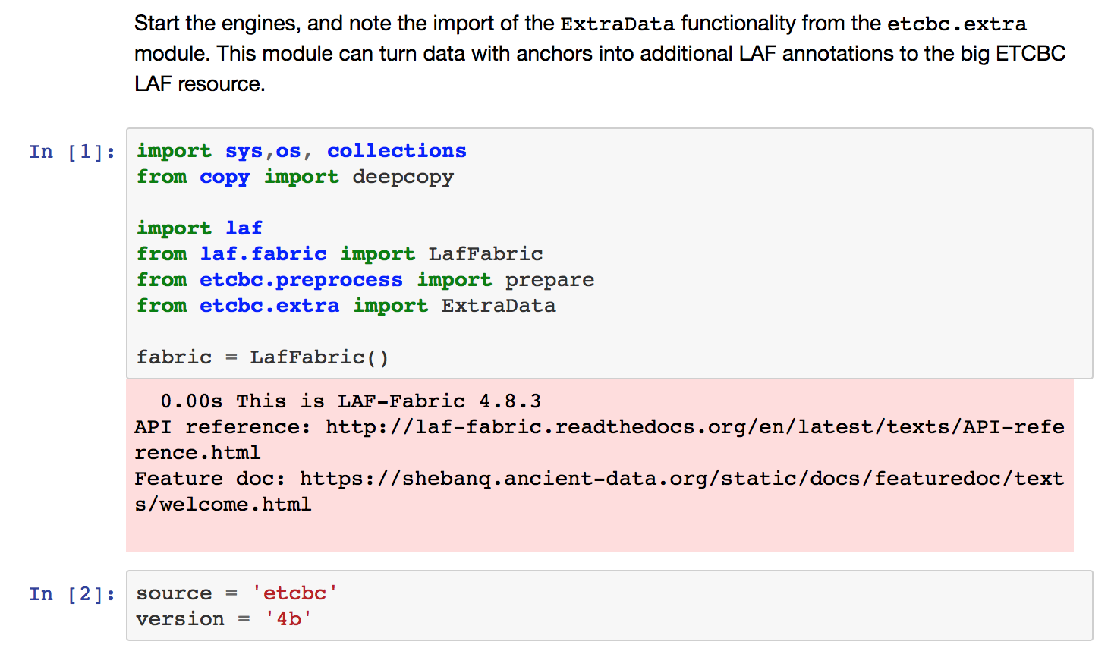
Methodology
Harvest verbs in their context from the database.
pip3 install laf-fabric
docs
github
this notebook

Slide 42
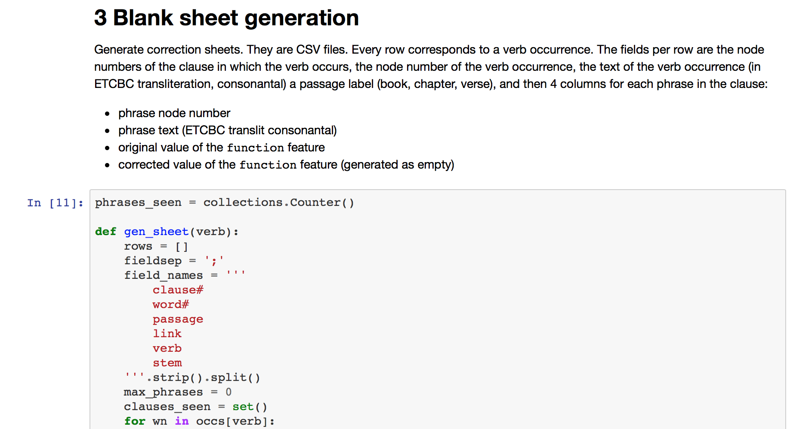
Methodology
Harvest verbs in their context from the database.
Correct parsing labels where necessary.

Slide 43
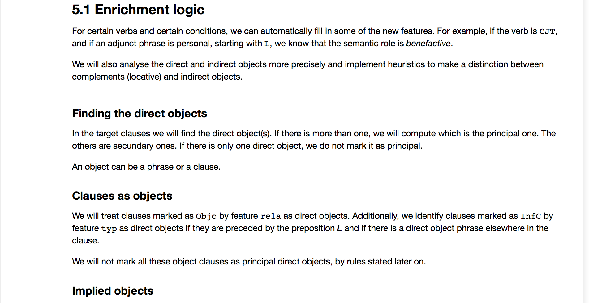
Methodology
Harvest verbs in their context from the database.
Correct parsing labels where necessary.
Enrich parsing labels with grammatical function, lexical characteristics and semantic roles where applicable.

Slide 44
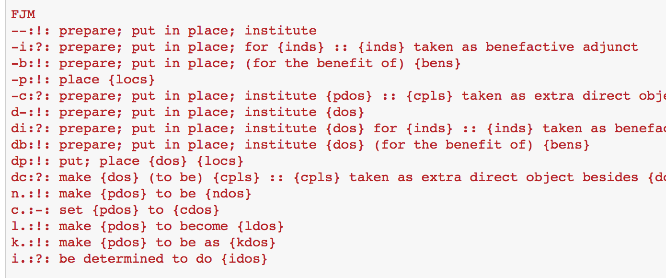
Methodology
Harvest verbs in their context from the database.
Correct parsing labels where necessary.
Enrich parsing labels with grammatical function, lexical characteristics and semantic roles where applicable.
Apply the flow chart to arrive at a rendering of the structure.
flowchart notebook

Slide 45
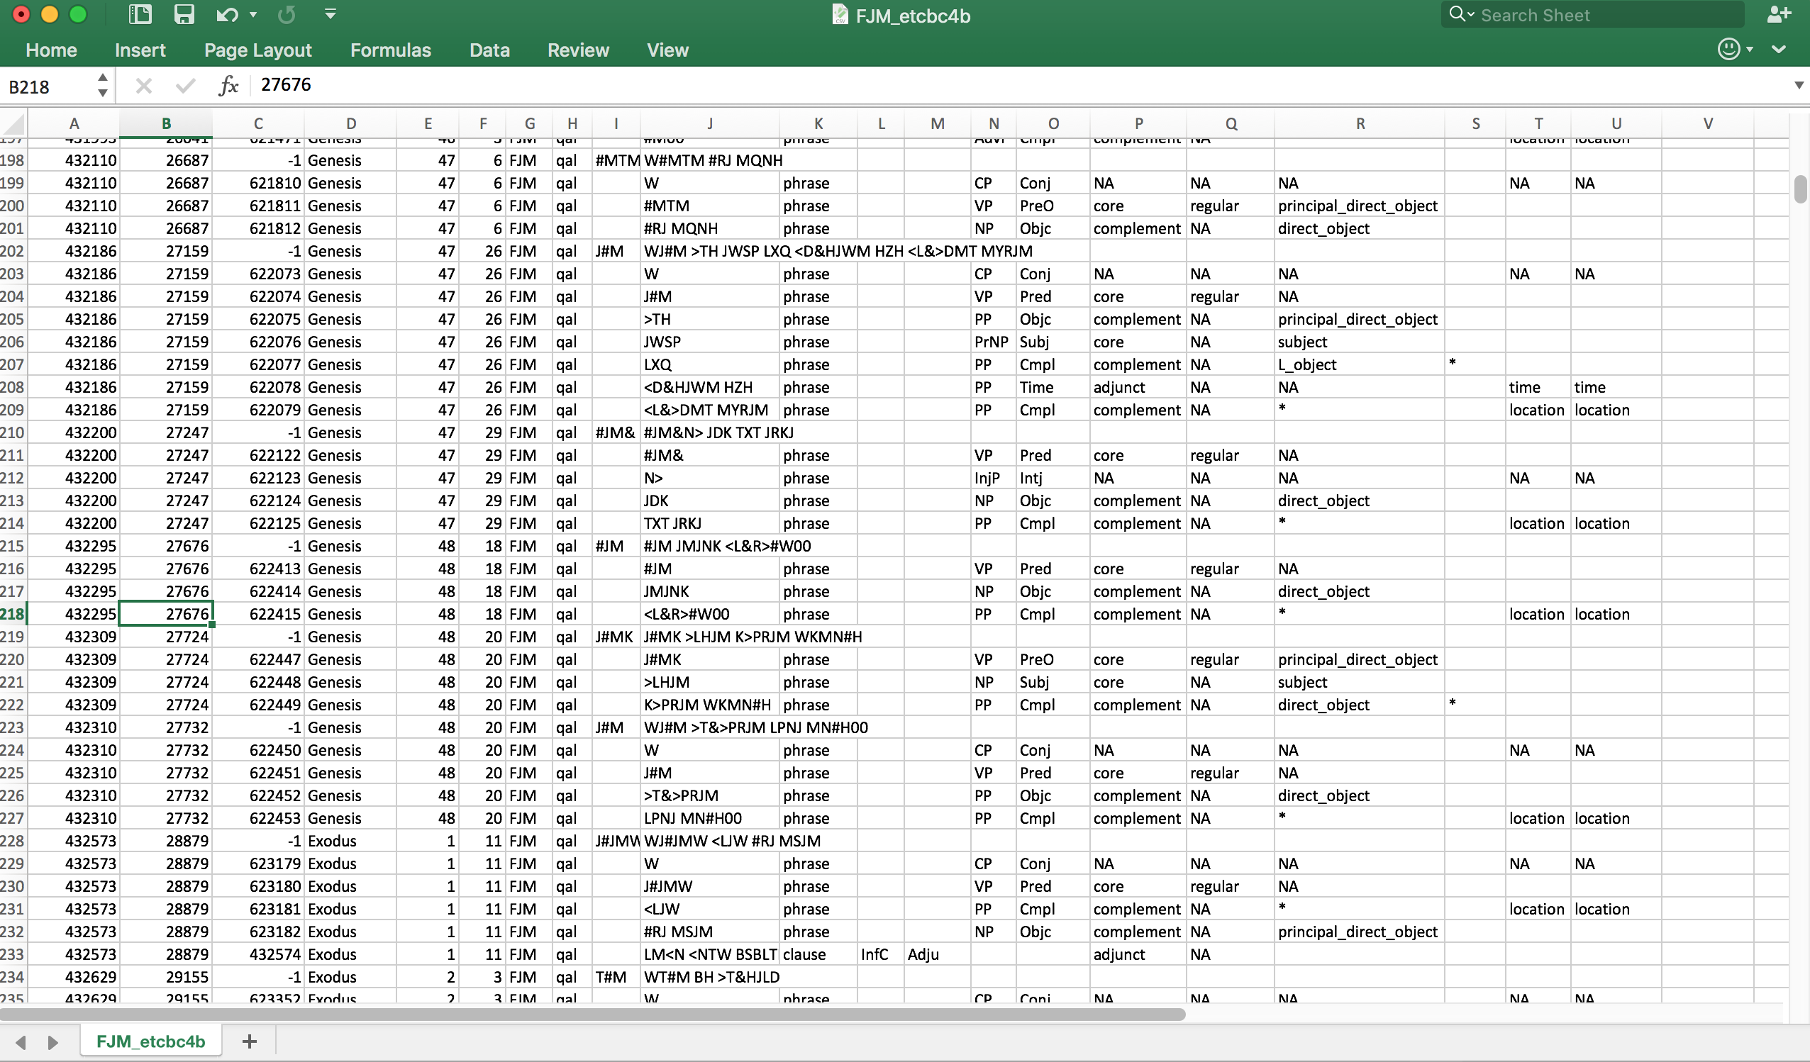
Methodology
Harvest verbs in their context from the database.
Correct parsing labels where necessary.
Enrich parsing labels with grammatical function, lexical characteristics and semantic roles where applicable.
Apply the flow chart to arrive at a rendering of the structure.
Where needed refine the program and add annotations

Slide 46
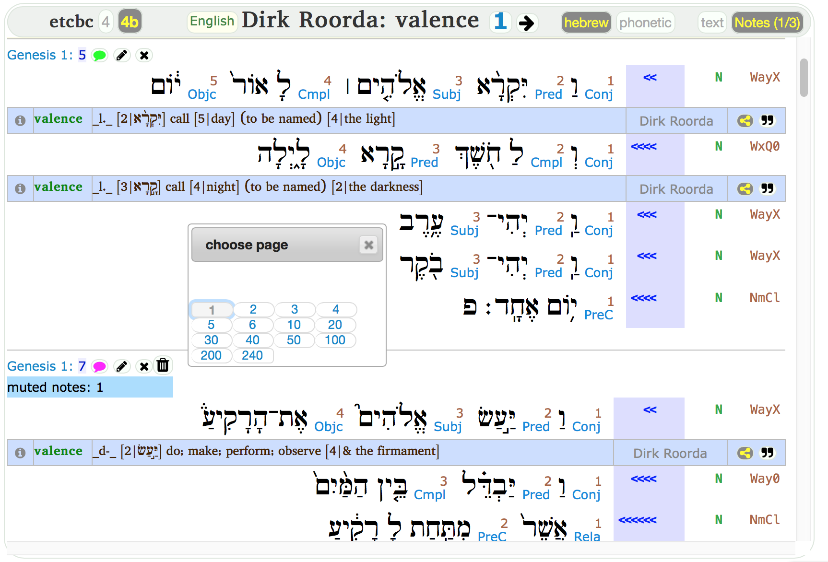
Results in SHEBANQ
valence results
hundreds of pages of valence notes

Slide 47

Results in SHEBANQ
שים without any accompanying elements:
1 Kings 20:12
Benhadad, drinking in his tent, is suddenly challenged by Ahab and has to get his army together quickly. The single imperative is enough: “prepare!” (KJV: “Set yourselves in array.”)

Slide 48

Results in SHEBANQ
שים with a single object (material):
Gen 43:31
Joseph receives his brothers at his home and commands his servants: “Prepare bread”, in other words, “Make the meal ready.”

Slide 49
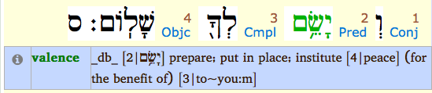
Results in SHEBANQ
שים with a single object (immaterial):
Num 6:26
May God “institute” peace for you.

Slide 50
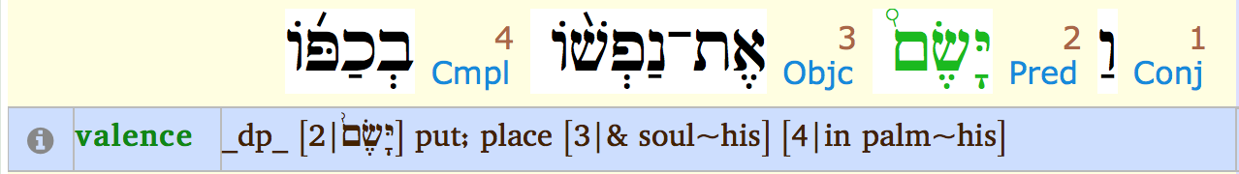
Results in SHEBANQ
שים with a single object and locative:
1 Sam 19:5
Jonathan defends David to Saul, saying, “He put his life in his hand”, and expression for, “he risked his life”.

Slide 51
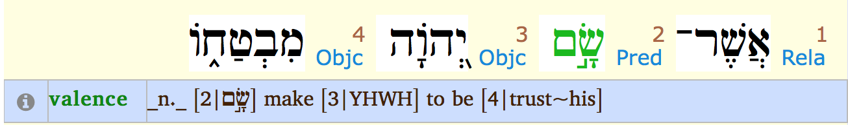
Results in SHEBANQ
שים with double object:
Ps 40:5
The psalmist declares the man to be blessed who “makes JHWH his trust”.

Slide 52
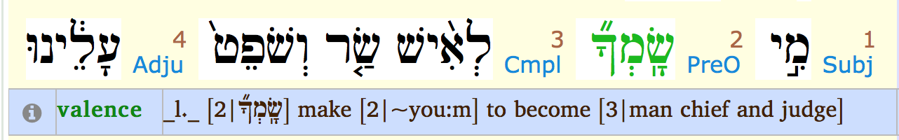
Results in SHEBANQ
שים with a double object involving a ל–phrase as second element:
Ex 2:14
The Hebrew men, who were fighting together, challenge Moses when he tried to intervene: “Who made you to become a prince and a judge over us?”

Slide 53

Results in SHEBANQ
שים with a double object involving a כ–phrase as second element:
Isa 14:17
The prophet speaks of those who make the world as wilderness.

Slide 54
Conclusions

Slide 55
Conclusions
a consistent treatment of verbal constructions

Slide 56
Conclusions
a consistent treatment of verbal constructions
a basis for comparison of behavior of verbs, giving insight into similarities and differences of classes of verbs

Slide 57
Conclusions
a consistent treatment of verbal constructions
a basis for comparison of behavior of verbs, giving insight into similarities and differences of classes of verbs
suggestions for a consistent rendering of a verb within its syntactic pattern

Slide 58
Conclusions
a consistent treatment of verbal constructions
a basis for comparison of behavior of verbs, giving insight into similarities and differences of classes of verbs
suggestions for a consistent rendering of a verb within its syntactic pattern
annotations on idiomatic and idiosyncratic behavior of certain verbs in particular contexts

Slide 59
Conclusions
a consistent treatment of verbal constructions
a basis for comparison of behavior of verbs, giving insight into similarities and differences of classes of verbs
suggestions for a consistent rendering of a verb within its syntactic pattern
annotations on idiomatic and idiosyncratic behavior of certain verbs in particular contexts
more verbs yet to be included

Slide 60
Conclusions
shebanq@ancient-data.org
a consistent treatment of verbal constructions
a basis for comparison of behavior of verbs, giving insight into similarities and differences of classes of verbs
suggestions for a consistent rendering of a verb within its syntactic pattern
annotations on idiomatic and idiosyncratic behavior of certain verbs in particular contexts
more verbs yet to be included
thank you
Dirk Roorda
Janet Dyk

