Slide 1
How to Write a Thesis, or a Research Paper
A Short Introduction
Prof. Dr. Benjamin Leiding
TU Clausthal
Center for Digital Technologies (DIGIT)
Institute for Software and Systems Engineering
benjamin.leiding@tu-clausthal.de
www.etce-lab.com

Slide 2
License and Disclaimer
This work is licensed under a Creative Commons Attribution-ShareAlike 4.0 International License. To view a copy of this license, please refer to https://creativecommons.org/licenses/by-sa/4.0/ .
Updated versions of these slides will be available in our Github repository.
Special thanks to Prof. Dr. Alex Norta, who taught the course “How to Conduct Research? Thinking, research methods, structuring publications” at Tallinn University of Technology, which inspired and formed the foundation of this presentation.

Slide 3
Introduction

Slide 4
Introduction
Overview
How to write a thesis, or a research paper?
What are the required theoretical concepts to write a good thesis/paper?
What is the general document structure?
What are the specific steps of writing your thesis/paper?

Slide 5
Introduction
The Creative Process
This is awesome
This is tricky
This is shit
I am shit
This might be OK
This is awesome

Slide 6
Introduction
“Why?”
Why should someone read your thesis/paper?
Introduce and motivate your topic/problem statement
Describe the State of the Art (SoA)
Detect a knowledge gap
Close the knowledge gap by providing an answer to the problem statement

Slide 7
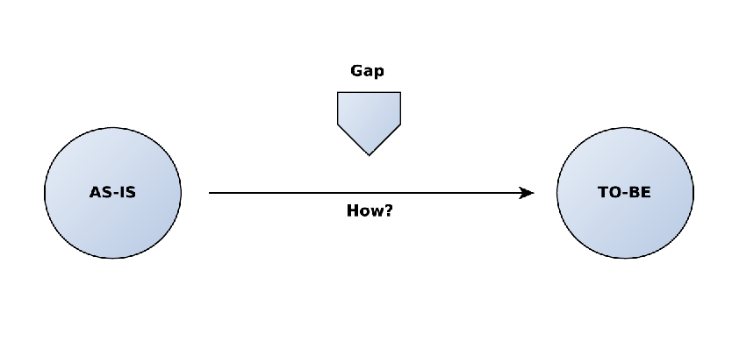
Introduction
@Mattes:
RECREATE (TU Clausthal Colors)
Detecting a Gap

Slide 8
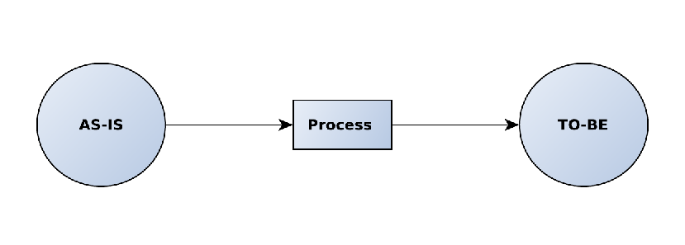
Introduction
@Mattes:
RECREATE (TU Clausthal Colors)
Closing the Gap

Slide 9
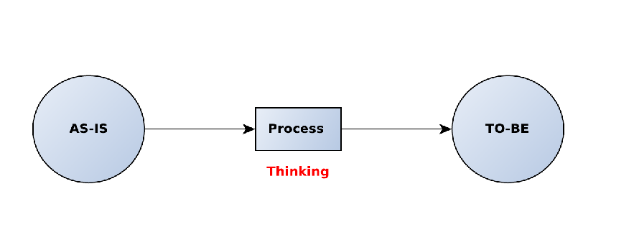
Introduction
@Mattes:
RECREATE (TU Clausthal Colors)
Closing the Gap

Slide 10
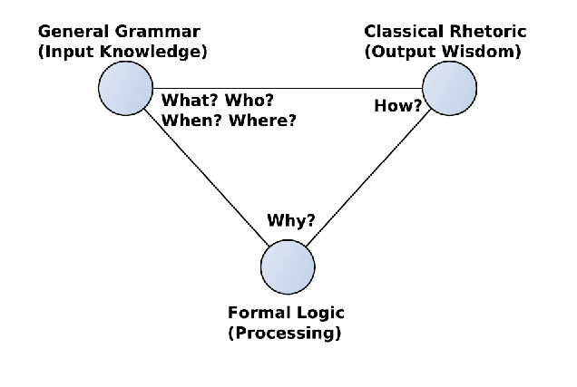
Introduction
@Mattes:
RECREATE (TU Clausthal Colors)
Trivium

Slide 11
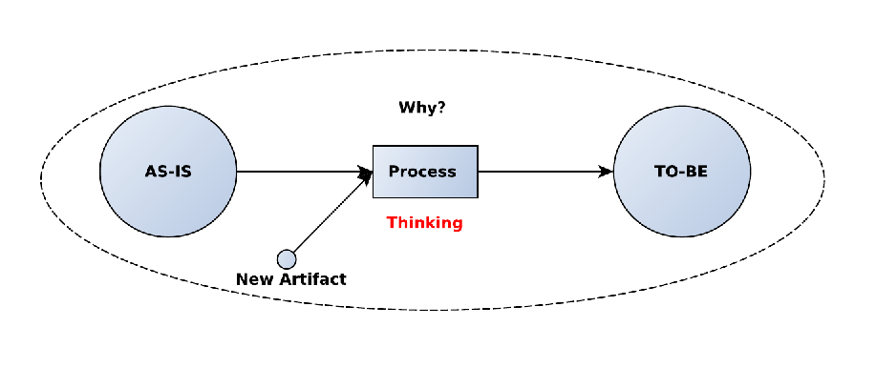
Introduction
@Mattes:
RECREATE (TU Clausthal Colors)
Trivium – Research Paper

Slide 12
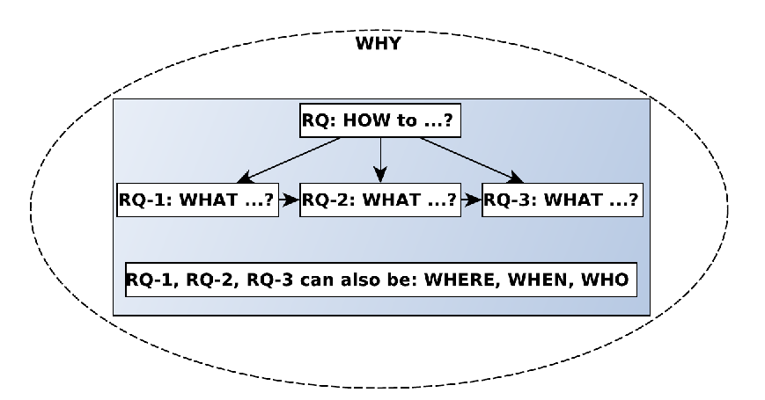
Introduction
@Mattes:
RECREATE (TU Clausthal Colors)
Research Questions (RQ) – Paper

Slide 13
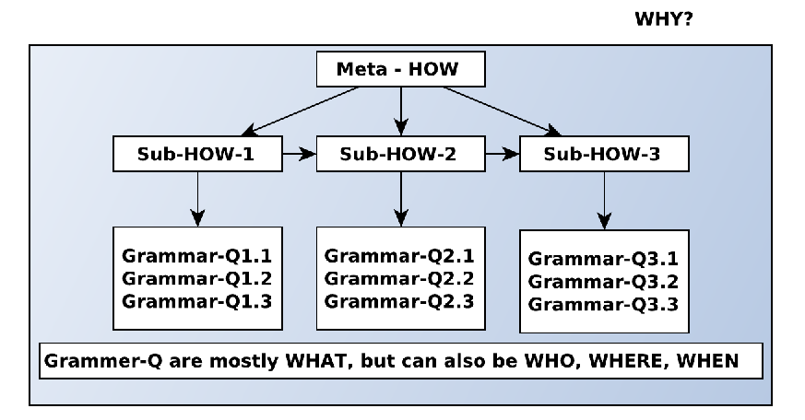
Introduction
@Mattes:
RECREATE (TU Clausthal Colors)
Research Questions (RQ) – Thesis

Slide 14
Research Methods

Slide 15
Research Methods
Overview
Rigor in research methods is integral to producing valid, reliable, and credible findings – not only in computer science.
Rigorous research methods allow for accurate data collection, analysis, and interpretation, ensuring the reliability of results in computer science projects.
Ensures validity of results, allowing for meaningful conclusions and actionable insights in developing technologies and algorithms.
Studies and experiments can be replicated, corroborating findings and bolstering the reliability and utility of research outcomes.

Slide 16
Research Methods
Overview
Rigor in research methods is integral to producing valid, reliable, and credible findings – not only in computer science.
Rigorous research methods allow for accurate data collection, analysis, and interpretation, ensuring the reliability of results in computer science projects.
Ensures validity of results, allowing for meaningful conclusions and actionable insights in developing technologies and algorithms.
Studies and experiments can be replicated, corroborating findings and bolstering the reliability and utility of research outcomes.

Slide 17
Research Methods
Quantitative & Qualitative Research Methods
Quantitative research methods
Usually associated with natural sciences
Methods associated with measurements, e.g., numeric scales
Used to test hypotheses or create a set of observations for inductive reasoning
Accuracy and repeatability of vital importance
Qualitative research methods
Usually associated with social sciences
Methods involving case studies, surveys, etc.
Concerned with increasing understanding of an area, rather than an explanation
Repeatability might be challenging

Slide 18
Research Methods
Information Systems Research Methods
Common Information System (IS) Research Methods
Design Science Research (DSR)
Action Research (AR)
Action Design Research (ADR)

Slide 19
Research Methods
Design Science Research (DSR)
DSR is a research methodology in computer science, combining practical problem-solving, theory building and testing, and iterative development to create robust and effective solutions.
The key output in DSR is an artifact, which can be a model, a method, a construct, or software. The artifact is created to solve a particular problem.
The DSR process involves the iterative design and testing of artifacts, where each iteration offers an opportunity for refinement and learning.
By observing how artifacts work in practice, DSR can contribute to the development of new theories and the testing of existing ones.
Rigorous evaluation plays a critical role in DSR, validating the effectiveness of the artifact in meeting its intended goals.
DSR aims to make tangible contributions to the field, addressing complex issues and providing clear, actionable solutions.

Slide 20
Research Methods
Action Research (AR)
Action Research combines real-world problem-solving with scientific inquiry. By involving researchers and participants in a collaborative, cyclic process, it aims to bring practical improvements and expand knowledge within the specific context.
AR involves the active participation of researchers and participants working together to solve a specific problem.
The dual objectives of AR are to improve a particular practice (e.g., a process, a method) and to gain deeper understanding of it.
It ollows a cyclic process of planning, action, observation, and reflection, resulting in a revised plan for the next cycle.
It attempts to link theory and the real world, creating actionable knowledge that is applicable to real-world issues.

Slide 21
Research Methods
Action Design Research (ADR)
ADR merges the best of both worlds from design science research and action research. Via its iterative and participative process, ADR provides solutions to practical problems while contributing to the theoretical body of knowledge.
ADR combines DSR and AR by integrating the problem-solving focus of DSR with the interactive, participatory aspects of AR.
ADR operates in iterative cycles involving problem identification, solution design, implementation, and reflection, aimed at refining both practice and theory.
ADR's stages include: problem formulation (Building), intervention in the application environment (Intervention), and evaluation of the intervention (Evaluation).
ADR seeks to generate new theories emergent from the application of the design artifact in a real-world setting.

Slide 22
Structure

Slide 23
Structure
@Mattes:
RECREATE (TU Clausthal Colors)
RQs – Paper vs. Thesis

Slide 24
Structure – Research Paper

Slide 25
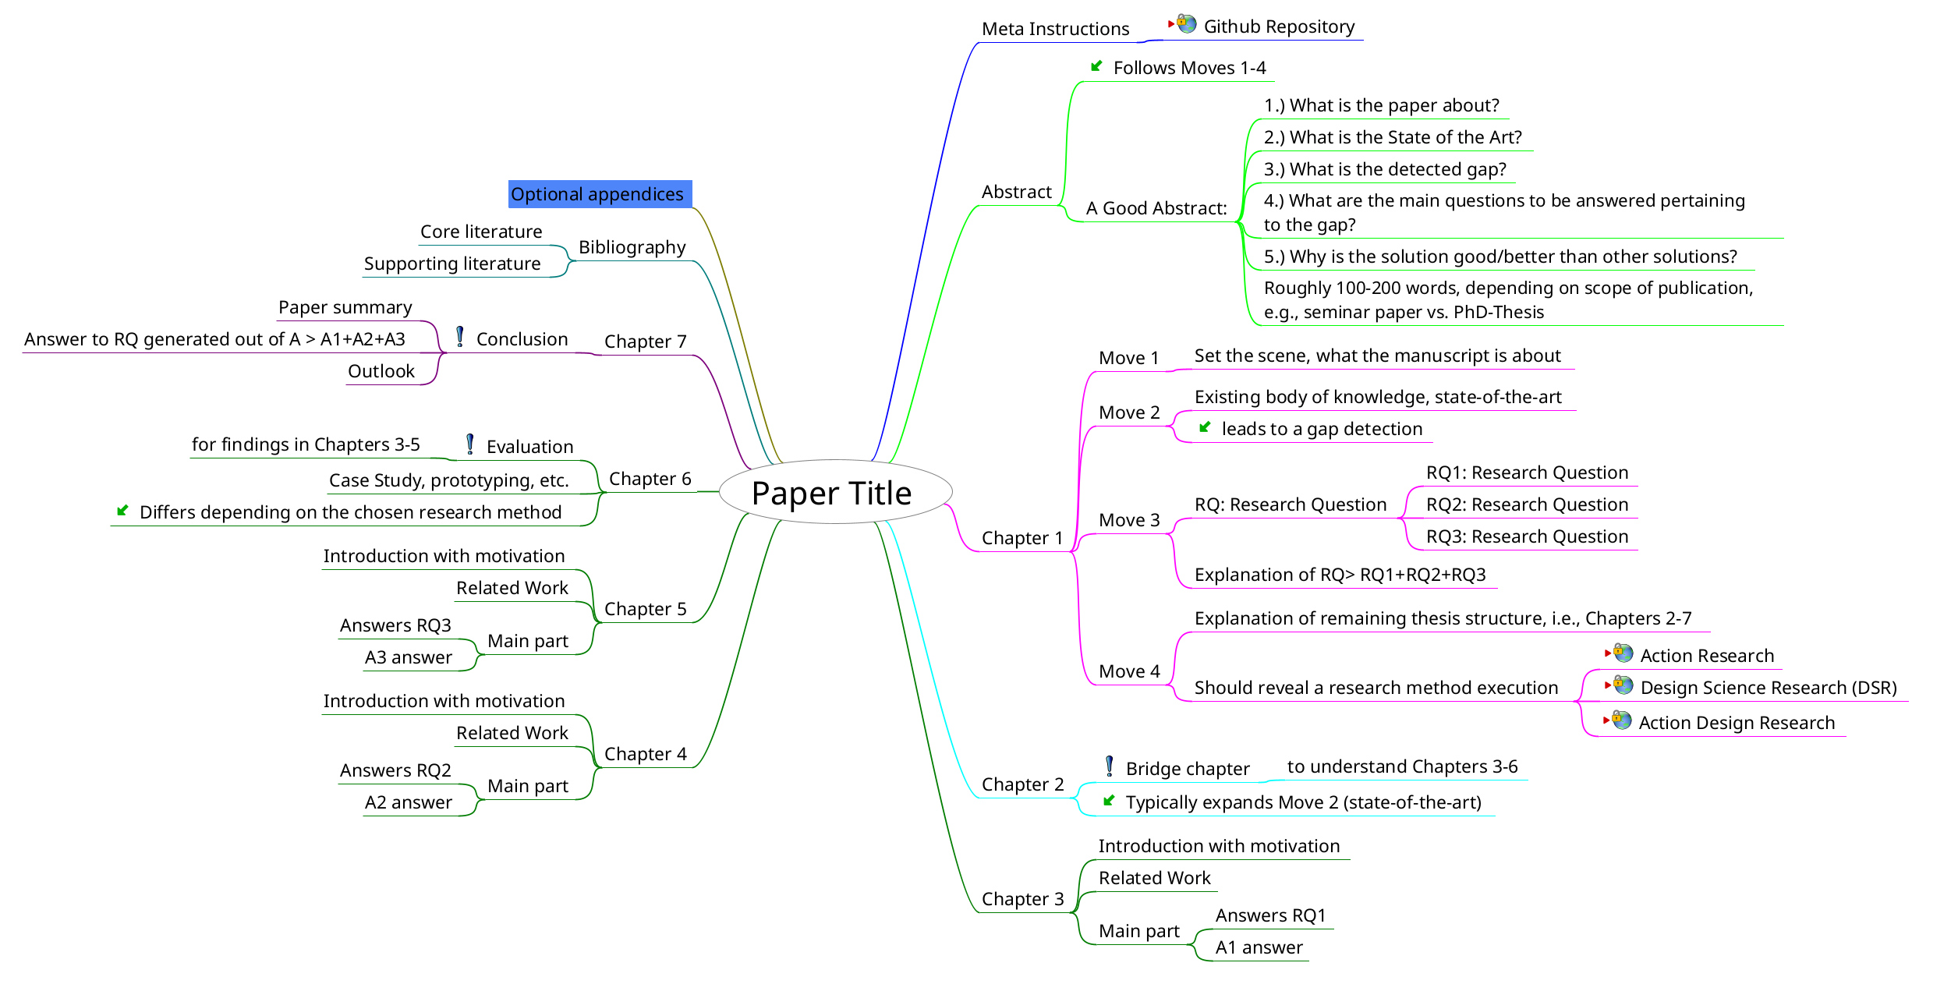
Structure – Paper
Mind Map – Overview

Slide 26
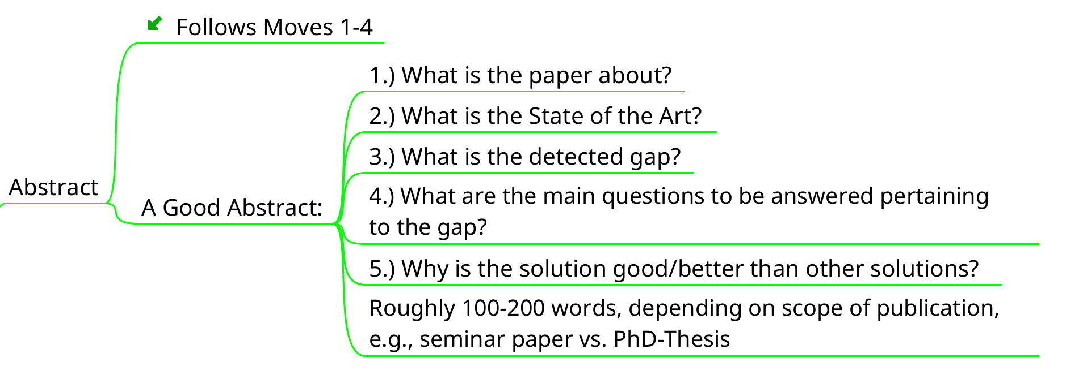
Structure – Paper
Mind Map – Abstract

Slide 27
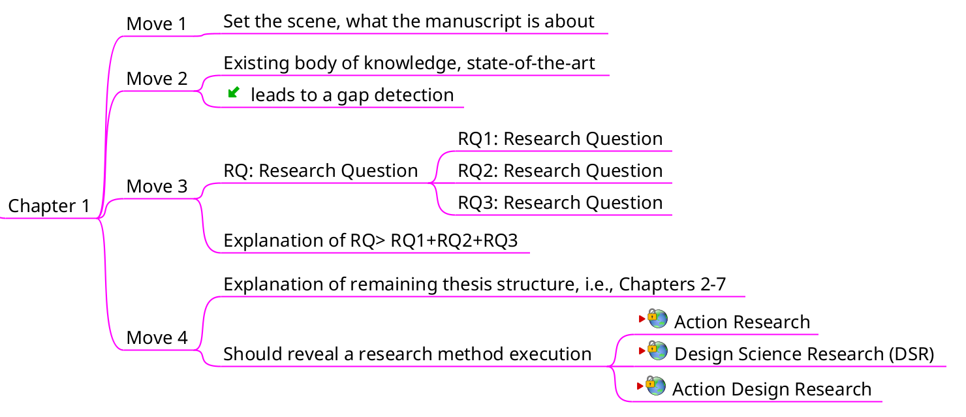
Structure – Paper
Mind Map – Section 1 (Introduction)

Slide 28
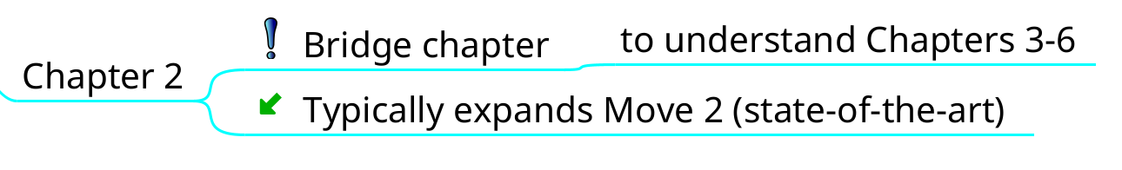
Structure – Paper
Mind Map – Section 2 (Bridge Section)

Slide 29
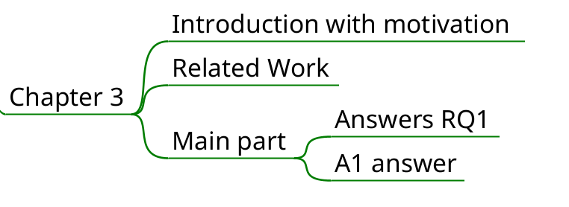
Structure – Paper
Mind Map – Section 3/4/5 (Answers to RQs)

Slide 30
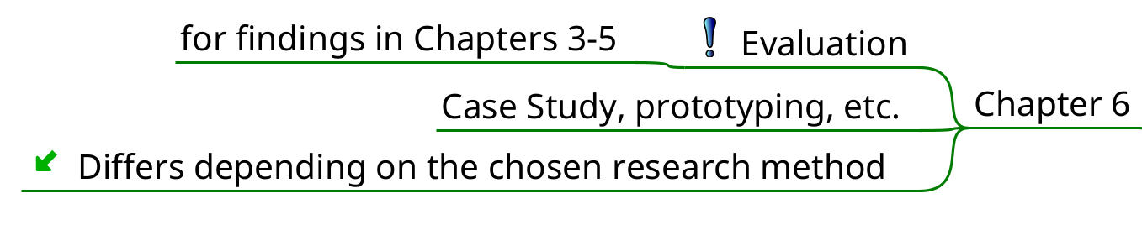
Structure – Paper
Mind Map – Section 6 (Evaluation)

Slide 31
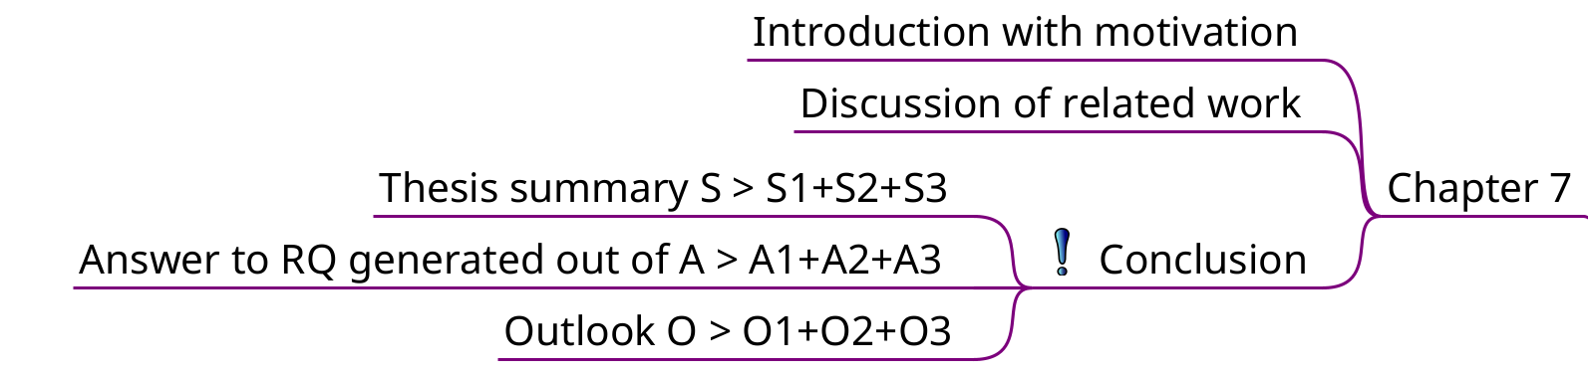
Structure – Paper
Mind Map – Section 7 (Conclusion)

Slide 32
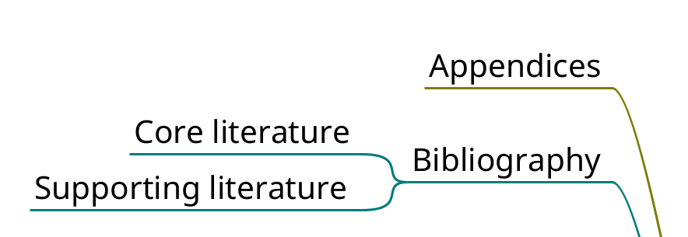
Structure – Paper
Mind Map – References

Slide 33
Structure – Thesis

Slide 34
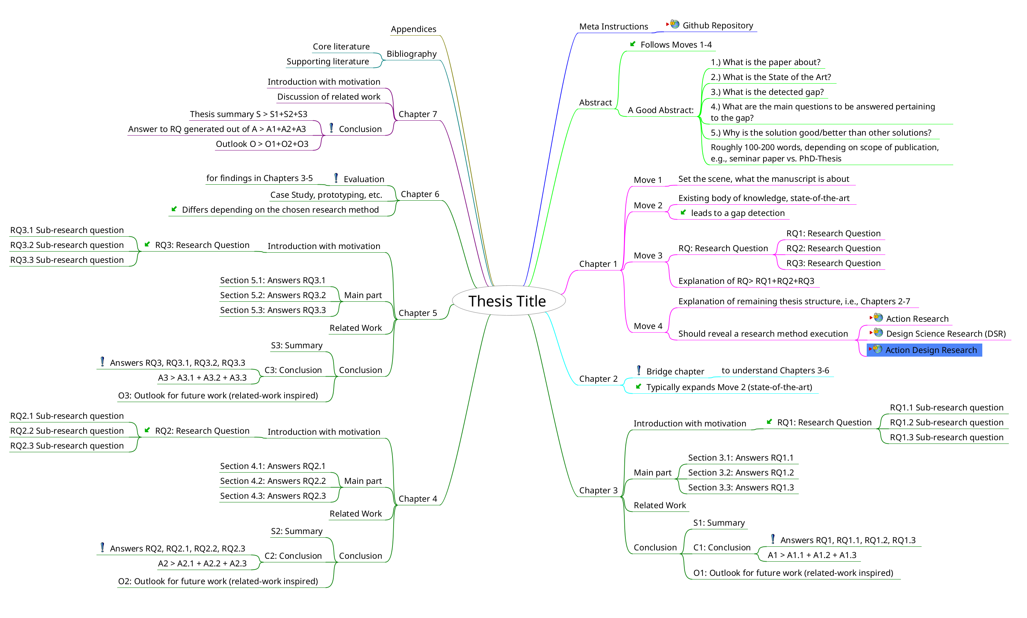
Structure – Thesis
Mind Map – Overview

Slide 35
Structure – Thesis
Mind Map – Abstract

Slide 36
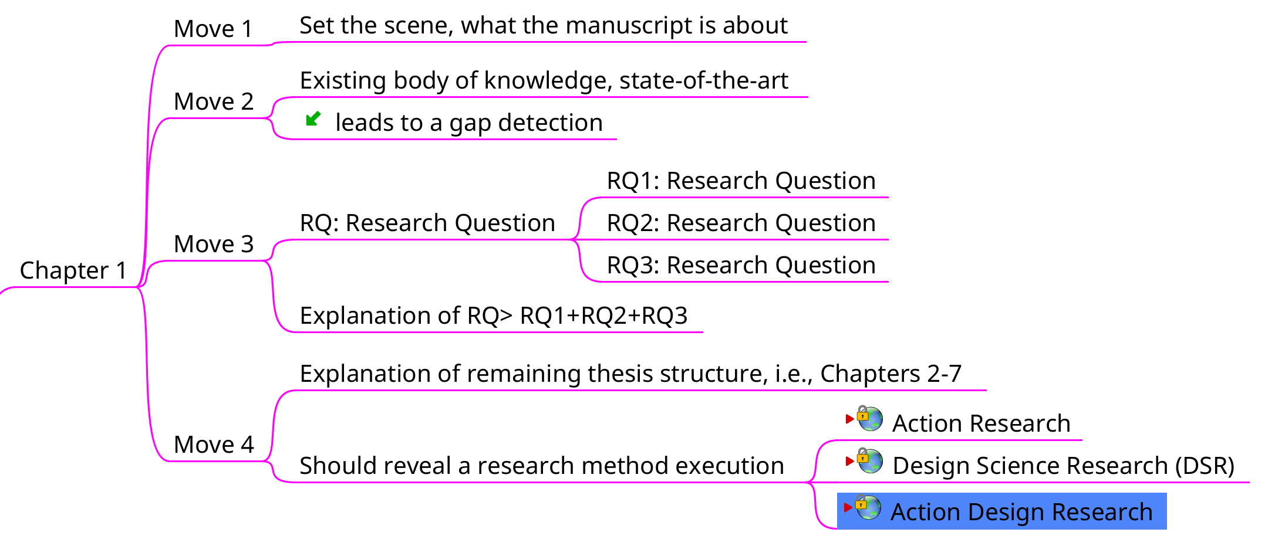
Structure – Thesis
Mind Map – Section 1 (Introduction)

Slide 37
Structure – Thesis
Mind Map – Section 2 (Bridge Section)

Slide 38
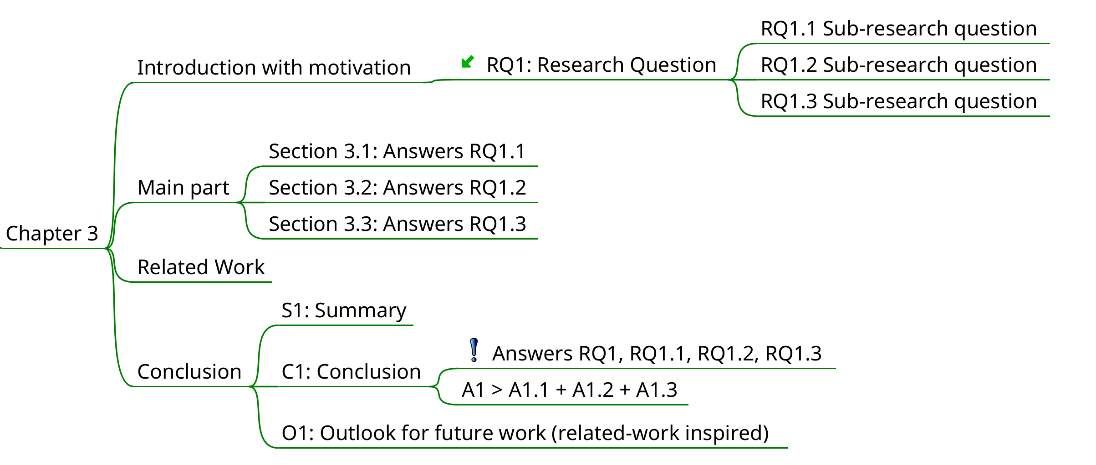
Structure – Thesis
Mind Map – Section 3/4/5 (Answers to RQs)

Slide 39
Structure – Thesis
Mind Map – Section 6 (Evaluation)

Slide 40
Structure – Thesis
Mind Map – Section 7 (Conclusion)

Slide 41
Structure – Thesis
Mind Map – Appendix

Slide 42
Running Case – Seminar Paper

Slide 43
Running Case – Seminar Paper
Overview
How to write a seminar paper?
RQ-1: What is a good way to review and process literature?
RQ-2: What is a good way to structure your paper?
RQ-3: What is a good way to write your paper?
What are the specific steps of writing your thesis/paper?

Slide 44
Running Case – Seminar Paper
Overview
How to write a seminar paper?
RQ-1: What is a good way to review and process literature?
RQ-2: What is a good way to structure your paper?
RQ-3: What is a good way to write your paper?
What are the specific steps of writing your thesis/paper?
Might not be the best and most well defined RQs

Slide 45
Running Case – Seminar Paper
Literature Sources
Google Scholar → Link
Journals/Conferences/Magazines/etc., eg.,
IEEE → Link
ACM → Link
AISeL → Link
Etc.
Libraries
Researcher
Etc.What are the specific steps of writing your thesis/paper?

Slide 46
Running Case – Seminar Paper
Systematic Literature Review
Systematic Literature Review in Computer Science - A Practical Guide → Link
e the specific steps of writing your

Slide 47
Running Case – Seminar Paper
“Good” Literature – Examples
Peer-reviewed paper, journals, poster, etc.
Scientific books
(Bachelor-, Master-, PhD-Thesis)
(Patents)

Slide 48
Running Case – Seminar Paper
“Difficult” Literature – Examples
Whitepaper / Technical Reports
Websites (Blogs, Newspaper, etc.)
Unreviewed scientific materials (e.g., arXiv.org)
Peer-reviewed ≠ good literature (e.g., bogus/predatory conferences)

Slide 49
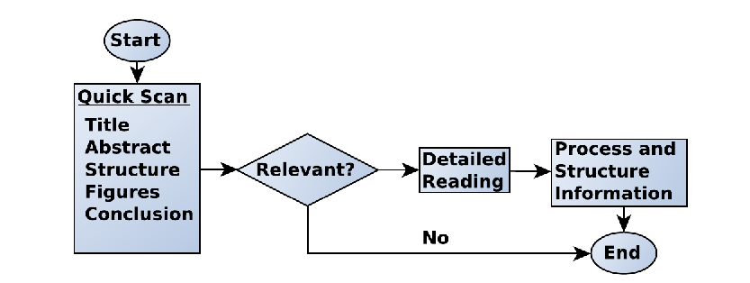
Running Case – Seminar Paper
@Mattes:
RECREATE (TU Clausthal Colors)
How to Read a Paper?
Critical thinking!
Check the references of papers that you read!

Slide 50
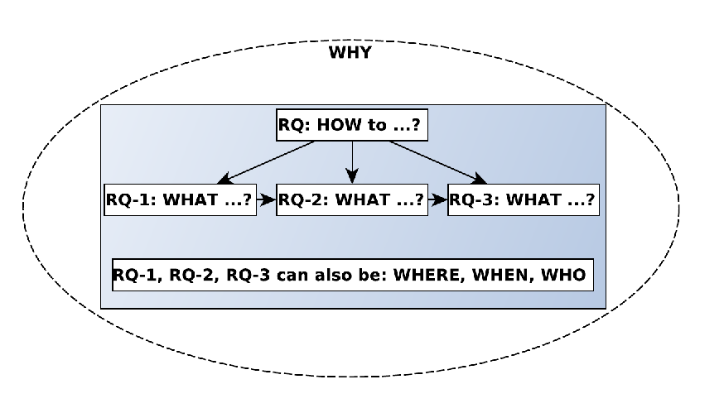
Running Case – Seminar Paper
@Mattes:
RECREATE (TU Clausthal Colors)
Identify Your Gap and Define Your RQs

Slide 51
Running Case – Seminar Paper
Write Your Paper – LaTex vs. Word
LibreOffice / Word:
Widespread
Nice for short paper (1-3 pages)
Awful for long papers and complex structures
Move one figure and you may accidentally summon Satan
LaTex:
Simple scripting language
Professional results, customizable and reusable
Visualize complex mathematical equations
Awesome reference management (Bibtex)
Required by most conferences, journals, etc.
Many templates available (Paper, Bachelor, Master, PhD, Book, etc.)

Slide 52
Running Case – Seminar Paper
Write Your Paper – LaTex vs. Word
LibreOffice / Word:
Widespread
Nice for short paper (1-3 pages)
Awful for long papers and complex structures
Move one figure and you may accidentally summon Satan
LaTex:
Simple scripting language
Professional results, customizable and reusable
Visualize complex mathematical equations
Awesome reference management (Bibtex)
Required by most conferences, journals, etc.
Many templates available (Paper, Bachelor, Master, PhD, Book, etc.)

Slide 53
Running Case – Seminar Paper
Write Your Paper – Tips
Tell a story!
BUT, don’t write about your personal journey from the problem to the solution. Instead, write about the final and “correct” approach that leads to the solution.
Write for your audience? (Beginners vs. Experts)
Are you writing a BA/MA/PhD-Thesis, a seminar paper or a research paper?
Writing is only 25% of the work, the other 75% happen before you even start writing.

Slide 54
Running Case – Seminar Paper
Write Your Paper – Tips
Avoid spelling mistakes.
Many iterations and proof-read several times.
Adhere to the template guidelines.
Avoid long sentences.
Clarify special notations.
Figures are very helpful, but make sure to properly integrate them into you text (reference, comment, analyze).
Use equations if necessary, but be careful (+ same as for figures).
Balance between details and abstract ideas (page limits).
Making a claim? Provide a source or proof it!

Slide 55
Running Case – Seminar Paper
Write Your Paper – A Good Abstract
What is the paper about?
What is the State of the Art?
What is the detected gap?
What are the main questions to be answered pertaining to the gap?
Why is the solution good/better than other solutions?
Roughly 100-200 words, depending on scope of publication, e.g., seminar paper vs. PhD-Thesis

Slide 56
Running Case – Seminar Paper
Write Your Paper – Introduction

Slide 57
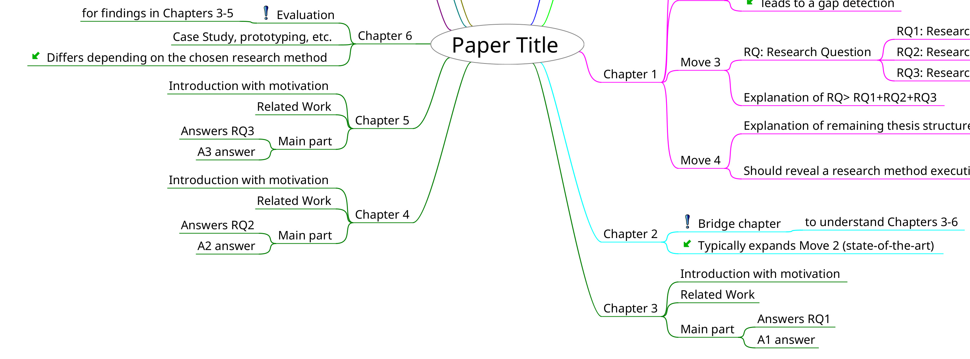
Running Case – Seminar Paper
Write Your Paper – Main Part

Slide 58
Running Case – Seminar Paper
Write Your Paper – A Good Conclusion
General summary
Answer to RQ-1
Answer to RQ-2
Answer to RQ-3
(Evaluation)
Future Work

Slide 59
Running Case – Seminar Paper
Write Your Paper – References
Different sources (book, paper, phd/master thesis, website, journal, etc.)
Direct vs. indirect citations
“Penguins are black and white” vs. The authors [Ref.] argue that penguins are black and white.
Different citation styles (IEEE, APA, MLA, etc.)
It is not your own idea or work? Provide reference to the original source!

Slide 60
Running Case – Seminar Paper
Write Your Paper – References (BibTex – Example)
Example for the publication “Self-managed and blockchain-based vehicular ad-hoc networks ” - Link
@inproceedings{leiding2016self,
title={Self-managed and blockchain-based vehicular ad-hoc networks},
author={Leiding, Benjamin and Memarmoshrefi, Parisa and Hogrefe, Dieter},
booktitle={Proceedings of the 2016 ACM international joint conference on pervasive and ubiquitous computing: adjunct},
pages={137--140},
year={2016}
}

Slide 61
Additional Resources

Slide 62
Additional Resources
Templates
Mind Map Template (Freeplane) – Paper → Link
Mind Map Template (Freeplane) – Thesis → Link
Latex – Paper (Springer) → Link
Latex – Paper (IEEE) → Link
Latex – Thesis → Link

Slide 63
Additional Resources
LaTex Tutorials
A simple guide to LaTeX – Step by Step → Link
A Beginner’s Guide to LaTex → Link
Using BibTex: A Short Guide → Link

Slide 64
Additional Resources
Systematic Literature Review
Systematic Literature Review in Computer Science - A Practical Guide → Link
e the specific steps of writing your

Slide 65
Additional Resources
Research Methods
Design Science Research → Link
Action Research → Link
Action Design Research → Link

Slide 66
Questions?

