Slide 1
Requirement Engineering
Lecture 3: Requirements Elicitation
Part 1
Prof. Dr. Benjamin Leiding
M.Sc. Anant Sujatanagarjuna

Slide 2
Lecture Schedule Update
26.10.2022 → No lecture
02.11.2022 → Organization (L00) + Introduction (L01)
09.11.2022 → System Context Boundaries and Types of Requirements (L02)
16.11.2022 → Elicitation – Part 1 (L03)
23.11.2022 → Elicitation – Part 2 (L04) and Negotiations (L05)
30.11.2022 → Documentation – Introduction (L06)
07.12.2022 → Documentation – Textual Requirements Specification (L07)
14.12.2022 → Documentation – Model-based Requirements Documentation (L08)
21.12.2022 → No Lecture
11.01.2023 → Documentation – Formal Requirements Specification (L09)
18.01.2023 → Validation (L10)
25.01.2023 → Traceability (L11)
01.02.2023 → Requirements Management (L12) and Tool Support (L13)
08.02.2023 → Exam Q&A

Slide 3
Exercise Schedule Update
09.11.2022 → Exercise 01 – Knowledge Test (MC)
23.11.2022 → Exercise 02 – Elicitation I
30.11.2022 → Exercise 03 – Elicitation II
14.12.2022 → Exercise 04 – Agent-oriented Modelling
21.12.2022 → No Exercise
11.01.2023 → Exercise 05 – Coloured Petri Nets I
18.01.2023 → Exercise 06 – Coloured Petri Nets II
25.01.2023 → Bonus Task
01.02.2023 → Exercise 07 – Management and Traceability (MC)

Slide 4
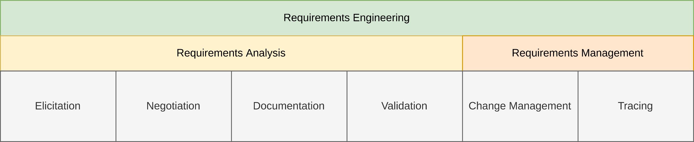
General Requirements Engineering Process
Overview

Slide 5
Lecture 3: Requirements Elicitation
Content
Getting the Right Information is Tricky
Requirement Sources
Elicitation Techniques
HSN:/RE as part of Software Engineering

Slide 6
Getting the Right Information is Tricky

Slide 7
Getting the Right Information is Tricky
Requirements Engineering = Communication
In Software Engineering (SE) we can assume that there exists prior documentation → But not in Requirements Engineering

Slide 8
Getting the Right Information is Tricky
Requirements Engineering = Communication
In Software Engineering (SE) we can assume that there exists prior documentation → But not in Requirements Engineering
In the beginning requirements are
unknown
unconscious
Misunderstood
Furthermore there are different opinions about the requirements (in general at least one per stakeholder)

Slide 9
Getting the Right Information is Tricky
Requirements Engineering = Communication
In Software Engineering (SE) we can assume that there exists prior documentation → But not in Requirements Engineering
In the beginning requirements are
unknown
unconscious
Misunderstood
Furthermore there are different opinions about the requirements (in general at least one per stakeholder)
→ Acquisition of information as part of the requirements engineering activity is called Elicitation

Slide 10

Getting the Right Information is Tricky
Objectives of the Elicitation Phase
Why do we need to elicit information?
Knowledge acquisition (Elicitation, Acquisition)
About involved persons and objectives
Current state
Expectations
Domain

Slide 11
Getting the Right Information is Tricky
Communication Problems
Communication happens via speech
Representation of experiences → perceptions)
Communication of personal reality → presentation) Conflicts
Customer / User
Requirements Engineer
Perception
Presentation
Interpretation
Objective reality
Personal reality
Linguistic expression
Result
interference
interference
interference

Slide 12
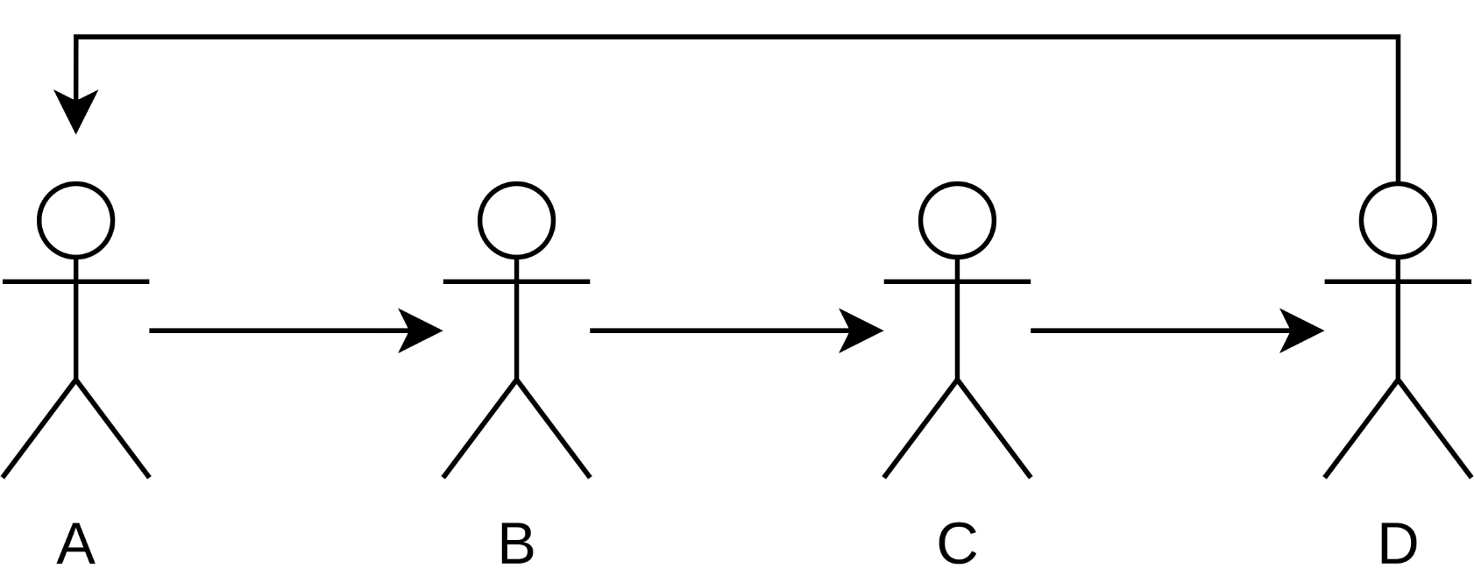
Getting the Right Information is Tricky
Communication Problems – Telephone Game
Youtube → Link

Slide 13
Getting the Right Information is Tricky
Communication Problems
Consideration of all stakeholders
Communication
Stakeholders can not describe abstractly what they are doing, why they are doing it, nor what they need to be able to do things.
Requests are much too general
Presentation of new possibilities and their consequences
Stakeholder like to keep their existing approaches
It is difficult to invent new approaches

Slide 14
Getting the Right Information is Tricky
Communication Problems
Conflicts
Cause of power struggles
Cause of opposition against changes
Priorities
Stakeholders want too much
Changes
Stakeholders always add new ideas

Slide 15
Requirement sources

Slide 16
Requirement Sources
Sources
Three kinds of requirement sources:
Stakeholders
People or organizations that influence the requirements of a system → users, operators, architects, testers, ...
Documents
Contain important information that can provide requirements → e.g., standards, legal documents, requirements documents, error reports of legacy systems, ...
Systems in operation
Legacy/predecessor systems or computer systems
Notes:
54

Slide 17
Requirement Sources
Type of Knowledge to Gain
Previous functions
e.g. secretary organized meetings
Problems
e.g. status of the organization is not recognizable for everyone, takes too long
Objectives for new functions / systems
e.g. transparent organization, faster
Factors of success
e.g. organizing a typical meeting within one day
Basic system architecture (how much components, partitioning)
e.g. install software for every employee
Notes:
54
54

Slide 18
Requirement Sources
Type of Knowledge to Gain
Realistic Solutions
e.g. System is gathering data, people are solving problems
Consequences and risks
e.g. too little freedom of decision for participants
Notes:
54
54

Slide 19
Requirement Sources
Typical Stakeholders
Customer
Actual and potential customers
Project leader
Business manager
User
Old and new users
Notes:
54
54

Slide 20
Requirement Sources
Typical Stakeholders
Developer
Product marketing
Project leader
Technical leader
Architect / Designer
Developer
Tester
Legal Department
Maybe in different locations, maybe in competing divisions
Notes:
54
54

Slide 21
Requirement Sources
Significance of Stakeholders
Stakeholders are the main source of requirements
Missing stakeholders → Missing requirements
Leads to change requests
Retroactive changes are expensive
Not all stakeholders are equally important
The stakeholders also require prioritization → Never tell them!
Maintain checklists of all stakeholders
Notes:
54

Slide 22
Requirement Sources
Maintenance of Stakeholder Data
Use tables and spreadsheets to handle stakeholder data
For each stakeholder, maintain at least:
The name
The function
Additional personal and contact data
Temporal and spatial availability during the project progress
Relevance of the stakeholder
Area and extent of expertise of the stakeholder
Goals in interests regarding the project
Notes:
54

Slide 23
Requirement Sources
Handling Stakeholders Throughout the Project
Continuous exchange of information
Periodic status updates
Continuous involvement turns stakeholders from affected by the project into collaborators
Principally affected stakeholders vs. well-integrated, jointly responsible stakeholders
Lack of attention may lead to overcritical stakeholders
However, stakeholders might not be motivated from the beginning → e.g., they like the existing legacy system
Requirements engineer supports project management with convincing stakeholders of the benefit of a project
Notes:
54

Slide 24
Requirement Sources
Agreement with Stakeholders
Formal agreements with stakeholders are often useful
Avoid misunderstandings and disputes regarding competence
Such agreements should include
Tasks
Responsibilities
Managerial authority
Individual goals
Communication paths
Feedback loops
Notes:
54

Slide 25
Requirement Sources
Agreement with Stakeholders
Can be informal (“shaking hands”) or formal with written documents
Should be signed of by the management
Notes:
54

Slide 26
Requirement Sources
Tasks of the Requirements Engineer
Speaks language of the stakeholders
Becomes thoroughly familiar with the application domain
Creates a requirements document
Is able to get work results across
Maintains a respectful relationship with any stakeholder
Presents ideas and alternatives as well as realizations
Allows stakeholders to demand properties that make the system user-friendly and simple.
Ensures that the system satisfies the functional and qualitative demands of the stakeholders
Notes:
54

Slide 27
Requirement Sources
Tasks of the Stakeholder
Introduce the requirements engineer into the application domain
Supply the requirements engineer with requirements
Documents requirements assiduously
Make timely decisions
Respect the requirements engineer’s estimates of costs and feasibility
Prioritize requirements
Notes:
54

Slide 28
Requirement Sources
Tasks of the Stakeholder
Inspect requirements that the requirements engineer documents, such as prototypes, etc.
Communicate changes in the requirements immediately
Adhere to the predetermined change process
Respect the requirements engineering process that has been instated
Notes:
54

Slide 29
Elicitation Techniques

Slide 30
Elicitation Techniques
Overview
Support the identification of the conscious, unconscious, and subconscious requirements
No universal method!
Elicitation techniques must match the project
Factors for choosing a technique are
The distinction between conscious, unconscious and subconscious requirements
Time and budget constraints
Availability of stakeholders
Experience with a particular technique
Chances and risks of the project
Combination of different techniques minimizes risks
Notes:
54

Slide 31
Elicitation Techniques
Overview
Survey Techniques | Creativity Techniques | Document-centric Techniques | Observation Techniques | Support Techniques
Interviews | Brainstorming | System Archaeology | Field Observation | Mind Mapping
Questionnaires | Brainstorming Paradox | Perspective-based Reading | Apprenticing | Workshops
 | Change of Perspective | Reuse |  | CRC Cards
 | Analogy Technique |  |  | Audio and Video Recording
 |  |  |  | Use Case Modeling
 |  |  |  | Prototypes
Notes:
54

Slide 32
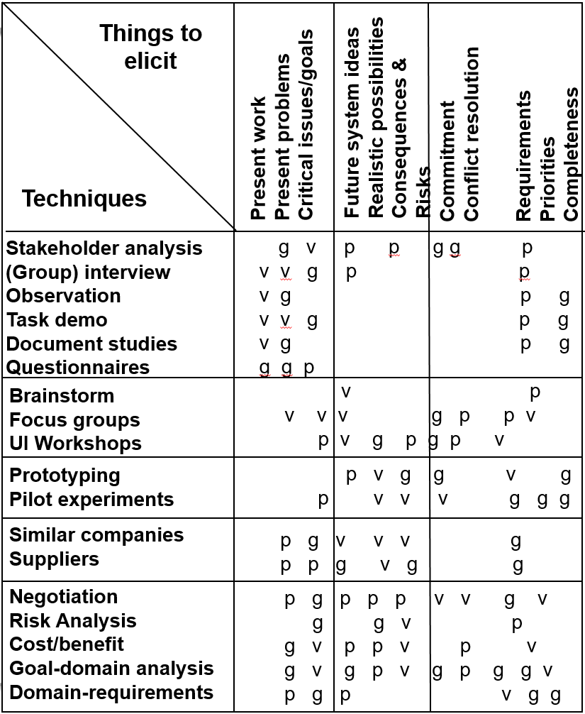
Elicitation Techniques
Aquisition Techniques
p = possible g = good
v = very good
Based on S. Lauesen (2002) – Software Requirements – Styles and Techniques
Notes:
54
54

Slide 33
Elicitation Techniques
The most common / important techniques
Interview
More time consuming
Requires explicit integration of standpoints
Allows better adaptation on background of the interviewed person and interests of the interviewee
Observations
Most complicated technique
Least impact of presumptions
A.M. Hickey, A.M. Davis (2003) – Elicitation Technique Selection: How do Experts do it?
Notes:
54

Slide 34
Elicitation Techniques
The most common / important techniques
Workshop
Frequently used technique
Relative little expenditure of time
Fundamental for team creation
Creates new ideas (→ Vision workshop)
Problems with social structures, focus on hot spots
Other techniques may be used in addition
A.M. Hickey, A.M. Davis (2003) – Elicitation Technique Selection: How do Experts do it?
Notes:
54

Slide 35
Elicitation Techniques
Survey Techniques
The requirements engineer asks questions, the stakeholders answer
Driven by the requirements engineer
Possible that stakeholder concerns are missed
Used for eliciting explicit knowledge
Conscious requirements
Assumptions:
All respondents are capable of explicitly expressing their knowledge
All respondents are committed to invest time and effort
Notes:
54

Slide 36
Elicitation Techniques
Survey Techniques – Interviews
Can be employed during the entire development
Requirements engineer prepares questions beforehand
Might be the same for multiple stakeholders
Questions that arise during the interview can be discussed immediately
Clever questions may uncover subconscious requirements
Experienced interviewers
control the course of the conversation
commit themselves to each stakeholder
inquire about specific aspects
Drawback of interviews: very time-consuming
Notes:
54

Slide 37
Elicitation Techniques
Survey Techniques – Interviews
Preparation
Analysis of documents (e.g. scenarios, previous work documents)
Prepare questions (with at least one domain expert)
Performance
Two interviewers if possible (Analyst; Transcript writer)
Single or multiple person interviews
Maybe recording on tape
Analysis
Analysis / Summary of answers
Feedback to participants

Slide 38
Elicitation Techniques
Survey Techniques – Prepare an Interview
Purpose → Define the purpose of the interview explicitly
Participants (interviewees)
Invite participants, taking the object of the interview into account
Communicate with participants (invitation, purpose and background)
Location → Select a suitable location for the interview
Questions
Prepare open and closed questions, where possible with a specific context (with at least one domain expert)
Avoid leading questions
Interviewer → Make yourself familiar with the participants and their terminology
Notes:
54
54
Nach Pohl S.332f

Slide 39
Elicitation Techniques
Survey Techniques – Conduct an Interview
Introduction
What is the interview good for?
What will happen with the answers?
The questionnaire
Start general, progress to more specific issues
Mixture of open and closed questions
Active listening! (esp. paraphrasing)
Ensure non-verbal communication
Prevent typical mistakes:
Deviation from topic
Answers too general
Uneasy atmosphere (noise, interruptions, etc.)
Notes:
54
54
Nach Pohl S.332f

Slide 40
Elicitation Techniques
Survey Techniques – Conduct an Interview
Finish
Comment on the first impression
Outline further activities
Thank the interviewed person
Interviewed person has the final say
Notes:
54
54
Nach Pohl S.332f

Slide 41
Elicitation Techniques
Survey Techniques – Post-processing the Interview
Write a protocol of the interview
Document explicitly gained requirements
Revise your models and scenarios used for the interview
Make a to-do-List of the remaining questions
Further communication with the interviewed persons
Give them your results, so they can check and confirm them
Identify conflicts between the requirements
Try to resolve identified conflicts
Notes:
54
54
Nach Pohl S.332f

Slide 42
Elicitation Techniques
Survey Techniques – Questionnaires
Only viable option for a large number of participants
Cheap and time efficient in comparison to interviews
May use online questionnaire
Can use different kinds of questions
Open questions → What do you think is the most important feature of the new system?
Closed questions → Do you think the new system requires a GUI?
Closed questions better suited for less experienced stakeholders
Notes:
54

Slide 43
Elicitation Techniques
Survey Techniques – Questionnaires
Drawbacks
Only for eliciting requirements known or conjectured → Not able to pose additional question due to feedback
No immediate feedback → Forgotten or badly phrased questions possible
Notes:
54

Slide 44
Elicitation Techniques
Overview
Survey Techniques | Creativity Techniques | Document-centric Techniques | Observation Techniques | Support Techniques
Interviews | Brainstorming | System Archaeology | Field Observation | Mind Mapping
Questionnaires | Brainstorming Paradox | Perspective-based Reading | Apprenticing | Workshops
 | Change of Perspective | Reuse |  | CRC Cards
 | Analogy Technique |  |  | Audio and Video Recording
 |  |  |  | Use Case Modeling
 |  |  |  | Prototypes
Notes:
54

Slide 45
Elicitation Techniques
Creativity Techniques
Well-suited for:
Outlining an initial vision of a system
Developing innovative requirements
Eliciting excitement factors
Not well-suited for getting fine-grained requirements
Techniques yield general ideas about possible requirements, not specifics
Especially unsuited for complex charting of system behavior
Notes:
54

Slide 46
Elicitation Techniques
Creativity Techniques – Brainstorming
Fixed timeframe
Usually in groups of 5 to 10 people
Moderator documents ideas without discussing, judging, or commenting on them
Participants expand and modify ideas to add new ones
Once the ideas are collected, they are discussed
Each idea is subjected to thorough analysis
Especially effective if different stakeholders are involved
Notes:
54

Slide 47
Elicitation Techniques
Creativity Techniques – Brainstorming
Large number of ideas can be collected in a short amount of time
People can expand on ideas collaboratively
Unbiased collection allows new ideas and solutions to pop up
Effectiveness depends on the group dynamics
Varied levels of dominance effectively reduce number of participants
Other techniques better suited → 6-3-5 method: six participants, three ideas each, fivefold hand-off
Notes:
54

Slide 48
Elicitation Techniques
Creativity Techniques – Brainstorming Paradox
Variant of brainstorming
Collects events that must not occur, instead of ideas
Develops measures to prevent the events
Well-suited for the early identification of risks and countermeasures
Same advantages and drawbacks as brainstorming
Notes:
54

Slide 49
Elicitation Techniques
Creativity Techniques – Change of Perspective
Involved people change their perspective
Most popular: Six Thinking Hats → Approach a problem from six different perspectives
Information: what is available
Emotions: intuitive reactions
Discernment: logical analysis of reasons to be cautious
Notes:
54

Slide 50
Elicitation Techniques
Creativity Techniques – Change of Perspective
Optimistic response: logically identifying benefits
Creativity: provocation and investigation
Ordered: overview over processes, “big picture”
→ Solutions approach the problems from different standpoints
Stakeholders convinced of their opinion are persuaded to adopt a different point of view
Notes:
54

Slide 51
Elicitation Techniques
Creativity Techniques – Analogy Technique
Provide an analogy for the system or a partial problem
Discuss the analogy instead of the system
Draw conclusions for the real system based on the analogy
Assumes that each participant is capable of analogous thinking
Can be applied in the open or covertly
Covert application
Only the requirements engineer knows the relationship to the real system
Participants only know the analogy
Requirements engineer responsible to map everything back to the real world
Open application → Everybody knows the relationship to the real system
Notes:
<number>

Slide 52
Summary

Slide 53
Summary
Planning Requirement Elicitation
Prepare about domain
Identify Information Goals
Not shown:
Application of analysis techniques
Often overlapping and parallel activities
still deficits
Determine appr.techniques / identify stakeholders
Conduct technique
Sufficient knowledge
Notes:
<number>
Nicht sicher, ob ich die Schrift in der Skizze richtig deuten konnte.

Slide 54
Summary
Elicitation is a core activity of requirements engineering
Without good elicitation, requirements will be wrong or missing
Stakeholders, documents and existing systems as requirements sources
Missing a source leads to missing the requirements of the source
Many techniques for requirements elicitation
Not every technique is good in every scenario
Select the techniques depending on the project
Usually, a combination of multiple techniques yields the best results
Notes:
<number>

Slide 55
Questions?

