Slide 1
Requirement Engineering
Lecture 6: Requirements Documentation
Introduction
Prof. Dr. Benjamin Leiding
M.Sc. Anant Sujatanagarjuna

Slide 2
News
Bonus Task Update
Will be published on: 21.12.2022 - 4:00 PM
Submission Deadline: 25.01.2023 – 1:59 PM
Submission Location: Moodle

Slide 3
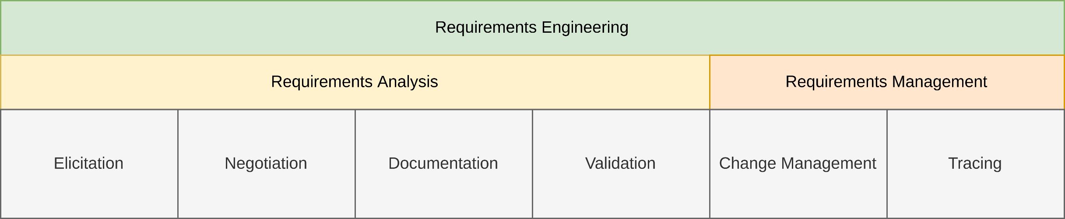
General Requirements Engineering Process
Overview

Slide 4
Lecture 6: Requirements Documentation
Content
Documentation in General
Criteria for Good Requirements
Document Structure
Document Templates

Slide 5
Documentation in general

Slide 6
Documentation in General
Software Projects
Require cooperation of large numbers of people
May extend over a significant period of time
Are typically based on contracts
May require maintenance over many years
Complete change of personnel might be required
→ Documentation is a means to deal with these issues.

Slide 7
Documentation in General
Software Projects
Require cooperation of large numbers of people
May extend over a significant period of time
Are typically based on contracts
May require maintenance over many years
Complete change of personnel might be required
→ Documentation is a means to deal with these issues.
Agile methods try to avoid documentation.
This leads to short term gains, but incurs long term costs

Slide 8
Documentation in General
Why?
Requirements are the basis of system development
Influence analysis, design, implementation, and test phases
Requirements document has strong impact on the project
Specifications have legal relevance
Often the foundation for contracts
Ambiguities may lead to legal conflicts
Requirements are possibly extremely complex
Thousands of requirements
Complex interdependencies
Requirements must be accessible
Without documentation access for all involved persons not possible

Slide 9
Documentation in General
Communication
Documentation serves communication purposes:
Communication within the team
Communication over time (e.g., change of personnel)
Communication between development team and customer (contracts)
Depending on:
The importance of these dimensions
The involved stakeholder groups (e.g., capability to deal with notations)
Project characteristics (e.g., reliabiliy, maintenance period)
The amount, form and contents of the requirements documentation needs to be adapted

Slide 10
Documentation in General
Documentation vs Specification
Documentation
→ Refers to any form of information written down relating to a software or system artifact.
Requirements documentation
→ Any form of explicit documentation of a requirement
Requirement
→ Any (documented) information relating to a system that shall be developed
Note:
This is sometimes used in contrast to specification, then requirements only refers to informal (i.e. abstract) requirements

Slide 11
Documentation in General
Documentation vs Specification
Specification
→ Requirements documentation that is in accordance with a certain specification approach. (not necessarily formal)
Note:
This is sometimes also used to imply that the requirements are specified on the level of developer requirements (we will not use it this way).
Specification
Requirements
Documentation

Slide 12
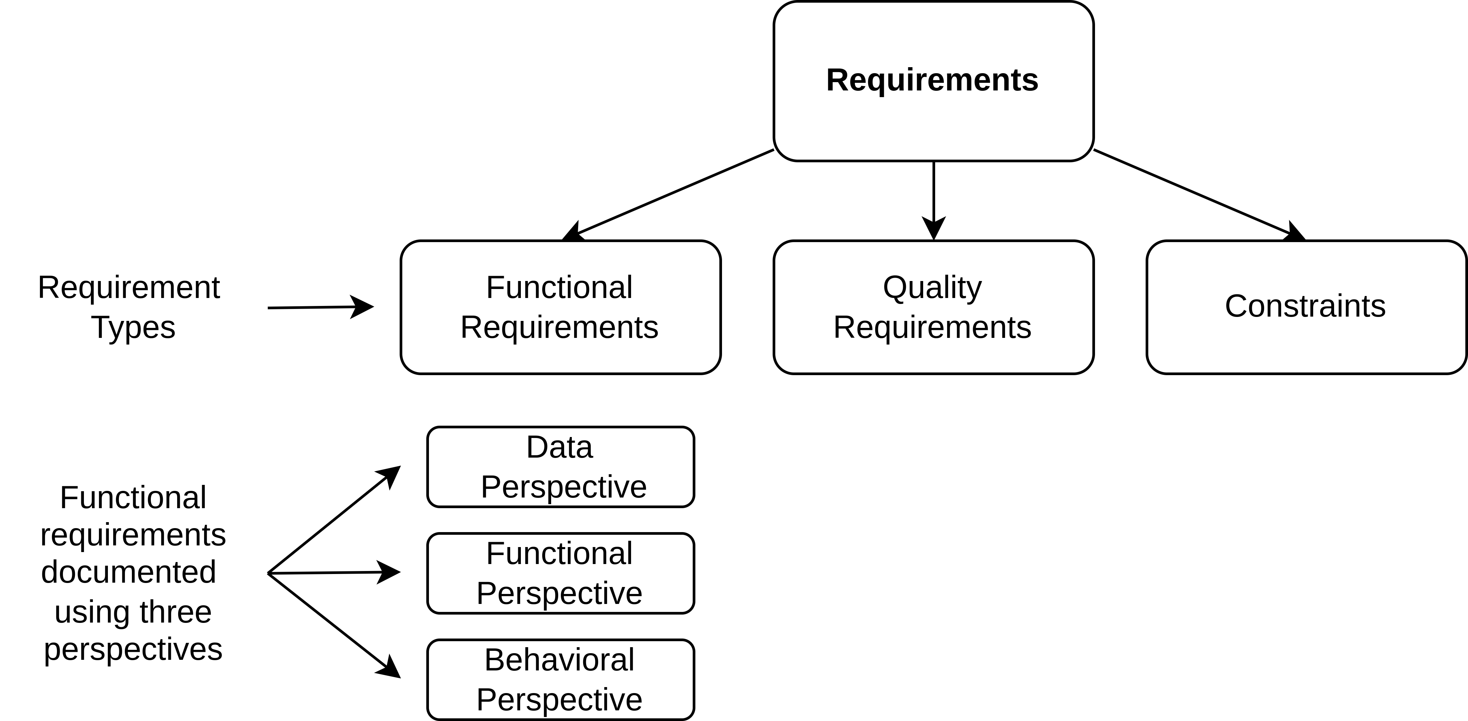
Documentation in General
Perspectives on Functional Requirements

Slide 13
Documentation in General
Perspectives on Functional Requirements
Three different perspectives
Data
Functional
Behavioral

Slide 14
Documentation in General
Perspectives on Functional Requirements
Data perspective
Static-structural perspective
Structure of input/output data
Static structure of the system itself
Usage relationships
Dependencies

Slide 15
Documentation in General
Perspectives on Functional Requirements
Functional perspective
Which information is received by the system and how is it manipulated?
Data-flow through the system
Dynamic!
Behavioral perspective
State-oriented perspective on how the system is embedded into the system context
Documents reactions by the system on events in the system context
Reaction depends on the system’s state
Reactions include state transitions and effects on the system’s environment

Slide 16
Documentation in General
Types of Documentation
Three different ways to document requirements
Natural language
Conceptual Models
Hybrid approach
No “one best way”
Depends on the project
Requirements
People involved

Slide 17
Documentation in General
Types of Documentation – Natural Language
Most commonly applied documentation form
Usually: prose
Advantages
Can be read by every stakeholder
Applicable for miscellaneous purposes
Can be used for any kind of requirement
Well-suited for all three perspectives
Drawbacks
Ambiguities possible
Unintentional mix of different kinds of requirements possible
Unintentional mix of different perspectives possible

Slide 18
Documentation in General
Types of Documentation – Conceptual Models
Different kinds of conceptual models
Cannot be used universally
Have to fit the type of the requirements and the perspective
Advantages
Correct use → no switch of perspective
Compact documentation
Easy for trained readers
Less ambiguity than natural language
Drawbacks
Knowledge about modeling required

Slide 19
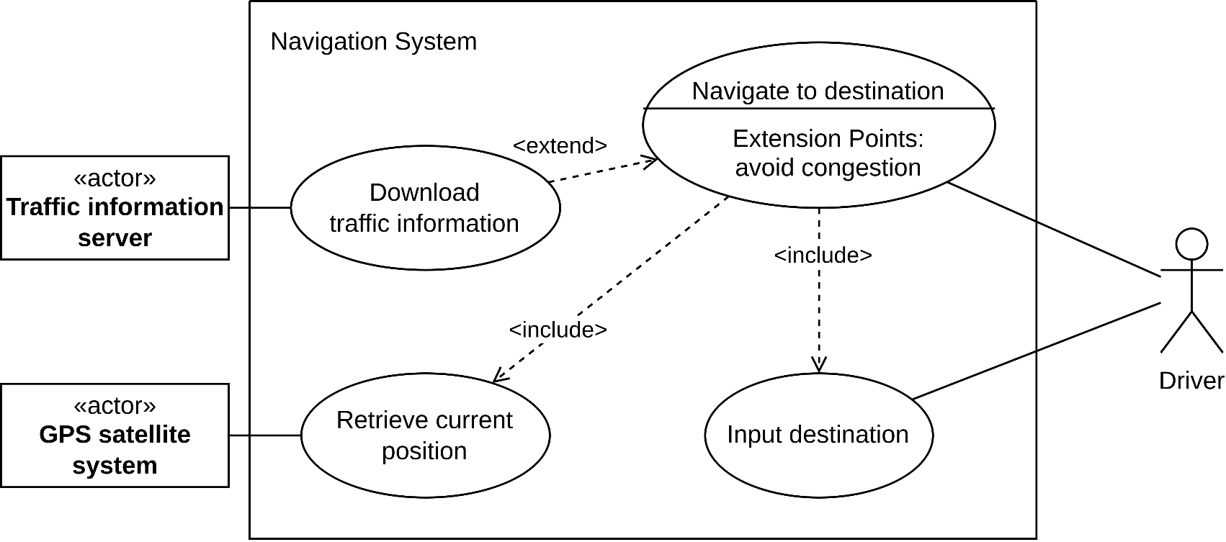
Documentation in General
Types of Documentation – Conceptual Model Types
Use case diagrams
Quick overview of system functionalities
Do not describe responsibilities in detail
Based on K. Pohl, C. Rupp (2011) – Requirements Engineering Fundamentals: A study guide for Requirements Engineering Foundation Level

Slide 20
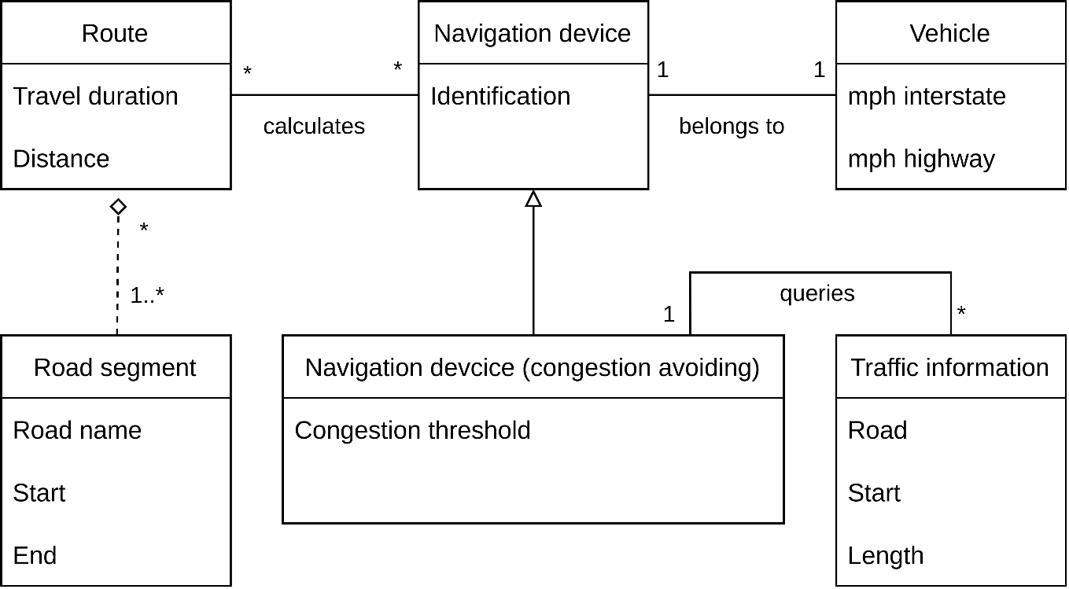
Documentation in General
Types of Documentation – Conceptual Model Types
Class diagrams
Capture static structure of data
Structural dependencies between the system and the context
Based on K. Pohl, C. Rupp (2011) – Requirements Engineering Fundamentals: A study guide for Requirements Engineering Foundation Level

Slide 21
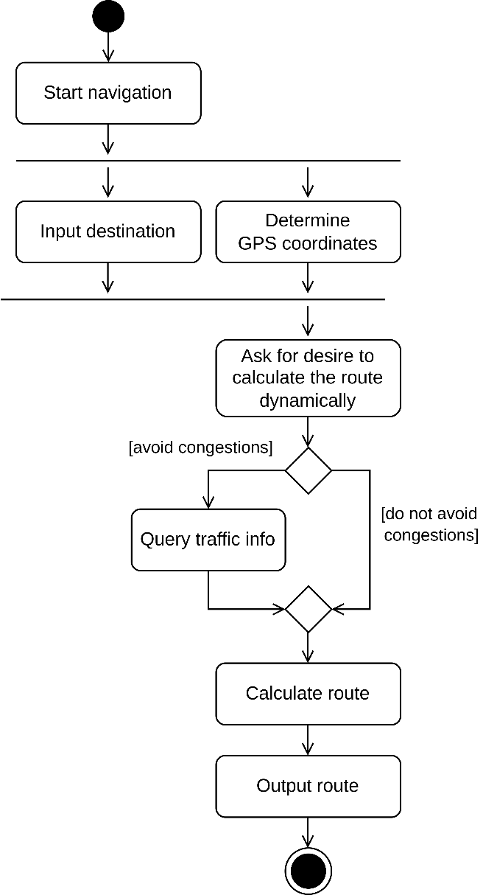
Documentation in General
Types of Documentation – Conceptual Model Types
Activity diagrams
Business processes, sequence-oriented dependencies
Sequential character of use cases
Based on K. Pohl, C. Rupp (2011) – Requirements Engineering Fundamentals: A study guide for Requirements Engineering Foundation Level

Slide 22
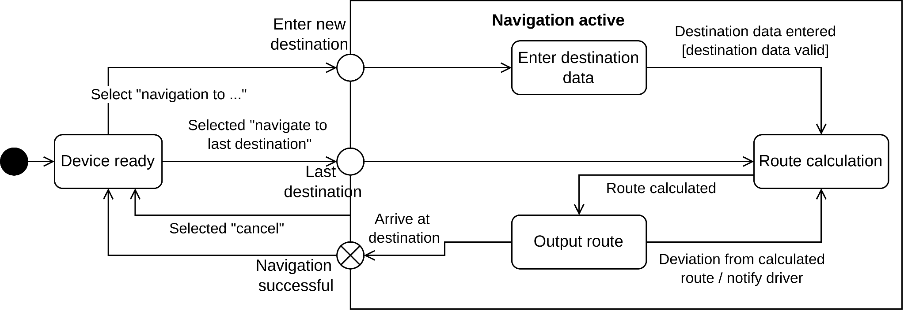
Documentation in General
Types of Documentation – Conceptual Model Types
State diagram
Event-driven behavior of a system
Based on K. Pohl, C. Rupp (2011) – Requirements Engineering Fundamentals: A study guide for Requirements Engineering Foundation Level

Slide 23
Documentation in General
Types of Documentation – Conceptual Models
No single type of documentation has to be selected
Depends on the view, audience, ...
Hybrid = natural language + conceptual models
Not redundant, but complementary
Balance out each others weaknesses
Example
Description of the general architecture in natural language
Details in form of models

Slide 24
Criteria For Good Requirements

Slide 25
Criteria for Good Requirements
Characteristics of Good Requirements
Agreed
Requirement reflects the correct and agreed upon opinion of all stakeholders
Ranked (IEEE Std. 830-1998)
E.g., by legal obligations or priorities
Especially important if not all functionalities are provided at with the same release
Unambiguous (IEEE Std. 830-1998)
Can be understood in only one way
Conceptual models help to achieve this
Valid and up-to-date
Must be consistent with the system context and not outdated
IEEE 830-1998 (1998) – IEEE Recommended Practice for Software Requirements Specifications (https://standards.ieee.org/ieee/830/1222/)

Slide 26
Criteria for Good Requirements
Characteristics of Good Requirements
Correct (IEEE Std. 830-1998)
The requirement represents the idea of the stakeholder
Consistent (IEEE Std. 830-1998)
Requirements must not contradict each other
Requirements must be on the same level of abstraction/detail
Requirements should use the same documentation type
IEEE 830-1998 (1998) – IEEE Recommended Practice for Software Requirements Specifications (https://standards.ieee.org/ieee/830/1222/)

Slide 27
Criteria for Good Requirements
Characteristics of Good Requirements
Verifiable (IEEE Std. 830-1998)
Definition of a requirement must allow for its verification → e.g., through tests or measurements
Realizable
Requirements must be implementable within the scope of the project
Traceable (IEEE Std. 830-1998)
Retracing of
the origin
the realization
Relationships to other documents → e.g., through unique identifiers
IEEE 830-1998 (1998) – IEEE Recommended Practice for Software Requirements Specifications (https://standards.ieee.org/ieee/830/1222/)

Slide 28
Criteria for Good Requirements
Characteristics of Good Requirements
Complete (IEEE Std. 830-1998)
Requirements must fully describe the specified functionality
If not yet known → mark, e.g., as “tbd” (“to be determined”)
Understandability
Requirements must be comprehensible for all stakeholders
IEEE 830-1998 (1998) – IEEE Recommended Practice for Software Requirements Specifications (https://standards.ieee.org/ieee/830/1222/)

Slide 29
Criteria for Good Requirements
Further Characteristics of Good Requirements
Atomic (it is not possible to subdivide the requirement)

Slide 30
Criteria for Good Requirements
Example – Unambiguous
Why are these not unambiguous?
In order to retrieve money from the ATM (automatic teller machine), the customer needs to insert a valid card and type in his PIN. If the validation fails, the machine keeps the card.
When the driver turns the steering wheel, the direction of the car is changed accordingly.
Notes:
<number>
further benefits Pohl, Kap. 3, F. 6

Slide 31
Criteria for Good Requirements
Example – Atomic
Why is this not atomic ?
As part of the web shop, the customers may search for goods using key words or product categories.
Notes:
<number>
further benefits Pohl, Kap. 3, F. 6

Slide 32
Document Structure

Slide 33
Document Structure
Characteristics of Good Requirements Documents
Unambiguity and Consistency (IEEE Std. 830-1998)
Requires individual requirements also to be unambiguous and consistent
All requirements should be uniquely identifiable
Modifiability and Extendibility (IEEE Std. 830-1998)
Must be easy to modify and to extend
Should be subject to a version control management system
IEEE 830-1998 (1998) – IEEE Recommended Practice for Software Requirements Specifications (https://standards.ieee.org/ieee/830/1222/)

Slide 34
Document Structure
Characteristics of Good Requirements Documents
Completeness (IEEE Std. 830-1998)
Must contain all requirements
Each requirement must be documented completely
Required additional information must be present
IEEE 830-1998 (1998) – IEEE Recommended Practice for Software Requirements Specifications (https://standards.ieee.org/ieee/830/1222/)

Slide 35
Document Structure
Characteristics of Good Requirements Documents
Includes:
Required reactions
Influential factors
Inputs
Error and exception cases
Quality requirements
Structural completeness
Labels for figures and tables
Consistent references and index directories
IEEE 830-1998 (1998) – IEEE Recommended Practice for Software Requirements Specifications (https://standards.ieee.org/ieee/830/1222/)

Slide 36
Document Structure
Characteristics of Good Requirements Documents
Traceability (IEEE Std. 830-1998)
Relationships between requirements documents and other documents
Traceability of changes
Clear Structure
Comprehensive and clear structure
Examples shown in the previous section
IEEE 830-1998 (1998) – IEEE Recommended Practice for Software Requirements Specifications (https://standards.ieee.org/ieee/830/1222/)

Slide 37
Document Structure
Types of Documents – Characterizing Developer vs. User Requirements
Lastenheft (engl. product requirements document)
Written by the customer
Defines what is expected / has to be provided
Legally: may define a call for bids

Slide 38
Document Structure
Types of Documents – Characterizing Developer vs. User Requirements
Pflichtenheft (engl. scope statement)
Written by the development organization
Defines what will be delivered (this may exceed, restrict, or modify the expectations of the “Lastenheft”)
Lasten- and Pflichtenheft are mostly defined by their implications for legal affairs and negotiation

Slide 39
Document Structure
Types of Documents – Characterizing Developer vs. User Requirements
Lastenheft
Should not overconstrain the possible solution
Should focus on prioritized expectations
Pflichtenheft
Should also have a user focus in writing
Also addresses “User requirements”
Typically uses the same techniques for specification as in Lastenheft
Note: There are typically requirements that are not described in “Pflichtenheft”, e.g., internal to development organization, higher level of detail, technical aspects

Slide 40
Document Structure
Required Content – ToC
Every requirement document should contain certain contents
Introduction
General Overview
Requirements
Appendices
Index
Independent of the concrete structure

Slide 41
Document Structure
Required Content – Introduction
Contains information about the entire document
Provides an overview of the system
Addresses the following issues
Purpose Why was the document created, who is the target audience
System coverage → Name, principle goals, and advantages of the system to be developed
Stakeholder → List of stakeholders and their relevant information

Slide 42
Document Structure
Required Content – Introduction
Definitions, acronyms, and abbreviations
Terms used throughout the document are defined for consistent use
Can also be in the appendix
References (might be part of the appendix) → List of all referenced documents
Overview → Outline of the content and structure of the remainder of the document

Slide 43
Document Structure
Required Content – General Overview
Information that increase the understandability of the requirements
Operational information
No administrative, management of organizational aspects
Addresses the following issues:
System environment
How is the system embedded into its environment
Defines the system boundary and the context boundary
Architecture description
Operational interfaces of the system
Additional information pertaining to the architecture → e.g., storage limitations

Slide 44
Document Structure
Required Content – General Overview
System functionality
Tasks and coarse functionalities of the system → e.g., use cases
User and target audience
Users of the system
State the target audience separately → Not all users are necessarily part of the target audience!
Constraints
Everything that is not documented elsewhere that poses constraints on the system
Assumptions
General assumptions about the system context → e.g., that a certain functionality is out of scope due to budgeting reasons

Slide 45
Document Structure
Required Content – Remainder
Requirements
Contains the functional and non-functional requirements
Appendices
Additional information that completes the document
Standards, conventions, background information
Index
Table of contents
Index directory

Slide 46
Document Structure
Glossary – Why?
Some technical terms are ambiguous
Example:
Interface
User Interface
Java Interfaces
API
...
Service
Web service
Generic term to describe provided functionality

Slide 47
Document Structure
Glossary – Why?
Some terms may not be known by all stakeholders
Some terms may be specific to the project
Example
Model Driven Architecture
Interoperability Testing Framework

Slide 48
Document Structure
Glossary – Purpose
Definition of the meaning of terms
Increases the understandability
Avoids misunderstandings and different interpretations
Unifies language between the stakeholders
Glossary entries can (and should) be reused
Across projects
Some definitions are even universal → IEEE Std. 610.12-1990: Standard Glossary of Software Engineering Terminology

Slide 49
Document Structure
Glossary – Definition
Reference book for the terms in the requirements document
“A glossary is a collection of technical terms that are part of a language (terminology). A glossary defines the specific meaning of each of these terms. A glossary can additionally contain references to related terms as well as examples that explain the terms.”
K. Pohl (2010) – Requirements Engineering – Fundamentals, Principles and Techniques

Slide 50
Document Structure
Glossary – Elements
Context-specific technical terms
Abbreviations and acronyms
Everyday concepts with special meaning in the given context
Synonyms
Same meaning, different terms
Homonyms
Different meaning, same terms

Slide 51
Document Structure
Glossary – Rules
Central Management
Only one valid glossary at a time
Responsibilities must be clear
One individual must be responsible for the glossary
Avoids confusion
Maintenance
The glossary is a living document
Must be maintained throughout the life cycle
Commonly accessible
Available for all involved persons

Slide 52
Document Structure
Glossary – Rules
Obligatory
Only the terms from the glossary are to be used
If additional synonyms are available, they are not to be used!
Should include sources
If a source for a term is available, it should be part of a glossary
Avoids discussions about terms
Agreed upon between stakeholders
The stakeholders should agree on the terminology that is used
Consistent structure
All entries must have the same structure

Slide 53
Document Structure
Glossary – Structure
Each entry in a glossary should have the same general structure
A good glossary structure contains:
The name of the term
The definition of the term
Synonyms of the term
Related terms
Examples/counter-examples

Slide 54
Document Structure
Glossary – Structure (Example)
Example of a (tabular) glossary entry
Term | Route
Definition | The specific distance of a direction from a starting point to a destination.
Synonyms | Itinerary
Related Terms | Alternative route (specialization)
Examples/Counter-examples | https://goo.gl/maps/3L82YanUoidbj1HJ6

Slide 55
Document Structure
Glossary – How to create a glossary?
Definition of the structure of the glossary
Provide initial entries and definitions for all glossary entries
Ask stakeholders to
Check the definitions
Provide their own definition in case of differences
Identify missing entries
Update and align definitions in the glossary
Make the glossary available to everyone
Ideally online

Slide 56
Document Templates

Slide 57
Document Templates
Standardized Document Structures
Standard outlines predefine the structure
Simplify incorporation of new staff members
Desired contents can be quickly found
Selective reading possibly
Automated verification of documents → e.g., their completeness (is every required section present)
Reuse of contents of other requirements documents
Structures must be tailored to project properties!

Slide 58
Document Templates
Standardized Document Structures – Overview
Various document templates and guidelines
Some selected (common) examples:
IEEE-830
V-Model
V-Model XT
Volere

Slide 59
Document Templates
IEEE Std. 830-1998
Recommended Practice for Software Requirements Specifications
Developed by IEEE
Presents a template that might be used to specify developer requirements (some times it is partially used to describe user developer requirements as it contains parts that are on a higher level)
In addition the template provides characteristics for a good software requirements specification document

Slide 60
Document Templates
IEEE Std. 830-1998 – Structure
Suggest dividing the document into three main chapters
Chapter with introductory information
System goal, system bounds, ...
Chapter with general descriptions of the software
Perspective of the system, future users, constraints, ...
Chapter with specific requirements
Functional and non-functional requirements

Slide 61
Document Templates
IEEE Std. 830-1998 – Example
Introduction
Purpose
Definitions
System Overview
References

Slide 62
Document Templates
IEEE Std. 830-1998 – Example
Overall Description
Product perspective
System Interfaces
User Interfaces
Hardware Interfaces
Software Interfaces
Communication Interfaces
Memory Constraints
Operations
Site Adaptation Requirements
Product functions
User Characteristics
Constraints, Assumptions and Dependencies

Slide 63
Document Templates
IEEE Std. 830-1998 – Example
Specific Requirements
External Interface
Requirements
Functional
Requirements
Design Constraints
Standard Compliance
Logical Database Requirements
Software System Attributes
Reliability
Availability
Security
Maintainability
Portability
Other Requirements

Slide 64
Document Templates
IEEE Std. 830-1998 – Example
Introduction
Purpose
Definitions
System Overview
References
Overall Description
Product perspective
System Interfaces
User Interfaces
Hardware Interfaces
Software Interfaces
Communication Interfaces
Memory Constraints
Operations
Site Adaptation Requirements
Product Functions
User Characteristics
Constraints, Assumptions and Dependencies
Specific Requirements
External Interface Requirements
Functional Requirements
Design Constraints
Standard Compliance
Logical Database Requirements
Software System Attributes
Reliability
Availability
Security
Maintainability
Portability
Other Requirements

Slide 65
Document Templates
V-Model
Defines different structures, depending on the creator of the document
In Germany DIN 69905 defines the structure and terminology of the “Lastenheft” and “Pflichtenheft”
Customer Requirements Specification (“Lastenheft”)
Describes demands on the contractor
Deliveries and services
Often includes demands of users
Includes constraints on the system, the development, ...

Slide 66
Document Templates
V-Model
System Requirements Specification (“Pflichtenheft”)
Based on the Customer Requirements Specification
Refinement that includes implementation suggestions

Slide 67
Document Templates
V-Model – Structure
Structure of the Customer/System Requirements Specification
Objectives
Product Usage
Product Functions
Product Data
Product Requirements
Quality Requirements
Supplements
Glossary
Difference in the level of detail

Slide 68
Document Templates
V-Model XT
XT = Extreme Tailoring
V-Model vs. V-Model XT:
Tailoring V-Model to specific needs, thereby avoiding unnecessary work by defining deletion conditions for small and medium-sized projects
Better suited for smaller and medium-sized projects
Involvement of the client: Up to now, the specifications were geared towards the contractor.
Greater modularization
Stronger orientation towards agile and incremental approaches
Available Online (German): Link

Slide 69
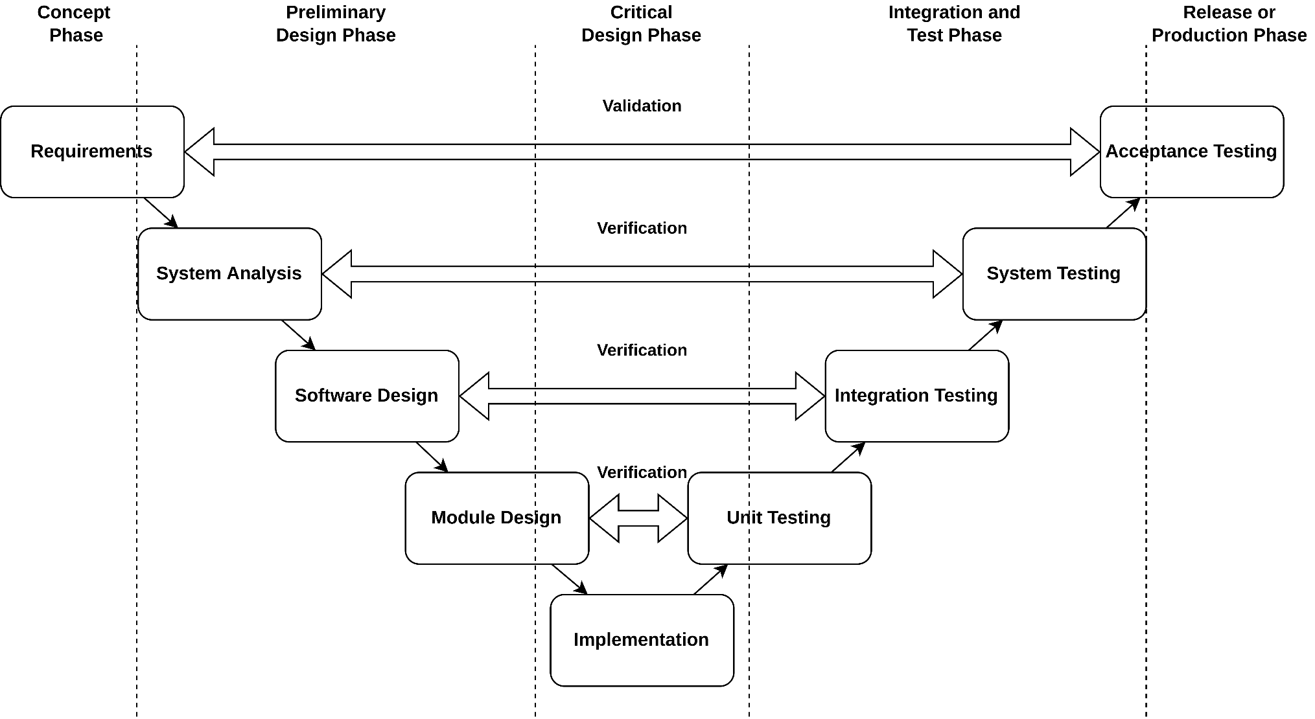
Document Templates
V-Model (XT) – Why V?

Slide 70
Document Templates
Volere Template
Developed by James & Suzanne Robertson (The Atlantic Systems Guild)
Presents a template that may be used to specify user requirements as well as developer requirements
some template sections describe very detailed information about the system while other sections are very high level (developer vs. user)
some template sections can be used for a developer audience as well as a user audience.
In these cases either the used notation is the key differentiator or the information contained in the user document is refined in the developer section
Available online: Link
https://www.volere.org/

Slide 71
Document Templates
Volere Template – Structure
The Purpose of the Project
The Stakeholders
Project Constraints
Mandated Constraints
Naming Conventions and Definitions
Relevant Facts and Assumptions
Functional Requirements
The scope of the Work
Business Data Model & Data Dictionary
The Scope of the Product
Functional Requirements
https://www.volere.org/

Slide 72
Document Templates
Volere Template – Structure
Non-functional Requirements
Look and Feel Requirements
Usability and Humanity Requirements
Performance Requirements
Operational and Environmental Requirements
Maintainability and Support Requirements
Security Requirements
Cultural Requirements
Legal Requirements
https://www.volere.org/

Slide 73
Document Templates
Volere Template – Structure
Project Issues
Open Issues
Off-the-Shelf Solutions
New Problems
Tasks
Migration to the New Product (Cutover)
Risks
Costs
User Documentation and Testing
Waiting Room
Ideas for Solutions
https://www.volere.org/

Slide 74
Summary

Slide 75
Summary
Different types of documentation
Natural language, conceptual models, and hybrid approach
Different perspectives
Data, functional, and behavioral
Standardized structures available
Standards provide means to structure requirements documents
Indicate what should be the content of a requirements specification

Slide 76
Summary
Standards do not:
indicate how to specify different parts or
indicate how to guarantee the characteristics of a good document
support to choose notation to specify a certain section
support in how to achieve for example completeness or traceability
Quality of the documentation is important

Slide 77
Questions?

Slide 78
References

