Slide 1
Requirement Engineering
Lecture 9: Requirements Documentation
Formal Requirements Specification
Prof. Dr. Benjamin Leiding
M.Sc. Anant Sujatanagarjuna

Slide 2

News
Course Evaluation
Link: Click Me

Slide 3
Reminder
Bonus Task
Submission Deadline: 25.01.2023 – 1:59 PM
Submission Location: Moodle

Slide 4
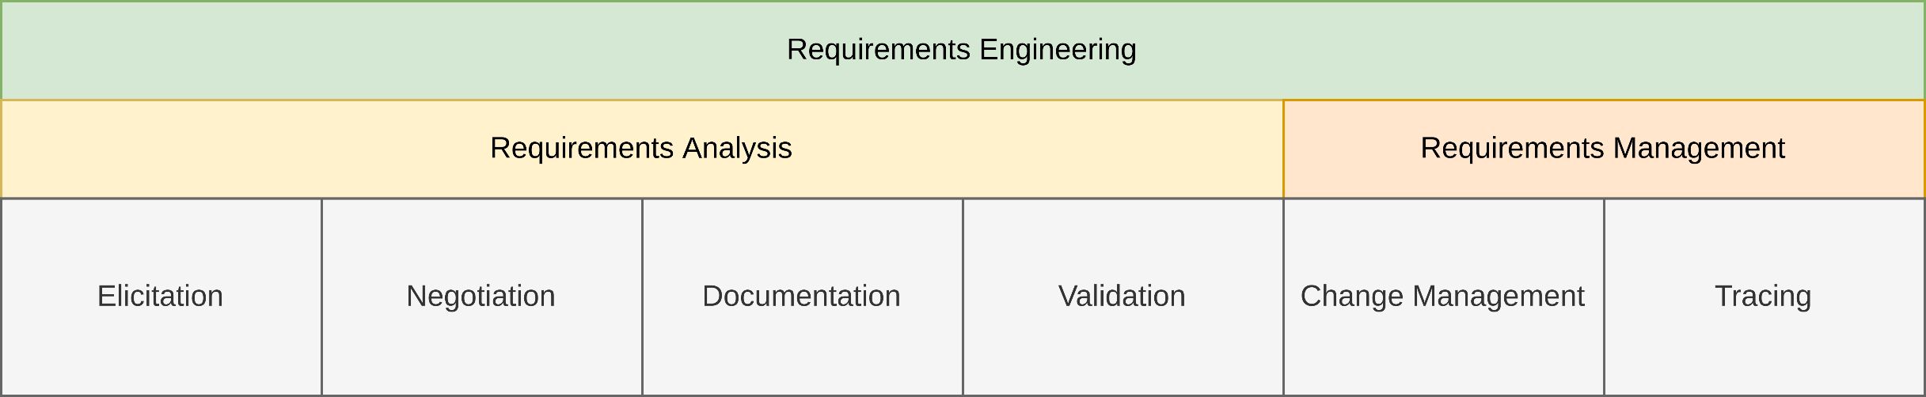
General Requirements Engineering Process
Overview

Slide 5
Lecture 9: Requirements Documentation
Content
Formal Specification Techniques

Slide 6
Formal Requirements Specification

Slide 7
Lecture 4: Requirements Documentation
Content
Model-based Requirements Documentation Techniques
Formal Specification Techniques
Coloured Petri Nets (CPNs)
AOM → CPN Mapping
Four Variable Model
NRL / SCR

Slide 8
Formal Specification Techniques
Coloured Petri Nets – Motivation: Why CPNs?
They can model concurrency and communication in complex systems very well.
They combine concepts from Petri Nets and programming languages (CPN ML).
They are Formal (syntatically and mathematically defined)
They are executable.
They can be derived from other models, such as AOM.
Allows for easy manual or automatic system verification and evaluation.

Slide 9
Formal Specification Techniques
Coloured Petri Nets – Motivation: Why CPNs?
Activity | Trigger(s) | Precondition(s) | Postcondition(s)
Reserve Charging Port(CP) | Driver wants to charge EV | Driver has bought energy, CP is free, EV is ready to charge | Driver has reserved CP
Charge EV | 〃 | Driver has reserved CP | Driver has charged EV
Agree on charging speed | 〃 | Driver has reserved CP, Max CP speed ≥ Min EV speed, Max EV speed ≥ Min CP speed | Charging speed is agreed upon
Begin Charging | 〃 | Charging speed is agreed upon | EV has begun charging
End Charging | None | EV has competed charging | Driver has charged EV, CP is free

Slide 10
Formal Specification Techniques
Coloured Petri Nets – Motivation: Why CPNs?
Activity | Trigger(s) | Precondition(s) | Postcondition(s)
Reserve Charging Port(CP) | Driver wants to charge EV | Driver has bought energy, CP is free, EV is ready to charge | Driver has reserved CP
Charge EV | 〃 | Driver has reserved CP | Driver has charged EV
Agree on charging speed | 〃 | Driver has reserved CP, Max CP speed ≥ Min EV speed, Max EV speed ≥ Min CP speed | Charging speed is agreed upon
Begin Charging | 〃 | Charging speed is agreed upon | EV has begun charging
End Charging | None | EV has competed charging | Driver has charged EV, CP is free
How do we know that these conditions are enough?
Can we model these conditions and simulate, for example; can the system handle 10 EVs and 3 charging stations, or does the system ever get into an infitinte blocking state?

Slide 11
Formal Specification Techniques
Coloured Petri Nets – What are CPNs?
Directed bipartite graphs:
Bipartite graphs divide the vertices of the graph into:
two disjoint and independent sets.
Edges in the graph ONLY connect vertices from one set to the other.

Slide 12
Formal Specification Techniques
Coloured Petri Nets – What are CPNs?
Directed bipartite graphs:
CPNs divide the vertices of the graph into:
Arcs in the graph ONLY connect Places with Transitions.
Places
Transitions
Places
Transitions

Slide 13
Formal Specification Techniques
Coloured Petri Nets – What are CPNs?
CPNs simulate the change of state in the system with the exchange of Tokens.
Tokens reside in, and flow between Places though transitions.
Tokens never stay in Transitions.
Places
Transitions

Slide 14
Formal Specification Techniques
Coloured Petri Nets – Core Concepts : ColorSets, Tokens and Variables
Places can hold tokens of only one type(= ColorSet ).
Tokens are instances of ColorSets.
Variables are used to distinguish tokens while in transit.
var a: INT;
var a2: INT;

Slide 15
Formal Specification Techniques
Coloured Petri Nets – Core Concepts : Markings, Arc Inscriptions and Guards
Markings specify the tokens held by a Place.
Arc Inscriptions are expressions that can modify the tokens when the transition occurs.
Guards are a comma-separated list of conditions that must be satisfied for a Transition.
var a: INT;
var a2: INT;

Slide 16
Formal Specification Techniques
Coloured Petri Nets – Core Concepts : Flow of Tokens
A Transition is enabled if and only if:
All it’s incoming arcs have at least one token.
All guard conditions are satisfied.
No place that is connected with an inhibhitor arc has any tokens.
var a: INT;
var a2: INT;

Slide 17
Formal Specification Techniques
Coloured Petri Nets – Core Concepts : Flow of Tokens
When a Transition is fired:
Any one suitable token is consumed from each input place, according to outgoing arc inscriptions.
The tokens are transferred to the output places according to outgoing arc inscriptions.
IMP: Only one transition can be fired at a time.
var a: INT;
var a2: INT;

Slide 18
Formal Specification Techniques
Coloured Petri Nets – Core Concepts : Hierarchical CPNs
var a: INT;
var a2: INT;

Slide 19
Formal Specification Techniques
Coloured Petri Nets – Evaluation using state-space simulations
Basic Idea
Compute all the reachable states and the state changes of the CPN model
Represent these as a directed graph where nodes represent states and arcs represent occurring events
Pros
From a constructed state–space, it is possible to verify various aspects of the behaviour of the system:
Absence of deadlocks
Possibility of always being able to reach a given state
Guaranteed delivery of a given service
Cons
State-space graph size (and computation time) increases exponentially! → requires independent computation in some cases.
K. Jensen et al. (2007) – Coloured Petri Nets and CPN Tools for modelling and validation of concurrent systems. International Journal on Software Tools for Technology Transfer (9): 213-254. DOI:10.1007/s10009-007-0038-x

Slide 20
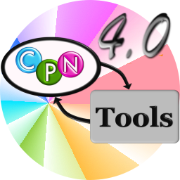
Formal Specification Techniques
Coloured Petri Nets – CPN Tools
“A tool for editing, simulating, and analysing Coloured Petri Nets”
cpntools.org

Slide 21
Formal Specification Techniques
Coloured Petri Nets – Live Example
“Simulate a program reading a file and then writing to it.”
cpntools.org

Slide 22
Lecture 4: Requirements Documentation
Content
Model-based Requirements Documentation Techniques
Formal Specification Techniques
Coloured Petri Nets (CPNs)
AOM → CPN Mapping
Four Variable Model
NRL / SCR

Slide 23
AOM → CPN Mapping
Motivation and Methodology
CPN models are powerful, BUT can be arbitrarily complex. Where to start?
It is important to ensure inter-model consistancy.
Mapping AOM → CPN models leverages the advantages of both, and also creates a feedback loop using the simulation and evaluation capabilities of CPNs.
Heuristics for Designing and Evaluating Socio-Technical Agent-Oriented Behaviour Models with Coloured Petri Nets (2014). Msury Mahunnah, Alex Norta, Lixin Ma, Kuldar Taveter
M. Mahunnah et al. (2014) – Heuristics for Designing and Evaluating Socio-technical Agent-Oriented Behaviour Models with Coloured Petri Nets. IEEE 38th International Computer Software and Applications Conference Workshops (2014): 438-443. https://doi.org/10.1109/COMPSACW.2014.74

Slide 24
AOM → CPN Mapping
Mapping Methodology
Notation | Name
 | Connecting arc
 | Sub-goal or activity
 | Trigger/ precondition
 | Postcondition
 | Goal
[<condition(s)>] | Precondition(s)
Trigger
Precondition
Activity
Postcondition
Adapted from M. Mahunnah et al. (2014) – Heuristics for Designing and Evaluating Socio-technical Agent-Oriented Behaviour Models with Coloured Petri Nets. IEEE 38th International Computer Software and Applications Conference Workshops (2014): 438-443. https://doi.org/10.1109/COMPSACW.2014.74

Slide 25
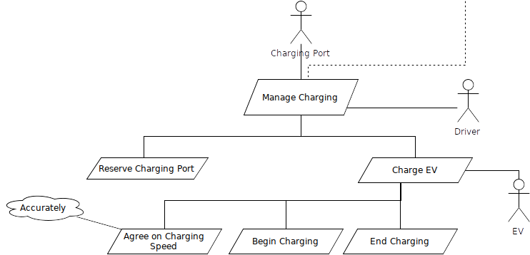
AOM → CPN Mapping
Example: Automated EV Charging Station (Manage Charging)

Slide 26
AOM → CPN Mapping
Example: Automated EV Charging Station (Manage Charging)
Activity | Trigger(s) | Precondition(s) | Postcondition(s)
Reserve Charging Port(CP) | Driver wants to charge EV | Driver has bought energy, CP is free, EV is ready to charge | Driver has reserved CP
Charge EV | 〃 | Driver has reserved CP | Driver has charged EV
Agree on charging speed | 〃 | Driver has reserved CP, Max CP speed ≥ Min EV speed, Max EV speed ≥ Min CP speed | Charging speed is agreed upon
Begin Charging | 〃 | Charging speed is agreed upon | EV has begun charging
End Charging | None | EV has competed charging | Driver has charged EV, CP is free

Slide 27
AOM → CPN Mapping
Example: Automated EV Charging Station (Manage Charging)

Slide 28
AOM → CPN Mapping
Example: Automated EV Charging Station (Charge EV)

Slide 29
AOM → CPN Mapping
State-space Simulations
Basic Idea
Compute all the reachable states and the state changes of the CPN model
Represent these as a directed graph where nodes represent states and arcs represent occurring events
Pros
From a constructed state–space, it is possible to verify various aspects of the behaviour of the system:
Absence of deadlocks
Possibility of always being able to reach a given state
Guaranteed delivery of a given service
Cons
State-space graph size (and computation time) increases exponentially! → requires independent computation in some cases.
K. Jensen et al. (2007) – Coloured Petri Nets and CPN Tools for modelling and validation of concurrent systems. International Journal on Software Tools for Technology Transfer (9): 213-254. DOI:10.1007/s10009-007-0038-x

Slide 30
Lecture 4: Requirements Documentation
Content
Model-based Requirements Documentation Techniques
Formal Specification Techniques
Coloured Petri Nets (CPNs)
AOM → CPN Mapping
Four Variable Model
NRL / SCR

Slide 31
Formal Specification Techniques
Four Variable Model – Basic Elements
Four Variables
Input variables → Physical variables measured by input devices
Output variables → Physical variables controlled by output devices
Monitored environmental variables
Controlled environmental variables
Relations
NAT, REQ, IN/OUT, SOF, SOFREQ
Are used as basis for requirements documentation
Notes:
Vier Variablen Modell in einem Satz: Grundlagen sind Variablen (Grundlegendes Modell), Erweiterung über Realtionen -> Grundlage für Dokumente: Wie dokumentiere ich sowas
Controlled V-> Ausgabewerte die durch das System beschrieben / verändert werden
Monitored V -> EingabeWerte, die durch das System beschrieben werden
Output V -> represents controlled V.
Input V -> represents monitored V.
Eschbach, Elicitation & Modeling: Embedded Systems Industrial Formal Techniques, 2006

Slide 32
Formal Specification Techniques
Four Variable Model – Documents
System Requirements Document
Models the complete system as a black-box
Includes a description of the environment
Identifies a set of quantities and associates each one with a mathematical variable
Describes constraints of the environment like physical laws
Describes constraints related to the new system
Notes:
beschreibt das System als Black-Box
beschreibt die Systemumgebung
identifiziert Messgrößen, die mathematisch beschrieben werden können
beschreibt physikalische / System Einschränkungen
Grundidee alles mathematisch formal beschreiben – identifizieren von Größen, jede dieser Umgebungseigenschaften wird durch mathematische Variablen beschrieben
Wie schnell ist das auto -> das nenne ich dann v -> monitored variable = wie schnell drehen sich die räder?
Bsp Airbus – ich messe wann das flugzeug am boden ist und nicht umdrehungsgeschw. Der Räder
Eschbach, Elicitation & Modeling: Embedded Systems Industrial Formal Techniques, 2006

Slide 33
Formal Specification Techniques
Four Variable Model – Documents
System Design Document
Describes relevant properties of peripheral devices
Identifies input- and output registers, modeled as mathematical variables
Describes relation between input registers and associated environmental quantities
Describes relation between output registers and associated environmental quantities
Notes:
beschreibt die notwendigen Eigenschaften der anzuschließenden Geräte
identifiziert Input- und Output-Register (modelliert als math. Variablen) = pseudo speicherstellen für tatsächliche größen
beschreibt Relation zwischen Input-Registern und Umgebungswerten
beschreibt Relation zwischen Output-Registern und Umgebungswerten
Eschbach, Elicitation & Modeling: Embedded Systems Industrial Formal Techniques, 2006

Slide 34
Formal Specification Techniques
Four Variable Model – Documents
Software Requirements Document
Combination of system requirements document and system design document
Software Behavior Specification
Records additional design decisions
Provides a description of the actual software behavior
Notes:
Warum fasse ich system req & system design doc zusammen? -> Ergeben zusammen die Anforderungen an die Software
Eschbach, Elicitation & Modeling: Embedded Systems Industrial Formal Techniques, 2006

Slide 35
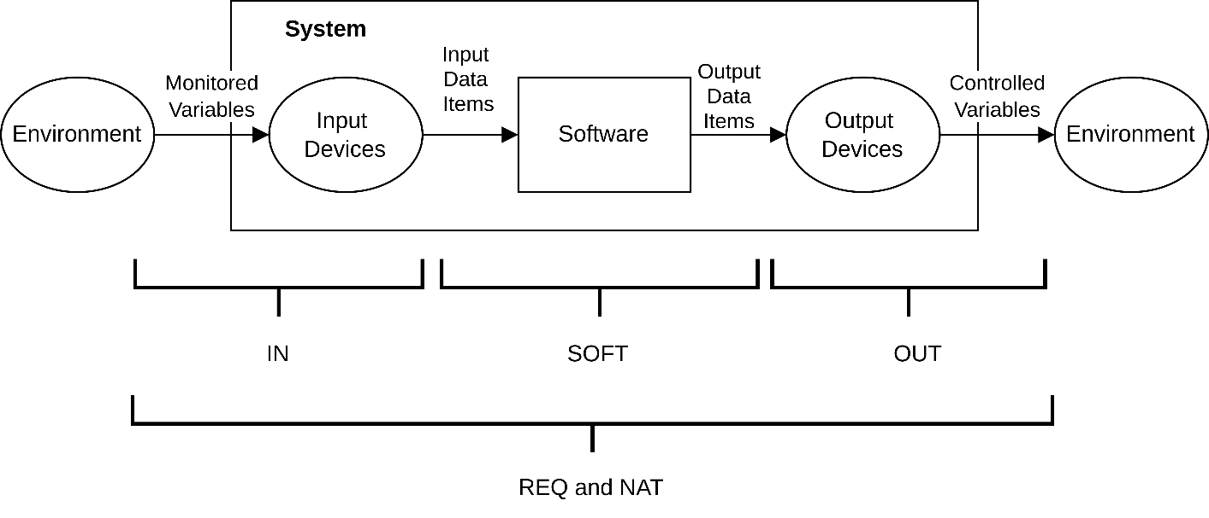
Formal Specification Techniques
NAT: expresses constraints due to restrictions imposed by nature
REQ: expresses the requirements of the system
IN, OUT: input and output relations
SOF: behavior of a particular software implementation
SOFREQ: software requirements relation, all acceptable software behavior
Four Variable Model – Relations
Based on C.L. Heitmeyer, R.D. Jeffords, B.G. Labaw (2013) – Automated Consistency Checking Requirements Specifications
Notes:
NAT = natürliche Einschränkungen
REQ = erwartetes Verhalten des Systems
IN/OUT = Verhalten der Ein/Ausgabegeräte
SOF = akt SW-Verhalten
SOFREQ = beschreibt das Verhalten der Software, dessen Rahmen akzeptabel wäre
m(t) = monitored variables
i(t)= input variables
o(t)= output variables
c(t)= controlled variables
Eschbach, Elicitation & Modeling: Embedded Systems Industrial Formal Techniques, 2006

Slide 36
Formal Specification Techniques
Four Variable Model – Basic Relations
Basic Relations
SOFREQ ⊆ SOF
IN, OUT, REQ SOFREQ
OUT ○ SOFREQ ○ IN = REQ
REQ
w.r.t. NAT
SOFREQ
IN
OUT

Slide 37
Formal Specification Techniques
Four Variable Model – Variables
Monitored variables
Mathematical function whose domain consists of real numbers
Environmental function m^{t} : ℝ→Value
Value at time s: m^{t}(s)
Vector of monitored variables: m^{t} = (m^{t}₁,m^{t}₂, . . . ,m^{t}_{p})
Controlled variables
Mathematical function whose domain consists of real numbers
Environmental function c^{t} : ℝ→Value
Vector of monitored variables: c^{t} = (c^{t}₁,c^{t}₂, . . . ,c^{t}_{q})
~
~
Notes:
Eschbach, Elicitation & Modeling: Embedded Systems Industrial Formal Techniques, 2006

Slide 38
Formal Specification Techniques
Four Variable Model – Relations
REQ
Expresses the requirements of the system
domain(REQ): set of vectors containing exactly the instances of m^{t} allowed by the environmental constraints
range(REQ): set of vectors containing only those instances of c^{t} considered permissible
(m^{t}, c^{t}) ∈ REQ if environmental constraints allow the controlled variables to take the values given by c^{t}, if the values of the monitored variables are given by m^{t}
REQ may tolerate ’small’ errors in the values of controlled variables
~
Notes:
Domain = Menge von Vektoren mit allen monitored Variablen
Range = Menge von Vektoren mit allen controlled Variablen
(m,c) elem REQ gdw zu jeder contrallod auch eine monitored existiert
Eschbach, Elicitation & Modeling: Embedded Systems Industrial Formal Techniques, 2006

Slide 39
Formal Specification Techniques
Four Variable Model – Relations
IN
Describes the behavior of the input devices
Is a relation due to imprecision in the measurement
OUT
Describes the behavior of output devices
Is a relation due to device imperfections
Notes:
IN = Verhalten der Eingabgeräte, Ungenauigkeiten betrachten
OUT = Verhalten der Ausgabgeräte
Eschbach, Elicitation & Modeling: Embedded Systems Industrial Formal Techniques, 2006

Slide 40
Formal Specification Techniques
Four Variable Model – Relations
SOF
Describes behavior of a particular software implementation
domain(SOF): set of vectors containing all possible instances of i^{t}
range(SOF): set of vectors containing all possible instances of o^{t}
(i^{t}, o^{t}) ∈ SOF iff the software could produce values described by o^{t}
Verification condition: SOF implements a subset of REQ
SOF ⊆ IN⁻¹ ○ REQ ○ OUT⁻¹
(where ○ denotes the composition of binary relations)
Often: SOF = IN⁻¹ ○ REQ ○ OUT⁻¹
Notes:
Domain = Menge von Vektoren mit Eingaben
Range = Menge von Vektoren mit Ausgaben
(i,o) elem SOF gdw alle Werte in o produziert werden können
Verification:
REQ = INoSOFREQo OUT
IN-1o REQ o OUT-1 = SOFREQ
IN-1o REQ o OUT-1 = SOFREQ superset SOF
Eschbach, Elicitation & Modeling: Embedded Systems Industrial Formal Techniques, 2006

Slide 41
Formal Specification Techniques
Four Variable Model – Relations
SOFREQ
Characterizes all acceptable software behavior
SOFREQ corresponds on the software level to REQ on the system level
It consists of all tuples (i ^{t}, o ^{t}) satisfying for all m^{t}, c^{t} :
(IN(m^{t} ,i^{t}) ⋀ OUT(o^{t}, c^{t}) ⋀ NAT(m^{t}, c^{t})) → REQ(m^{t}, c^{t})
Notes:
SOFREQ = akzeptiertes Verhalten
Eingaben messen und Ausgaben produzieren und Naturbedingungen ebenfalls gelten, dann können Anforderungen gefolgert werden
→Erlaubtes Verhalten aufgrund der Naturgegebenheiten
Eschbach, Elicitation & Modeling: Embedded Systems Industrial Formal Techniques, 2006

Slide 42
Formal Specification Techniques
Four Variable Model – Feasibility and Acceptability
Feasibility of REQ w.r.t. NAT
Requirements should specify behavior for all cases that can arise
domain(NAT) ⊆ domain(REQ)
domain(NAT ⋂ REQ) = domain(NAT) ⋂ domain(REQ) = domain(NAT)
Acceptability
Describes the behavior that the software must exhibit to be acceptable for use and for the requirements to be satisfied
NAT ⋂ (IN ○ SOF ○ OUT) ⊆ REQ
Notes:
Feasability = ich fordere nichts was im Wiederspruch zur Natur ist
Acceptability = beschreibt das Verhalten der SW, das mindestens erfüllt werden muss, um sie SW zu benutzen
SW-Verhalten beschränken auf NAT -> Verhalten entspricht anf
Ariane 4 – sw funktioniert einwandfrei wenn die beschleunigungskräfte nicht über best. Betrag liegen (nat n sof)
Ariane 5 – nat hat sich geändert
Eschbach, Elicitation & Modeling: Embedded Systems Industrial Formal Techniques, 2006
David Lorge Parnas, Jan Madey. Functional Documents for Computer Science. Science of Computer Programming, Elsevier, 1995
Dennis K. Peters and David Lorge Parnas. Requirements-based Monitors for Real-Time Systems. IEEE Transactions on

Slide 43
Lecture 4: Requirements Documentation
Content
Model-based Requirements Documentation Techniques
Formal Specification Techniques
Coloured Petri Nets (CPNs)
AOM → CPN Mapping
Four Variable Model
NRL / SCR

Slide 44
Formal Specification Techniques
NRL / SCR – Motivation
Tabular notations → precise and compact notation for requirements
Applications → avionics systems, controlling nuclear power plants, telephone networks
Can be used for automatic analysis
History
1978: flight program of the A-7 aircraft
Real-time, embedded system
Organizations: Bell Laboratories, Ontario Hydro, Naval Research Laboratory, Lockheed
Applications: submarine communication system, shutdown system for the Darlington nuclear power plant, flight program for Lockheed’s C130J aircraft.
Notes:
NRL/SCR -> SCR = Name, Erfinder waren zu der Zeit am NRL.
Eschbach, Elicitation & Modeling: Embedded Systems Industrial Formal Techniques, 2006

Slide 45
Formal Specification Techniques
NRL / SCR – SCR Formal Model
Behavior
Non-deterministic system environment
Deterministic system behavior
4VM → Monitored and controlled variables, NAT, REQ
Model: System is represented as labeled transition system (LTS), responds to each monitored event
Synchronous behavior: The system completely processes one set of inputs before processing the next state
One input assumption: At most one monitored variable is allowed to change from one state to the next
Notes:
Eschbach, Elicitation & Modeling: Embedded Systems Industrial Formal Techniques, 2006

Slide 46
Formal Specification Techniques / NRL / SCR
NRL / SCR – SCR Formal Model
Auxiliary variables: (specification of REQ)
Mode classes: values are called modes
Modes: equivalence class of system states
Terms: internal variables
System: labeled transition system (S, I, E^{m},→) consisting of
States S, initial states I
Labels E^{m} (set of monitored events)
Transition relation → realized as a function that maps a monitored event e ∈ E^{m} and the current state s ∈ S to the next state s’ ∈ S
Notes:
Hilfsvar werden eingeführt um REQ einfacher hinzuschreiben
Auxiliary V: = Hilfsvariablen – Modi – repräsentieren System Status
System = unter bestimmten Bedingungen gibt es Zustandsübergang – Zustandsdiagramm UML
Eschbach, Elicitation & Modeling: Embedded Systems Industrial Formal Techniques, 2006

Slide 47
Formal Specification Techniques / NRL / SCR
NRL / SCR – SCR Formal Model
Condition → Predicate defined on a single system state
Event → Predicate defined on two system states
Occurrence → An event occurs if a condition changes
@T(c): c becomes true
@F(c): c becomes false
Conditioned event → @T(c₁) WHEN c₂
Special form: @T(c) WHEN d iff ¬c ⋀ c’ ⋀ d
Notes:
Bedingungen = beziehen sich auf einen Status
Event = verbindet 2 Systemzustände
Vorkommen: ein Event tritt auf wenn Bedingung ändert
@T(c) = der moment in dem c wahr wird
Conditioned event = Event unter bedingung
Special form = verschärfte Form von Conditioned Event
Eschbach, Elicitation & Modeling: Embedded Systems Industrial Formal Techniques, 2006

Slide 48
Formal Specification Techniques / NRL / SCR
NRL / SCR – SCR Tables
Mode transition table:
Associates a source mode and an event with a destination mode
Each table should describe a total function
Should exhibit disjointness and coverage properties
Event table:
An event table defines how a term or controlled variable changes in response to input events
Defines a (partial) function from modes and events to variable values
Condition table:
A condition table defines the value of a term or controlled variable under every possible condition
Defines a total function from modes and conditions to variable values
Notes:
Mode transition table = mode + event = neuer mode - Verbindet den Ausgangsmodus und ein Event mit einem Zielmodus
Event table = Veränderungen von termen / contr. Variablen in abh. Von inputs
Cond. Table = Wert einer controlled Variable unter jeder möglichen Bedingung
Easterbrook: L17-formalmodelling

Slide 49
Formal Specification Techniques / NRL / SCR
NRL / SCR – SCR Tables
Current Mode | Powered on | Too Cold | Temp OK | Too Hot | New Mode
Off | @T @T @T | - t - | t - - | - - t | Inactive Heat AC
Inactive | @F - - | - @T - | - - - | - - @ | Off Heat AC
Heat | @F - | - - | - @T | - - | Off Inactive
AC | @F - | - - | - @T | - - | Off Inactive
Notes:
Easterbrook: L17-formalmodelling

Slide 50
Formal Specification Techniques / NRL / SCR
NRL / SCR – SCR Tables
Modes
NoFailure | @T(INMODE) | Never
ACFailure, HeatFailure | Never | @T(INMODE)
Warning light = | Off | On
Event table
Modes | Events
NoFailure | true | false
ACFailure | temp > temp0 | temp <= temp0
HeatFailure | false | waterlevel = low
Warning light = | Off | On
Condition table
Notes:
Easterbrook: L17-formalmodelling

Slide 51
Formal Specification Techniques / NRL / SCR
NRL / SCR – Tool Support: SCR Toolset
Specification editor for creating the tabular specification
Simulator for validation
Dependency graph browser for understanding the relationship between different parts of the specification
Consistency checker for analyzing syntax, type correctness, determinism, case coverage, ...
Model checker for checking linear temporal properties of finite state systems
Theorem prover for checking properties deductively, avoiding the state explosion problem, often user interaction necessary
Notes:
Eschbach, Elicitation & Modeling: Embedded Systems Industrial Formal Techniques, 2006

Slide 52
Formal Specification Techniques / NRL / SCR
NRL / SCR – SCR Toolset: Construction of Requirements Specifications
Specification
Specification editor
Function tables: define the value of dependent variables
Dictionaries: variable declarations, environmental assumptions, type definitions
Analysis
Consistency checker, property checker, dependency graph browser
Well-formedness errors
Disjointness and coverage: no nondeterminism, no missing cases
Notes:
Eschbach, Elicitation & Modeling: Embedded Systems Industrial Formal Techniques, 2006

Slide 53
Formal Specification Techniques / NRL / SCR
NRL / SCR – SCR Toolset: Construction of Requirements Specifications
Validation
Check inconsistencies between the intended and the specified behavior
Simulator: the user can run scenarios (sequences of monitored events)
Invariant generator: the user can generate state invariants
Application analysis
Check application properties
Model checker
Property checker
Theorem prover (TAME, PVS)
Notes:
Eschbach, Elicitation & Modeling: Embedded Systems Industrial Formal Techniques, 2006
Constance Heitmeyer, Myla Archer, Ramesh Bharadwaj and Ralph Jeffords. Tools for constructing requirements specifications: The SCR toolset at the age of ten. International Journal of Computer Systems Science & Engineering, Vol 20, No. 1, p 19-35, January 2005

Slide 54
Summary

Slide 55
Summary
Formal specification techniques
Coloured Petri Nets (incl. mapping from AOM), four variable model, NRL/SCR
More exist and might be better suited for your project

Slide 56
Questions?

Slide 57
References

