Slide 1
Requirement Engineering
Lecture 11: Traceability
Prof. Dr. Benjamin Leiding
M.Sc. Anant Sujatanagarjuna

Slide 2

News
Course Evaluation
Link: Click Me

Slide 3
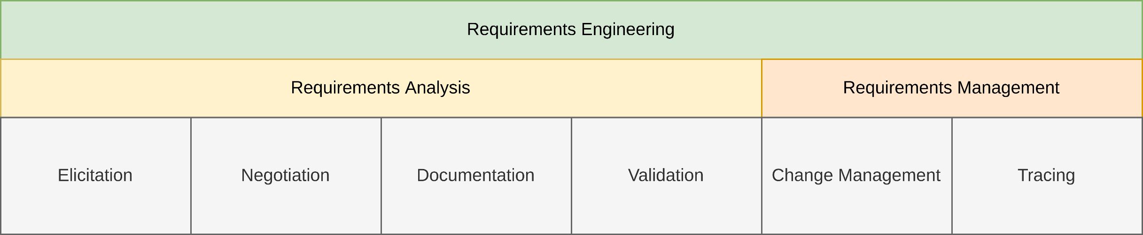
General Requirements Engineering Process
Overview

Slide 4
Lecture 11: Traceability
Content
Introduction
Classification
Documentation

Slide 5
Introduction

Slide 6
Introduction
Traceability in a Nutshell
What happened when to a/the requirement(s)?

Slide 7
Introduction
Definition – Requirements Traceability
“Requirements traceability refers to the ability to describe and follow the life of a requirement, in both a forwards and backwards direction (i.e., from its origins, through its development and specification, to its subsequent deployment and use, and through all periods of on-going refinement and iteration in any of these phases).”
O. C. Z. Gotel and A. C. W. Finkelstein (1994) – An Analysis of the Requirements Traceability Problem

Slide 8
Introduction
Advantages of Traceable Requirements
Change management → Which other artefacts are affected by a change?
Process improvements → Trace problems in the development process back to their cause
Reuse
Identify development artefacts associated with a requirement → If requirement is reused, the development artefact might also be reused
Accountability
Calculate/estimate the development effort to implement a requirement
Maintenance
Simplified cause-effect analysis, impact analysis, etc.

Slide 9
Introduction
Advantages of Traceable Requirements
Verifiability
Easy to verify whether a requirement has been implemented or not
Identification of gold-plated solutions in the system
Gold-plated = unnecessary attention to details
Reverse function to “verifiability” → Checks for each function whether it implements a requirement
Identification of gold-plated solutions in the requirements
Tracing requirements to their origin
Analysis whether a requirement contributes to a goal

Slide 10
Introduction
Purpose-driven Tracing
Extensive tracing is expensive
Purpose-driven!
Do not trace everything
Trace according to needs → Too much/little information (sufficient level of detail)

Slide 11
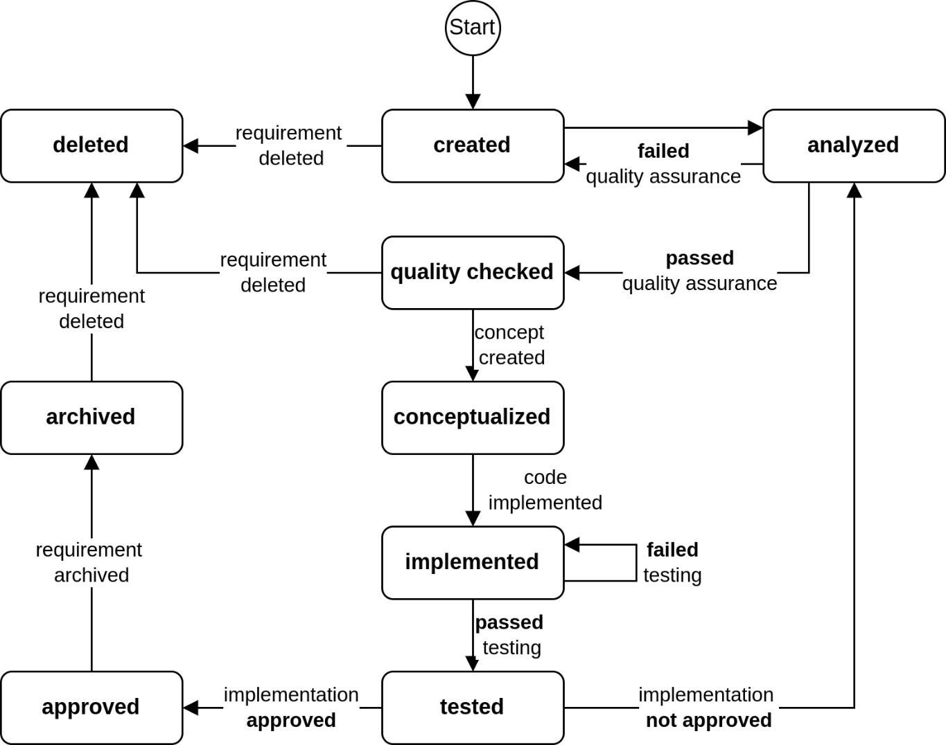
Introduction
State Changes of a Requirement
Based on Chris Rupp et al. (2021) – Requirements Engineering und Management – Das Handbuch für Anforderungen in jeder Situation (7th Edition)

Slide 12
Classification

Slide 13
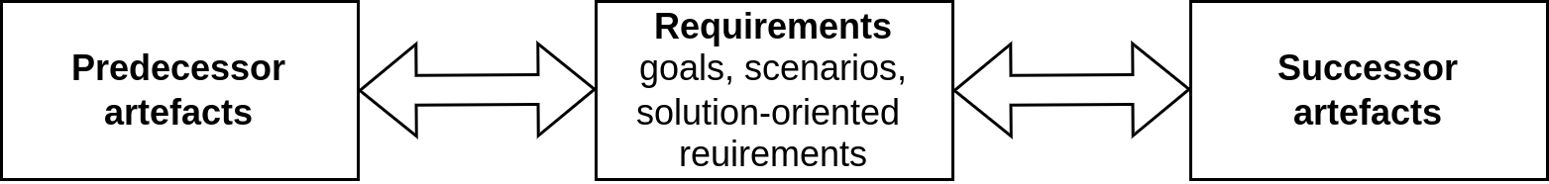
Classification
Pre- and Post-Traceability
Based on K. Pohl (2010) – Requirements Engineering – Fundamentals, Principles and Techniques

Slide 14
Classification
Overview
Pre-requirements-specification (pre-RS) traceability
Post-requirements-specification (post-RS) traceability
Traceability among requirements
E.g., requirement A refines/generalized/replaces requirement B

Slide 15
Classification
Classes of Traceability Relationships
Condition
Content
Abstraction
Evolution
Miscellaneous
K. Pohl (2010) – Requirements Engineering – Fundamentals, Principles and Techniques

Slide 16
Classification
Traceability Relationships – Condition
constraint:
E.g., artefact A defines a constraint on artefact B
precondition:
E.g., artefact A defines a condition that must be fulfilled before artefact B can be realized
K. Pohl (2010) – Requirements Engineering – Fundamentals, Principles and Techniques

Slide 17
Classification
Traceability Relationships – Content
similar:
Two associated artefacts are similar in content
compares:
Artefact A₁ represents the result of a comparison of the artefacts A₂ … A_{n}
contradicts:
Two artefacts cannot be realized together
conflicts:
Artefact A may hinder (but not necessarily exclude) the realization of artefact B
K. Pohl (2010) – Requirements Engineering – Fundamentals, Principles and Techniques

Slide 18
Classification
Traceability Relationships – Abstraction
classifies:
Artefact A classifies a set of artefacts B₁ … B_{n} → e.g., a goal classifies a set of solution-oriented requirements
aggregates:
Artefact A is an aggregation of a set of other artefacts B₁ … B_{n}
generalizes:
Artefact A is a generalization of (one or) several other artefacts → e.g., an abstract scenario (e.g., a type scenario) is a generalization of a set of more concrete scenarios (e.g., instance scenarios)
K. Pohl (2010) – Requirements Engineering – Fundamentals, Principles and Techniques

Slide 19
Classification
Traceability Relationships – Evolution
replaces:
Artefact B replaces artefact A
based_on:
Artefact A has influenced the definition of artefact B
formalizes:
Artefact A is a formal documentation of artefact B → e.g., relate a solution-oriented requirements model to a set of textual requirements
refines:
Artefact A refines artefact B
derived:
Artefact A was derived based on (a set of) other artefact(s)
K. Pohl (2010) – Requirements Engineering – Fundamentals, Principles and Techniques

Slide 20
Classification
Traceability Relationships – Miscellaneous
example_of:
Artefact A contains exemplary aspects of a set of artefacts → e.g., relates an interaction scenario to a set of solution-oriented requirements to document an exemplary sequence of interactions that a system implementing the solution-oriented requirements will support
verifies:
Test artefact A verifies requirement artefact B
rationale:
Artefact A justifies artefact B → e.g., text fragment contains justification for the existence of a scenario
K. Pohl (2010) – Requirements Engineering – Fundamentals, Principles and Techniques

Slide 21
Classification
Traceability Relationships – Miscellaneous
responsible_for:
Stakeholder (or role) A is responsible for the associated artefact B
background:
Assign background information to a requirement artefact → e.g., standardization document relating to a solution-oriented requirement
comment:
Relates any kind of information to a requirements artefact – use sparingly!
K. Pohl (2010) – Requirements Engineering – Fundamentals, Principles and Techniques

Slide 22
DocumentaTION

Slide 23
Documentation
Overview
Textual references
Hyperlinks
Traceability models
Matrix
Graph

Slide 24
Documentation
Textual References
R2-17: For selecting the trip destination, the navigation system shall display the last ten trip destinations. [based_on→R1-17] […]
K. Pohl (2010) – Requirements Engineering – Fundamentals, Principles and Techniques

Slide 25
Documentation
Hyperlinks
R2-17: For selecting the trip destination, the navigation system shall display the last ten trip destinations.
R3-11: The system shall not store any information about the destinations of previous trips
hyperlink (type: conflicts)
K. Pohl (2010) – Requirements Engineering – Fundamentals, Principles and Techniques

Slide 26
Documentation
Textual References & Hyperlinks
Simple and easy
Links are textually part of the requirements themselves
Disadvantages:
Maintenance is time-consuming and tedious
Bidirectionality is difficult to achieve/maintain

Slide 27
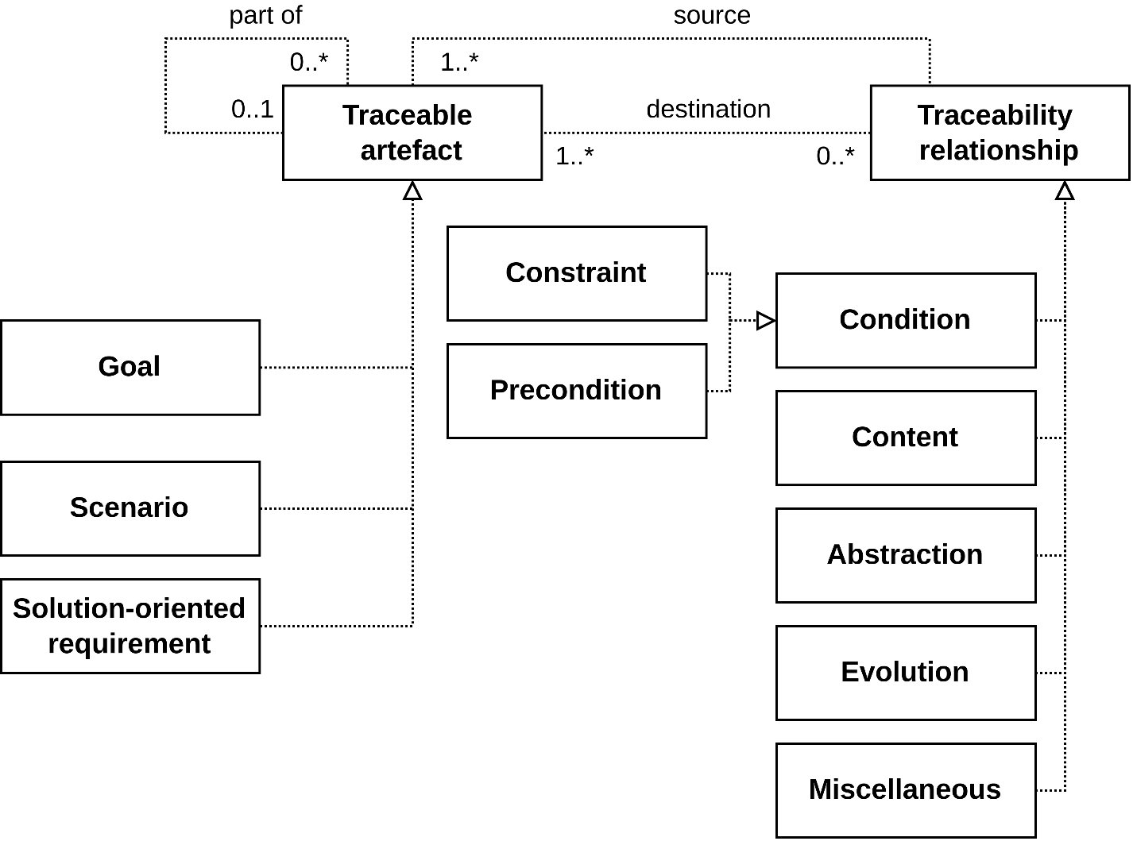
Documentation
Traceability Models
K. Pohl (2010) – Requirements Engineering – Fundamentals, Principles and Techniques

Slide 28
Documentation
Traceability Matrix
Target artefacts
satisfies | Goal 1 | Goal 2 | Goal 3 | Goal 4 | Goal 5
Scenario 1
Scenario 2
Scenario 3 |  |  | Traceability
Scenario 4 |  |  | relationships
Scenario 5
Source artefacts
K. Pohl (2010) – Requirements Engineering – Fundamentals, Principles and Techniques

Slide 29
Documentation
Traceability Matrix
Target artefacts
 | Goal 1 | Goal 2 | Goal 3 | Goal 4 | Goal 5
Scenario 1 | satisfies
Scenario 2 | based_on | conflicts |  | satisfies
Scenario 3 |  | satisfies
Scenario 4 | conflicts |  | satisfies |  | satisfies
Scenario 5 |  | satisfies |  | based_on
Source artefacts
K. Pohl (2010) – Requirements Engineering – Fundamentals, Principles and Techniques

Slide 30
Documentation
Traceability Matrix
Documents traceability in a matrix
Rows represent the initial artefact
Columns represent the target artefact
Sources of requirements
Development artefacts
Requirements

Slide 31
Documentation
Traceability Matrix
Advantages:
Good overview
Separation → One matrix per traceability aspect
Disadvantages:
Difficult to maintain (might be very large)
Multiple matrices required

Slide 32
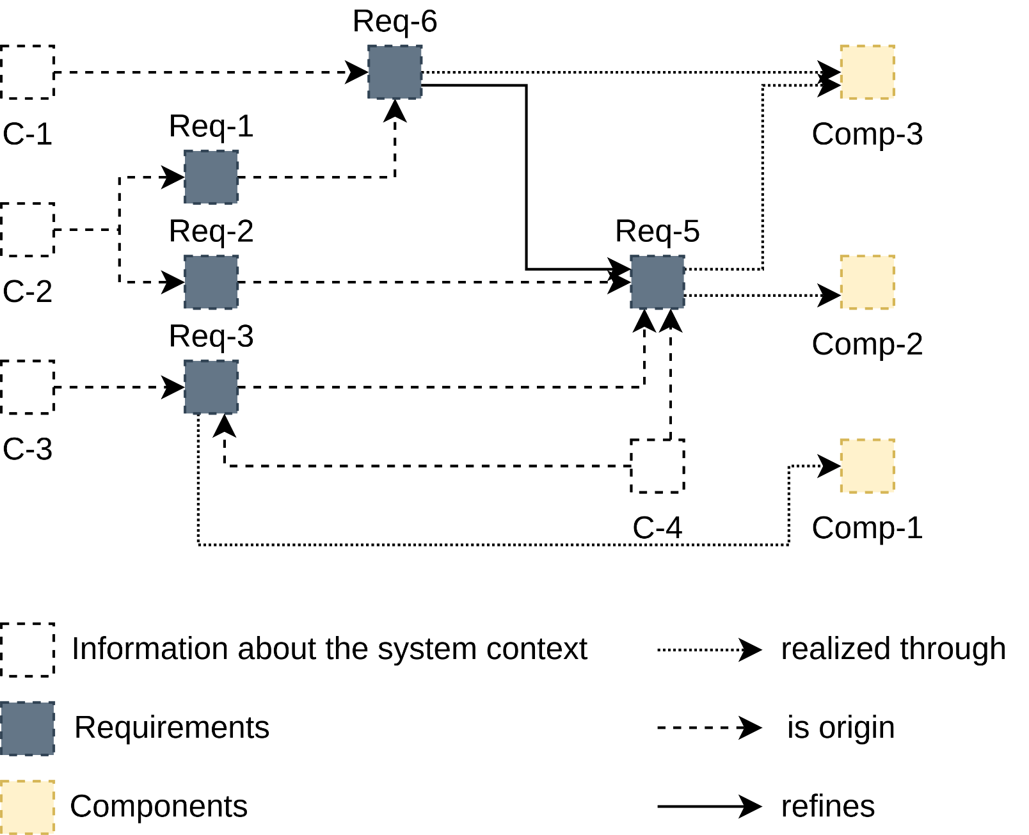
Documentation
Traceability Graph
Based on K. Pohl, C. Rupp (2011) – Requirements Engineering Fundamentals: A study guide for Requirements Engineering Foundation Level

Slide 33
Documentation
Traceability Graph
Graphical notation for traceability
Nodes represent development artefacts
Edges represent traceability relations
Infeasible to create and maintain manually → Requires tool support

Slide 34
Summary

Slide 35
Summary
Analysis and understanding of the relations among
Requirements
Requirements sources
Development artefacts
Supports other activities
Especially useful for maintenance
E.g., analyze impact of (requirement) changes
Good traceability is difficult to maintain
Tool support might help

Slide 36
Questions?

Slide 37
References

