Slide 1
Emerging Technologies for the Circular Economy
Lecture 0: Organization
Prof. Dr. Benjamin Leiding (Clausthal)
Dr. Arne Bochem (Göttingen)
M.Sc. Anant Sujatanagarjuna (Clausthal)
M.Sc. Shohreh Kia (Clausthal)

Slide 2
License
This work is licensed under a Creative Commons Attribution-ShareAlike 4.0 International License. To view a copy of this license, please refer to https://creativecommons.org/licenses/by-sa/4.0/ .
Updated versions of these slides will be available in our Github repository.

Slide 3
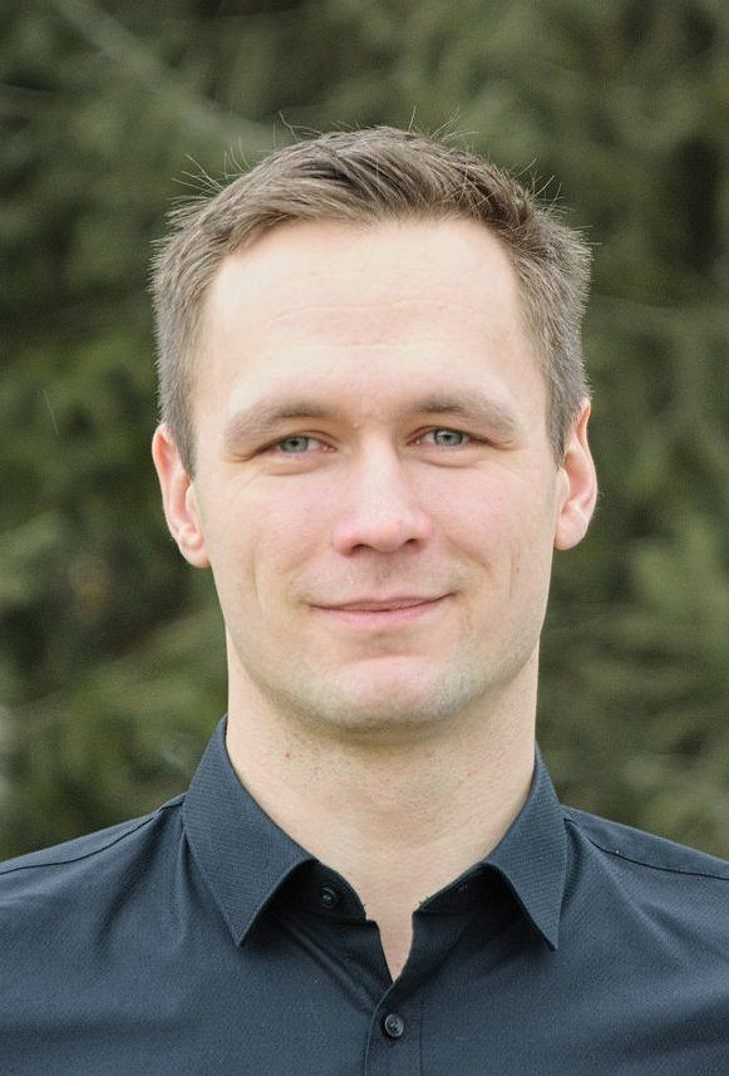
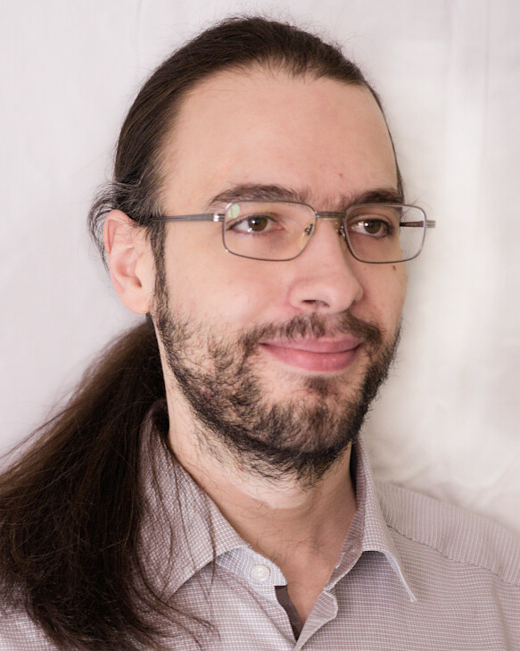
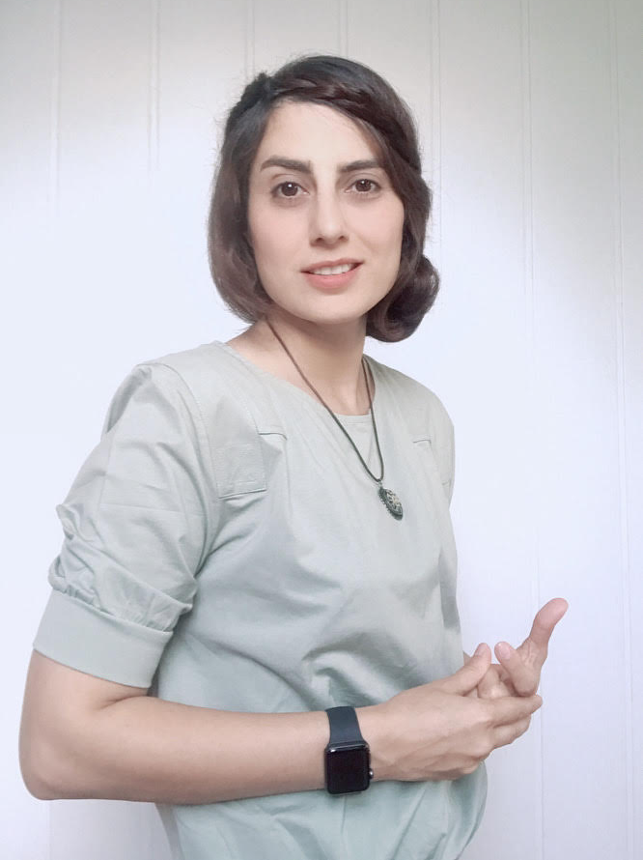

Team
Prof. Dr. Benjamin Leiding
Dr. Arne Bochem
M.Sc. Anant Sujatanagarjuna
M.Sc. Shohreh Kia

Slide 4
ETCE Research Group
Emerging Technologies for the Circular Economy → ETCE
Research focus:
Intersection of IT and sustainability
Circular Economy
Self-organized, decentralized and distributed systems
Machine-to-Everything Economy (M2X Economy)
Other courses:
The Limits to Growth – Sustainability and the Circular Economy (SS/WS – open for everyone)
Requirements Engineering (WS – M.Sc.)
Notes:
<number>

Slide 5
ETCE Research Group
ETCE Website – Link
Course material
Theses/project topics
Our research in action:
ZDF documentary (German) – Link
Klartext Preis 2020 (German) – Link
You want join us? Write us an email!
→ benjamin.leiding@tu-clausthal.de
Notes:
<number>

Slide 6
ETCE Research Group
ETCE Website – Link
Course material
Theses/project topics
Our research in action:
ZDF documentary (German) – Link
Klartext Preis 2020 (German) – Link
You want join us? Write us an email!
→ benjamin.leiding@tu-clausthal.de
Notes:
<number>

Slide 7
Learning Outcome
Basic understanding of the concept of the Linear Economy, the Circular Economy, the Performance Economy and sustainability

Slide 8
Learning Outcome
Basic understanding of the concept of the Linear Economy, the Circular Economy, the Performance Economy and sustainability
Basic understanding of new technologies in the field of decentralized and smart systems

Slide 9
Learning Outcome
Basic understanding of the concept of the Linear Economy, the Circular Economy, the Performance Economy and sustainability
Basic understanding of new technologies in the field of decentralized and smart systems
Understanding and overview of the Internet of Things and related concepts

Slide 10
Learning Outcome
Basic understanding of the concept of the Linear Economy, the Circular Economy, the Performance Economy and sustainability
Basic understanding of new technologies in the field of decentralized and smart systems
Understanding and overview of the Internet of Things and related concepts
Ability to design decentralized smart systems and applications in the context of connected sensor systems

Slide 11
Learning Outcome
Basic understanding of the concept of the Linear Economy, the Circular Economy, the Performance Economy and sustainability
Basic understanding of new technologies in the field of decentralized and smart systems
Understanding and overview of the Internet of Things and related concepts
Ability to design decentralized smart systems and applications in the context of connected sensor systems
Knowledge of the design and consideration of privacy-preserving data processing procedures for smart and decentralized applications

Slide 12
Learning Outcome
Basic understanding of the concept of the Linear Economy, the Circular Economy, the Performance Economy and sustainability
Basic understanding of new technologies in the field of decentralized and smart systems
Understanding and overview of the Internet of Things and related concepts
Ability to design decentralized smart systems and applications in the context of connected sensor systems
Knowledge of the design and consideration of privacy-preserving data processing procedures for smart and decentralized applications
Experience in prototyping such applications and systems

Slide 13
Lectures
17.04.2023 → Organization (L00) + Introduction (L01)
24.04.2023 → Circular Economy (L02)
08.05.2023 → Lifecycle Assessment – LCA (L03)
15.05.2023 → Introduction to the Internet of Things (L04)
22.05.2023 → Internet of Things – Communication + Security and Privacy (L05)
05.06.2023 → Internet of Things – Data Processing and BigData (L06)
→ Extra MOOC - Foodsharing
12.06.2023 → Industrial Internet of Things (L07)
19.06.2023 → Introduction to Blockchain Technology (L08)
26.06.2023 → Blockchain Technology – Consensus (L09)
03.07.2023 → Blockchain Technology – Ethereum and Smart Contracts (L10)
10.07.2023 → Blockchain Technology and Sustainability (L11)
17.07.2023 → Invited Lecture XOR The Machine-to-Everything Economy – A step towards the CE 2.0? (L12)
31.07.2023 → Exam Q&A

Slide 14
Exercises
17.04.2023 → Exercise 01 – Knowledge Test (MC)
24.04.2023 → Exercise 02 – Circular Economy (MC)
08.05.2023 → Exercise 03 – Lifecycle Assessment (LCA)
15.05.2023 → Exercise 04 – IoT Sensing and Gathering Data
22.05.2023 → Exercise 05 – IoT Security
05.06.2023 → Exercise 06 – IoT Data Processing
12.06.2023 → Exercise 07 – Industrial IoT
19.06.2023 → Exercise 08 – Blockchain (MC)
26.06.2023 → Exercise 09 – Blockchain Basics
03.07.2023 → Exercise 10 – Blockchain Conensus
10.07.2023 → Exercise 11 – Blockchain Tokens
17.07.2023 → Exercise 12 – Blockchain Smart Contracts and IoT

Slide 15
Course Organization
Online course that is offered in parallel at the Clausthal University of Technology and the University of Göttingen
Organization of the lecture:
Slides will be uploaded to StudIP (Clausthal and Göttingen) and Github (Link)
Please report bugs!
Lectures and exercises as live stream (BBB – next slide)
Lecture recordings will be available on StudIP and on Github
Exercise time slots = Time for questions and eventual tutorials related to the exercises
Questions? Write us an email: etce-etce@tu-clausthal.de ← We will only respond to
emails written to this specific email address!

Slide 16
Dates/Times/Locations
Lecture:
Monday 2:15 pm to 3:45 pm (Berlin time) – 17.04.2023 to 17.07.2023
Location: Goslar Gotec (Am Stollen 19 C, 38640 Goslar, Germany) or via BigBlueButton (Link)
Exercise / Q&A:
Monday 4 pm to 5 pm (Berlin time) – 17.04.2023 to 17.07.2023
Location: Goslar Gotec (Am Stollen 19 C, 38640 Goslar, Germany) or via BigBlueButton (Link)

Slide 17
Exercises
Individual work → no group submissions
Multiple-Choice or coding tasks
7-14 days to submit (depending on the task)
Submission deadline is always Monday at 1:59pm (right before the next lecture)
Submission of each exercise is mandatory
You pass by submitting an exercise – even if it is an empty page
You will receive feedback on your submission
Exercise = learning feedback

Slide 18
Coding Exercise Submission and Grading – Clausthal and Göttingen
Coding exercises are graded semi-automatically. Due to this it is highly important that you follow the required submission format. Otherwise the grading process will fail and you will receive 0 points.
Code must use Python. Do not use any libraries beyond what is specified in the assignment as they may not be available in the grading environment.
Follow the directory structure from the handout file exactly. Usually this means:
If the handout contains a folder ‘lab1’, your submission should have a folder ‘lab1’ in the archive with the files inside it. The folder must not be inside another folder and the files must not be directly in the archive outside the folder.
The archive must be an uncompressed zip archive, not tar, rar, tar.gz or anything else.

Slide 19
Coding Exercise Submission and Grading – Clausthal and Göttingen
Before submitting, unpack your archive to a new folder and check that the Makefile runs correctly.
For grading, we use a different test program, so, no, hardcoding the answers to the provided driver.py will not work.
Code is submitted via a timed write-only StudIP submission folder. Only a single file can be submitted. The file name must follow the exact format ‘lab<n>_<matriculation number>.zip’, so for example ‘lab4_123456789.zip’, no extra space or _ symbols anywhere.

Slide 20
Multiple-Choice Exercises – Göttingen
Every student enrolled in this course is required to take the Knowledge quiz in first two weeks of the course.
The first knowledge test will be available on ILIAS from Monday, 17 April 2023, 5:00 PM until 24 April 2023 01:59 PM
The second knowledge test will be available on ILIAS from Monday, 24 April 2023, 5:00 PM until 01 May 2023 01:59 PM
Goal of the test:
To check the knowledge level of the student that is relevant to this course of study.
Preparation:
A review of basic concepts of Cryptography and Circular Economy is recommended for Week 1 and Week 2 respectively
Knowledge quiz for Week 1 only tests your existing knowledge.
Test sturcture:
Total 25 multiple choice questions → no time limit.
Each question can fetch a maximum of 1 point
IMPORTANT : Incorrect choices will yield in negative points. An incorrect choice in a question will take away just as many points as a correct choice is awarded.
Each test is evaluated on a grade scale of 10.
The result of your test will be available after the quiz is closed.

Slide 21
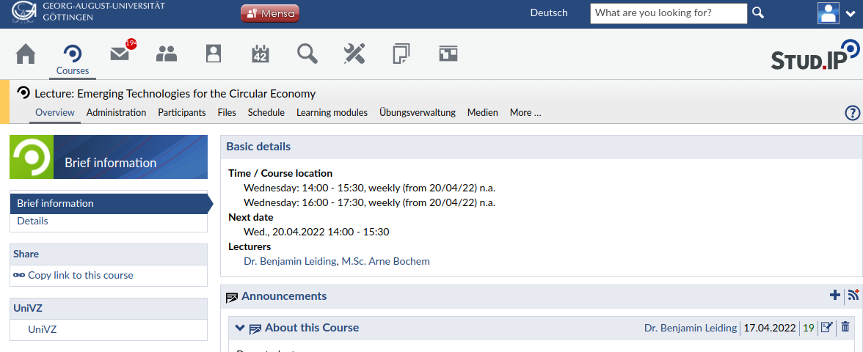
Multiple-Choice Exercises – Göttingen
Step-1: Navigate to StudIP, select "Lernmodule/Learning modules"

Slide 22
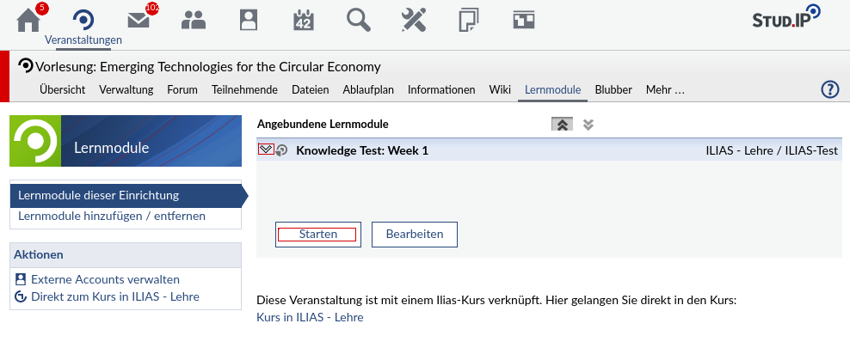
Multiple-Choice Exercises – Göttingen
Step-2: Use the dropdown arrow to select an available Test, and click on "Starten". This will take you to the ILIAS Page

Slide 23
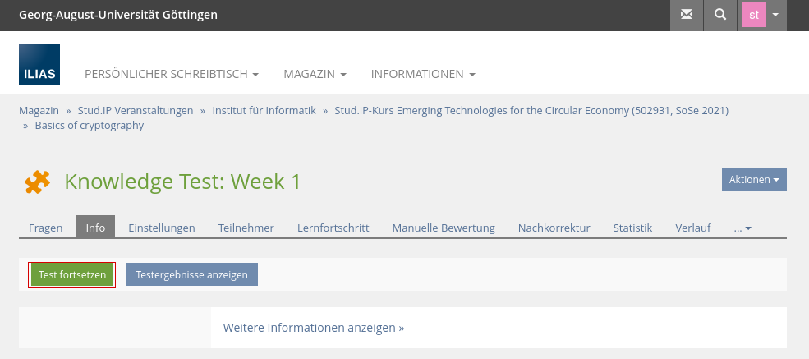
Multiple-Choice Exercises – Göttingen
Step-3: On ILIAS, to attempt the test, click on "Test Fortsetzen"

Slide 24
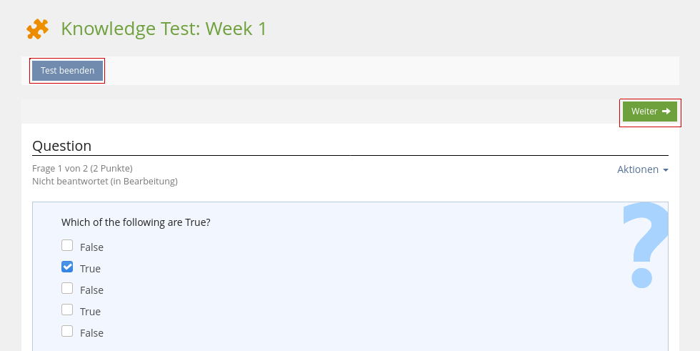
Multiple-Choice Exercises – Göttingen
Step-4: After answering a question, click on "Weiter" for the next question, and on "Test beenden" after you answer all questions

Slide 25
Multiple-Choice Exercises – Clausthal
Every student enrolled in this course is required to take the Knowledge quiz in first two weeks of the course.
The first knowledge test will be available on Moodle from Monday, 17 April 2023, 5:00 PM until 24 April 2023 01:59 PM
The second knowledge test will be available on Moodle from Monday, 24 April 2023, 5:00 PM until 01 May 2023 01:59 PM
Goal of the test:
To check the knowledge level of the student that is relevant to this course of study.
Preparation:
A review of basic concepts of Cryptography and Circular Economy is recommended for Week 1 and Week 2 respectively
Knowledge quiz for Week 1 only tests your existing knowledge.
Test structure:
Total 25 multiple choice questions → no time limit.
Each question can fetch a maximum of 1 point
IMPORTANT : Incorrect choices will yield in negative points. An incorrect choice in a question will take away just as many points as a correct choice is awarded.
Each test is evaluated on a grade scale of 10.
The result of your test will be available after the quiz is closed.

Slide 26
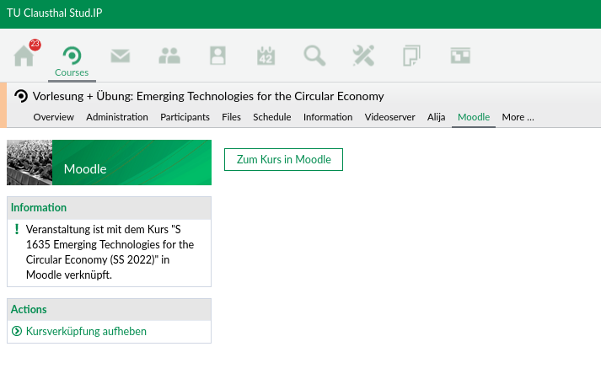
Multiple-Choice Exercises – Clausthal
Step-1: Navigate to Moodle on your studip, select "Zum Kurs in Moodle"

Slide 27
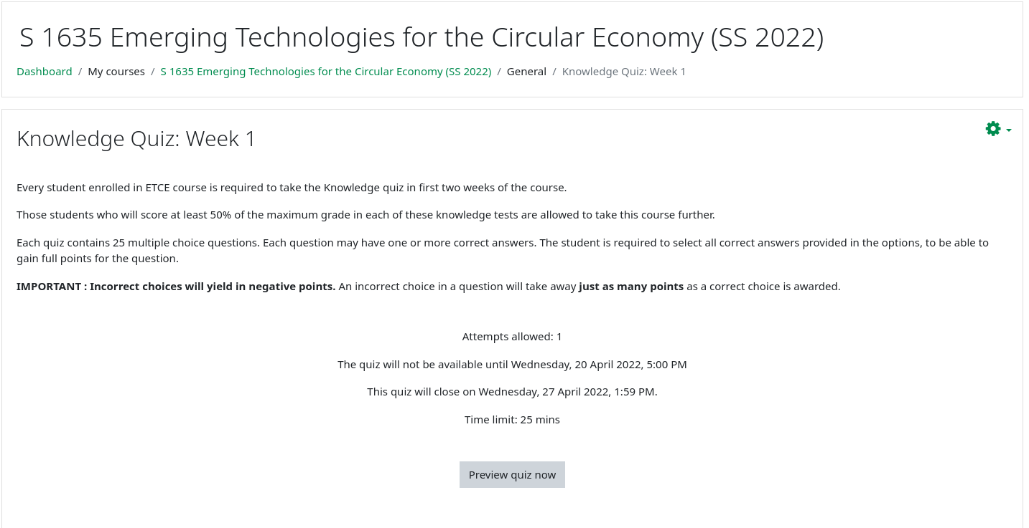
Multiple-Choice Exercises – Clausthal
Step-2 : Select "Knowledge Quiz - Week 1"

Slide 28
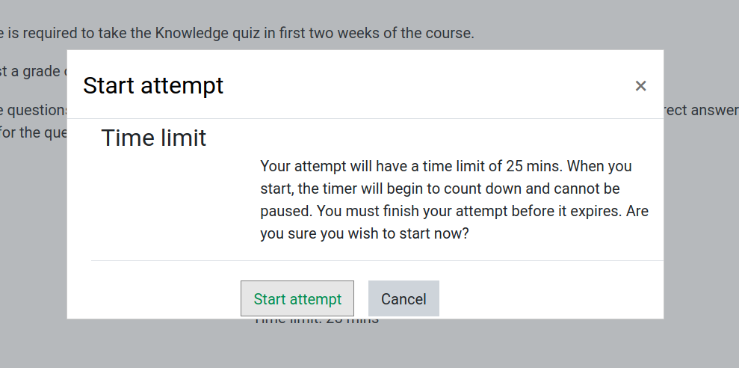
Multiple-Choice Exercises – Clausthal
Step-3 : Start your test if you are ready

Slide 29
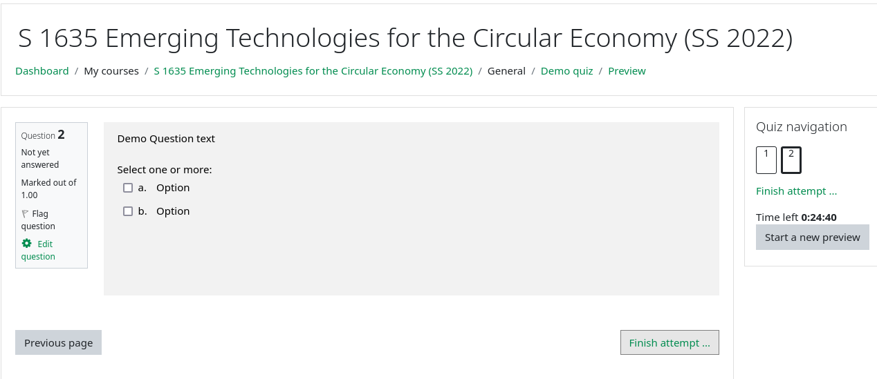
Multiple-Choice Exercises – Clausthal
Step-4 :
A. Sequence of questions
B. Timer running for the test
C. Navigate to next question/Finish attampt
D. Navigate to previous question
A
B
D
C

Slide 30
Examination
Prerequisite for admission to the final exam (all criteria have to be fulfilled):
Submit all exercises
Final exam:
Clausthal
Written exam (120min) via Moodle
Date → Most likely 07.08.2023 from 2 pm – 5 pm
Göttingen
Oral examination (20min) via BBB
Date → Most likely 08.08.2023

Slide 31
Self-Study Star
Slides with the self-study star indicate optional/additional study material that is not mandatory but could be helpful or interesting
Self-Study Star →

Slide 32
Literature
This course is not based on a single book and you do not need to buy a book to pass the exam.
Donella H. Meadows, Jorgen Randers, and Dennis L. Meadows. The Limits to Growth (1972).
Donella H. Meadows, Jorgen Randers, and Dennis L. Meadows. Limits To Growth: The 30-Year Update (2004).
Baccini et al. Metabolism of the Anthroposphere: Analysis, Evaluation, Design (2012).
Walter R. Stahel. The Circular Economy: A User's Guide (2019).
W. Brian Arthur. The Nature of Technology: What It Is and How it Evolves (2011).
David Wallace-Wells. The Uninhabitable Earth, Annotated Edition (2017).

Slide 33
Literature
(German) Stefan Rahmstorf, Hans Joachim Schellnhuber. Der Klimawandel (2019).
David Archer, Stefan Rahmstorf. The Climate Crisis (2010).
Gabrielle Walker, David King. The Hot Topic: How to Tackle Global Warming and Still Keep the Lights on (2008).

Slide 34
Literature
Satoshi Nakamoto. Bitcoin: A Peer-to-Peer Electronic Cash System (2008) – (Link).
Gavin Wood. Ethereum: A Secure Decentralized Generalised Transaction Ledger (2014) – (Link).
Andreas Schütz und Tobias Fertig. Blockchain für Entwickler: Grundlagen, Programmierung, Anwendung (2019).
M.A. Khan, M.T. Quasim, F. Algarni, A. Alharthi. Decentralised Internet of Things (2020).
Dimitrios Serpanos und Marilyn Claire Wolf. Internet-of-Things (IoT) Systems Architectures, Algorithms, Methodologies (2018).
Perry Lea. Internet of Things for Architects: Architecting IoT solutions by implementing sensors, communication infrastructure, edge computing, analytics, and security (2018).
Dan Boneh, Amit Sahai und Brent Waters. Functional Encryption: Definitions and Challenges (2010).

Slide 35
Further Resources
Climate University – Teaching and learning for a sustainable future – Link
Circular Societies (German) – Link
Server Infrastructure for a Global Rebellion – Link
Podcasts:
Drilled (Link)
How to Save a Planet (Link)
1,5 Grad – der Klima-Podcast mit Luisa Neubauer (German) (Link)

Slide 36
Questions?

