Slide 1
Requirement Engineering
Lecture 0: Organization
Prof. Dr. Benjamin Leiding
M.Sc. Anant Sujatanagarjuna

Slide 2
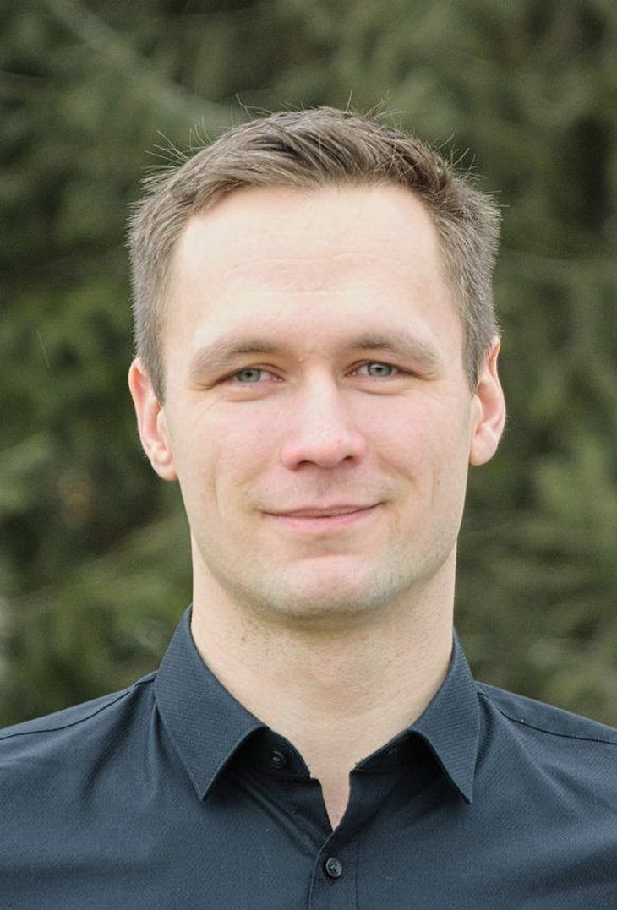

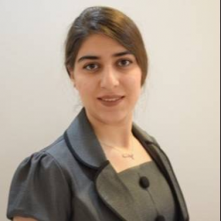
Team
Prof. Dr. Benjamin Leiding
benjamin.leiding@tu-clausthal.de
M.Sc. Anant Sujatanagarjuna
anant.sujatanagarjuna@tu-clausthal.de
B.Sc. Sepideh Sayadkouh
sepideh.sayadkouh@tu-clausthal.de

Slide 3
Research Group
Emerging Technologies for the Circular Economy → ETCE
Research focus:
Intersection of IT and sustainability
Circular Economy and Circular Societies
Self-organized, decentralized and distributed systems
Localized and resilient food production → watch our mushrooms! (Link)
Other courses:
Emerging Technologies for the Circular Economy (SS – M.Sc.)
The Limits to Growth – Sustainability and the Circular Economy (SS – open for everyone)
Notes:
6

Slide 4
Research Group
Website – Link
Course material
Thesis/project topics
Publications
Etc.
Our research in action:
ZDF documentary (German) – Link
Klartext Preis 2020 (German) – Link
You want join us? Write us an email!
→ benjamin.leiding@tu-clausthal.de
Notes:
6

Slide 5
Course Content
Core terminology and core tasks of requirements engineering
Requirements engineering process
Elicitation techniques
Documentation methods
Textual, model-based and formal requirements specification
Requirements negotiation
Requirements Management
Traceability
Requirements validation and quality assurance
Notes:
6

Slide 6
Learning Outcome
Core terminology and core tasks of requirements engineering
Understanding of the requirements engineering process
Ability to choose, justify and apply appropriate methods and techniques for each step of the requirements engineering process given project constraints and properties
What is this course about, what is it not about?
Notes:
<number>

Slide 7
Disclaimer
The course modelled and built based on the book „Requirements Engineering – Fundamentals, Principles and Techniques (2010)” from Klaus Pohl
Special thanks to Prof. Dr. Steffen Herbold and Dr. Christian Bartelt, who provided valuable input in the form of the teaching materials of their requirements engineering courses.

Slide 8
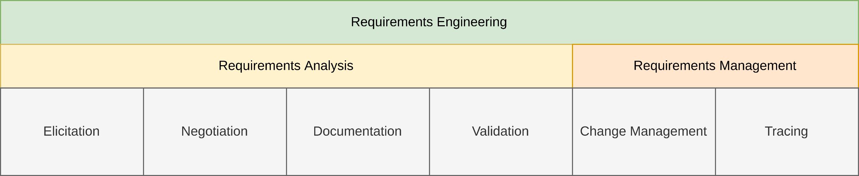
Course Content

Slide 9
Lectures
26.10.2022 → No lecture
02.11.2022 → Organization (L00) + Introduction (L01)
09.11.2022 → System Context Boundaries and Types of Requirements (L02)
16.11.2022 → Elicitation – Part 1 (L03)
23.11.2022 → Elicitation – Part 2 (L04) and Negotiations (L05)
30.11.2022 → Documentation – Introduction (L06)
07.12.2022 → Documentation – Textual Requirements Specification (L07)
14.12.2022 → Documentation – Model-based Requirements Documentation (L08)
21.12.2022 → Documentation – Formal Requirements Specification (L09)
11.01.2023 → Validation (L10)
18.01.2023 → Traceability (L11)
25.01.2023 → Requirements Management (L12) and Tool Support (L13)
01.02.2023 → No lecture
08.02.2023 → Exam Q&A

Slide 10
Exercises
09.11.2022 → Exercise 01 – Knowledge Test (MC)
23.11.2022 → Exercise 02 – Elicitation I
30.11.2022 → Exercise 03 – Elicitation II
14.12.2022 → Exercise 04 – Agent-oriented Modelling
21.12.2022 → Exercise 05 – Coloured Petri Nets I
11.01.2023 → Exercise 06 – Coloured Petri Nets II
18.01.2023 → Bonus Task
25.01.2023 → Exercise 07 – Management and Traceability (MC)

Slide 11
Course Organization
Organization of the lecture:
Slides are available via Github (Link)
Please report bugs!
Lectures and exercises live stream (BBB – next slide) and Goslar
No lecture recordings
Exercise time slots = Time for questions and eventual tutorials related to the exercises
Questions? Write us an email: etce-re@tu-clausthal.de ← We will only respond to
emails written to this specific email address!

Slide 12
Dates/Times/Locations
Lecture:
Wednesday 2:15 pm to 3:45 pm (Berlin time) – 02.11.2022 to 08.02.2023
Location: Goslar Gotec (Am Stollen 19 C, 38640 Goslar, Germany) or via BigBlueButton (Link)
Exercise / Q&A:
Wednesday 4 pm to 5:30 pm (Berlin time) – 02.11.2022 to 08.02.2023
Location: Goslar Gotec (Am Stollen 19 C, 38640 Goslar, Germany) or via BigBlueButton (Link)

Slide 13
Exercises
Organization of the exercise:
Individual work → no group submissions
Multiple-Choice or practical tasks
7-14 days to submit (depending on the task)
Submission deadline is always Wednesday at 1:59pm (right before the next lecture)
Submission of each exercise is mandatory
More info on points, percentages, etc. follow on the next slides (Examination)

Slide 14
Exercises
Bonus task:
You may miss/fail one of the regular exercises
Submitting AND passing the bonus task substitutes the missed/failed exercise
Bonus task will be very difficult → don’t “plan” with the bonus task. Rather submit and pass the regular exercises.

Slide 15
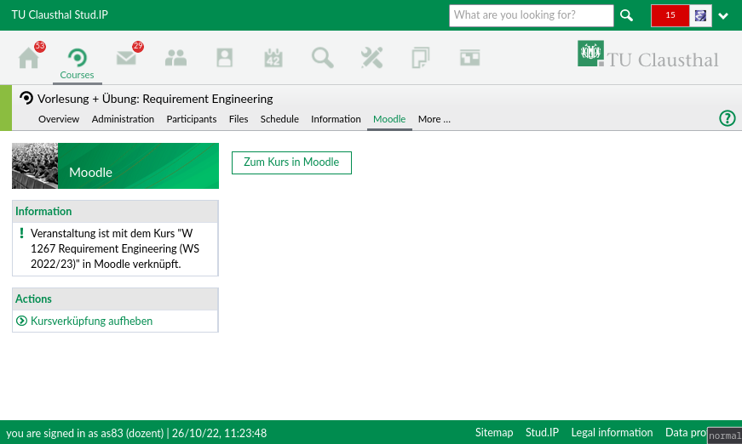
Multiple-Choice Exercises
Step-1: Navigate to Moodle on your studip, select "Zum Kurs in Moodle"

Slide 16
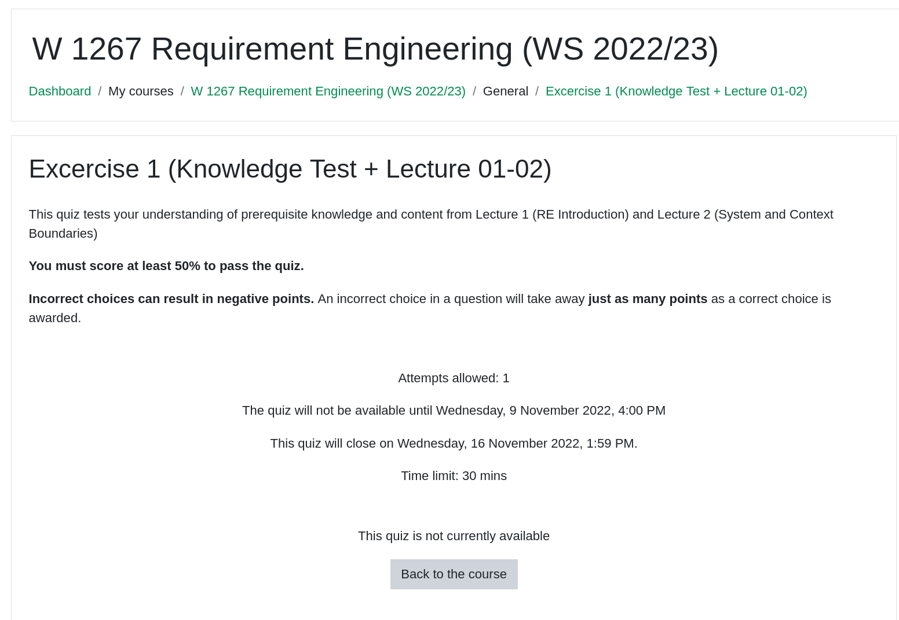
Multiple-Choice Exercises
Step-2 : Select "Exercise 1"

Slide 17
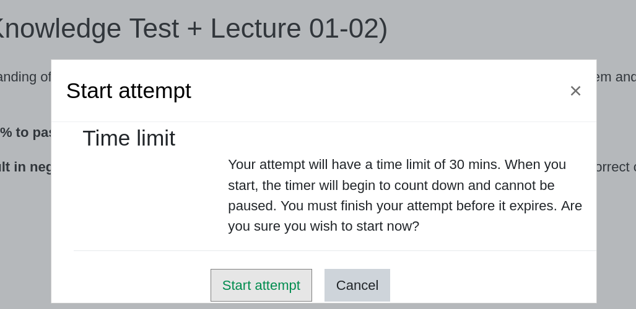
Multiple-Choice Exercises
Step-3 : Start your test if you are ready

Slide 18
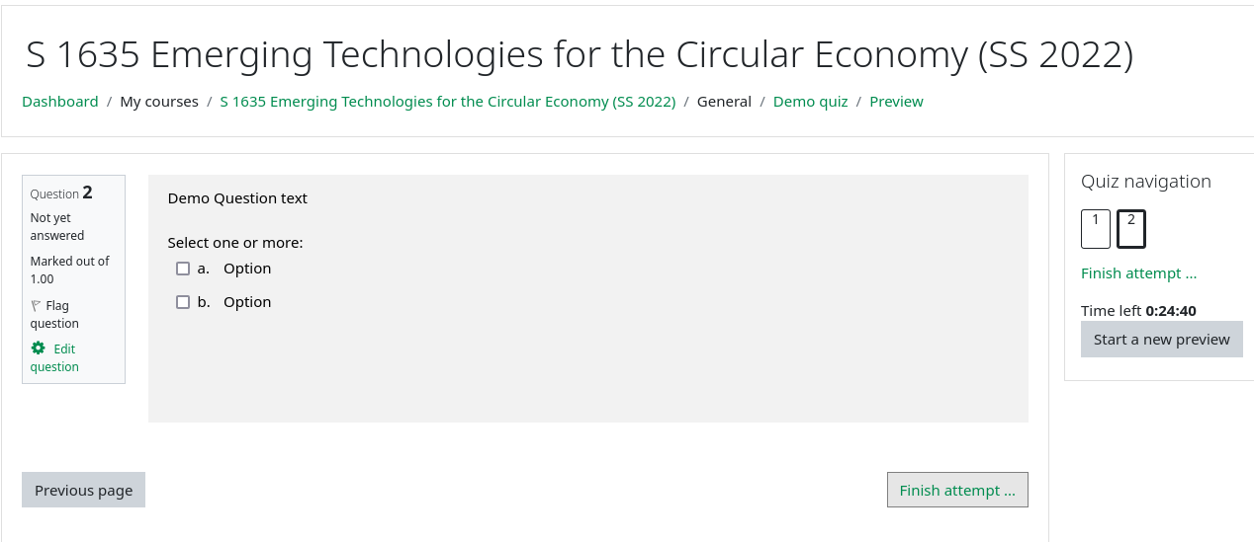
TODO – Update images
Multiple-Choice Exercises
Step-4 :
A. Sequence of questions
B. Timer running for the test
C. Navigate to next question/Finish attampt
D. Navigate to previous question
A
B
D
C

Slide 19
Examination
Prerequisites for admission to the final exam (all criteria have to be fulfilled):
Successful completion of the compulsory five exercises
You pass an exercise if you score 50% (or more)
You have to submit every exercise
Final exam:
22.02.2023 → 14:00 – 16:00
Written exam (120min)

Slide 20
Self-Study Star
Slides with the self-study star indicate optional/additional study material that is not mandatory but could be helpful for your future career
Of course it won’t hurt to have extra knowledge to impress us during the examination ;)
Self-Study Star →

Slide 21
Literature
This course is not based on a single book and you do not need to buy a book to pass the exam.
K. Pohl. Requirements Engineering – Fundamentals, Principles and Techniques (2010).
K. Pohl, C. Rupp. Requirements Engineering Fundamentals: A Study Guide for Requirements Engineering Foundation Level (2011).
J. Dick, E. Hull, K. Jackson. Requirements Engineering (4th Edition) (2017).
Chris Rupp et al. Requirements Engineering und Management – Das Handbuch für Anforderungen in jeder Situation (7th Edition) (2021).

Slide 22
Questions?

