Slide 1
The Limits to Growth: Sustainability and the Circular Economy
Lecture 12: Beyond the Circular Economy II
Prof. Dr. Benjamin Leiding
M.Sc. Anant Sujatanagarjuna
M.Sc. Nelly Nicaise Nyeck Mbialeu

Slide 2
License
This work is licensed under a Creative Commons Attribution-ShareAlike 4.0 International License. To view a copy of this license, please refer to https://creativecommons.org/licenses/by-sa/4.0/ .
Updated versions of these slides will be available in our Github repository.

Slide 3
Recap

Slide 4
Recap
Eco-Sufficiency – Definition(s)
“Seeking enough when more is possible is both intuitive and rational - personally, organizationally and ecologically. And under global ecological constraint, it is ethical.” - Thomas Princen
“A set of policy measures and daily practices that avoid the demand for energy, materials, land, water, and other natural resources while providing wellbeing for all within the planetary boundaries.” - IPCC
Thomas Princen (2005) – The Logic of Sufficiency
IPCC AR6 Synthesis Report: Climate Change 2023 – https://www.ipcc.ch/report/sixth-assessment-report-cycle/

Slide 5
Recap
Eco-Sufficiency – Definition(s)
“Seeking enough when more is possible is both intuitive and rational - personally, organizationally and ecologically. And under global ecological constraint, it is ethical.” - Thomas Princen
“A set of policy measures and daily practices that avoid the demand for energy, materials, land, water, and other natural resources while providing wellbeing for all within the planetary boundaries.” - IPCC
Sufficiency → All you need is less
Thomas Princen (2005) – The Logic of Sufficiency
IPCC AR6 Synthesis Report: Climate Change 2023 – https://www.ipcc.ch/report/sixth-assessment-report-cycle/

Slide 6
Recap
15h Work Week
John Maynard Keynes predicted a 15h work week in his 1930 essay “Economic Possibilities for our Grandchildren”

Slide 7
Recap
Bullshit Job – Definition
„Form of paid employment that is so completely pointless, unnecessary, or pernicious that even the employee cannot justify its existence even though, as part of the conditions of employment, the employee feels obliged to pretend that this is not the case.”
→ Inefficiencies in capitalism?
D. Graeber (2013) – On the Phenomenon of Bullshit Jobs – Essay – Link
D. Graeber (2018) – Bullshit Jobs: A Theory

Slide 8
Recap
Bullshit Jobs – Now What?
Graeber’s solution → Universal Basic Income (UBI) → Livable benefit paid to all, thus letting people work at their leisure
D. Graeber (2013) – On the Phenomenon of Bullshit Jobs – Essay – Link
D. Graeber (2018) – Bullshit Jobs: A Theory

Slide 9
Universal basic income

Slide 10
Universal Basic Income
Overview
Short → UBI
Synonym(s):
Basic Income Guarantee (BIG)
Unconditional Basic Income
Currently not implemented by any country
Several small-scal pilots and a few large-scale experiments have been conducted or are still being conducted

Slide 11
Universal Basic Income
Overview
Short → UBI
Synonym(s):
Basic Income Guarantee (BIG)
Unconditional Basic Income
Currently not implemented by any country
Several small-scale pilots and a few large-scale experiments have been conducted or are still being conducted

Slide 12
Universal Basic Income
Overview
Everyone receives a minimum income in the form of an unconditional transfer payment → no strings attached | no extra conditions (e.g., work, etc.)
Different forms, e.g.:
Guaranteed minimum income → Paid to those who do not make enough money to live
Universal basic income → Indepent of any other income
Full basic income → Sufficient to meet a person's basic needs (above poverty level)
Partial basic income → Below poverty level
This is just a very short teaser on UBI → You can do a complete lecture series just on UBI.

Slide 13
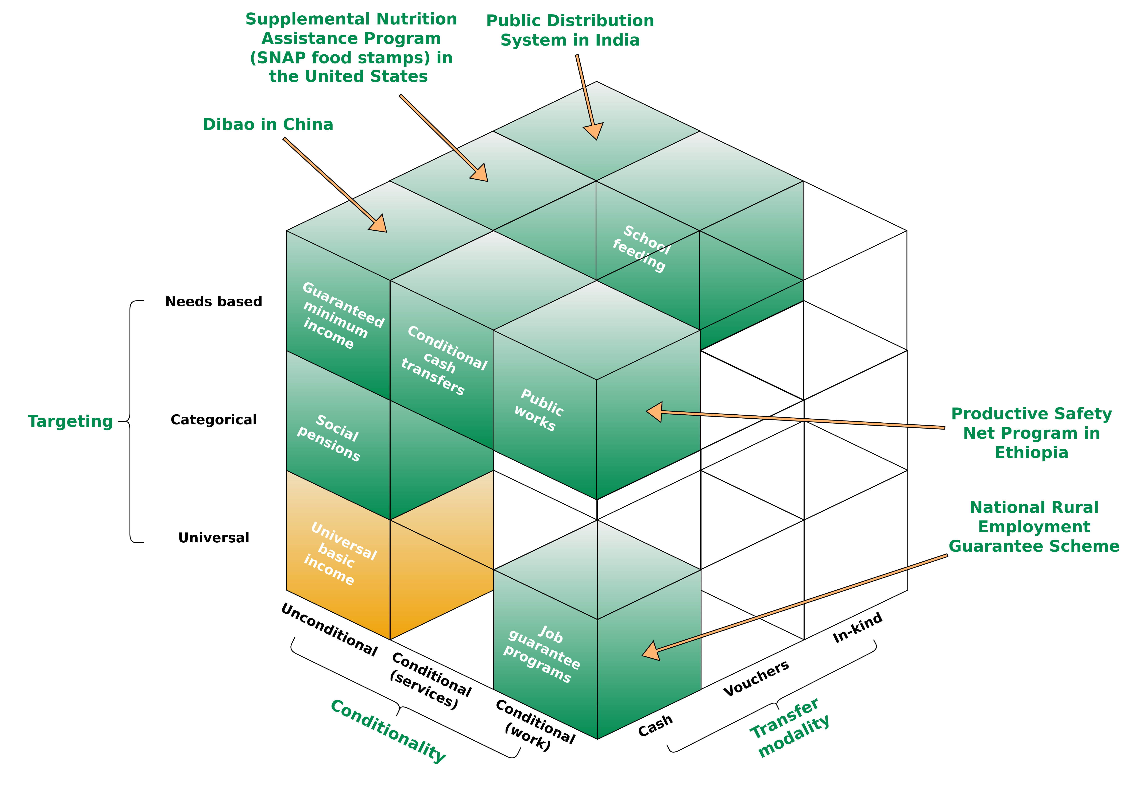
Universal Basic Income
Overview
Figure adapted from Gentilini, Ugo, Margaret Grosh, Jamele Rigolini, and Ruslan Yemtsov, eds. Exploring universal basic income: A guide to navigating concepts, evidence, and practices. World Bank Publications, 2019.

Slide 14
Universal Basic Income
TODO
A Short History
TODO – future iterations of the course

Slide 15
Universal Basic Income
Definition(s)
“A transfer that is provided universally, unconditionally, and in cash” – World Bank
“A Basic Income is a periodic cash payment unconditionally delivered to all on an individual basis, without means-test or work requirement.” - Basic Income Earth Network
1.) The World Bank (2020) – Exploring Universal Basic Income : A Guide to Navigating Concepts, Evidence, and Practices - Link
2.) BIEN (Basic Income Earth Network) – https://basicincome.org/about-basic-income

Slide 16
Universal Basic Income
Definition(s)
“A transfer that is provided universally, unconditionally, and in cash” – World Bank
“A Basic Income is a periodic cash payment unconditionally delivered to all on an individual basis, without means-test or work requirement.” - Basic Income Earth Network
Periodic → Paid at regular intervals
Cash payment → Paid in an appropriate medium of exchange
Individual → Paid on an individual basis (e.g., not to households)
Universal → Paid to everyone
Unconditional → Paid without means test and without a requirement to work or to demonstrate willingness-to-work
1.) The World Bank (2020) – Exploring Universal Basic Income : A Guide to Navigating Concepts, Evidence, and Practices - Link
2.) BIEN (Basic Income Earth Network) – https://basicincome.org/about-basic-income

Slide 17
Universal Basic Income
Definition(s)
“A transfer that is provided universally, unconditionally, and in cash” – World Bank
“A Basic Income is a periodic cash payment unconditionally delivered to all on an individual basis, without means-test or work requirement.” - Basic Income Earth Network
Periodic → Paid at regular intervals
Cash payment → Paid in an appropriate medium of exchange
Individual → Paid on an individual basis (e.g., not to households)
Universal → Paid to everyone
Unconditional → Paid without means test and without a requirement to work or to demonstrate willingness-to-work
1.) The World Bank (2020) – Exploring Universal Basic Income : A Guide to Navigating Concepts, Evidence, and Practices - Link
2.) BIEN (Basic Income Earth Network) – https://basicincome.org/about-basic-income

Slide 18
Universal Basic Income
Definition(s)
“A transfer that is provided universally, unconditionally, and in cash” – World Bank
“A Basic Income is a periodic cash payment unconditionally delivered to all on an individual basis, without means-test or work requirement.” - Basic Income Earth Network
Periodic → Paid at regular intervals
Cash payment → Paid in an appropriate medium of exchange
Individual → Paid on an individual basis (e.g., not to households)
Universal → Paid to everyone
Unconditional → Paid without means test and without a requirement to work or to demonstrate willingness-to-work
1.) The World Bank (2020) – Exploring Universal Basic Income : A Guide to Navigating Concepts, Evidence, and Practices - Link
2.) BIEN (Basic Income Earth Network) – https://basicincome.org/about-basic-income

Slide 19
Universal Basic Income
Definition(s)
“A transfer that is provided universally, unconditionally, and in cash” – World Bank
“A Basic Income is a periodic cash payment unconditionally delivered to all on an individual basis, without means-test or work requirement.” - Basic Income Earth Network
Periodic → Paid at regular intervals
Cash payment → Paid in an appropriate medium of exchange
Individual → Paid on an individual basis (e.g., not to households)
Universal → Paid to everyone
Unconditional → Paid without means test and without a requirement to work or to demonstrate willingness-to-work
1.) The World Bank (2020) – Exploring Universal Basic Income : A Guide to Navigating Concepts, Evidence, and Practices - Link
2.) BIEN (Basic Income Earth Network) – https://basicincome.org/about-basic-income

Slide 20
Universal Basic Income
Definition(s)
“A transfer that is provided universally, unconditionally, and in cash” – World Bank
“A Basic Income is a periodic cash payment unconditionally delivered to all on an individual basis, without means-test or work requirement.” - Basic Income Earth Network
Periodic → Paid at regular intervals
Cash payment → Paid in an appropriate medium of exchange
Individual → Paid on an individual basis (e.g., not to households)
Universal → Paid to everyone
Unconditional → Paid without means test and without a requirement to work or to demonstrate willingness-to-work
1.) The World Bank (2020) – Exploring Universal Basic Income : A Guide to Navigating Concepts, Evidence, and Practices - Link
2.) BIEN (Basic Income Earth Network) – https://basicincome.org/about-basic-income

Slide 21
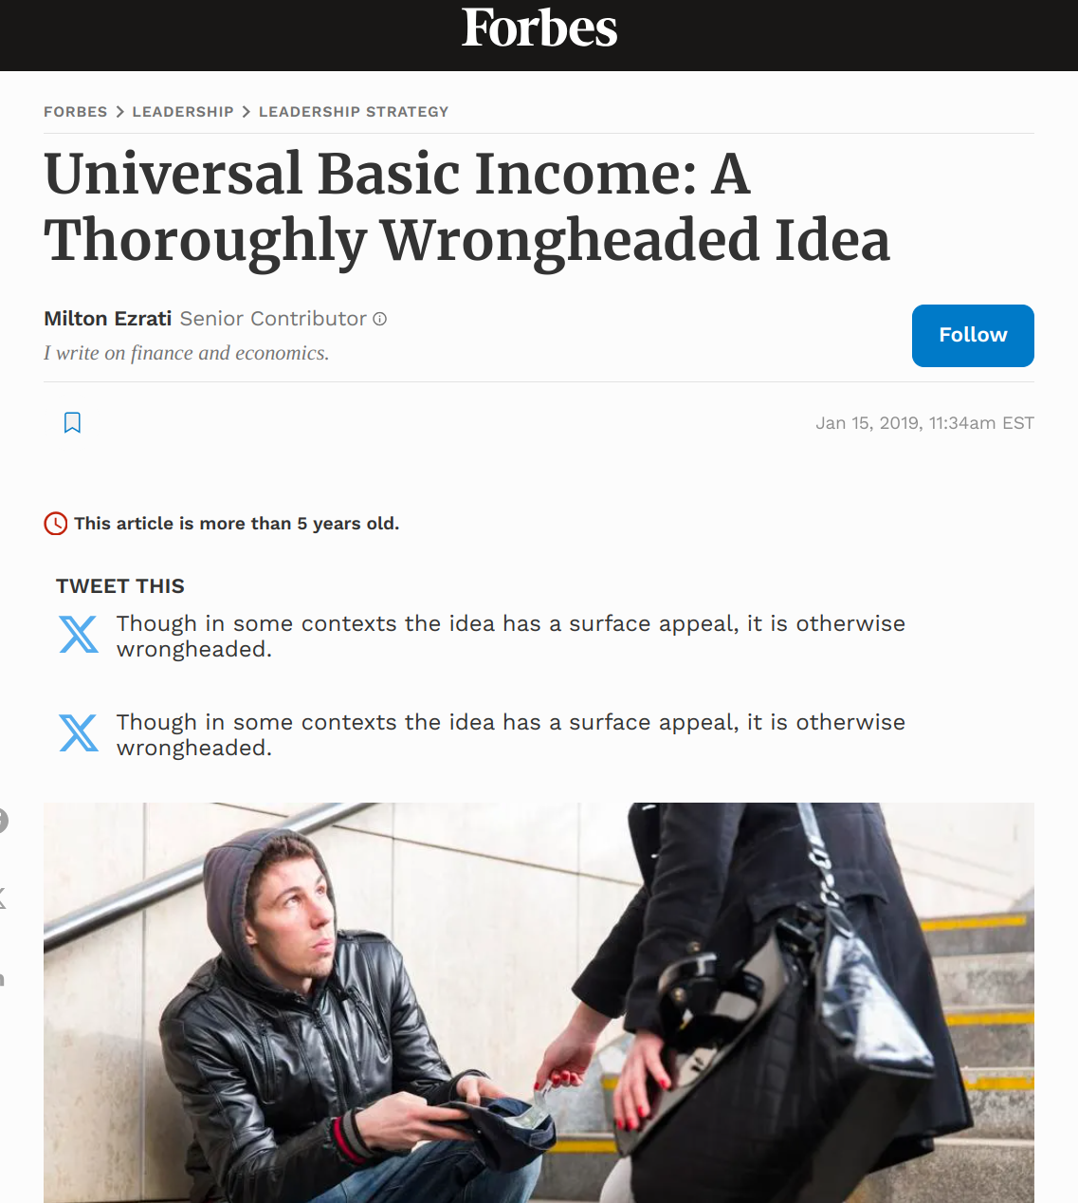
Universal Basic Income
Detour – AI Propaganda
https://www.forbes.com/sites/miltonezrati/2019/01/15/universal-basic-income-a-thoroughly-wrongheaded-idea/

Slide 22
Universal Basic Income
Detour – AI Propaganda
https://www.forbes.com/sites/miltonezrati/2019/01/15/universal-basic-income-a-thoroughly-wrongheaded-idea/

Slide 23
Task 1 – what are the Advantages / Disadvantages of A UBI? (10min)

Slide 24
Universal Basic Income
Advantages
Results → Group Presentation

Slide 25
Universal Basic Income
Challenges / Critiscm
Results → Group Presentation

Slide 26
Universal Basic Income
Funding (Germany)
German population: 84 million
UBI per person → 1.200€
Cost for a German UBI ~ 1 trillion Euro

Slide 27
Universal Basic Income
Funding (Germany)
Bundesministerium der Finanzen 2025
Adapted from https://www.bundeshaushalt.de/DE/Bundeshaushalt-digital/bundeshaushalt-digital.html

Slide 28
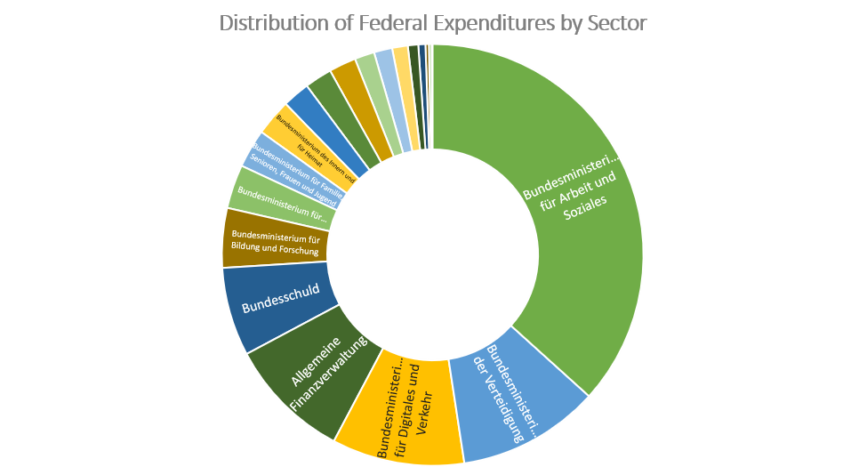
Universal Basic Income
Funding (Germany)
Amount in thousands of Euro
488.609.000
36,69%
179.257.094 (in Tausend Euro)
6,8%
33.216.446 (in Tausend Euro)
9,45%
46.170.579 (in Tausend Euro)
10,17%
49.667.947 (in Tausend Euro)
10,09%
53.250.000 (in Tausend Euro)
Adapted from https://www.bundeshaushalt.de/DE/Bundeshaushalt-digital/bundeshaushalt-digital.html
Bundesministerium der Finanzen 2025

Slide 29
Universal Basic Income
Funding (Germany) – Financial Transaction Tax
Financial transaction tax
Tax financial transactions (stock exchange, etc. - not everyday transactions, e.g., supermarket)
Prevent financial market speculation from being more profitable than investments in the real economy.
→ Less gambline in the finance sector
→ Only professional finanance gamblers loose money, nobody else

Slide 30
Universal Basic Income
Funding (Germany) – Financial Transaction Tax
Financial transaction tax
Tax financial transactions (stock exchange, etc. - not everyday transactions, e.g., supermarket)
Prevent financial market speculation from being more profitable than investments in the real economy.
→ Less gambling in the finance sector
→ Only professional finanance gamblers loose money, nobody else

Slide 31
Universal Basic Income
Funding (Germany) – Various Other Tax Apporaches
Negative income tax
→ Individuals earning below a certain threshold receive supplemental pay from the government instead of paying taxes
Taxation of consumption
→ Financed by a value-added tax (VAT), which replaces all other taxes and social security contributions levied to date.
Taxation of natural ressources
Etc.

Slide 32
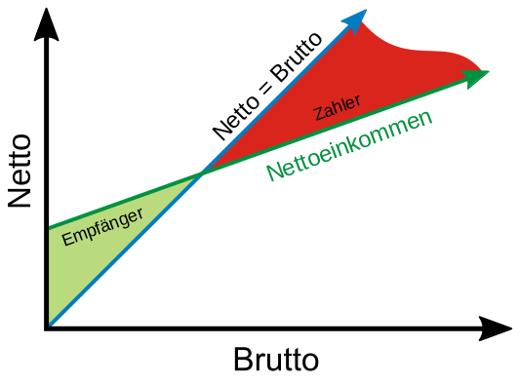
Universal Basic Income
Funding (Germany) – Various Other Tax Apporaches
Negative income tax
→ Individuals earning below a certain threshold receive supplemental pay from the government instead of paying taxes
Taxation of consumption
→ Financed by a value-added tax (VAT), which replaces all other taxes and social security contributions levied to date.
Taxation of natural ressources
Etc.
Figure adapted from Frank Murmann - https://de.wikipedia.org/wiki/Datei:Negative_Einkommenssteuer.svg

Slide 33
Universal Basic Income
Funding (Germany) – Various Other Tax Apporaches
Negative income tax
→ Individuals earning below a certain threshold receive supplemental pay from the government instead of paying taxes
Taxation of consumption
→ Financed by a value-added tax (VAT), which replaces all other taxes and social security contributions levied to date.
Taxation of natural ressources
Etc.

Slide 34
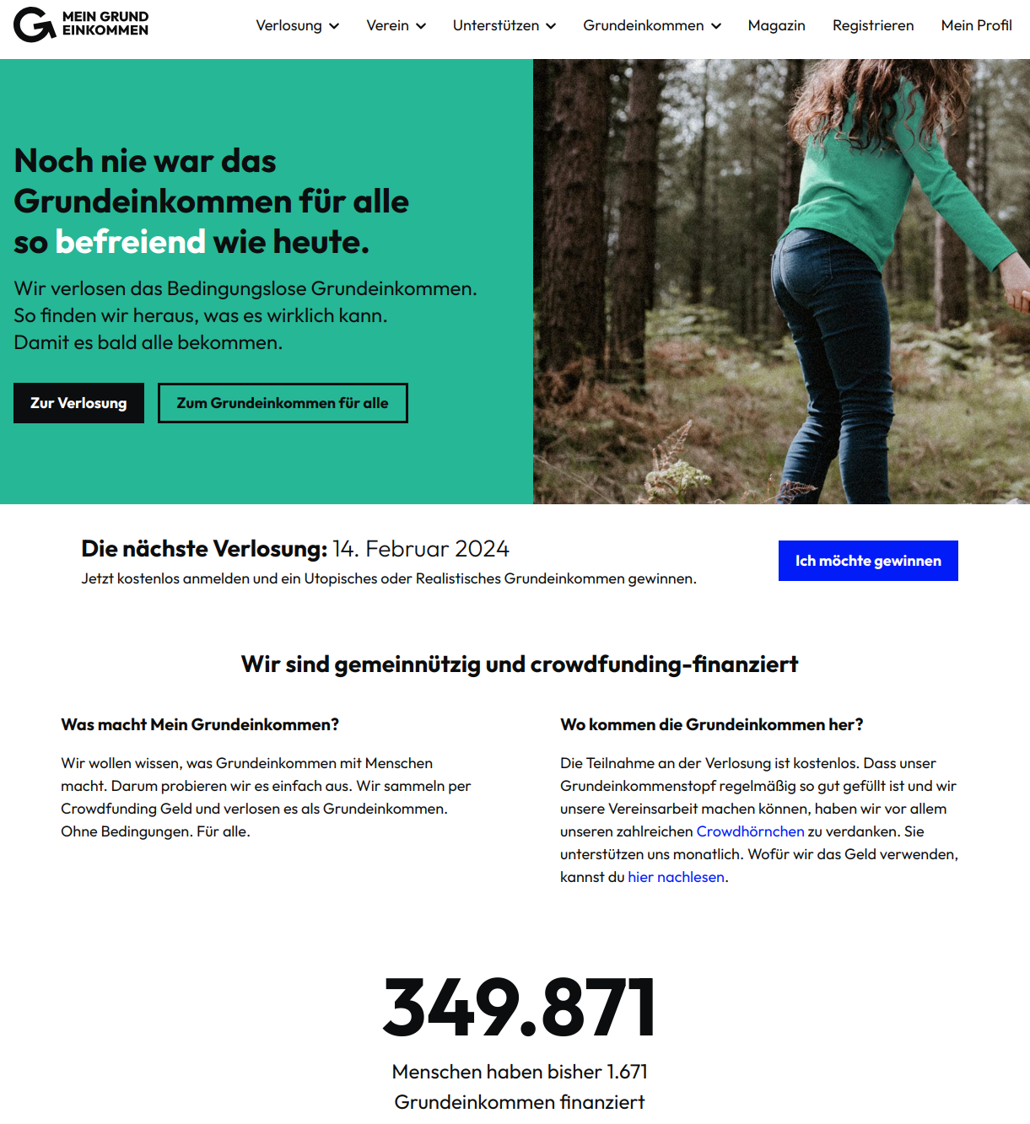
Universal Basic Income
UBI Raffle – Get a UBI for Free
https://www.mein-grundeinkommen.de

Slide 35
Economy for the Common Good
(Gemeinwohl-Ökonomie)

Slide 36
Post-Growth Economy
(Postwachstumsökonomie)

Slide 37
Post-Growth Economy
TODO
Post-Growth Economy vs. Economy for the Common Good
a

Slide 38
Conclusion

Slide 39
Conclusion
Everyone receives a minimum income in the form of an unconditional transfer payment → no strings attached | no extra conditions (e.g., work, etc.)
Different forms, e.g.: Guaranteed minimum income vs. Universal basic income (full | partial)
UBI funding is challenging, various approaches have been discussed
Currently not implemented by any country
Several small-scale pilots and a few large-scale experiments have been conducted or are still being conducted

Slide 40
Additional Resources
Manfred Folkers, Niko Paech (2020) – All you need is less
Christian Felber (2010) - Die Gemeinwohl-Ökonomie – Das Wirtschaftsmodell der Zukunft
Christian Felber, Gus Hagelberg (2017) – The Economy for the Common Good: A Workbable, Transformative Ethics-Based Alternative – Link
Rutger Bregman (2017) – Utopia for Realists: And How We Can Get There
Mein Grund Einkommen (Berlin based non-profit organization) – Link

Slide 41
Questions?

