Slide 1
Requirement Engineering
Lecture 3: Requirements Elicitation
Prof. Dr. Benjamin Leiding
Anant Sujatanagarjuna

Slide 2
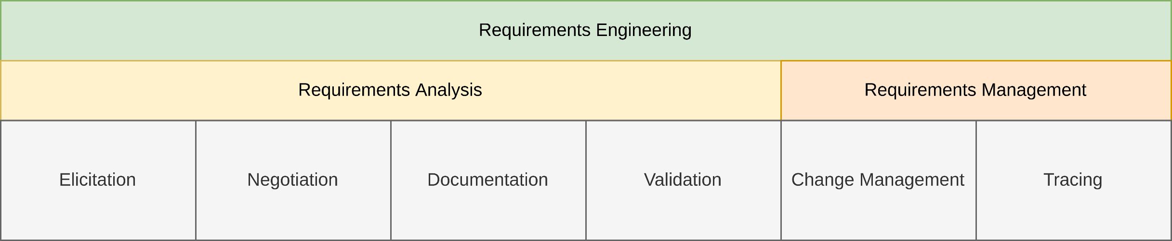
General Requirements Engineering Process
Overview

Slide 3
Lecture 3: Requirements Elicitation
Content
Getting the Right Information is Tricky
Requirement Sources
Elicitation Techniques
Assistance/Support Techniques
HSN:/RE as part of Software Engineering

Slide 4
Getting the Right Information is Tricky

Slide 5
Getting the Right Information is Tricky
Requirements Engineering = Communication
In Software Engineering (SE) we can assume that there exists prior documentation → But not in Requirements Engineering

Slide 6
Getting the Right Information is Tricky
Requirements Engineering = Communication
In Software Engineering (SE) we can assume that there exists prior documentation → But not in Requirements Engineering
In the beginning requirements are
unknown
unconscious
Misunderstood
Furthermore there are different opinions about the requirements (in general at least one per stakeholder)

Slide 7
Getting the Right Information is Tricky
Requirements Engineering = Communication
In Software Engineering (SE) we can assume that there exists prior documentation → But not in Requirements Engineering
In the beginning requirements are
unknown
unconscious
Misunderstood
Furthermore there are different opinions about the requirements (in general at least one per stakeholder)
→ Acquisition of information as part of the requirements engineering activity is called Elicitation

Slide 8

Getting the Right Information is Tricky
Objectives of the Elicitation Phase
Why do we need to elicit information?
Knowledge acquisition (Elicitation, Acquisition)
About involved persons and objectives
Current state
Expectations
Domain

Slide 9
Getting the Right Information is Tricky
Communication Problems
Communication happens via speech
Representation of experiences → perceptions)
Communication of personal reality → presentation) Conflicts
Customer / User
Requirements Engineer
Perception
Presentation
Interpretation
Objective reality
Personal reality
Linguistic expression
Result
interference
interference
interference

Slide 10
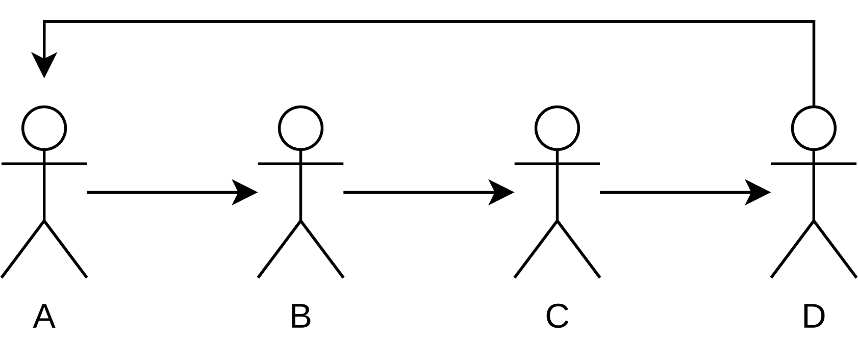
Getting the Right Information is Tricky
Communication Problems – Telephone Game
Youtube → Link

Slide 11
Getting the Right Information is Tricky
Communication Problems
Consideration of all stakeholders
Communication
Stakeholders can not describe abstractly what they are doing, why they are doing it, nor what they need to be able to do things.
Requests are much too general
Presentation of new possibilities and their consequences
Stakeholder like to keep their existing approaches
It is difficult to invent new approaches

Slide 12
Getting the Right Information is Tricky
Communication Problems
Conflicts
Cause of power struggles
Cause of opposition against changes
Priorities
Stakeholders want too much
Changes
Stakeholders always add new ideas

Slide 13
Requirement sources

Slide 14
Requirement Sources
Sources
Three kinds of requirement sources:
Stakeholders
People or organizations that influence the requirements of a system → users, operators, architects, testers, ...
Documents
Contain important information that can provide requirements → e.g., standards, legal documents, requirements documents, error reports of legacy systems, ...
Systems in operation
Legacy/predecessor systems or computer systems
Notes:
<number>

Slide 15
Requirement Sources
Type of Knowledge to Gain
Previous functions
e.g. secretary organized meetings
Problems
e.g. status of the organization is not recognizable for everyone, takes too long
Objectives for new functions / systems
e.g. transparent organization, faster
Factors of success
e.g. organizing a typical meeting within one day
Basic system architecture (how much components, partitioning)
e.g. install software for every employee
Notes:
<number>
<number>

Slide 16
Requirement Sources
Type of Knowledge to Gain
Realistic Solutions
e.g. System is gathering data, people are solving problems
Consequences and risks
e.g. too little freedom of decision for participants
Notes:
<number>
<number>

Slide 17
Requirement Sources
Typical Stakeholders
Customer
Actual and potential customers
Project leader
Business manager
User
Old and new users
Notes:
<number>
<number>

Slide 18
Requirement Sources
Typical Stakeholders
Developer
Product marketing
Project leader
Technical leader
Architect / Designer
Developer
Tester
Legal Department
Maybe in different locations, maybe in competing divisions
Notes:
<number>
<number>

Slide 19
Requirement Sources
Significance of Stakeholders
Stakeholders are the main source of requirements
Missing stakeholders → Missing requirements
Leads to change requests
Retroactive changes are expensive
Not all stakeholders are equally important
The stakeholders also require prioritization → Never tell them!
Maintain checklists of all stakeholders
Notes:
<number>

Slide 20
Requirement Sources
Maintenance of Stakeholder Data
Use tables and spreadsheets to handle stakeholder data
For each stakeholder, maintain at least:
The name
The function
Additional personal and contact data
Temporal and spatial availability during the project progress
Relevance of the stakeholder
Area and extent of expertise of the stakeholder
Goals in interests regarding the project
Notes:
<number>

Slide 21
Requirement Sources
Handling Stakeholders Throughout the Project
Continuous exchange of information
Periodic status updates
Continuous involvement turns stakeholders from affected by the project into collaborators
Principally affected stakeholders vs. well-integrated, jointly responsible stakeholders
Lack of attention may lead to overcritical stakeholders
However, stakeholders might not be motivated from the beginning → e.g., they like the existing legacy system
Requirements engineer supports project management with convincing stakeholders of the benefit of a project
Notes:
<number>

Slide 22
Requirement Sources
Agreement with Stakeholders
Formal agreements with stakeholders are often useful
Avoid misunderstandings and disputes regarding competence
Such agreements should include
Tasks
Responsibilities
Managerial authority
Individual goals
Communication paths
Feedback loops
Notes:
<number>

Slide 23
Requirement Sources
Agreement with Stakeholders
Can be informal (“shaking hands”) or formal with written documents
Should be signed of by the management
Notes:
<number>

Slide 24
Requirement Sources
Tasks of the Requirements Engineer
Speaks language of the stakeholders
Becomes thoroughly familiar with the application domain
Creates a requirements document
Is able to get work results across
Maintains a respectful relationship with any stakeholder
Presents ideas and alternatives as well as realizations
Allows stakeholders to demand properties that make the
system user-friendly and simple.
Ensures that the system satisfies the functional and qualitative demands of the stakeholders
Notes:
<number>

Slide 25
Requirement Sources
Tasks of the Stakeholder
Introduce the requirements engineer into the application domain
Supply the requirements engineer with requirements
Documents requirements assiduously
Make timely decisions
Respect the requirements engineer’s estimates of costs and feasibility
Prioritize requirements
Notes:
<number>

Slide 26
Requirement Sources
Tasks of the Stakeholder
Inspect requirements that the requirements engineer documents, such as prototypes, etc.
Communicate changes in the requirements immediately
Adhere to the predetermined change process
Respect the requirements engineering process that has been instated
Notes:
<number>

Slide 27
Elicitation Techniques

Slide 28
Elicitation Techniques
Overview
Support the identification of the conscious, unconscious, and subconscious requirements
No universal method!
Elicitation techniques must match the project
Factors for choosing a technique are
The distinction between conscious, unconscious and subconscious requirements
Time and budget constraints
Availability of stakeholders
Experience with a particular technique
Chances and risks of the project
Combination of different techniques minimizes risks
Notes:
<number>

Slide 29
Elicitation Techniques
Overview
Survey Techniques | Creativity Techniques | Document-centric Techniques | Observation Techniques | Support Techniques
Interviews | Brainstorming | System Archaeology | Field Observation | Mind Mapping
Questionnaires | Brainstorming Paradox | Perspective-based Reading | Apprenticing | Workshops
 | Change of Perspective | Reuse |  | CRC Cards
 | Analogy Technique |  |  | Audio and Video Recording
 |  |  |  | Use Case Modeling
 |  |  |  | Prototypes
Notes:
<number>

Slide 30
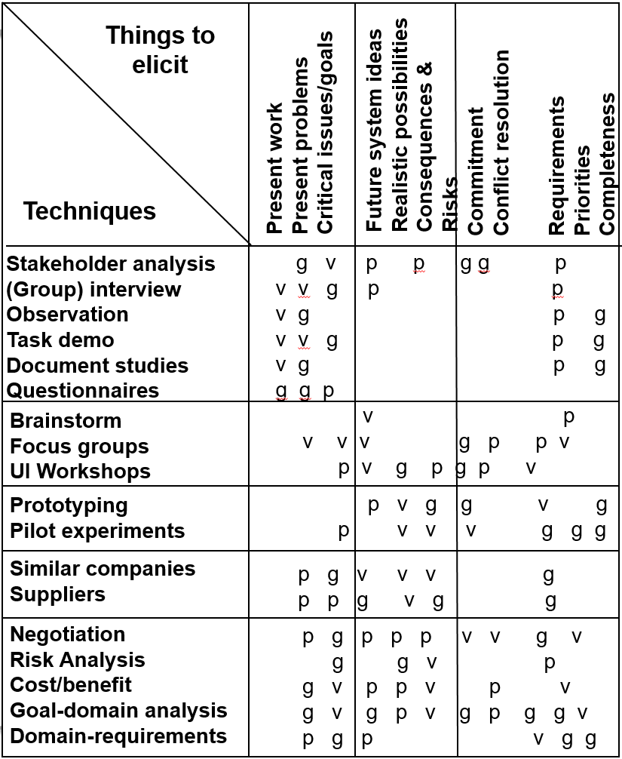
Elicitation Techniques
Aquisition Techniques
p = possible g = good
v = very good
Based on S. Lauesen (2002) – Software Requirements – Styles and Techniques
Notes:
<number>
<number>

Slide 31
Elicitation Techniques
The most common / important techniques
Interview
More time consuming
Requires explicit integration of standpoints
Allows better adaptation on background of the interviewed person and interests of the interviewee
Observations
Most complicated technique
Least impact of presumptions
A.M. Hickey, A.M. Davis (2003) – Elicitation Technique Selection: How do Experts do it?
Notes:
<number>

Slide 32
Elicitation Techniques
The most common / important techniques
Workshop
Frequently used technique
Relative little expenditure of time
Fundamental for team creation
Creates new ideas (→ Vision workshop)
Problems with social structures, focus on hot spots
Other techniques may be used in addition
A.M. Hickey, A.M. Davis (2003) – Elicitation Technique Selection: How do Experts do it?
Notes:
<number>

Slide 33
Elicitation Techniques
Survey Techniques
The requirements engineer asks questions, the stakeholders answer
Driven by the requirements engineer
Possible that stakeholder concerns are missed
Used for eliciting explicit knowledge
Conscious requirements
Assumptions:
All respondents are capable of explicitly expressing their knowledge
All respondents are committed to invest time and effort
Notes:
<number>

Slide 34
Elicitation Techniques
Survey Techniques – Interviews
Can be employed during the entire development
Requirements engineer prepares questions beforehand
Might be the same for multiple stakeholders
Questions that arise during the interview can be discussed immediately
Clever questions may uncover subconscious requirements
Experienced interviewers
control the course of the conversation
commit themselves to each stakeholder
inquire about specific aspects
Drawback of interviews: very time-consuming
Notes:
<number>

Slide 35
Elicitation Techniques
Survey Techniques – Interviews
Preparation
Analysis of documents (e.g. scenarios, previous work documents)
Prepare questions (with at least one domain expert)
Performance
Two interviewers if possible (Analyst; Transcript writer)
Single or multiple person interviews
Maybe recording on tape
Analysis
Analysis / Summary of answers
Feedback to participants

Slide 36
Elicitation Techniques
Survey Techniques – Prepare an Interview
Purpose → Define the purpose of the interview explicitly
Participants (interviewees)
Invite participants, taking the object of the interview into account
Communicate with participants (invitation, purpose and background)
Location → Select a suitable location for the interview
Questions
Prepare open and closed questions, where possible with a specific context (with at least one domain expert)
Avoid leading questions
Interviewer → Make yourself familiar with the participants and their terminology
Notes:
<number>
<number>
Nach Pohl S.332f

Slide 37
Elicitation Techniques
Survey Techniques – Conduct an Interview
Introduction
What is the interview good for?
What will happen with the answers?
The questionnaire
Start general, progress to more specific issues
Mixture of open and closed questions
Active listening! (esp. paraphrasing)
Ensure non-verbal communication
Prevent typical mistakes:
Deviation from topic
Answers too general
Uneasy atmosphere (noise, interruptions, etc.)
Notes:
<number>
<number>
Nach Pohl S.332f

Slide 38
Elicitation Techniques
Survey Techniques – Conduct an Interview
Finish
Comment on the first impression
Outline further activities
Thank the interviewed person
Interviewed person has the final say
Notes:
<number>
<number>
Nach Pohl S.332f

Slide 39
Elicitation Techniques
Survey Techniques – Post-processing the Interview
Write a protocol of the interview
Document explicitly gained requirements
Revise your models and scenarios used for the interview
Make a to-do-List of the remaining questions
Further communication with the interviewed persons
Give them your results, so they can check and confirm them
Identify conflicts between the requirements
Try to resolve identified conflicts
Notes:
<number>
<number>
Nach Pohl S.332f

Slide 40
Elicitation Techniques
Survey Techniques – Questionnaires
Only viable option for a large number of participants
Cheap and time efficient in comparison to interviews
May use online questionnaire
Can use different kinds of questions
Open questions → What do you think is the most important feature of the new system?
Closed questions → Do you think the new system requires a GUI?
Closed questions better suited for less experienced stakeholders
Notes:
<number>

Slide 41
Elicitation Techniques
Survey Techniques – Questionnaires
Drawbacks
Only for eliciting requirements known or conjectured → Not able to pose additional question due to feedback
No immediate feedback → Forgotten or badly phrased questions possible
Notes:
<number>

Slide 42
Elicitation Techniques
Overview
Survey Techniques | Creativity Techniques | Document-centric Techniques | Observation Techniques | Support Techniques
Interviews | Brainstorming | System Archaeology | Field Observation | Mind Mapping
Questionnaires | Brainstorming Paradox | Perspective-based Reading | Apprenticing | Workshops
 | Change of Perspective | Reuse |  | CRC Cards
 | Analogy Technique |  |  | Audio and Video Recording
 |  |  |  | Use Case Modeling
 |  |  |  | Prototypes
Notes:
<number>

Slide 43
Elicitation Techniques
Creativity Techniques
Well-suited for:
Outlining an initial vision of a system
Developing innovative requirements
Eliciting excitement factors
Not well-suited for getting fine-grained requirements
Techniques yield general ideas about possible requirements, not specifics
Especially unsuited for complex charting of system behavior
Notes:
<number>

Slide 44
Elicitation Techniques
Creativity Techniques – Brainstorming
Fixed timeframe
Usually in groups of 5 to 10 people
Moderator documents ideas without discussing, judging, or commenting on them
Participants expand and modify ideas to add new ones
Once the ideas are collected, they are discussed
Each idea is subjected to thorough analysis
Especially effective if different stakeholders are involved
Notes:
<number>

Slide 45
Elicitation Techniques
Creativity Techniques – Brainstorming
Large number of ideas can be collected in a short amount of time
People can expand on ideas collaboratively
Unbiased collection allows new ideas and solutions to pop up
Effectiveness depends on the group dynamics
Varied levels of dominance effectively reduce number of participants
Other techniques better suited → 6-3-5 method: six participants, three ideas each, fivefold hand-off
Notes:
<number>

Slide 46
Elicitation Techniques
Creativity Techniques – Brainstorming Paradox
Variant of brainstorming
Collects events that must not occur, instead of ideas
Develops measures to prevent the events
Well-suited for the early identification of risks and countermeasures
Same advantages and drawbacks as brainstorming
Notes:
<number>

Slide 47
Elicitation Techniques
Creativity Techniques – Change of Perspective
Involved people change their perspective
Most popular: Six Thinking Hats → Approach a problem from six different perspectives
Information: what is available
Emotions: intuitive reactions
Discernment: logical analysis of reasons to be cautious
Notes:
<number>

Slide 48
Elicitation Techniques
Creativity Techniques – Change of Perspective
Optimistic response: logically identifying benefits
Creativity: provocation and investigation
Ordered: overview over processes, “big picture”
→ Solutions approach the problems from different standpoints
Stakeholders convinced of their opinion are persuaded to adopt a different point of view
Notes:
<number>

Slide 49
Elicitation Techniques
Creativity Techniques – Analogy Technique
Provide an analogy for the system or a partial problem
Discuss the analogy instead of the system
Draw conclusions for the real system based on the analogy
Assumes that each participant is capable of analogous thinking
Can be applied in the open or covertly
Covert application
Only the requirements engineer knows the relationship to the real system
Participants only know the analogy
Requirements engineer responsible to map everything back to the real world
Open application → Everybody knows the relationship to the real system
Notes:
<number>

Slide 50
Elicitation Techniques
Overview
Survey Techniques | Creativity Techniques | Document-centric Techniques | Observation Techniques | Support Techniques
Interviews | Brainstorming | System Archaeology | Field Observation | Mind Mapping
Questionnaires | Brainstorming Paradox | Perspective-based Reading | Apprenticing | Workshops
 | Change of Perspective | Reuse |  | CRC Cards
 | Analogy Technique |  |  | Audio and Video Recording
 |  |  |  | Use Case Modeling
 |  |  |  | Prototypes
Notes:
<number>

Slide 51
Elicitation Techniques
Document-centric Techniques
Reuse of solutions and experiences made with existing systems
Used when a legacy system is replaced
Make sure that the new system covers all important features of the legacy system
Should be combined with other techniques
Validation of the elicited requirements
Discovery of new requirements impossible
Notes:
<number>

Slide 52
Elicitation Techniques
Document-centric Techniques
Document analysis is an important part of requirements elicitation
Typical types of documents:
Development documents (of current or earlier systems)
Standards & Norms
Compliance (legal information)

Slide 53
Elicitation Techniques
Document-centric Techniques – System Archaeology
Extracts information from documentation or implementations of existing systems
Legacy systems or competitor’s system
Can recover lost knowledge about system logic
System logic is elicited anew
Yields large amount of detailed requirements
Notes:
<number>

Slide 54
Elicitation Techniques
Document-centric Techniques – Reuse
Assumption:
Documented requirements are available
The requirements have a high quality
Such requirements do not have to be reelicited
Instead → just reuse the existing requirements
Saves costs and time!
Notes:
<number>

Slide 55
Elicitation Techniques
Document-centric Techniques – Perspective-based Reading
Analyzes documents from a certain perspective → e.g., implementer or tester
All aspects not related to the perspective are ignored
Allows analysis focused on particular aspects
Can separate technology-related or implementation- related aspects from operational aspects
Notes:
<number>

Slide 56
Elicitation Techniques
Document-centric Techniques – Prepare Perspective-based Reading
Define goals and expected results
Define perspectives based on the goals
Pick documents based on the defined perspectives and goal
Choose stakeholders matching the perspectives to do the reading

Slide 57
Elicitation Techniques
Document-centric Techniques – Conduct Perspective-based Reading
The two methods to conduct perspective-based reading are sequenced reading and top-down reading.
Sequenced reading
The whole documents are read with the defined perspectives
Top-down reading
The documents must have structuring means (table of contents, index, list of figures etc.)
Only relevant text passages found with the structuring means and the perspective are read

Slide 58
Elicitation Techniques
Document-centric Techniques – Post-process Perspective-based Reading
Documenting the requirements
Document the gained requirements
Ensure the traceability between the requirements and the text passages

Slide 59
Elicitation Techniques
Overview
Survey Techniques | Creativity Techniques | Document-centric Techniques | Observation Techniques | Support Techniques
Interviews | Brainstorming | System Archaeology | Field Observation | Mind Mapping
Questionnaires | Brainstorming Paradox | Perspective-based Reading | Apprenticing | Workshops
 | Change of Perspective | Reuse |  | CRC Cards
 | Analogy Technique |  |  | Audio and Video Recording
 |  |  |  | Use Case Modeling
 |  |  |  | Prototypes
Notes:
<number>

Slide 60
Elicitation Techniques
Observation Techniques
Observation of stakeholders during their work
Instead of a stakeholder or domain expert describing their work
Active demonstration or passive observation both possible
Requirements engineer documents all steps
Elicits the business process
Observes mistakes, risks, and open questions
Question the existing process in order to determine how the process should look like
Avoids documenting an outdated or suboptimal process
Well-suited to obtain dissatisfiers
Not well-suited for the development of new requirements
Notes:
<number>

Slide 61
Elicitation Techniques
Observation Techniques – Field Observation
Requirements engineer is on location
Observes and documents processes
May be supported by video and audio recordings
Well-suited for requirements and processes that are difficult to describe verbally
Instead, they are simply shown
Notes:
<number>

Slide 62
Elicitation Techniques
Observation Techniques – Field Observation / Preparation
Purpose
Decide on the purpose of the observation
Object
Decide on the object of the observation
Work results
Define the planed work results
Notes:
<number>
<number>

Slide 63
Elicitation Techniques
Observation Techniques – Conduct Observation
Ethnographic observation
The observer works together with the stakeholders over a longer time
During this time the observer watches the stakeholders to learn and understand their mode of operation and procedure
If possible, the observer does these operations independently
Direct observation
The observer watches the stakeholders, analyses their operations and asks comprehension questions
Also systems can be observed through observation of their usage
Notes:
<number>
<number>

Slide 64
Elicitation Techniques
Observation Techniques – Field Observation / Conducting
Guideline for an observation
Gain the trust of the observed stakeholders
Pay attention to details
Write down your expressions immediately
Check the objectivity of your documentation
Check the authenticity of the observed activities
Forms of documentation
Writing
Audio recording
Video recording
Notes:
<number>
<number>

Slide 65
Elicitation Techniques
Observation Techniques – Field Observation / Conducting
Observation of stakeholders in their environment:
Can be done by observer, camera or computer monitoring
Objectives are:
Identify fundamental knowledge, that nobody is going to mention (implicit knowledge)
Find hidden requirements / causes
Get a better understanding for the real situation on the side of the requirements engineers
Disadvantages:
Large amounts of irrelevant data
Time consuming
Rare events may be eventually disregarded
Notes:
<number>

Slide 66
Elicitation Techniques
Observation Techniques – Field Observation / Post-processing
Post process the records
Link the records of your observation with the gained requirements
Adjust your results together with the participating stakeholders (for example with an interview or a workshop)
Notes:
<number>
<number>

Slide 67
Elicitation Techniques
Observation Techniques – Apprenticing
The requirements engineer actively learns and performs the procedures of the stakeholders
Like an apprentice
Encouraged to question unclear and complex procedures
Allows the elicitation of requirements the stakeholders take for granted
Reverses the balance of power between the requirements engineer and the domain specialist
Notes:
<number>

Slide 68
Assistance / Support Techniques

Slide 69
Elicitation Techniques
Overview
Survey Techniques | Creativity Techniques | Document-centric Techniques | Observation Techniques | Support Techniques
Interviews | Brainstorming | System Archaeology | Field Observation | Mind Mapping
Questionnaires | Brainstorming Paradox | Perspective-based Reading | Apprenticing | Workshops
 | Change of Perspective | Reuse |  | CRC Cards
 | Analogy Technique |  |  | Audio and Video Recording
 |  |  |  | Use Case Modeling
 |  |  |  | Prototypes
Notes:
<number>

Slide 70
Assistance / Support Techniques
Support Techniques
Support the previously presented elicitation techniques
General techniques not only related to requirements
Not every support technique is suitable for every elicitation technique
Should improve the efficiency, balance out weakness, or prevent pitfalls of a technique
Notes:
<number>

Slide 71
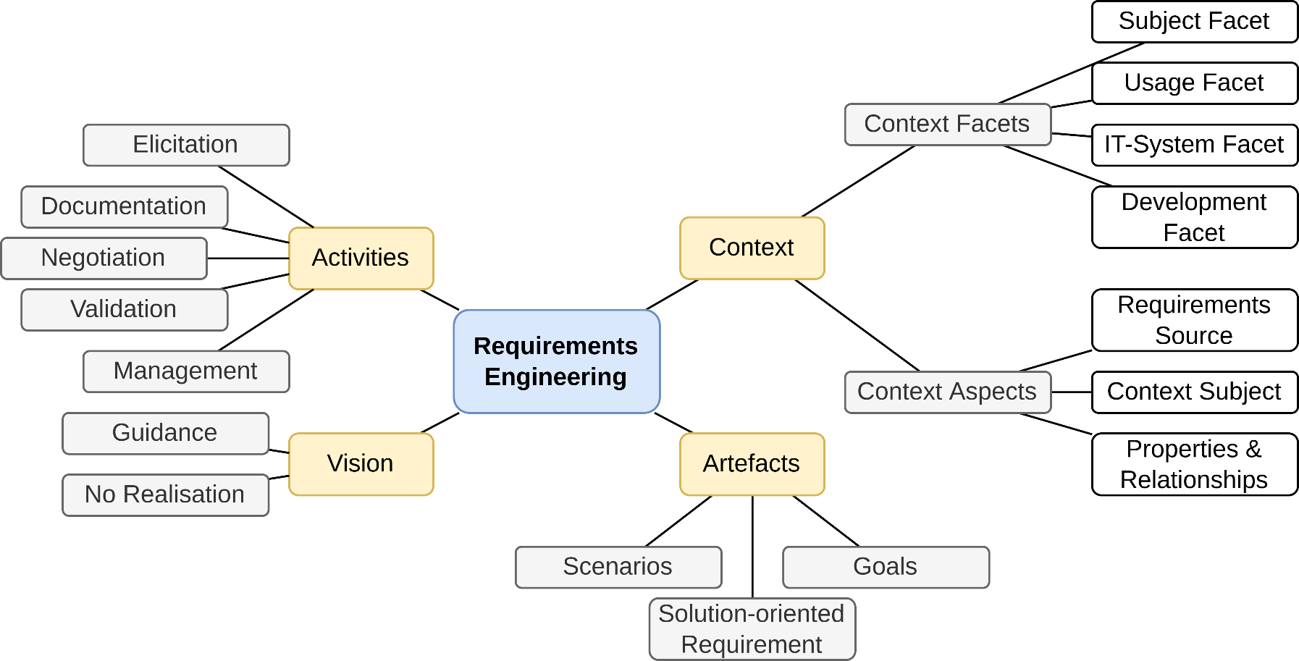
Assistance / Support Techniques
Support Techniques – Mind Mapping
Graphical representation
Shows relationships and interdependencies between terms
Based on K. Pohl (2010) – Requirements Engineering – Fundamentals, Principles and Techniques
Notes:
<number>

Slide 72
Assistance / Support Techniques
Support Techniques – Workshop
Joint meeting of requirements engineer and stakeholders
Use meeting to elaborate on goals
May also go into details
Example:
Use a workshop to design the user interfaces
Notes:
<number>

Slide 73
Assistance / Support Techniques
Support Techniques – Prepare Workshop
Objective
Define the objective of the workshop explicitly
Work results and procedure
Decide the work results explicitly
Define the procedure to gain and develop the work results
Combine them to an agenda
Plan regular breaks

Slide 74
Assistance / Support Techniques
Support Techniques – Prepare Workshop
Participants
Choose the participants based on the work results
Make sure your selection of participants is representative
Invite the participants early enough
Agree with the participants upon the work results

Slide 75
Assistance / Support Techniques
Support Techniques – Prepare Workshop
Location
Ensure the location has enough room for the participants
Provide the proper atmosphere
Organize technical equipment (whiteboard, projector etc.)
Moderator and transcript writer
Invite an external moderator and an external transcript writer

Slide 76
Assistance / Support Techniques
Support Techniques – Conduct Workshop
Introduction
Present the workshops object and work results
Give the participants the opportunity to discuss them
Explain the procedure
Set the discussion rules explicitly
Let the participants vote on the application of these rules one by one
Working part
Make sure that the participants adhere to the agenda and the discussion rules
Protocol the results
Document and identify conflicts and try to solve them
Document decisions explicitly

Slide 77
Assistance / Support Techniques
Support Techniques – Conduct Workshop
Finish
Be sure to gather all remaining topics
Define the further procedure for each remaining topic
Allow your participants to give a feedback about the workshop (participants have the last word)
Thank the participants for their attendance

Slide 78
Assistance / Support Techniques
Support Techniques – Post-processing Workshop
Consolidate the work results
Ask the participants for their approval of the transcript
Let each participant approve on the consolidated work results

Slide 79
Assistance / Support Techniques
Support Techniques – Prototypes for Illustrations
Well-suited to illustrate requirements
Allows clarification of vague requirements
Consequences of new or changed requirements can be identified
Mostly used for user interface prototypes
Notes:
<number>

Slide 80
Assistance / Support Techniques
Support Techniques – Prototypes
Prototypes can be very different:
Paper prototypes
e.g. for graphical user interfaces
“Wizard of Oz” Prototype
Development of a graphical user interface (GUI), but input will be sent directly to an operator, who is simulating the systems behavior and who produces the appropriate output.
Software prototypes
e.g. realized in Visual Basic (throw-away prototypes)
Notes:
<number>
<number>

Slide 81
Assistance / Support Techniques
Support Techniques – Focus Group
Special form of workshop (6-10 participants)
Start with problems
e.g. map collection, flipchart
Collect reasons
Then focus on optimal solution
But not only opposites of the problems
Collect reasons, too
Then group the issues
Should be about 40 issues
Then priorities
e.g. distribute 10 points
e.g. in groups according to stakeholder roles
Finish with a review of the results

Slide 82
Assistance / Support Techniques
Support Techniques – CRC Cards
CRC = Class Responsibility Collaboration
Denote context aspects and their attributes on index cards
Formulate requirements based on the cards
Notes:
<number>

Slide 83
Assistance / Support Techniques
Support Techniques – Audio and Video Recordings
Recordings as substitute for actual contact with the stakeholders
If the stakeholders are not available
The budget is tight
The system is highly critical
Especially useful for field observations
Stakeholders might feel supervised
Changes behavior
Might refuse to participate
Notes:
<number>

Slide 84
Assistance / Support Techniques
Support Techniques – Modeling Action Sequences
Use cases are the external view of how the system will be used
Have a trigger event
Have an expected result
Describe functionality that the system must support
Notes:
<number>

Slide 85
Summary

Slide 86
Summary
Planning Requirement Elicitation
Prepare about domain
Identify Information Goals
Not shown:
Application of analysis techniques
Often overlapping and parallel activities
still deficits
Determine appr.techniques / identify stakeholders
Conduct technique
Sufficient knowledge
Notes:
<number>
Nicht sicher, ob ich die Schrift in der Skizze richtig deuten konnte.

Slide 87
Summary
Elicitation is a core activity of requirements engineering
Without good elicitation, requirements will be wrong or missing
Stakeholders, documents and existing systems as requirements sources
Missing a source leads to missing the requirements of the source
Many techniques for requirements elicitation
Not every technique is good in every scenario
Select the techniques depending on the project
Usually, a combination of multiple techniques yields the best results
Notes:
<number>

Slide 88
Questions?

