Slide 1
The Limits to Growth: Sustainability and the Circular Economy
Lecture 7: Circular Societies
Prof. Dr. Benjamin Leiding
M.Sc. Anant Sujatanagarjuna
M.Sc. Chintan Patel

Slide 2
License
This work is licensed under a Creative Commons Attribution-ShareAlike 4.0 International License. To view a copy of this license, please refer to https://creativecommons.org/licenses/by-sa/4.0/ .
Updated versions of these slides will be available in our Github repository.

Slide 3
Circular Economy vs. Circular Society

Slide 4
Circular Society
CE Recap
Goals of the CE:
  Maintain natural resources and minimize the discharge of substances that are harmful to health and nature
  Ecological modernization of the economy to increase resource efficiency, e.g., by technical innovation and digital solutions
  Products/services designed and constructed in such a way, that they can be returned to the economic and material flows at any time with little financial and energetic effort
  Increase/maximize utilization of resources, e.g., Performance Economy
Partially based on: F. Hofmann, J. Zwiers (2018) – Circular Society – Eine pluralistische und emanzipatorische Alternative zur Circular Economy? – Link.
.

Slide 5
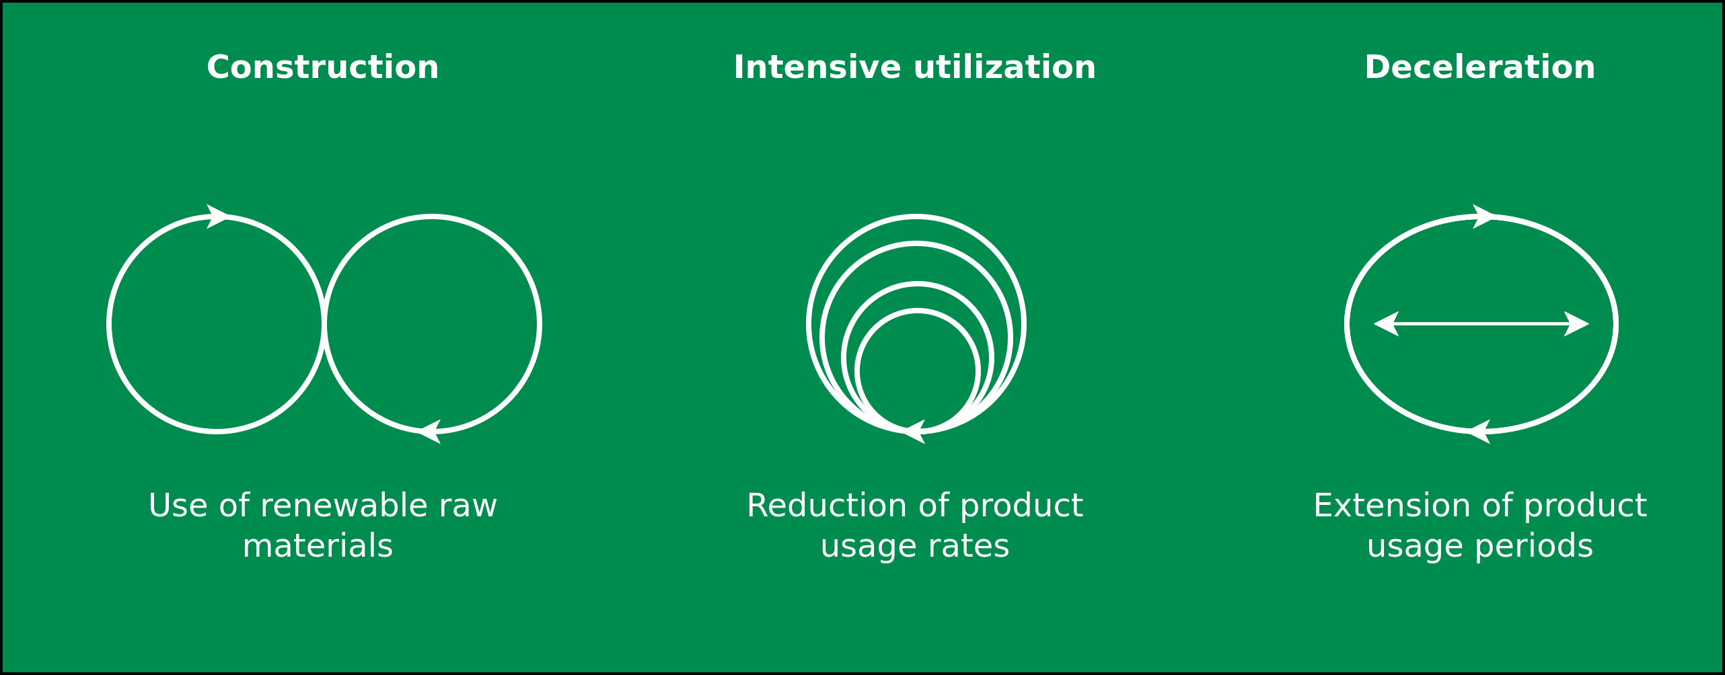
Circular Society
CE Recap
Image adapted from: M. Jaeger-Erben, F. Hofmann (2019) – Kreislaufwirtschaft - Ein Ausweg aus der sozial-ökologischen Krise? – Link.

Slide 6
Circular Society
CE Criticism
Replace the LE with circularly oriented forms of consumption and production
CE focus mostly on earned value management (“Wertschöpfungsmanagement”), product-service systems, product/business model innovations within existing power asymmetries
Decouple economic growth and consumption of natural resources
→ But why do we need neverending economic growth and why is it good to consume as many goods and services as possible?
Alternatives:
Sufficiency strategies and lifestyle changes
Question the prevailing entrepreneurial orientation towards the shareholder concept
Deconstruction of existing power and hegemonic relations
Partially based on: F. Hofmann, J. Zwiers (2018) – Circular Society – Eine pluralistische und emanzipatorische Alternative zur Circular Economy? – Link.
.

Slide 7
Circular Society
CE Criticism
Replace the LE with circularly oriented forms of consumption and production
CE focus mostly on earned value management (“Wertschöpfungsmanagement”), product-service systems, product/business model innovations within existing power asymmetries
Decouple economic growth and consumption of natural resources
→ But why do we need never ending economic growth and why is it good to consume as many goods and services as possible?
Alternatives:
Sufficiency strategies and lifestyle changes
Question the prevailing entrepreneurial orientation towards the shareholder concept
Deconstruction of existing power and hegemonic relations
Partially based on: F. Hofmann, J. Zwiers (2018) – Circular Society – Eine pluralistische und emanzipatorische Alternative zur Circular Economy? – Link.
.

Slide 8
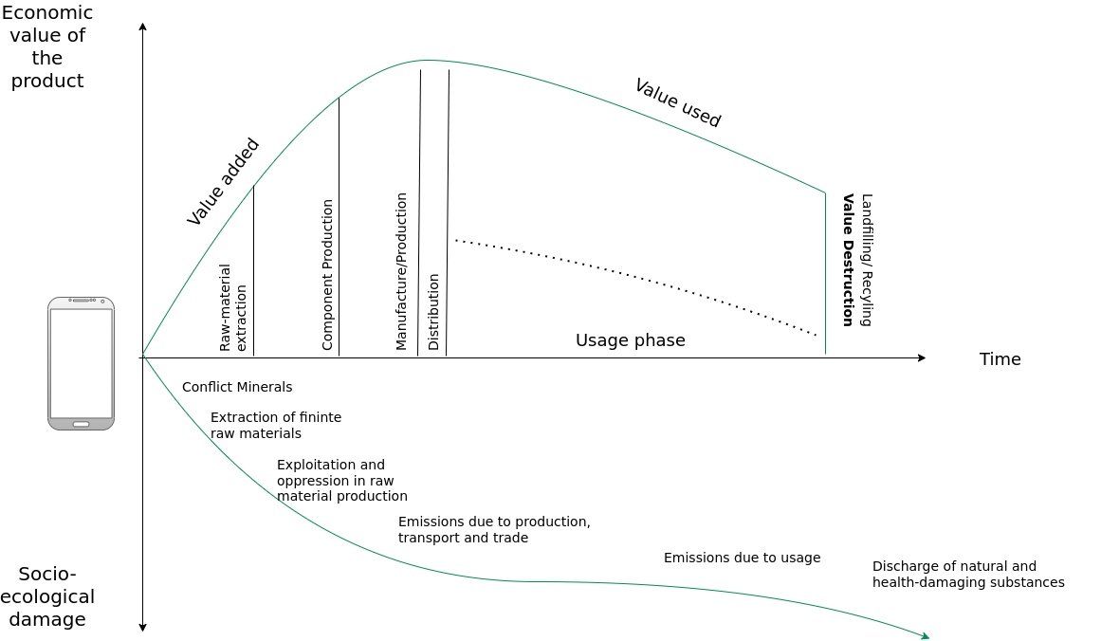
Circular Society
CE Criticism
Image adapted from: M. Jaeger-Erben, F. Hofmann (2019) – Kreislaufwirtschaft - Ein Ausweg aus der sozial-ökologischen Krise? – Link.

Slide 9
Circular Society
CE Criticism
Replace the LE with circularly oriented forms of consumption and production
CE focuses mainly on earned value management (“Wertschöpfungsmanagement”), product-service systems, product/business model innovations within existing power asymmetries
Decouple economic growth and consumption of natural resources
→ But why do we need never-ending economic growth, and why is it good to consume as many goods and services as possible?
Alternatives:
  Sufficiency strategies and lifestyle changes
  Question the prevailing entrepreneurial orientation towards the shareholder concept
  Deconstruction of existing power and hegemonic relations
Partially based on: F. Hofmann, J. Zwiers (2018) – Circular Society – Eine pluralistische und emanzipatorische Alternative zur Circular Economy? – Link.
.

Slide 10
Circular Society
Overview
Circular Society → CS
Goals of the CS:
  Not just “CE + social”
  Socio-political transformation and reorganization
  Replace intransparent and inequity-based value chains of the LE with democratic, transparent and cooperatively organized value chains
Also → preserve the environment/ressources for present and future generations and enable social participation and quality of life
All-encompassing change necessary if the CE is to be the subject of a socio-ecological transformation
Democratisation of value creation processes and strategies for the activation and emancipation of different stakeholder groups
Partially based on: F. Hofmann, J. Zwiers (2018) – Circular Society – Eine pluralistische und emanzipatorische Alternative zur Circular Economy? – Link.
.

Slide 11
Circular Society
Overview
Circular Society → CS
Goals of the CS:
  Not just “CE + social”
  Socio-political transformation and reorganization
  Replace intransparent and inequity-based value chains of the LE with democratic, transparent and cooperatively organized value chains
  Also → preserve the environment/resources for present and future generations and enable social participation and quality of life
All-encompassing change necessary if the CE is to be the subject of a socio-ecological transformation
Democratisation of value creation processes and strategies for the activation and emancipation of different stakeholder groups
Partially based on: F. Hofmann, J. Zwiers (2018) – Circular Society – Eine pluralistische und emanzipatorische Alternative zur Circular Economy? – Link.
.

Slide 12
Circular Society
Overview
Circular Society → CS
Goals of the CS:
  Not just “CE + social”
  Socio-political transformation and reorganization
  Replace intransparent and inequity-based value chains of the LE with democratic, transparent and cooperatively organized value chains
  Also → preserve the environment/resources for present and future generations and enable social participation and quality of life
  All-encompassing change necessary if the CE is to be the subject of a socio-ecological transformation
  Democratization of value creation processes and strategies for the activation and emancipation of different stakeholder groups
Partially based on: F. Hofmann, J. Zwiers (2018) – Circular Society – Eine pluralistische und emanzipatorische Alternative zur Circular Economy? – Link.
.

Slide 13
Circular Society
Definition
„A circular society defines discourses with a vision of circularity where not only resources are circulated in sustainable loops, but also wealth, knowledge, technology and power is
circulated and redistributed throughout society”
M. C. Friant, R. Salomone, W. J. V. Vermeulen (2020) – A Typology of Circular Economy Discourses: Navigating the Diverse Visions of a Contested Paradigm – Link

Slide 14
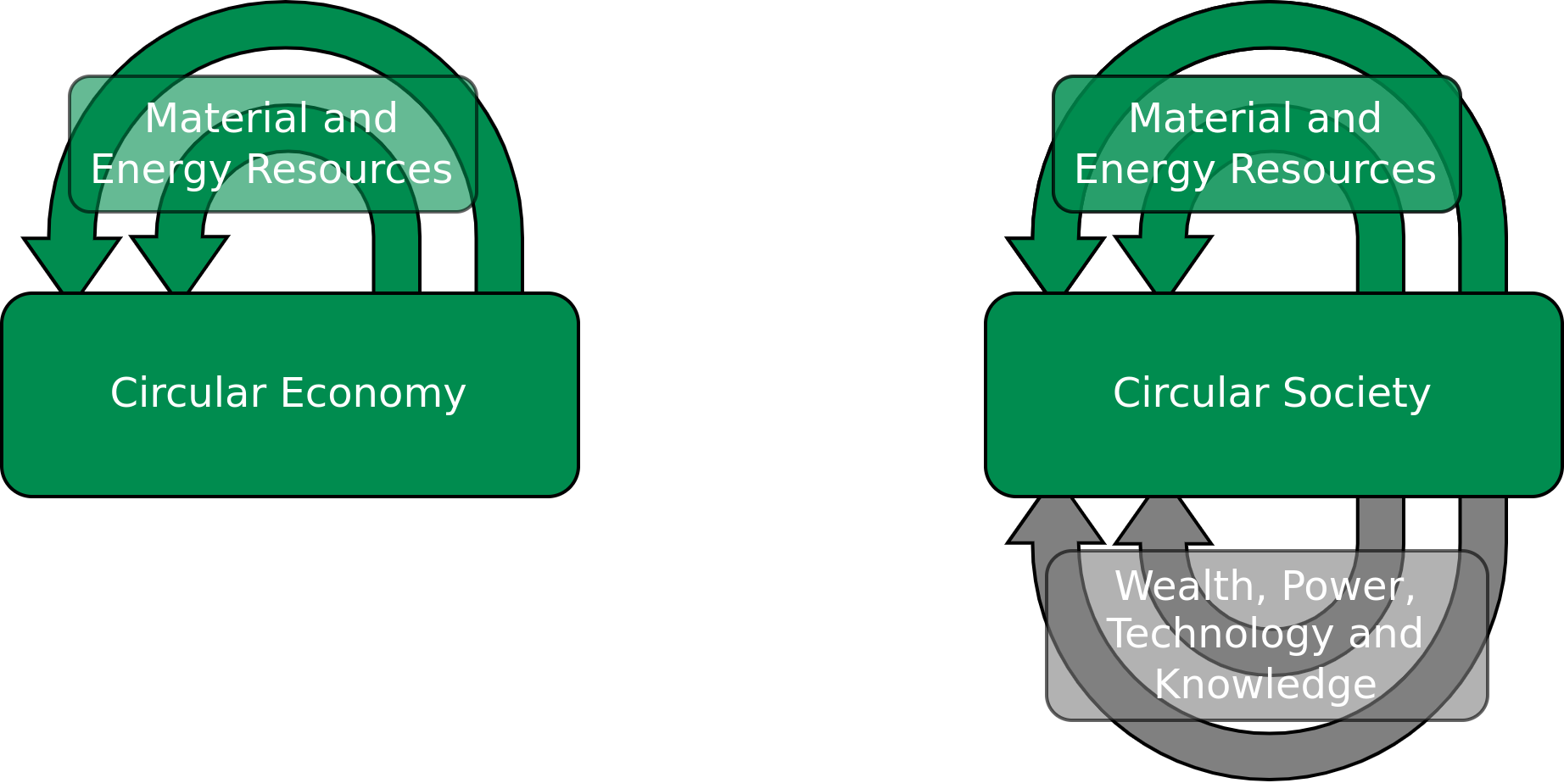
Circular Society
Definition
„ A circular society defines discourses with a vision of circularity where not only resources are circulated in sustainable loops, but also wealth, knowledge, technology and power is
circulated and redistributed throughout society”
Image licensed under CC BY-SA 4.0, sourced from M. C. Friant, R. Salomone, W. J. V. Vermeulen (2020) – A Typology of Circular Economy Discourses: Navigating the Diverse Visions of a Contested Paradigm – Link

Slide 15
Circular Society
CE vs. CS
CE = market-based solutions and economic considerations
CS = Circularity as a holistic social transformation
M. C. Friant, R. Salomone, W. J. V. Vermeulen (2020) – A Typology of Circular Economy Discourses: Navigating the Diverse Visions of a Contested Paradigm – Link

Slide 16
Circular Society
CE vs. CS
Circularity vision | Temporal scale | Spatial scale | Sustainability factors included | Perspective on the resource nexus | Views on capitalism and decoupling | Main goal/objective | Narrative
Circular Society | Very long term: multiple generations (beyond 50 years) | Macro-scale: planet Earth | People, Planet, Prosperity | Changing consumption and production patterns to keep energy, biodiversity and aterial resources within safe planetary limits. | Sceptical regarding the possiblity of decoupling and the sustainability of capitalism. | Maintaining socio-ecological health and wellbield for present and future generations of human and non-human life. | The earth is borrowed from future generations of living beingd, humans must preserve, respect, restore and share it in a fair maner, even if that entails changing lifestyles and consumption patterns.
 | Long term: 1 to 2 generations (20-50 years) | Macro-scale: planet Earth | People, Planet, Prosperity | Balancing trade-offs and synergies to keep energy, biodiversity and material resources within safe planetary limits. | Believe in the possibility of decoupling and the sustainability of capitalism. | Preserving social well-being and the biophysical health of the Earch system in line with the SDGs. | Humans must ensure justice, fairness and participation in the sustainable stewardship of the Earth, even if that entails redistributing and changing consumption patterns.
Table adapted from M. C. Friant, R. Salomone, W. J. V. Vermeulen (2020) – A Typology of Circular Economy Discourses: Navigating the Diverse Visions of a Contested Paradigm – Link

Slide 17
Circular Society
CE vs. CS
Circularity vision | Temporal scale | Spatial scale | Sustainability factors included | Perspective on the resource nexus | Views on capitalism and decoupling | Main goal/objective | Narrative
Circular Economy | Long term: one generation (19-25 years) | Macro-scale: planet Earth | Planet, Prosperity | Balancing trade-offs and synergies to keep energy, biodiversity and material resources within safe planetary limits. | Believe in the possibility of decoupling and the sustainability of capitalism. | Maintaining the biophysical health of the Earth system. | Reducing humanity’s overall ecological footprint and balancing resource limits and constraints is key to ensure the stability of the biosphere and long-term economic prosperity.
 | Mid-term: 1 to 2 government planning cycles (5-10 years) | Meso-scale (country, region, industrial park, city) | Planet, Prosperity | Optimizing and securing material, natural and energy resources, especially for critical raw materials. | Believe in the possibility of decoupling and the sustainability of capitalism. | Securing and preserving critical resources and materials. | Strategically maximising sco-efficiency and balancing resource use is necessary to maintain resource security and ensure geopolitical stability.
 | Short-term: single product life-cycle(1 to 2 years) | Micro-scale (single product, service, or firm) | Planet, Prosperity | Optimizing material and energy resource flows in product design. | Believe in the possibility of decoupling and the sustainability of capitalism. | Capturing oppostunities to lower both environmental impacts and economic costs. | Ensuring optimium resource efficiency through eco-innovation leads to win-win solutions that reduce ecological harm and increase economic value.
Table adapted from M. C. Friant, R. Salomone, W. J. V. Vermeulen (2020) – A Typology of Circular Economy Discourses: Navigating the Diverse Visions of a Contested Paradigm – Link

Slide 18
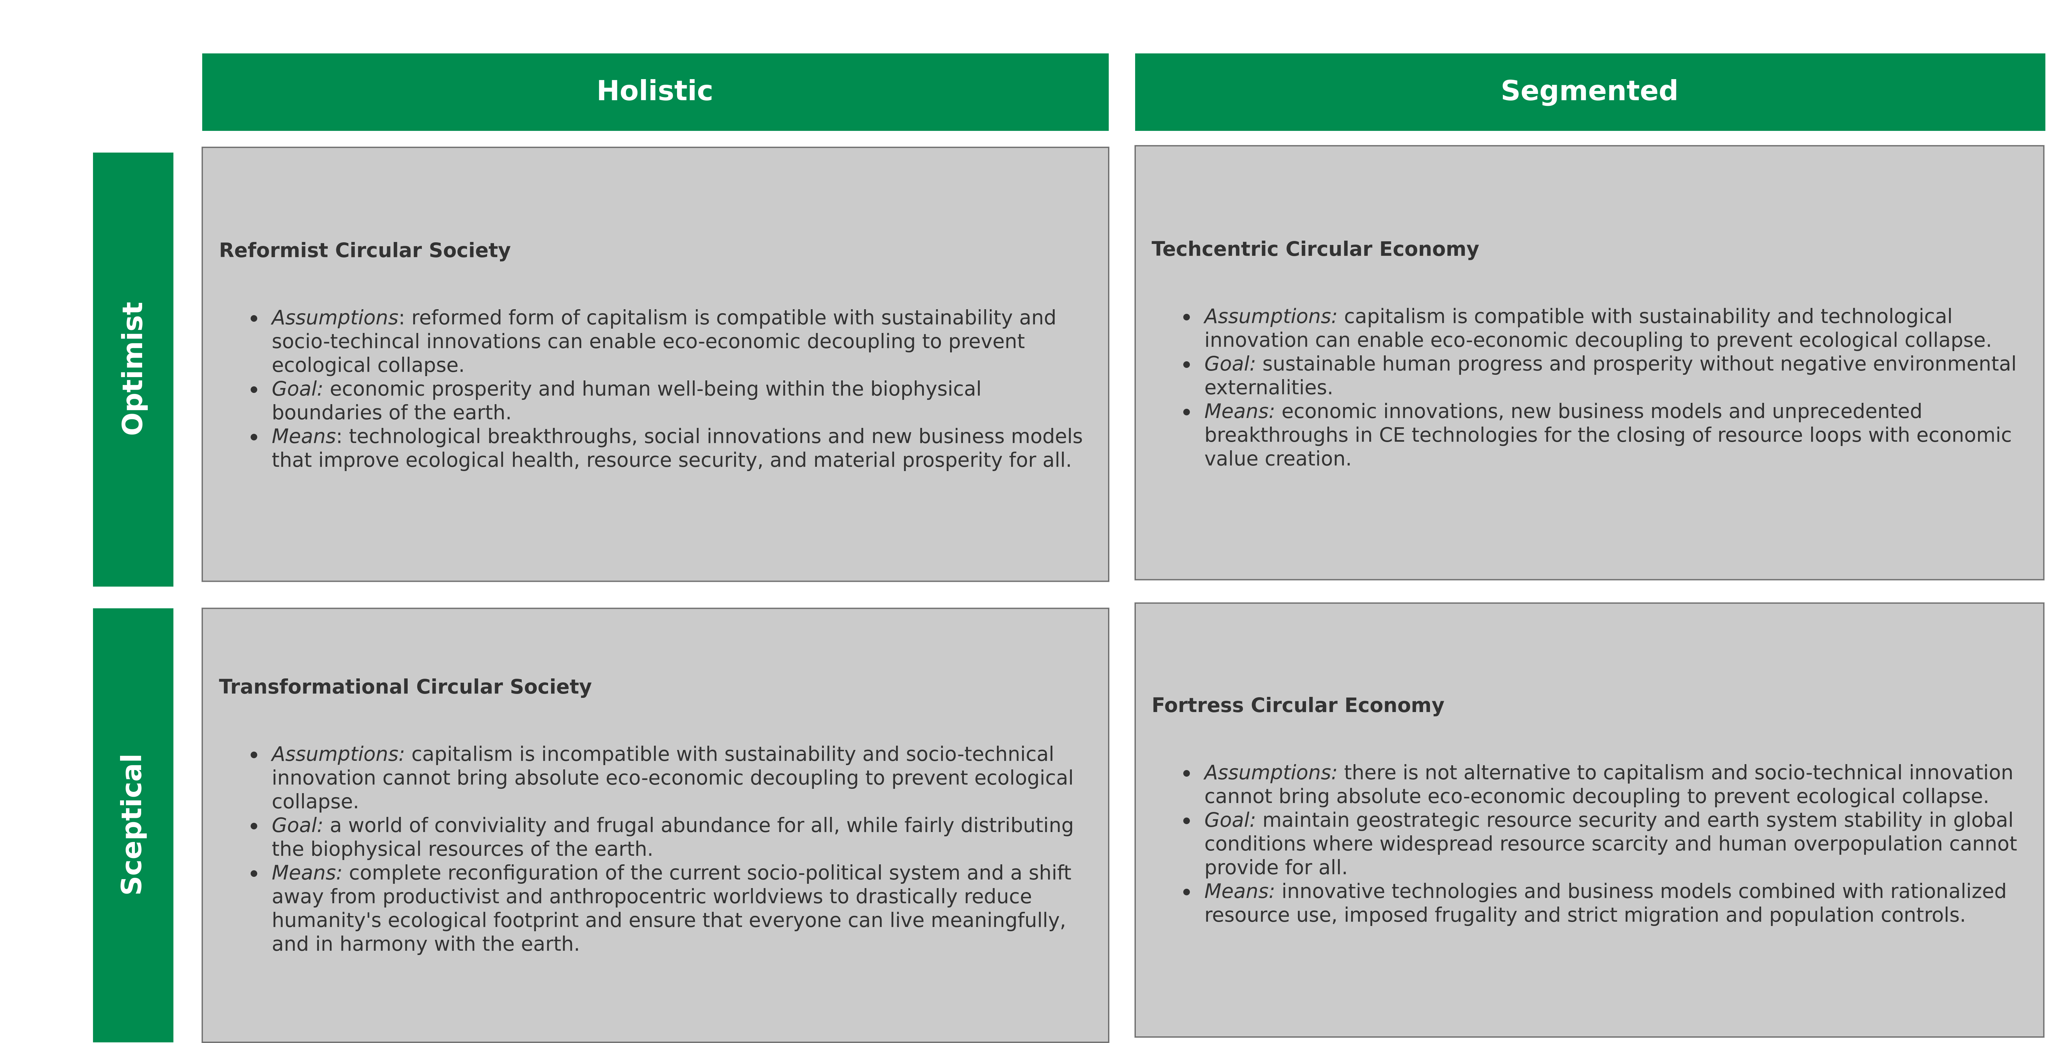
Circular Society
CE vs. CS – Typology
Image recreated from: M. C. Friant, R. Salomone, W. J. V. Vermeulen (2020) – A Typology of Circular Economy Discourses: Navigating the Diverse Visions of a Contested Paradigm – Link

Slide 19
Conclusion

Slide 20
Conclusion
Circular Economy (CE):
  Maintain natural resources and minimize the discharge of substances that are harmful to health and nature → Increase/maximize utilization of resources, e.g., Performance Economy
  Ecological modernization of the economy to increase resource efficiency, e.g., by technical innovation and digital solutions
Circular Society (CS):
Not just “CE + social” instead socio-political transformation and reorganization
Replace intransparent and inequity-based value chains of the LE with democratic, transparent and cooperatively organized value chains
Democratization of value creation processes and strategies for the activation and emancipation of different stakeholder groups

Slide 21
Conclusion
Circular Economy (CE):
  Maintain natural resources and minimize the discharge of substances that are harmful to health and nature → Increase/maximize utilization of resources, e.g., Performance Economy
  Ecological modernization of the economy to increase resource efficiency, e.g., by technical innovation and digital solutions
Circular Society (CS):
  Not just “CE + social” instead socio-political transformation and reorganization
  Replace intransparent and inequity-based value chains of the LE with democratic, transparent and cooperatively organized value chains
  Democratization of value creation processes and strategies for the activation and emancipation of different stakeholder groups

Slide 22
Additional Resources
Circular Societies (German) – Link
David Graeber. Debt: The First 5000 Years (2011).
David Graeber. On the Phenomenon of Bullshit Jobs – Essay (2013) – Link.
David Graeber. Bullshit Jobs – Book (2018).

Slide 23
Questions?

