Slide 1
Emerging Technologies for the Circular Economy
Lecture 5b: IoT Security and Privacy
Prof. Dr. Benjamin Leiding (Clausthal)
Dr. Arne Bochem (Göttingen)
M.Sc. Anant Sujatanagarjuna (Clausthal)
M.Sc. Shohreh Kia (Clausthal)
Notes:
<number>

Slide 2
License
This work is licensed under a Creative Commons Attribution-ShareAlike 4.0 International License. To view a copy of this license, please refer to https://creativecommons.org/licenses/by-sa/4.0/ .
Updated versions of these slides will be available in our Github repository.

Slide 3
Examples and Lessons Learned

Slide 4
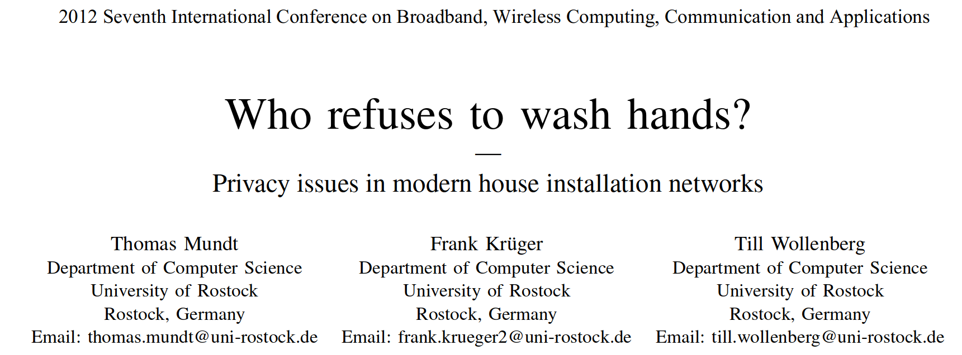
Who Refuses to Wash Hands?

Slide 5
Who Refuses to Wash Hands?
Swagatam Majumdar – https://commons.wikimedia.org/wiki/File:How_PIR_Sensor_Device_Detects_Human_Presence.gif – CC BY-SA 4.0

Slide 6
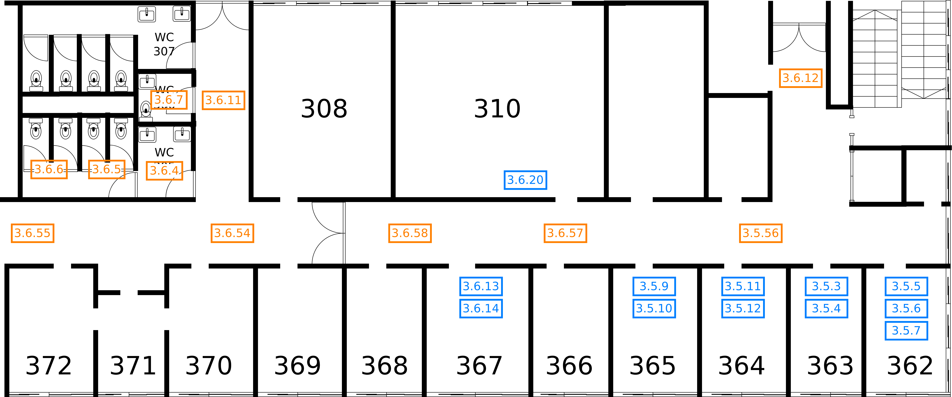
Who Refuses to Wash Hands?

Slide 7
Who Refuses to Wash Hands?
Lessons learned:
Correlation of data might reveal interesting and unexpected information.
Implement existing IT security and data protection concepts (KNX can be operated securely) → e.g. encryption and authentication.
In general:
Collect/store/analyze data vs. GDPR
Stored data must be secured and protected accordingly

Slide 8
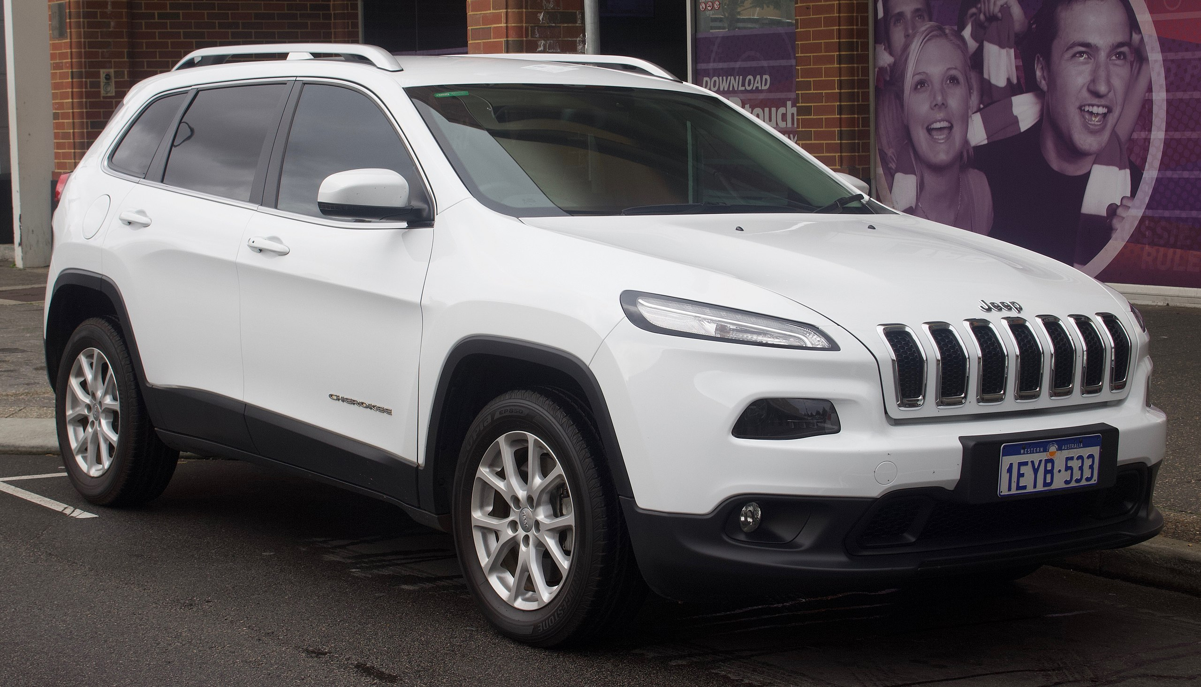
Jeep Cherokee Hack 2015
EurovisionNim – https://commons.wikimedia.org/wiki/File:2015_Jeep_Cherokee_(KL)_Longitude_wagon_(2018-09-03)_01.jpg – CC BY-SA 4.0

Slide 9
Jeep Cherokee Hack 2015
https://www.kaspersky.com/blog/blackhat-jeep-cherokee-hack-explained/9493/

Slide 10
Jeep Cherokee Hack 2015
WPA2 password → “TyYMxfPhZxkp”
This corresponds to Epoch time 0x50e22720
This is Jan 01 2013 00:00:32 GMT
Took 32 seconds for WifiSvc to get started up
Really only a few dozen passwords to try
https://www.kaspersky.com/blog/blackhat-jeep-cherokee-hack-explained/9493/

Slide 11
Jeep Cherokee Hack 2015
WPA2 password → “TyYMxfPhZxkp”
This corresponds to Epoch time 0x50e22720
This is Jan 01 2013 00:00:32 GMT
Took 32 seconds for WifiSvc to get started up
Really only a few dozen passwords to try
https://www.kaspersky.com/blog/blackhat-jeep-cherokee-hack-explained/9493/

Slide 12
Jeep Cherokee Hack 2015
WPA2 password → “TyYMxfPhZxkp”
This corresponds to Epoch time 0x50e22720
This is Jan 01 2013 00:00:32 GMT
Took 32 seconds for WifiSvc to get started up
Really only a few dozen passwords to try
https://www.kaspersky.com/blog/blackhat-jeep-cherokee-hack-explained/9493/

Slide 13
Jeep Cherokee Hack 2015
WPA2 password → “TyYMxfPhZxkp”
This corresponds to Epoch time 0x50e22720
This is Jan 01 2013 00:00:32 GMT
Took 32 seconds for WifiSvc to get started up
Really only a few dozen passwords to try
https://www.kaspersky.com/blog/blackhat-jeep-cherokee-hack-explained/9493/

Slide 14
Jeep Cherokee Hack 2015
Lessons learned:
No security by obscurity

Slide 15
More examples

Slide 16
Fish Tank Thermometer
Casino with fish tank in the lobby
IoT fish tank thermometer
Attackers compromise thermometer
Use it to further compromise local network
Exfiltrate customer database
https://www.businessinsider.in/Hackers-stole-a-casinos-high-roller-database-through-a-thermometer-in-the-lobby-fish-tank/articleshow/63769685.cms

Slide 17
Fish Tank Thermometer
Lessons learned:
IoT devices can be the weakest link
Consider security between possibly vulnerable devices and local networks
https://www.businessinsider.in/Hackers-stole-a-casinos-high-roller-database-through-a-thermometer-in-the-lobby-fish-tank/articleshow/63769685.cms

Slide 18
Library vulnerabilities: NAME:WRECK
Vulnerabilities in multiple TCP/IP stacks
Impact: From DoS to RCE
Affects:
Medical devices
Avionics
Baseband processors in mobile phones
Servers
Vulnerability in domain name parsing
https://www.forescout.com/company/resources/namewreck-breaking-and-fixing-dns-implementations/

Slide 19
Ripple20
19 vulnerabilities including remote code execution in widely used low-level TCP/IP-stack library distributed under various names
“Affected vendors range from one-person boutique shops to Fortune 500 multinational corporations, including HP, Schneider Electric, Intel, Rockwell Automation, Caterpillar, Baxter, as well as many other major international vendors suspected of being of vulnerable in medical, transportation, industrial control, enterprise, energy (oil/gas), telecom, retail and commerce, and other industries.” – JSOF
Demonstration: Turning off IoT UPS
https://www.jsof-tech.com/disclosures/ripple20/

Slide 20
Library Vulnerabilities
Lessons learned:
Even widely used libraries can contain grave security issues

Slide 21
SECURING the IoT

Slide 22
Security
General best practices for developing secure software
Avoid common issues:
Buffer overflows
SQL injections
etc..
Input validation
Secure defaults
Overall system design
May also need to consider hardware security
Tamper-proof devices
However: Often IoT devices are not designed with security in mind from the start.

Slide 23
Cryptography (1)
Consider low-power devices
Common protocols (SSL/TLS) often too heavy
Main things to consider:
Confidentiality
Integrity
Authentication
Different approaches

Slide 24
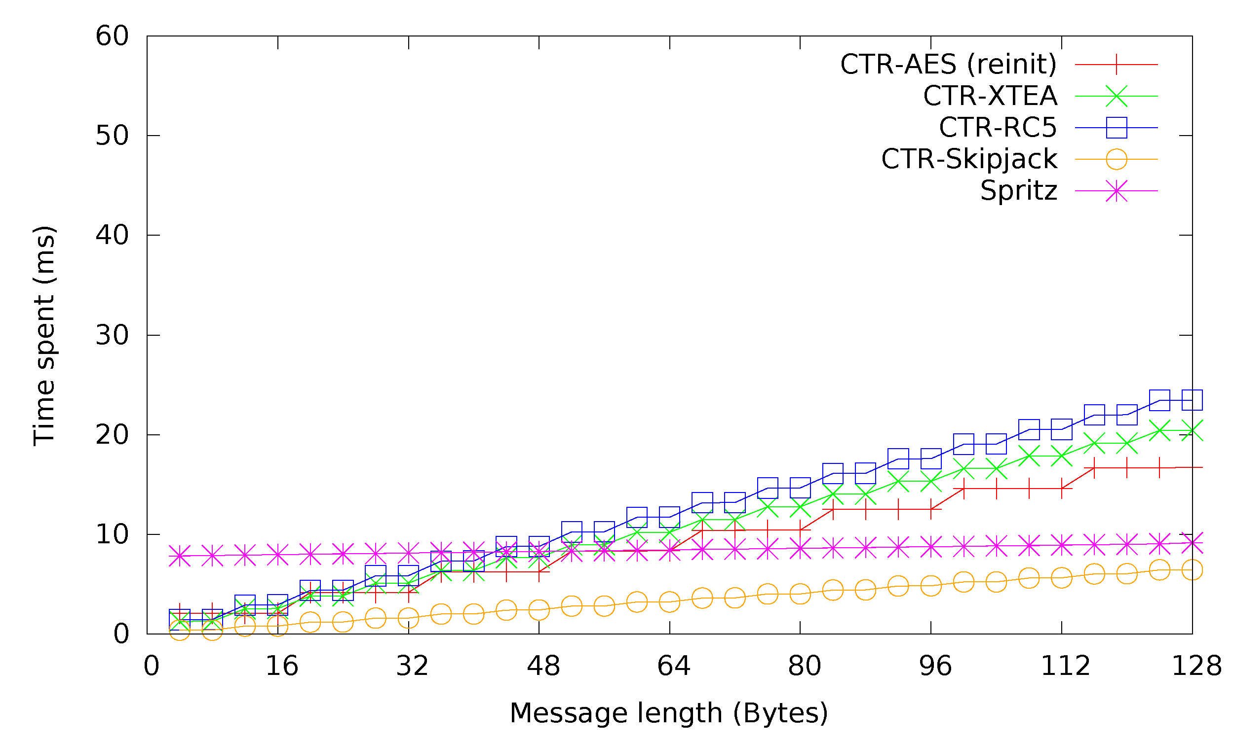
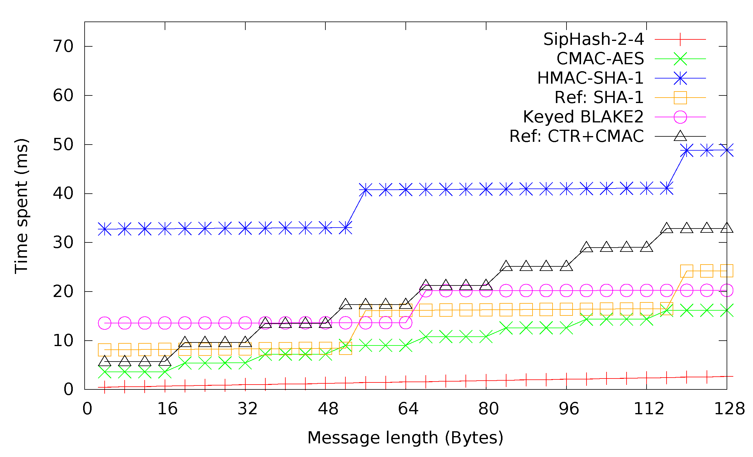
Cryptography (2)
RSA too heavy for very low-powered devices
ECC can be acceptable, but still slow
Main focus on symmetric cryptography:
AES128 can perform well even on 8bit micro-controllers
Block cipher based MACs
SipHash (but is short)
SHA family comparatively slow
Issue: Shared keys
https://www.mdpi.com/1424-8220/15/8/19560/htm
O. Alfandi, A. Bochem, A. Kellner, C. Göge, D. Hogrefe (2015) – Secure and Authenticated Data Communication in Wireless Sensor Networks – https://www.mdpi.com/1424-8220/15/8/19560/htm – CC BY 4.0

Slide 25
Privacy
Complex topic
Requires:
Secure implementations
Additional care take to:
Minimize personal data being stored/processed
Where possible, process locally
Where necessary, store encrypted
Trust considerations

Slide 26
Exercise E04

Slide 27
E04 – IoT Processing
In E03, you gathered weather data from different sources (sensors) and aggregated
them into a single data set. Now, the energy sellers will use that data to predict
their energy output and sell and serve as many customers as possible. To do so,
your task is to use the resulting data set from E03 as an input. The timestamps of
the data set begin with 2021-04-10 02:00:00.000; we assume all later timestamps
represent a weather prediction in the future.

Slide 28
Questions?

