Slide 1
Requirement Engineering
Lecture 4: Requirements Documentation
Part 2
Prof. Dr. Benjamin Leiding
Anant Sujatanagarjuna

Slide 2
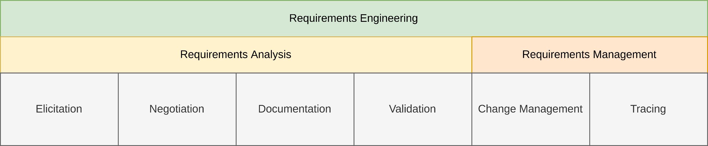
General Requirements Engineering Process
Overview

Slide 3
Lecture 4: Requirements Documentation
Content
Types of Requirements
Textual Requirements Specification

Slide 4
Types of Requirements

Slide 5
Types of Requirements
Motivation
Different types of requirements must be documented for a complete requirements documentation.
These requirements types differ with respect to:
adequate specification techniques
their importance for different types of systems
Notes:
<number>

Slide 6
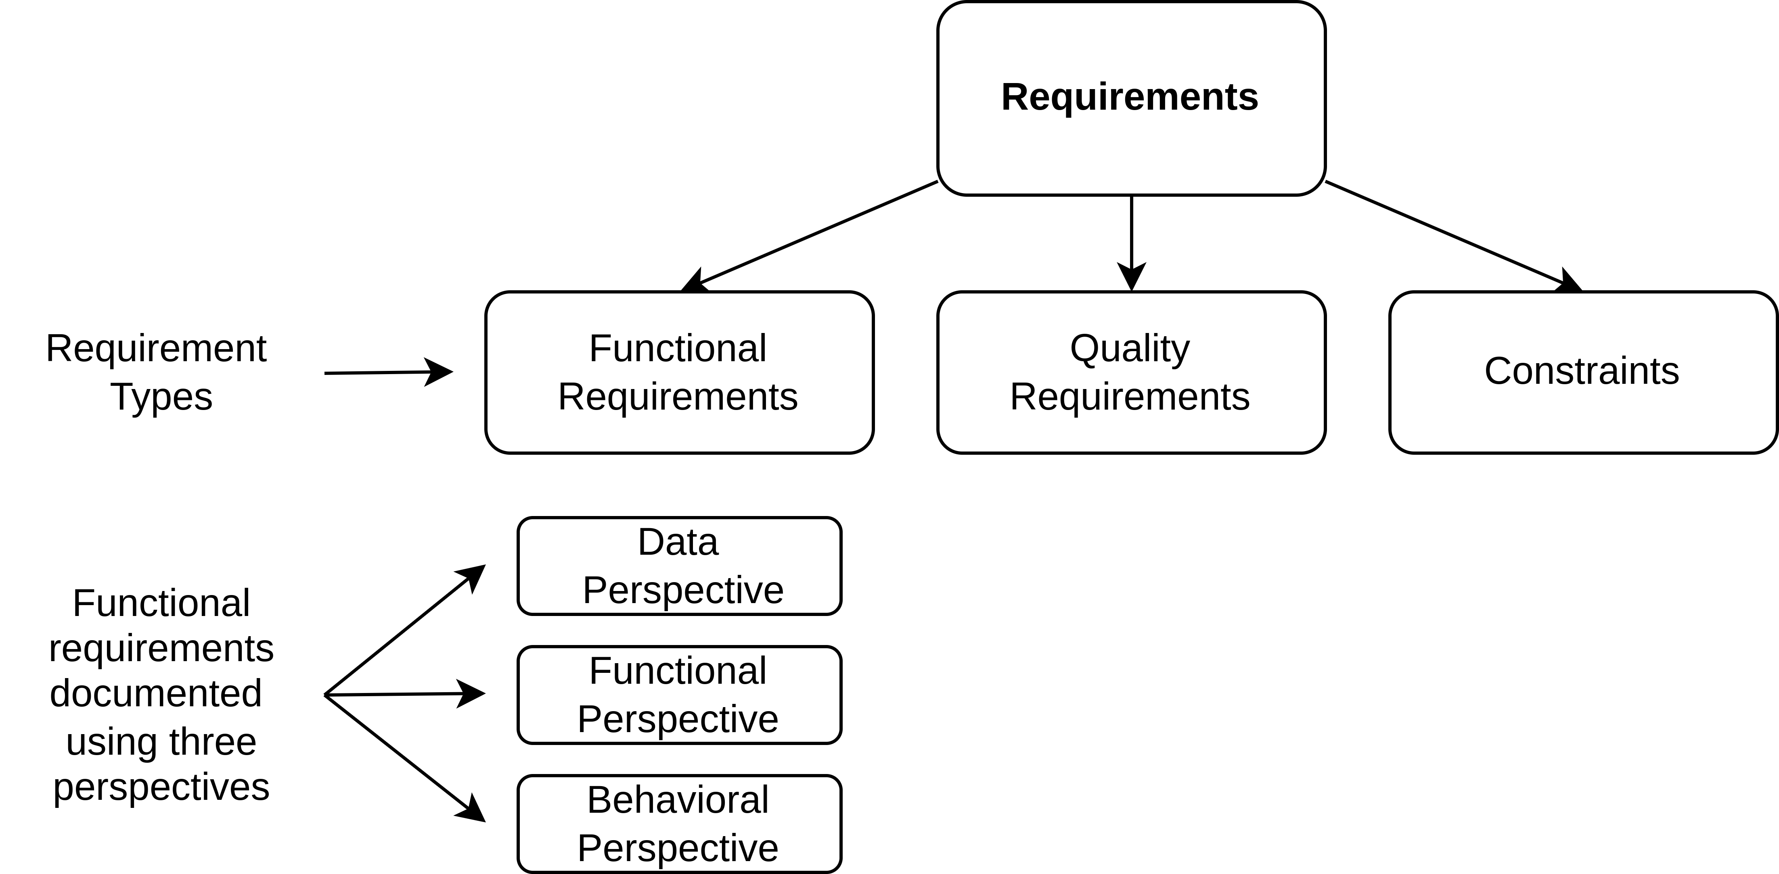
Types of Requirements
Functional Requirements
Notes:
<number>

Slide 7
Types of Requirements / Functional Requirements
Data Perspective
All systems need to deal with data
Data on customers, articles, etc.
Multimedia, e.g., videos, songs, etc.
…
Information must be adequately structured and represented:
Which information / data items are relevant to the system?
Which information / data items are at the boundary of the system?
Notes:
<number>

Slide 8
Types of Requirements / Functional Requirements
Data Perspective – Representing Data
UML class diagrams
Context diagrams
Data dictionary
Note:
the data specified in the requirements need not be directly related to the implementation
same information, but different structure possible
e.g. attributes versus classes may change strongly
In information systems understanding the data is a key driver !
Notes:
<number>

Slide 9
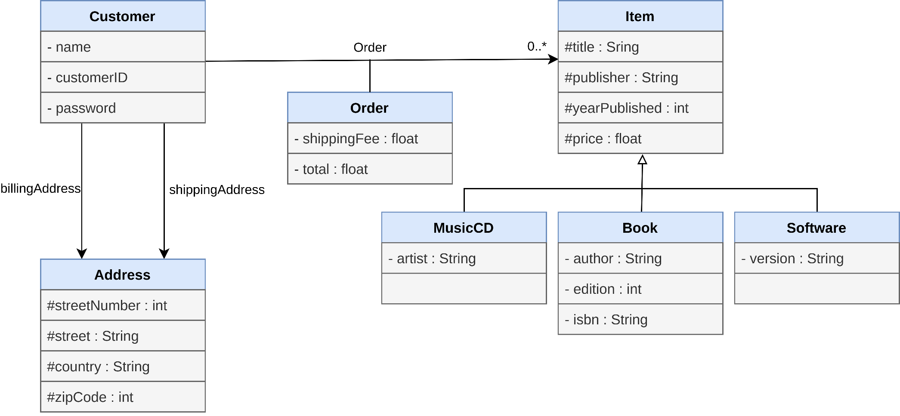
Types of Requirements / Functional Requirements
Data Perspective – Book Shop UML Example
Notes:
<number>

Slide 10
Types of Requirements / Functional Requirements
Data Perspective – Context Diagram Example
instructor
customer
manage
courses and
customers
courses
clerk
customer clerk
accounting
Notes:
<number>

Slide 11
Types of Requirements / Functional Requirements
Behavioral Perspective
Behavioral requirements describe what a system will do (with the data):
how input information is transformed into state information and output information
sequences of interaction of the software system with its environment (people, software, hardware)
System behavior is important on various levels:
Business processes - describe the fundamental flow of activities in an enterprise
Task level - describe the interaction of people with a software system on a coarse grained level (e.g., define new customer)
Stimulus / response - describe interactions
Notes:
<number>

Slide 12
Types of Requirements / Functional Requirements
Behavioral Perspective – Specification Techniques
Many different techniques were developed for specifying this:
Textual Use Cases
Business Process Modeling Languages
Scenario-Based Modeling Approaches
Event-Based Modeling Techniques
The techniques can be categorized along the following dimensions:
data-flow (-transformation) vs. stimulus-/response
complete description vs. prototypical description
Notes:
<number>

Slide 13
Types of Requirements / Functional Requirements
Behavioral Perspective – Specification Techniques
The UML provides different approaches:
Use Case Diagram
State Machine Diagram
Activity Diagram
Notes:
<number>

Slide 14
Types of Requirements / Functional Requirements
Interface Requirements
The interface takes apart interior and exterior
Interfaces are defined by the project context
Different types of interfaces:
User interfaces (Human-Machine Interface)
Software Interfaces
Hardware-related interfaces
Notes:
<number>
Genau in der Systemgrenze, vergleiche Kapitel 2

Slide 15
Types of Requirements / Functional Requirements
Interface Requirements – User Interface
Interface Description must describe
Layout
Look & Feel
Category of Interface (WIMP, ASCII-based, tactile, …)
Interaction sequences
..
Usability aspects are specific to this type of interface
Person (e.g., impairements, knowledge)
Situation
Task
…
Notes:
<number>
WIMP steht meist für „Windows“, „Icons“, „Menus“ und „Pointer“ ➔ GUI

Slide 16
Types of Requirements / Functional Requirements
Interface Requirements – Software Interface
Interfaces to other software interfaces are defined based on
Identification of service, i.e., how to find it
The protocol (how to interact)
The data format(s), e.g., how to exchange data
Typically use of standard protocols, like
Web-Service
HTTP
…
But also possible → Data file is written to a specific location and read by another program
Notes:
<number>
Auffinden von fremden Diensten
Identifikation von Services, Protokoll, Datenformat gegeben → gleich zu HW Interface

Slide 17
Types of Requirements / Functional Requirements
Interface Requirements – Hardware Interface
Hardware interfaces are often:
Time critical
Protocol specification must include timing information
Specified close to hardware (e.g. addressing)
Hardware-based → service identification may be given in bits and bytes
Other than that, usually hardware interfaces are like a software interface
Mapping software information to the physical world is done by hardware!
Notes:
<number>
Wenn ich A mache muss ich min 5 Sekunden warten und max 7 Sekunden warten bis ich Aktion B mache
Nachdem ich Ventil geöffnet habe muss ich x Sekunden warten, bis ich korrekten Druckwert ablesen kann
Embbeded Systeme/Register, wenn ich folgende Daten in Speicherzelle 3700 ablege, wie werden diese interpretiert
Hardware Adressen nehmen mir RAM Adressen weg
Beispiel: http://en.wikipedia.org/wiki/Memory-mapped_I/O

Slide 18
Types of Requirements
Non-Functional & Quality Requirements – Definition
Quality requirements define qualitative attributes of the whole system, a single function or a group of functions, i.e. how good a system shall do the things it is supposed to do.
Non-functional requirements are used to encompass all kinds of not functional requirements for a system:
quality requirements should be related to the functional requirement or group of requirements they are relevant to
development constraints should be captured separately
project aspects should be clearly separated from product aspects
he term
Notes:
<number>

Slide 19
Types of Requirements
Non-Functional & Quality Requirements – Definition
Quality requirements define qualitative attributes of the whole system, a single function or a group of functions, i.e. how good a system shall do the things it is supposed to do.
Non-functional requirements are used to encompass all kinds of not functional requirements for a system:
quality requirements should be related to the functional requirement or group of requirements they are relevant to
development constraints should be captured separately
project aspects should be clearly separated from product aspects
The term non-functional requirements is depreciated (according to IEEE)
Notes:
<number>

Slide 20
Types of Requirements
Non-Functional & Quality Requirements – Kinds of Requirements
Requirements
Functional requirements
Non-functional requirements
Constraints
Functional attributes
Development attributes
Maintainability, portablility, ...
Local attributes (QoS)
Non-local attributes
Performance, reliability, ...
Security, usability
Notes:
<number>

Slide 21
Types of Requirements
Non-Functional & Quality Requirements – Product Quality (ISO 9126 / DIN 66272)
Functionality
Adequacy
Security
Precision of calculation
Interoperability
Conformity with standards
Reliability
Maturation
Fault tolerance
Recovery
Usability
Comprehensibility
Learnability
Operability
Notes:
<number>

Slide 22
Types of Requirements
Non-Functional & Quality Requirements – Product Quality (ISO 9126 / DIN 66272)
Efficiency
Time response
Resource Consumption
Changeability
Analyzability
Modifiability
Stability
Verifiability
Portability
Adaptivity
Installability
Conformity with standards
Replaceability
Notes:
<number>

Slide 23
Types of Requirements
Non-Functional & Quality Requirements – Example „Performance“
User level → The user can create accounts with only two interactions
System task level → The creation of an account (pressing of the „system availability“ button) takes max. 0.5 seconds
→ Derived non-functional requirement result from the interplay between both levels.
Notes:
<number>

Slide 24
Textual Requirements Specification

Slide 25
Lecture 4: Requirements Documentation
Content
Types of Requirements
Textual Requirements Specification
Ambiguity
Guidelines
Syntactic Requirements Patterns

Slide 26
Textual Requirements Specification
Advantages of Natural Language
Three essential advantages
Universal
Can be used in any problem area or domain
Flexible
Allows arbitrary abstractions and refinements
Comprehensible
Can (potentially) be understood by any stakeholder
Notes:
<number>

Slide 27
Textual Requirements Specification
Mixing Concepts
Mixing of the three perspectives (data/structural, function, behavioral) in functional requirements
Often even mixed with quality requirements
Example
The glass break detector at the window detects that the pane has been damaged, the system shall inform the security service within 2 seconds at the least.
Structural: glass break detector, window, pane, system, security service
Function: detects, inform the security service
Behavior: if damaged, shall inform
Quality: 2 seconds
→ Mixing concepts is a bad idea
Notes:
<number>

Slide 28
Textual Requirements Specification
Separation of Functional and Quality Aspects
At least separate functional and quality aspects
Functional
The glass break detector at the window shall detect if the glass pane is damaged.
If the detector detects damage to the pane, the system shall inform the security service.
Quality
The system shall inform the security service within 2 seconds after detecting the damage.
Notes:
<number>

Slide 29
Textual Requirements Specification
Ambiguity
A requirement is ambiguous, if it allows more than one interpretation even though the relevant context (other requirements, application domain, software system) is known.
Notes:
<number>

Slide 30
Textual Requirements Specification
Ambiguity – Why should we care?
Ambiguity is a common problem
Ambiguity is often overlooked, as an interpretation is chosen unconsciously
Cause: Ambiguity as „under-specification“ is a typical phenomenon of natural language. The solution of ambiguity is an (often unconscious) cognitive process taking context (e.g. shared situation) or other cues (e.g. nonverbal) into account.
The „most likely“ interpretation of a requirement is chosen unconsciously, thus the interpretation causing the least contradictions with already known requirements, domain attributes or standards is chosen.
Because requirements can be controversial, this – in contrast to the common, verbal everyday communication – is not an optimal strategy! Contradictions must be discussed with the parties and must be solved.
Ambiguity can be a sign for incompleteness!
Notes:
<number>

Slide 31
Textual Requirements Specification
Ambiguity – Impact on Software Engineering
Consequences show up very late
During integration of software components
During acceptance test
During usage of the software
Are ambiguous requirements a frequent problem?
Result of a survey with specification techniques:
Omissions and conflicts in specifications are noticed more often than ambiguities
Ambiguities are rather self-interpreted and more often misinterpreted than other types of defects
RE specific ambiguity: a frequent problem
Linguistic ambiguity: a rare problem
Notes:
<number>

Slide 32
Textual Requirements Specification
Ambiguity – Categories
Conscious ambiguity:
Client wants to keep requirements open e.g. usual in public projects
Unconscious ambiguity:
Client expects a certain interpretation of the requirement, ambiguity occurs as the expectations of customer and client are not shared
Linguistic ambiguity:
Inherent attributes of the natural language „Flying airplanes can be dangerous”
RE specific ambiguity:
Arises from interpretation of a requirement via background knowledge (other requirements, domain, etc.)
Notes:
<number>

Slide 33
Textual Requirements Specification
Ambiguity – Types of Ambiguities
Vagueness:
Continuum of interpretations, diffuse classification, summarized version of the interpretation available
The text editor has to respond to user input in the adequate time
Are 10 seconds still adequate?
Generality:
Continuum of interpretations, but exact classification, summarized version of the interpretation is available
The ATM system shall increase the market coverage of the bank company XYZ by at least 5%
No charge for ATM transactions, user interface should require as few user interactions as possible …
Notes:
<number>
Was muss ich für 5% mehr Umsatz machen?

Slide 34
Textual Requirements Specification
Ambiguity – Types of Ambiguities
Genuine Ambiguity:
Countable number of interpretations, no summarized version of the interpretation available, thus immediate clarification needed
Lexical: A term with several, in most cases related meanings
When the user presses the L- and R-button simultaneously, alarm is turned off → The current alarm or the ability to sound alarms?
Syntactic: Structure of a sentence is not clear without ambiguity
The customer enters a card with a code → Is the code read from the card or is it typed in?
Notes:
<number>

Slide 35
Textual Requirements Specification
Ambiguity – Types of Ambiguities
Semantic: A sentence can be translated into several logic terms
An alarm must be triggered if an aircraft is identified as hostile and has an unknown mission or in case the aircraft is able to reach the protected airspace within 5 minutes → Is the „and“ or the „or“ the stronger binding operator?
Referential: A reference to an object is ambiguous to a previous sentence or subordinate clause. Is caused by nouns and pronouns.
The customer enters a card and a numeric personal code. If it is not valid then the ATM rejects the card. → Card or code not valid?
[…] The product shall show all roads predicted to freeze. Reference of “all roads”?
Notes:
<number>

Slide 36
Textual Requirements Specification
Ambiguity – Types of Ambiguities
Discourse ambiguity = A requirement is ambiguous in relation to other requirements.
Example 1:
(A1) When the XYZ button is pressed, the Head-up Display (HUD) shows the aircraft‘s current coordinates.
(A2) When the aircraft is not airborne, the HUD shows the current weather conditions.
→ Will the coordinates be displayed if the XYZ button is pressed and the aircraft is currently not airborne?
Example 2:
The first dunning letter has to be created after 2 weeks and the second after 4 weeks. At that time the system is also sending a notice to the responsible official in charge. → Is the notice send after 2 or after 4 weeks? (or after 6 weeks?)
Notes:
<number>

Slide 37
Textual Requirements Specification
Typical Quality Problems
Most requirements documentation is still done using text
Typical quality problems of requirements
Too restrictive: requirements are described that unnecessarily restrict the range of possible interpretations
Unnecessary: single users request highly specialized functions, or the requirement does not contribute to the software systems goals.
Inconsistent: with goals of the software system, standards, directives, etc.
Redundant: with other information (in the requirements document)
le guide
Notes:
<number>

Slide 38
Textual Requirements Specification
Typical Quality Problems
Most requirements documentation is still done using text
Typical quality problems of requirements
Too restrictive: requirements are described that unnecessarily restrict the range of possible interpretations
Unnecessary: single users request highly specialized functions, or the requirement does not contribute to the software systems goals.
Inconsistent: with goals of the software system, standards, directives, etc.
Redundant: with other information (in the requirements document)
→ Style Guide
Style guide
Notes:
<number>

Slide 39
Lecture 4: Requirements Documentation
Content
Types of Requirements
Textual Requirements Specification
Ambiguity
Guidelines
Syntactic Requirements Patterns

Slide 40
Textual Requirements Specification
Guidelines – Style Guide for the Specification of Requirements
Objectives:
Requirements are easier to read and thus easier to understand
Our style guide handles the most frequent problems, project-specific extensions may be reasonable
Directives should be consolidated in a company-specific style guide
Notes:
<number>

Slide 41
Textual Requirements Specification
Guidelines – Style Guide
Short sentences, because of the limitation of the human short-term memory
Describe only one requirement per sentence, avoid „and“
Avoid jargon, use abbreviations sparingly
Short paragraphs (max. 7 sentences)
Use lists, instead of listing sentences
Use terminology consistent; repetition of words is welcome!
Avoid nested logic terms
If X or Y is given in case Z, but not..
Use pseudo code or decision tables
Notes:
<number>

Slide 42
Textual Requirements Specification
Guidelines – Example
Users attempting to access the ABC database should be reminded by a system message that will be acknowledged and by page headings on all reports that the data is sensitive, and access is limited by their system privileges.
4.1 The system shall notify users attempting to access the ABC database that
The ABC data is classified “sensitive”
Access to the ABC data is limited according to the user’s system privileges
Page headings on all reports generated using the ABC database must state that the report contains sensitive information
4.1.1 The system shall require the user to acknowledge the notification before being allowed to access the ABC database.
Bad
Good
Notes:
<number>

Slide 43
Textual Requirements Specification
Guidelines – Style Guide
Use words like ‘must’, ‘can’, ‘ought’, ‘should’, ‘is’, etc. carefully
Either: precise definition: ‘must’, ‘ought’ show that the requirement is mandatory, etc.
Or: separate mandatory from optional requirements through a definition of a respective attribute or through a chapter heading
Use active instead of passive
Wrong: a result is displayed
Right: the system displays the result (thus the actor is obvious!)
Illustrate complex dependencies with graphics
Use precise references
Use automatic spellchecker
Notes:
<number>
Actor muss klar sein: Tut es das System oder die Umgebung.
Aber nicht Entwurf vorwegnehmen

Slide 44
Textual Requirements Specification
Guidelines – Style Guide
Express requirements so they are testable. Thus it is possible to check whether or not the system meets the requirements
Is it possible to create a test case for requirement X?
State rationale for each requirement
The rationale is important as a basis for deciding upon changes or omissions of requirements during development
Explanations in requirements are confusing
Negative example: “To enable an experienced user to work efficiently, the access authorization is also checked on double-clicking a list item and if this authorization is valid, the customer-specific data will be displayed in ‘Access’ field. In case the SQL-query returns an error code (-1), …“
Better solution: Make explanations explicit
Notes:
<number>
Sauber trennen was ist Requirement und was ist Begründung (Rationale)

Slide 45
Textual Requirements Specification
Guidelines – Style Guide
Avoid generalities
Leads to ambiguities → Example Tamagotchi: “On clicking the R-button the selected function is canceled.“ Is this also true for the time function?
Seems boring if it has platitude characteristics → Example: “Input masks should be displayed entirely on screen. Scrolling should be avoided if possible. That is a principle of graphical user-interface design!“
Document the sources (persons) of all requirements
For a large number of requirements or after a certain period of time, it is difficult to remember a source, if a requirement must be changed.
Notes:
<number>

Slide 46
Textual Requirements Specification
Guidelines – Technical Terms
Why should technical terms be defined?
The advantage is to avoid misunderstandings caused by the following phenomena:
Unclear terms. Meaning is unclear to the requirement engineer (e.g., “butterfly valve”)
Ordinary terms may have special meanings to clients/users (“article”, “call”)
Different terms for the same „thing“ (synonyms) used by different sources or because the vocabulary of concepts of the client is not yet defined
Same term for related, but still different „things“ (polysemy) e.g. “school” = the institution or specific school (e.g., Werner v. Siemens Schule in Hildesheim)
Notes:
<number>

Slide 47
Textual Requirements Specification
Guidelines – Technical Terms
Choose terms appropriate for the readers
Example → ISDN phone
For the hardware engineer: key codes and activation of the LCD display
For the interface designer: key sequences and masks on the LCD display
For the user of the telephone: functions like call forwarding
The correct description level is the one, that suits the expectations of the requirements-document reader
Notes:
<number>
Nicht den Begriff Telefon verwenden um alle 3 Teile zu subsumieren, sondern Zielgruppe adäquat ansprechen

Slide 48
Lecture 4: Requirements Documentation
Content
Types of Requirements
Textual Requirements Specification
Ambiguity
Guidelines
Syntactic Requirements Patterns

Slide 49
Textual Requirements Specification
Syntactic Requirements Patterns
Technique that aims at avoiding mistakes
Also known as requirement templates
A good pattern contains:
Condition, subject, “legal obligation”, verb, object
“A syntactic requirement pattern defines a syntactic structure for documenting requirements in natural language and defines meaning of each part of the syntactic structure.”
K. Pohl (2010) – Requirements Engineering – Fundamentals, Principles and Techniques
Notes:
<number>
Vier Variablen Modell in einem Satz: Grundlagen sind Variablen (Grundlegendes Modell), Erweiterung über Realtionen -> Grundlage für Dokumente: Wie dokumentiere ich sowas
Controlled V-> Ausgabewerte die durch das System beschrieben / verändert werden
Monitored V -> EingabeWerte, die durch das System beschrieben werden
Output V -> represents controlled V.
Input V -> represents monitored V.
Eschbach, Elicitation & Modeling: Embedded Systems Industrial Formal Techniques, 2006

Slide 50
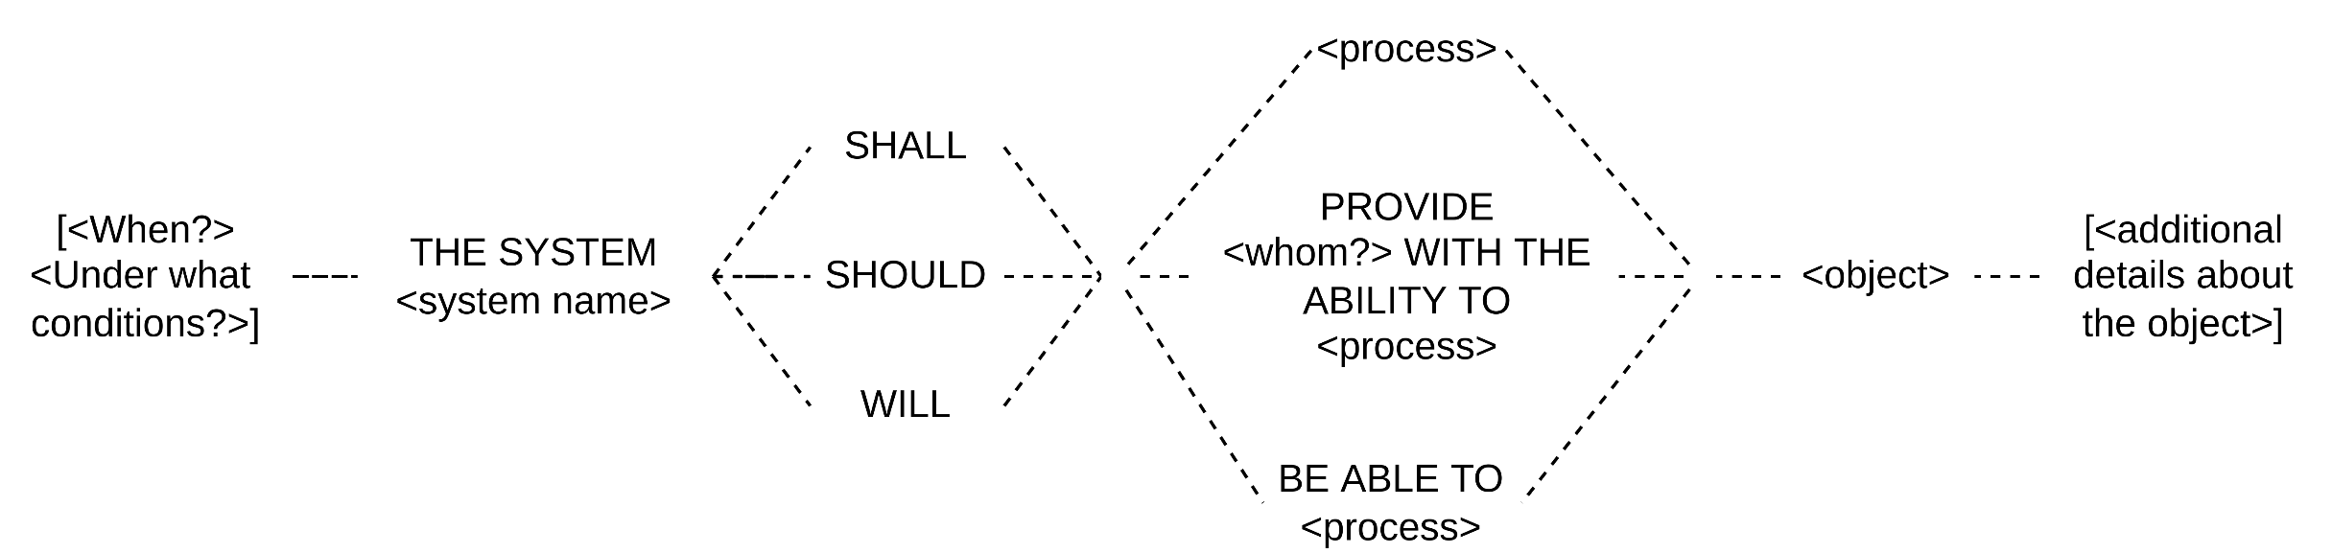
Textual Requirements Specification
Syntactic Requirements Patterns – Example
<when?> / <under what conditions>
Conditions under which the function documented in the requirement is performed
Temporal or logical
One or more
C. Rupp (2009) – Requirements Engineering and Management
Notes:
<number>
Vier Variablen Modell in einem Satz: Grundlagen sind Variablen (Grundlegendes Modell), Erweiterung über Realtionen -> Grundlage für Dokumente: Wie dokumentiere ich sowas
Controlled V-> Ausgabewerte die durch das System beschrieben / verändert werden
Monitored V -> EingabeWerte, die durch das System beschrieben werden
Output V -> represents controlled V.
Input V -> represents monitored V.
Eschbach, Elicitation & Modeling: Embedded Systems Industrial Formal Techniques, 2006

Slide 51

Textual Requirements Specification
Syntactic Requirements Patterns – Example
THE SYSTEM / <system name>
Name of the system that shall provide the functionality
Subject of the sentence
C. Rupp (2009) – Requirements Engineering and Management
Notes:
<number>
Vier Variablen Modell in einem Satz: Grundlagen sind Variablen (Grundlegendes Modell), Erweiterung über Realtionen -> Grundlage für Dokumente: Wie dokumentiere ich sowas
Controlled V-> Ausgabewerte die durch das System beschrieben / verändert werden
Monitored V -> EingabeWerte, die durch das System beschrieben werden
Output V -> represents controlled V.
Input V -> represents monitored V.
Eschbach, Elicitation & Modeling: Embedded Systems Industrial Formal Techniques, 2006

Slide 52
Textual Requirements Specification
Syntactic Requirements Patterns – Example
SHALL
Legally binding requirement
If a statement does not contain “shall”, it is not a requirement
C. Rupp (2009) – Requirements Engineering and Management
Notes:
<number>
Vier Variablen Modell in einem Satz: Grundlagen sind Variablen (Grundlegendes Modell), Erweiterung über Realtionen -> Grundlage für Dokumente: Wie dokumentiere ich sowas
Controlled V-> Ausgabewerte die durch das System beschrieben / verändert werden
Monitored V -> EingabeWerte, die durch das System beschrieben werden
Output V -> represents controlled V.
Input V -> represents monitored V.
Eschbach, Elicitation & Modeling: Embedded Systems Industrial Formal Techniques, 2006

Slide 53
Textual Requirements Specification
Syntactic Requirements Patterns – Example
SHOULD
Highly recommended feature
Optional, not contractually required
More like goals instead of requirements
C. Rupp (2009) – Requirements Engineering and Management
Notes:
<number>
Vier Variablen Modell in einem Satz: Grundlagen sind Variablen (Grundlegendes Modell), Erweiterung über Realtionen -> Grundlage für Dokumente: Wie dokumentiere ich sowas
Controlled V-> Ausgabewerte die durch das System beschrieben / verändert werden
Monitored V -> EingabeWerte, die durch das System beschrieben werden
Output V -> represents controlled V.
Input V -> represents monitored V.
Eschbach, Elicitation & Modeling: Embedded Systems Industrial Formal Techniques, 2006

Slide 54
Textual Requirements Specification
Syntactic Requirements Patterns – Example
WILL
Statements of fact
Example: If I want to tell you something about another system I will use “will”.
C. Rupp (2009) – Requirements Engineering and Management
Notes:
<number>
Vier Variablen Modell in einem Satz: Grundlagen sind Variablen (Grundlegendes Modell), Erweiterung über Realtionen -> Grundlage für Dokumente: Wie dokumentiere ich sowas
Controlled V-> Ausgabewerte die durch das System beschrieben / verändert werden
Monitored V -> EingabeWerte, die durch das System beschrieben werden
Output V -> represents controlled V.
Input V -> represents monitored V.
Eschbach, Elicitation & Modeling: Embedded Systems Industrial Formal Techniques, 2006

Slide 55
Textual Requirements Specification
Syntactic Requirements Patterns – Example
PROVIDE <whom?> WITH THE ABILITY TO <process>
Same as <process>, except: Applies to requirements offered to specific users → <whom?>
C. Rupp (2009) – Requirements Engineering and Management
Notes:
<number>
Vier Variablen Modell in einem Satz: Grundlagen sind Variablen (Grundlegendes Modell), Erweiterung über Realtionen -> Grundlage für Dokumente: Wie dokumentiere ich sowas
Controlled V-> Ausgabewerte die durch das System beschrieben / verändert werden
Monitored V -> EingabeWerte, die durch das System beschrieben werden
Output V -> represents controlled V.
Input V -> represents monitored V.
Eschbach, Elicitation & Modeling: Embedded Systems Industrial Formal Techniques, 2006

Slide 56
Textual Requirements Specification
Syntactic Requirements Patterns – Example
BE ABLE TO <process>
Same as <process>, except: Applies to requirements that are performed as reactions to trigger events from other systems
C. Rupp (2009) – Requirements Engineering and Management
Notes:
<number>
Vier Variablen Modell in einem Satz: Grundlagen sind Variablen (Grundlegendes Modell), Erweiterung über Realtionen -> Grundlage für Dokumente: Wie dokumentiere ich sowas
Controlled V-> Ausgabewerte die durch das System beschrieben / verändert werden
Monitored V -> EingabeWerte, die durch das System beschrieben werden
Output V -> represents controlled V.
Input V -> represents monitored V.
Eschbach, Elicitation & Modeling: Embedded Systems Industrial Formal Techniques, 2006

Slide 57
Textual Requirements Specification
Syntactic Requirements Patterns – Example
<object> and <additional details about the object>
Object for which the functionality is required, e.g., which document shall be printed
C. Rupp (2009) – Requirements Engineering and Management
Notes:
<number>
Vier Variablen Modell in einem Satz: Grundlagen sind Variablen (Grundlegendes Modell), Erweiterung über Realtionen -> Grundlage für Dokumente: Wie dokumentiere ich sowas
Controlled V-> Ausgabewerte die durch das System beschrieben / verändert werden
Monitored V -> EingabeWerte, die durch das System beschrieben werden
Output V -> represents controlled V.
Input V -> represents monitored V.
Eschbach, Elicitation & Modeling: Embedded Systems Industrial Formal Techniques, 2006

Slide 58
Textual Requirements Specification
Syntactic Requirements Patterns – Example
“If the glass break detector detects the damaging of a window, the Burglar3000 shall inform the head office of the security service.”
<when>: if the glass break detector detects the damaging of a window
<system name>: the Burglar3000
SHALL
<process>: inform
<object>: the head office of the security service
K. Pohl (2010) – Requirements Engineering – Fundamentals, Principles and Techniques
Notes:
<number>
Vier Variablen Modell in einem Satz: Grundlagen sind Variablen (Grundlegendes Modell), Erweiterung über Realtionen -> Grundlage für Dokumente: Wie dokumentiere ich sowas
Controlled V-> Ausgabewerte die durch das System beschrieben / verändert werden
Monitored V -> EingabeWerte, die durch das System beschrieben werden
Output V -> represents controlled V.
Input V -> represents monitored V.
Eschbach, Elicitation & Modeling: Embedded Systems Industrial Formal Techniques, 2006

Slide 59
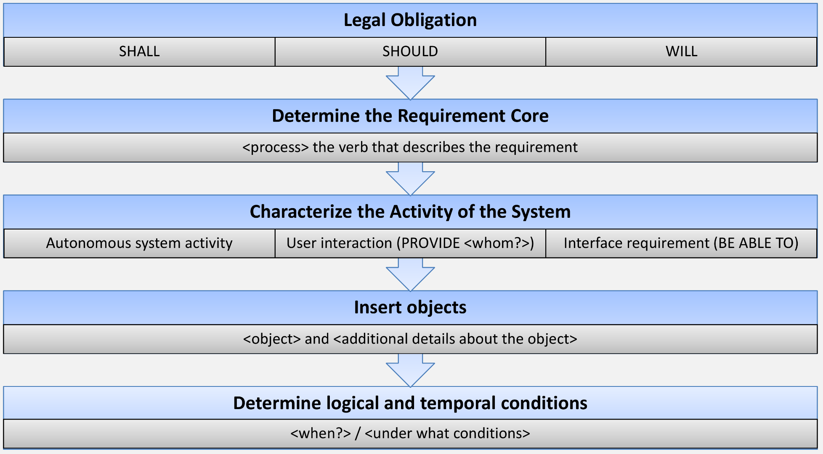
Textual Requirements Specification
Syntactic Requirements Patterns – Fitting a Requirement into the Pattern
K. Pohl (2010) – Requirements Engineering – Fundamentals, Principles and Techniques
Notes:
<number>
Vier Variablen Modell in einem Satz: Grundlagen sind Variablen (Grundlegendes Modell), Erweiterung über Realtionen -> Grundlage für Dokumente: Wie dokumentiere ich sowas
Controlled V-> Ausgabewerte die durch das System beschrieben / verändert werden
Monitored V -> EingabeWerte, die durch das System beschrieben werden
Output V -> represents controlled V.
Input V -> represents monitored V.
Eschbach, Elicitation & Modeling: Embedded Systems Industrial Formal Techniques, 2006

Slide 60
Summary

Slide 61
Summary
Requirements Documentation is a key artifact
Required amount of requirements documentation depends on context
Natural language is a versatile means for requirements documentation
Versatility allows ambiguities and problems with the perspective
Ambiguity (multiple forms)
Guidelines for writing requirements documents
Syntactic Requirements Patterns define a fixed structure for the requirements documentation
Condition, subject, legal obligation, verb, object

Slide 62
Questions?

Slide 63
References

