Slide 1
Requirement Engineering
Lecture 4: Requirements Elicitation
Part 2
Prof. Dr. Benjamin Leiding
M.Sc. Anant Sujatanagarjuna

Slide 2
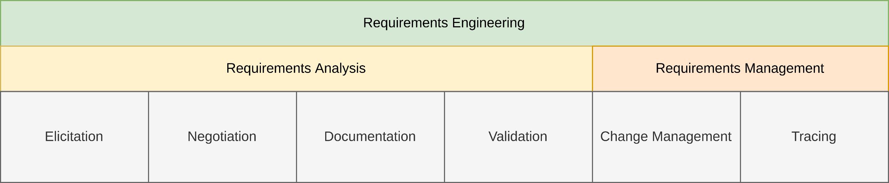
General Requirements Engineering Process
Overview

Slide 3
Lecture 4: Requirements Elicitation
Content
Elicitation Techniques
Assistance/Support Techniques
HSN:/RE as part of Software Engineering

Slide 4
Elicitation Techniques
Overview
Survey Techniques | Creativity Techniques | Document-centric Techniques | Observation Techniques | Support Techniques
Interviews | Brainstorming | System Archaeology | Field Observation | Mind Mapping
Questionnaires | Brainstorming Paradox | Perspective-based Reading | Apprenticing | Workshops
 | Change of Perspective | Reuse |  | CRC Cards
 | Analogy Technique |  |  | Audio and Video Recording
 |  |  |  | Use Case Modeling
 |  |  |  | Prototypes
Notes:
41

Slide 5
Elicitation Techniques
Document-centric Techniques
Reuse of solutions and experiences made with existing systems
Used when a legacy system is replaced
Make sure that the new system covers all important features of the legacy system
Should be combined with other techniques
Validation of the elicited requirements
Discovery of new requirements impossible
Notes:
41

Slide 6
Elicitation Techniques
Document-centric Techniques
Document analysis is an important part of requirements elicitation
Typical types of documents:
Development documents (of current or earlier systems)
Standards & Norms
Compliance (legal information)

Slide 7
Elicitation Techniques
Document-centric Techniques – System Archaeology
Extracts information from documentation or implementations of existing systems
Legacy systems or competitor’s system
Can recover lost knowledge about system logic
System logic is elicited anew
Yields large amount of detailed requirements
Notes:
41

Slide 8
Elicitation Techniques
Document-centric Techniques – Reuse
Assumption:
Documented requirements are available
The requirements have a high quality
Such requirements do not have to be reelicited
Instead → just reuse the existing requirements
Saves costs and time!
Notes:
41

Slide 9
Elicitation Techniques
Document-centric Techniques – Perspective-based Reading
Analyzes documents from a certain perspective → e.g., implementer or tester
All aspects not related to the perspective are ignored
Allows analysis focused on particular aspects
Can separate technology-related or implementation- related aspects from operational aspects
Notes:
41

Slide 10
Elicitation Techniques
Document-centric Techniques – Prepare Perspective-based Reading
Define goals and expected results
Define perspectives based on the goals
Pick documents based on the defined perspectives and goal
Choose stakeholders matching the perspectives to do the reading

Slide 11
Elicitation Techniques
Document-centric Techniques – Conduct Perspective-based Reading
The two methods to conduct perspective-based reading are sequenced reading and top-down reading.
Sequenced reading
The whole documents are read with the defined perspectives
Top-down reading
The documents must have structuring means (table of contents, index, list of figures etc.)
Only relevant text passages found with the structuring means and the perspective are read

Slide 12
Elicitation Techniques
Document-centric Techniques – Post-process Perspective-based Reading
Documenting the requirements
Document the gained requirements
Ensure the traceability between the requirements and the text passages

Slide 13
Elicitation Techniques
Overview
Survey Techniques | Creativity Techniques | Document-centric Techniques | Observation Techniques | Support Techniques
Interviews | Brainstorming | System Archaeology | Field Observation | Mind Mapping
Questionnaires | Brainstorming Paradox | Perspective-based Reading | Apprenticing | Workshops
 | Change of Perspective | Reuse |  | CRC Cards
 | Analogy Technique |  |  | Audio and Video Recording
 |  |  |  | Use Case Modeling
 |  |  |  | Prototypes
Notes:
41

Slide 14
Elicitation Techniques
Observation Techniques
Observation of stakeholders during their work
Instead of a stakeholder or domain expert describing their work
Active demonstration or passive observation both possible
Requirements engineer documents all steps
Elicits the business process
Observes mistakes, risks, and open questions
Question the existing process in order to determine how the process should look like
Avoids documenting an outdated or suboptimal process
Well-suited to obtain dissatisfiers
Not well-suited for the development of new requirements
Notes:
41

Slide 15
Elicitation Techniques
Observation Techniques – Field Observation
Requirements engineer is on location
Observes and documents processes
May be supported by video and audio recordings
Well-suited for requirements and processes that are difficult to describe verbally
Instead, they are simply shown
Notes:
41

Slide 16
Elicitation Techniques
Observation Techniques – Field Observation / Preparation
Purpose
Decide on the purpose of the observation
Object
Decide on the object of the observation
Work results
Define the planed work results
Notes:
41
41

Slide 17
Elicitation Techniques
Observation Techniques – Conduct Observation
Ethnographic observation
The observer works together with the stakeholders over a longer time
During this time the observer watches the stakeholders to learn and understand their mode of operation and procedure
If possible, the observer does these operations independently
Direct observation
The observer watches the stakeholders, analyses their operations and asks comprehension questions
Also systems can be observed through observation of their usage
Notes:
41
41

Slide 18
Elicitation Techniques
Observation Techniques – Field Observation / Conducting
Guideline for an observation
Gain the trust of the observed stakeholders
Pay attention to details
Write down your expressions immediately
Check the objectivity of your documentation
Check the authenticity of the observed activities
Forms of documentation
Writing
Audio recording
Video recording
Notes:
41
41

Slide 19
Elicitation Techniques
Observation Techniques – Field Observation / Conducting
Observation of stakeholders in their environment:
Can be done by observer, camera or computer monitoring
Objectives are:
Identify fundamental knowledge, that nobody is going to mention (implicit knowledge)
Find hidden requirements / causes
Get a better understanding for the real situation on the side of the requirements engineers
Disadvantages:
Large amounts of irrelevant data
Time consuming
Rare events may be eventually disregarded
Notes:
41

Slide 20
Elicitation Techniques
Observation Techniques – Field Observation / Post-processing
Post process the records
Link the records of your observation with the gained requirements
Adjust your results together with the participating stakeholders (for example with an interview or a workshop)
Notes:
41
41

Slide 21
Elicitation Techniques
Observation Techniques – Apprenticing
The requirements engineer actively learns and performs the procedures of the stakeholders
Like an apprentice
Encouraged to question unclear and complex procedures
Allows the elicitation of requirements the stakeholders take for granted
Reverses the balance of power between the requirements engineer and the domain specialist
Notes:
41

Slide 22
Assistance / Support Techniques

Slide 23
Elicitation Techniques
Overview
Survey Techniques | Creativity Techniques | Document-centric Techniques | Observation Techniques | Support Techniques
Interviews | Brainstorming | System Archaeology | Field Observation | Mind Mapping
Questionnaires | Brainstorming Paradox | Perspective-based Reading | Apprenticing | Workshops
 | Change of Perspective | Reuse |  | CRC Cards
 | Analogy Technique |  |  | Audio and Video Recording
 |  |  |  | Use Case Modeling
 |  |  |  | Prototypes
Notes:
41

Slide 24
Assistance / Support Techniques
Support Techniques
Support the previously presented elicitation techniques
General techniques not only related to requirements
Not every support technique is suitable for every elicitation technique
Should improve the efficiency, balance out weakness, or prevent pitfalls of a technique
Notes:
41

Slide 25
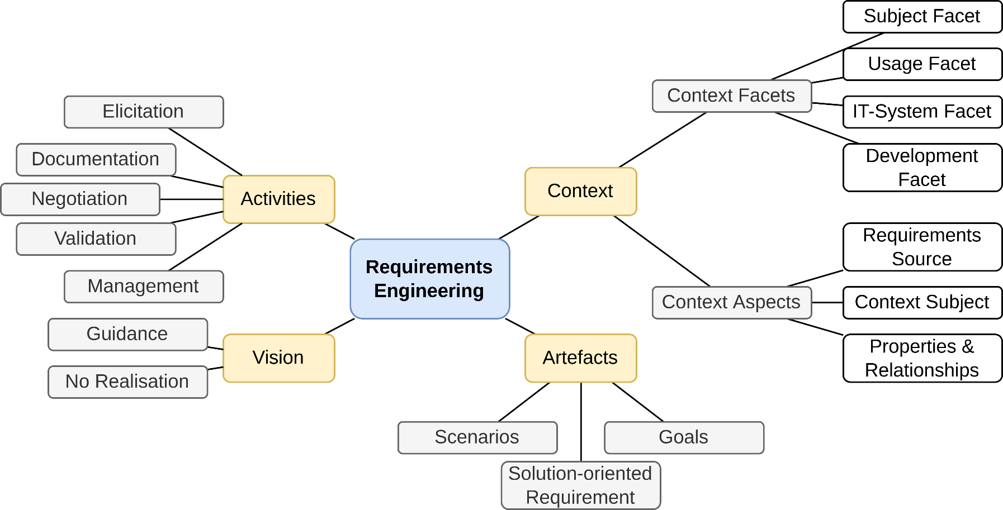
Assistance / Support Techniques
Support Techniques – Mind Mapping
Graphical representation
Shows relationships and interdependencies between terms
Based on K. Pohl (2010) – Requirements Engineering – Fundamentals, Principles and Techniques
Notes:
41

Slide 26
Assistance / Support Techniques
Support Techniques – Workshop
Joint meeting of requirements engineer and stakeholders
Use meeting to elaborate on goals
May also go into details
Example:
Use a workshop to design the user interfaces
Notes:
41

Slide 27
Assistance / Support Techniques
Support Techniques – Prepare Workshop
Objective
Define the objective of the workshop explicitly
Work results and procedure
Decide the work results explicitly
Define the procedure to gain and develop the work results
Combine them to an agenda
Plan regular breaks

Slide 28
Assistance / Support Techniques
Support Techniques – Prepare Workshop
Participants
Choose the participants based on the work results
Make sure your selection of participants is representative
Invite the participants early enough
Agree with the participants upon the work results

Slide 29
Assistance / Support Techniques
Support Techniques – Prepare Workshop
Location
Ensure the location has enough room for the participants
Provide the proper atmosphere
Organize technical equipment (whiteboard, projector etc.)
Moderator and transcript writer
Invite an external moderator and an external transcript writer

Slide 30
Assistance / Support Techniques
Support Techniques – Conduct Workshop
Introduction
Present the workshops object and work results
Give the participants the opportunity to discuss them
Explain the procedure
Set the discussion rules explicitly
Let the participants vote on the application of these rules one by one
Working part
Make sure that the participants adhere to the agenda and the discussion rules
Protocol the results
Document and identify conflicts and try to solve them
Document decisions explicitly

Slide 31
Assistance / Support Techniques
Support Techniques – Conduct Workshop
Finish
Be sure to gather all remaining topics
Define the further procedure for each remaining topic
Allow your participants to give a feedback about the workshop (participants have the last word)
Thank the participants for their attendance

Slide 32
Assistance / Support Techniques
Support Techniques – Post-processing Workshop
Consolidate the work results
Ask the participants for their approval of the transcript
Let each participant approve on the consolidated work results

Slide 33
Assistance / Support Techniques
Support Techniques – Prototypes for Illustrations
Well-suited to illustrate requirements
Allows clarification of vague requirements
Consequences of new or changed requirements can be identified
Mostly used for user interface prototypes
Notes:
41

Slide 34
Assistance / Support Techniques
Support Techniques – Prototypes
Prototypes can be very different:
Paper prototypes
e.g. for graphical user interfaces
“Wizard of Oz” Prototype
Development of a graphical user interface (GUI), but input will be sent directly to an operator, who is simulating the systems behavior and who produces the appropriate output.
Software prototypes
e.g. realized in Visual Basic (throw-away prototypes)
Notes:
41
41

Slide 35
Assistance / Support Techniques
Support Techniques – Focus Group
Special form of workshop (6-10 participants)
Start with problems
e.g. map collection, flipchart
Collect reasons
Then focus on optimal solution
But not only opposites of the problems
Collect reasons, too
Then group the issues
Should be about 40 issues
Then priorities
e.g. distribute 10 points
e.g. in groups according to stakeholder roles
Finish with a review of the results

Slide 36
Assistance / Support Techniques
Support Techniques – CRC Cards
CRC = Class Responsibility Collaboration
Denote context aspects and their attributes on index cards
Formulate requirements based on the cards
Notes:
<number>

Slide 37
Assistance / Support Techniques
Support Techniques – Audio and Video Recordings
Recordings as substitute for actual contact with the stakeholders
If the stakeholders are not available
The budget is tight
The system is highly critical
Especially useful for field observations
Stakeholders might feel supervised
Changes behavior
Might refuse to participate
Notes:
<number>

Slide 38
Assistance / Support Techniques
Support Techniques – Modeling Action Sequences
Use cases are the external view of how the system will be used
Have a trigger event
Have an expected result
Describe functionality that the system must support
Notes:
<number>

Slide 39
Summary

Slide 40
Summary
Planning Requirement Elicitation
Prepare about domain
Identify Information Goals
Not shown:
Application of analysis techniques
Often overlapping and parallel activities
still deficits
Determine appr.techniques / identify stakeholders
Conduct technique
Sufficient knowledge
Notes:
<number>
Nicht sicher, ob ich die Schrift in der Skizze richtig deuten konnte.

Slide 41
Summary
Elicitation is a core activity of requirements engineering
Without good elicitation, requirements will be wrong or missing
Stakeholders, documents and existing systems as requirements sources
Missing a source leads to missing the requirements of the source
Many techniques for requirements elicitation
Not every technique is good in every scenario
Select the techniques depending on the project
Usually, a combination of multiple techniques yields the best results
Notes:
<number>

Slide 42
Questions?

