Slide 1
Emerging Technologies for the Circular Economy
Lecture 0: Organization
Prof. Dr. Benjamin Leiding
M.Sc. Anant Sujatanagarjuna
M.Sc. Shohreh Kia

Slide 2
License
This work is licensed under a Creative Commons Attribution-ShareAlike 4.0 International License. To view a copy of this license, please refer to https://creativecommons.org/licenses/by-sa/4.0/ .
Updated versions of these slides will be available in our Github repository.

Slide 3
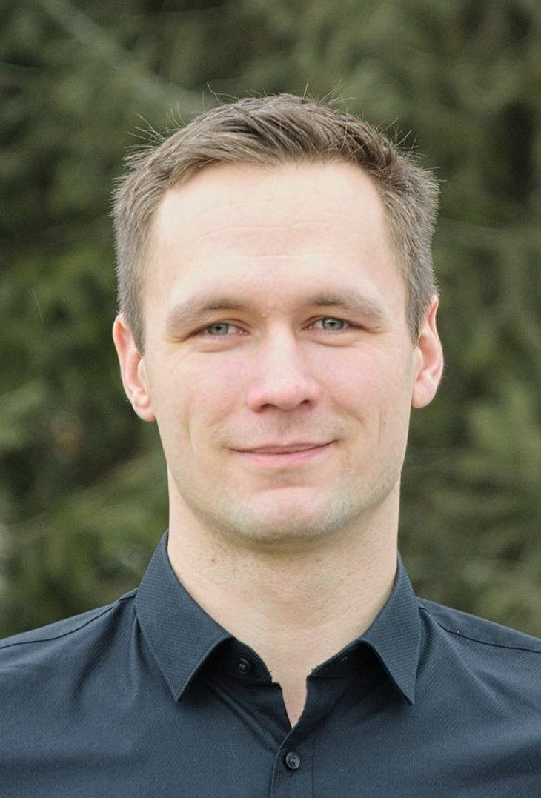
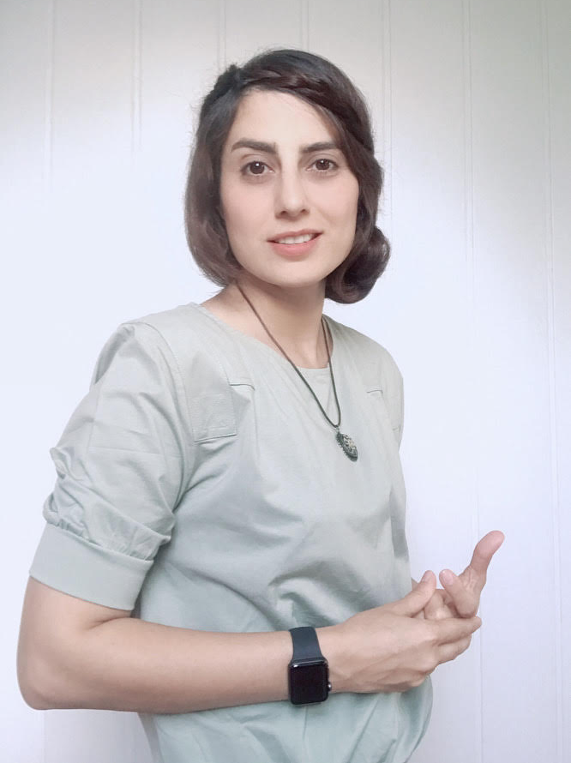

Team
Prof. Dr. Benjamin Leiding
M.Sc. Anant Sujatanagarjuna
M.Sc. Shohreh Kia

Slide 4
ETCE Research Group
Emerging Technologies for the Circular Economy → ETCE
Research focus:
Intersection of IT and sustainability
Circular Economy
Self-organized, decentralized and distributed systems
Sustainable and resilient food production
Other courses:
The Limits to Growth – Sustainability and the Circular Economy (WS – open for everyone)
Requirements Engineering (WS – M.Sc.)
Notes:
6

Slide 5
ETCE Research Group
ETCE Website – Link
Course material
Theses/project topics
Our research in action:
ZDF documentary (German) – Link
Klartext Preis 2020 (German) – Link
You want join us? Write us an email!
→ benjamin.leiding@tu-clausthal.de
Notes:
<number>

Slide 6
ETCE Research Group
ETCE Website – Link
Course material
Theses/project topics
Our research in action:
ZDF documentary (German) – Link
Klartext Preis 2020 (German) – Link
You want join us? Write us an email!
→ benjamin.leiding@tu-clausthal.de
Notes:
<number>

Slide 7
Learning Outcome
Basic understanding of the concept of the Linear Economy, the Circular Economy, the Performance Economy and sustainability

Slide 8
Learning Outcome
Basic understanding of the concept of the Linear Economy, the Circular Economy, the Performance Economy and sustainability
Basic understanding of new technologies in the field of decentralized and smart systems

Slide 9
Learning Outcome
Basic understanding of the concept of the Linear Economy, the Circular Economy, the Performance Economy and sustainability
Basic understanding of new technologies in the field of decentralized and smart systems
Understanding and overview of the Internet of Things and related concepts

Slide 10
Learning Outcome
Basic understanding of the concept of the Linear Economy, the Circular Economy, the Performance Economy and sustainability
Basic understanding of new technologies in the field of decentralized and smart systems
Understanding and overview of the Internet of Things and related concepts
Ability to design decentralized smart systems and applications in the context of connected sensor systems

Slide 11
Learning Outcome
Basic understanding of the concept of the Linear Economy, the Circular Economy, the Performance Economy and sustainability
Basic understanding of new technologies in the field of decentralized and smart systems
Understanding and overview of the Internet of Things and related concepts
Ability to design decentralized smart systems and applications in the context of connected sensor systems
Knowledge of the design and consideration of privacy-preserving data processing procedures for smart and decentralized applications

Slide 12
Learning Outcome
Basic understanding of the concept of the Linear Economy, the Circular Economy, the Performance Economy and sustainability
Basic understanding of new technologies in the field of decentralized and smart systems
Understanding and overview of the Internet of Things and related concepts
Ability to design decentralized smart systems and applications in the context of connected sensor systems
Knowledge of the design and consideration of privacy-preserving data processing procedures for smart and decentralized applications
Experience in prototyping such applications and systems

Slide 13
Lectures
15.04.2024 → Organization (L00) + Introduction (L01)
22.04.2024 → Circular Economy (L02)
29.04.2024 → Lifecycle Assessment – LCA (L03)
06.05.2024 → Introduction to the Internet of Things (L04)
13.05.2024 → Internet of Things – Communication + Security and Privacy (L05)
27.05.2024 → Internet of Things – Data Processing and BigData (L06)
03.06.2024 → Industrial Internet of Things (L07)
10.06.2024 → Introduction to Blockchain Technology (L08)
17.06.2024 → Blockchain Technology – Consensus (L09)
24.06.2024 → Blockchain Technology – Ethereum and Smart Contracts (L10)
01.07.2024 → Blockchain Technology and Sustainability (L11)
08.07.2024 → The Machine-to-Everything Economy – A step towards the CE 2.0? (L12)
29.07.2024 → Exam Q&A

Slide 14
Exercises
15.04.2024 → Exercise 01 – Knowledge Test (MC)
22.04.2024 → Exercise 02 – Circular Economy (MC)
29.04.2024 → Exercise 03 – Lifecycle Assessment (LCA)
06.05.2024 → Exercise 04 – IoT Sensing and Gathering Data
13.05.2024 → Exercise 05 – IoT Security
27.05.2024 → Exercise 06 – IoT Data Processing
03.06.2024 → Exercise 07 – Industrial IoT
10.06.2024 → Exercise 08 – Blockchain (MC)
17.06.2024 → Exercise 09 – Blockchain Basics
24.06.2024 → Exercise 10 – Blockchain Conensus
01.07.2024 → Exercise 11 – Blockchain Tokens

Slide 15
Course Organization
Organization of the lecture:
Slides are available on Github (Link)
Please report bugs!
Lectures and exercises as live stream (BBB – next slide)
Lecture recordings will be available on StudIP and on Github
Exercise time slots = Time for questions and eventual tutorials related to the exercises
Questions? Write us an email: etce-etce@tu-clausthal.de ← We will only respond to
emails written to this specific email address!

Slide 16
Dates/Times/Locations
Lecture:
Monday 2:15 pm to 3:45 pm (Berlin time) – 15.04.2024 to 08.07.2024
Location: Goslar Gotec (Am Stollen 19 C, 38640 Goslar, Germany) or via BigBlueButton (Link)
Exercise / Q&A:
Monday 4 pm to 5 pm (Berlin time) – 15.04.2024 to 08.07.2024
Location: Goslar Gotec (Am Stollen 19 C, 38640 Goslar, Germany) or via BigBlueButton (Link)

Slide 17
Exercises
Individual work → no group submissions
Multiple-Choice or coding tasks
7-14 days to submit (depending on the task)
Submission deadline is always Monday at 1:59pm (right before the next lecture)
Submission of each exercise is mandatory
You pass by submitting an exercise – even if it is an empty page
You will receive feedback on your submission
Exercise = learning feedback

Slide 18
Coding Exercise Submission and Grading
Coding exercises are graded semi-automatically. Due to this it is highly important that you follow the required submission format. Otherwise the grading process will fail and you will receive 0 points.
Code must use Python. Do not use any libraries beyond what is specified in the assignment as they may not be available in the grading environment.
Follow the directory structure from the handout file exactly. Usually this means:
If the handout contains a folder ‘lab1’, your submission should have a folder ‘lab1’ in the archive with the files inside it. The folder must not be inside another folder and the files must not be directly in the archive outside the folder.
The archive must be an uncompressed zip archive, not tar, rar, tar.gz or anything else.

Slide 19
Coding Exercise Submission and Grading
Before submitting, unpack your archive to a new folder and check that the Makefile runs correctly.
For grading, we use a different test program, so, no, hardcoding the answers to the provided driver.py will not work.
Code is submitted via a timed write-only StudIP submission folder. Only a single file can be submitted. The file name must follow the exact format ‘lab<n>_<matriculation number>.zip’, so for example ‘lab4_123456789.zip’, no extra space or _ symbols anywhere.

Slide 20
Multiple-Choice Exercises
Every student enrolled in this course is advised to take the knowledge quiz in first two weeks of the course.
Goal of the test:
To check the knowledge level of the student that is relevant to this course of study.
Preparation:
A review of basic concepts of Cryptography and Circular Economy is recommended for Week 1 and Week 2 respectively
Knowledge quiz for Week 1 only tests your existing knowledge.
THE TEST IS JUST FOR YOU → WE CANNOT CHECK THE TEST RESULTS

Slide 21
Multiple-Choice Exercises
Every student enrolled in this course is advised to take the knowledge quiz in first two weeks of the course.
Goal of the test:
To check the knowledge level of the student that is relevant to this course of study.
Preparation:
A review of basic concepts of Cryptography and Circular Economy is recommended for Week 1 and Week 2 respectively
Knowledge quiz for Week 1 only tests your existing knowledge.
THE TEST IS JUST FOR YOU → WE CANNOT CHECK THE TEST RESULTS
Link for all multiple-choice exercises → etce.etce-lab.de

Slide 22

Multiple-Choice Exercises

Slide 23
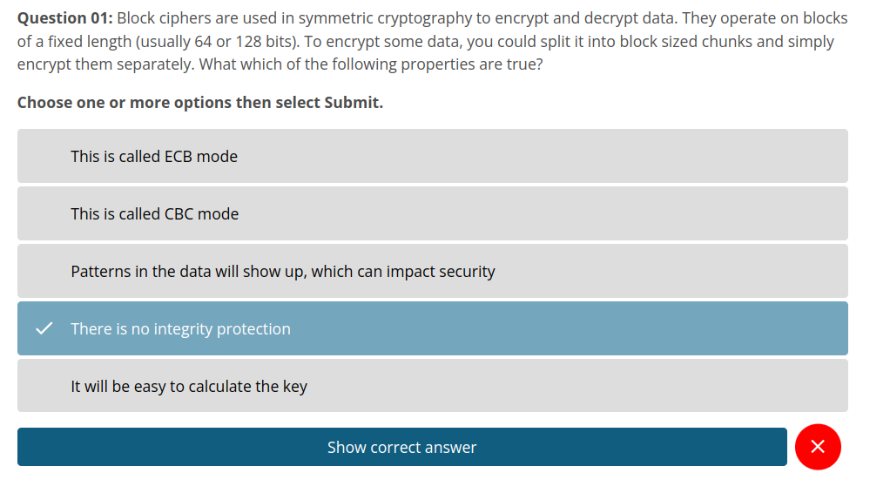
Multiple-Choice Exercises

Slide 24
Examination
Prerequisite for admission to the final exam (all criteria have to be fulfilled):
Submit all exercises (except for the MC exercises).
Final exam:
Written exam (120min) via Moodle
Date → Most likely 05.08.2024 from 2 pm – 4 pm

Slide 25
Self-Study Star
Slides with the self-study star indicate optional/additional study material that is not mandatory but could be helpful or interesting
Self-Study Star →

Slide 26
Literature
This course is not based on a single book and you do not need to buy a book to pass the exam.
Donella H. Meadows, Jorgen Randers, and Dennis L. Meadows. The Limits to Growth (1972).
Donella H. Meadows, Jorgen Randers, and Dennis L. Meadows. Limits To Growth: The 30-Year Update (2004).
Baccini et al. Metabolism of the Anthroposphere: Analysis, Evaluation, Design (2012).
Walter R. Stahel. The Circular Economy: A User's Guide (2019).
W. Brian Arthur. The Nature of Technology: What It Is and How it Evolves (2011).
David Wallace-Wells. The Uninhabitable Earth, Annotated Edition (2017).

Slide 27
Literature
(German) Stefan Rahmstorf, Hans Joachim Schellnhuber. Der Klimawandel (2019).
David Archer, Stefan Rahmstorf. The Climate Crisis (2010).
Gabrielle Walker, David King. The Hot Topic: How to Tackle Global Warming and Still Keep the Lights on (2008).

Slide 28
Literature
Satoshi Nakamoto. Bitcoin: A Peer-to-Peer Electronic Cash System (2008) – (Link).
Gavin Wood. Ethereum: A Secure Decentralized Generalised Transaction Ledger (2014) – (Link).
Andreas Schütz und Tobias Fertig. Blockchain für Entwickler: Grundlagen, Programmierung, Anwendung (2019).
M.A. Khan, M.T. Quasim, F. Algarni, A. Alharthi. Decentralised Internet of Things (2020).
Dimitrios Serpanos und Marilyn Claire Wolf. Internet-of-Things (IoT) Systems Architectures, Algorithms, Methodologies (2018).
Perry Lea. Internet of Things for Architects: Architecting IoT solutions by implementing sensors, communication infrastructure, edge computing, analytics, and security (2018).
Dan Boneh, Amit Sahai und Brent Waters. Functional Encryption: Definitions and Challenges (2010).

Slide 29
Further Resources
Climate University – Teaching and learning for a sustainable future – Link
Circular Societies (German) – Link
Server Infrastructure for a Global Rebellion – Link
Podcasts:
Drilled (Link)
How to Save a Planet (Link)
1,5 Grad – der Klima-Podcast mit Luisa Neubauer (German) (Link)

Slide 30
Questions?

