Slide 1
Industrial IoT for the Circular Economy
Lecture 07: IIoT
SS-2024
Prof. Dr. Benjamin Leiding
M.Sc. Anant Sujatanagarjuna
M.Sc Shohreh Kia

Slide 2
News/Updates

Slide 3

Course Evaluation – QR Code and Link
For the course: „Emerging Technolgoies for the Circular Economy”
Link: Click Me

Slide 4

Course Evaluation – QR Code and Link
For the course: „IoT and Digitalization for Circular Economy”
Link: Click Me

Slide 5
Lecture 07: Industrial Internet of Things
Content
An introduction to the IIoT
Comparison of IoT and IIoT
Advantages of IIoT
How to use the IIoT?
Challenges and the future of IIoT

Slide 6
Introduction

Slide 7
Defining Industrial IoT
Results
“Industrial internet of things or industry 4.0 is a combination of IoT technology and data with production and other industrial processes, which is often done with the aim of increasing the automation of efficiency and productivity.”
“IIoT also refers to connected sensors, tools and other devices related to industrial applications of computers, including connected manufacturing and energy management. This connection enables data collection, data exchange and data analysis and it potentially leads to improvements in productivity as well as other economics benefits.”
Alasdair Gilchrist (auth.) - Industry 4.0_ The Industrial Internet of Things-Apress (2016)
Sudip Misra, Chandana Roy, Anandarup Mukherjee- Introduction to Industrial Internet of Tings and Industry 4.0

Slide 8
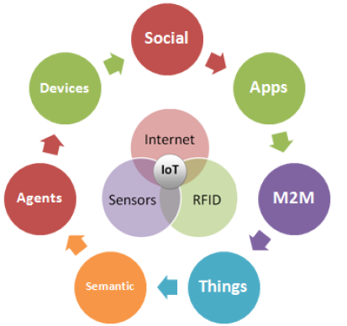
What do we mean with “ things “ in IoT and IIoT
The classification of objects in IoT and IIoT
Those that collect and send information
Those that receive and act on information
Those that do both
Image by Toma Cristian, Cristian Ciurea and Ion Ivan-https://en.wikisource.org/wiki/Approaches_on_Internet_of_Things_Solutions- CC BY 3.0

Slide 9
Evolution of IIoT
The Industrial Internet of Things(IIoT) has its roots in the field of industrial automation and has evolved over the years to become a prominent technology that is transforming industries globally.
Industrial Automation
Advancements in sensors and connectivity
Cloud computing and big data
Edge computing
Convergence of IT and OT
Industry-specific IIoT solutions
Alasdair Gilchrist (auth.) - Industry 4.0_ The Industrial Internet of Things-Apress (2016)

Slide 10
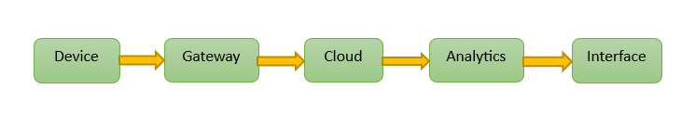
The components of an IIoT system
Sensors / Devices
Ability to connect
Cloud computing
Data processing
User interface
“Remember, the IoT and IIoT are not sensors and equipments but an ecosystem based on information which is ecosystem of communication base.”
The Industrial Internet of Things Volume G5: Connectivity Framework, Rajive Joshi, Paul Didier, Jaime Jimenez, Timothy Carey, 2017

Slide 11
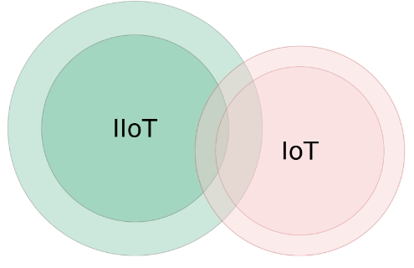
Comparison of IoT and IIoT
Security
Interoperability
Scalability
Precision and accuracy
Programmability
Low latency
Reliability
Resilience
Automation
Serviceability
Image adapted from:https://web.stanford.edu/class/archive/ee/ee392b.1186/lecture/apr3/ee392b_2018_Lecture1_Overview.pdf

Slide 12
Comparison of IoT and IIoT
Security in IIoT
Cloud | Using multiple cloud providers and adhering to cloud standards and certifications to support regional data laws. Mapping to the Cloud Security Alliance Cloud Controls Matrix and complying with national, international, and governing body regulations
Authentication and authorization | Securely enroll edge devices using PKI for authentication before data is collected. Authenticate connections from edge to cloud. Have precise control over who can read and write data.
Encryption | Encrypt data during transit using the strongest security (TLS). Establish secure tunnels and VPNs from edge to cloud. Allow traffic only from specific IP addresses. Encrypt data at rest, keeping it isolated from other tenants' data.
Code security | Implementing code signing, conducting code reviews, and prioritizing a security-focused approach.
Industrial Internet of Things for Developers by Ryane Bohm

Slide 13
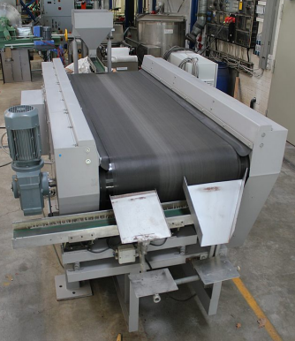
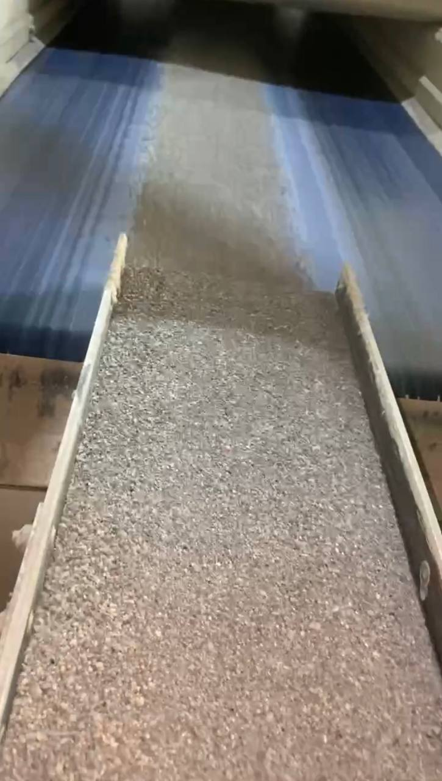
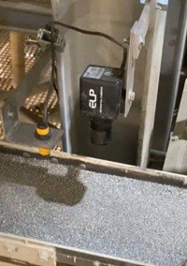
Comparison of IoT and IIoT
Examples
Interoperability
Scalability
Precision and accuracy
Programmability
Low latency
Reliability
Resilience
Automation
Serviceability
Eddy current separation machine
Materials on conveyor belt
Integrating IIoT
Image by ETCE lab- https://etce-lab.com/ - CC BY-SA 4.0

Slide 14
Other benefits of IIoT
Real-time information on the state of the supply chain
Automatic timely decision-making during the production process
Predictive maintenance
Cost reduction
Increased safety of the environment and employees
Let’s do more with less always
Industrial Internet of Things for Developers by Ryane Bohm

Slide 15
Why Industrial Internet and Why Now?
Need for Efficiency: Complexity of systems and economic pressure demand innovative solutions.
Technological Maturity: Advancement in sensor technology, analytics, and cloud computing make IioT feasible and beneficial.
Alasdair Gilchrist (auth.) - Industry 4.0_ The Industrial Internet of Things-Apress (2016)

Slide 16
Other benefits of IIoT
Use cases
Manufacturing
Energy
Smart Office
Transportation
Agriculture
Healthcare
Recycling
Logistic
Retail
Aviation
Space Travel
Smart Factory
AND → Smart city
Optimization and Sustainability
Resource optimization
Energy management
Waste reduction
Environment monitoring

Slide 17
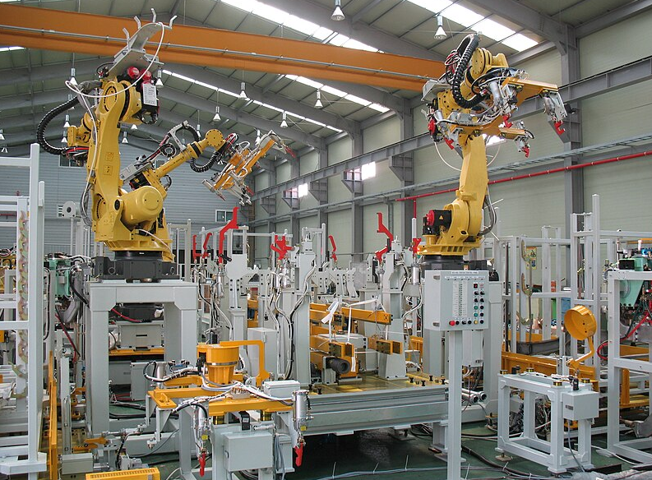
Use cases
Manufacturing
Predictive maintenance
Condition monitoring
Supply chain management
Asset tracking and management
Energy management
Remote monitoring and control
Quality control
Image by Mixabest, https://commons.wikimedia.org/wiki/File:Manufacturing_equipment_070.jpg, CC BY-SA 3.0.

Slide 18
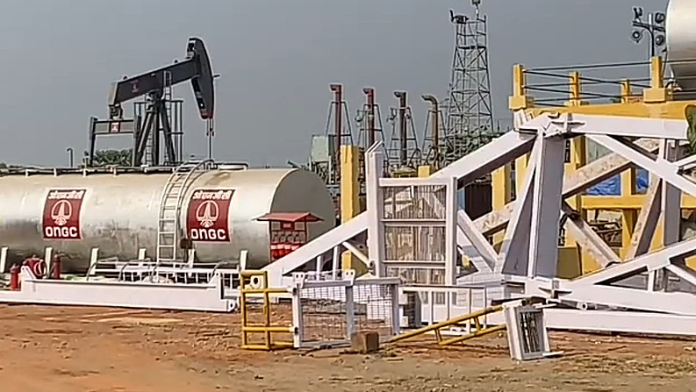
Use cases
Oil and Gas Industry
Challenges in oil and gas industry
Natural disasters
Oil and gas pipeline leaks
Communication and regulatory restrictions
They can cause a lot of financial and life damage.
Image by BNJ Nilam, https://commons.wikimedia.org/wiki/File:ONGC_Ashoknagar_Oil_Field_West_Bengal,_07-Jan-2021.jpg, CC BY-SA 4.0

Slide 19
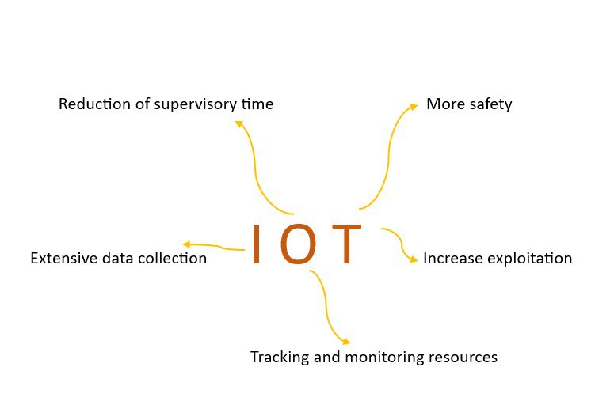
Use cases
Oil and Gas Industry
Reduce cost of extraction
Creation of a fast and reliable platform for collecting extensive data in the refinery
Increase the speed of system
Being able to monitor and check information in short time
Monitoring the level of tanks
Real-time checking thickness of pipes
Real-time checking rate of flow and pressure of pipes

Slide 20
Use cases
Oil and Gas Industry
The use of IoT in this industry provides:
  Close monitoring of harmful gases, pressure, and other important factors
  Minimization of possible risks for employees
IoT enables monitoring of oil and gas production in seas and areas with low access to communication networks
Ability to measure water salinity and monitor employee's health
Monitoring of pipelines and quick notification of leaks
Prevention of financial damages and environmental destruction
Creation of a platform to check different parts of energy-carrying ships
Remote accessibility for employees to check difficult-to-access ship parts

Slide 21
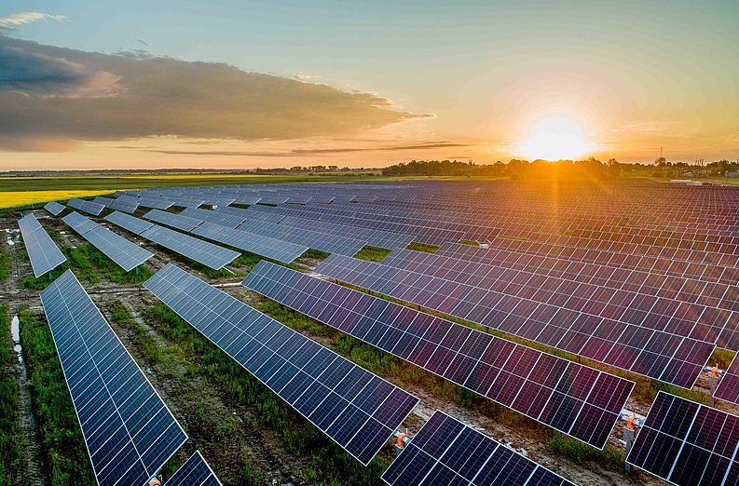
Use cases
IIoT integration in solar and wind farms
Enhances operational efficiency
Reduces downtime
Improves maintenance practices
Maximizes energy production
Image by Aiseinau, https://commons.wikimedia.org/wiki/File:Saul%C4%97s_elektrin%C4%97.jpg,CC BY-SA 4.0

Slide 22
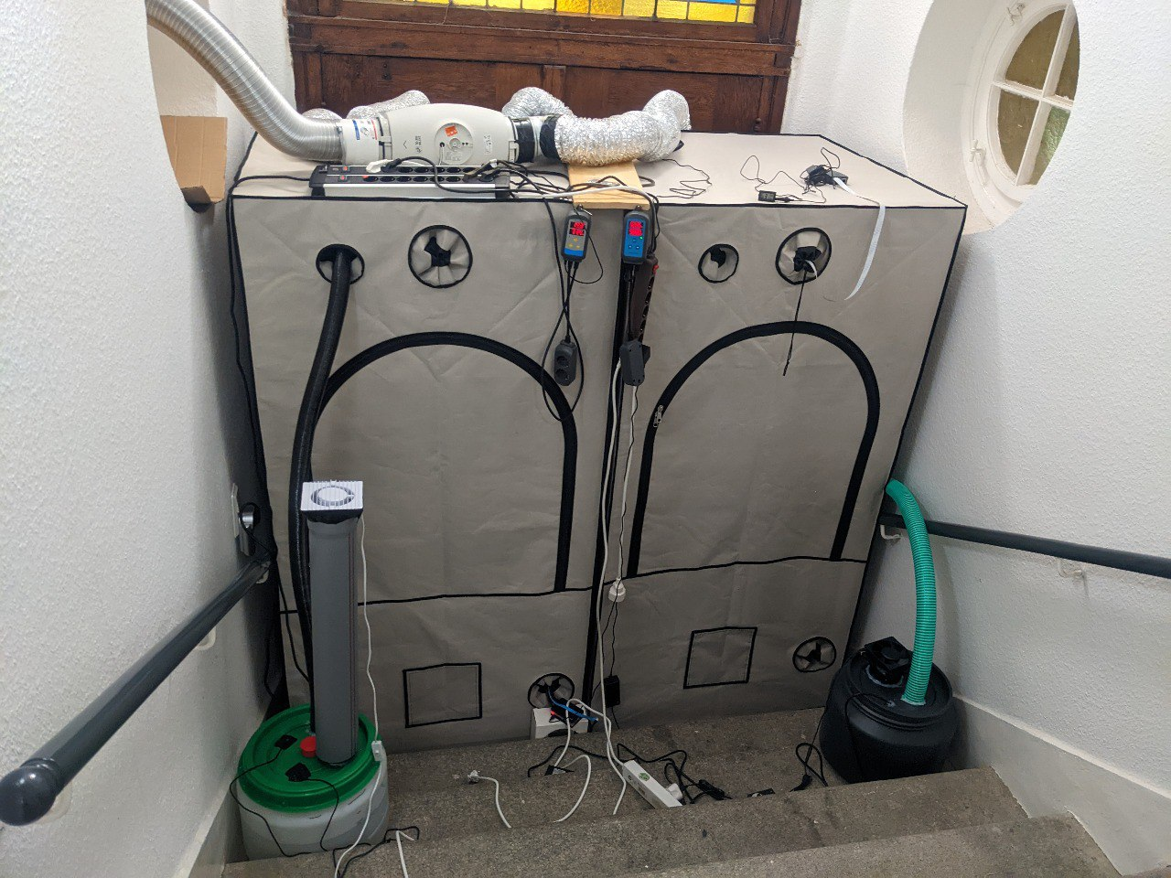
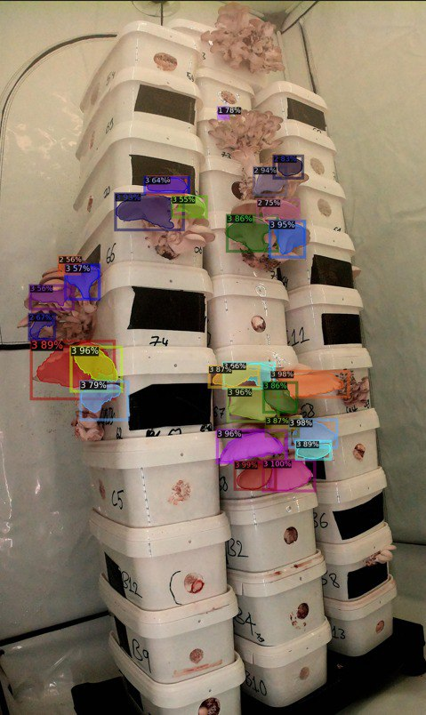
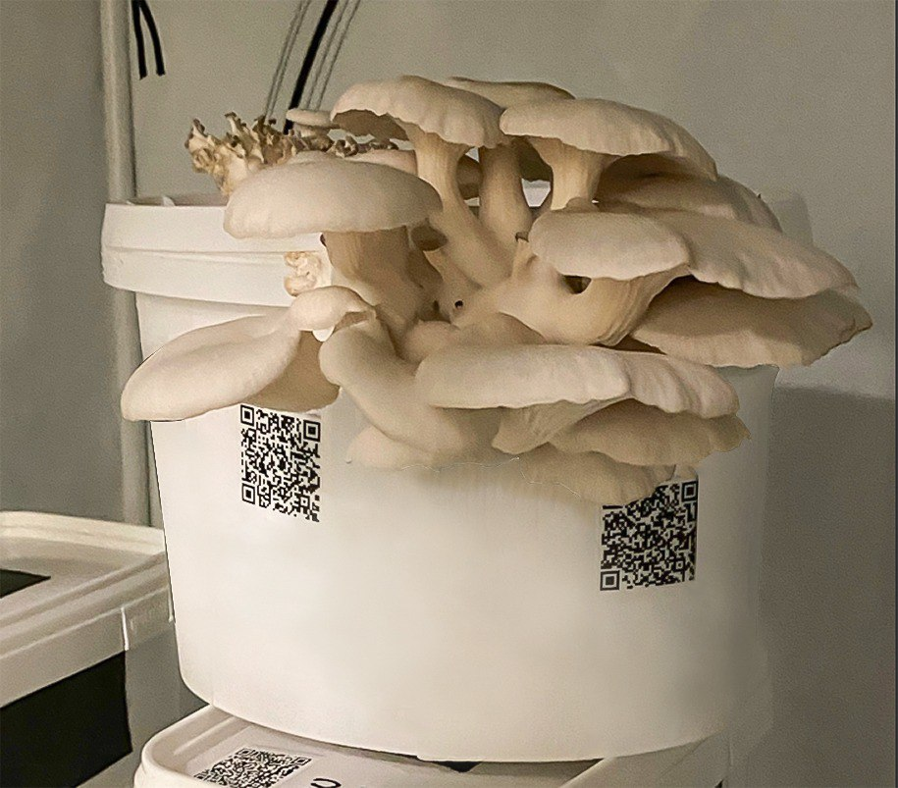
Use cases
Agriculture
Precision Agriculture
Livestock Monitoring
Automated Farming
Weather Monitoring and Forecasting
Supply Chain and Traceability
Smart Greenhouse
Image by ETCE lab- https://etce-lab.com/ - CC BY-SA 4.0

Slide 23
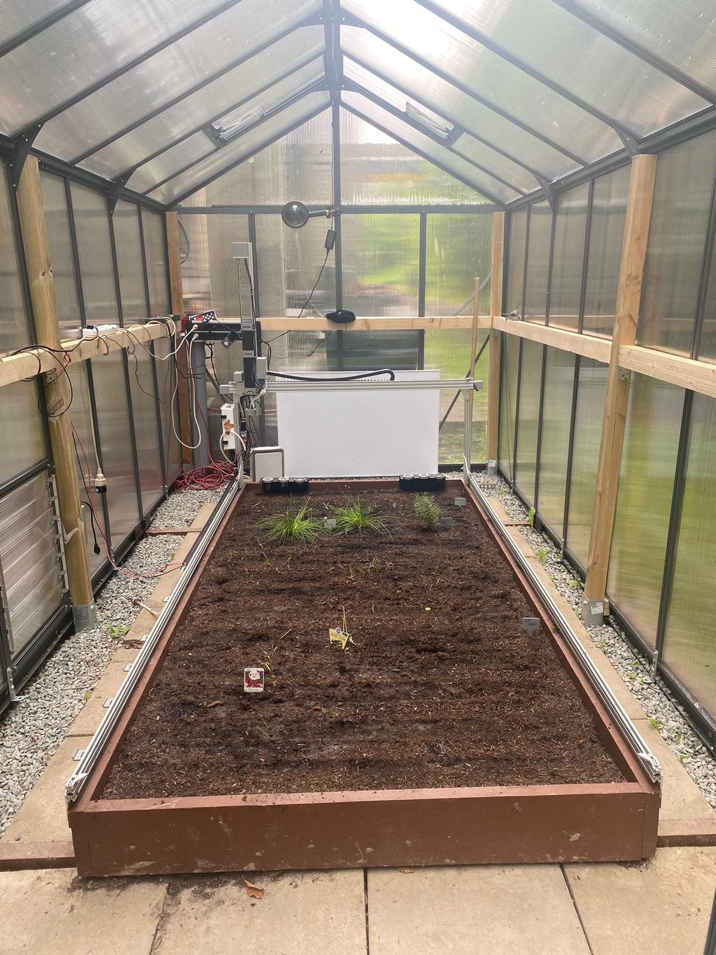
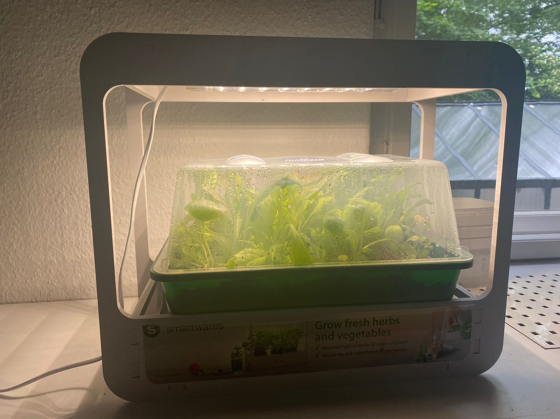
Use cases
Agriculture
Image by ETCE lab- https://etce-lab.com/ - CC BY-SA 4.0

Slide 24

Use cases
Healthcare
Remote Patient Monitoring
Smart Medical Devices
Asset and Inventory Management
Telemedicine
Patient Safety and Security
Health and Wellness Monitoring
Image by ETCE lab- https://etce-lab.com/ - CC BY-SA 4.0

Slide 25
Healthcare
Examples
Giraff Robot
Automation
Supervision
Communication
All in remote.
https://link.springer.com/article/10.1007/s12369-021-00843-0
Check the image from the above link.

Slide 26
Healthcare
Examples
Baymax
A robot with a soft synthetic skin that can detect medical conditions.
https://www.awn.com/animationworld/roy-conli-talks-production-disneys-big-hero-6
Check the image from the above link.

Slide 27
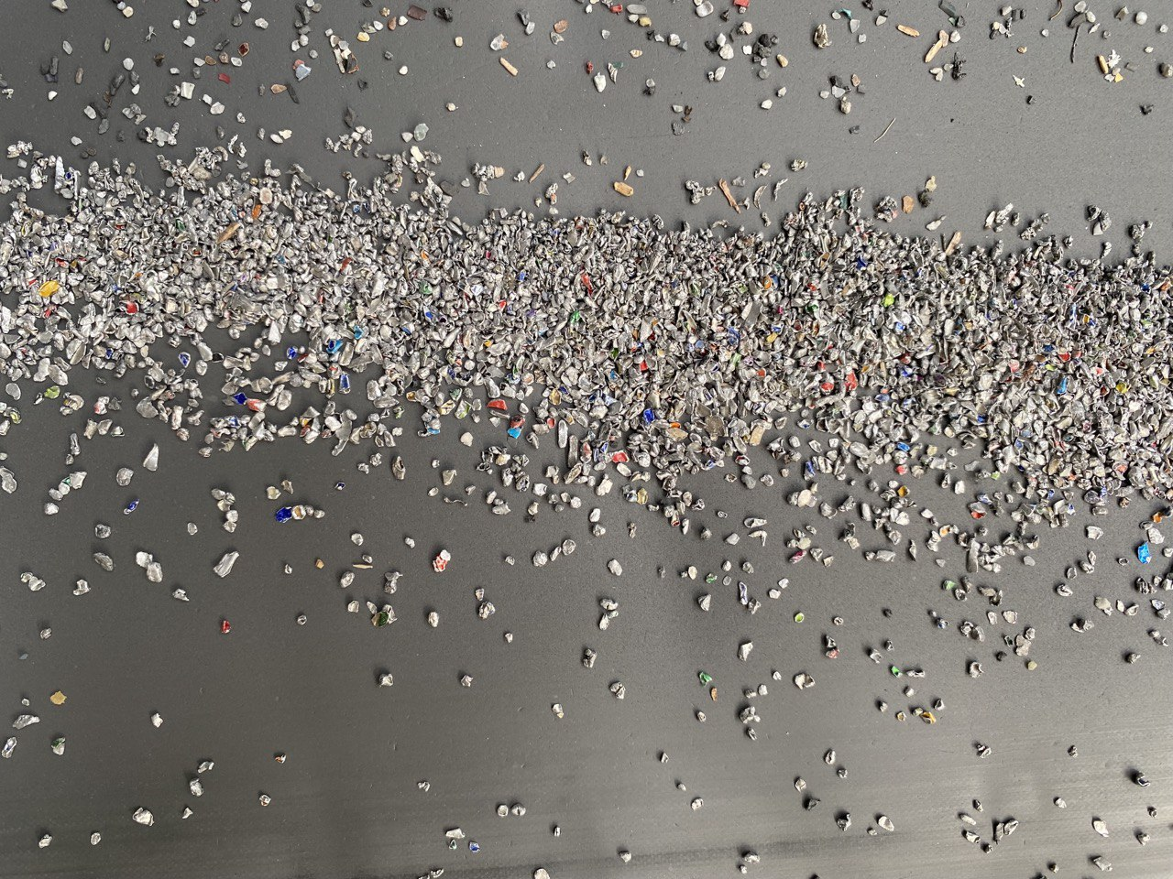
Use Cases
Recycling
Smart Bins
Sorting and Separation
Predictive Maintenance
Energy Management
Supply Chain Management
Image by ETCE lab- https://etce-lab.com/ - CC BY-SA 4.0

Slide 28
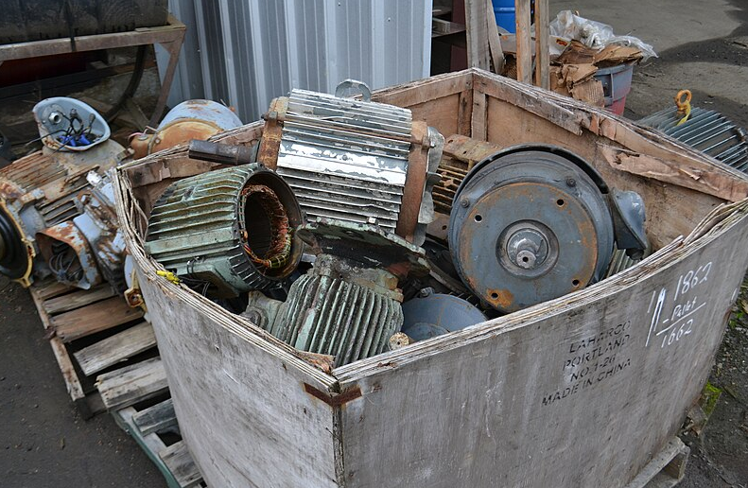
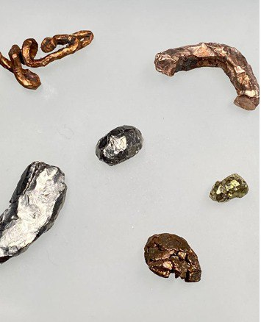
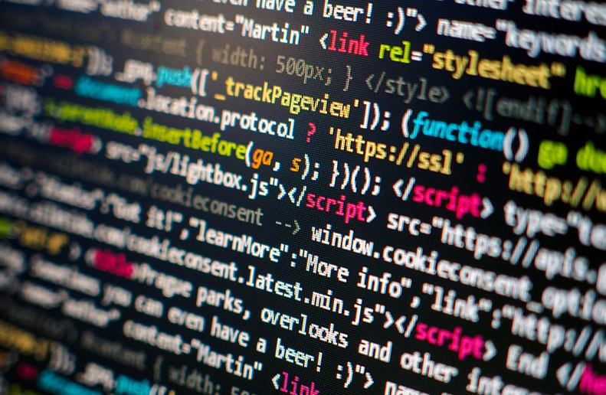
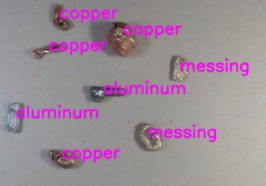
Recycling
Examples
Separation in Recycling
Hand picking
Separationsp [1]
Mixed metals [2]
Monitoring [3]
Digitalizing[4]
Digitalized separation
[5]
Image [1] by Visitor 7- https://commons.wikimedia.org/wiki/File:Metal_Parts_8.JPG- CC BY-SA 3.0
Images [2,3,5] by ETCE lab- https://etce-lab.com/ - CC BY-SA 4.0
Image [4] by Martin Vorel- https://commons.wikimedia.org/wiki/File:Programming_code.jpg- CC BY-SA 4.0

Slide 29
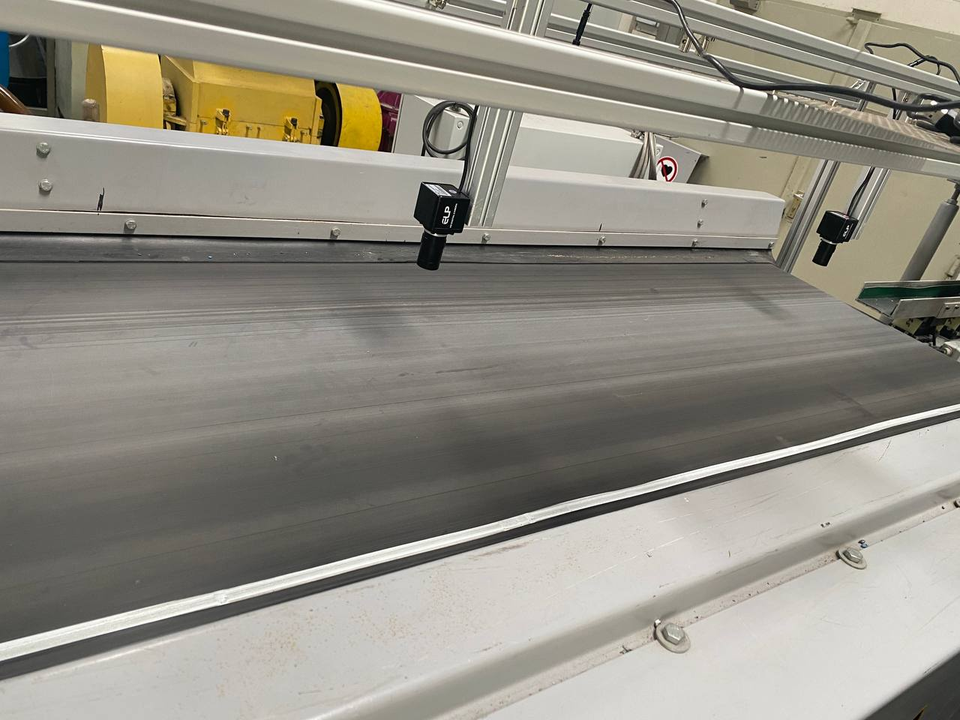
Recycling
Examples
Separation in Recycling
Set up of monitoring the belt
Image by ETCE lab- https://etce-lab.com/ - CC BY-SA 4.0

Slide 30
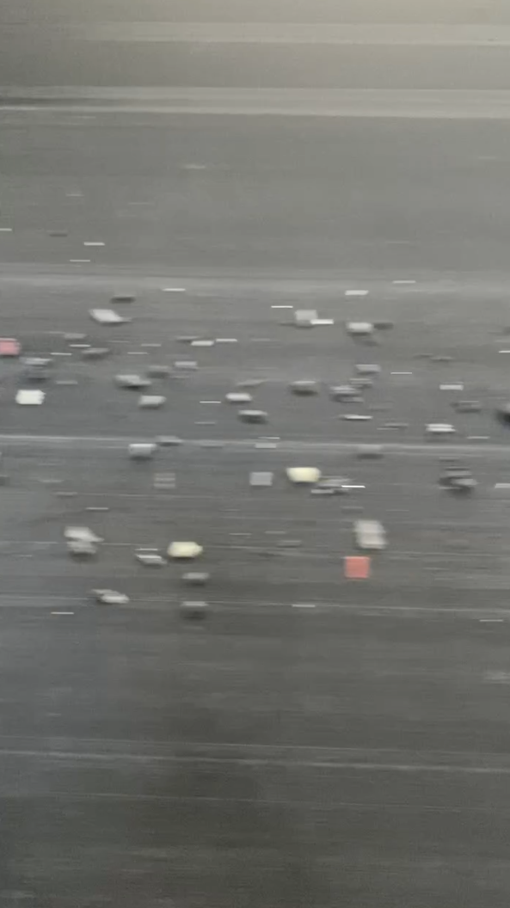
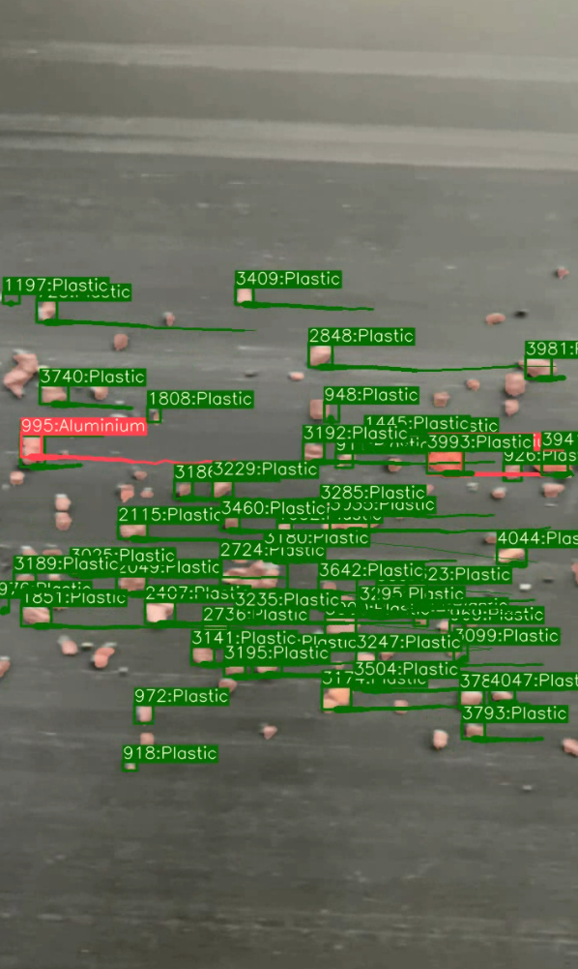
Recycling
Examples
Monitoring
Image of original material
Image of predicted material
Image by ETCE lab- https://etce-lab.com/ - CC BY-SA 4.0

Slide 31
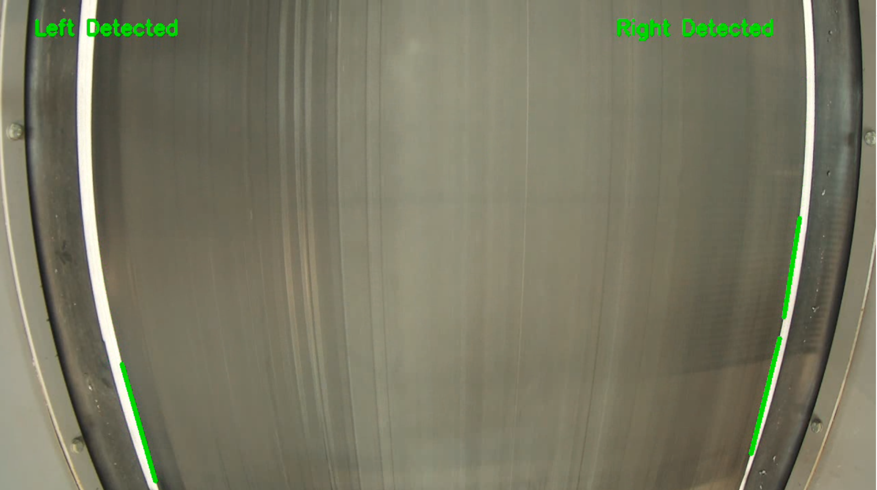
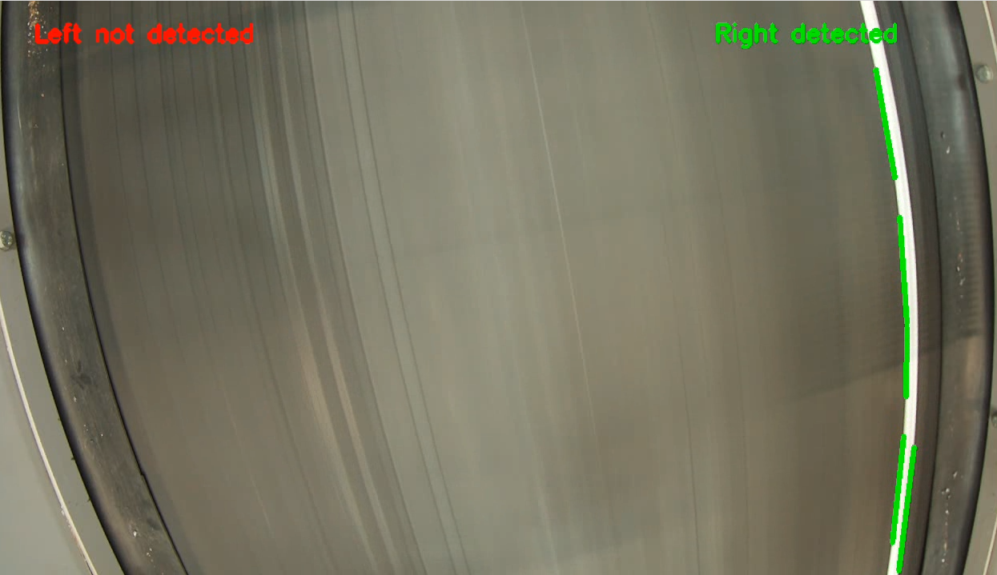
Recycling
Examples
Monitoring
Belt at the center
Belt has moved
Image by ETCE lab- https://etce-lab.com/ - CC BY-SA 4.0

Slide 32
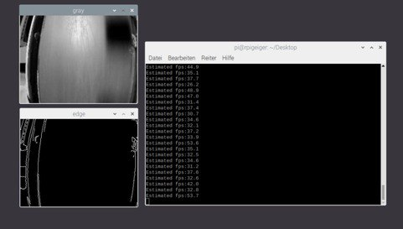
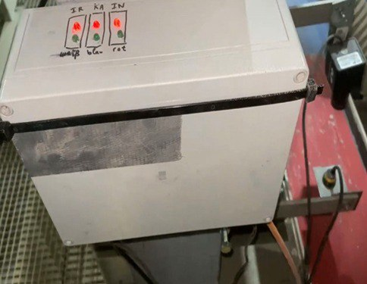
Recycling
Examples
Monitoring
Monitoring the absence of materials
Informing to human forces
Image by ETCE lab- https://etce-lab.com/ - CC BY-SA 4.0

Slide 33
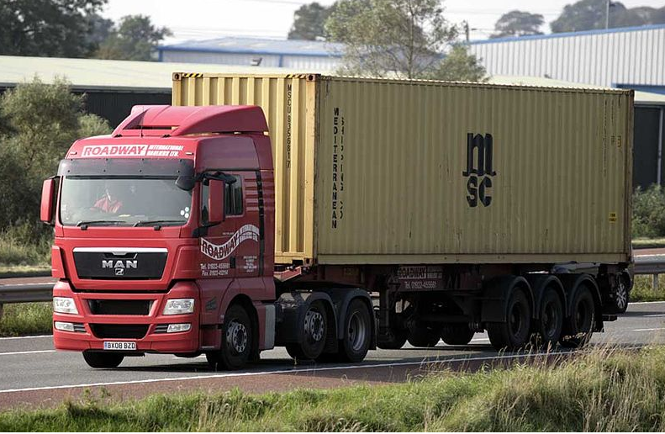
Use cases
Logistics
Data driven decision making
Improved safety and security
Enhanced product quality and innovation
Sustainable operations
Imge by Bilbobagweed - https://commons.wikimedia.org/wiki/File:Roadway_International_Hauliers_2008_MAN_truck_with_Mediterranean_Shipping_Company_(MSC)_container_on_a_skeleton_trailer,_24_January_2009.jpg- CC BY 2.0

Slide 34
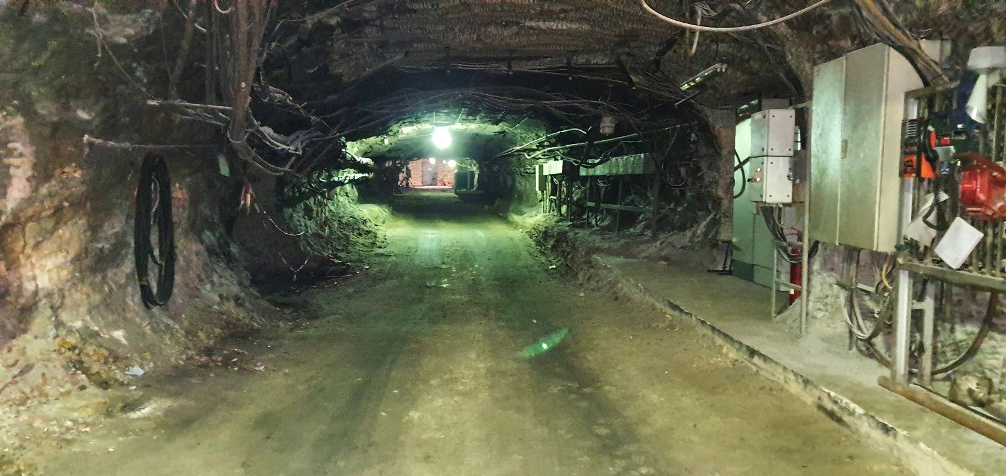
Use cases
Mining
Image by Amir Ehteshami- Mining department at TU-Clausthal

Slide 35
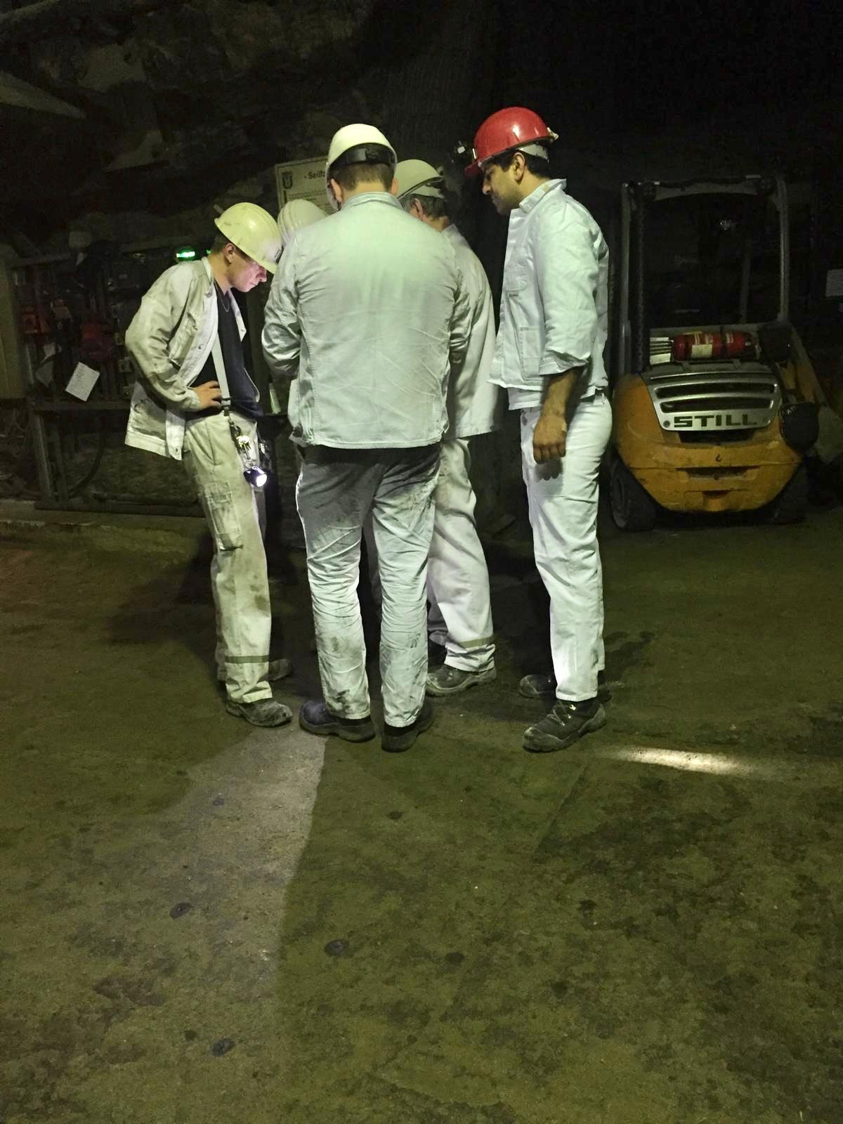
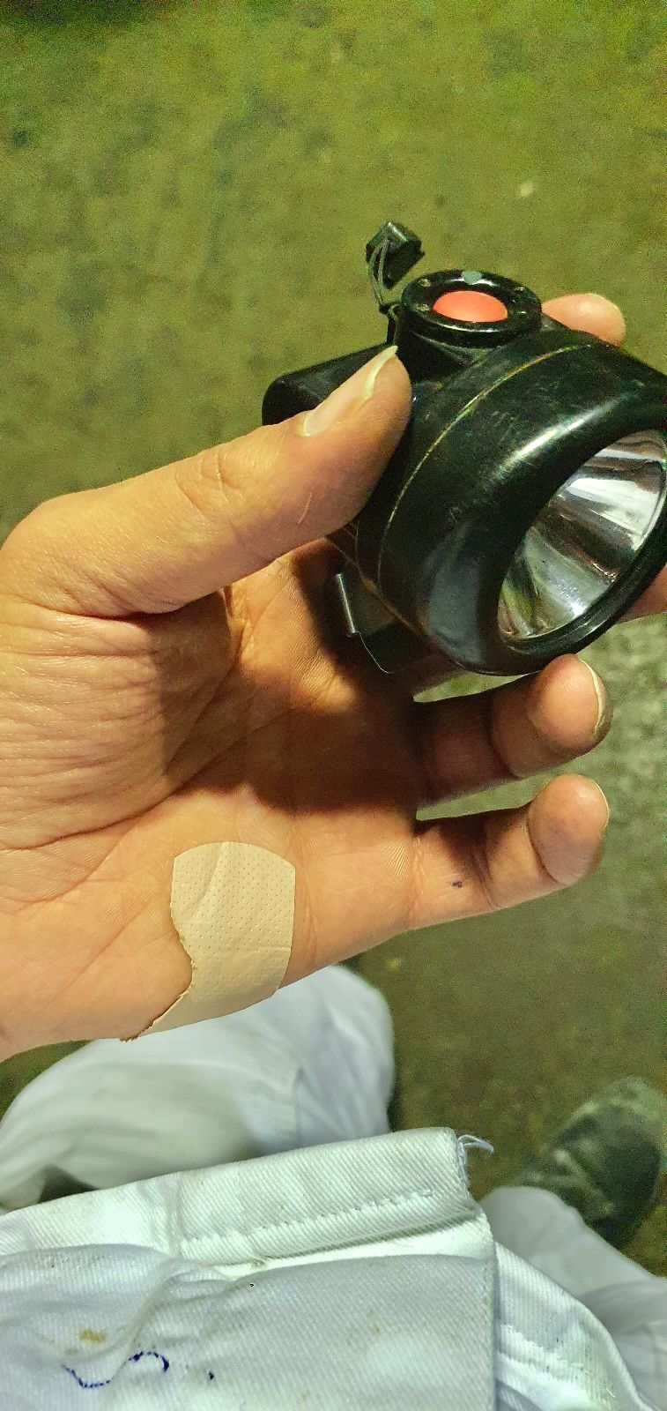
Use cases
Mining
Continuous health monitoring
Detection of hazardous gases
Environmental monitoring
Smart alert systems
Workers position tracking
Image by Amir Ehteshami- Mining department at TU-Clausthal

Slide 36
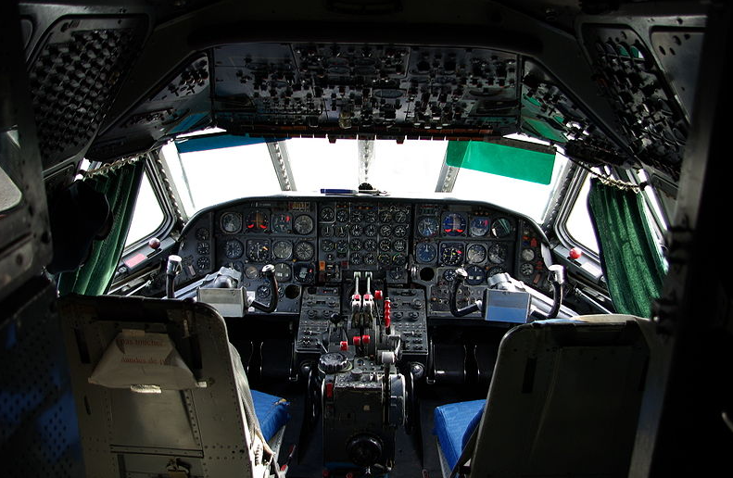
Use cases
Aviation
integration of IoT technologies and data analytics in the aviation industry.
Real-time monitoring of aircraft systems
Predictive maintenance
Optimized fuel consumption
Enhanced safety measures
By collecting and analyzing data from various aircraft components and systems
Improves operational efficiency
Reduces downtime
Facilitates proactive decision-making for airlines and maintenance crews
Image by Duch.seb- https://commons.wikimedia.org/wiki/File:Sud-Aviation_Caravelle_-_Cockpit_%28MAA%29.jpg- CC BY-SA 2.0

Slide 37
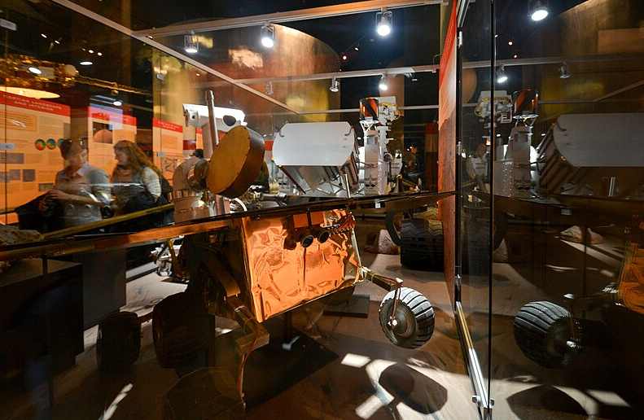
Use cases
Space Travel
Enables enhanced communication
Monitoring
Control of spacecraft and space systems
Real-time tracking of spacecraft
Remote diagnostics and maintenance
Predictive analytics for equipment performance
Efficient resource management
It enables astronauts and mission control...
To gather valuable data
Make informed decisions
Optimize mission operations for safer and more successful space exploration
Opportunity and Spirit
Image by xiquinhosilva- https://commons.wikimedia.org/wiki/File:Model_of_the_Spirit_and_Opportunity_rovers_-_02822-National-Air-and-Space-Museum_%2826697181074%29.jpg- CC BY 2.0

Slide 38
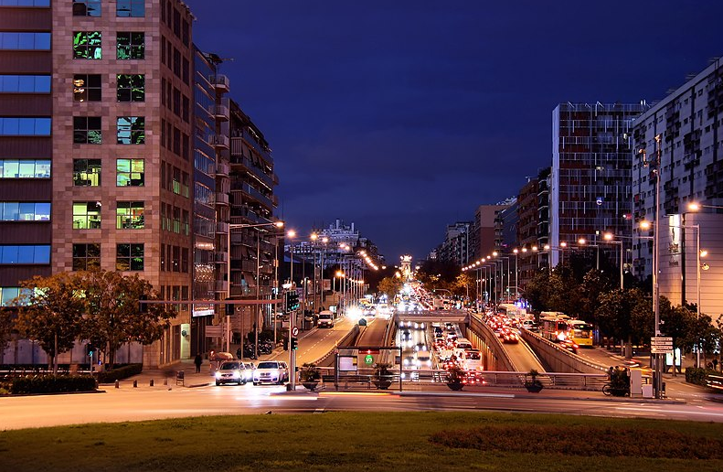
Use cases
Smart city
what is smart city?
A smart city means a city where all data and information are connected and easily available to citizens.
Image by Jorge Franganillo- https://commons.wikimedia.org/wiki/File:Barcelona_Pla%C3%A7a_d%27Ildefons_Cerd%C3%A0_%2815331641694%29.jpg- CC BY 2.0

Slide 39
Smart city(specific example)
Examples
Barcelona city
Barcelona has implemented a new approach to managing traffic flow in its busiest zones.
Instead of using sensors for general parking spaces, the city has installed sensors targeting high-importance spaces.
This includes parking areas for tourist buses near the renowned tourist attraction, La sagrada Familia.
The new approach also extends to areas outside the city to support the “ Low Emission Zone” initiative.
Urbiotica and world sensing offer additional insights into this strategic shift.
Tuba Bakici. Esteve Almirall. Jonathan Wareham- https://link.springer.com/article/10.1007/s13132-012-0084-9

Slide 40
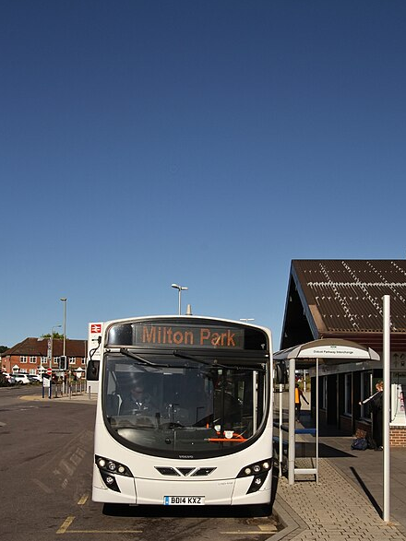
Use cases
Examples
Easy communication is a key feature of a smart city.
Buses in Barcelona are equipped with solar panels to store solar energy as a clean fuel source.
Solar panels were implemented in Barcelona starting from 2008, serving as a successful model for other Spanish cities.
The city has a total of 30,000 solar panels, capable of producing 550,000 kilowatts of electricity per hour.
The electricity generated by these panels helps prevent the emission of 440 tons of greenhouse gases annually.
Image by Motacilla- https://commons.wikimedia.org/wiki/File:Volvo_B7_Wright_Eclipse2_BD14_KXZ_DidcotPky_front.jpg - CC BY-SA 4.0
Tuba Bakici. Esteve Almirall. Jonathan Wareham- https://link.springer.com/article/10.1007/s13132-012-0084-9

Slide 41
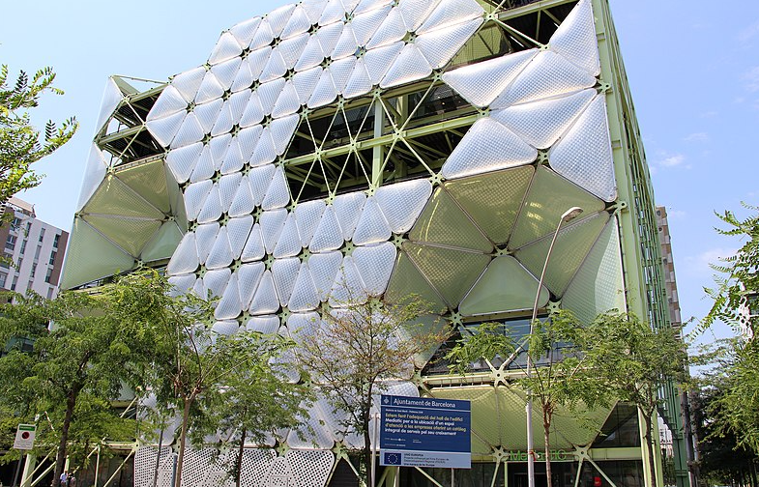
Use cases
Examples
Media Tech
The Media tech building in Barcelona is recognized as one of the smart buildings globally.
ATFT metal coverings are utilized in the building, incorporating lightweight cushions filled with low-pressure air.
These coverings provide both resistance and heat insulation for the building.
The heat insulation contributes to approximately 20% of the building’s energy consumption savings.
Image by Fred Romero- https://commons.wikimedia.org/wiki/File:Barcelona_-_Edifici_Media-TIC_%281%29.jpg- CC BY 2.0
https://www.youtube.com/watch?v=2ejzrZaD-PI

Slide 42
How to use the IIoT
What issues should we pay attention in designing and implementing an industrial system?
Equipment
Communication
Protocols
Big data
Robotics
Cyber security
Digital twins
Cloud computing
Security (has been covered in previous slides)

Slide 43
Introduction to Mining Sensors
Mining sensors are an essential component of modern mining operations,
providing crucial data that ensures the safety, efficiency, and productivity
of the industry.
These sensors are designed to monitor various
environmental parameters and detect potential hazards, allowing for
proactive measures to be taken. From detecting toxic gases to monitoring
temperature and pressure, mining sensors play a pivotal role in the overall
management of mining sites.

Slide 44
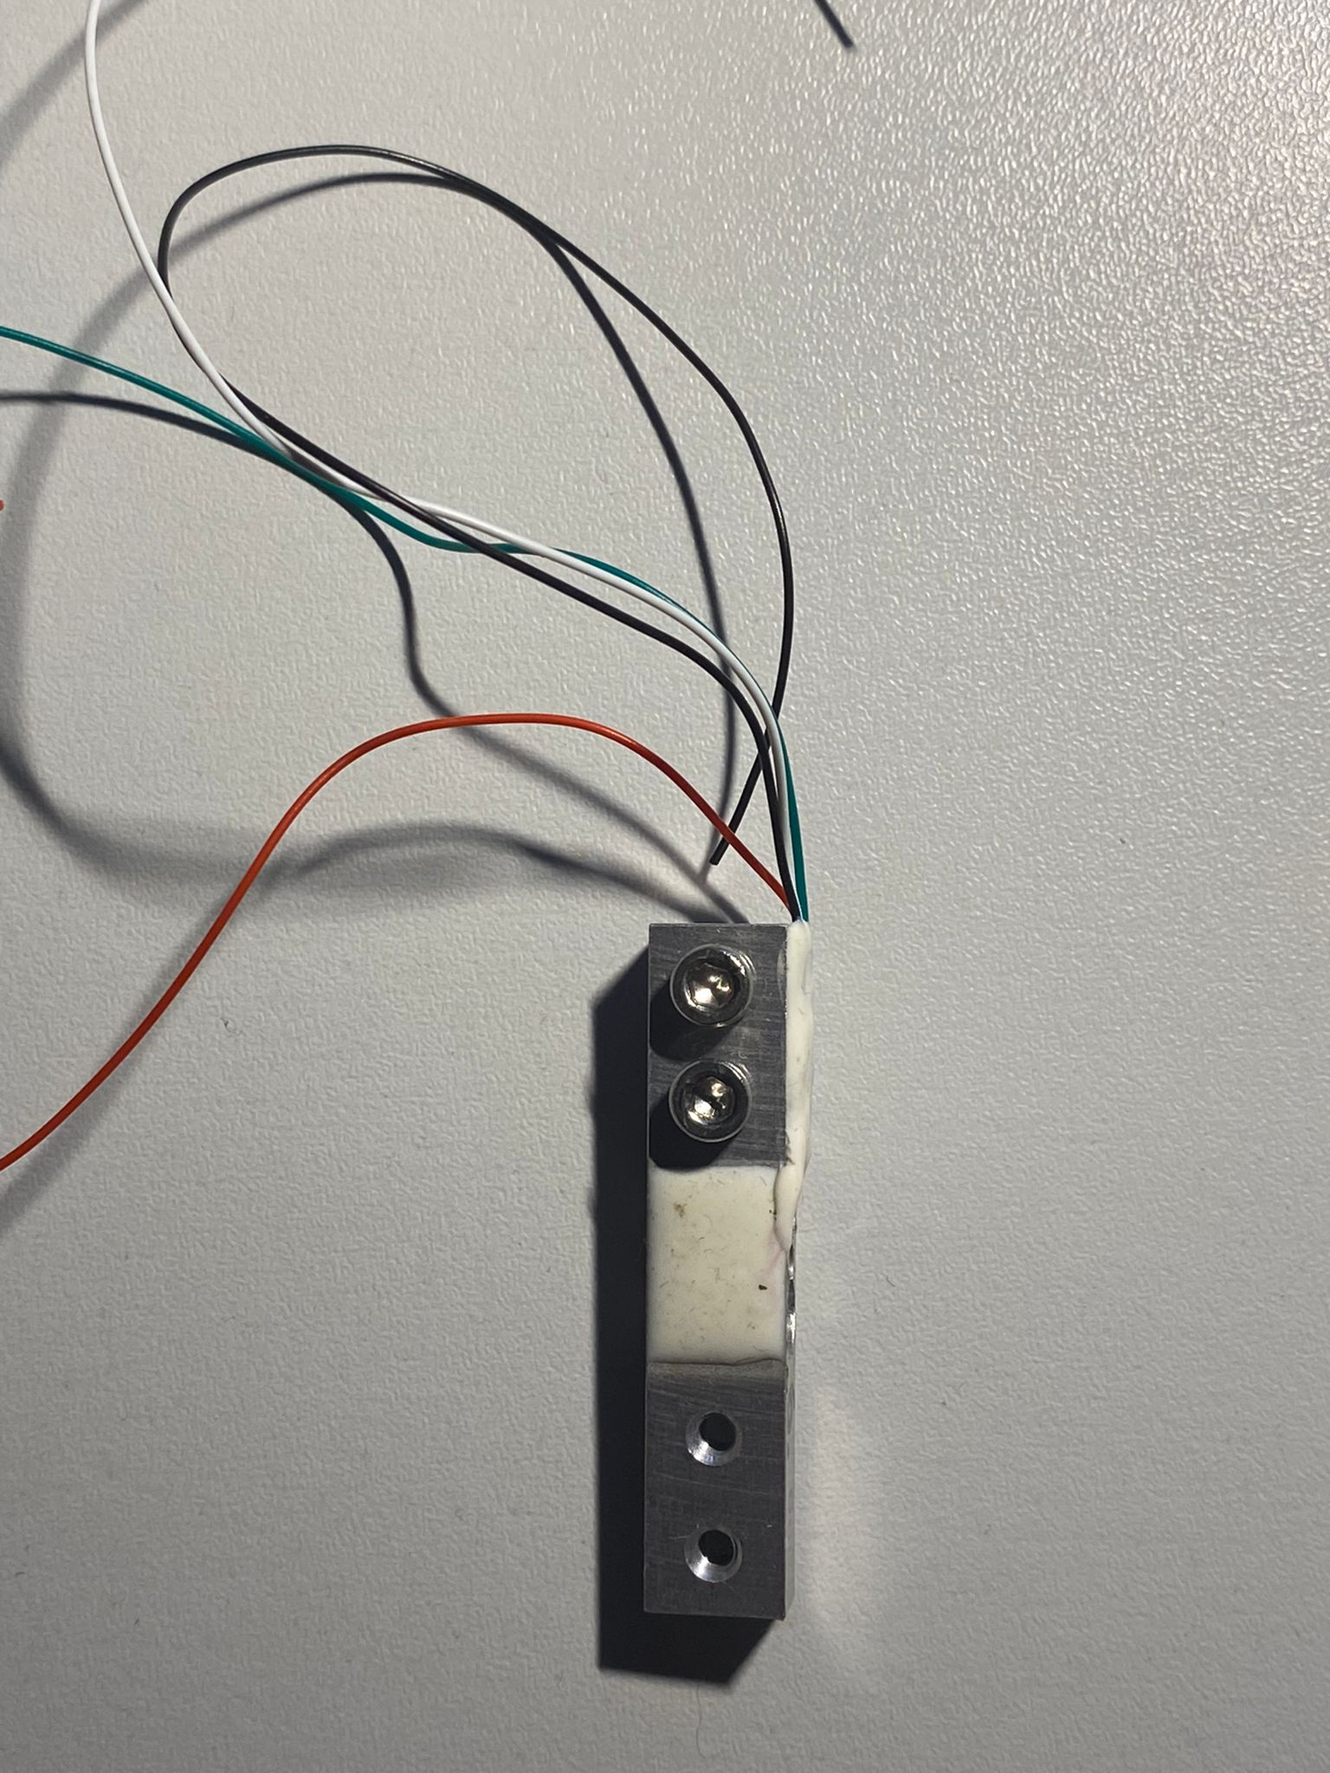
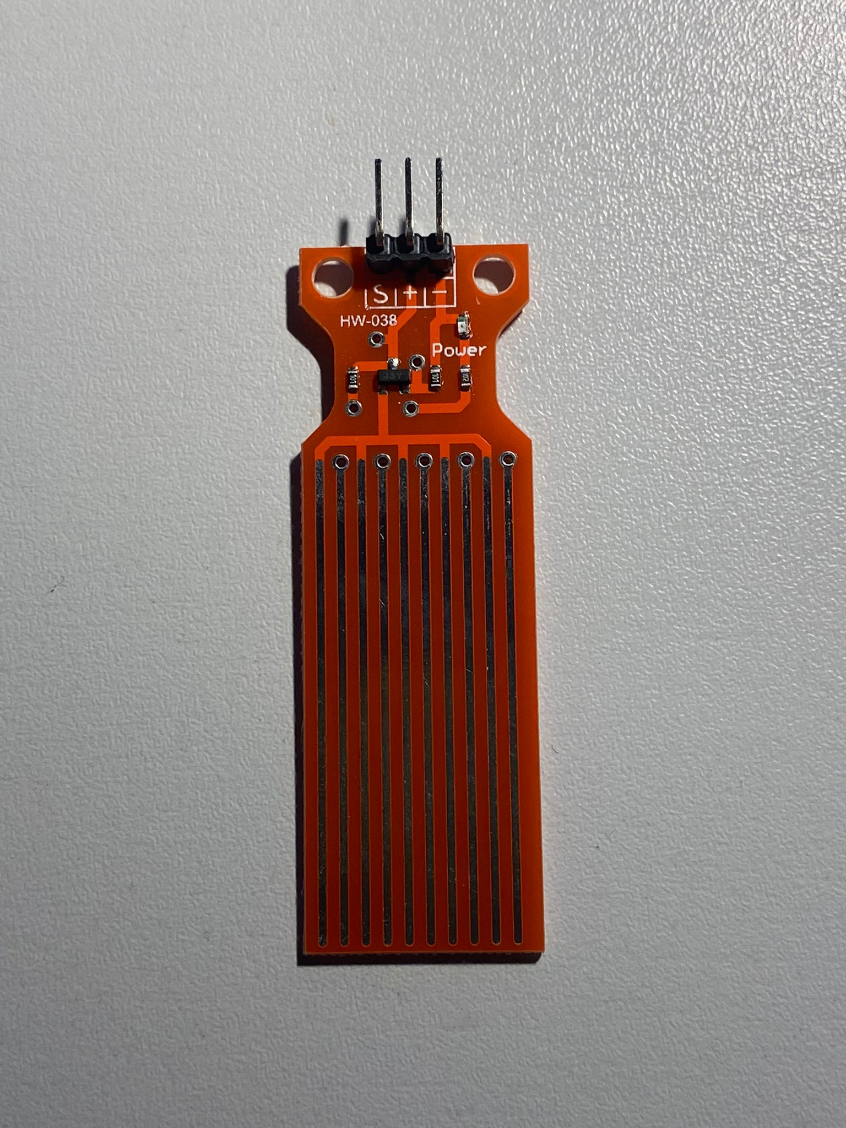
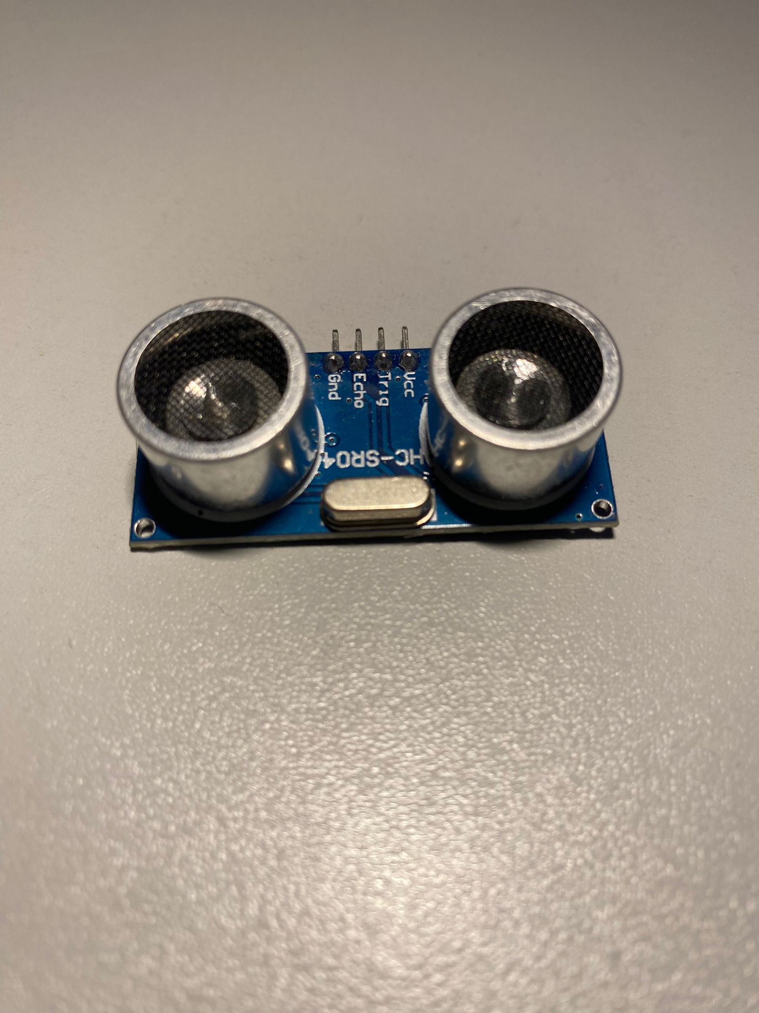
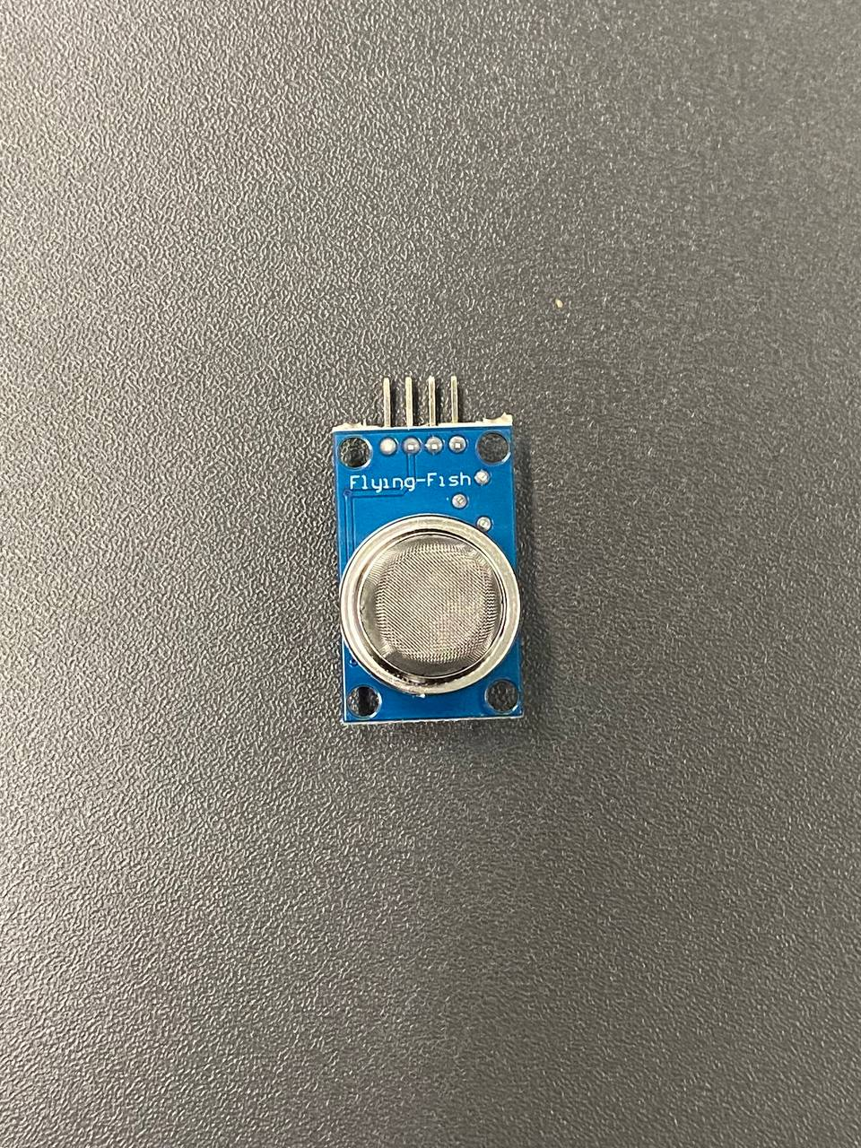
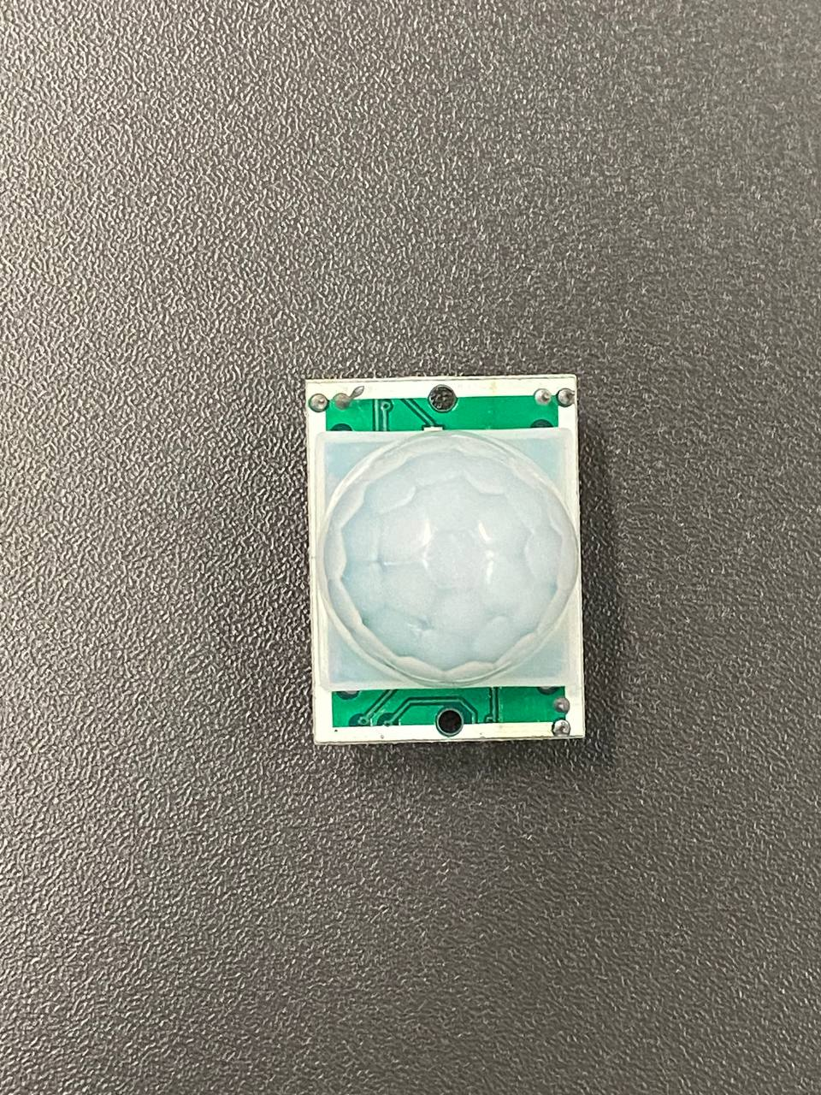
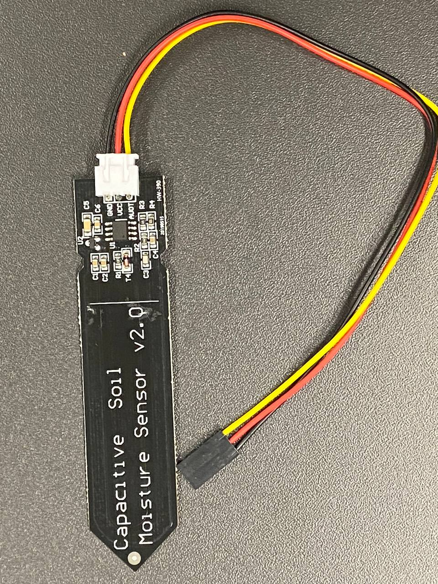
How to use the IIoT
Equipment
Home used sensors
Weight sensor
Temperature
sensor
Sound sensor
Gas detection
Movement sensor
Moisture sensor
Image by ETCE lab- https://etce-lab.com/ - CC BY-SA 4.0

Slide 45
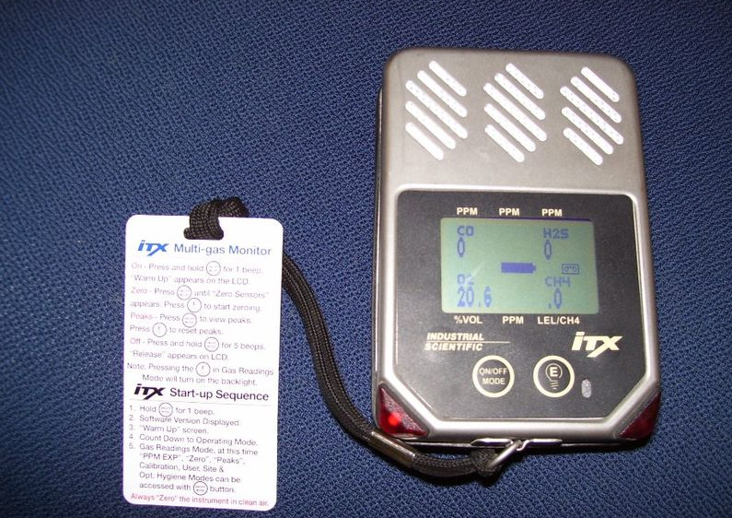
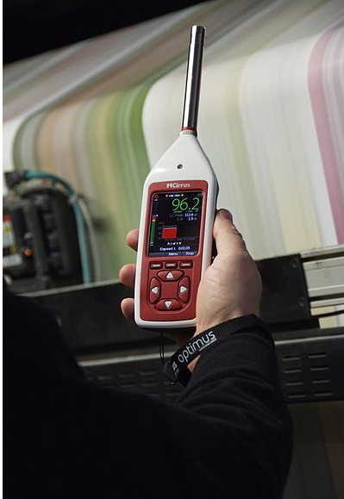
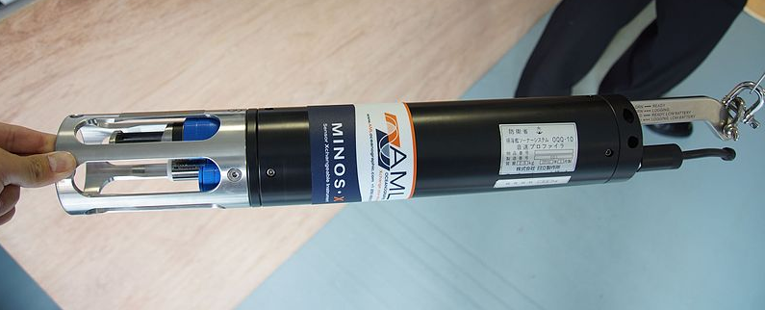
How to use the IIoT
Equipment
Industrial used sensors
Velocity [1]
Gas detection [2]
Sound detection [3]
Image [1] by Hunini- https://commons.wikimedia.org/wiki/File:JS_Awaji%28MSO-304%29_OQQ-10_Sound_Velocity_Profiler%28AML_Oceanographic_Minos_X%29_at_JMSDF_Hanshin_Base_April_1,_2017_01.jpg -
CC BY-SA 4.0
Image [2] by Sansumaria at English Wikipedia- https://commons.wikimedia.org/wiki/File:Detector_for_Gas.jpg- CC BY-SA 3.0
Image [3] by Cirrus Research Pic-https://commons.wikimedia.org/wiki/File:Optimus_Sound_Level_Meter.jpg - CC BY-SA 3.0

Slide 46
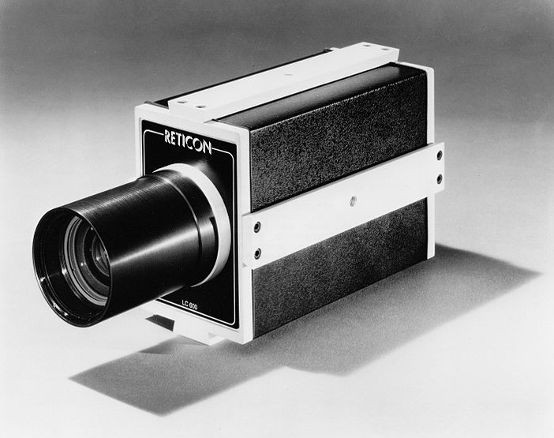
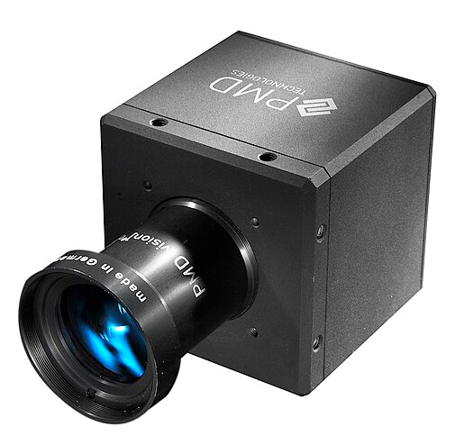
How to use the IIoT
Equipment
Industrial Cameras
Line scan camera [1]
PMDCamCube camera [2]
Image [1] by Cromemco - https://commons.wikimedia.org/wiki/File:Reticon_LC600_Digital_Line_Scan_Camera_%281974%29.jpg- CC BY-SA 3.0
Image [2] by ToFExpert- https://commons.wikimedia.org/wiki/File:PMDCamCube.jpg- CC BY-SA 3.0

Slide 47
Introduction to Network Protocols in IIoT
The Industrial Internet of Things (IIoT) represents the use of smart
technology within various industries to improve efficiency, productivity,
and safety.
Industrial Internet of Things and Communications at the Edge, by Tony Paine, Kepware Platform President, PTC

Slide 48
Importance of Network Protocols in IIoT
Efficient Data Transfer
IIoT network protocols enable efficient data transfer, crucial for real-time monitoring and process optimization in industrial settings.
Interoperability
Network protocols allow devices from different manufacturers to communicate seamlessly, forming a unified network.
Security and Privacy
Robust network protocols protect IIoT data from cybersecurity threats and unauthorized access.
Industrial Internet of Things and Communications at the Edge, by Tony Paine, Kepware Platform President, PTC

Slide 49
How to use the IIoT
Protocols
And what is protocols?
IP (Internet Protocol)
TCP (Transmission Control Protocol)
MQTT (Message Queuing Telemetry Transport)
CoAP (Constrained Application Protocol)
HTTP/HTTPS (Hypertext Transfer Protocol/Secure)
Wifi
Bluetooth
NFC
Satellite
IIoT Protocols:
A set of rules for communication between two or more than two systems.
Industrial Internet of Things and Communications at the Edge, by Tony Paine, Kepware Platform President, PTC

Slide 50

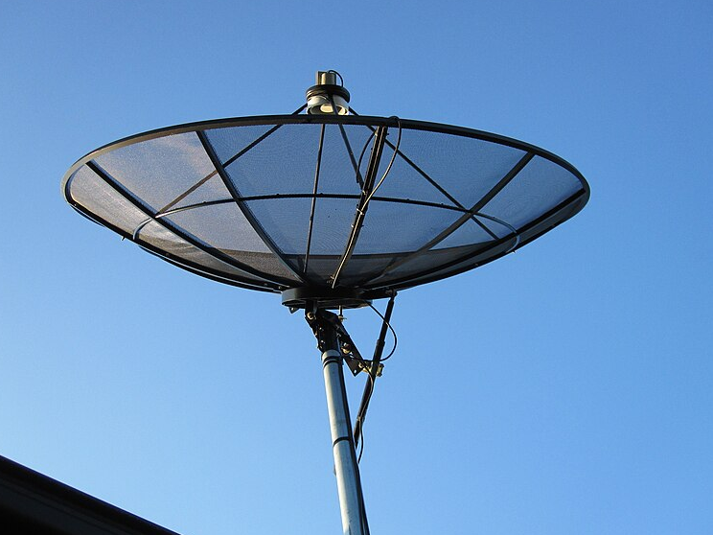


How to use the IIoT
Communications
Communication Protocol
Wi-Fi → belongs to OSI layer → 1-2
Satellite Communication → belongs to OSI layer→ 1-7
Bluetooth → belongs to OSI layers→ 1-7
NFC → belongs to OSI layers → 1,2,7
RFID→ belongs to OSI layer → 1,2,7
[1]
[2]
[3]
[4]
Image [1] by Mam'Gobozi Design Factory (MDF)- https://commons.wikimedia.org/wiki/File:Conversation.png- CC BY-SA 4.0
Image [2] by vexels- https://commons.wikimedia.org/wiki/File:0207a74a86c5255a9d6458e587f1e9e4-flat-wifi-icon-by-vexels.png- CC BY-SA 4.0
Image [3] by Coekon- https://commons.wikimedia.org/wiki/File:Satellite_antenna.JPG- CC BY-SA 4.0
Image [4] by Font Awesome - https://commons.wikimedia.org/wiki/File:Font_Awesome_5_brands_bluetooth.svg- CC BY 4.0

Slide 51
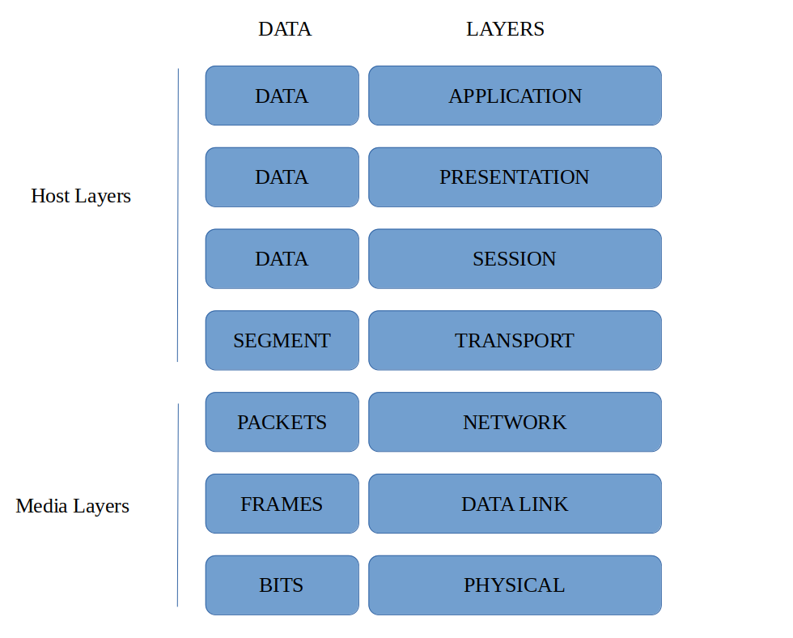
OSI Layers
Based on → https://commons.wikimedia.org/wiki/File:Osi-model-jb.png- CC BY-SA 3.0

Slide 52
IIoT Protocols
IP (Internet Protocol)
IP → OSI layer → 3 (Internet layer)
(host-to-host and end-to-end)
  Fundamental protocol/ serve as the backbone of internet communication
  Responsible for routing packets across network boundaries
  Provides addressing and packet forwarding functionalities
  Facilitating the delivery of packets from the source host to the destination host based on their IP addresses.
Industrial Internet of Things and Communications at the Edge, by Tony Paine, Kepware Platform President, PTC

Slide 53
IIoT Protocols
TCP(Transmission Control Protocol)
TCP → OSI layer → 4 (Transport layer)
(host-to-host and end-to-end)
  Provides reliable, ordered and error-checked delivery of data
  Uses acknowledgments to confirm of data packets
  If a packet is lost or corrupted during transmission, TCP will retransmit the packet.
  Data is broken into smaller segments for the transmission.
  Each segment contains a sequence of numbers which make it more secure and accurate to track.
Industrial Internet of Things and Communications at the Edge, by Tony Paine, Kepware Platform President, PTC

Slide 54
IIoT Protocols
MQTT(Message Queuing Telemetry Transport)
MQTT → OSI layer → 7 (Application layer)
(machine to machine)
  Message Queuing Telemetry Transport
  Lightweight
  Efficient Messaging Protocol
  Ideal for low-bandwidth
Industrial Internet of Things and Communications at the Edge, by Tony Paine, Kepware Platform President, PTC

Slide 55
IIoT Protocols
MQTT(Message Queuing Telemetry Transport)
MQTT → OSI layer → 7 (Application layer)
(machine to machine)
  MQTT specifies topics, messages, publish/subscribe machanism.
  Used by applications to communicate.
  Relies on other protocols to handle the transport of messages.
  Transport layer (layer 4)
  MQTT uses TCP as its transport layer protocol.
  TCP ensures reliable delivery of the messages MQTT sends between client and brokers.
Industrial Internet of Things and Communications at the Edge, by Tony Paine, Kepware Platform President, PTC

Slide 56
IIoT Protocols
CoAP(Constrained Application Protocol)
CoAP → OSI layer → 7 (Application layer)
(machine to machine)
  Low-power networks needed
  Offers simple and effective way to enable communication in IIoT ecosystems.
  Provides web-like interaction using a request/response model
  Support methods such as GET,POST,PUT, and DELETE
  Uses UDP (User Datagram Protocol) as its transport layer protocol(4)
Industrial Internet of Things and Communications at the Edge, by Tony Paine, Kepware Platform President, PTC

Slide 57
Comparison
TCP/IP | Known for its reliability, extensive usage. Is a top choice for applications requiring assured data delivery within IIoT.
MQTT | Popular in IIoT for its efficient, low-bandwidth message distribution, where minimal network resource use is crucial.
CoAP | CoAP provides a lightweight messaging solution for IIoT devices requiring minimal data exchange overhead.
Industrial Internet of Things and Communications at the Edge, by Tony Paine, Kepware Platform President, PTC

Slide 58
How to use the IIoT
Big Data
The community’s collection of data and information from various production lines and equipments, will be used to make real-time decisions.
“BigData represents the information assets characterized by such a high volume, velocity and variety to require specific technology and analytical methods for its transformation into value”
De Mauro, Andrea, Marco Greco, and Michele Grimaldi. "What is big data? A consensual definition and a review of key research topics." In AIP conference proceedings, vol.
1644, no. 1, pp. 97-104. American Institute of Physics, 2015.

Slide 59
How to use the IIoT
Robotics
Enhance system flexibility and collaborate with humans.
Capable of working in challenging environment where human access is limited.
Equipped to make intelligent and safe decisions.
Able to carry out the tasks with precision and within specified time limits.

Slide 60
How to use the IIoT
Digital twins
“ A virtual representation or digital replica of a physical objects, process, or system.”
“ Digital twins are created by collecting data from sensors, devices and other sources that capture information about the physical object or system. This data is used to build a dynamic model that reflect the state, performance, and behavior of the physical asset.”
“ Digital twin is not just a static model but is continuously updated with real-time data from the physical object or system. It enables monitoring, analysis, and simulation of the asset’s performance, allowing for predictive and proactive maintenance, optimization, and decision-making.”
Industrial Internet of Things for Developers by Ryane Bohm
Alasdair Gilchrist (auth.) - Industry 4.0_ The Industrial Internet of Things-Apress (2016)

Slide 61
How to use the IIoT
Digital twins
Creating a virtual replica of a physical asset or system.
Utilized for real-time monitoring, predictive maintenance.
Optimization of industrial processes.
Through simulation, digital twins provide an understanding of system functionality before constructing the actual physical system.
Reduce design time
Minimize failures
Leading to improved quality
Better decision-making
Industrial Internet of Things for Developers by Ryane Bohm

Slide 62
How to use the IIoT
Cloud computing
Industry 4.0 connects information technology platform to the cloud for communication.
Data sharing in industry 4.0 has increased significantly among companies.
Internal communication in industry 4.0 occurs at millisecond or microsecond speeds.
Cloud computing enables different devices to connect to the same cloud.
Devices in cloud computing share information that is beneficial for the entire factory.
Internet of Things in Industries: A Survey, by Wu He, Shancang Li

Slide 63
IIoT and Artificial Intelligence(AI)
Convergence of IIoT and AI technologies.
Use of machine learning, deep learning, and other AI techniques.
Advanced analytics employed in IIoT applications.
Predictive maintenance facilitated by AI in IIoT.
Autonomous decision-making enabled through AI in IIoT.
Image by ETCE lab- https://etce-lab.com/ - CC BY-SA 4.0

Slide 64
IIoT and Blockchain
Definition
“Blockchain is a decentralized and distributed digital board technology that records transactions across multiple computers or nodes. It provides a secure and transparent way to store and verify data, enabling trust and eliminating the need for intermediaries.”
More simple?!
“ Blockchain can be thought of as a chain of blocks, where each block contains a list of transactions. These transactions are validated, encrypted, and added to the chain in a chronological order. Once a block is added to the chain, it is extremely difficult to alter the information it contains.
Blockchain, A practical Guide to Developing Business, Law, and Technology Solutions by Joseph J.Bambara, Paul R.Allen

Slide 65
IIoT and Blockchain
The potential of blockchain technology in IIoT, including its applications in…
Data security
Privacy
Trust
Decentralized government of IIoT networks.

Slide 66
Challenges and future of IIoT
Current challenges:
Privacy concerns
Secure data storage and management
The upcoming challenges
Data management and processing (cloud, fog and edge computing)
Security
Internet of Things in Industries: A Survey by Wu He and Shancang Li, November 2014

Slide 67
How to make IIoT more secure?
Some techniques
Lets start with a lot of donot’s
Using default passwords
Storing hard-coded passwords
Protocols that have no encryption protocols (for ex. HTTPS instead of HTTP)
Giving a public IP address
Turn off certificate verification
Physical security ignorance
X If its easy for someone to plug an Ethernet cable from the IT network to the plant control network X

Slide 68
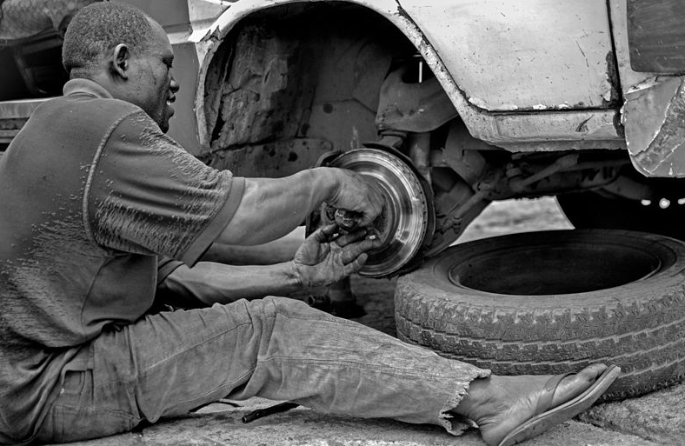
Isn’t it the time for humans to say bye to some jobs?!!
Image by Kaizenify - https://commons.wikimedia.org/wiki/File:A_young_mechanic_doing_his_job_with_a_smile_on_his_face_at_Ibadan,_Nigeria.jpg- CC BY-SA 4.0

Slide 69
Conclusion

Slide 70

Digitization
Digitalization
Digital Transformation
Image based on → https://medium.com/@everlynsalt/what-is-digitization-in-education-6b697bcfb38b-

Slide 71
An introduction to the IIoT
  IIoT is transforming industries such as manufacturing, energy, and infrastructure.
Comparison of IoT and IIoT
  IIoT leverage connected device, sensors, and advanced analytics for industrial applications.
Advantages of IIoT
  Real-time data enables informed decision-making and operational optimization.
  Remote monitoring, predictive maintenance, and enhanced safety measures are facilitated by IIoT.

Slide 72
How to use the IIoT?
Challenges and the future of IIoT
  Address the challenges associated with interoperability, scalability, data privacy.
  Highlight the potential of IIoT to revolutionize industries and drive efficiency

Slide 73
Thank You!

