Slide 1
Requirement Engineering
Lecture 10: Requirements Validation
Prof. Dr. Benjamin Leiding
M.Sc. Anant Sujatanagarjuna

Slide 2
News
26.10.2022 → No lecture
02.11.2022 → Organization (L00) + Introduction (L01)
09.11.2022 → System Context Boundaries and Types of Requirements (L02)
16.11.2022 → Elicitation – Part 1 (L03)
23.11.2022 → Elicitation – Part 2 (L04) and Negotiations (L05)
30.11.2022 → Documentation – Introduction (L06)
07.12.2022 → Documentation – Textual Requirements Specification (L07)
14.12.2022 → Documentation – Model-based Requirements Documentation (L08)
21.12.2022 → No Lecture
11.01.2023 → Documentation – Formal Requirements Specification (L09)
18.01.2023 → Validation (L10)
25.01.2023 → Traceability (L11), Requirements Management (L12) and Tool Support (L13)
01.02.2023 → No Lecture
08.02.2023 → Exam Q&A

Slide 3
Exercises
09.11.2022 → Exercise 01 – Knowledge Test (MC)
23.11.2022 → Exercise 02 – Elicitation I
30.11.2022 → Exercise 03 – Elicitation II
14.12.2022 → Exercise 04 – Agent-oriented Modelling
21.12.2022 → No Exercise
11.01.2023 → Exercise 05 – Coloured Petri Nets I
18.01.2023 → Exercise 06 – Coloured Petri Nets II
25.01.2023 → Bonus Task
01.02.2023 → Exercise 07 – Management and Traceability (MC)

Slide 4
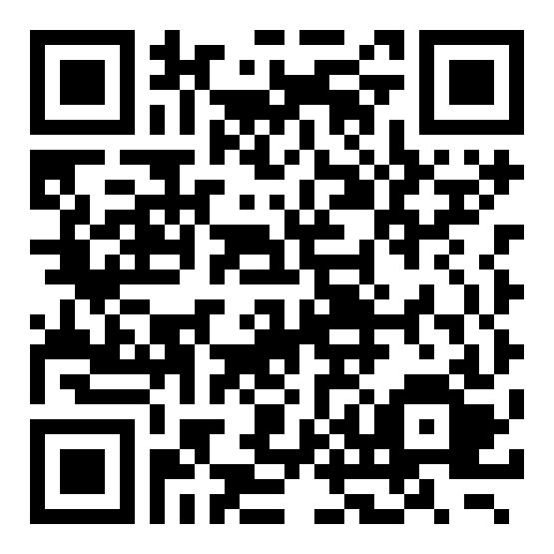
News
Course Evaluation
Link: Click Me

Slide 5
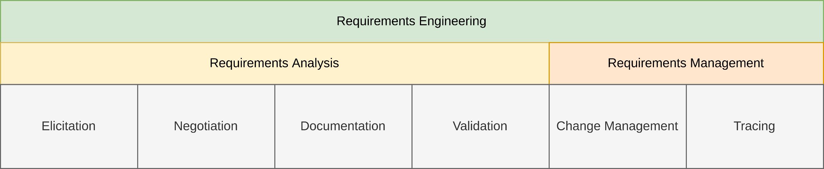
General Requirements Engineering Process
Overview

Slide 6
Lecture 10: Requirements Validation
Content
Requirements Validation in General
Principles of Requirements Validation
Requirements Validation Techniques

Slide 7
Requirements Validation in general

Slide 8
Requirements Validation in General
Why?
Review of the requirements
Should uncover errors in requirements
Present requirements to stakeholders
Identify deviations between requirements and actual wishes
Quality of requirements is evaluated
Decision is made if quality is sufficient
Leads to approval of requirements
Should use predefined criteria

Slide 9
Requirements Validation in General
Quality Aspects of Requirements
Three major goals of validation:
Content
Are all relevant requirements elicited and documented?
Is the level of detail appropriate?
Documentation
Is the documentation according to predefined guidelines and specifications?
Agreement
Do all stakeholders concur with the documented requirements

Slide 10
Requirements Validation in General
Quality Aspects – Content
Refers to the content of the document
The requirements themselves
The completeness of the requirements

Slide 11
Requirements Validation in General
Quality Aspects – Documentation
Validates the documentation of the requirements
Flaws in the documentation
Violation of documentation guidelines
Project specific
Organization specific
Understandability of document formats
Structure of the documents

Slide 12
Requirements Validation in General
Quality Aspects – Documentation (Guideline Violation Risks)
Impairment of development activities
Development activities may require certain document formats
For example, consider the Rational Unified Process (RUP)
Later stages refine models created during the requirements engineering
If models have not been created, refinement is not possible
Misunderstandings
The target audience may not understand or misinterpret requirements in certain document formats
Requirements may become unusable

Slide 13
Requirements Validation in General
Quality Aspects – Documentation (Guideline Violation Risks)
Incompleteness
Relevant information may be missing from the document
Must not necessarily be the requirements themselves
Stakeholders involved
Persons responsible
Overlooking requirements
Requirements documented at the wrong place → Not missing!
May be overlooked in later activities → Example: Developer wants to implement the persistence features of a system. Checks section “4.3 Persistence requirements” and implements all documented features. Additional persistence requirements hiding in other sections

Slide 14
Requirements Validation in General
Quality Aspects – Documentation (Test Criteria)
Conformation to documentation format and rules
Are all documents in the predetermined documentation format?
Have modeling languages been used properly?
Conformity to documentation structures
Has the structure of the document been maintained?
Is everything where it belongs?
Understandability
Is the documentation understandable in the given context?
Is the glossary sufficient?

Slide 15
Requirements Validation in General
Quality Aspects – Agreement
Stakeholders gain additional knowledge during the course of requirements engineering
May lead to changes between the begin of the elicitation and the end of the documentation
Validation offers a last opportunity for changes without impacting later phases
Test criteria
Agreed → Is every requirement agreed upon with all relevant stakeholders?
Agreed after changes → Is every requirement agreed upon with all relevant stakeholders after it has been changed?
Conflicts resolved → Have all known conflicts with regard to the requirements been resolved?

Slide 16
Principles of Requirements Validation

Slide 17
Principles of Requirements Validation
Overview
6 principles of requirements validation

Slide 18
Principles of Requirements Validation
Overview
1. Involvement of the correct stakeholders
Independence of the author
Author should not be the one validate a requirement
Has prior knowledge which influences the validation
Internal auditors
Stakeholders that are members of the developing organization
Easy to organize
External auditors
Higher effort
Have to become familiar with the document
Independent perspective

Slide 19
Principles of Requirements Validation
Overview
2. Separating the identification and the correction of errors
Identify flaw
Document flaw
Fix flaw
Separation allows concentration on identification → Better separation of resources
3. Validation from different views
Different people → Different perspectives

Slide 20
Principles of Requirements Validation
Overview
4. Adequate change of documentation type
Check if usage of different documentation types balances out weaknesses
Natural language → Very expressive
Conceptual models → Abstraction and complex behavior
5. Construction of development artifacts
Creation of artifacts reveals ambiguities
Example:
Creation of a test case to validate the requirement
Problems during the test creation

Slide 21
Principles of Requirements Validation
Overview
6. Repeated validation
Positive validation at one point does not guarantee that a requirement is still valid at a later point in time
Should be repeated in the following cases
Lots of innovative ideas and technologies
Significant gain of knowledge
Long-lasting projects
Very early previous validation
Unknown domain
Reuse of requirements

Slide 22
Validation Techniques

Slide 23
Validation Techniques
Overview
6 validation techniques in this lecture
Three types of reviews
Commenting
Inspections
Walk-throughs
Three supporting techniques
Perspective-based reading
Prototypes
Checklists

Slide 24
Validation Techniques
Commenting
Author gives requirements to another person
Usually a co-worker
Receive expert opinion of the other person
Marks flaws in the document
Briefly discusses the flaws with the author
Informal and cheap

Slide 25
Validation Techniques
Inspection
Error detection
Inspectors analyze the requirements for flaws → Individually or in teams
Error collection and consolidation
Results are collected and consolidated
Duplicate errors removed
Check if each finding is indeed an error
Systematic check development artifacts for errors
Consists of 4 phases
Planning
Object and goals of the inspection are determined
Roles and participants are selected
Overview
Author explains the requirements to the inspection team → Common understanding

Slide 26
Validation Techniques
Inspection – Roles
Organizer
Plans and supervises the inspection process
Moderator
Leads collection and consolidation session
Neutral
Author
Explains the requirements
Responsible for error correction
Reader
Introduces the requirements to be inspected
Neutral (usually the moderator)

Slide 27
Validation Techniques
Inspection – Roles
Inspectors / Reviewers
Responsible for the flaw detection
Communicate findings to members of the project team
Minute-taker / Recorder
Takes minutes of the results during the collection and consolidation session
Writes protocol of the inspection results

Slide 28
Validation Techniques
Walk-Through
“Lightweight” inspection
Less strict
Roles not strongly differentiated
Step-by-step “walk-through” of the requirements during the review session
Author introduces the requirements
Can use the opportunity to give additional details about the requirements
For example, rationale for a decision

Slide 29
Validation Techniques
Perspective-based Reading
Validate the requirements from a certain perspective
Examples:
User/customer perspective → Do the requirements meat the expectations and desired functions of a user?
Software architect perspective → Do the requirements contain all information required for the architectural design?
Tester perspective → Do the requirements contain all information necessary to derive test cases?
Content / documentation / agreement perspective

Slide 30
Validation Techniques
Prototypes
Implement something to try out
Not everything, but a subset of the requirements
Throw-away prototypes
Use once, throw away
Evolutionary prototypes
Develop further after prototypical use
Additional prototypes
Development artifact

Slide 31
Validation Techniques
Prototypes
Validation with prototypes requires
Manuals / Instructions → Information necessary to apply the prototype
Validation scenarios
Scenarios to perform with the prototype
Encompasses data and user interactions
Checklist with validation criteria → Define how users of the prototype validate the requirements
Results:
Protocol of the auditor → Experiences with the prototype of the auditor
Observation protocol (optional) → “Second person” writes protocol of how the auditor interacted with the prototype

Slide 32
Validation Techniques
Checklists
Set of questions and/or statements about a certain circumstance
Make sure no aspect is omitted
Should not be longer than a single page
Can be used in combination with all previously introduced techniques
Provide a guideline
Automatically structure review results

Slide 33
Validation Techniques
Checklists
Sources for checklist entries
The three quality aspects of requirements
Principles of requirements validation
Criteria for good requirements (Lecture 04, Part 1, Section 2)
Characteristics for good requirements documents (Lecture 04, Part 1, Section 3)
Experience from prior projects
Error statistics

Slide 34
Validation Techniques
(Software-) Reviews – Its Complicated
90% of all companies choose testing as their only quality assurance measure
Test requires executable code → Bugs are discovered late
Failures are discovered not the bugs themselves
Isolation of the error requires additional effort
Not all errors are found with testing
No proof of correctness
Test effort ("debugging") often more than 50% of the development effort
→ Do not use “reviews” as your only validation technique

Slide 35
Validation Techniques
(Software-) Reviews – Its Complicated
90% of all companies choose testing as their only quality assurance measure
Test requires executable code → Bugs are discovered late
Failures are discovered not the bugs themselves
Isolation of the error requires additional effort
Not all errors are found with testing
No proof of correctness
Test effort ("debugging") often more than 50% of the development effort
→ Do not use “reviews” as your only validation technique

Slide 36
Validation Techniques
(Software-) Reviews – Overview
Without reviews
With reviews (ideally):
Req.
Design
Code
Test
Maintenance
Bug – origin
Bug – discovery
Req.
Design
Code
Test
Maintenance
Chaos
Req.
Design
Code
Test
Maintenance
Bug – origin
Bug – discovery
Req.
Design
Code
Test
Maintenance

Slide 37
Validation Techniques
Review Techniques – Overview
Inspections as the most reliable review technique
Empirical studies
Inspections find 50% more defects than walkthroughs
Inspections find up to 6x more defects than ad-hoc reviews
very
formal
less formal
Inspection
Team Review
Walkthrough
Pair Programming
Peer Desk-Checking
Ad-hoc

Slide 38
Validation Techniques
Review Techniques
Ad-hoc Review
If you cannot solve a problem, you spontaneously ask an employee for help
Result depends entirely on the experience of one employee
Peer Desk-Checking
Similar to ad-hoc review
The employee "executes the product to be checked on paper" (mostly code)

Slide 39
Validation Techniques
Review Techniques
Pair Programming
Two developers share a PC workstation. While one operates the keyboard, the other checks the input.
One of the practices of eXtreme Programming.
Walkthrough
The author of a document presents it to collaborators to gain a general understanding and improve the quality of the document.
No predefined process and no guidance on how to find errors.
Risk: The author easily forgets to focus on the essential parts of the document during the presentation.

Slide 40
Validation Techniques
Review Techniques
Team-Review
Similar to the inspection technique but less formal
Several employees inspect a product individually
The results are discussed in a meeting with the author

Slide 41
Summary

Slide 42
Summary
Validation ensures quality of the requirements
Makes sure all stakeholders are on the same page
Also offers last chance for changes without negative impact on later phases
Different aspects of quality
Content, documentation, agreement
Should abide by the six principles of validation
Increases the quality of validation results
Different techniques available for validation
Usually some flavor of a review
Checklists are helpful

Slide 43
News
Course Evaluation
Link: Click Me

Slide 44
Questions?

Slide 45
References
Additional literature on reviews and software inspection
Karl E. Wiegers (2002) – Peer Reviews in Software – A practical Guide.
T. Gilb, D. Graham (1993) – Software Inspection.

