Slide 1
The Limits to Growth: Sustainability and the Circular Economy
Lecture 8: Circular Societies
Prof. Dr. Benjamin Leiding
M.A. Theresa Sommer

Slide 2
License
This work is licensed under a Creative Commons Attribution-ShareAlike 4.0 International License. To view a copy of this license, please refer to https://creativecommons.org/licenses/by-sa/4.0/ .
Updated versions of these slides will be available in our Github repository.

Slide 3
News/Updates

Slide 4

Course Evaluation
Link: Click Me

Slide 5
Exercise E06

Slide 6
Exercise E06
Feeback
A few students had issues downloading OpenLCA.
In general, a large variety of fruits/vegetables selected for LCA:
Lemons
Avocados
Mangoes
Potatoes
Strawberries
Tomatoes
Bananas
..

Slide 7
Exercise E06
Feeback
Some of you were able to run impact assessment calculations
A (completely un-scientific) comparison of some of your calculations in terms of GWP, for a 1kg functional unit:
Strawberries: 1293.7 kg CO2 eq
Tomatoes: 3950 kg CO2 eq
Avocados: 1.38kg CO2 eq * (Could not verify this calculation since LCI graph was not included)
LCA for strawberries included aspects of packaging, transportation and bio-waste, while the others were lacking at least some of these aspects.

Slide 8
Exercise E06
Feeback
How easy difficult was it to use/understand openLCA?
a) easy
b) okay
c) difficult
d) impossible

Slide 9
Circular Economy vs. Circular Society

Slide 10
Circular Society
CE Recap
Goals of the CE:
Maintain natural resources and minimize the discharge of substances that are harmful to health and nature
Ecological modernization of the economy to increase resource efficiency, e.g., by technical innovation and digital solutions
Products/services designed and constructed in such a way, that they can be returned to the economic and material flows at any time with little financial and energetic effort
Increase/maximize utilization of resources, e.g., Performance Economy
Partially based on: F. Hofmann, J. Zwiers (2018) – Circular Society – Eine pluralistische und emanzipatorische Alternative zur Circular Economy? – Link.
.

Slide 11
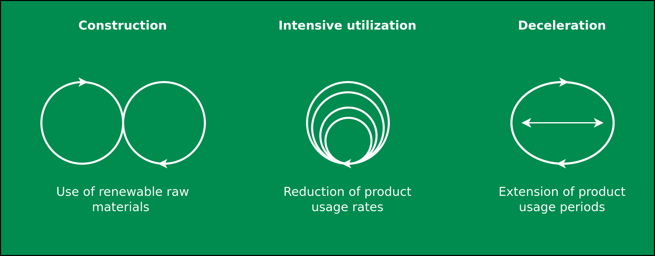
Circular Society
CE Recap
Image adapted from: M. Jaeger-Erben, F. Hofmann (2019) – Kreislaufwirtschaft - Ein Ausweg aus der sozial-ökologischen Krise? – Link.

Slide 12
Circular Society
CE Criticism
Replace the LE with circularly oriented forms of consumption and production
CE focus mostly on earned value management (“Wertschöpfungsmanagement”), product-service systems, product/business model innovations within existing power asymmetries
Decouple economic growth and consumption of natural resources
→ But why do we need neverending economic growth and why is it good to consume as many goods and services as possible?
Alternatives:
Sufficiency strategies and lifestyle changes
Question the prevailing entrepreneurial orientation towards the shareholder concept
Deconstruction of existing power and hegemonic relations
Partially based on: F. Hofmann, J. Zwiers (2018) – Circular Society – Eine pluralistische und emanzipatorische Alternative zur Circular Economy? – Link.
.

Slide 13
Circular Society
CE Criticism
Replace the LE with circularly oriented forms of consumption and production
CE focus mostly on earned value management (“Wertschöpfungsmanagement”), product-service systems, product/business model innovations within existing power asymmetries
Decouple economic growth and consumption of natural resources
→ But why do we need never ending economic growth and why is it good to consume as many goods and services as possible?
Alternatives:
Sufficiency strategies and lifestyle changes
Question the prevailing entrepreneurial orientation towards the shareholder concept
Deconstruction of existing power and hegemonic relations
Partially based on: F. Hofmann, J. Zwiers (2018) – Circular Society – Eine pluralistische und emanzipatorische Alternative zur Circular Economy? – Link.
.

Slide 14
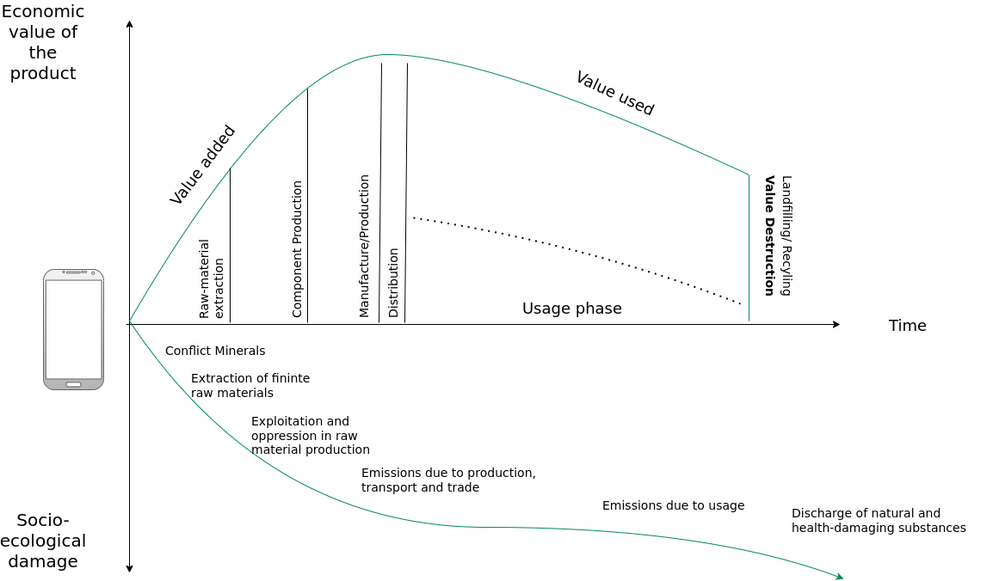
Circular Society
CE Criticism
Image adapted from: M. Jaeger-Erben, F. Hofmann (2019) – Kreislaufwirtschaft - Ein Ausweg aus der sozial-ökologischen Krise? – Link.

Slide 15
Circular Society
CE Criticism
Replace the LE with circularly oriented forms of consumption and production
CE focus mostly on earned value management (“Wertschöpfungsmanagement”), product-service systems, product/business model innovations within existing power asymmetries
Decouple economic growth and consumption of natural resources
→ But why do we need never ending economic growth and why is it good to consume as many goods and services as possible?
Alternatives:
Sufficiency strategies and lifestyle changes
Question the prevailing entrepreneurial orientation towards the shareholder concept
Deconstruction of existing power and hegemonic relations
Partially based on: F. Hofmann, J. Zwiers (2018) – Circular Society – Eine pluralistische und emanzipatorische Alternative zur Circular Economy? – Link.
.

Slide 16
Circular Society
Overview
Circular Society → CS
Goals of the CS:
Not just “CE + social”
Socio-political transformation and reorganization
Replace intransparent and inequity-based value chains of the LE with democratic, transparent and cooperatively organized value chains
Also → preserve the environment/ressources for present and future generations and enable social participation and quality of life
All-encompassing change necessary if the CE is to be the subject of a socio-ecological transformation
Democratisation of value creation processes and strategies for the activation and emancipation of different stakeholder groups
Partially based on: F. Hofmann, J. Zwiers (2018) – Circular Society – Eine pluralistische und emanzipatorische Alternative zur Circular Economy? – Link.
.

Slide 17
Circular Society
Overview
Circular Society → CS
Goals of the CS:
Not just “CE + social”
Socio-political transformation and reorganization
Replace intransparent and inequity-based value chains of the LE with democratic, transparent and cooperatively organized value chains
Also → preserve the environment/resources for present and future generations and enable social participation and quality of life
All-encompassing change necessary if the CE is to be the subject of a socio-ecological transformation
Democratisation of value creation processes and strategies for the activation and emancipation of different stakeholder groups
Partially based on: F. Hofmann, J. Zwiers (2018) – Circular Society – Eine pluralistische und emanzipatorische Alternative zur Circular Economy? – Link.
.

Slide 18
Circular Society
Overview
Circular Society → CS
Goals of the CS:
Not just “CE + social”
Socio-political transformation and reorganization
Replace intransparent and inequity-based value chains of the LE with democratic, transparent and cooperatively organized value chains
Also → preserve the environment/resources for present and future generations and enable social participation and quality of life
All-encompassing change necessary if the CE is to be the subject of a socio-ecological transformation
Democratization of value creation processes and strategies for the activation and emancipation of different stakeholder groups
Partially based on: F. Hofmann, J. Zwiers (2018) – Circular Society – Eine pluralistische und emanzipatorische Alternative zur Circular Economy? – Link.
.

Slide 19
Circular Society
Definition
„A circular society defines discourses with a vision of circularity where not only resources are circulated in sustainable loops, but also wealth, knowledge, technology and power is
circulated and redistributed throughout society”
M. C. Friant, R. Salomone, W. J. V. Vermeulen (2020) – A Typology of Circular Economy Discourses: Navigating the Diverse Visions of a Contested Paradigm – Link

Slide 20
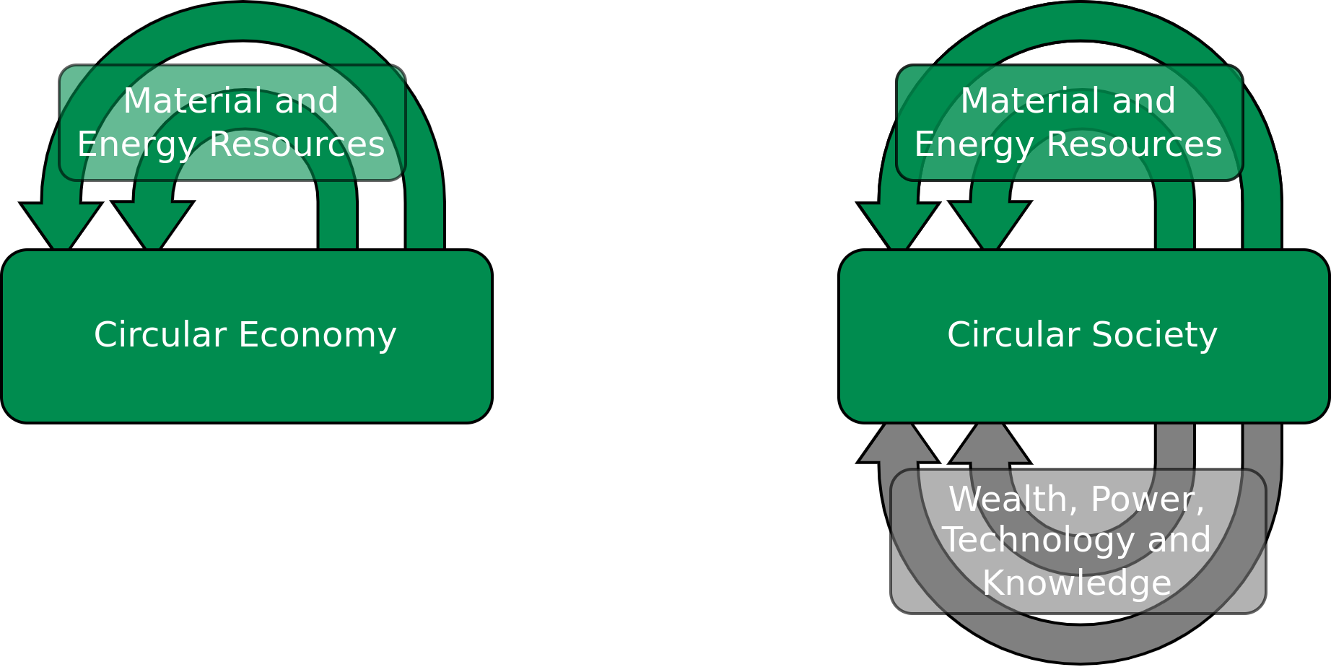
Circular Society
Definition
„ A circular society defines discourses with a vision of circularity where not only resources are circulated in sustainable loops, but also wealth, knowledge, technology and power is
circulated and redistributed throughout society”
Image licensed under CC BY-SA 4.0, sourced from M. C. Friant, R. Salomone, W. J. V. Vermeulen (2020) – A Typology of Circular Economy Discourses: Navigating the Diverse Visions of a Contested Paradigm – Link

Slide 21
Circular Society
CE vs. CS
CE = market-based solutions and economic considerations
CS = Circularity as a holistic social transformation
M. C. Friant, R. Salomone, W. J. V. Vermeulen (2020) – A Typology of Circular Economy Discourses: Navigating the Diverse Visions of a Contested Paradigm – Link

Slide 22
Circular Society
CE vs. CS
Circularity vision | Temporal scale | Spatial scale | Sustainability factors included | Perspective on the resource nexus | Views on capitalism and decoupling | Main goal/objective | Narrative
Circular Society | Very long term: multiple generations (beyond 50 years) | Macro-scale: planet Earth | People, Planet, Prosperity | Changing consumption and production patterns to keep energy, biodiversity and aterial resources within safe planetary limits. | Sceptical regarding the possiblity of decoupling and the sustainability of capitalism. | Maintaining socio-ecological health and wellbield for present and future generations of human and non-human life. | The earth is borrowed from future generations of living beingd, humans must preserve, respect, restore and share it in a fair maner, even if that entails changing lifestyles and consumption patterns.
 | Long term: 1 to 2 generations (20-50 years) | Macro-scale: planet Earth | People, Planet, Prosperity | Balancing trade-offs and synergies to keep energy, biodiversity and material resources within safe planetary limits. | Believe in the possibility of decoupling and the sustainability of capitalism. | Preserving social well-being and the biophysical health of the Earch system in line with the SDGs. | Humans must ensure justice, fairness and participation in the sustainable stewardship of the Earth, even if that entails redistributing and changing consumption patterns.
Table adapted from M. C. Friant, R. Salomone, W. J. V. Vermeulen (2020) – A Typology of Circular Economy Discourses: Navigating the Diverse Visions of a Contested Paradigm – Link

Slide 23
Circular Society
CE vs. CS
Circularity vision | Temporal scale | Spatial scale | Sustainability factors included | Perspective on the resource nexus | Views on capitalism and decoupling | Main goal/objective | Narrative
Circular Economy | Long term: one generation (19-25 years) | Macro-scale: planet Earth | Planet, Prosperity | Balancing trade-offs and synergies to keep energy, biodiversity and material resources within safe planetary limits. | Believe in the possibility of decoupling and the sustainability of capitalism. | Maintaining the biophysical health of the Earth system. | Reducing humanity’s overall ecological footprint and balancing resource limits and constraints is key to ensure the stability of the biosphere and long-term economic prosperity.
 | Mid-term: 1 to 2 government planning cycles (5-10 years) | Meso-scale (country, region, industrial park, city) | Planet, Prosperity | Optimizing and securing material, natural and energy resources, especially for critical raw materials. | Believe in the possibility of decoupling and the sustainability of capitalism. | Securing and preserving critical resources and materials. | Strategically maximising sco-efficiency and balancing resource use is necessary to maintain resource security and ensure geopolitical stability.
 | Short-term: single product life-cycle(1 to 2 years) | Micro-scale (single product, service, or firm) | Planet, Prosperity | Optimizing material and energy resource flows in product design. | Believe in the possibility of decoupling and the sustainability of capitalism. | Capturing oppostunities to lower both environmental impacts and economic costs. | Ensuring optimium resource efficiency through eco-innovation leads to win-win solutions that reduce ecological harm and increase economic value.
Table adapted from M. C. Friant, R. Salomone, W. J. V. Vermeulen (2020) – A Typology of Circular Economy Discourses: Navigating the Diverse Visions of a Contested Paradigm – Link

Slide 24
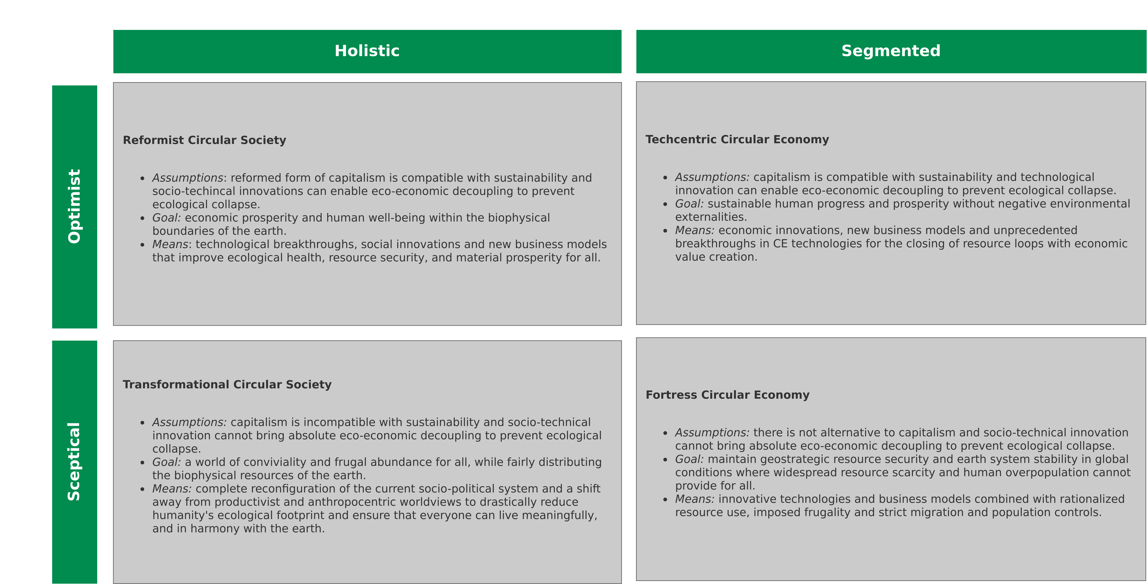
Circular Society
CE vs. CS – Typology
Image recreated from: M. C. Friant, R. Salomone, W. J. V. Vermeulen (2020) – A Typology of Circular Economy Discourses: Navigating the Diverse Visions of a Contested Paradigm – Link

Slide 25
Conclusion

Slide 26
Conclusion
Circular Economy (CE):
Maintain natural resources and minimize the discharge of substances that are harmful to health and nature → Increase/maximize utilization of resources, e.g., Performance Economy
Ecological modernization of the economy to increase resource efficiency, e.g., by technical innovation and digital solutions
Circular Society (CS):
Not just “CE + social” instead socio-political transformation and reorganization
Replace intransparent and inequity-based value chains of the LE with democratic, transparent and cooperatively organized value chains
Democratization of value creation processes and strategies for the activation and emancipation of different stakeholder groups

Slide 27
Conclusion
Circular Economy (CE):
Maintain natural resources and minimize the discharge of substances that are harmful to health and nature → Increase/maximize utilization of resources, e.g., Performance Economy
Ecological modernization of the economy to increase resource efficiency, e.g., by technical innovation and digital solutions
Circular Society (CS):
Not just “CE + social” instead socio-political transformation and reorganization
Replace intransparent and inequity-based value chains of the LE with democratic, transparent and cooperatively organized value chains
Democratization of value creation processes and strategies for the activation and emancipation of different stakeholder groups

Slide 28
Detour

Slide 29
Detour
Sustainability
Sustainability → Consume less
Consume less → Less money spend, i.e. lower living costs?
Lower living costs → less work hours required pay costs, e.g., 20h work week?
Technological advances reducing workload even further?

Slide 30
Detour
Sustainability
Sustainability → Consume less
Consume less → Less money spend, i.e. lower living costs?
Lower living costs → Less work hours required cover costs, e.g., 20h work week?
Technological advances reducing workload even further?

Slide 31
Detour
Sustainability
Sustainability → Consume less
Consume less → Less money spend, i.e. lower living costs?
Lower living costs → Less work hours required to cover costs, e.g., 20h work week?
Technological advances reducing workload even further?

Slide 32
Detour
15h Work Week
John Maynard Keynes predicted a 15h work week in his 1930 essay “Economic Possibilities for our Grandchildren”

Slide 33
Detour
Why am I working 40+h a week?
Lively debates pertaining to Keynes prediction – especially among economists.
Main problem: Keynes did not account for the massive increase in consumerism → Majority of people chooses more toys and pleasure over less work hours
↔
Contradicts our sustainability paradigm (consume less).

Slide 34
Detour
Why am I working 40+h a week?
Lively debates pertaining to Keynes prediction – especially among economists.
Main problem: Keynes did not account for the massive increase in consumerism → Majority of people chooses more toys and pleasure over less work hours
↔
Contradicts our sustainability paradigm (consume less).

Slide 35
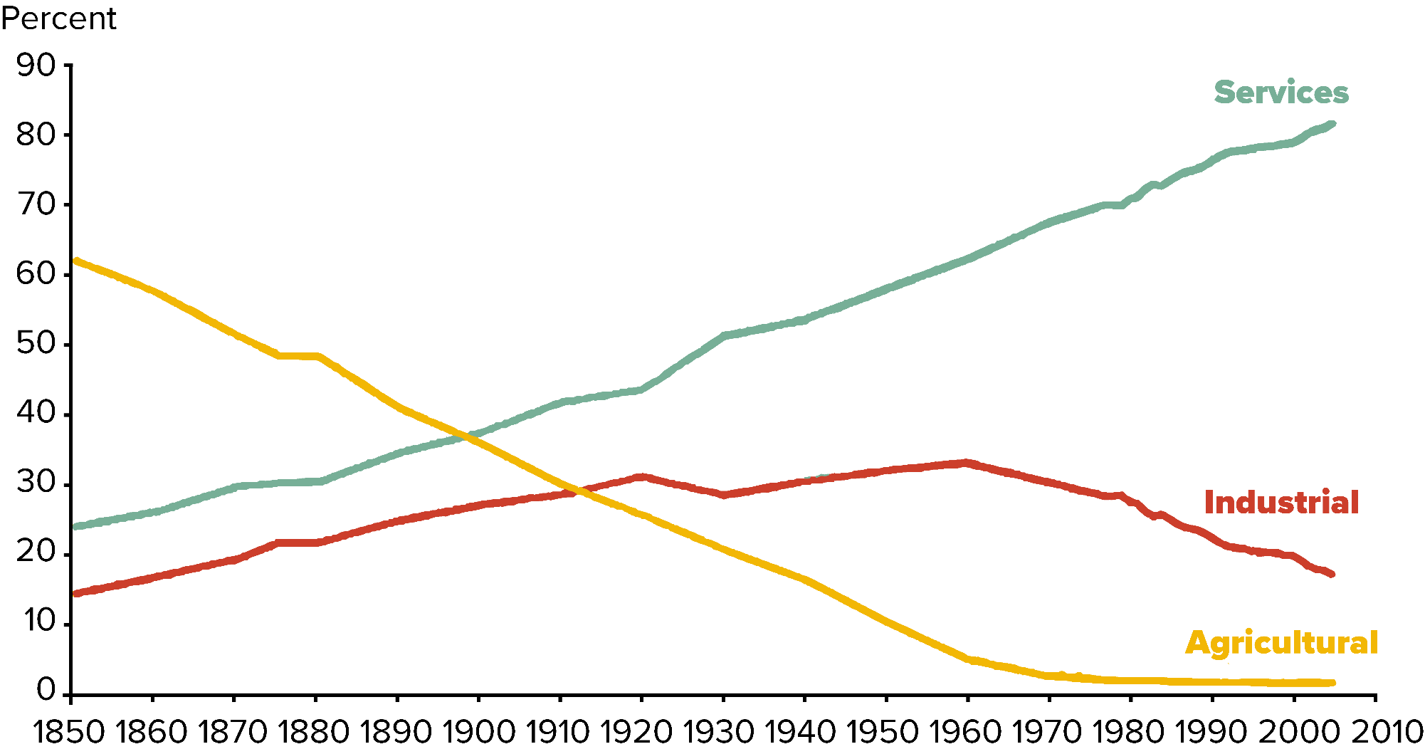
Detour
Shift in Labor Force 1850 – 2010
Image recreated from: International Historical Statistics (2013): “Market Services Productivity Across Europe and the U.S.” by Robert Inklaar, Marcel P. Timmer and Bart van Ark, Economic Policy, Vol. 23, No. 53, 2008, pp. 139-94; authors calculations.

Slide 36
Detour
Bullshit Job – Essay and Book by David Graeber
Essay: On the Phenomenon of Bullshit Jobs: A Work Rant (2013) – Link
Book: Bullshit Jobs: A Theory (2018)

Slide 37
Detour
Bullshit Job – Definition
„Form of paid employment that is so completely pointless, unnecessary, or pernicious that even the employee cannot justify its existence even though, as part of the conditions of employment, the employee feels obliged to pretend that this is not the case.”
D. Graeber (2013) – On the Phenomenon of Bullshit Jobs – Essay – Link
D. Graeber (2018) – Bullshit Jobs: A Theory

Slide 38
Detour
Bullshit Job – Definition
„Form of paid employment that is so completely pointless, unnecessary, or pernicious that even the employee cannot justify its existence even though, as part of the conditions of employment, the employee feels obliged to pretend that this is not the case.”
→ Inefficiencies in capitalism?
D. Graeber (2013) – On the Phenomenon of Bullshit Jobs – Essay – Link
D. Graeber (2018) – Bullshit Jobs: A Theory

Slide 39
Detour
Bullshit Jobs – Categories
D. Graeber (2013) – On the Phenomenon of Bullshit Jobs – Essay – Link
D. Graeber (2018) – Bullshit Jobs: A Theory

Slide 40
Detour
Bullshit Jobs – Categories
Flunkies: Serve to make their superiors feel important, e.g., receptionists, administrative assistants, door attendants, store greeters, makers of websites whose sites neglect ease of use and speed for looks
Goons: Act to harm or deceive others on behalf of their employer, e.g., lobbyists, corporate lawyers, telemarketers, public relations specialists, community managers;
Duct tapers: Temporarily fix problems that could be fixed permanently, e.g., programmers repairing bloated code, airline desk staff who calm passengers whose bags do not arrive;
Box tickers: Create the appearance that something useful is being done when it is not, e.g., survey administrators, in-house magazine journalists, corporate compliance officers, quality service managers;
Taskmasters: Create extra work for those who do not need it, e.g., middle management, leadership professionals.
D. Graeber (2013) – On the Phenomenon of Bullshit Jobs – Essay – Link
D. Graeber (2018) – Bullshit Jobs: A Theory

Slide 41
Detour
Bullshit Jobs – Categories
Flunkies: Serve to make their superiors feel important, e.g., receptionists, administrative assistants, door attendants, store greeters, makers of websites whose sites neglect ease of use and speed for looks
Goons: Act to harm or deceive others on behalf of their employer, e.g., lobbyists, corporate lawyers, telemarketers, public relations specialists, community managers
Duct tapers: Temporarily fix problems that could be fixed permanently, e.g., programmers repairing bloated code, airline desk staff who calm passengers whose bags do not arrive;
Box tickers: Create the appearance that something useful is being done when it is not, e.g., survey administrators, in-house magazine journalists, corporate compliance officers, quality service managers;
Taskmasters: Create extra work for those who do not need it, e.g., middle management, leadership professionals.
D. Graeber (2013) – On the Phenomenon of Bullshit Jobs – Essay – Link
D. Graeber (2018) – Bullshit Jobs: A Theory

Slide 42
Detour
Bullshit Jobs – Categories
Flunkies: Serve to make their superiors feel important, e.g., receptionists, administrative assistants, door attendants, store greeters, makers of websites whose sites neglect ease of use and speed for looks
Goons: Act to harm or deceive others on behalf of their employer, e.g., lobbyists, corporate lawyers, telemarketers, public relations specialists, community managers
Duct tapers: Temporarily fix problems that could be fixed permanently, e.g., programmers repairing bloated code, airline desk staff who calm passengers whose bags do not arrive
Box tickers: Create the appearance that something useful is being done when it is not, e.g., survey administrators, in-house magazine journalists, corporate compliance officers, quality service managers;
Taskmasters: Create extra work for those who do not need it, e.g., middle management, leadership professionals.
D. Graeber (2013) – On the Phenomenon of Bullshit Jobs – Essay – Link
D. Graeber (2018) – Bullshit Jobs: A Theory

Slide 43
Detour
Bullshit Jobs – Categories
Flunkies: Serve to make their superiors feel important, e.g., receptionists, administrative assistants, door attendants, store greeters, makers of websites whose sites neglect ease of use and speed for looks
Goons: Act to harm or deceive others on behalf of their employer, e.g., lobbyists, corporate lawyers, telemarketers, public relations specialists, community managers
Duct tapers: Temporarily fix problems that could be fixed permanently, e.g., programmers repairing bloated code, airline desk staff who calm passengers whose bags do not arrive
Box tickers: Create the appearance that something useful is being done when it is not, e.g., survey administrators, in-house magazine journalists, corporate compliance officers, quality service managers
Taskmasters: Create extra work for those who do not need it, e.g., middle management, leadership professionals.
D. Graeber (2013) – On the Phenomenon of Bullshit Jobs – Essay – Link
D. Graeber (2018) – Bullshit Jobs: A Theory

Slide 44
Detour
Bullshit Jobs – Categories
Flunkies: Serve to make their superiors feel important, e.g., receptionists, administrative assistants, door attendants, store greeters, makers of websites whose sites neglect ease of use and speed for looks
Goons: Act to harm or deceive others on behalf of their employer, e.g., lobbyists, corporate lawyers, telemarketers, public relations specialists, community managers
Duct tapers: Temporarily fix problems that could be fixed permanently, e.g., programmers repairing bloated code, airline desk staff who calm passengers whose bags do not arrive
Box tickers: Create the appearance that something useful is being done when it is not, e.g., survey administrators, in-house magazine journalists, corporate compliance officers, quality service managers
Taskmasters: Create extra work for those who do not need it, e.g., middle management, leadership professionals
D. Graeber (2013) – On the Phenomenon of Bullshit Jobs – Essay – Link
D. Graeber (2018) – Bullshit Jobs: A Theory

Slide 45
Detour
Bullshitization
Transition of a meaningful job into a bullshit job through corporatization,
marketization or managerialism.
D. Graeber (2018) – Bullshit Jobs: A Theory
D. Graeber (2018) – Are You in a BS Job? In Academe, You’re Hardly Alone (Chronicle of Higher Education) – Link

Slide 46
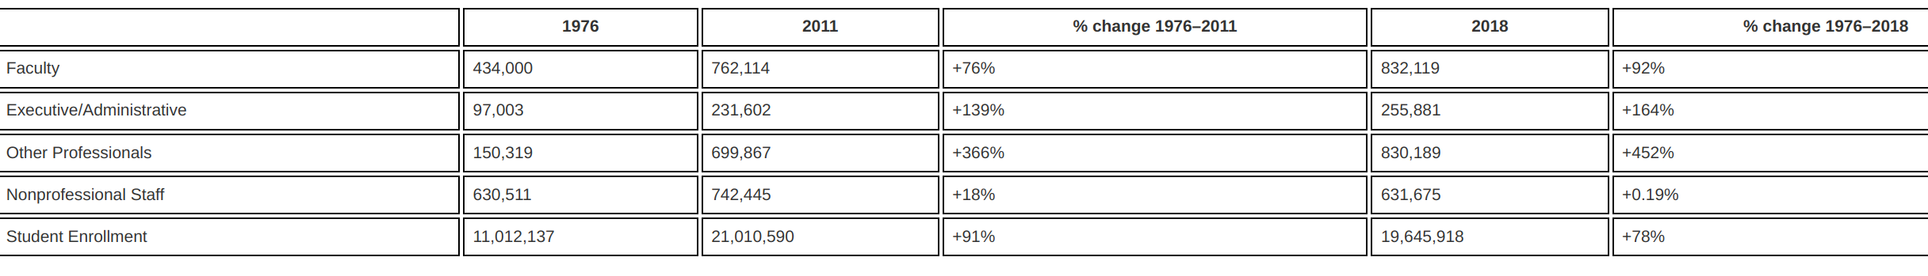
Detour
Changes in full-time staff size and student enrollment
(1976–2011 and 1976–2018)
Michael Delucchi, Richard B. Dadzie, Erik Dean & Xuan Pham (2021) What’s that smell? Bullshit jobs in higher education, Review of Social Economy, DOI: 10.1080/00346764.2021.1940255

Slide 47
Detour
15h Work Week
John Maynard Keynes predicted a 15h work week in his 1930 essay “Economic Possibilities for our Grandchildren”

Slide 48
Detour
Bullshit Jobs – Why?
Assumption → Capitalism does not allow for inefficiencies
Hypothesis → Maybe this is not capitalism and rather just "managerial feudalism"?
The pains of dull work as a justification for the ability to fulfill consumer desires
Fulfilling those desires → Reward for suffering through pointless work
Feudalism: „The dominant social system in medieval Europe, in which the nobility held lands from the Crown in exchange for military service, and vassals were in turn tenants of the nobles, while the peasants (villeins or serfs) were obliged to live on their lord's land and give him homage, labour, and a share of the produce, notionally in exchange for military protection.”
(Oxford Dictionary)
D. Graeber (2013) – On the Phenomenon of Bullshit Jobs – Essay – Link
D. Graeber (2018) – Bullshit Jobs: A Theory

Slide 49
Detour
Bullshit Jobs – Why?
Assumption → Capitalism does not allow for inefficiencies
Hypothesis → Maybe this is not capitalism and rather just "managerial feudalism"?
The pains of dull work as a justification for the ability to fulfill consumer desires
Fulfilling those desires → Reward for suffering through pointless work
Bullshit jobs also serve political ends, in which political parties are more concerned about having jobs than whether the jobs are fulfilling.
Also → Populations occupied with busy work have less time to revolt
Feudalism: „The dominant social system in medieval Europe, in which the nobility held lands from the Crown in exchange for military service, and vassals were in turn tenants of the nobles, while the peasants (villeins or serfs) were obliged to live on their lord's land and give him homage, labour, and a share of the produce, notionally in exchange for military protection.”
(Oxford Dictionary)
D. Graeber (2013) – On the Phenomenon of Bullshit Jobs – Essay – Link
D. Graeber (2018) – Bullshit Jobs: A Theory

Slide 50
Detour
Bullshit Jobs – Why?
Assumption → Capitalism does not allow for inefficiencies
Hypothesis → Maybe this is not capitalism and rather just "managerial feudalism"?
The pains of dull work as a justification for the ability to fulfill consumer desires
Fulfilling those desires → Reward for suffering through pointless work
Bullshit jobs also serve political ends, in which political parties are more concerned about having jobs than whether the jobs are fulfilling.
Also → Populations occupied with busy work have less time to revolt
Feudalism: „The dominant social system in medieval Europe, in which the nobility held lands from the Crown in exchange for military service, and vassals were in turn tenants of the nobles, while the peasants (villeins or serfs) were obliged to live on their lord's land and give him homage, labour, and a share of the produce, notionally in exchange for military protection.”
(Oxford Dictionary)
D. Graeber (2013) – On the Phenomenon of Bullshit Jobs – Essay – Link
D. Graeber (2018) – Bullshit Jobs: A Theory

Slide 51
Detour
Bullshit Jobs – Why?
Assumption → Capitalism does not allow for inefficiencies
Hypothesis → Maybe this is not capitalism and rather just "managerial feudalism"?
The pains of dull work as a justification for the ability to fulfill consumer desires
Fulfilling those desires → Reward for suffering through pointless work
Bullshit jobs also serve political ends, in which political parties are more concerned about having jobs than whether the jobs are fulfilling.
Also → Populations occupied with busy work have less time to revolt
Feudalism: „The dominant social system in medieval Europe, in which the nobility held lands from the Crown in exchange for military service, and vassals were in turn tenants of the nobles, while the peasants (villeins or serfs) were obliged to live on their lord's land and give him homage, labour, and a share of the produce, notionally in exchange for military protection.”
(Oxford Dictionary)
D. Graeber (2013) – On the Phenomenon of Bullshit Jobs – Essay – Link
D. Graeber (2018) – Bullshit Jobs: A Theory

Slide 52
Detour
Bullshit Jobs – Why?
Assumption → Capitalism does not allow for inefficiencies
Hypothesis → Maybe this is not capitalism and rather just "managerial feudalism"?
The pains of dull work as a justification for the ability to fulfill consumer desires
Fulfilling those desires → Reward for suffering through pointless work
Bullshit jobs also serve political ends, in which political parties are more concerned about having jobs than whether the jobs are fulfilling.
Also → Populations occupied with busy work have less time to revolt
Feudalism: „The dominant social system in medieval Europe, in which the nobility held lands from the Crown in exchange for military service, and vassals were in turn tenants of the nobles, while the peasants (villeins or serfs) were obliged to live on their lord's land and give him homage, labour, and a share of the produce, notionally in exchange for military protection.”
(Oxford Dictionary)
D. Graeber (2013) – On the Phenomenon of Bullshit Jobs – Essay – Link
D. Graeber (2018) – Bullshit Jobs: A Theory

Slide 53
Detour
Bullshit Jobs – Now What?
D. Graeber (2013) – On the Phenomenon of Bullshit Jobs – Essay – Link
D. Graeber (2018) – Bullshit Jobs: A Theory

Slide 54
Detour
Bullshit Jobs – Now What?
Graeber’s solution → Universal Basic Income (UBI) → Livable benefit paid to all, thus letting people work at their leisure
D. Graeber (2013) – On the Phenomenon of Bullshit Jobs – Essay – Link
D. Graeber (2018) – Bullshit Jobs: A Theory

Slide 55
Exercise E08

Slide 56
Exercise E08
Circular Economy vs. Circular Society
Task: In the lecture, we presented a typology of the circular economy vs. circular society discourse (CE vs. CS – Typology). Which of the four categories (Reformist Circular Society, Transformational Circular Society, Techcentric Circular Economy, Fortress Circular Economy) do you prefer and/or deem to be more likely and why?
Explain your choice.
Submit your submission according to the instructions in the exercise sheet.

Slide 57
Additional Resources
Circular Societies (German) – Link
David Graeber. Debt: The First 5000 Years (2011).
David Graeber. On the Phenomenon of Bullshit Jobs – Essay (2013) – Link.
David Graeber. Bullshit Jobs – Book (2018).

Slide 58
Questions?

