Slide 1
Emerging Technologies for the Circular Economy
Lecture 6: Internet of Things Communications
Prof. Dr. Benjamin Leiding
M.Sc. Anant Sujatanagarjuna
M.Sc. Chintan Patel

Slide 2
License
This work is licensed under a Creative Commons Attribution-ShareAlike 4.0 International License. To view a copy of this license, please refer to https://creativecommons.org/licenses/by-sa/4.0/ .
Updated versions of these slides will be available in our Github repository.

Slide 3
News/Updates

Slide 4

Course Evaluation – QR Code and Link
For the course: „Emerging Technolgoies for the Circular Economy”
Link: Click Me

Slide 5

Course Evaluation – QR Code and Link
For the course: „IoT and Digitalization for Circular Economy”
Link: Click Me

Slide 6
Iot COMMUNICATIONS

Slide 7
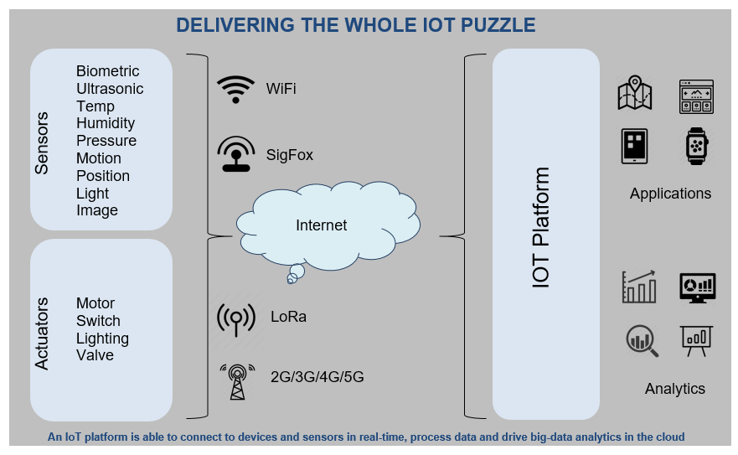
Overview

Slide 8
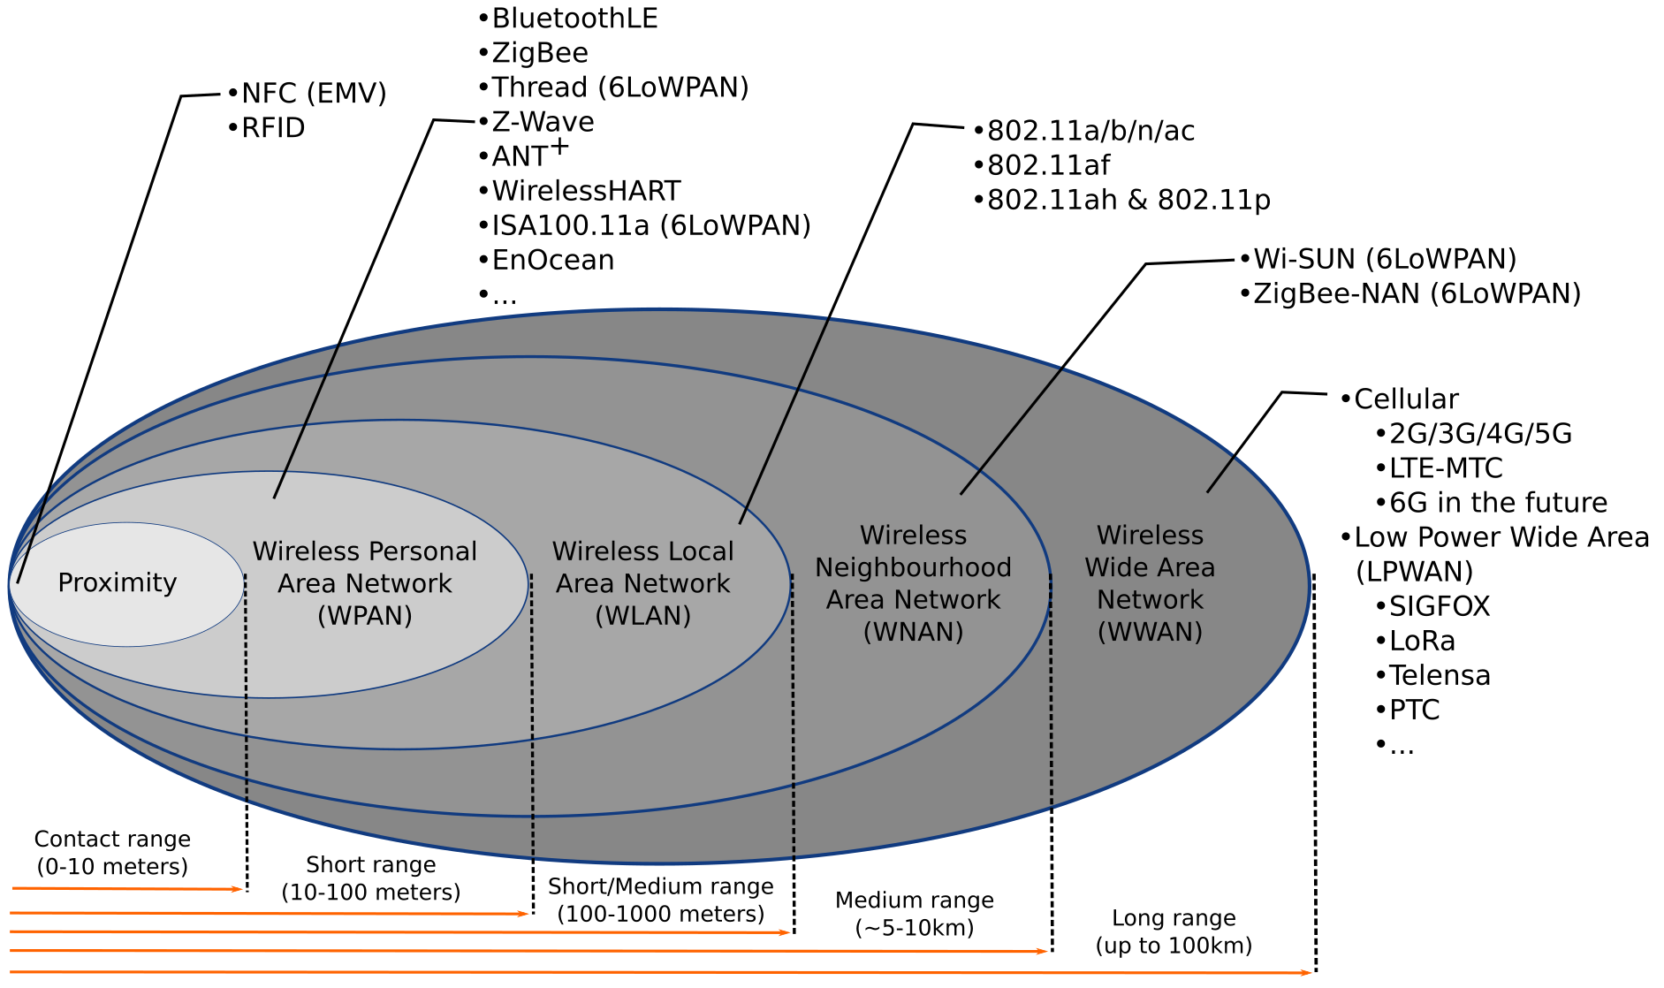
Different ranges, different standards
Source: M.S. Mahmoud, A. Mohamad, “A Study of Efficient Power Consumption Wireless Communication Techniques/ Modules for Internet of Things (IoT) Applications”, January 2016, Advances in Internet of Things 06(02):19-29, DOI:10.4236/ait.2016.62002

Slide 9
WPAN

Slide 10
Wireless Personal Area Network
IP-Based
Protocol | Description | Power Consumption | Usage
6LoWPAN | IPv6 over Low-Power Wireless Personal Area Networks | Low (< 100 mW) | IPv6-based IoT networks
IEEE 802.11p (V2V) | WiFi-based | High (>1W) | Vehicle-to-vehicle (V2V) communications
RuBee | Uses magnetic fields over short range | Very Low (<10 mW) | Harsh environments / tracking high-value assets

Slide 11
Wireless Personal Area Network
Not IP-Based
Protocol | Description | Power Consumption | Usage
Bluetooth/BLE | Versatile and high data throughput per watt | Low (< 100 mW) | Varies by specific protocol
ZigBee | Low-power, Low data-rate | Low (< 100 mW) | Vehicle-to-vehicle (V2V) communications
IrDA | Infrared Data Association (Only works with line-of-sight) | Medium (100-500 mW ) over short bursts | Remote controls
Z-Wave | Similar to ZigBee and BLE, but also supports mesh networking | Low (25-80 mW) | Home automation, sensors, locks, etc.

Slide 12
Bluetooth
Pros
Low power requirements
Resilient against interference
Cons
Low bandwidth
Limited range
Limited number of participants in network
Applications
Beacons
Fitness trackers, smart watches
Medical applications
Smart homes
Smart cars
Earbuds, headsets etc.
Classes for different applications with different ranges/power usages.

Slide 13
Zigbee
Pros
Low power requirements
Scales to large network sizes (~6500 nodes)
Cons
Low range
Low bandwidth
Security issues (fixed, known fallback keys in at least one profile)
Applications
Wireless sensor networks (WSN)
Industrial automation
Smart homes

Slide 14
6LoWPAN
Pros
IPv6 based
Built-in security
Scalability
Interoperability
Cons
Higher minimum requirements due to IPv6 minimum complexity
Not as popular as ZigBee
Applications
Wireless sensor networks (WSN)
Internet of Things
Industrial Internet of Things

Slide 15
IEEE 802.11p
Vehicular network optimized
Vehicle to vehicle (V2V)
Vehicle to infrastructure (V2I) such as road side units (RSU)
Built in time synchronization
Applications
Vehicular networks

Slide 16
WAN

Slide 17
Wide Area Network
Service/subscription model based
Service provider runs infrastructure such as base stations and radio towers
Protocol | Power Consumption | Data throughput
2G (GSM) | ~1-2 W | 0.03-0.24 Mb/s
3G (UMTS/HSPA) | ~1-1.5 W | 1-5 Mb/s
4G (LTE 1/4/6) | ~400 mW – 1.5W | 5-150 Mb/s
5G | ~500 mW – 2W+ | 50 Mb/s – 1+ Gb/s
LoRaWAN | ~10 mW – 100 mW | 0.3 – 50 kb/s
SigFox | ~10 mW – 80 mW | 0.1 – 0.6kb/s

Slide 18
Cellular network architecture
Grid of cell towers
Overlapping cells
Requires handover for mobile stations between cells
Network planning
Space division multiple access
Minimize interference
Avoid allocating overlapping spectrum on nearby cells

Slide 19
5G
New radio communication techniques and spectrum
Support for device to device communications (D2D)
Improved performance
Theoretical latency in single digit ms
Bandwidth in gbps range
Ability to provide connectivity in fast moving vehicles
Enables more dense connectivity and scalability (more devices)

Slide 20
LoRa/LoRaWAN
Uses unlicensed spectrum
Low number of base stations (Gateways) covers wide area
7 are enough to cover Belgium
Only produced by a single company (Simtech)
High latency, no realtime applications
Subscription based
Misses some common features from LTE networks
Only physical and MAC layers are covered => Higher OSI layers have to be implemented on top

Slide 21
Sigfox
Uses unlicensed spectrum
Uplink
100bps
12B payloads
Maximum of 6 messages per device and hour (140 per day)
Downlink
600bps
8B payloads
Maximum of 4 messages per day
Open hardware
Network subscription based

Slide 22
Software-Defined Networks (SDN)

Slide 23
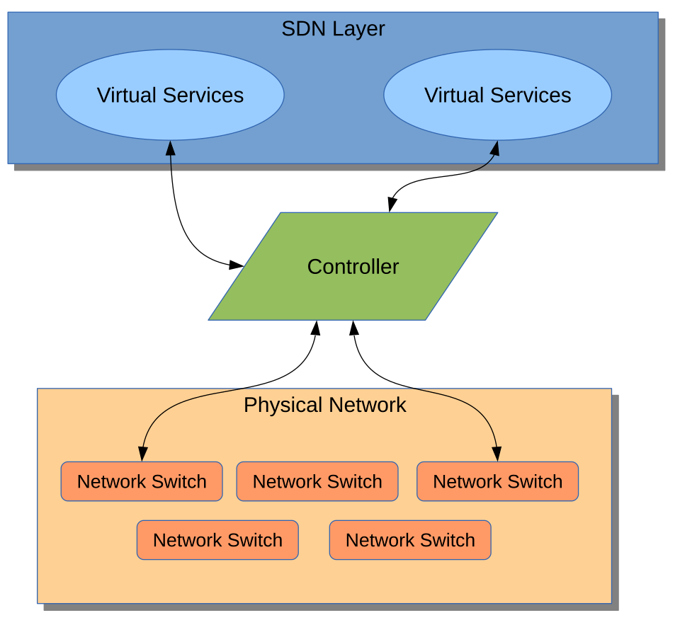
TODO: Add reference
https://www.researchgate.net/publication/319602888_Software_Defined_Network_SDN_Based_Internet_of_Things_IoT_A_Road_Ahead
TODO: Add reference
https://commons.wikimedia.org/wiki/File:Software_Defined_Networking_System_Overview.svg
TODO: Add reference
https://commons.wikimedia.org/wiki/File:Software_Defined_Networking_System_Overview.svg
SDN Architecture
SDN: Umbrella term used for when the physical networking layer is abstracted from the logical layer.
All physical networking devices simply forward data packets to a centralized controller.
Virtual services (apps/databases/IoT applications) also rely on communication with the central controller to interface with other IoT components like sensors, actuators, etc.
Only the controller is “aware” of the physical networking architecture in relation to the virtual services and routes network traffic accordingly.

Slide 24
TODO: Add reference
https://www.researchgate.net/publication/319602888_Software_Defined_Network_SDN_Based_Internet_of_Things_IoT_A_Road_Ahead
TODO: Add reference
https://commons.wikimedia.org/wiki/File:Software_Defined_Networking_System_Overview.svg
TODO: Add reference
https://commons.wikimedia.org/wiki/File:Software_Defined_Networking_System_Overview.svg
SDN Architecture
Salient Features:
Programmatically more flexible: network managers can optimize network resources dynamically and automatically.
The controller is generally centralized – simplifying implementation of control logic.
Centralization might introduce more issues such as security, scalability and reliability.
Open protocols and standards for SDN (like OpenFlow) can be used on top of proprietary networks for added privacy.
Especially suited to cloud-based IoT systems.
Significantly higher energy usage!
Khan, Sahrish & Shah, Munam & Khan, Omair & Ahmed, Abdul. (2017). Software Defined Network (SDN) Based Internet of Things (IoT): A Road Ahead. 1-8. 10.1145/3102304.3102319.
“Software Defined Networking System Overview” is authored by Denwid, and licensed under the GNU Free Documentation License

Slide 25
Routers and gateways

Slide 26
Routers and Gateways
Router
Bridges two networks
Can translate between protocols
Routes data
Port forwarding and network address translation (mainly end user or carrier grade)
VNETs
Gateway (not in the routing sense)
Bridges wireless network and internet
Can translate between protocols
Edge/Fog computing capabilities (Lecture 8: IoT Data processing and Big Data)
Routers can be gateways

Slide 27
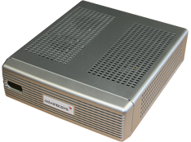
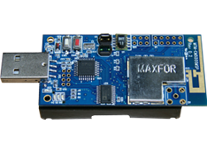
Gateway example
Wireless sensor nodes running Contiki RPL with Ipv6
Node attached to gateway over USB acts as gateway
IPv6 connectivity between networks provided through SLIP (Serial Line Internet Protocol)

Slide 28
Questions?

