Slide 1
Emerging Technologies for the Circular Economy
Lecture 0: Organization
Prof. Dr. Benjamin Leiding (Clausthal)
M.Sc. Arne Bochem (Göttingen)
M.Sc. Anant Sujatanagarjuna (Clausthal)

Slide 2
License
This work is licensed under a Creative Commons Attribution-ShareAlike 4.0 International License. To view a copy of this license, please refer to https://creativecommons.org/licenses/by-sa/4.0/ .
Updated versions of these slides will be available in our Github repository.

Slide 3
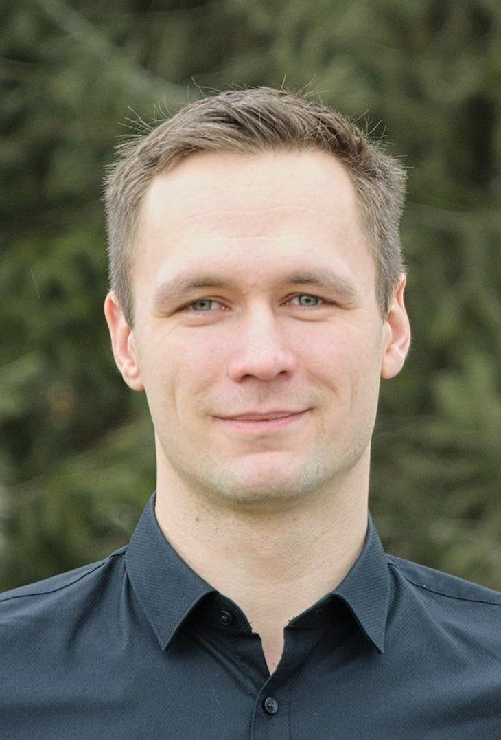
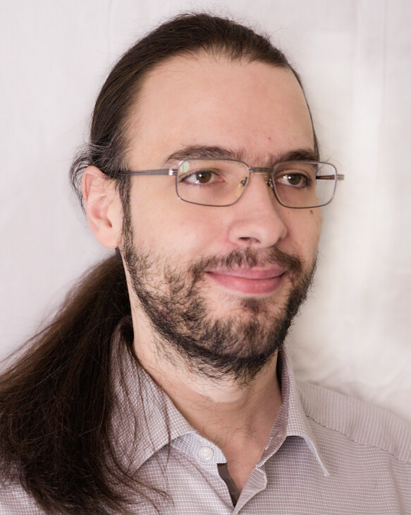
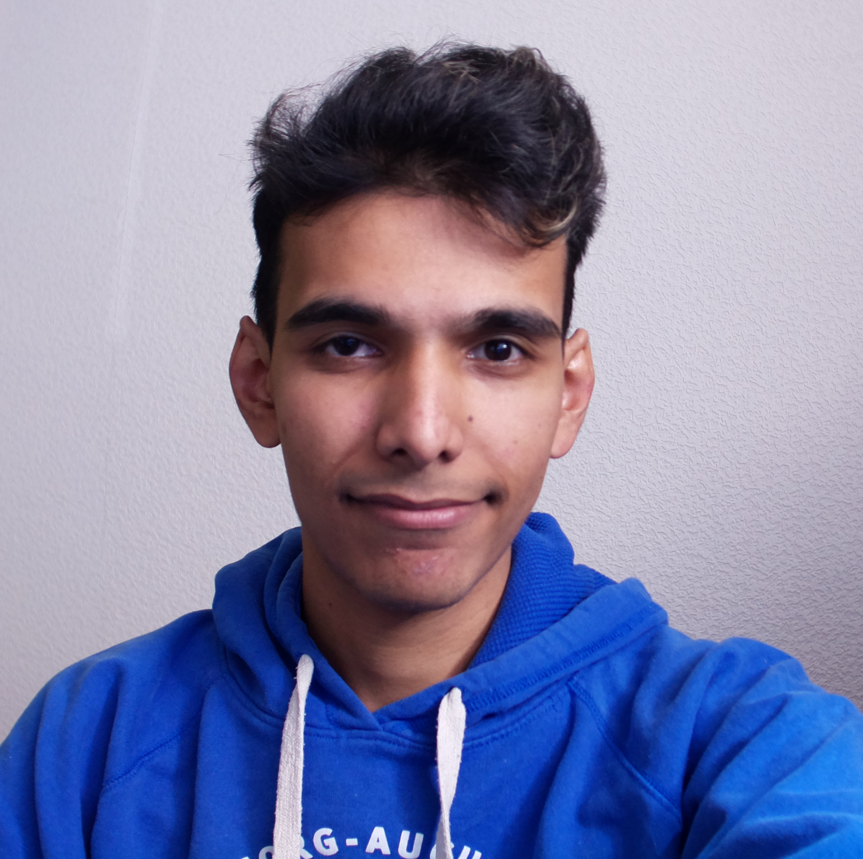
Team
Prof. Dr. Benjamin Leiding
benjamin.leiding@tu-clausthal.de
M.Sc. Arne Bochem
arne.bochem@cs.uni-goettingen.de
M.Sc. Anant Sujatanagarjuna
anant.sujatanagarjuna@tu-clausthal.de.de

Slide 4
ETCE Research Group
Emerging Technologies for the Circular Economy → ETCE
Research focus:
Intersection of IT and sustainability
Circular Economy
Self-organized, decentralized and distributed systems
Machine-to-Everything Economy (M2X Economy)
Other courses:
The Limits to Growth – Sustainability and the Circular Economy (SS – open for everyone)
Requirements Engineering (WS – M.Sc.)
Notes:
<number>

Slide 5
ETCE Research Group
ETCE Website – Link
Course material
Theses/project topics
Our research in action:
ZDF documentary (German) – Link
Klartext Preis 2020 (German) – Link
You want join us? Write us an email!
→ benjamin.leiding@tu-clausthal.de
Notes:
<number>

Slide 6
ETCE Research Group
ETCE Website – Link
Course material
Theses/project topics
Our research in action:
ZDF documentary (German) – Link
Klartext Preis 2020 (German) – Link
You want join us? Write us an email!
→ benjamin.leiding@tu-clausthal.de
Notes:
<number>

Slide 7
Learning Outcome
Basic understanding of the concept of the Linear Economy, the Circular Economy, the Performance Economy and sustainability

Slide 8
Learning Outcome
Basic understanding of the concept of the Linear Economy, the Circular Economy, the Performance Economy and sustainability
Basic understanding of new technologies in the field of decentralized and smart systems

Slide 9
Learning Outcome
Basic understanding of the concept of the Linear Economy, the Circular Economy, the Performance Economy and sustainability
Basic understanding of new technologies in the field of decentralized and smart systems
Understanding and overview of the Internet of Things and related concepts

Slide 10
Learning Outcome
Basic understanding of the concept of the Linear Economy, the Circular Economy, the Performance Economy and sustainability
Basic understanding of new technologies in the field of decentralized and smart systems
Understanding and overview of the Internet of Things and related concepts
Ability to design decentralized smart systems and applications in the context of connected sensor systems

Slide 11
Learning Outcome
Basic understanding of the concept of the Linear Economy, the Circular Economy, the Performance Economy and sustainability
Basic understanding of new technologies in the field of decentralized and smart systems
Understanding and overview of the Internet of Things and related concepts
Ability to design decentralized smart systems and applications in the context of connected sensor systems
Knowledge of the design and consideration of privacy-preserving data processing procedures for smart and decentralized applications

Slide 12
Learning Outcome
Basic understanding of the concept of the Linear Economy, the Circular Economy, the Performance Economy and sustainability
Basic understanding of new technologies in the field of decentralized and smart systems
Understanding and overview of the Internet of Things and related concepts
Ability to design decentralized smart systems and applications in the context of connected sensor systems
Knowledge of the design and consideration of privacy-preserving data processing procedures for smart and decentralized applications
Experience in prototyping such applications and systems

Slide 13
Lectures
20.04.2022 → Organization + Introduction
27.04.2022 → Emerging Technologies for the Circular Economy I
04.05.2022 → Emerging Technologies for the Circular Economy II
11.05.2022 → Introduction to the Internet of Things
18.05.2022 → Internet of Things – Communication
25.05.2022 → Internet of Things – Cloud and BigData + Privacy and Security
01.06.2022 → Introduction to Blockchain Technology
15.06.2022 → Blockchain Technology – Consensus
22.06.2022 → Blockchain Technology – Ethereum and Smart Contracts Part 1
29.06.2022 → Blockchain Technology – Ethereum and Smart Contracts Part 2
06.07.2022 → Invited speaker → Dr. Uli Gallersdörfer (TU Munich)
13.07.2022 → Invited speaker → Prof. Dr. Steffen Herbold (TU Clausthal)
20.07.2022 → Blockchain Technology and Sustainability
27.07.2022 → The Machine-to-Everything Economy – A step towards the CE 2.0?

Slide 14
Exercises
20.04.2022 → Exercise 01 – Knowledge Test (MC)
27.04.2022 → Exercise 02 – Circular Economy (MC)
11.05.2022 → Exercise 03 – IoT Sensing and Gathering Data
18.05.2022 → Exercise 04 – IoT Data Processing
01.06.2022 → Exercise 05 – IoT Security
15.06.2022 → Exercise 07 – Blockchain (MC)
22.06.2022 → Exercise 08 – Blockchain Basics
29.06.2022 → Exercise 09 – Blockchain Conensus
05.07.2022 → Exercise 10 – Blockchain Tokens
20.07.2022 → Exercise 11 – Blockchain Smart Contracts and IoT

Slide 15
Course Organization
Online course that is offered in parallel at the Clausthal University of Technology and the University of Göttingen
Organization of the lecture:
Slides will be uploaded to StudIP (Clausthal and Göttingen) and Github (Link)
Please report bugs!
Lectures and exercises as live stream (BBB – next slide)
Lecture recordings will be available on StudIP and on Github
Exercise time slots = Time for questions and eventual tutorials related to the exercises
Questions? Write us an email: etce-etce@tu-clausthal.de ← We will only respond to
emails written to this specific email address!

Slide 16
Dates/Times/Locations
Please note:
The Gotec (Am Stollen 19 C, 38640 Goslar) in Goslar is limited to ca. 15 seats due to the current COVID restrictions. Thus, only DigiTec students may join us in Goslar.
We kindly ask everyone else to use the BBB rooms (links below).
Lecture:
Wednesday 2 pm to 3:30 pm (Berlin time) – 20.04.2022 to 27.07.2022
Location: Goslar Gotec (Am Stollen 19 C, 38640 Goslar, Germany) or via BigBlueButton (Link)
Exercise / Q&A:
Wednesday 4 pm to 5:30 pm (Berlin time) – 20.04.2022 to 27.07.2022
Location: Goslar Gotec (Am Stollen 19 C, 38640 Goslar, Germany) or via BigBlueButton (Link)

Slide 17
Exercises
Individual work → no group submissions
Multiple-Choice or coding tasks
7-14 days to submit (depending on the task)
Submission deadline is always Wednesday at 1:59pm (right before the next lecture)
Submission of each exercise is mandatory
You pass by submitting an exercise – even if it is an empty page
You will receive feedback on your submission
Exercise = learning feedback

Slide 18
Exercises
Bonus task:
Form groups of two or more people
Come up with a great idea that revolves around sustainability and emerging technologies
Push the idea as far as possible throughout the semester
Record a 60s video explaining your idea and what you did throughout the semester
Selection of the 5 best ideas → bonus points for the exam (e.g., better grade – instead of 2.0 → 1.7 or something similar)

Slide 19
Coding Exercise Submission and Grading – Clausthal and Göttingen
Coding exercises are graded semi-automatically. Due to this it is highly important that you follow the required submission format. Otherwise the grading process will fail and you will receive 0 points.
Code must use Python. Do not use any libraries beyond what is specified in the assignment as they may not be available in the grading environment.
Follow the directory structure from the handout file exactly. Usually this means:
If the handout contains a folder ‘lab1’, your submission should have a folder ‘lab1’ in the archive with the files inside it. The folder must not be inside another folder and the files must not be directly in the archive outside the folder.
The archive must be an uncompressed zip archive, not tar, rar, tar.gz or anything else.

Slide 20
Coding Exercise Submission and Grading – Clausthal and Göttingen
Before submitting, unpack your archive to a new folder and check that the Makefile runs correctly.
For grading, we use a different test program, so, no, hardcoding the answers to the provided driver.py will not work.
Code is submitted via a timed write-only StudIP submission folder. Only a single file can be submitted. The file name must follow the exact format ‘lab<n>_<matriculation number>.zip’, so for example ‘lab4_123456789.zip’, no extra space or _ symbols anywhere.

Slide 21
Multiple-Choice Exercises – Göttingen
Every student enrolled in this course is required to take the Knowledge quiz in first two weeks of the course.
The first knowledge test will be available on ILIAS from Wednesday, 20 April 2022, 5:00 PM until 27 April 2022 01:59 PM
The second knowledge test will be available on ILIAS from Wednesday, 27 April 2022, 5:00 PM until 04 May 2022 01:59 PM
Goal of the test:
To check the knowledge level of the student that is relevant to this course of study.
Preparation:
A review of basic concepts of Cryptography and Circular Economy is recommended for Week 1 and Week 2 respectively
Knowledge quiz for Week 1 only tests your existing knowledge.
Test sturcture:
Total 25 multiple choice questions → no time limit.
Each question can fetch a maximum of 1 point
IMPORTANT : Incorrect choices will yield in negative points. An incorrect choice in a question will take away just as many points as a correct choice is awarded.
Each test is evaluated on a grade scale of 10.
The result of your test will be available after the quiz is closed.

Slide 22
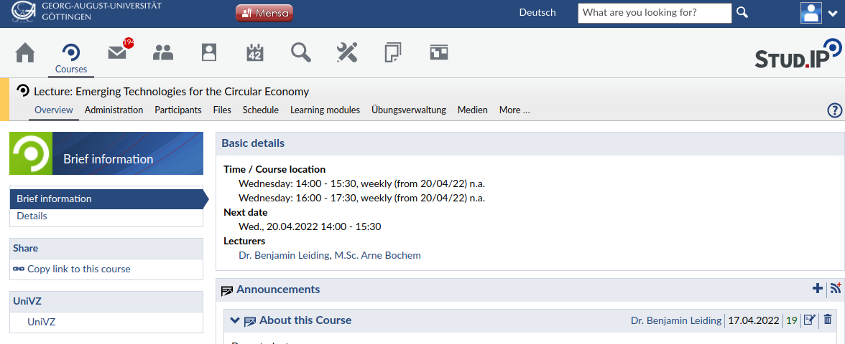
Multiple-Choice Exercises – Göttingen
Step-1: Navigate to StudIP, select "Lernmodule/Learning modules"

Slide 23
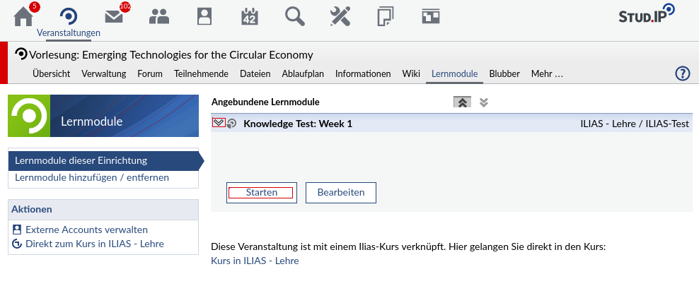
Multiple-Choice Exercises – Göttingen
Step-2: Use the dropdown arrow to select an available Test, and click on "Starten". This will take you to the ILIAS Page

Slide 24
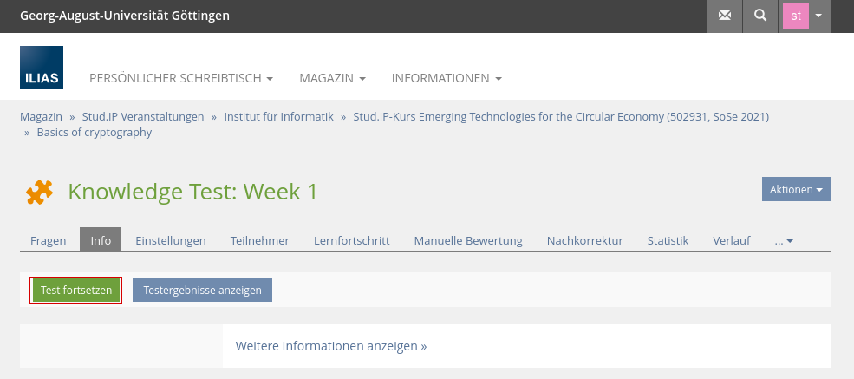
Multiple-Choice Exercises – Göttingen
Step-3: On ILIAS, to attempt the test, click on "Test Fortsetzen"

Slide 25
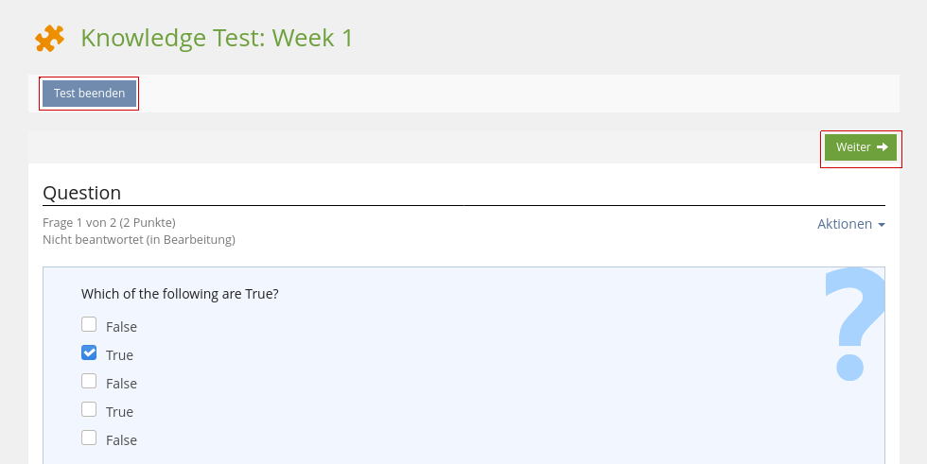
Multiple-Choice Exercises – Göttingen
Step-4: After answering a question, click on "Weiter" for the next question, and on "Test beenden" after you answer all questions

Slide 26
Multiple-Choice Exercises – Clausthal
Every student enrolled in this course is required to take the Knowledge quiz in first two weeks of the course.
The first knowledge test will be available on Moodle from Wednesday, 20 April 2022, 5:00 PM until 27 April 2022 01:59 PM
The second knowledge test will be available on Moodle from Wednesday, 27 April 2022, 5:00 PM until 04 May 2022 01:59 PM
Goal of the test:
To check the knowledge level of the student that is relevant to this course of study.
Preparation:
A review of basic concepts of Cryptography and Circular Economy is recommended for Week 1 and Week 2 respectively
Knowledge quiz for Week 1 only tests your existing knowledge.
Test structure:
Total 25 multiple choice questions → no time limit.
Each question can fetch a maximum of 1 point
IMPORTANT : Incorrect choices will yield in negative points. An incorrect choice in a question will take away just as many points as a correct choice is awarded.
Each test is evaluated on a grade scale of 10.
The result of your test will be available after the quiz is closed.

Slide 27
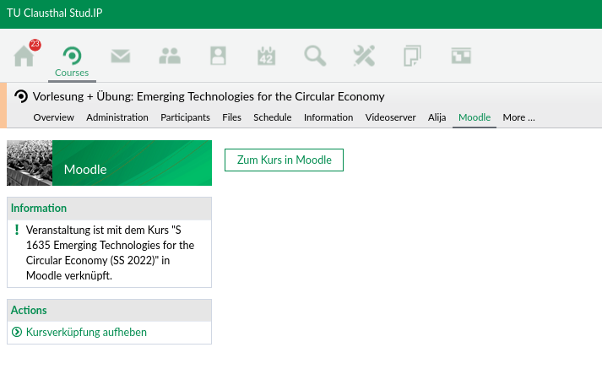
Multiple-Choice Exercises – Clausthal
Step-1: Navigate to Moodle on your studip, select "Zum Kurs in Moodle"

Slide 28
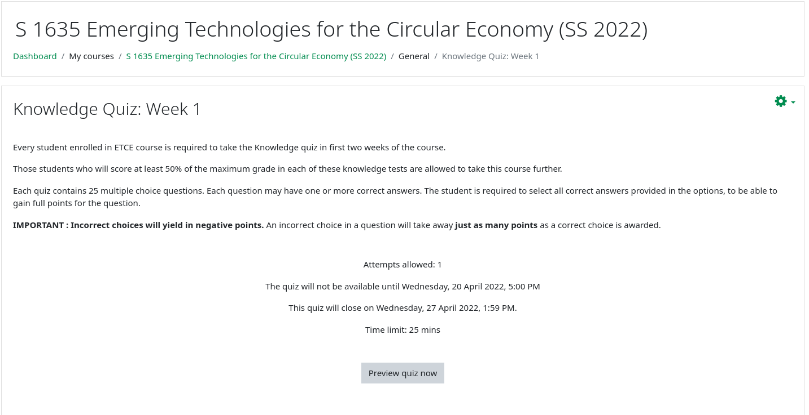
Multiple-Choice Exercises – Clausthal
Step-2 : Select "Knowledge Quiz - Week 1"

Slide 29
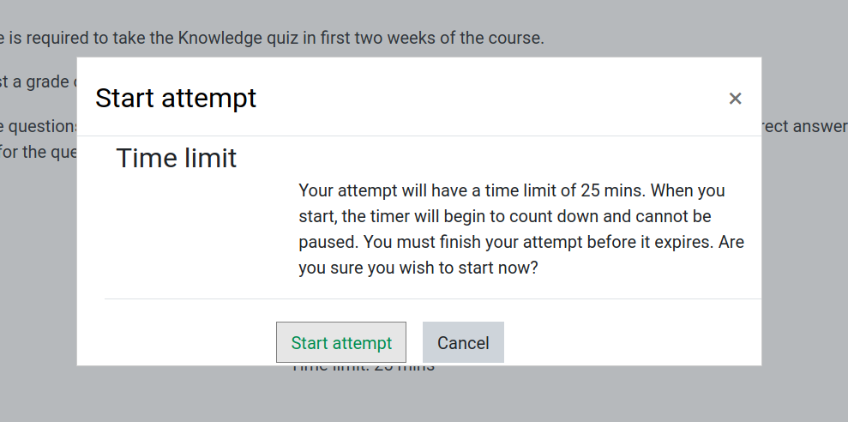
Multiple-Choice Exercises – Clausthal
Step-3 : Start your test if you are ready

Slide 30
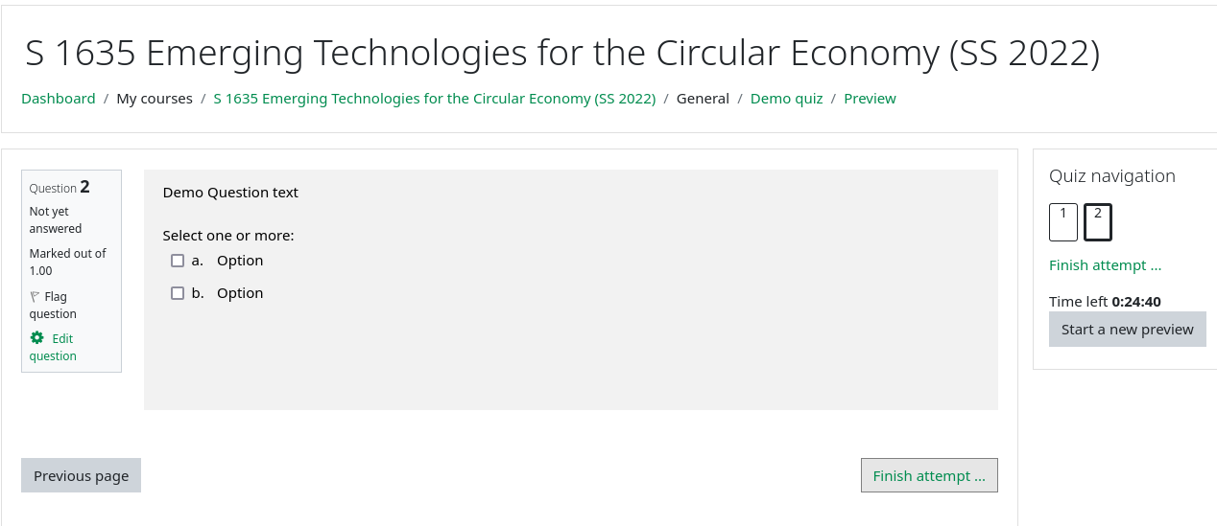
Multiple-Choice Exercises – Clausthal
Step-4 :
A. Sequence of questions
B. Timer running for the test
C. Navigate to next question/Finish attampt
D. Navigate to previous question
A
B
D
C

Slide 31
Examination
Prerequisite for admission to the final exam (all criteria have to be fulfilled):
Submit all exercises
Final exam:
No Specific date yet → waiting for the announcement of the examination period in Clausthal
Either written exam (120min) or oral examination (20min)
Online vs. lecture room examination → depends on the pandemic and the number of students

Slide 32
Self-Study Star
Slides with the self-study star indicate optional/additional study material that is not mandatory but could be helpful or interesting
Self-Study Star →

Slide 33
Literature
This course is not based on a single book and you do not need to buy a book to pass the exam.
Donella H. Meadows, Jorgen Randers, and Dennis L. Meadows. The Limits to Growth (1972).
Donella H. Meadows, Jorgen Randers, and Dennis L. Meadows. Limits To Growth: The 30-Year Update (2004).
Baccini et al. Metabolism of the Anthroposphere: Analysis, Evaluation, Design (2012).
Walter R. Stahel. The Circular Economy: A User's Guide (2019).
XR. This is not a Drill (2019)
W. Brian Arthur. The Nature of Technology: What It Is and How it Evolves (2011).
David Wallace-Wells. The Uninhabitable Earth, Annotated Edition (2017).

Slide 34
Literature
(German) Stefan Rahmstorf, Hans Joachim Schellnhuber. Der Klimawandel (2019).
David Archer, Stefan Rahmstorf. The Climate Crisis (2010).
Gabrielle Walker, David King. The Hot Topic: How to Tackle Global Warming and Still Keep the Lights on (2008).

Slide 35
Literature
Satoshi Nakamoto. Bitcoin: A Peer-to-Peer Electronic Cash System (2008) – (Link).
Gavin Wood. Ethereum: A Secure Decentralized Generalised Transaction Ledger (2014) – (Link).
Andreas Schütz und Tobias Fertig. Blockchain für Entwickler: Grundlagen, Programmierung, Anwendung (2019).
M.A. Khan, M.T. Quasim, F. Algarni, A. Alharthi. Decentralised Internet of Things (2020).
Dimitrios Serpanos und Marilyn Claire Wolf. Internet-of-Things (IoT) Systems Architectures, Algorithms, Methodologies (2018).
Perry Lea. Internet of Things for Architects: Architecting IoT solutions by implementing sensors, communication infrastructure, edge computing, analytics, and security (2018).
Dan Boneh, Amit Sahai und Brent Waters. Functional Encryption: Definitions and Challenges (2010).

Slide 36
Further Resources
Climate University – Teaching and learning for a sustainable future – Link
Circular Societies (German) – Link
Server Infrastructure for a Global Rebellion – Link
Podcasts:
Drilled (Link)
How to Save a Planet (Link)
1,5 Grad – der Klima-Podcast mit Luisa Neubauer (German) (Link)

Slide 37
Questions?

