Slide 1
The Limits to Growth: Sustainability and the Circular Economy
Lecture 11 – Complex Societies and Technologies
Prof. Dr. Benjamin Leiding
M.Sc. Anant Sujatanagarjuna
M.Sc. Chintan Patel

Slide 2
License
This work is licensed under a Creative Commons Attribution-ShareAlike 4.0 International License. To view a copy of this license, please refer to https://creativecommons.org/licenses/by-sa/4.0/ .
Updated versions of these slides will be available in our Github repository.

Slide 3
News/Updates

Slide 4

Course Evaluation
Link: Click Me

Slide 5
Introduction

Slide 6
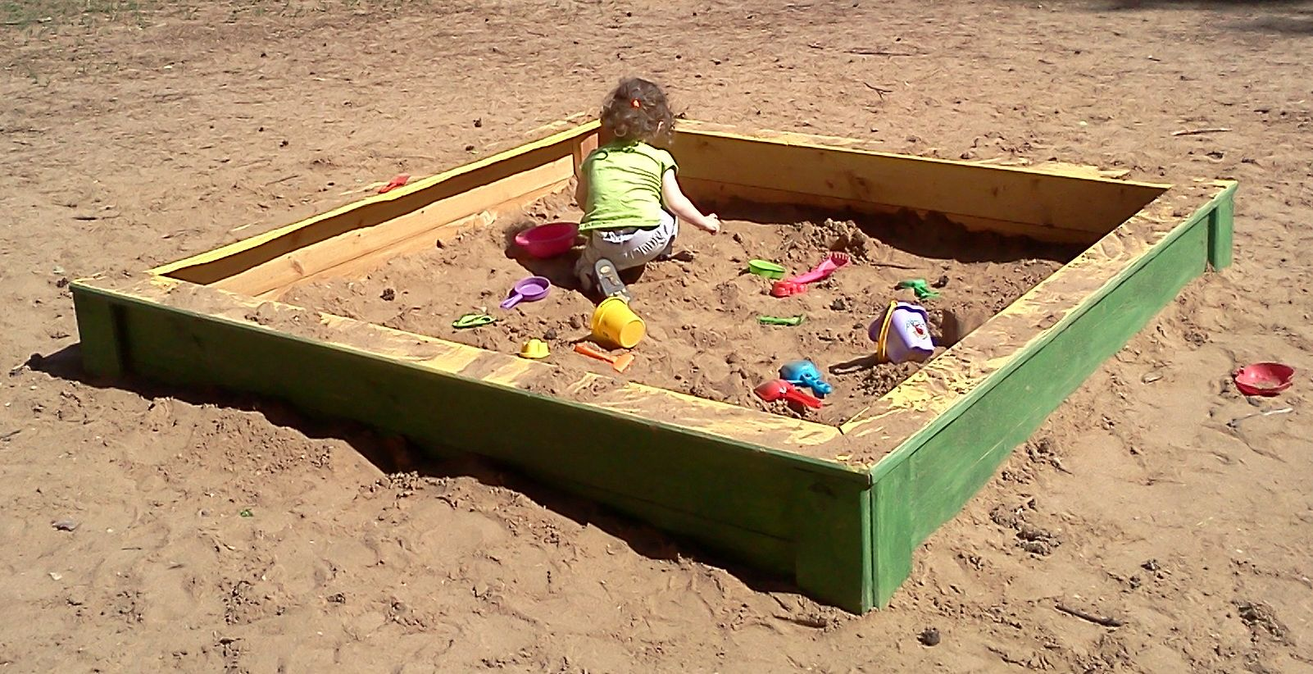
Introduction
Finite Systems – Sandbox / Playground
Al Silonov – https://commons.wikimedia.org/wiki/File:Sandbox-2013.jpg – CC BY-SA 4.0.

Slide 7
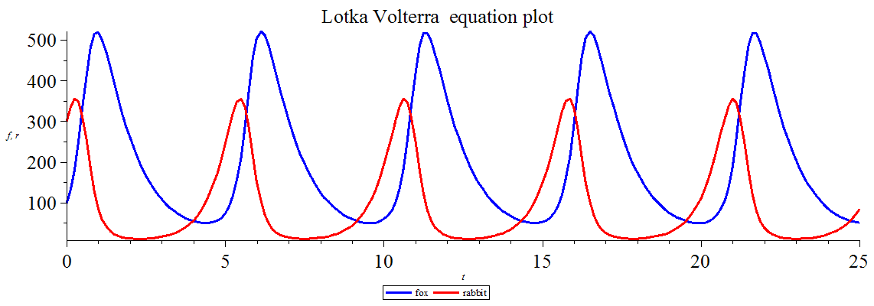
Introduction
Lotka–Volterra Equations (Predator–Prey Equations)
Gisling – https://commons.wikimedia.org/wiki/File:Lotka_Volterra_equation_Maple_plot.png – CC BY-SA 3.0.

Slide 8
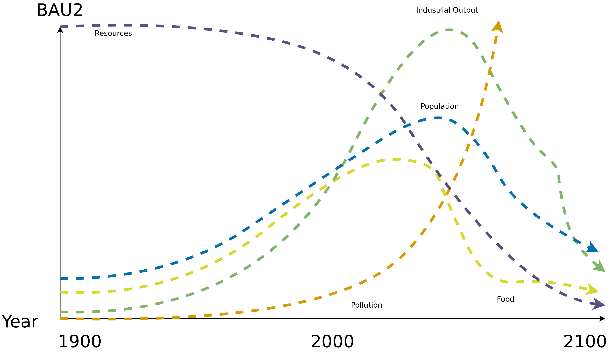
Introduction
World3 Standard Run – Business-as-Usual2 (BAU2)
→ Collapse due to pollution (climate change equivalent)
Image recreated from: Gaya Herrington (2020) – Update to limits to growth: Comparing the World3 model with empirical data – Link

Slide 9
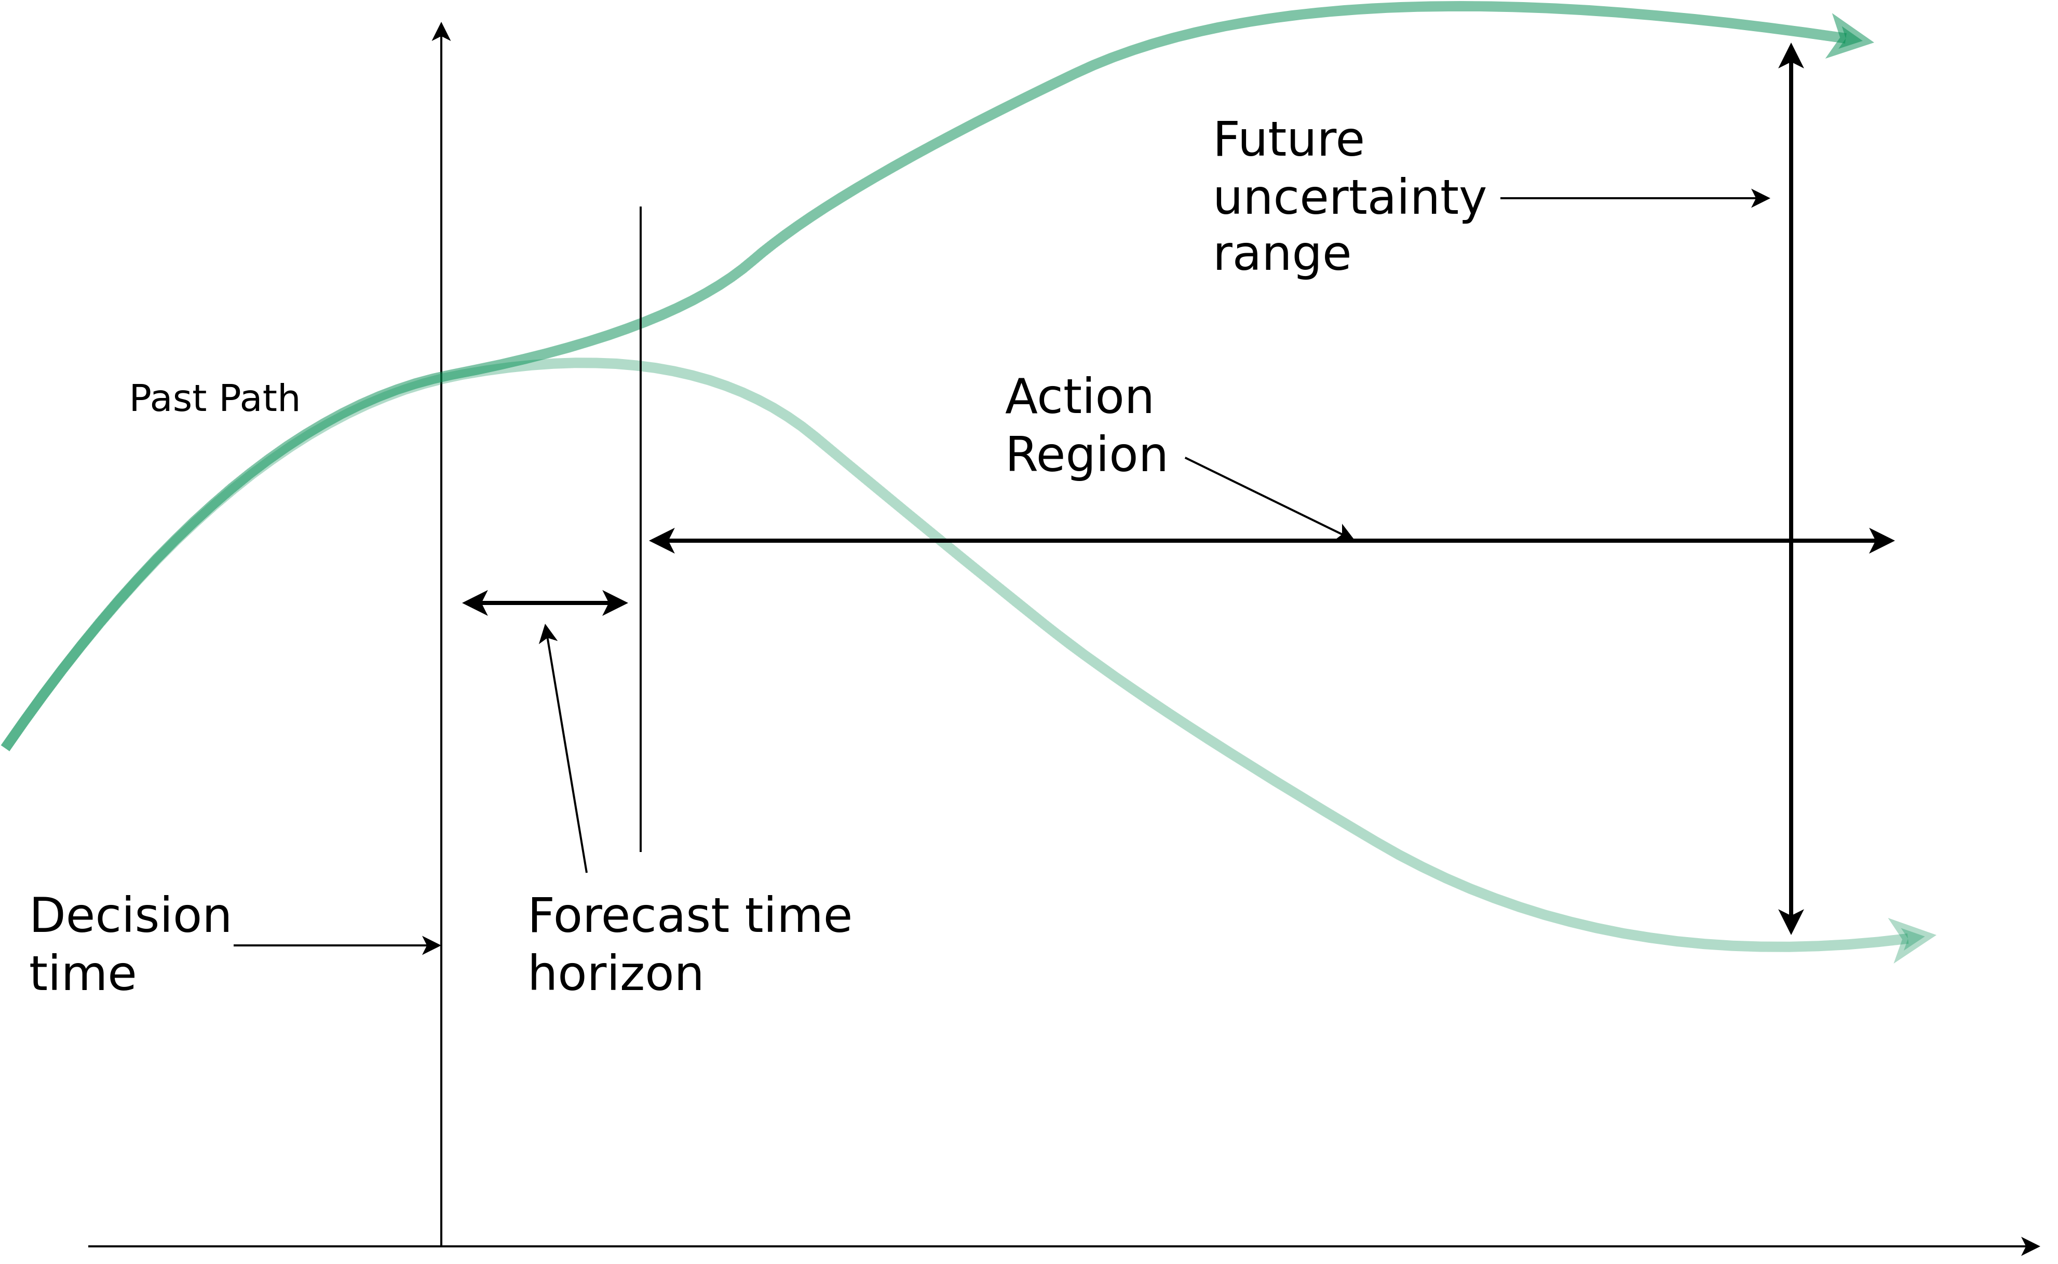
Introduction
Forrester’s Dilemma
“One can forecast future conditions in the region where action is not effective, and one can have influence in the region where forecasting is not reliable.” – Forrester, 2007
Image recreated from: Brian Hayes (2012) – Computation and the Human Condition (Harvard SEAS) – Link

Slide 10
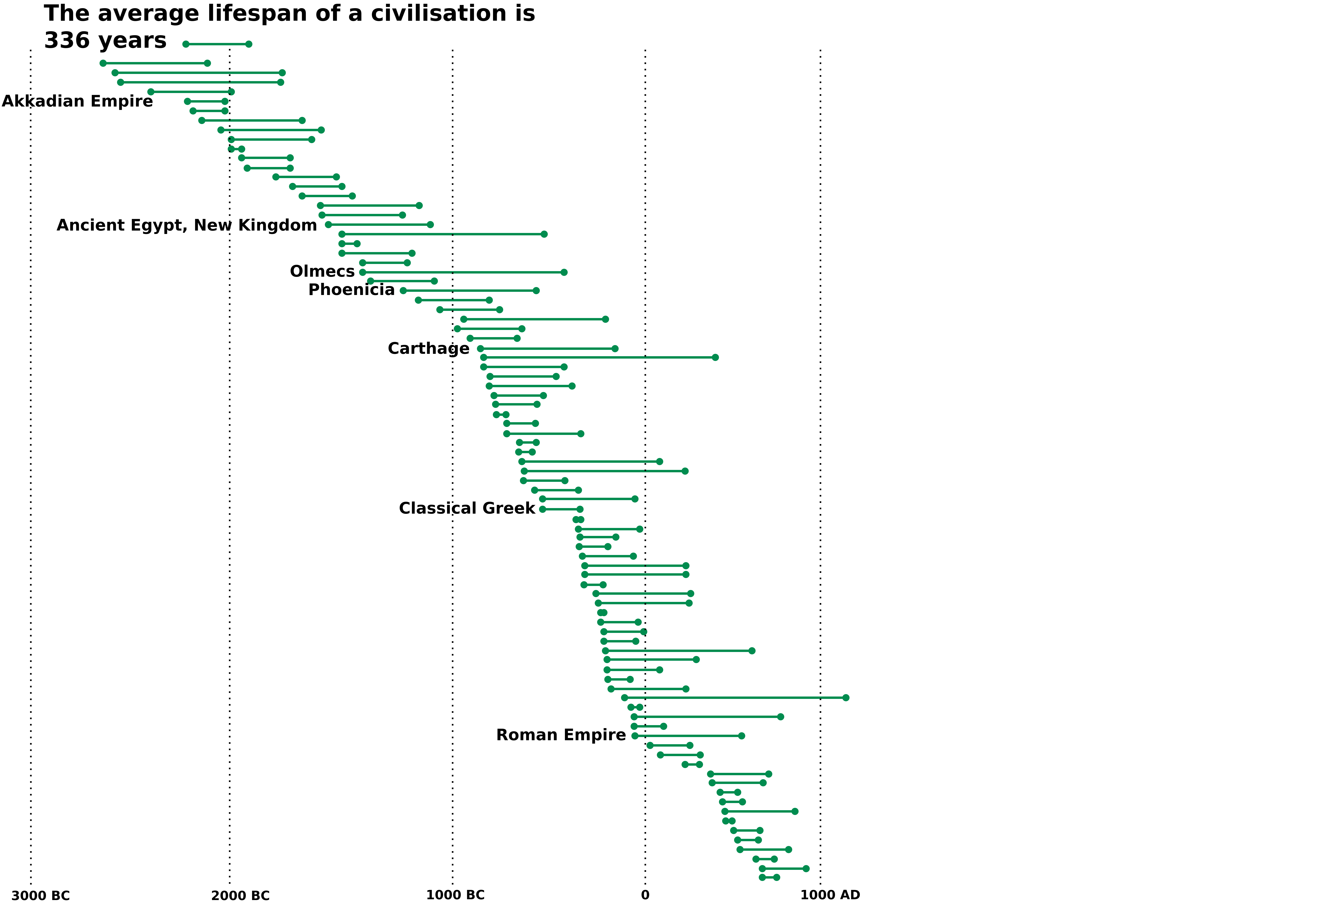
Introduction
Ancient Civilizations
Image recreated from BBC (2019) — Link

Slide 11
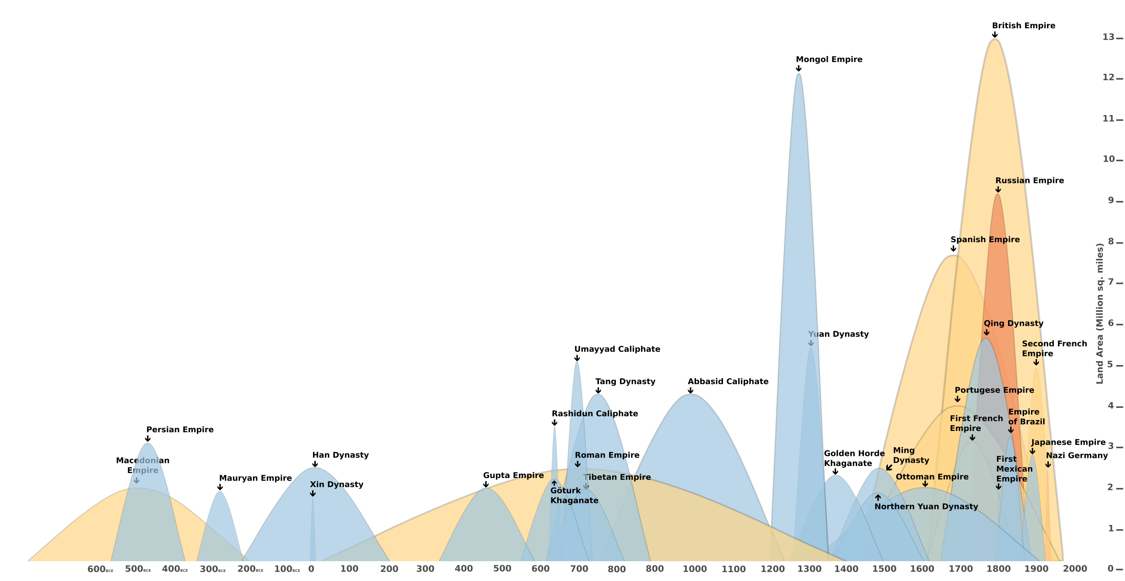
Age of Empires
How do History’s empires compare?
Empires don’t grow and collapse at a steady rate; they grow in hops and jumps and frequently collapse all at once (there’s often blood involved). This chart shows peak size, start and end dates, and symbolic rise and decline.
Image recreated from Brian Hay From J. Schwochow’s ‘The World Explained in 264 Infographics’ (2021)

Slide 12
Task 1 – what is Collapse gonna Look Like?
(20min)

Slide 13
Catabolic Collapse

Slide 14
Catabolic Collapse
Collapse
“A society has collapsed when it displays a rapid, significant loss of an established level of sociopolitical complexity”
Joseph Tainter (1988) – The Collapse of Complex Societies. Cambridge University Press.

Slide 15
Catabolic Collapse
Definition
“Relationships among resources, capital, waste, and production form the basis for an
ecological model of collapse in which production fails to meet maintenance
requirements for existing capital. Societies facing such crises after having depleted
essential resources risk catabolic collapse, a self-reinforcing cycle of contraction
converting most capital to waste.”
John Michael Greer (2015) – How Civilizations Fall: A Theory of Catabolic Collapse

Slide 16
Catabolic Collapse
Theory – Resources and Capital
Resources (R)
  Naturally occurring exploitable factors in the environment
  Not (yet) extracted/incorporated into the society’s flows of energy and material
  E.g., not yet mined minerals, soil fertility, human resources (not yet working), etc.
Capital
  All factors from whatever source that have been incorporated into the society’s flows of energy and material but are capable of further use.
  E.g., food, tools, buildings, human capital (labourers), etc.
John Michael Greer (2015) – How Civilizations Fall: A Theory of Catabolic Collapse

Slide 17
Catabolic Collapse
Theory – Waste and Production
Waste (W)
  Energy and material that have been incorporated into society but are now exploited to the point that they are incapable of further use.
  Also → pollution
Production (P) is the process by which existing capital and resources are combined to create new capital and waste.
John Michael Greer (2015) – How Civilizations Fall: A Theory of Catabolic Collapse

Slide 18
Catabolic Collapse
Theory – Production vs. Maintenance
C(p) = M(p)
  C(p) is new capital produced
  M(p) is maintenance of production
C(p) = M(p) = W(p) + W(c) == steady state
W(p) is existing capital converted to waste in the production of new capital
W(c) is existing capital converted to waste outside of production
C(p) > M(p) == expansion
C(p) < M(p) == contraction
John Michael Greer (2015) – How Civilizations Fall: A Theory of Catabolic Collapse

Slide 19
Catabolic Collapse
Theory – Production vs. Maintenance
C(p) = M(p)
  C(p) is new capital produced
  M(p) is maintenance of production
C(p) = M(p) = W(p) + W(c) == steady state
  W(p) is existing capital converted to waste in the production of new capital
  W(c) is existing capital converted to waste outside of production
C(p) > M(p) == expansion
C(p) < M(p) == contraction
John Michael Greer (2015) – How Civilizations Fall: A Theory of Catabolic Collapse

Slide 20
Catabolic Collapse
Theory – Production vs. Maintenance
C(p) = M(p)
  C(p) is new capital produced
  M(p) is maintenance of production
C(p) = M(p) = W(p) + W(c) == steady state
  W(p) is existing capital converted to waste in the production of new capital
  W(c) is existing capital converted to waste outside of production
C(p) > M(p) == expansion
C(p) < M(p) == contraction
John Michael Greer (2015) – How Civilizations Fall: A Theory of Catabolic Collapse

Slide 21
Catabolic Collapse
Theory – Production vs. Maintenance
C(p) = M(p)
  C(p) is new capital produced
  M(p) is maintenance of production
C(p) = M(p) = W(p) + W(c) == steady state
  W(p) is existing capital converted to waste in the production of new capital
  W(c) is existing capital converted to waste outside of production
C(p) > M(p) == expansion
C(p) < M(p) == contraction
John Michael Greer (2015) – How Civilizations Fall: A Theory of Catabolic Collapse

Slide 22
Catabolic Collapse
Theory – Replenishment vs. Depletion
r(R) → replenishment rate
d(R) → depletion rate
d(R) / r(R) > 1 → resources become depleted
Liebig’s law of the minimum:
Essential resource with the highest value for d(R)/r(R) may be used as a working value of d(R)/r(R) for resources as a whole
John Michael Greer (2015) – How Civilizations Fall: A Theory of Catabolic Collapse

Slide 23
Catabolic Collapse
Theory – Replenishment vs. Depletion
r(R) → replenishment rate
d(R) → depletion rate
d(R) / r(R) > 1 → resources become depleted
Liebig’s law of the minimum:
  Essential resource with the highest value for d(R)/r(R) may be used as a working value of d(R)/r(R) for resources as a whole
John Michael Greer (2015) – How Civilizations Fall: A Theory of Catabolic Collapse

Slide 24
Catabolic Collapse
Theory
C(p) < M(p) → contraction, but also maintenance crisis
d(R) / r(R) > 1 → contraction, but also depletion crisis
John Michael Greer (2015) – How Civilizations Fall: A Theory of Catabolic Collapse

Slide 25
Catabolic Collapse
Theory – Catabolic Cycle
“A self-reinforcing process in which C(p) stays below M(p) while
both decline. Catabolic cycles may occur in maintenance crises if the gap between
C(p) and M(p) is large enough, but tend to be self-limiting in such cases. In
depletion crises, by contrast, catabolic cycles can proceed to catabolic collapse, in which C(p) approaches zero and most of a society’s capital is converted to waste.”
John Michael Greer (2015) – How Civilizations Fall: A Theory of Catabolic Collapse

Slide 26
Collapse
Causes of Collapse
Resource scarcity
Large-scale catastrophic events (e.g., pandemics)
Inadequate institutional responsiveness (e.g., insufficient speed or adaptability)
Inter-societal conflict among complex polities (e.g., interstate warfare)
External incursions (e.g., raids by non-state or peripheral groups)
Governance failures and administrative mismanagement
Social fragmentation and dysfunction (e.g., intensified intra-familial conflict)
Cascading systemic failures (i.e., sequential, compounding disruptions)
Economic collapse or severe fiscal distress

Slide 27
Task 2 – Lessons Learned? (15 min)

Slide 28
Catabolic Collapse
Lessons Learned / Implications
“Technology is gonna safe us” vs. maintenance cost/crisis
Minimize use of resources
  Sufficiency
  Consume less
Less complex societies → The earlier we adapt, the better
What else?

