Slide 1
The Limits to Growth: Sustainability and the Circular Economy
Lecture 12: Beyond the Circular Economy
Prof. Dr. Benjamin Leiding
M.Sc. Anant Sujatanagarjuna
M.Sc. Chintan Patel

Slide 2
License
This work is licensed under a Creative Commons Attribution-ShareAlike 4.0 International License. To view a copy of this license, please refer to https://creativecommons.org/licenses/by-sa/4.0/ .
Updated versions of these slides will be available in our Github repository.

Slide 3
News/Updates

Slide 4

Course Evaluation
Link: Click Me

Slide 5
Introduction

Slide 6
Introduction
CE Recap
Goals of the CE:
  Maintain natural resources and minimize the discharge of substances that are harmful to health and nature
  Ecological modernization of the economy to increase resource efficiency, e.g., by technical innovation and digital solutions
  Products/services designed and constructed in such a way, that they can be returned to the economic and material flows at any time with little financial and energetic effort
  Increase/maximize utilization of resources, e.g., Performance Economy
Partially based on: F. Hofmann, J. Zwiers (2018) – Circular Society – Eine pluralistische und emanzipatorische Alternative zur Circular Economy? – Link.
.

Slide 7
Introduction
CE Criticism
Replace the LE with circularly oriented forms of consumption and production
CE focus mostly on earned value management (“Wertschöpfungsmanagement”), product-service systems, product/business model innovations within existing power asymmetries
Decouple economic growth and consumption of natural resources
→ But why do we need neverending economic growth and why is it good to consume as many goods and services as possible?
Alternatives:
Sufficiency strategies and lifestyle changes
Question the prevailing entrepreneurial orientation towards the shareholder concept
Deconstruction of existing power and hegemonic relations
Partially based on: F. Hofmann, J. Zwiers (2018) – Circular Society – Eine pluralistische und emanzipatorische Alternative zur Circular Economy? – Link.
.

Slide 8
Introduction
CE Criticism
Replace the LE with circularly oriented forms of consumption and production
CE focus mostly on earned value management (“Wertschöpfungsmanagement”), product-service systems, product/business model innovations within existing power asymmetries
Decouple economic growth and consumption of natural resources
→ But why do we need never ending economic growth and why is it good to consume as many goods and services as possible?
Alternatives:
Sufficiency strategies and lifestyle changes
Question the prevailing entrepreneurial orientation towards the shareholder concept
Deconstruction of existing power and hegemonic relations
Partially based on: F. Hofmann, J. Zwiers (2018) – Circular Society – Eine pluralistische und emanzipatorische Alternative zur Circular Economy? – Link.
.

Slide 9
Introduction
CE Criticism
Replace the LE with circularly oriented forms of consumption and production
CE focus mostly on earned value management (“Wertschöpfungsmanagement”), product-service systems, product/business model innovations within existing power asymmetries
Decouple economic growth and consumption of natural resources
→ But why do we need never ending economic growth and why is it good to consume as many goods and services as possible?
Alternatives:
  Sufficiency strategies and lifestyle changes
  Question the prevailing entrepreneurial orientation towards the shareholder concept
  Deconstruction of existing power and hegemonic relations
Partially based on: F. Hofmann, J. Zwiers (2018) – Circular Society – Eine pluralistische und emanzipatorische Alternative zur Circular Economy? – Link.
.

Slide 10
Eco-sufficiency

Slide 11
Eco-Sufficiency
Eco-Efficiency – Definition
Eco-Efficency → Minimise the material input required to achieve a certain economic result, i.e. to improve the ratio between the use of resources and the production of goods.
Manfred Folkers, Niko Paech (2020) – All you need is less

Slide 12
Eco-Sufficiency
Eco-Efficiency – Definition/Example
Example: A car that consumes 3 liter per 100km is 2x more ecologically efficient than a car that consumes 6 liter.
Eco-Efficency → Minimise the material input required to achieve a certain economic result, i.e. to improve the ratio between the use of resources and the production of goods.
Manfred Folkers, Niko Paech (2020) – All you need is less

Slide 13
Eco-Sufficiency
Eco-Efficiency – Definition/Example
Example: A car that consumes 3 liter per 100km is 2x more ecologically efficient than a car that consumes 6 liter.
Eco-Efficency → Minimise the material input required to achieve a certain economic result, i.e. to improve the ratio between the use of resources and the production of goods.
Manfred Folkers, Niko Paech (2020) – All you need is less

Slide 14
Eco-Sufficiency
Eco-Consistency – Definition
Eco-Consistency → Ecological consistency is based on the damage intensity and environmental impact of the resources used. Instead of reducing their quantity, their nature or the product design should be optimised so that no emissions or waste are produced, regardless of the level of consumption → i.e., Circular Economy
Manfred Folkers, Niko Paech (2020) – All you need is less

Slide 15
Eco-Sufficiency
Eco-Consistency – Definition/Example
Example: A battery electric vehicle (BEV) that runs on green energy (e.g., solar/wind/etc.)
Eco-Consistency → Ecological consistency is based on the damage intensity and environmental impact of the resources used. Instead of reducing their quantity, their nature or the product design should be optimised so that no emissions or waste are produced, regardless of the level of consumption → i.e., Circular Economy
Manfred Folkers, Niko Paech (2020) – All you need is less

Slide 16
Eco-Sufficiency
Eco-Consistency – Definition/Example
Example: A battery electric vehicle (BEV) that runs on green energy (e.g., solar/wind/etc.)
Eco-Consistency → Ecological consistency is based on the damage intensity and environmental impact of the resources used. Instead of reducing their quantity, their nature or the product design should be optimised so that no emissions or waste are produced, regardless of the level of consumption → i.e., Circular Economy
Manfred Folkers, Niko Paech (2020) – All you need is less

Slide 17
Eco-Sufficiency
Efficiency + Consistency – Example
Example:
  First, minimize the fuel/energy consumption of a car
  Second, operate the car with carbon-neutral fuel/energy
Manfred Folkers, Niko Paech (2020) – All you need is less

Slide 18
Eco-Sufficiency
Definition(s)

Slide 19
Eco-Sufficiency
Definition(s)
“Seeking enough when more is possible is both intuitive and rational - personally, organizationally and ecologically. And under global ecological constraint, it is ethical.” - Thomas Princen
Thomas Princen (2005) – The Logic of Sufficiency

Slide 20
Eco-Sufficiency
Definition(s)
“Seeking enough when more is possible is both intuitive and rational - personally, organizationally and ecologically. And under global ecological constraint, it is ethical.” - Thomas Princen
“A set of policy measures and daily practices that avoid the demand for energy, materials, land, water, and other natural resources while providing wellbeing for all within the planetary boundaries.” - IPCC
Thomas Princen (2005) – The Logic of Sufficiency
IPCC AR6 Synthesis Report: Climate Change 2023 – https://www.ipcc.ch/report/sixth-assessment-report-cycle/

Slide 21
Eco-Sufficiency
Definition(s)
“Seeking enough when more is possible is both intuitive and rational - personally, organizationally and ecologically. And under global ecological constraint, it is ethical.” - Thomas Princen
“A set of policy measures and daily practices that avoid the demand for energy, materials, land, water, and other natural resources while providing wellbeing for all within the planetary boundaries.” - IPCC
Sufficiency → All you need is less
Thomas Princen (2005) – The Logic of Sufficiency
IPCC AR6 Synthesis Report: Climate Change 2023 – https://www.ipcc.ch/report/sixth-assessment-report-cycle/

Slide 22
Eco-Sufficiency
Example – New Apartment
Scenario:
  Size: 120m²
  Heat demand: 130 kWh pro m² and year
Energy-)efficiency: Well-insulated houses and highly-efficient heating systems require less energy to heat the apartment, i.e., minimize the heat demand as much as possible
Consistency: Minimize ecological damage by choosing the most sustainable way of heating
Sufficiency: Live in a smaller apartment (or utilize less space per person)
Manfred Folkers, Niko Paech (2020) – All you need is less

Slide 23
Eco-Sufficiency
Example – New Apartment
Scenario:
  Size: 120m²
  Heat demand: 130 kWh pro m² and year
(Energy-)efficiency: Well-insulated houses and highly-efficient heating systems require less energy to heat the apartment, i.e., minimize the heat demand as much as possible
Consistency: Minimize ecological damage by choosing the most sustainable way of heating
Sufficiency: Live in a smaller apartment (or utilize less space per person)
Manfred Folkers, Niko Paech (2020) – All you need is less

Slide 24
Eco-Sufficiency
Example – New Apartment
Scenario:
  Size: 120m²
  Heat demand: 130 kWh pro m² and year
(Energy-)efficiency: Well-insulated houses and highly-efficient heating systems require less energy to heat the apartment, i.e., minimize the heat demand as much as possible
Consistency: Minimize ecological damage by choosing the most sustainable way of heating
Sufficiency: Live in a smaller apartment (or utilize less space per person)
Manfred Folkers, Niko Paech (2020) – All you need is less

Slide 25
Eco-Sufficiency
Example – New Apartment
Scenario:
  Size: 120m²
  Heat demand: 130 kWh pro m² and year
(Energy-)efficiency: Well-insulated houses and highly-efficient heating systems require less energy to heat the apartment, i.e., minimize the heat demand as much as possible
Consistency: Minimize ecological damage by choosing the most sustainable way of heating
Sufficiency: Live in a smaller apartment (or utilize less space per person)
Manfred Folkers, Niko Paech (2020) – All you need is less

Slide 26
Eco-Sufficiency
Example – New Apartment
Problem(s):
  Efficiency and consistency allow us to either:
    a) continue living a nice life using less resources
    b) Live even more comfortably using the same amount of resources
  They promise to maintain your individual freedom (of choices) by fixing ecological challenges/downsides using technological/political action
    Also personal responsibility by buying yourself out of this mess → just buy high-prices eco-friendly products and everything will be fine. No need to consume less.
Manfred Folkers, Niko Paech (2020) – All you need is less

Slide 27
Eco-Sufficiency
Example – New Apartment
Problem(s):
  Efficiency and consistency allow us to either:
    a) continue living a nice life using less resources
    b) Live even more comfortably using the same amount of resources
  They promise to maintain your individual freedom (of choices) by fixing ecological challenges/downsides using technological/political action
    Also personal responsibility by buying yourself out of this mess → just buy high-prices eco-friendly products and everything will be fine. No need to consume less.
Manfred Folkers, Niko Paech (2020) – All you need is less

Slide 28
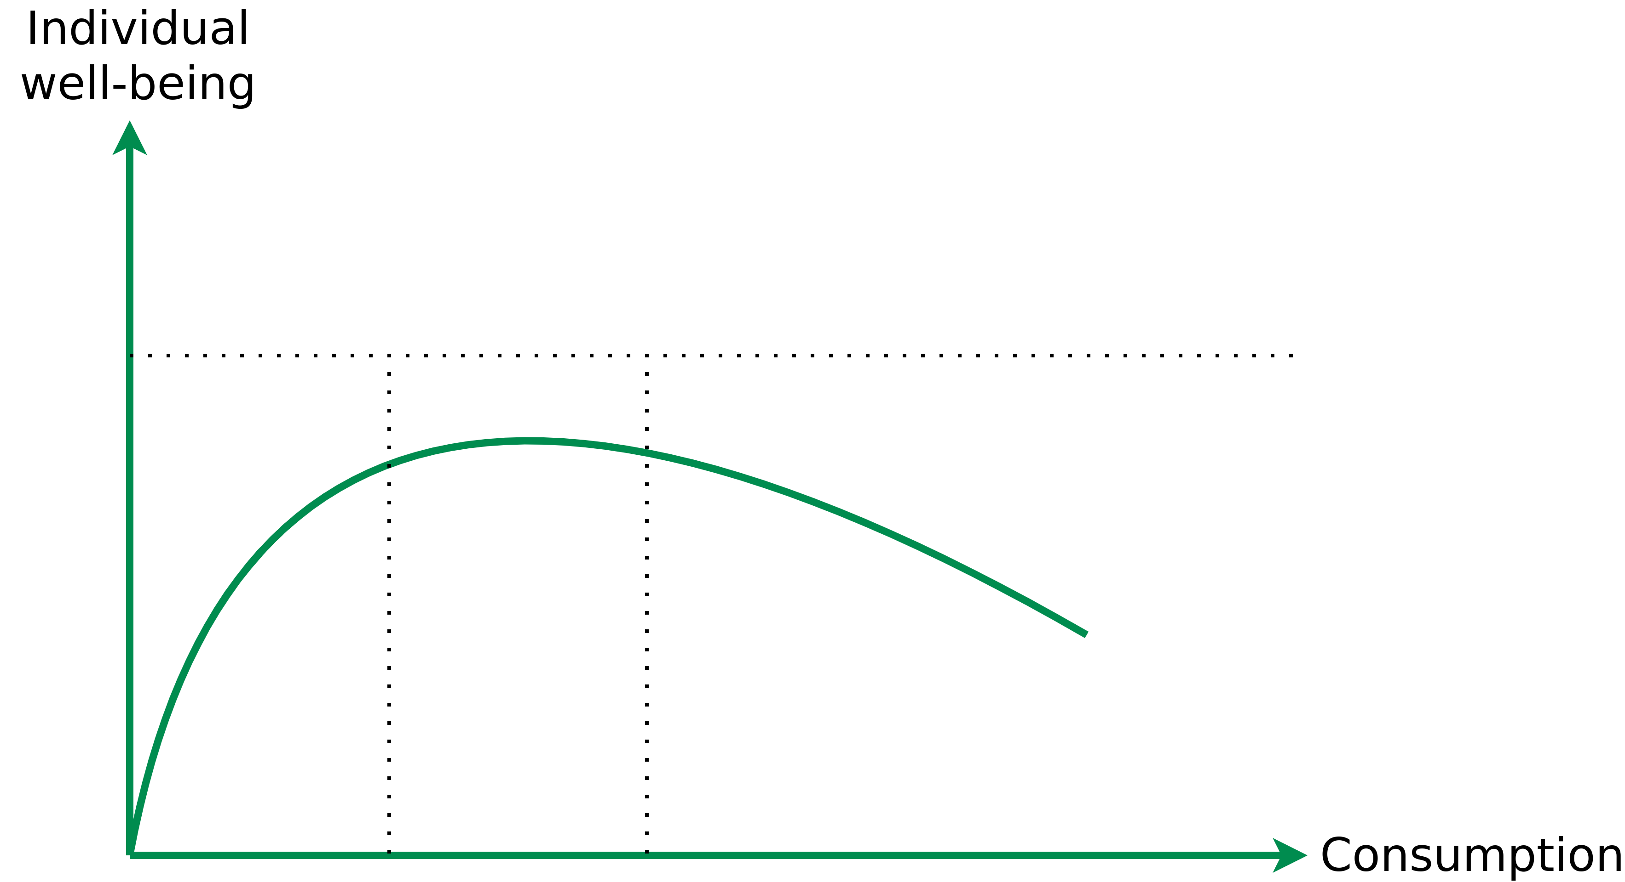
Eco-Sufficiency
Sufficiency vs. Overconsumption
Shortage; global south; emerging countries
Saturation in consumption-oriented society
Overstimulation, lack of time, stress
<”Consumer congestion”>
Image recreated from „Manfred Folkers, Niko Paech (2020) – All you need is less“

Slide 29
Detour

Slide 30
Detour
Sustainability
Sustainability → Consume less
Consume less → Less money spend, i.e. lower living costs?
Lower living costs → less work hours required pay costs, e.g., 20h work week?
Technological advances reducing workload even further?

Slide 31
Detour
Sustainability
Sustainability → Consume less
Consume less → Less money spend, i.e. lower living costs?
Lower living costs → Less work hours required cover costs, e.g., 20h work week?
Technological advances reducing workload even further?

Slide 32
Detour
Sustainability
Sustainability → Consume less
Consume less → Less money spend, i.e. lower living costs?
Lower living costs → Less work hours required to cover costs, e.g., 20h work week?
Technological advances reducing workload even further?

Slide 33
Detour
15h Work Week
John Maynard Keynes predicted a 15h work week in his 1930 essay “Economic Possibilities for our Grandchildren”

Slide 34
Detour
Why am I working 40+h a week?
Lively debates pertaining to Keynes prediction – especially among economists.
Main problem: Keynes did not account for the massive increase in consumerism → Majority of people chooses more toys and pleasure over less work hours
↔
Contradicts our sustainability paradigm (consume less).

Slide 35
Detour
Why am I working 40+h a week?
Lively debates pertaining to Keynes prediction – especially among economists.
Main problem: Keynes did not account for the massive increase in consumerism → Majority of people chooses more toys and pleasure over less work hours
↔
Contradicts our sustainability paradigm (consume less).

Slide 36
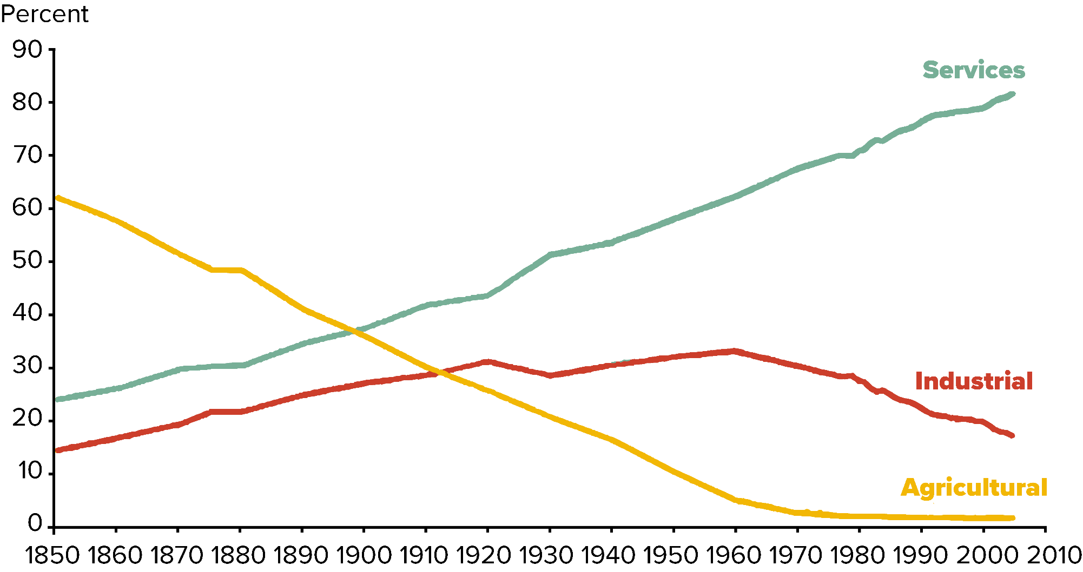
Detour
Shift in Labor Force 1850 – 2010
Image recreated from: International Historical Statistics (2013): “Market Services Productivity Across Europe and the U.S.” by Robert Inklaar, Marcel P. Timmer and Bart van Ark, Economic Policy, Vol. 23, No. 53, 2008, pp. 139-94; authors calculations.

Slide 37
Detour
Bullshit Job – Essay and Book by David Graeber
Essay: On the Phenomenon of Bullshit Jobs: A Work Rant (2013) – Link
Book: Bullshit Jobs: A Theory (2018)

Slide 38
Detour
Bullshit Job – Definition
„Form of paid employment that is so completely pointless, unnecessary, or pernicious that even the employee cannot justify its existence even though, as part of the conditions of employment, the employee feels obliged to pretend that this is not the case.”
D. Graeber (2013) – On the Phenomenon of Bullshit Jobs – Essay – Link
D. Graeber (2018) – Bullshit Jobs: A Theory

Slide 39
Detour
Bullshit Job – Definition
„Form of paid employment that is so completely pointless, unnecessary, or pernicious that even the employee cannot justify its existence even though, as part of the conditions of employment, the employee feels obliged to pretend that this is not the case.”
→ Inefficiencies in capitalism?
D. Graeber (2013) – On the Phenomenon of Bullshit Jobs – Essay – Link
D. Graeber (2018) – Bullshit Jobs: A Theory

Slide 40
Detour
Bullshit Jobs – Categories
D. Graeber (2013) – On the Phenomenon of Bullshit Jobs – Essay – Link
D. Graeber (2018) – Bullshit Jobs: A Theory

Slide 41
Detour
Bullshit Jobs – Categories
Flunkies: Serve to make their superiors feel important, e.g., receptionists, administrative assistants, door attendants, store greeters, makers of websites whose sites neglect ease of use and speed for looks
Goons: Act to harm or deceive others on behalf of their employer, e.g., lobbyists, corporate lawyers, telemarketers, public relations specialists, community managers;
Duct tapers: Temporarily fix problems that could be fixed permanently, e.g., programmers repairing bloated code, airline desk staff who calm passengers whose bags do not arrive;
Box tickers: Create the appearance that something useful is being done when it is not, e.g., survey administrators, in-house magazine journalists, corporate compliance officers, quality service managers;
Taskmasters: Create extra work for those who do not need it, e.g., middle management, leadership professionals.
D. Graeber (2013) – On the Phenomenon of Bullshit Jobs – Essay – Link
D. Graeber (2018) – Bullshit Jobs: A Theory

Slide 42
Detour
Bullshit Jobs – Categories
Flunkies: Serve to make their superiors feel important, e.g., receptionists, administrative assistants, door attendants, store greeters, makers of websites whose sites neglect ease of use and speed for looks
Goons: Act to harm or deceive others on behalf of their employer, e.g., lobbyists, corporate lawyers, telemarketers, public relations specialists, community managers
Duct tapers: Temporarily fix problems that could be fixed permanently, e.g., programmers repairing bloated code, airline desk staff who calm passengers whose bags do not arrive;
Box tickers: Create the appearance that something useful is being done when it is not, e.g., survey administrators, in-house magazine journalists, corporate compliance officers, quality service managers;
Taskmasters: Create extra work for those who do not need it, e.g., middle management, leadership professionals.
D. Graeber (2013) – On the Phenomenon of Bullshit Jobs – Essay – Link
D. Graeber (2018) – Bullshit Jobs: A Theory

Slide 43
Detour
Bullshit Jobs – Categories
Flunkies: Serve to make their superiors feel important, e.g., receptionists, administrative assistants, door attendants, store greeters, makers of websites whose sites neglect ease of use and speed for looks
Goons: Act to harm or deceive others on behalf of their employer, e.g., lobbyists, corporate lawyers, telemarketers, public relations specialists, community managers
Duct tapers: Temporarily fix problems that could be fixed permanently, e.g., programmers repairing bloated code, airline desk staff who calm passengers whose bags do not arrive
Box tickers: Create the appearance that something useful is being done when it is not, e.g., survey administrators, in-house magazine journalists, corporate compliance officers, quality service managers;
Taskmasters: Create extra work for those who do not need it, e.g., middle management, leadership professionals.
D. Graeber (2013) – On the Phenomenon of Bullshit Jobs – Essay – Link
D. Graeber (2018) – Bullshit Jobs: A Theory

Slide 44
Detour
Bullshit Jobs – Categories
Flunkies: Serve to make their superiors feel important, e.g., receptionists, administrative assistants, door attendants, store greeters, makers of websites whose sites neglect ease of use and speed for looks
Goons: Act to harm or deceive others on behalf of their employer, e.g., lobbyists, corporate lawyers, telemarketers, public relations specialists, community managers
Duct tapers: Temporarily fix problems that could be fixed permanently, e.g., programmers repairing bloated code, airline desk staff who calm passengers whose bags do not arrive
Box tickers: Create the appearance that something useful is being done when it is not, e.g., survey administrators, in-house magazine journalists, corporate compliance officers, quality service managers
Taskmasters: Create extra work for those who do not need it, e.g., middle management, leadership professionals.
D. Graeber (2013) – On the Phenomenon of Bullshit Jobs – Essay – Link
D. Graeber (2018) – Bullshit Jobs: A Theory

Slide 45
Detour
Bullshit Jobs – Categories
Flunkies: Serve to make their superiors feel important, e.g., receptionists, administrative assistants, door attendants, store greeters, makers of websites whose sites neglect ease of use and speed for looks
Goons: Act to harm or deceive others on behalf of their employer, e.g., lobbyists, corporate lawyers, telemarketers, public relations specialists, community managers
Duct tapers: Temporarily fix problems that could be fixed permanently, e.g., programmers repairing bloated code, airline desk staff who calm passengers whose bags do not arrive
Box tickers: Create the appearance that something useful is being done when it is not, e.g., survey administrators, in-house magazine journalists, corporate compliance officers, quality service managers
Taskmasters: Create extra work for those who do not need it, e.g., middle management, leadership professionals
D. Graeber (2013) – On the Phenomenon of Bullshit Jobs – Essay – Link
D. Graeber (2018) – Bullshit Jobs: A Theory

Slide 46
Detour
Bullshitization
Transition of a meaningful job into a bullshit job through corporatization,
marketization or managerialism.
D. Graeber (2018) – Bullshit Jobs: A Theory
D. Graeber (2018) – Are You in a BS Job? In Academe, You’re Hardly Alone (Chronicle of Higher Education) – Link

Slide 47
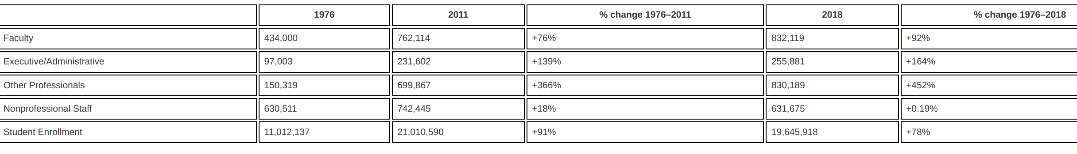
Detour
Changes in full-time staff size and student enrollment
(1976–2011 and 1976–2018)
Michael Delucchi, Richard B. Dadzie, Erik Dean & Xuan Pham (2021) What’s that smell? Bullshit jobs in higher education, Review of Social Economy, DOI: 10.1080/00346764.2021.1940255

Slide 48
Detour
15h Work Week
John Maynard Keynes predicted a 15h work week in his 1930 essay “Economic Possibilities for our Grandchildren”

Slide 49
Detour
Bullshit Jobs – Why?
Assumption → Capitalism does not allow for inefficiencies
Hypothesis → Maybe this is not capitalism and rather just "managerial feudalism"?
The pains of dull work as a justification for the ability to fulfill consumer desires
Fulfilling those desires → Reward for suffering through pointless work
Feudalism: „The dominant social system in medieval Europe, in which the nobility held lands from the Crown in exchange for military service, and vassals were in turn tenants of the nobles, while the peasants (villeins or serfs) were obliged to live on their lord's land and give him homage, labour, and a share of the produce, notionally in exchange for military protection.”
(Oxford Dictionary)
D. Graeber (2013) – On the Phenomenon of Bullshit Jobs – Essay – Link
D. Graeber (2018) – Bullshit Jobs: A Theory

Slide 50
Detour
Bullshit Jobs – Why?
Assumption → Capitalism does not allow for inefficiencies
Hypothesis → Maybe this is not capitalism and rather just "managerial feudalism"?
The pains of dull work as a justification for the ability to fulfill consumer desires
Fulfilling those desires → Reward for suffering through pointless work
Bullshit jobs also serve political ends, in which political parties are more concerned about having jobs than whether the jobs are fulfilling.
Also → Populations occupied with busy work have less time to revolt
Feudalism: „The dominant social system in medieval Europe, in which the nobility held lands from the Crown in exchange for military service, and vassals were in turn tenants of the nobles, while the peasants (villeins or serfs) were obliged to live on their lord's land and give him homage, labour, and a share of the produce, notionally in exchange for military protection.”
(Oxford Dictionary)
D. Graeber (2013) – On the Phenomenon of Bullshit Jobs – Essay – Link
D. Graeber (2018) – Bullshit Jobs: A Theory

Slide 51
Detour
Bullshit Jobs – Why?
Assumption → Capitalism does not allow for inefficiencies
Hypothesis → Maybe this is not capitalism and rather just "managerial feudalism"?
The pains of dull work as a justification for the ability to fulfill consumer desires
Fulfilling those desires → Reward for suffering through pointless work
Bullshit jobs also serve political ends, in which political parties are more concerned about having jobs than whether the jobs are fulfilling.
Also → Populations occupied with busy work have less time to revolt
Feudalism: „The dominant social system in medieval Europe, in which the nobility held lands from the Crown in exchange for military service, and vassals were in turn tenants of the nobles, while the peasants (villeins or serfs) were obliged to live on their lord's land and give him homage, labour, and a share of the produce, notionally in exchange for military protection.”
(Oxford Dictionary)
D. Graeber (2013) – On the Phenomenon of Bullshit Jobs – Essay – Link
D. Graeber (2018) – Bullshit Jobs: A Theory

Slide 52
Detour
Bullshit Jobs – Why?
Assumption → Capitalism does not allow for inefficiencies
Hypothesis → Maybe this is not capitalism and rather just "managerial feudalism"?
  The pains of dull work as a justification for the ability to fulfill consumer desires
  Fulfilling those desires → Reward for suffering through pointless work
Bullshit jobs also serve political ends, in which political parties are more concerned about having jobs than whether the jobs are fulfilling.
Also → Populations occupied with busy work have less time to revolt
Feudalism: „The dominant social system in medieval Europe, in which the nobility held lands from the Crown in exchange for military service, and vassals were in turn tenants of the nobles, while the peasants (villeins or serfs) were obliged to live on their lord's land and give him homage, labour, and a share of the produce, notionally in exchange for military protection.”
(Oxford Dictionary)
D. Graeber (2013) – On the Phenomenon of Bullshit Jobs – Essay – Link
D. Graeber (2018) – Bullshit Jobs: A Theory

Slide 53
Detour
Bullshit Jobs – Why?
Assumption → Capitalism does not allow for inefficiencies
Hypothesis → Maybe this is not capitalism and rather just "managerial feudalism"?
  The pains of dull work as a justification for the ability to fulfill consumer desires
  Fulfilling those desires → Reward for suffering through pointless work
  Bullshit jobs also serve political ends, in which political parties are more concerned about having jobs than whether the jobs are fulfilling.
  Also → Populations occupied with busy work have less time to revolt
Feudalism: „The dominant social system in medieval Europe, in which the nobility held lands from the Crown in exchange for military service, and vassals were in turn tenants of the nobles, while the peasants (villeins or serfs) were obliged to live on their lord's land and give him homage, labour, and a share of the produce, notionally in exchange for military protection.”
(Oxford Dictionary)
D. Graeber (2013) – On the Phenomenon of Bullshit Jobs – Essay – Link
D. Graeber (2018) – Bullshit Jobs: A Theory

Slide 54
Detour
Bullshit Jobs – Now What?
D. Graeber (2013) – On the Phenomenon of Bullshit Jobs – Essay – Link
D. Graeber (2018) – Bullshit Jobs: A Theory

Slide 55
Detour
Bullshit Jobs – Now What?
Graeber’s solution → Universal Basic Income (UBI) → Livable benefit paid to all, thus letting people work at their leisure
D. Graeber (2013) – On the Phenomenon of Bullshit Jobs – Essay – Link
D. Graeber (2018) – Bullshit Jobs: A Theory

Slide 56
Universal basic income

Slide 57
Universal Basic Income
Overview
Short → UBI
Synonym(s):
  Basic Income Guarantee (BIG)
  Unconditional Basic Income
Currently not implemented by any country
Several small-scal pilots and a few large-scale experiments have been conducted or are still being conducted

Slide 58
Universal Basic Income
Overview
Short → UBI
Synonym(s):
  Basic Income Guarantee (BIG)
  Unconditional Basic Income
Currently not implemented by any country
Several small-scale pilots and a few large-scale experiments have been conducted or are still being conducted

Slide 59
Universal Basic Income
Overview
Everyone receives a minimum income in the form of an unconditional transfer payment → no strings attached | no extra conditions (e.g., work, etc.)
Different forms, e.g.:
  Guaranteed minimum income → Paid to those who do not make enough money to live
  Universal basic income → Indepent of any other income
    Full basic income → Sufficient to meet a person's basic needs (above poverty level)
    Partial basic income → Below poverty level
This is just a very short teaser on UBI → You can do a complete lecture series just on UBI.

Slide 60
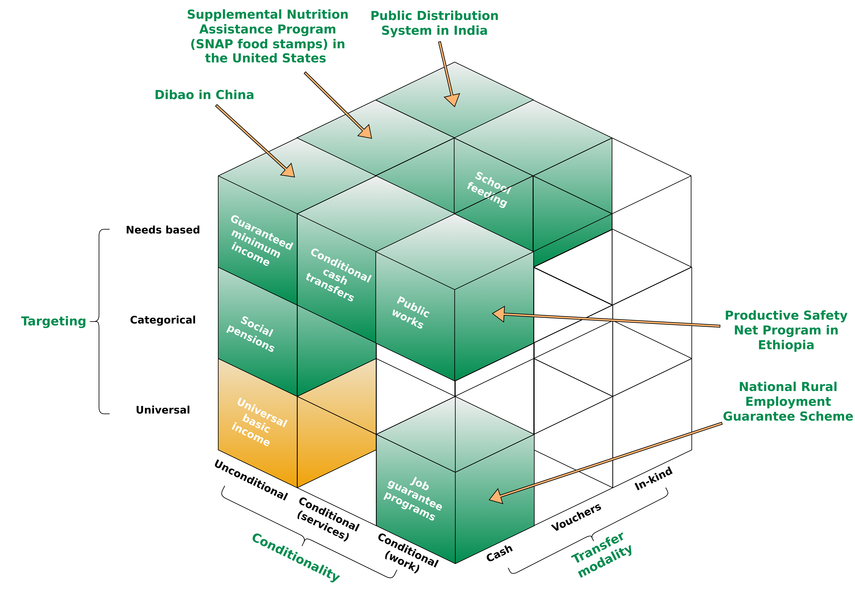
Universal Basic Income
Overview
Figure adapted from Gentilini, Ugo, Margaret Grosh, Jamele Rigolini, and Ruslan Yemtsov, eds. Exploring universal basic income: A guide to navigating concepts, evidence, and practices. World Bank Publications, 2019.

Slide 61
Universal Basic Income
A Short History
TODO – future iterations of the course

Slide 62
Universal Basic Income
Definition(s)
“A transfer that is provided universally, unconditionally, and in cash” – World Bank
“A Basic Income is a periodic cash payment unconditionally delivered to all on an individual basis, without means-test or work requirement.” - Basic Income Earth Network
1.) The World Bank (2020) – Exploring Universal Basic Income : A Guide to Navigating Concepts, Evidence, and Practices - Link
2.) BIEN (Basic Income Earth Network) – https://basicincome.org/about-basic-income

Slide 63
Universal Basic Income
Definition(s)
“A transfer that is provided universally, unconditionally, and in cash” – World Bank
“A Basic Income is a periodic cash payment unconditionally delivered to all on an individual basis, without means-test or work requirement.” - Basic Income Earth Network
Periodic → Paid at regular intervals
Cash payment → Paid in an appropriate medium of exchange
Individual → Paid on an individual basis (e.g., not to households)
Universal → Paid to everyone
Unconditional → Paid without means test and without a requirement to work or to demonstrate willingness-to-work
1.) The World Bank (2020) – Exploring Universal Basic Income : A Guide to Navigating Concepts, Evidence, and Practices - Link
2.) BIEN (Basic Income Earth Network) – https://basicincome.org/about-basic-income

Slide 64
Universal Basic Income
Definition(s)
“A transfer that is provided universally, unconditionally, and in cash” – World Bank
“A Basic Income is a periodic cash payment unconditionally delivered to all on an individual basis, without means-test or work requirement.” - Basic Income Earth Network
Periodic → Paid at regular intervals
Cash payment → Paid in an appropriate medium of exchange
Individual → Paid on an individual basis (e.g., not to households)
Universal → Paid to everyone
Unconditional → Paid without means test and without a requirement to work or to demonstrate willingness-to-work
1.) The World Bank (2020) – Exploring Universal Basic Income : A Guide to Navigating Concepts, Evidence, and Practices - Link
2.) BIEN (Basic Income Earth Network) – https://basicincome.org/about-basic-income

Slide 65
Universal Basic Income
Definition(s)
“A transfer that is provided universally, unconditionally, and in cash” – World Bank
“A Basic Income is a periodic cash payment unconditionally delivered to all on an individual basis, without means-test or work requirement.” - Basic Income Earth Network
Periodic → Paid at regular intervals
Cash payment → Paid in an appropriate medium of exchange
Individual → Paid on an individual basis (e.g., not to households)
Universal → Paid to everyone
Unconditional → Paid without means test and without a requirement to work or to demonstrate willingness-to-work
1.) The World Bank (2020) – Exploring Universal Basic Income : A Guide to Navigating Concepts, Evidence, and Practices - Link
2.) BIEN (Basic Income Earth Network) – https://basicincome.org/about-basic-income

Slide 66
Universal Basic Income
Definition(s)
“A transfer that is provided universally, unconditionally, and in cash” – World Bank
“A Basic Income is a periodic cash payment unconditionally delivered to all on an individual basis, without means-test or work requirement.” - Basic Income Earth Network
Periodic → Paid at regular intervals
Cash payment → Paid in an appropriate medium of exchange
Individual → Paid on an individual basis (e.g., not to households)
Universal → Paid to everyone
Unconditional → Paid without means test and without a requirement to work or to demonstrate willingness-to-work
1.) The World Bank (2020) – Exploring Universal Basic Income : A Guide to Navigating Concepts, Evidence, and Practices - Link
2.) BIEN (Basic Income Earth Network) – https://basicincome.org/about-basic-income

Slide 67
Universal Basic Income
Definition(s)
“A transfer that is provided universally, unconditionally, and in cash” – World Bank
“A Basic Income is a periodic cash payment unconditionally delivered to all on an individual basis, without means-test or work requirement.” - Basic Income Earth Network
Periodic → Paid at regular intervals
Cash payment → Paid in an appropriate medium of exchange
Individual → Paid on an individual basis (e.g., not to households)
Universal → Paid to everyone
Unconditional → Paid without means test and without a requirement to work or to demonstrate willingness-to-work
1.) The World Bank (2020) – Exploring Universal Basic Income : A Guide to Navigating Concepts, Evidence, and Practices - Link
2.) BIEN (Basic Income Earth Network) – https://basicincome.org/about-basic-income

Slide 68
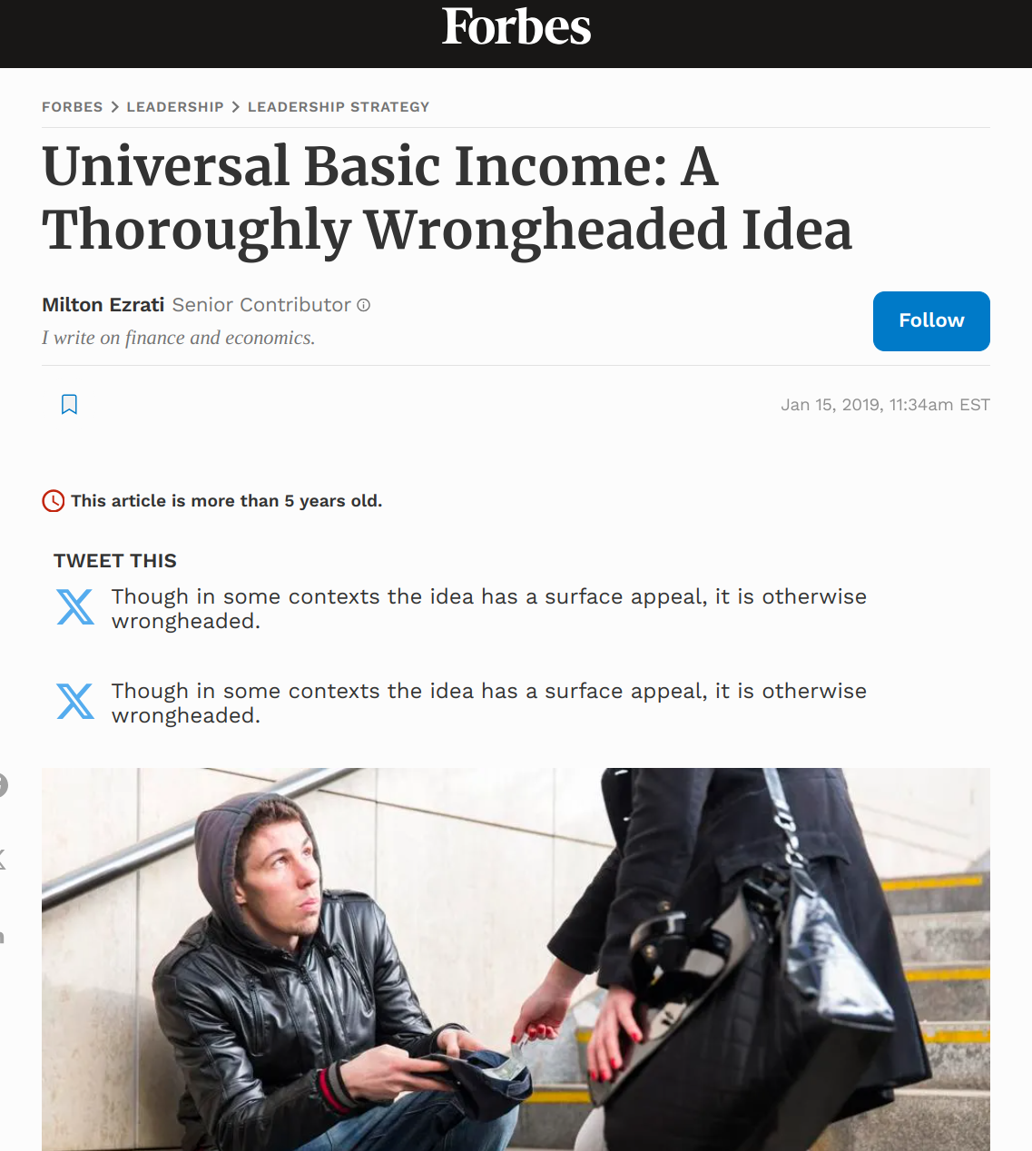
Universal Basic Income
Detour – AI Propaganda
https://www.forbes.com/sites/miltonezrati/2019/01/15/universal-basic-income-a-thoroughly-wrongheaded-idea/

Slide 69
Universal Basic Income
Detour – AI Propaganda
https://www.forbes.com/sites/miltonezrati/2019/01/15/universal-basic-income-a-thoroughly-wrongheaded-idea/

Slide 70
Universal Basic Income
Funding (Germany)
German population: 84 million
UBI per person → 1.200€
Cost for a German UBI ~ 1 trillion Euro

Slide 71
Universal Basic Income
Funding (Germany)
Bundesministerium der Finanzen 2025
Adapted from https://www.bundeshaushalt.de/DE/Bundeshaushalt-digital/bundeshaushalt-digital.html

Slide 72
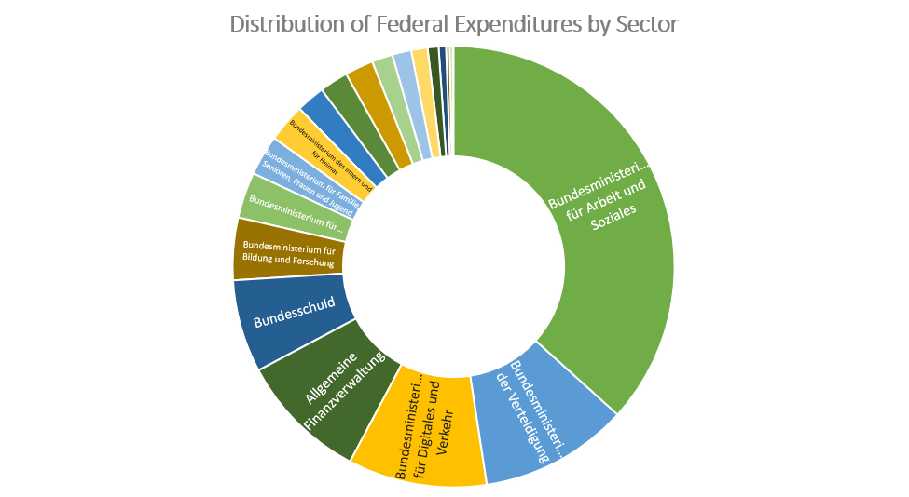
Universal Basic Income
Funding (Germany)
Amount in thousands of Euro
488.609.000
36,69%
179.257.094 (in Tausend Euro)
6,8%
33.216.446 (in Tausend Euro)
9,45%
46.170.579 (in Tausend Euro)
10,17%
49.667.947 (in Tausend Euro)
10,09%
53.250.000 (in Tausend Euro)
Adapted from https://www.bundeshaushalt.de/DE/Bundeshaushalt-digital/bundeshaushalt-digital.html
Bundesministerium der Finanzen 2025

Slide 73
Universal Basic Income
Funding (Germany) – Financial Transaction Tax
Financial transaction tax
  Tax financial transactions (stock exchange, etc. - not everyday transactions, e.g., supermarket)
  Prevent financial market speculation from being more profitable than investments in the real economy.
→ Less gambline in the finance sector
→ Only professional finanance gamblers loose money, nobody else

Slide 74
Universal Basic Income
Funding (Germany) – Financial Transaction Tax
Financial transaction tax
  Tax financial transactions (stock exchange, etc. - not everyday transactions, e.g., supermarket)
  Prevent financial market speculation from being more profitable than investments in the real economy.
→ Less gambling in the finance sector
→ Only professional finanance gamblers loose money, nobody else

Slide 75
Universal Basic Income
Funding (Germany) – Various Other Tax Apporaches
Negative income tax
  → Individuals earning below a certain threshold receive supplemental pay from the government instead of paying taxes
Taxation of consumption
→ Financed by a value-added tax (VAT), which replaces all other taxes and social security contributions levied to date.
Taxation of natural ressources
Etc.

Slide 76
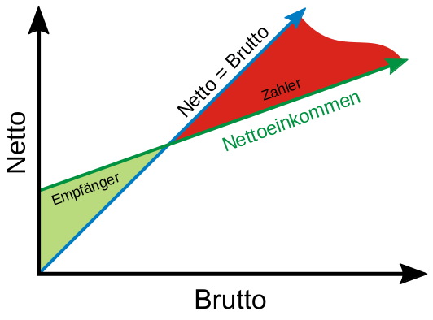
Universal Basic Income
Funding (Germany) – Various Other Tax Apporaches
Negative income tax
  → Individuals earning below a certain threshold receive supplemental pay from the government instead of paying taxes
Taxation of consumption
→ Financed by a value-added tax (VAT), which replaces all other taxes and social security contributions levied to date.
Taxation of natural ressources
Etc.
Figure adapted from Frank Murmann - https://de.wikipedia.org/wiki/Datei:Negative_Einkommenssteuer.svg

Slide 77
Universal Basic Income
Funding (Germany) – Various Other Tax Apporaches
Negative income tax
  → Individuals earning below a certain threshold receive supplemental pay from the government instead of paying taxes
Taxation of consumption
  → Financed by a value-added tax (VAT), which replaces all other taxes and social security contributions levied to date.
Taxation of natural ressources
Etc.

Slide 78
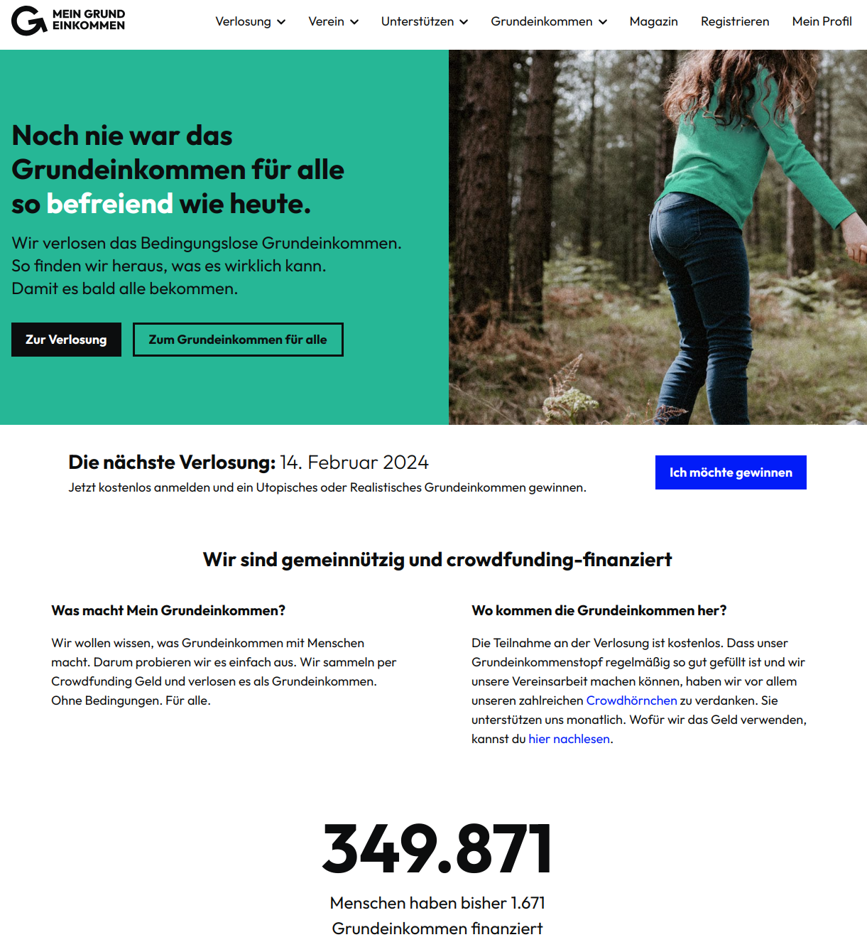
Universal Basic Income
UBI Raffle – Get a UBI for Free
https://www.mein-grundeinkommen.de

Slide 79
Conclusion

Slide 80
Conclusion
Everyone receives a minimum income in the form of an unconditional transfer payment → no strings attached | no extra conditions (e.g., work, etc.)
  Different forms, e.g.: Guaranteed minimum income vs. Universal basic income (full | partial)
UBI funding is challenging, various approaches have been discussed
Currently not implemented by any country
Several small-scale pilots and a few large-scale experiments have been conducted or are still being conducted

Slide 81
Additional Resources
Manfred Folkers, Niko Paech (2020) – All you need is less
Christian Felber (2010) - Die Gemeinwohl-Ökonomie – Das Wirtschaftsmodell der Zukunft
Christian Felber, Gus Hagelberg (2017) – The Economy for the Common Good: A Workbable, Transformative Ethics-Based Alternative – Link
Rutger Bregman (2017) – Utopia for Realists: And How We Can Get There
Mein Grund Einkommen (Berlin based non-profit organization) – Link
David Graeber. Debt: The First 5000 Years (2011).
David Graeber. On the Phenomenon of Bullshit Jobs – Essay (2013) – Link.
David Graeber. Bullshit Jobs – Book (2018).

Slide 82
Questions?

