Slide 1
Requirement Engineering
Lecture 0: Organization
Prof. Dr. Benjamin Leiding
Anant Sujatanagarjuna

Slide 2
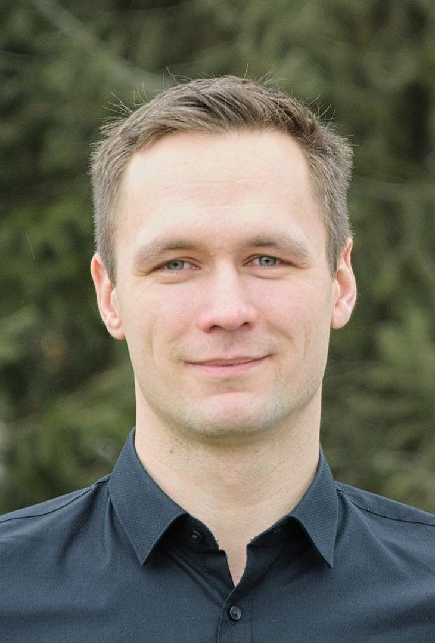

Team
Prof. Dr. Benjamin Leiding
benjamin.leiding@tu-clausthal.de
M.Sc. Anant Sujatanagarjuna
anant.sujatanagarjuna@tu-clausthal.de

Slide 3
Research Group
Emerging Technologies for the Circular Economy → ETCE
Research focus:
Intersection of IT and sustainability
Circular Economy
Self-organized, decentralized and distributed systems
Machine-to-Everything Economy (M2X Economy)
Other courses:
Emerging Technologies for the Circular Economy (SS – M.Sc.)
The Limits to Growth – Sustainability and the Circular Economy (SS – open for everyone)
Notes:
<number>

Slide 4
Research Group
Website – Link (work-in-progress)
Course material
Thesis/project topics
Publications
Etc.
Our research in action:
ZDF documentary (German) – Link
Klartext Preis 2020 (German) – Link
You want join us? Write us an email!
→ benjamin.leiding@tu-clausthal.de
Notes:
<number>

Slide 5
Course Content
Core terminology and core tasks of requirements engineering
Requirements engineering process
Elicitation techniques
Documentation methods
Textual, model-based and formal requirements specification
Requirements negotiation
Requirements Management
Traceability
Requirements validation and quality assurance
Notes:
<number>

Slide 6
Learning Outcome
Core terminology and core tasks of requirements engineering
Understanding of the requirements engineering process
Ability to choose, justify and apply appropriate methods and techniques for each step of the requirements engineering process given project constraints and properties
What is this course about, what is it not about?
Notes:
<number>

Slide 7
Learning Outcome
Core terminology and core tasks of requirements engineering
Understanding of the requirements engineering process
Ability to choose, justify and apply appropriate methods and techniques for each step of the requirements engineering process given project constraints and properties
What is this course about, what is it not about?
Notes:
<number>

Slide 8
Disclaimer
The course modelled and built based on the book „Requirements Engineering – Fundamentals, Principles and Techniques (2010)” from Klaus Pohl
Special thanks to Prof. Dr. Steffen Herbold and Dr. Christian Barelt, who provided valuable input in the form of the teaching materials of their requirements engineering courses.

Slide 9
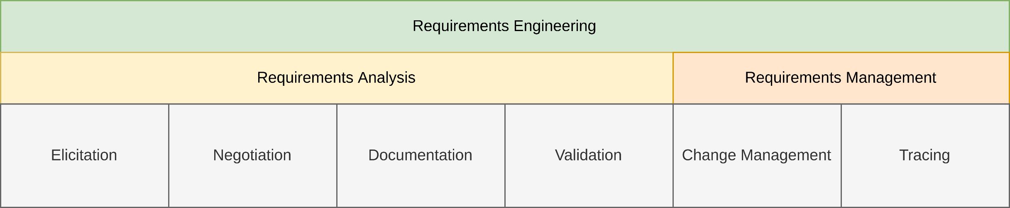
Course Content

Slide 10
Lecture Plan
Block course: 21.02.2022 – 25.02.2022
Lecture 0 (L00) → Organization
Lecture 1 (L01) → Introduction
Lecture 2 (L02) → System Context Boundaries
Lecture 3 (L03) → Elicitation
Lecture 4 (L04) → Documentation
Lecture 5 (L05) → Negotiation
Lecture 6 (L06) → Validation
Lecture 7 (L07) → Management
Lecture 8 (L08) → Traceability
Lecture 9 (L09) → Tool Support

Slide 11
Exercises
21.02.2022 → Exercise 01 – Knowledge Test (MC)
22.02.2022 → Exercise 02 – Elicitation
23.02.2022 → Exercise 03 – Agent-oriented Modelling
24.02.2022 → Exercise 04 – Colored Petri Nets
25.02.2022 → Exercise 05 – Management and Traceability (MC)

Slide 12
Times
Lectures (BBB – Link)
10:00 – 11:30
13:00 – 14:30
Exercise (BBB – Link)
15:00 – 16:30 → Q&A or specific tutorials

Slide 13
Lectures
Organization of the lectures:
Slide will be uploaded to StudIP
Future iterations of the slide set will also be available in our research group Github repository (Link) and on our website (Link) → (work-in-progress)
Please report bugs ;)
Lectures and exercises as live stream
Unfortunately, no recordings this semester
Exercise time slots = Time for questions and eventual tutorials related to the exercises

Slide 14
Exercises
Organization of the exercise:
Individual work → no group submissions
Multiple-Choice or practical tasks
24h to 7 days to submit the exercise (depending on the task)
More info on points, percentages, etc. follow on the next slides (Examination)

Slide 15
Exercises
Organization of the exercise:
Individual work → no group submissions
Multiple-Choice or practical tasks
24h to 7 days to submit the exercise (depending on the task)
More info on points, percentages, etc. follow on the next slides (Examination)

Slide 16
Examination
Prerequisite for admission to the final exam (all criteria have to be fulfilled):
Successful completion of the compulsory five exercises
You pass an exercise if you score 50% (or more)
You have to submit every exercise
Final exam:
No Specific date yet
Either written exam (120min) or oral examination (20-25min)
Online vs. lecture room examination → depends on the pandemic and the number of students
We will announce the examination format on Wednesday (23.02.2022)

Slide 17
Examination
Prerequisite for admission to the final exam (all criteria have to be fulfilled):
Successful completion of the compulsory five exercises
You pass an exercise if you score 50% (or more)
You have to submit every exercise
Final exam:
No Specific date yet
Either written exam (120min) or oral examination (20-25min)
Online vs. lecture room examination → depends on the pandemic and the number of students
We will announce the examination format on Wednesday (23.02.2022)

Slide 18
Self-Study Star
Slides with the self-study star indicate optional/additional study material that is not mandatory but could be helpful for your future career
Of course it won’t hurt to have extra knowledge to impress us during the examination ;)
Self-Study Star →

Slide 19
Literature
This course is not based on a single book and you do not need to buy a book to pass the exam.
K. Pohl. Requirements Engineering – Fundamentals, Principles and Techniques (2010).
K. Pohl, C. Rupp. Requirements Engineering Fundamentals: A Study Guide for Requirements Engineering Foundation Level (2011).
J. Dick, E. Hull, K. Jackson. Requirements Engineering (4th Edition) (2017).
Chris Rupp et al. Requirements Engineering und Management – Das Handbuch für Anforderungen in jeder Situation (7th Edition) (2021).

Slide 20
Questions?

