Slide 1
Requirement Engineering
Lecture 4: Requirements Documentation
Part 3
Prof. Dr. Benjamin Leiding
Anant Sujatanagarjuna

Slide 2
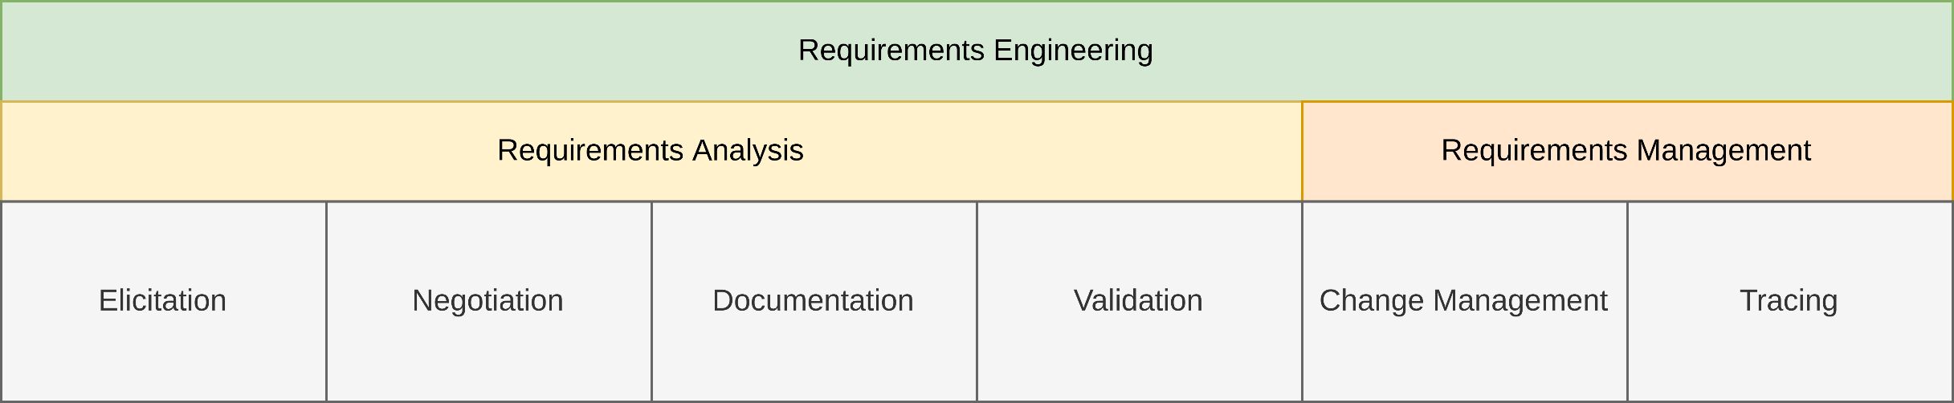
General Requirements Engineering Process
Overview

Slide 3
Lecture 4: Requirements Documentation
Content
Model-based Requirements Documentation Techniques
Formal Specification Techniques

Slide 4
Model-based Requirements Documentation Techniques

Slide 5
Lecture 4: Requirements Documentation
Content
Model-based Requirements Documentation Techniques
Models in General
Goal Models
Agent-oriented Modelling
Use Cases
Data | Functional | Behavioral Perspective
Formal Specification Techniques

Slide 6
Model-based Requirements Documentation Techniques
Models in General – Requirements Model vs. Design Model
Models are frequently used for system design
“Design Models”
E.g., architectural models
Considerable difference between requirements models and design models
Requirements models depict aspects of the underlying problem
Design models document solutions chosen during system development
Notes:
Vier Variablen Modell in einem Satz: Grundlagen sind Variablen (Grundlegendes Modell), Erweiterung über Realtionen -> Grundlage für Dokumente: Wie dokumentiere ich sowas
Controlled V-> Ausgabewerte die durch das System beschrieben / verändert werden
Monitored V -> EingabeWerte, die durch das System beschrieben werden
Output V -> represents controlled V.
Input V -> represents monitored V.
Eschbach, Elicitation & Modeling: Embedded Systems Industrial Formal Techniques, 2006

Slide 7
Model-based Requirements Documentation Techniques
Models in General – The Term “Model”
According to Merriam-Webster:
Structural design
A usually miniature representation of something
A system of postulates, data, and inferences presented as a mathematical description of an entity or state of affairs
We use the following definition in this lecture:
A model is an abstract representation of an existing reality or a reality to be created.
Notes:
Vier Variablen Modell in einem Satz: Grundlagen sind Variablen (Grundlegendes Modell), Erweiterung über Realtionen -> Grundlage für Dokumente: Wie dokumentiere ich sowas
Controlled V-> Ausgabewerte die durch das System beschrieben / verändert werden
Monitored V -> EingabeWerte, die durch das System beschrieben werden
Output V -> represents controlled V.
Input V -> represents monitored V.
Eschbach, Elicitation & Modeling: Embedded Systems Industrial Formal Techniques, 2006

Slide 8
Model-based Requirements Documentation Techniques
Models in General – Properties of Models
Mapping of reality
Aspects of the observed reality are mapped onto model elements
Descriptive model creation → Model documents the existing reality
Prescriptive model creation → Model prototypes fictious reality
Models can be both descriptive and prescriptive at the same time
Describes a stakeholder
Prescribes a use case of a system
Notes:
Vier Variablen Modell in einem Satz: Grundlagen sind Variablen (Grundlegendes Modell), Erweiterung über Realtionen -> Grundlage für Dokumente: Wie dokumentiere ich sowas
Controlled V-> Ausgabewerte die durch das System beschrieben / verändert werden
Monitored V -> EingabeWerte, die durch das System beschrieben werden
Output V -> represents controlled V.
Input V -> represents monitored V.
Eschbach, Elicitation & Modeling: Embedded Systems Industrial Formal Techniques, 2006

Slide 9
Model-based Requirements Documentation Techniques
Models in General – Properties of Models
Reduction of Reality
Models do not capture the complete reality
Instead, the models reduce the captured reality
Only particular aspects of the system are modeled
Subject matter is summarized during compression
Pragmatic Property
Models serve a special purpose
Models are within a special context
NOT general purpose!
Purpose affects the construction of models and the reduction of the reality
Ideally contains only information pertaining to its purpose
Notes:
Vier Variablen Modell in einem Satz: Grundlagen sind Variablen (Grundlegendes Modell), Erweiterung über Realtionen -> Grundlage für Dokumente: Wie dokumentiere ich sowas
Controlled V-> Ausgabewerte die durch das System beschrieben / verändert werden
Monitored V -> EingabeWerte, die durch das System beschrieben werden
Output V -> represents controlled V.
Input V -> represents monitored V.
Eschbach, Elicitation & Modeling: Embedded Systems Industrial Formal Techniques, 2006

Slide 10
Model-based Requirements Documentation Techniques
Models in General – Properties of Models
Defined through syntax and semantics
Syntax
Defines the modeling elements to be used
Specifies their valid combinations
Semantics
Defines the meaning of the individual model elements
Foundation for the interpretation of the models
Can be formal, informal, and semiformal
Depends on the magnitude of formal definitions
Notes:
Vier Variablen Modell in einem Satz: Grundlagen sind Variablen (Grundlegendes Modell), Erweiterung über Realtionen -> Grundlage für Dokumente: Wie dokumentiere ich sowas
Controlled V-> Ausgabewerte die durch das System beschrieben / verändert werden
Monitored V -> EingabeWerte, die durch das System beschrieben werden
Output V -> represents controlled V.
Input V -> represents monitored V.
Eschbach, Elicitation & Modeling: Embedded Systems Industrial Formal Techniques, 2006

Slide 11
Model-based Requirements Documentation Techniques
Models in General – Advantages of Models
Humans handle graphically depicted information better
Perceived faster
Memorized faster
Also true for requirements models
Strictly defined focus
Everything not part of the focus of the model is removed → Removal of noise
Harmonized level of abstraction
Modeling elements dictate the level of abstraction
Notes:
Vier Variablen Modell in einem Satz: Grundlagen sind Variablen (Grundlegendes Modell), Erweiterung über Realtionen -> Grundlage für Dokumente: Wie dokumentiere ich sowas
Controlled V-> Ausgabewerte die durch das System beschrieben / verändert werden
Monitored V -> EingabeWerte, die durch das System beschrieben werden
Output V -> represents controlled V.
Input V -> represents monitored V.
Eschbach, Elicitation & Modeling: Embedded Systems Industrial Formal Techniques, 2006

Slide 12
Model-based Requirements Documentation Techniques
Models in General – Suppression of Details
Complexity is reduced by abstraction
Three main mechanisms
Selection
Selects a particular aspect to be depicted by the model
Other aspects are ignored completely, i.e., not part of the model
Aggregation
Combines aspects into aggregated aspects
Condenses information
Classification/generalization
Identifies common features
Suppresses differences between the common features
Commonalities are represented as generalized information
Notes:
Vier Variablen Modell in einem Satz: Grundlagen sind Variablen (Grundlegendes Modell), Erweiterung über Realtionen -> Grundlage für Dokumente: Wie dokumentiere ich sowas
Controlled V-> Ausgabewerte die durch das System beschrieben / verändert werden
Monitored V -> EingabeWerte, die durch das System beschrieben werden
Output V -> represents controlled V.
Input V -> represents monitored V.
Eschbach, Elicitation & Modeling: Embedded Systems Industrial Formal Techniques, 2006

Slide 13
Model-based Requirements Documentation Techniques
Models in General – UML
Object Management Group (OMG) standard
Current version UML 2.5.1
Graphical notation for the analysis, design, and documentation of object-oriented systems
UML is not
a development process
specialized for a certain topic
complete & formal
Cannot be complied without additional information
→ Semiformal
Capable of semantics
UML only provides a syntax
Semantics depend on the reader of the document
Notes:
Vier Variablen Modell in einem Satz: Grundlagen sind Variablen (Grundlegendes Modell), Erweiterung über Realtionen -> Grundlage für Dokumente: Wie dokumentiere ich sowas
Controlled V-> Ausgabewerte die durch das System beschrieben / verändert werden
Monitored V -> EingabeWerte, die durch das System beschrieben werden
Output V -> represents controlled V.
Input V -> represents monitored V.
Eschbach, Elicitation & Modeling: Embedded Systems Industrial Formal Techniques, 2006

Slide 14
Lecture 4: Requirements Documentation
Content
Model-based Requirements Documentation Techniques
Models in General
Goal Models
Agent-oriented Modelling
Use Cases
Data | Functional | Behavioral Perspective
Formal Specification Techniques

Slide 15
Model-based Requirements Documentation Techniques
Goal Models – Goals in General
Goals are the stakeholders description of system properties
What they want from the system
Effort for goal considerations usually minimal
Positive impact of goal modeling is high
Especially concerning the comprehensiveness and quality
Notes:
Vier Variablen Modell in einem Satz: Grundlagen sind Variablen (Grundlegendes Modell), Erweiterung über Realtionen -> Grundlage für Dokumente: Wie dokumentiere ich sowas
Controlled V-> Ausgabewerte die durch das System beschrieben / verändert werden
Monitored V -> EingabeWerte, die durch das System beschrieben werden
Output V -> represents controlled V.
Input V -> represents monitored V.
Eschbach, Elicitation & Modeling: Embedded Systems Industrial Formal Techniques, 2006

Slide 16
Model-based Requirements Documentation Techniques
Goal Models – AND / OR Trees
Documents hierarchical decompositions of goals into sub-goals
Two types of decompositions
AND → All sub-goals must be fulfilled
OR → At least one sub-goal must be fulfilled
Notes:
Vier Variablen Modell in einem Satz: Grundlagen sind Variablen (Grundlegendes Modell), Erweiterung über Realtionen -> Grundlage für Dokumente: Wie dokumentiere ich sowas
Controlled V-> Ausgabewerte die durch das System beschrieben / verändert werden
Monitored V -> EingabeWerte, die durch das System beschrieben werden
Output V -> represents controlled V.
Input V -> represents monitored V.
Eschbach, Elicitation & Modeling: Embedded Systems Industrial Formal Techniques, 2006

Slide 17
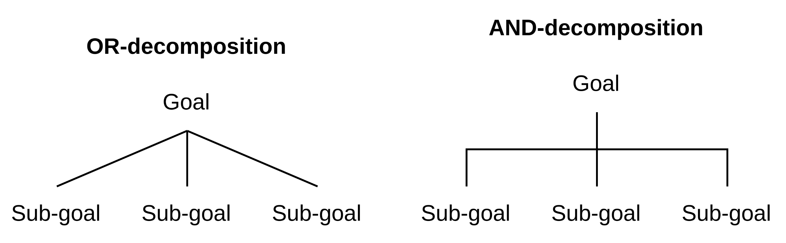
Model-based Requirements Documentation Techniques
Goal Models – AND / OR Trees
Notes:
Vier Variablen Modell in einem Satz: Grundlagen sind Variablen (Grundlegendes Modell), Erweiterung über Realtionen -> Grundlage für Dokumente: Wie dokumentiere ich sowas
Controlled V-> Ausgabewerte die durch das System beschrieben / verändert werden
Monitored V -> EingabeWerte, die durch das System beschrieben werden
Output V -> represents controlled V.
Input V -> represents monitored V.
Eschbach, Elicitation & Modeling: Embedded Systems Industrial Formal Techniques, 2006

Slide 18
Lecture 4: Requirements Documentation
Content
Model-based Requirements Documentation Techniques
Models in General
Goal Models
Agent-oriented Modelling
Use Cases
Data | Functional | Behavioral Perspective
Formal Specification Techniques

Slide 19
Agent-oriented Modelling
Motivation: Why AOM?
Most (if not all) processes in software systems are elicited by Agents playing a certain Role in the system, to achieve some Goal.
AOM is a tool for “modelling systems with multiple agents, both human and manmade, interacting with a diverse collection of hardware and software in a complex environment”
AOM models are clear and easily understandable for stakeholders → useful for Requirements Engineering
L. Sterling, K. Taveter (2009) – The Art of Agent-Oriented Modeling

Slide 20
Agent-oriented Modelling
Concepts and Definitions
Goal: A situation description that refers to the intended state of the environment. Goals can:
be functional or non-functional (quality).
have sub-goals.
“Goals are expressed by using nouns, verbs, and (optionally) adjectives. The nouns tend to be more of a state, and the verbs more into the activities that are needed to achieve a goal.”
e.g., if a message needs to be transmitted securely, the functional goal ‘Transmit Message’ can be associated with the quality goal ‘Securely’
L. Sterling, K. Taveter (2009) – The Art of Agent-Oriented Modeling

Slide 21
Agent-oriented Modelling
Goal vs. Requirement
Goal | Requirement
Single desired result | Statement of need
One goal may consist of several requirements | One requirement may be related to many goals
No one to one mapping between goals and requirements is possible

Slide 22
Agent-oriented Modelling
Concepts and Definitions
How does one identify functional and non-functional goals?
Functional goals usually describe what a system must accomplish = Identification depends heavily on the system.
Non-functional goals describe how the system must accomplish those goals, in terms of standards and quality = Identification can depend on functional goals.
However, there are many commonalities: Reliability, Availability, Security, …..
https://onlinelibrary.wiley.com/doi/pdf/10.1002/9781119202660.app6

Slide 23
Agent-oriented Modelling
Concepts and Definitions
Role: Some capacity or position that fascilitates the system to achieve it’s goals. Roles express functions, expectations, and obligations of the agents enacting them.
eg. Network Administrator, Firewall
Agent: An entity that can act in the environment, perceive events, and reason.
Can be human or software
L. Sterling, K. Taveter (2009) – The Art of Agent-Oriented Modeling

Slide 24
Agent-oriented Modelling
Concepts and Definitions
Activity: Some action performed by an agent playing a role in pursuance of a system goal.
Environment: An abstraction that provides the surrounding conditions for agents to exist and that mediates both the interaction among agents and the access to resources.
L. Sterling, K. Taveter (2009) – The Art of Agent-Oriented Modeling

Slide 25
Agent-oriented Modelling
Models
Models that we will take a look at:
Goal Models
Behavioural Interface Models

Slide 26

Agent-oriented Modelling
Goal Models
Goal models hierarchically express the relationships between goals (functional and non-functional) and the roles played by various agents in pursuit of those goals.
Sterling and Taveter’s AOM Goal models omit AND/OR decomposition for simplicity.
Symbol | Meaning
 | Goal
 | Quality Goal
 | Role
 | Reltionship between goals
 | Relationship between goals and quality goals

Slide 27
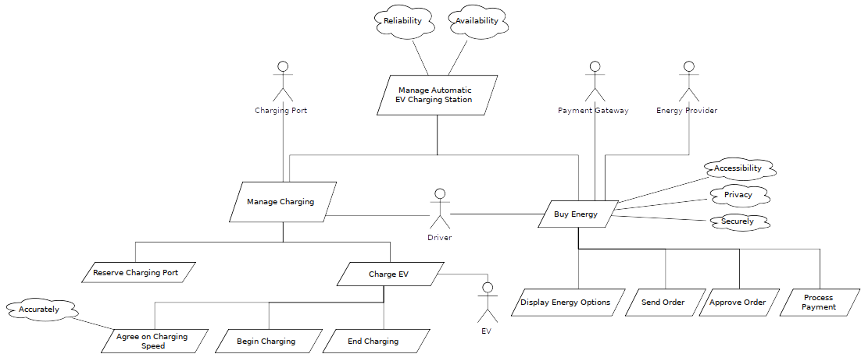
Agent-oriented Modelling
Goal Model Example: Automated EV Charging Station

Slide 28
Agent-oriented Modelling
Behavioural Interface Models (BIM)
Behavioral Interface Models model the behaviour of agents playing their roles
Models Behavioural Units (= Activities)
Represented as a table ↓
Activity | Trigger(s) | Precondition(s) | Postcondition(s)
Activity Name | Event(s) that trigger(s) the activity | Conditions for Activity to proceed | Conditions for Activity to be considered complete
... | ... | ... | ...

Slide 29
Agent-oriented Modelling
BIM Example: Automated EV Charging Station (Manage Charging)
Activity | Trigger(s) | Precondition(s) | Postcondition(s)
Reserve Charging Port(CP) | Driver wants to charge EV | Driver has bought energy, CP is free, EV is ready to charge | Driver has reserved CP
Charge EV | 〃 | Driver has reserved CP | Driver has charged EV
Agree on charging speed | 〃 | Driver has reserved CP, Max CP speed ≥ Min EV speed, Max EV speed ≥ Min CP speed | Charging speed is agreed upon
Begin Charging | 〃 | Charging speed is agreed upon | EV has begun charging
End Charging | None | EV has competed charging | Driver has charged EV, CP is free

Slide 30
Lecture 4: Requirements Documentation
Content
Model-based Requirements Documentation Techniques
Models in General
Goal Models
Agent-oriented Modelling
Use Cases
Data | Functional | Behavioral Perspective
Formal Specification Techniques

Slide 31
Model-based Requirements Documentation Techniques
Use Cases – Overview
Method to document functionalities
Planned
Of existing system
Relatively simple models
Two concepts
Use case diagrams
Use case specification
Both should be used in conjunction
Notes:
Vier Variablen Modell in einem Satz: Grundlagen sind Variablen (Grundlegendes Modell), Erweiterung über Realtionen -> Grundlage für Dokumente: Wie dokumentiere ich sowas
Controlled V-> Ausgabewerte die durch das System beschrieben / verändert werden
Monitored V -> EingabeWerte, die durch das System beschrieben werden
Output V -> represents controlled V.
Input V -> represents monitored V.
Eschbach, Elicitation & Modeling: Embedded Systems Industrial Formal Techniques, 2006

Slide 32
Model-based Requirements Documentation Techniques
Use Cases – UML Use Case Diagrams
Models to schematically depict:
Functions from a user’s point of view
Interrelations of functions of a system
Relations between functions and their environment
We do not cover all concepts of use case diagrams in this lecture
Additional information can be found in the literature
Notes:
Vier Variablen Modell in einem Satz: Grundlagen sind Variablen (Grundlegendes Modell), Erweiterung über Realtionen -> Grundlage für Dokumente: Wie dokumentiere ich sowas
Controlled V-> Ausgabewerte die durch das System beschrieben / verändert werden
Monitored V -> EingabeWerte, die durch das System beschrieben werden
Output V -> represents controlled V.
Input V -> represents monitored V.
Eschbach, Elicitation & Modeling: Embedded Systems Industrial Formal Techniques, 2006

Slide 33
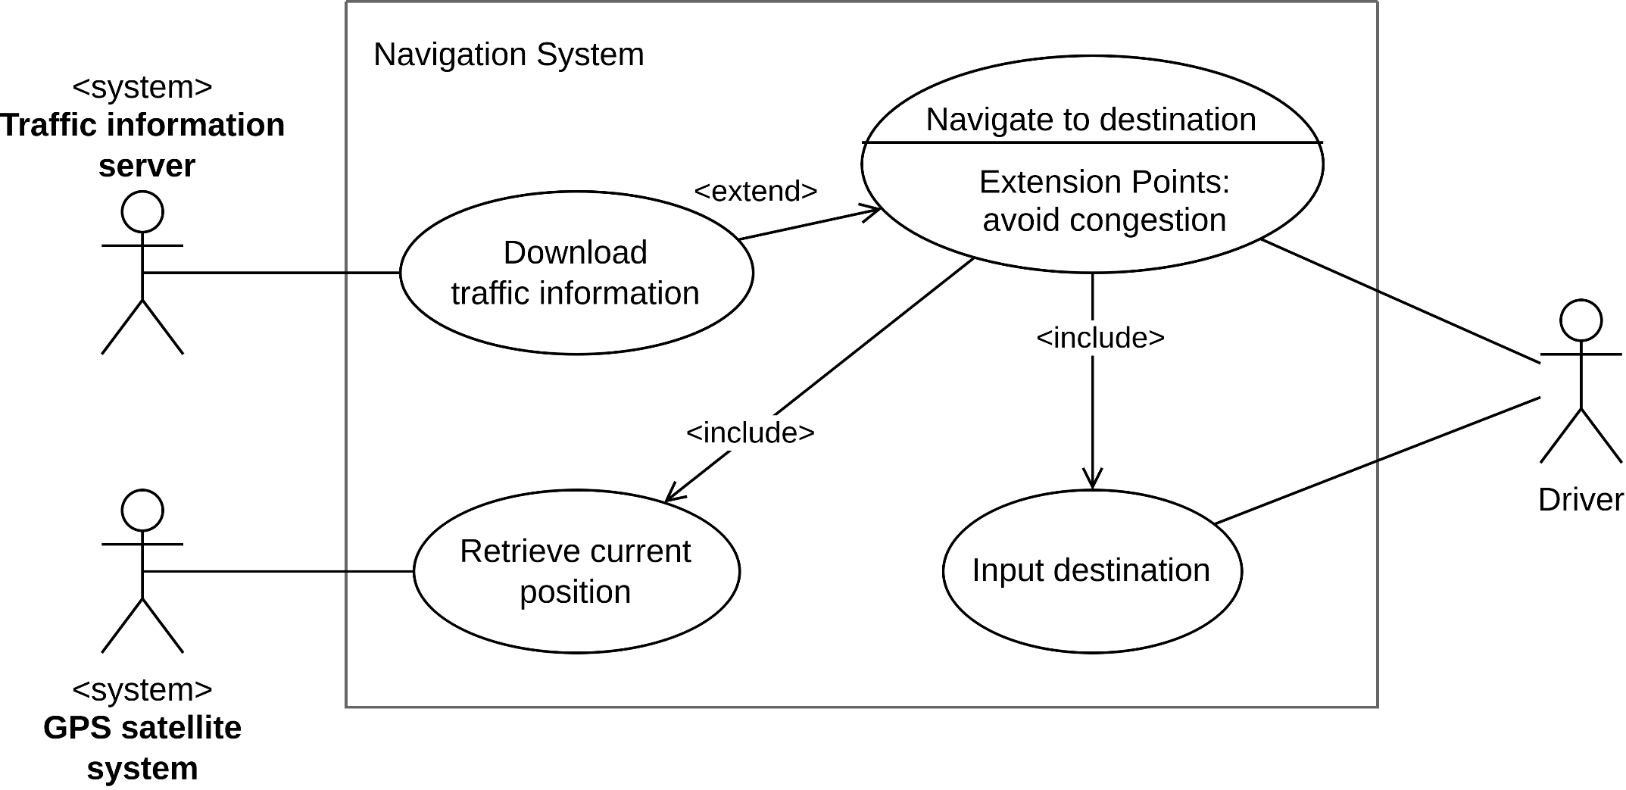
Model-based Requirements Documentation Techniques
Use Cases – UML Use Case Diagram (Example)
Based on K. Pohl, C. Rupp (2011) – Requirements Engineering Fundamentals: A study guide for Requirements Engineering Foundation Level
Notes:
Vier Variablen Modell in einem Satz: Grundlagen sind Variablen (Grundlegendes Modell), Erweiterung über Realtionen -> Grundlage für Dokumente: Wie dokumentiere ich sowas
Controlled V-> Ausgabewerte die durch das System beschrieben / verändert werden
Monitored V -> EingabeWerte, die durch das System beschrieben werden
Output V -> represents controlled V.
Input V -> represents monitored V.
Eschbach, Elicitation & Modeling: Embedded Systems Industrial Formal Techniques, 2006

Slide 34
Model-based Requirements Documentation Techniques
Use Cases – Issues of UML Use Case Diagrams
Diagrams do not contain details
Very high level
Very abstract
Examples for open questions
How does the driver communicate with the Navigate to destination use case?
Is there an order in the inclusion of the use cases Retrieve current location and Input destination?
Notes:
Vier Variablen Modell in einem Satz: Grundlagen sind Variablen (Grundlegendes Modell), Erweiterung über Realtionen -> Grundlage für Dokumente: Wie dokumentiere ich sowas
Controlled V-> Ausgabewerte die durch das System beschrieben / verändert werden
Monitored V -> EingabeWerte, die durch das System beschrieben werden
Output V -> represents controlled V.
Input V -> represents monitored V.
Eschbach, Elicitation & Modeling: Embedded Systems Industrial Formal Techniques, 2006

Slide 35
Model-based Requirements Documentation Techniques
Use Cases – Use Case Specifications
Use case specifications provide details to the diagrams
Specifications documented textually
Not simple prose, but in form of templates (usually tabular)
The template defines the concrete information contained in the use case specification
Notes:
Vier Variablen Modell in einem Satz: Grundlagen sind Variablen (Grundlegendes Modell), Erweiterung über Realtionen -> Grundlage für Dokumente: Wie dokumentiere ich sowas
Controlled V-> Ausgabewerte die durch das System beschrieben / verändert werden
Monitored V -> EingabeWerte, die durch das System beschrieben werden
Output V -> represents controlled V.
Input V -> represents monitored V.
Eschbach, Elicitation & Modeling: Embedded Systems Industrial Formal Techniques, 2006

Slide 36
Model-based Requirements Documentation Techniques
Use Cases – Use Case Specification Template
Template prescribes the following information
Attributes for unique identification of use cases
Management attributes
Attributes for the description of the use case
Specific use case attributes, e.g.,
the trigger event,
actors,
pre- and post-conditions,
the result of the use case,
the main scenario,
alternative and exception scenarios,
cross references,
quality requirements
Notes:
Vier Variablen Modell in einem Satz: Grundlagen sind Variablen (Grundlegendes Modell), Erweiterung über Realtionen -> Grundlage für Dokumente: Wie dokumentiere ich sowas
Controlled V-> Ausgabewerte die durch das System beschrieben / verändert werden
Monitored V -> EingabeWerte, die durch das System beschrieben werden
Output V -> represents controlled V.
Input V -> represents monitored V.
Eschbach, Elicitation & Modeling: Embedded Systems Industrial Formal Techniques, 2006

Slide 37
Model-based Requirements Documentation Techniques
Use Cases – Use Case Specification Template (Example)
Section | Content
Designation | UC-12-37
Name | Navigate to destination
Authors | John Smith, Sandra Miller
Priority | Importance for system success : high Technological risk : high
Criticality | High
Source | C. Warner (domain expert for navigation systems
Person Responsible | J. Smith
Description | The driver of the vehicle types the name of the destination. The navigation system guides the drive to the desired destination.
Trigger event | The driver wishes to navigate to his destination
Actors | Driver, traffic information system, GPS satellite system
Based on K. Pohl, C. Rupp (2011) – Requirements Engineering Fundamentals: A study guide for Requirements Engineering Foundation Level
Notes:
Vier Variablen Modell in einem Satz: Grundlagen sind Variablen (Grundlegendes Modell), Erweiterung über Realtionen -> Grundlage für Dokumente: Wie dokumentiere ich sowas
Controlled V-> Ausgabewerte die durch das System beschrieben / verändert werden
Monitored V -> EingabeWerte, die durch das System beschrieben werden
Output V -> represents controlled V.
Input V -> represents monitored V.
Eschbach, Elicitation & Modeling: Embedded Systems Industrial Formal Techniques, 2006

Slide 38
Model-based Requirements Documentation Techniques
Use Cases – Use Case Specification Template (Example)
Section | Content
Pre-conditions | The navigation system is activated
Post-conditions | The driver has reached his destination
Result | Route guidance
Main scenario | 1. The navigation system asks for the desired destination 2. The driver enters the desired destination 3. The navigation system pinpoints the destination in its maps 4. On the basis of the current position and the desired destination, the navigation system calculates a suitable route 5. The navigation system compiles a list of waypoints 6. The navigation system shows a map of the current position and shows the route to the next waypoint 7. When the last waypoint is reached, the navigation system shows “destination reached” on the screen
Based on K. Pohl, C. Rupp (2011) – Requirements Engineering Fundamentals: A study guide for Requirements Engineering Foundation Level
Notes:
Vier Variablen Modell in einem Satz: Grundlagen sind Variablen (Grundlegendes Modell), Erweiterung über Realtionen -> Grundlage für Dokumente: Wie dokumentiere ich sowas
Controlled V-> Ausgabewerte die durch das System beschrieben / verändert werden
Monitored V -> EingabeWerte, die durch das System beschrieben werden
Output V -> represents controlled V.
Input V -> represents monitored V.
Eschbach, Elicitation & Modeling: Embedded Systems Industrial Formal Techniques, 2006

Slide 39
Model-based Requirements Documentation Techniques
Use Cases – Use Case Specification Template (Example)
Section | Content
Alternative scenario | 4a. Calculation of the route must honor traffic information and avoid traffic congestions. 4a1. The navigation system queries the server for updated traffic information. 4a2. The navigation system calculates a route that does not contain any traffic congestions.
Exception scenarios | Trigger event: The navigation system does not receive GPS signal from the GPS satellite system.
Qualities | → QR.04 (reaction time upon user input) → QR.15 (operating comfort)
Based on K. Pohl, C. Rupp (2011) – Requirements Engineering Fundamentals: A study guide for Requirements Engineering Foundation Level
Notes:
Vier Variablen Modell in einem Satz: Grundlagen sind Variablen (Grundlegendes Modell), Erweiterung über Realtionen -> Grundlage für Dokumente: Wie dokumentiere ich sowas
Controlled V-> Ausgabewerte die durch das System beschrieben / verändert werden
Monitored V -> EingabeWerte, die durch das System beschrieben werden
Output V -> represents controlled V.
Input V -> represents monitored V.
Eschbach, Elicitation & Modeling: Embedded Systems Industrial Formal Techniques, 2006

Slide 40
Lecture 4: Requirements Documentation
Content
Model-based Requirements Documentation Techniques
Models in General
Goal Models
Agent-oriented Modelling
Use Cases
Data | Functional | Behavioral Perspective
Formal Specification Techniques

Slide 41
Model-based Requirements Documentation Techniques
Modelling Requirements in the Three Perspectives
Different perspective → Different models
Data perspective
Entity-relationship diagrams
UML class diagrams
Functional perspective
Data flow diagrams
UML activity diagrams
Behavioral perspective
Statecharts
UML state machine diagrams
Notes:
Vier Variablen Modell in einem Satz: Grundlagen sind Variablen (Grundlegendes Modell), Erweiterung über Realtionen -> Grundlage für Dokumente: Wie dokumentiere ich sowas
Controlled V-> Ausgabewerte die durch das System beschrieben / verändert werden
Monitored V -> EingabeWerte, die durch das System beschrieben werden
Output V -> represents controlled V.
Input V -> represents monitored V.
Eschbach, Elicitation & Modeling: Embedded Systems Industrial Formal Techniques, 2006

Slide 42
Model-based Requirements Documentation Techniques
Data Perspective – Entity-relationship Diagrams
Concept from the world of databases
Used to model data (entities) and their relationships
Extensions of entity-relationship diagrams developed over the years
Min/max notations for cardinalities
Inheritance mechanism
...
(Extensions out of scope in this lecture)
Notes:
Vier Variablen Modell in einem Satz: Grundlagen sind Variablen (Grundlegendes Modell), Erweiterung über Realtionen -> Grundlage für Dokumente: Wie dokumentiere ich sowas
Controlled V-> Ausgabewerte die durch das System beschrieben / verändert werden
Monitored V -> EingabeWerte, die durch das System beschrieben werden
Output V -> represents controlled V.
Input V -> represents monitored V.
Eschbach, Elicitation & Modeling: Embedded Systems Industrial Formal Techniques, 2006

Slide 43
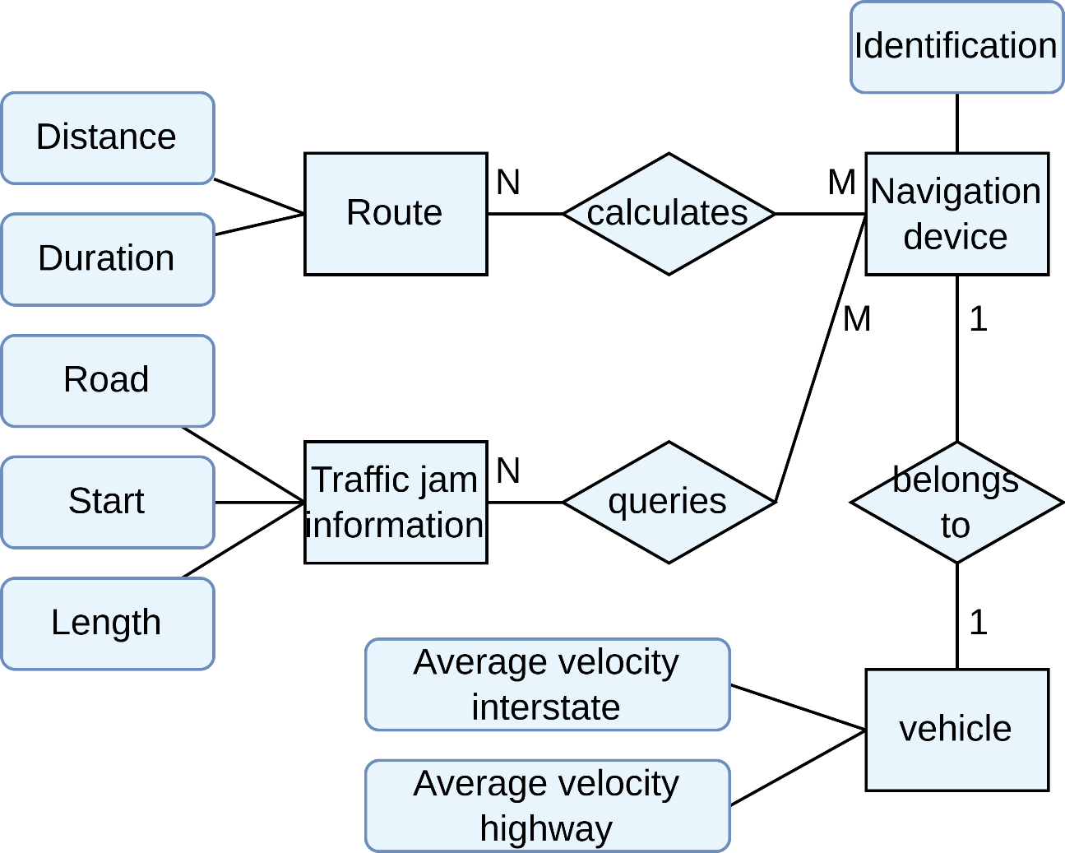
Model-based Requirements Documentation Techniques
Data Perspective – Entity-relationship Diagrams (Example)
Based on K. Pohl, C. Rupp (2011) – Requirements Engineering Fundamentals: A study guide for Requirements Engineering Foundation Level
Notes:
Vier Variablen Modell in einem Satz: Grundlagen sind Variablen (Grundlegendes Modell), Erweiterung über Realtionen -> Grundlage für Dokumente: Wie dokumentiere ich sowas
Controlled V-> Ausgabewerte die durch das System beschrieben / verändert werden
Monitored V -> EingabeWerte, die durch das System beschrieben werden
Output V -> represents controlled V.
Input V -> represents monitored V.
Eschbach, Elicitation & Modeling: Embedded Systems Industrial Formal Techniques, 2006

Slide 44
Model-based Requirements Documentation Techniques
Data Perspective – UML Class Diagrams
Consists of classes and their associations
In principle, similar to entity-relationship diagrams
Classes ~ entity types
Associations ~ relation types
Class diagrams more powerful than entity-relationship diagrams
Notes:
Vier Variablen Modell in einem Satz: Grundlagen sind Variablen (Grundlegendes Modell), Erweiterung über Realtionen -> Grundlage für Dokumente: Wie dokumentiere ich sowas
Controlled V-> Ausgabewerte die durch das System beschrieben / verändert werden
Monitored V -> EingabeWerte, die durch das System beschrieben werden
Output V -> represents controlled V.
Input V -> represents monitored V.
Eschbach, Elicitation & Modeling: Embedded Systems Industrial Formal Techniques, 2006

Slide 45
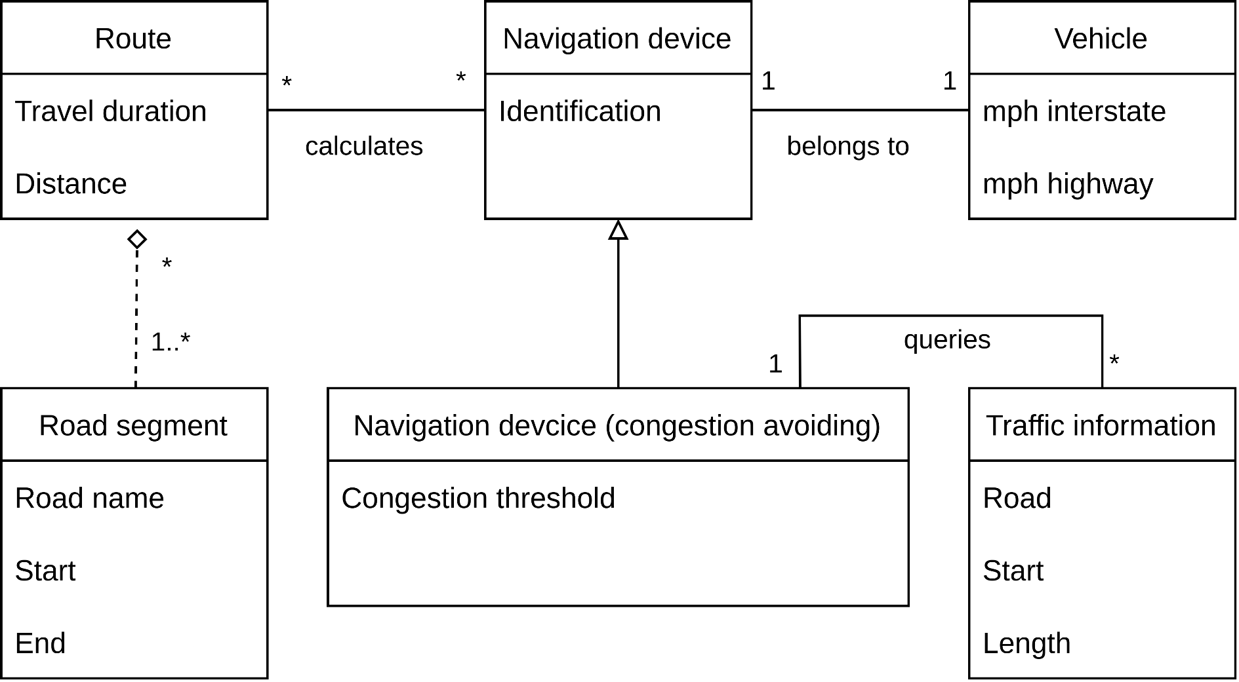
Model-based Requirements Documentation Techniques
Data Perspective – UML Class Diagrams (Example)
Based on K. Pohl, C. Rupp (2011) – Requirements Engineering Fundamentals: A study guide for Requirements Engineering Foundation Level
Notes:
Vier Variablen Modell in einem Satz: Grundlagen sind Variablen (Grundlegendes Modell), Erweiterung über Realtionen -> Grundlage für Dokumente: Wie dokumentiere ich sowas
Controlled V-> Ausgabewerte die durch das System beschrieben / verändert werden
Monitored V -> EingabeWerte, die durch das System beschrieben werden
Output V -> represents controlled V.
Input V -> represents monitored V.
Eschbach, Elicitation & Modeling: Embedded Systems Industrial Formal Techniques, 2006

Slide 46
Model-based Requirements Documentation Techniques
Functional Perspective – Data Flow Diagrams
Model the flow of the data through the system
Input/Output data
Recipients of the data
Can be applied on different levels of abstraction
Requirements on different levels of abstraction possible
Notes:
Vier Variablen Modell in einem Satz: Grundlagen sind Variablen (Grundlegendes Modell), Erweiterung über Realtionen -> Grundlage für Dokumente: Wie dokumentiere ich sowas
Controlled V-> Ausgabewerte die durch das System beschrieben / verändert werden
Monitored V -> EingabeWerte, die durch das System beschrieben werden
Output V -> represents controlled V.
Input V -> represents monitored V.
Eschbach, Elicitation & Modeling: Embedded Systems Industrial Formal Techniques, 2006

Slide 47
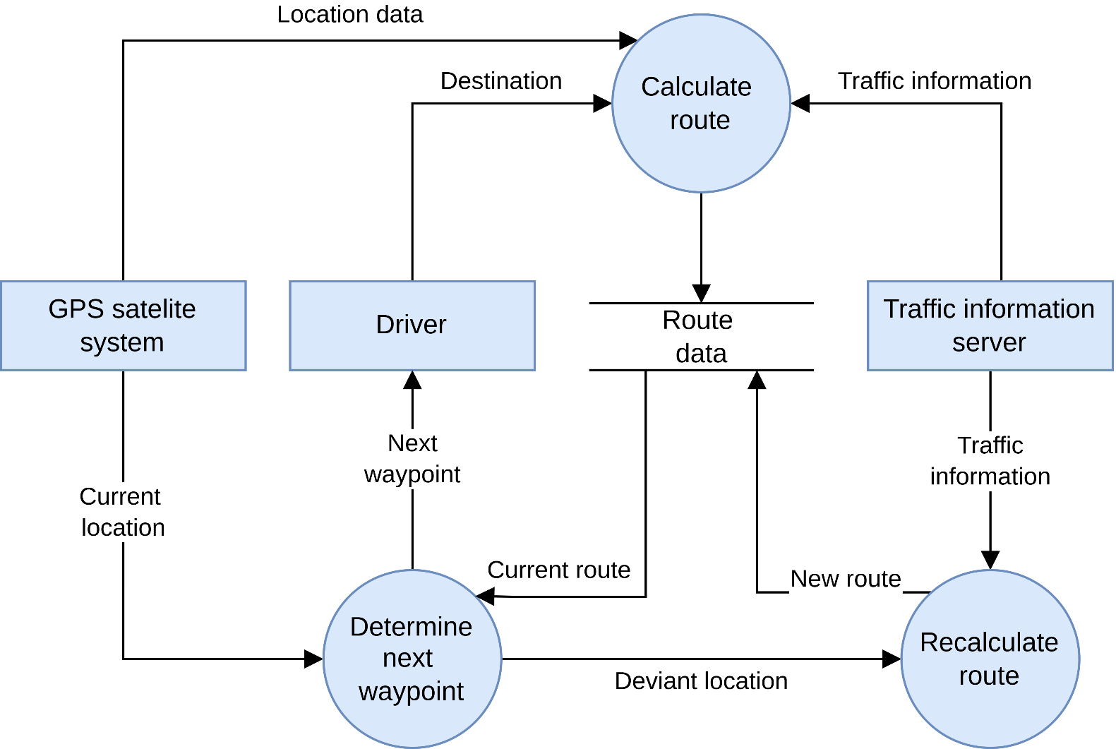
Model-based Requirements Documentation Techniques
Functional Perspective – Data Flow Diagrams (Example)
Based on K. Pohl, C. Rupp (2011) – Requirements Engineering Fundamentals: A study guide for Requirements Engineering Foundation Level
Notes:
Vier Variablen Modell in einem Satz: Grundlagen sind Variablen (Grundlegendes Modell), Erweiterung über Realtionen -> Grundlage für Dokumente: Wie dokumentiere ich sowas
Controlled V-> Ausgabewerte die durch das System beschrieben / verändert werden
Monitored V -> EingabeWerte, die durch das System beschrieben werden
Output V -> represents controlled V.
Input V -> represents monitored V.
Eschbach, Elicitation & Modeling: Embedded Systems Industrial Formal Techniques, 2006

Slide 48
Model-based Requirements Documentation Techniques
Functional Perspective – UML Activity Diagrams
Method to model action sequences
Depict the control flow between activities and actions
Can include the data flow (optional!)
Notes:
Vier Variablen Modell in einem Satz: Grundlagen sind Variablen (Grundlegendes Modell), Erweiterung über Realtionen -> Grundlage für Dokumente: Wie dokumentiere ich sowas
Controlled V-> Ausgabewerte die durch das System beschrieben / verändert werden
Monitored V -> EingabeWerte, die durch das System beschrieben werden
Output V -> represents controlled V.
Input V -> represents monitored V.
Eschbach, Elicitation & Modeling: Embedded Systems Industrial Formal Techniques, 2006

Slide 49
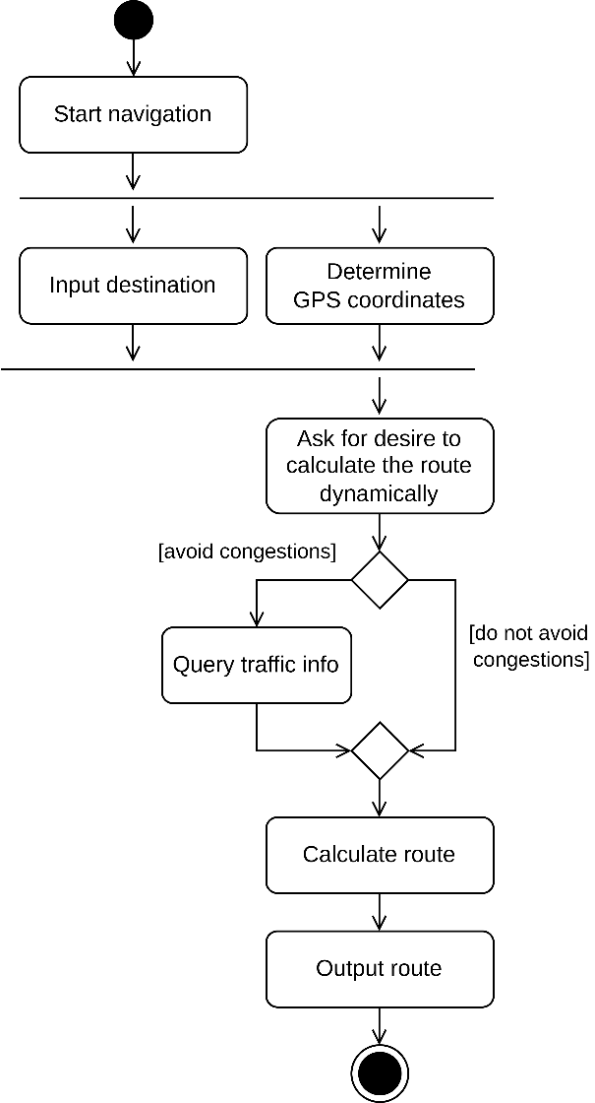
Model-based Requirements Documentation Techniques
Functional Perspective – UML Activity Diagrams (Example)
Based on K. Pohl, C. Rupp (2011) – Requirements Engineering Fundamentals: A study guide for Requirements Engineering Foundation Level
Notes:
Vier Variablen Modell in einem Satz: Grundlagen sind Variablen (Grundlegendes Modell), Erweiterung über Realtionen -> Grundlage für Dokumente: Wie dokumentiere ich sowas
Controlled V-> Ausgabewerte die durch das System beschrieben / verändert werden
Monitored V -> EingabeWerte, die durch das System beschrieben werden
Output V -> represents controlled V.
Input V -> represents monitored V.
Eschbach, Elicitation & Modeling: Embedded Systems Industrial Formal Techniques, 2006

Slide 50
Model-based Requirements Documentation Techniques
Behavioural Perspective – Statecharts
Extension of finite automata
Support hierarchization of states
Allow concurrent behavior
Notes:
Vier Variablen Modell in einem Satz: Grundlagen sind Variablen (Grundlegendes Modell), Erweiterung über Realtionen -> Grundlage für Dokumente: Wie dokumentiere ich sowas
Controlled V-> Ausgabewerte die durch das System beschrieben / verändert werden
Monitored V -> EingabeWerte, die durch das System beschrieben werden
Output V -> represents controlled V.
Input V -> represents monitored V.
Eschbach, Elicitation & Modeling: Embedded Systems Industrial Formal Techniques, 2006

Slide 51
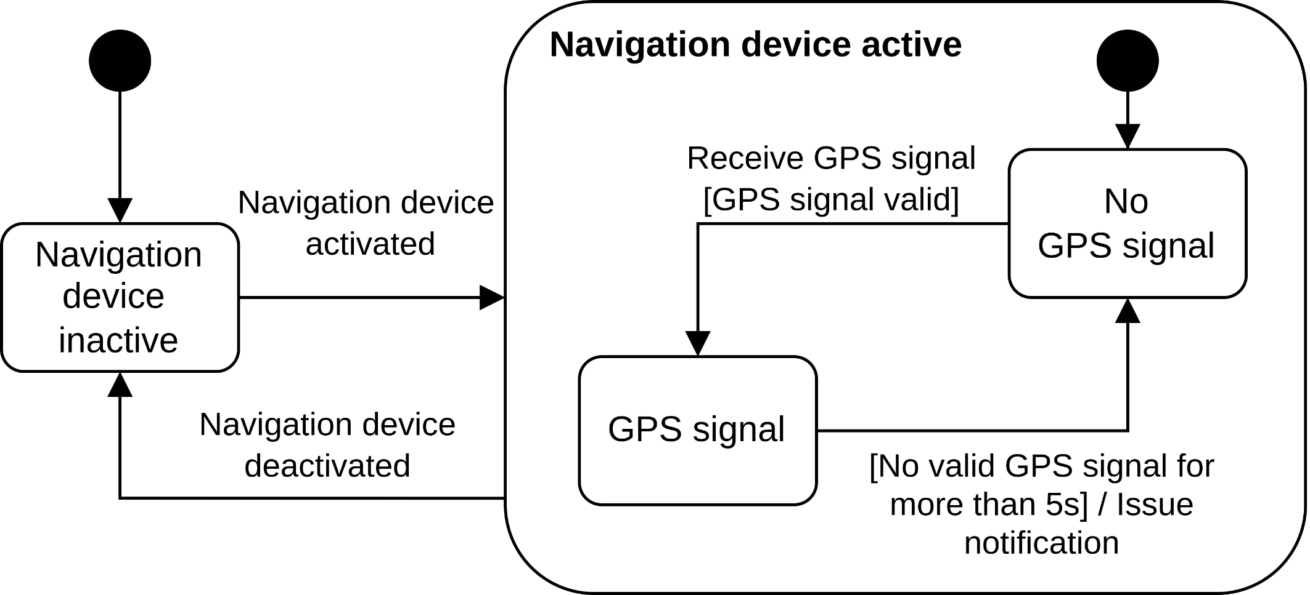
Model-based Requirements Documentation Techniques
Behavioural Perspective – Statechart (Example)
Based on K. Pohl, C. Rupp (2011) – Requirements Engineering Fundamentals: A study guide for Requirements Engineering Foundation Level
Notes:
Vier Variablen Modell in einem Satz: Grundlagen sind Variablen (Grundlegendes Modell), Erweiterung über Realtionen -> Grundlage für Dokumente: Wie dokumentiere ich sowas
Controlled V-> Ausgabewerte die durch das System beschrieben / verändert werden
Monitored V -> EingabeWerte, die durch das System beschrieben werden
Output V -> represents controlled V.
Input V -> represents monitored V.
Eschbach, Elicitation & Modeling: Embedded Systems Industrial Formal Techniques, 2006

Slide 52
Formal Requirements Specification

Slide 53
Lecture 4: Requirements Documentation
Content
Model-based Requirements Documentation Techniques
Formal Specification Techniques
Coloured Petri Nets (CPNs)
AOM → CPN Mapping
Four Variable Model
NRL / SCR

Slide 54
Formal Specification Techniques
Coloured Petri Nets – Motivation: Why CPNs?
They can model concurrency and communication in complex systems very well.
They combine concepts from Petri Nets and programming languages (CPN ML).
They are Formal (syntatically and mathematically defined)
They are executable.
They can be derived from other models, such as AOM.
Allows for easy manual or automatic system verification and evaluation.

Slide 55
Formal Specification Techniques
Coloured Petri Nets – What are CPNs?
Directed bipartite graphs:
Bipartite graphs divide the vertices of the graph into:
two disjoint and independent sets.
Edges in the graph ONLY connect vertices from one set to the other.

Slide 56
Formal Specification Techniques
Coloured Petri Nets – What are CPNs?
Directed bipartite graphs:
CPNs divide the vertices of the graph into:
Arcs in the graph ONLY connect Places with Transitions.
Places
Transitions
Places
Transitions

Slide 57
Formal Specification Techniques
Coloured Petri Nets – What are CPNs?
CPNs simulate the change of state in the system with the exchange of Tokens.
Tokens reside in, and flow between Places though transitions.
Tokens never stay in Transitions.
Places
Transitions

Slide 58
Formal Specification Techniques
Coloured Petri Nets – Core Concepts : ColorSets, Tokens and Variables
Places can hold tokens of only one type(= ColorSet ).
Tokens are instances of ColorSets.
Variables are used to distinguish tokens while in transit.
var a: INT;
var a2: INT;

Slide 59
Formal Specification Techniques
Coloured Petri Nets – Core Concepts : Markings, Arc Inscriptions and Guards
Markings specify the tokens held by a Place.
Arc Inscriptions are expressions that can modify the tokens when the transition occurs.
Guards are a comma-separated list of conditions that must be satisfied for a Transition.
var a: INT;
var a2: INT;

Slide 60
Formal Specification Techniques
Coloured Petri Nets – Core Concepts : Flow of Tokens
A Transition is enabled if and only if:
All it’s incoming arcs have at least one token.
All guard conditions are satisfied.
No place that is connected with an inhibhitor arc has any tokens.
var a: INT;
var a2: INT;

Slide 61
Formal Specification Techniques
Coloured Petri Nets – Core Concepts : Flow of Tokens
When a Transition is fired:
Any one suitable token is consumed from each input place, according to outgoing arc inscriptions.
The tokens are transferred to the output places according to outgoing arc inscriptions.
IMP: Only one transition can be fired at a time.
var a: INT;
var a2: INT;

Slide 62
Formal Specification Techniques
Coloured Petri Nets – Core Concepts : Hierarchical CPNs
var a: INT;
var a2: INT;

Slide 63
Formal Specification Techniques
Coloured Petri Nets – Evaluation using state-space simulations
Basic Idea
Compute all the reachable states and the state changes of the CPN model
Represent these as a directed graph where nodes represent states and arcs represent occurring events
Pros
From a constructed state–space, it is possible to verify various aspects of the behaviour of the system:
Absence of deadlocks
Possibility of always being able to reach a given state
Guaranteed delivery of a given service
Cons
State-space graph size (and computation time) increases exponentially! → requires independent computation in some cases.
K. Jensen et al. (2007) – Coloured Petri Nets and CPN Tools for modelling and validation of concurrent systems. International Journal on Software Tools for Technology Transfer (9): 213-254. DOI:10.1007/s10009-007-0038-x

Slide 64
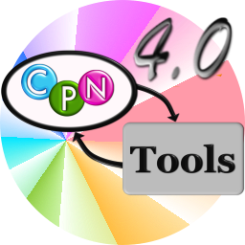
Formal Specification Techniques
Coloured Petri Nets – CPN Tools
“A tool for editing, simulating, and analysing Coloured Petri Nets”
cpntools.org

Slide 65
Lecture 4: Requirements Documentation
Content
Model-based Requirements Documentation Techniques
Formal Specification Techniques
Coloured Petri Nets (CPNs)
AOM → CPN Mapping
Four Variable Model
NRL / SCR

Slide 66
AOM → CPN Mapping
Motivation and Methodology
CPN models are powerful, BUT can be arbitrarily complex. Where to start?
It is important to ensure inter-model consistancy.
Mapping AOM → CPN models leverages the advantages of both, and also creates a feedback loop using the simulation and evaluation capabilities of CPNs.
Heuristics for Designing and Evaluating Socio-Technical Agent-Oriented Behaviour Models with Coloured Petri Nets (2014). Msury Mahunnah, Alex Norta, Lixin Ma, Kuldar Taveter
M. Mahunnah et al. (2014) – Heuristics for Designing and Evaluating Socio-technical Agent-Oriented Behaviour Models with Coloured Petri Nets. IEEE 38th International Computer Software and Applications Conference Workshops (2014): 438-443. https://doi.org/10.1109/COMPSACW.2014.74

Slide 67
AOM → CPN Mapping
Mapping Methodology
Notation | Name
 | Connecting arc
 | Sub-goal or activity
 | Trigger/ precondition
 | Postcondition
 | Goal
[<condition(s)>] | Precondition(s)
Trigger
Precondition
Activity
Postcondition
Adapted from M. Mahunnah et al. (2014) – Heuristics for Designing and Evaluating Socio-technical Agent-Oriented Behaviour Models with Coloured Petri Nets. IEEE 38th International Computer Software and Applications Conference Workshops (2014): 438-443. https://doi.org/10.1109/COMPSACW.2014.74

Slide 68
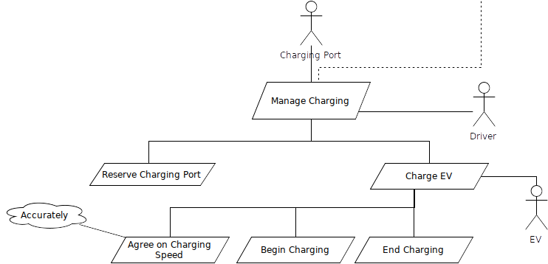
AOM → CPN Mapping
Example: Automated EV Charging Station (Manage Charging)

Slide 69
AOM → CPN Mapping
Example: Automated EV Charging Station (Manage Charging)
Activity | Trigger(s) | Precondition(s) | Postcondition(s)
Reserve Charging Port(CP) | Driver wants to charge EV | Driver has bought energy, CP is free, EV is ready to charge | Driver has reserved CP
Charge EV | 〃 | Driver has reserved CP | Driver has charged EV
Agree on charging speed | 〃 | Driver has reserved CP, Max CP speed ≥ Min EV speed, Max EV speed ≥ Min CP speed | Charging speed is agreed upon
Begin Charging | 〃 | Charging speed is agreed upon | EV has begun charging
End Charging | None | EV has competed charging | Driver has charged EV, CP is free

Slide 70
AOM → CPN Mapping
Example: Automated EV Charging Station (Manage Charging)

Slide 71
AOM → CPN Mapping
Example: Automated EV Charging Station (Charge EV)

Slide 72
AOM → CPN Mapping
State-space Simulations
Basic Idea
Compute all the reachable states and the state changes of the CPN model
Represent these as a directed graph where nodes represent states and arcs represent occurring events
Pros
From a constructed state–space, it is possible to verify various aspects of the behaviour of the system:
Absence of deadlocks
Possibility of always being able to reach a given state
Guaranteed delivery of a given service
Cons
State-space graph size (and computation time) increases exponentially! → requires independent computation in some cases.
K. Jensen et al. (2007) – Coloured Petri Nets and CPN Tools for modelling and validation of concurrent systems. International Journal on Software Tools for Technology Transfer (9): 213-254. DOI:10.1007/s10009-007-0038-x

Slide 73
Lecture 4: Requirements Documentation
Content
Model-based Requirements Documentation Techniques
Formal Specification Techniques
Coloured Petri Nets (CPNs)
AOM → CPN Mapping
Four Variable Model
NRL / SCR

Slide 74
Formal Specification Techniques
Four Variable Model – Basic Elements
Four Variables
Input variables → Physical variables measured by input devices
Output variables → Physical variables controlled by output devices
Monitored environmental variables
Controlled environmental variables
Relations
NAT, REQ, IN/OUT, SOF, SOFREQ
Are used as basis for requirements documentation
Notes:
Vier Variablen Modell in einem Satz: Grundlagen sind Variablen (Grundlegendes Modell), Erweiterung über Realtionen -> Grundlage für Dokumente: Wie dokumentiere ich sowas
Controlled V-> Ausgabewerte die durch das System beschrieben / verändert werden
Monitored V -> EingabeWerte, die durch das System beschrieben werden
Output V -> represents controlled V.
Input V -> represents monitored V.
Eschbach, Elicitation & Modeling: Embedded Systems Industrial Formal Techniques, 2006

Slide 75
Formal Specification Techniques
Four Variable Model – Documents
System Requirements Document
Models the complete system as a black-box
Includes a description of the environment
Identifies a set of quantities and associates each one with a mathematical variable
Describes constraints of the environment like physical laws
Describes constraints related to the new system
Notes:
beschreibt das System als Black-Box
beschreibt die Systemumgebung
identifiziert Messgrößen, die mathematisch beschrieben werden können
beschreibt physikalische / System Einschränkungen
Grundidee alles mathematisch formal beschreiben – identifizieren von Größen, jede dieser Umgebungseigenschaften wird durch mathematische Variablen beschrieben
Wie schnell ist das auto -> das nenne ich dann v -> monitored variable = wie schnell drehen sich die räder?
Bsp Airbus – ich messe wann das flugzeug am boden ist und nicht umdrehungsgeschw. Der Räder
Eschbach, Elicitation & Modeling: Embedded Systems Industrial Formal Techniques, 2006

Slide 76
Formal Specification Techniques
Four Variable Model – Documents
System Design Document
Describes relevant properties of peripheral devices
Identifies input- and output registers, modeled as mathematical variables
Describes relation between input registers and associated environmental quantities
Describes relation between output registers and associated environmental quantities
Notes:
beschreibt die notwendigen Eigenschaften der anzuschließenden Geräte
identifiziert Input- und Output-Register (modelliert als math. Variablen) = pseudo speicherstellen für tatsächliche größen
beschreibt Relation zwischen Input-Registern und Umgebungswerten
beschreibt Relation zwischen Output-Registern und Umgebungswerten
Eschbach, Elicitation & Modeling: Embedded Systems Industrial Formal Techniques, 2006

Slide 77
Formal Specification Techniques
Four Variable Model – Documents
Software Requirements Document
Combination of system requirements document and system design document
Software Behavior Specification
Records additional design decisions
Provides a description of the actual software behavior
Notes:
Warum fasse ich system req & system design doc zusammen? -> Ergeben zusammen die Anforderungen an die Software
Eschbach, Elicitation & Modeling: Embedded Systems Industrial Formal Techniques, 2006

Slide 78
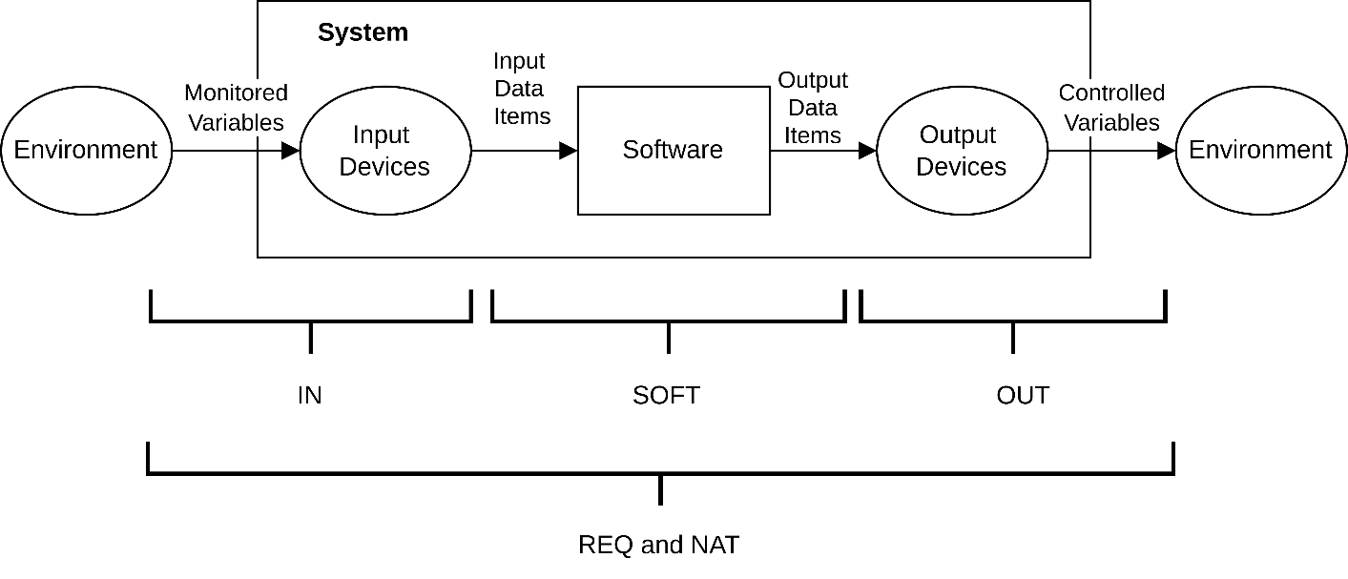
Formal Specification Techniques
NAT: expresses constraints due to restrictions imposed by nature
REQ: expresses the requirements of the system
IN, OUT: input and output relations
SOF: behavior of a particular software implementation
SOFREQ: software requirements relation, all acceptable software behavior
Four Variable Model – Relations
Based on C.L. Heitmeyer, R.D. Jeffords, B.G. Labaw (2013) – Automated Consistency Checking Requirements Specifications
Notes:
NAT = natürliche Einschränkungen
REQ = erwartetes Verhalten des Systems
IN/OUT = Verhalten der Ein/Ausgabegeräte
SOF = akt SW-Verhalten
SOFREQ = beschreibt das Verhalten der Software, dessen Rahmen akzeptabel wäre
m(t) = monitored variables
i(t)= input variables
o(t)= output variables
c(t)= controlled variables
Eschbach, Elicitation & Modeling: Embedded Systems Industrial Formal Techniques, 2006

Slide 79
Formal Specification Techniques
Four Variable Model – Basic Relations
Basic Relations
SOFREQ ⊆ SOF
IN, OUT, REQ SOFREQ
OUT ○ SOFREQ ○ IN = REQ
REQ
w.r.t. NAT
SOFREQ
IN
OUT

Slide 80
Formal Specification Techniques
Four Variable Model – Variables
Monitored variables
Mathematical function whose domain consists of real numbers
Environmental function m^{t} : ℝ→Value
Value at time s: m^{t}(s)
Vector of monitored variables: m^{t} = (m^{t}₁,m^{t}₂, . . . ,m^{t}_{p})
Controlled variables
Mathematical function whose domain consists of real numbers
Environmental function c^{t} : ℝ→Value
Vector of monitored variables: c^{t} = (c^{t}₁,c^{t}₂, . . . ,c^{t}_{q})
~
~
Notes:
Eschbach, Elicitation & Modeling: Embedded Systems Industrial Formal Techniques, 2006

Slide 81
Formal Specification Techniques
Four Variable Model – Relations
REQ
Expresses the requirements of the system
domain(REQ): set of vectors containing exactly the instances of m^{t} allowed by the environmental constraints
range(REQ): set of vectors containing only those instances of c^{t} considered permissible
(m^{t}, c^{t}) ∈ REQ if environmental constraints allow the controlled variables to take the values given by c^{t}, if the values of the monitored variables are given by m^{t}
REQ may tolerate ’small’ errors in the values of controlled variables
~
Notes:
Domain = Menge von Vektoren mit allen monitored Variablen
Range = Menge von Vektoren mit allen controlled Variablen
(m,c) elem REQ gdw zu jeder contrallod auch eine monitored existiert
Eschbach, Elicitation & Modeling: Embedded Systems Industrial Formal Techniques, 2006

Slide 82
Formal Specification Techniques
Four Variable Model – Relations
IN
Describes the behavior of the input devices
Is a relation due to imprecision in the measurement
OUT
Describes the behavior of output devices
Is a relation due to device imperfections
Notes:
IN = Verhalten der Eingabgeräte, Ungenauigkeiten betrachten
OUT = Verhalten der Ausgabgeräte
Eschbach, Elicitation & Modeling: Embedded Systems Industrial Formal Techniques, 2006

Slide 83
Formal Specification Techniques
Four Variable Model – Relations
SOF
Describes behavior of a particular software implementation
domain(SOF): set of vectors containing all possible instances of i^{t}
range(SOF): set of vectors containing all possible instances of o^{t}
(i^{t}, o^{t}) ∈ SOF iff the software could produce values described by o^{t}
Verification condition: SOF implements a subset of REQ
SOF ⊆ IN⁻¹ ○ REQ ○ OUT⁻¹
(where ○ denotes the composition of binary relations)
Often: SOF = IN⁻¹ ○ REQ ○ OUT⁻¹
Notes:
Domain = Menge von Vektoren mit Eingaben
Range = Menge von Vektoren mit Ausgaben
(i,o) elem SOF gdw alle Werte in o produziert werden können
Verification:
REQ = INoSOFREQo OUT
IN-1o REQ o OUT-1 = SOFREQ
IN-1o REQ o OUT-1 = SOFREQ superset SOF
Eschbach, Elicitation & Modeling: Embedded Systems Industrial Formal Techniques, 2006

Slide 84
Formal Specification Techniques
Four Variable Model – Relations
SOFREQ
Characterizes all acceptable software behavior
SOFREQ corresponds on the software level to REQ on the system level
It consists of all tuples (i ^{t}, o ^{t}) satisfying for all m^{t}, c^{t} :
(IN(m^{t} ,i^{t}) ⋀ OUT(o^{t}, c^{t}) ⋀ NAT(m^{t}, c^{t})) → REQ(m^{t}, c^{t})
Notes:
SOFREQ = akzeptiertes Verhalten
Eingaben messen und Ausgaben produzieren und Naturbedingungen ebenfalls gelten, dann können Anforderungen gefolgert werden
→Erlaubtes Verhalten aufgrund der Naturgegebenheiten
Eschbach, Elicitation & Modeling: Embedded Systems Industrial Formal Techniques, 2006

Slide 85
Formal Specification Techniques
Four Variable Model – Feasibility and Acceptability
Feasibility of REQ w.r.t. NAT
Requirements should specify behavior for all cases that can arise
domain(NAT) ⊆ domain(REQ)
domain(NAT ⋂ REQ) = domain(NAT) ⋂ domain(REQ) = domain(NAT)
Acceptability
Describes the behavior that the software must exhibit to be acceptable for use and for the requirements to be satisfied
NAT ⋂ (IN ○ SOF ○ OUT) ⊆ REQ
Notes:
Feasability = ich fordere nichts was im Wiederspruch zur Natur ist
Acceptability = beschreibt das Verhalten der SW, das mindestens erfüllt werden muss, um sie SW zu benutzen
SW-Verhalten beschränken auf NAT -> Verhalten entspricht anf
Ariane 4 – sw funktioniert einwandfrei wenn die beschleunigungskräfte nicht über best. Betrag liegen (nat n sof)
Ariane 5 – nat hat sich geändert
Eschbach, Elicitation & Modeling: Embedded Systems Industrial Formal Techniques, 2006
David Lorge Parnas, Jan Madey. Functional Documents for Computer Science. Science of Computer Programming, Elsevier, 1995
Dennis K. Peters and David Lorge Parnas. Requirements-based Monitors for Real-Time Systems. IEEE Transactions on

Slide 86
Lecture 4: Requirements Documentation
Content
Model-based Requirements Documentation Techniques
Formal Specification Techniques
Coloured Petri Nets (CPNs)
AOM → CPN Mapping
Four Variable Model
NRL / SCR

Slide 87
Formal Specification Techniques
NRL / SCR – Motivation
Tabular notations → precise and compact notation for requirements
Applications → avionics systems, controlling nuclear power plants, telephone networks
Can be used for automatic analysis
History
1978: flight program of the A-7 aircraft
Real-time, embedded system
Organizations: Bell Laboratories, Ontario Hydro, Naval Research Laboratory, Lockheed
Applications: submarine communication system, shutdown system for the Darlington nuclear power plant, flight program for Lockheed’s C130J aircraft.
Notes:
NRL/SCR -> SCR = Name, Erfinder waren zu der Zeit am NRL.
Eschbach, Elicitation & Modeling: Embedded Systems Industrial Formal Techniques, 2006

Slide 88
Formal Specification Techniques
NRL / SCR – SCR Formal Model
Behavior
Non-deterministic system environment
Deterministic system behavior
4VM → Monitored and controlled variables, NAT, REQ
Model: System is represented as labeled transition system (LTS), responds to each monitored event
Synchronous behavior: The system completely processes one set of inputs before processing the next state
One input assumption: At most one monitored variable is allowed to change from one state to the next
Notes:
Eschbach, Elicitation & Modeling: Embedded Systems Industrial Formal Techniques, 2006

Slide 89
Formal Specification Techniques / NRL / SCR
NRL / SCR – SCR Formal Model
Auxiliary variables: (specification of REQ)
Mode classes: values are called modes
Modes: equivalence class of system states
Terms: internal variables
System: labeled transition system (S, I, E^{m},→) consisting of
States S, initial states I
Labels E^{m} (set of monitored events)
Transition relation → realized as a function that maps a monitored event e ∈ E^{m} and the current state s ∈ S to the next state s’ ∈ S
Notes:
Hilfsvar werden eingeführt um REQ einfacher hinzuschreiben
Auxiliary V: = Hilfsvariablen – Modi – repräsentieren System Status
System = unter bestimmten Bedingungen gibt es Zustandsübergang – Zustandsdiagramm UML
Eschbach, Elicitation & Modeling: Embedded Systems Industrial Formal Techniques, 2006

Slide 90
Formal Specification Techniques / NRL / SCR
NRL / SCR – SCR Formal Model
Condition → Predicate defined on a single system state
Event → Predicate defined on two system states
Occurrence → An event occurs if a condition changes
@T(c): c becomes true
@F(c): c becomes false
Conditioned event → @T(c₁) WHEN c₂
Special form: @T(c) WHEN d iff ¬c ⋀ c’ ⋀ d
Notes:
Bedingungen = beziehen sich auf einen Status
Event = verbindet 2 Systemzustände
Vorkommen: ein Event tritt auf wenn Bedingung ändert
@T(c) = der moment in dem c wahr wird
Conditioned event = Event unter bedingung
Special form = verschärfte Form von Conditioned Event
Eschbach, Elicitation & Modeling: Embedded Systems Industrial Formal Techniques, 2006

Slide 91
Formal Specification Techniques / NRL / SCR
NRL / SCR – SCR Tables
Mode transition table:
Associates a source mode and an event with a destination mode
Each table should describe a total function
Should exhibit disjointness and coverage properties
Event table:
An event table defines how a term or controlled variable changes in response to input events
Defines a (partial) function from modes and events to variable values
Condition table:
A condition table defines the value of a term or controlled variable under every possible condition
Defines a total function from modes and conditions to variable values
Notes:
Mode transition table = mode + event = neuer mode - Verbindet den Ausgangsmodus und ein Event mit einem Zielmodus
Event table = Veränderungen von termen / contr. Variablen in abh. Von inputs
Cond. Table = Wert einer controlled Variable unter jeder möglichen Bedingung
Easterbrook: L17-formalmodelling

Slide 92
Formal Specification Techniques / NRL / SCR
NRL / SCR – SCR Tables
Current Mode | Powered on | Too Cold | Temp OK | Too Hot | New Mode
Off | @T @T @T | - t - | t - - | - - t | Inactive Heat AC
Inactive | @F - - | - @T - | - - - | - - @ | Off Heat AC
Heat | @F - | - - | - @T | - - | Off Inactive
AC | @F - | - - | - @T | - - | Off Inactive
Notes:
Easterbrook: L17-formalmodelling

Slide 93
Formal Specification Techniques / NRL / SCR
NRL / SCR – SCR Tables
Modes
NoFailure | @T(INMODE) | Never
ACFailure, HeatFailure | Never | @T(INMODE)
Warning light = | Off | On
Event table
Modes | Events
NoFailure | true | false
ACFailure | temp > temp0 | temp <= temp0
HeatFailure | false | waterlevel = low
Warning light = | Off | On
Condition table
Notes:
Easterbrook: L17-formalmodelling

Slide 94
Formal Specification Techniques / NRL / SCR
NRL / SCR – Tool Support: SCR Toolset
Specification editor for creating the tabular specification
Simulator for validation
Dependency graph browser for understanding the relationship between different parts of the specification
Consistency checker for analyzing syntax, type correctness, determinism, case coverage, ...
Model checker for checking linear temporal properties of finite state systems
Theorem prover for checking properties deductively, avoiding the state explosion problem, often user interaction necessary
Notes:
Eschbach, Elicitation & Modeling: Embedded Systems Industrial Formal Techniques, 2006

Slide 95
Formal Specification Techniques / NRL / SCR
NRL / SCR – SCR Toolset: Construction of Requirements Specifications
Specification
Specification editor
Function tables: define the value of dependent variables
Dictionaries: variable declarations, environmental assumptions, type definitions
Analysis
Consistency checker, property checker, dependency graph browser
Well-formedness errors
Disjointness and coverage: no nondeterminism, no missing cases
Notes:
Eschbach, Elicitation & Modeling: Embedded Systems Industrial Formal Techniques, 2006

Slide 96
Formal Specification Techniques / NRL / SCR
NRL / SCR – SCR Toolset: Construction of Requirements Specifications
Validation
Check inconsistencies between the intended and the specified behavior
Simulator: the user can run scenarios (sequences of monitored events)
Invariant generator: the user can generate state invariants
Application analysis
Check application properties
Model checker
Property checker
Theorem prover (TAME, PVS)
Notes:
Eschbach, Elicitation & Modeling: Embedded Systems Industrial Formal Techniques, 2006
Constance Heitmeyer, Myla Archer, Ramesh Bharadwaj and Ralph Jeffords. Tools for constructing requirements specifications: The SCR toolset at the age of ten. International Journal of Computer Systems Science & Engineering, Vol 20, No. 1, p 19-35, January 2005

Slide 97
Summary

Slide 98
Summary
Conceptual models as a means for requirements documentation
Abstraction and good overview vs. learning a modeling language
Different models for different purposes → Model needs to fit the purpose
UML provides models for almost anything
We only covered a small part → Other UML models can also be useful for requirements documentation
UML is not the only answer → Other models work fine, too.
Formal specification techniques
Coloured Petri Nets (incl. mapping from AOM), four variable model, NRL/SCR
More exist and might be better suited for your project

Slide 99
Questions?

Slide 100
References

