Slide 1
Requirement Engineering
Lecture 7: Requirements Management
Prof. Dr. Benjamin Leiding
Anant Sujatanagarjuna

Slide 2
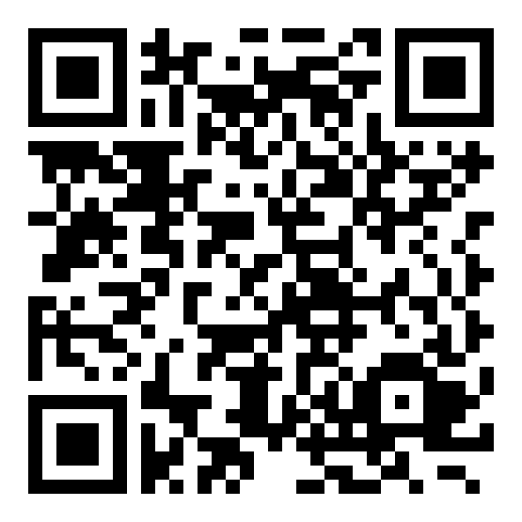
Course Evaluation – QR Code and Link
Link: Click Me

Slide 3
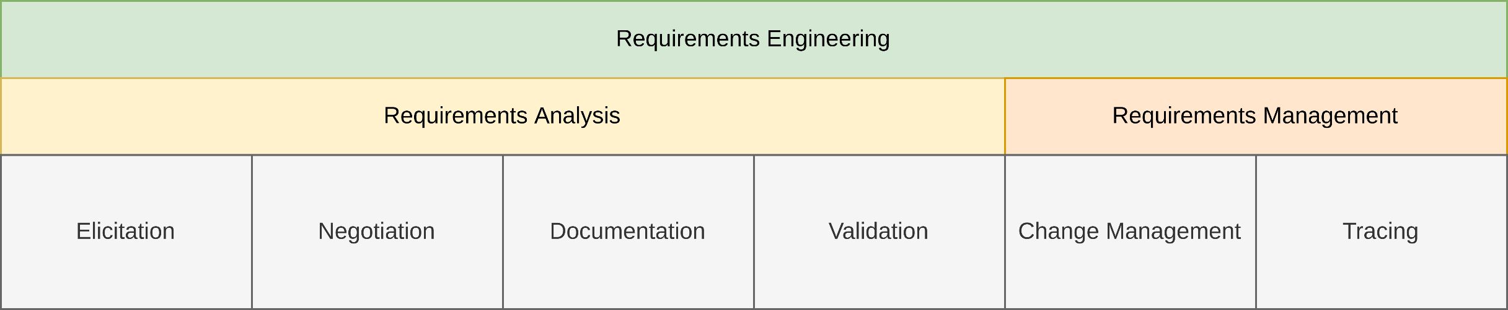
General Requirements Engineering Process
Overview

Slide 4
Lecture 7: Requirements Management
Content
Manage Requirements
Change Management

Slide 5
Manage Requirements

Slide 6
Manage Requirements
Motivation – Why do you need to manage requirements?
Number/scope of requirements and further information
Expected product lifetime
Rate of changes to requirements and related docs
Number of stakeholders
Availability of stakeholders
Heterogeneity of stakeholder opinions
Future reusability
Number of expected releases
Etc.

Slide 7
Manage Requirements
Motivation – What exactly needs to be managed?
Requirements
Definitions
Goals
Assumptions
Test Case
User Story
Epics
Use Case
Architecture Description
Change Request
Issues

Slide 8
Manage Requirements
Definition – Management in Requirements Engineering
“The process of managing existing requirements and requirements related work products, including the storing, changing and tracing of requirements (traceability).”
Martin Glinz (2020) – A Glossary of Requirements Engineering Terminology (Standard Glossary for the Certified Professional for Requirements Engineering (CPRE) Studies and Exam)

Slide 9
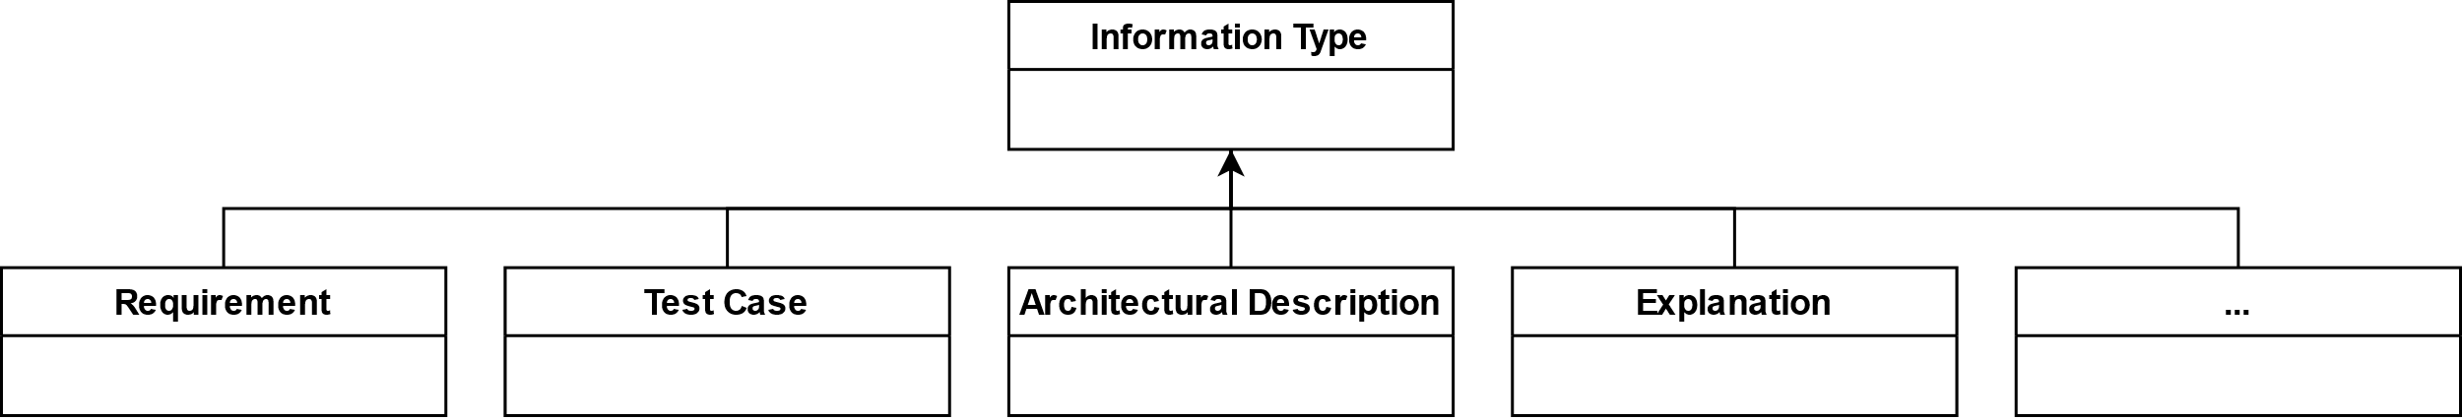
Manage Requirements
Information model - Simple
Based on Chris Rupp et al. (2021) – Requirements Engineering und Management – Das Handbuch für Anforderungen in jeder Situation (7th Edition)

Slide 10
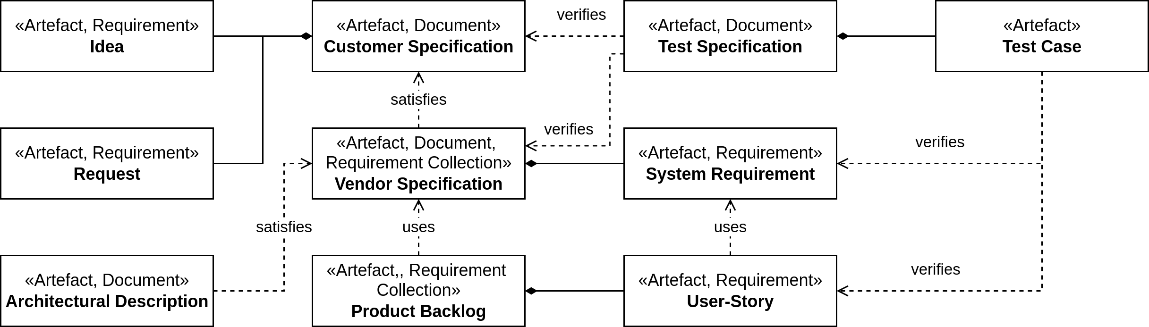
Manage Requirements
Information model – More complex
Based on Chris Rupp et al. (2021) – Requirements Engineering und Management – Das Handbuch für Anforderungen in jeder Situation (7th Edition)

Slide 11
Manage Requirements
Standardized structures and templates
Volere
V-Modell XT
IEEE 29148-2018
Etc.
1. https://www.volere.org/
2. Der Beauftragte der Bundesregierung für Informationstechnik. V-Modell XT (o.J.), URL: https://cio.bund.de/Web/DE/Architekturen-und-Standards/V-Modell-XT/vmodell_xt_node.html
3. https://standards.ieee.org/ieee/29148/6937/

Slide 12
Change Management

Slide 13
Change Management
Overview
Various reasons for changes
Errors or incomplete requirements
Evolution of context
Changes are not a bad thing
Stakeholders may gain new knowledge at later project stages
Proofs interest/involvement of the stakeholders
Frequent changes are problematic
Makes development in agreement with all stakeholders very challenging and time-consuming
Indicator for bad process quality

Slide 14
Change Management
Overview
Necessary to properly structure and process change requests for requirements
Structured process → Justifiable decisions if and how requests are approved
Changes may refer to:
Individual requirements, e.g., change/addition/removal of a feature
The requirements document itself, e.g., updating terminology

Slide 15
Change Management
Change Control Board
Change control board as entity responsible for change requests
Evaluation
Decision making
May delegate tasks to another party
For example, drafting of actual changes to the requirements
Decisions have to be negotiated and agreed upon
Contractor
All involved stakeholders

Slide 16
Change Management
Change Control Board – Tasks
Change effort estimation
Could be performed by third party
Evaluate change requests
For example, effort/benefit ratio
Define requirements change and/or new requirements
Based on the changed request
Changes should be kept to a minimum
Decide about acceptance or rejection of change requests

Slide 17
Change Management
Change Control Board – Tasks
Classify incoming changes
For example, based on their criticality
Prioritize accepted change requests
In which order should accepted changes be implemented?
Assign accepted change requests
Who is responsible for implementing the changes?

Slide 18
Change Management
Change Control Board – Members
The following parties should be represented in the change control board:
Change manager
Contractor
Architect
Developer
Configuration manager
Customer representative
Product manager
Project manager
Quality assurance representative
Requirements engineer

Slide 19
Change Management
Change Control Board – Change Manager
Chairperson of the change control board
Mediates between parties in case of conflicts
Communicates and documents changes
Similar to the role of the requirements engineer

Slide 20
Change Management
Change Requests
Should contain the following information:
Identifier
Unique identification of change request possible
Title
Summarizes key concern of the change request
Description
Documents change as precisely as possible
Also contains information on the expected effect of a change
Justification
Reasons why the change is necessary
Date filed
Date the change request was filed
Applicant
Name of the person who filed the change request
Priority
Importance of the change

Slide 21
Change Management
Change Requests
Date filed
Date the change request was filed
Applicant
Name of the person who filed the change request
Priority
Importance of the change

Slide 22
Change Management
Change Requests
The following information is helpful for the management of changes:
Change validator
Person who is responsible to verify if a change was performed correctly
Impact analysis status
Flag that shows if an impact analysis has been performed
Change control board decision status
Flat of the status of the handling of the request
For example, pending, rejected, accepted

Slide 23
Change Management
Change Requests
Change control board priority
Priority of the change request assigned by the change control board
Responsible
Person in charge of performing the change
System release
Version of the system that implements the change

Slide 24
Change Management
Change Requests – Classifications
Three types of change requests:
Corrective requirement change
Failure in the system Reason for failure is an error in the requirements
Change fixes the error
Adaptive requirement change
System needs to be amended
For example, change in the system context or stakeholder needs
Exceptional change (hotfix)
Must be immediately done at all costs
Can be either adaptive or corrective
Usually due to critical bugs

Slide 25
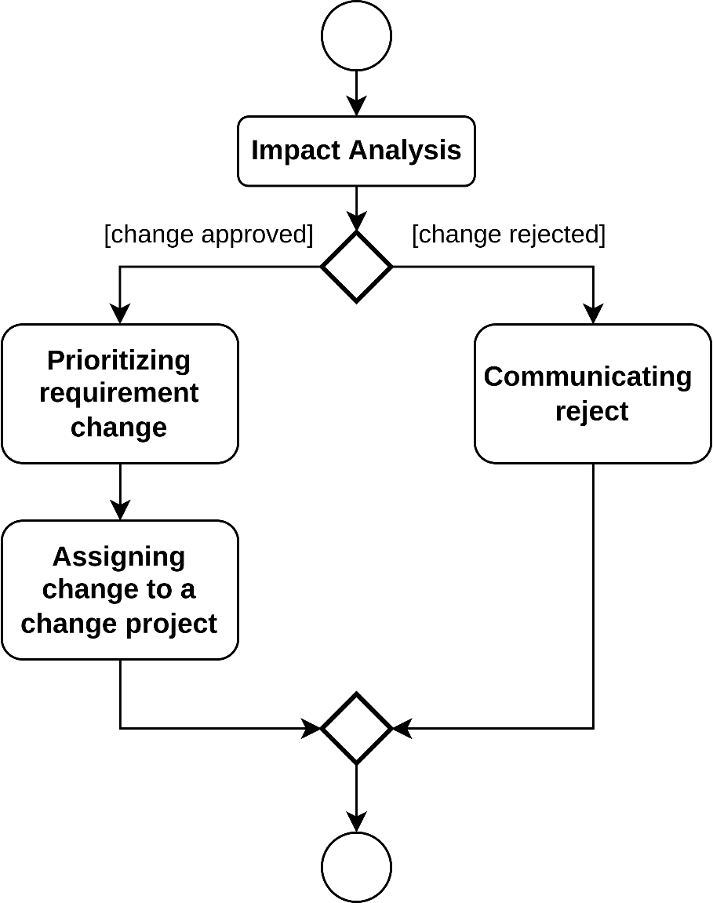
Change Management
Handling Change Requests
Impact analysis:
Effort the change is estimated
Affected requirements are determined
Includes new requirements
Development artifacts that need to be change are determined
Effort for artifact change usually significantly higher than for requirement changes
Maintaining the requirements document is cheap
Still often neglected
Can be supported by traceability information

Slide 26
Change Management
Handling Change Requests
Change evaluation
Costs and benefits are compared
Available resources are considered
Prioritizing
Importance of the change
Assigning
System release for implementing is decided
Rejection
If a change is rejected it is communicated

Slide 27
Summary

Slide 28
Summary
Requirements of complex projects need to be managed
Requirements can change throughout a project
Changes need to be structured and processed
Change management defines how change requests are handled
Change control board = Evaluates and approves/rejects changes
Handling change requests requires a process on its own

Slide 29
Questions?

