Slide 1
Requirement Engineering
Lecture 9: Tool Support
Prof. Dr. Benjamin Leiding
Anant Sujatanagarjuna

Slide 2
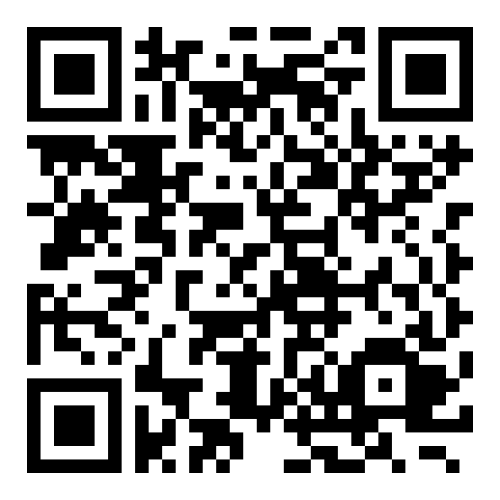
Course Evaluation – QR Code and Link
Link: Click Me

Slide 3
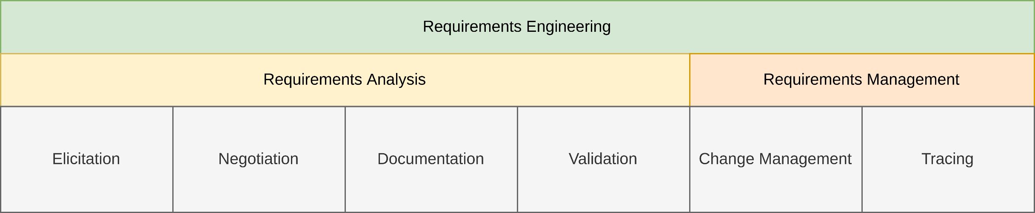
General Requirements Engineering Process
Overview

Slide 4
Lecture 9: Tool Support
Content
Tool Support in General
Requirements Management Tools
Introducing and Evaluating Tools

Slide 5
Tool Support in General

Slide 6
Tool Support in General
Motivation
Integrate and process already existing information
Information from requirements engineering
Natural language requirements, models, ...
Information that is the basis of requirements
Minutes, goal documents, stakeholder lists, ...
In practice mostly support of requirements management

Slide 7
Tool Support in General
Traceability between Tools
Usually, multiple tools are used
Interfaces for integration and traceability required
Should be either available or easy to create
Should allow tracing changes
Should allow managing the traces
Vital to know where changes are propagated to

Slide 8
Tool Support in General
Reuse of Tools from System Development
Tools for development can often be used for requirements engineering
Often offer ability to manage requirements
Examples:
Test management tools
Bug tracking tools
Configuration management tools
Advantage
Requirements automatically integrated with developed artifacts
Interface between requirements management tool and development tool not required

Slide 9
Tool Support in General
Wikis in Requirements Engineering
Wikis offer a simple to use and easy to access opportunity for collaboratively working on documents
Interesting for glossaries
Each wiki page defines a glossary term
Well suited if a lot of different stakeholders are involved

Slide 10
Tool Support in General
Visualization Tools
Mind mapping tools to support brainstorming sessions
Presentation tools can help guide through meetings and for describing rough analysis
GUI modeling tools for prototyping user interfaces
Flow charting tools to depict processes and work-flows

Slide 11
Tool Support in General
„Everyday” Tools
Mail clients, chat software, address books, online calendars vital for communication
Project management and controlling tools also required for managing the requirements engineering process
Help stakeholders with the coordination of tasks

Slide 12
Requirements Management Tools

Slide 13
Requirements Management Tools
Properties
Manage different types of information
Natural language requirements
Conceptual models
Sketches
Test plans
Change requests
Manage logical relationships
Traceability
Allow unique identification
Unique Ids for every artifact

Slide 14
Requirements Management Tools
Properties
Editors for managed information
Multi-user access
Access control
Configuration management
Version management
Different views on information
Developer view
Tester view
View on partial systems

Slide 15
Requirements Management Tools
Properties
Organization of managed information
Grouping
Hierarchical structuring
Assigning attributes
Annotation with additional information
Generation of reports and summaries
Reports of change requests
Reports on state of the requirements implementation
Generation of appropriate outputs
Requirements document for a system release

Slide 16
Requirements Management Tools
Special Purpose Tools
Comprehensive list:
http://www.volere.co.uk/tools.htm
Examples
Enterprise Architect (Sparx Systems)
HP Quality Center
IBM Rational DOORS

Slide 17
Requirements Management Tools
Standard Office Tools
Word processors, spreadsheet calculators
Used in many projects due to multiple reasons
Advantages
Are already available
No additional training required
Versatile
Well-suited for natural-language requirements
Adapted for requirements management, e.g., by using templates and predefined document formats
Allow traceability to some degree through hyperlinks

Slide 18
Requirements Management Tools
Standard Office Tools
Disadvantages
Do not offer version control on the level of requirements
Do not directly support requirements engineering, e.g., traceability links often have to be maintained manually
Drawbacks can be worked around
Still, the efficiency is lower than with a dedicated tool

Slide 19
Introducing and Evaluating Tools

Slide 20
Introducing and Evaluating Tools
Before Introducing Tools
Tools support existing processes
Process needs to be in place
Responsibilities must be clear
Techniques must be known
People must be able to follow all this
→ „Automating chaos just gives faster chaos“ (Dorothy Graham)

Slide 21
Introducing and Evaluating Tools
Before Introducing Tools
Choice and introduction of tool costs resources
Licensing costs
Training costs
Customization costs
Support costs
Not only current, but possible future efforts
Adaption of already existing artifacts may further increase the costs

Slide 22
Introducing and Evaluating Tools
Before Introducing Tools
Introduction into already started projects difficult
Structure in place
Existing concepts would have to be replaced
Effort and risk can be estimated
Often underestimated due to multiple factors
Employee resistance
Tool deficienciesInstead →

Slide 23
Introducing and Evaluating Tools
Before Introducing Tools
Introduction into already started projects difficult
Structure in place
Existing concepts would have to be replaced
Effort and risk can be estimated
Often underestimated due to multiple factors
Employee resistance
Tool deficiencies
Instead →

Slide 24
Introducing and Evaluating Tools
Before Introducing Tools
Introduction into already started projects difficult
Structure in place
Existing concepts would have to be replaced
Effort and risk can be estimated
Often underestimated due to multiple factors
Employee resistance
Tool deficiencies
Instead → pilot project

Slide 25
Introducing and Evaluating Tools
Evaluation of Tools
Different perspectives matter for tools
Project view
User view
Product view
Process view
Provider view
Technical view
Economic view
Should be taken into account when evaluating tools
Criteria for all views should be defined

Slide 26
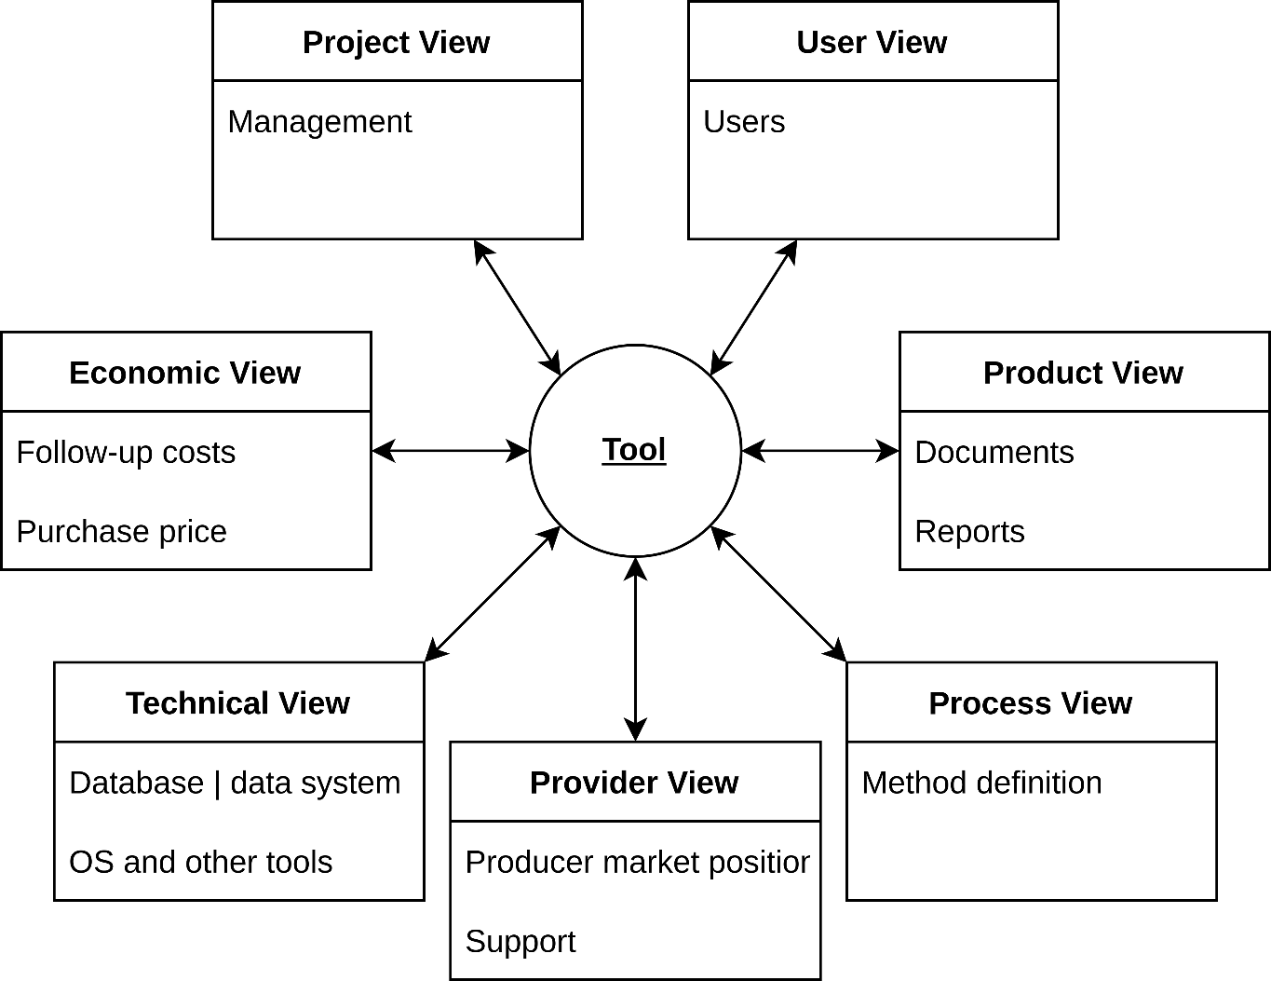
Introducing and Evaluating Tools
Views on RE Tools
Based on K. Pohl, C. Rupp (2011) – Requirements Engineering Fundamentals: A study guide for Requirements Engineering Foundation Level

Slide 27
Introducing and Evaluating Tools
Views on Tools: Project View
Extent to which a tool can support a project
Project preparation
Definition of project-specific information types
Definition of project-specific document formats
Project planning
Scope of milestones
How information managed by the tool pertains to milestones
Project execution
Project control, e.g., completion of requirements

Slide 28
Introducing and Evaluating Tools
Views on Tools: User View
Tool requirements from the user‘s perspective
Tool usage
Access to appropriate functions required
Mapping of roles
Stakeholders mapped to roles through user management and access rights
Support of group work
Multiple users should be able to work collaboratively

Slide 29
Introducing and Evaluating Tools
Views on Tools: Product View
Concerned with the functionalities possed by a tool
For example, for different documentation types
Considerations
Supported document types
Views on requirements
Reports that can be generated
Traceability

Slide 30
Introducing and Evaluating Tools
Views on Tools: Process View
From the perspective of method support
How does a tool support the application of a specific technique?
Ability to document activities
Method guidance
Strict and restrictive guidance (e.g., wizards)
Lenient guidance (e.g., suggestions and hints)
Project-specific process model definition
e.g, phases

Slide 31
Introducing and Evaluating Tools
Views on Tools: Provider View
Market position and services offered by the tool manufacturer
Brand awareness and reputation often important criteria
High costs and required long-term support require strong commitment

Slide 32
Introducing and Evaluating Tools
Views on Tools: Technical View
Considers technical context
Ability to integrate the tool with existing tools
Evaluate APIs
Performance of the tool
Evaluate how long importing/exporting data takes
Scalability
Maximum number of users/objects
Hardware and software requirements

Slide 33
Introducing and Evaluating Tools
Views on Tools: Economic View
Considers costs
Due to acquisition
Introduction
Maintenance
Integration costs
Operation costs
Method tailoring

Slide 34
Summary

Slide 35
Summary
Different kinds of tools available
Special RE tools vs. general purpose tools
A good process comes before a good tool
Whatever the tool, its use must be fitting for the process
New tools should be introduced in a pilot
Evaluating new tools is time consuming

Slide 36
Questions?

