Slide 1
IoT and Digitalization for the Circular Economy
Lecture 0: Organization
Prof. Dr. Benjamin Leiding
M.Sc. Anant Sujatanagarjuna
M.Sc Shohreh Kia

Slide 2
License
This work is licensed under a Creative Commons Attribution-ShareAlike 4.0 International License. To view a copy of this license, please refer to https://creativecommons.org/licenses/by-sa/4.0/ .
Updated versions of these slides will be available in our Github repository.

Slide 3
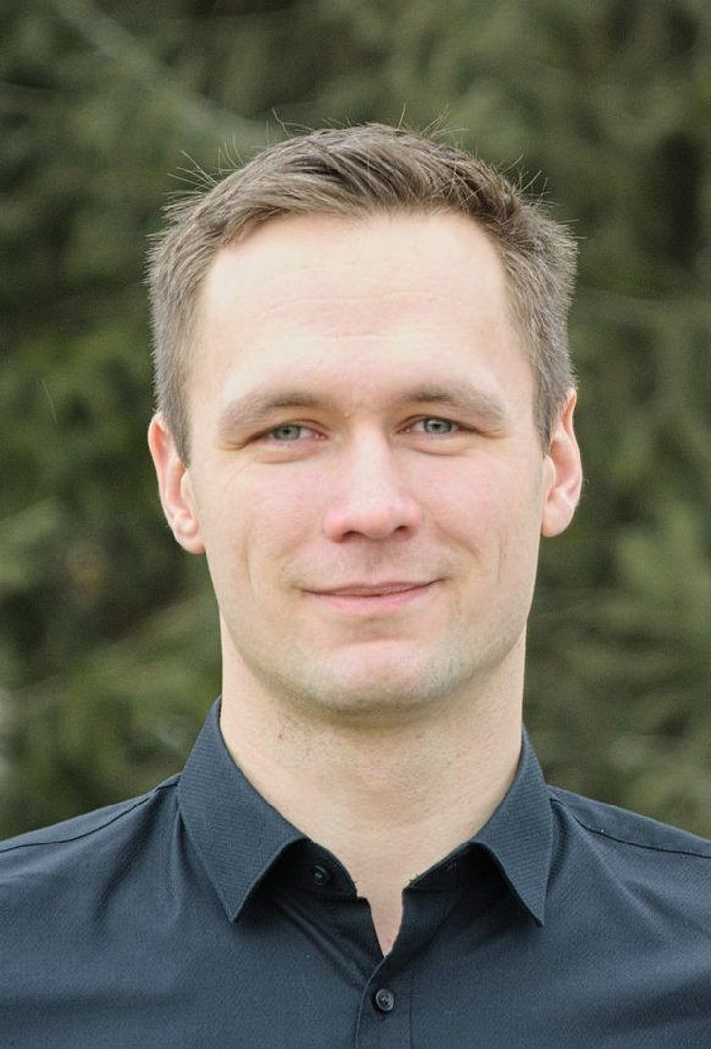
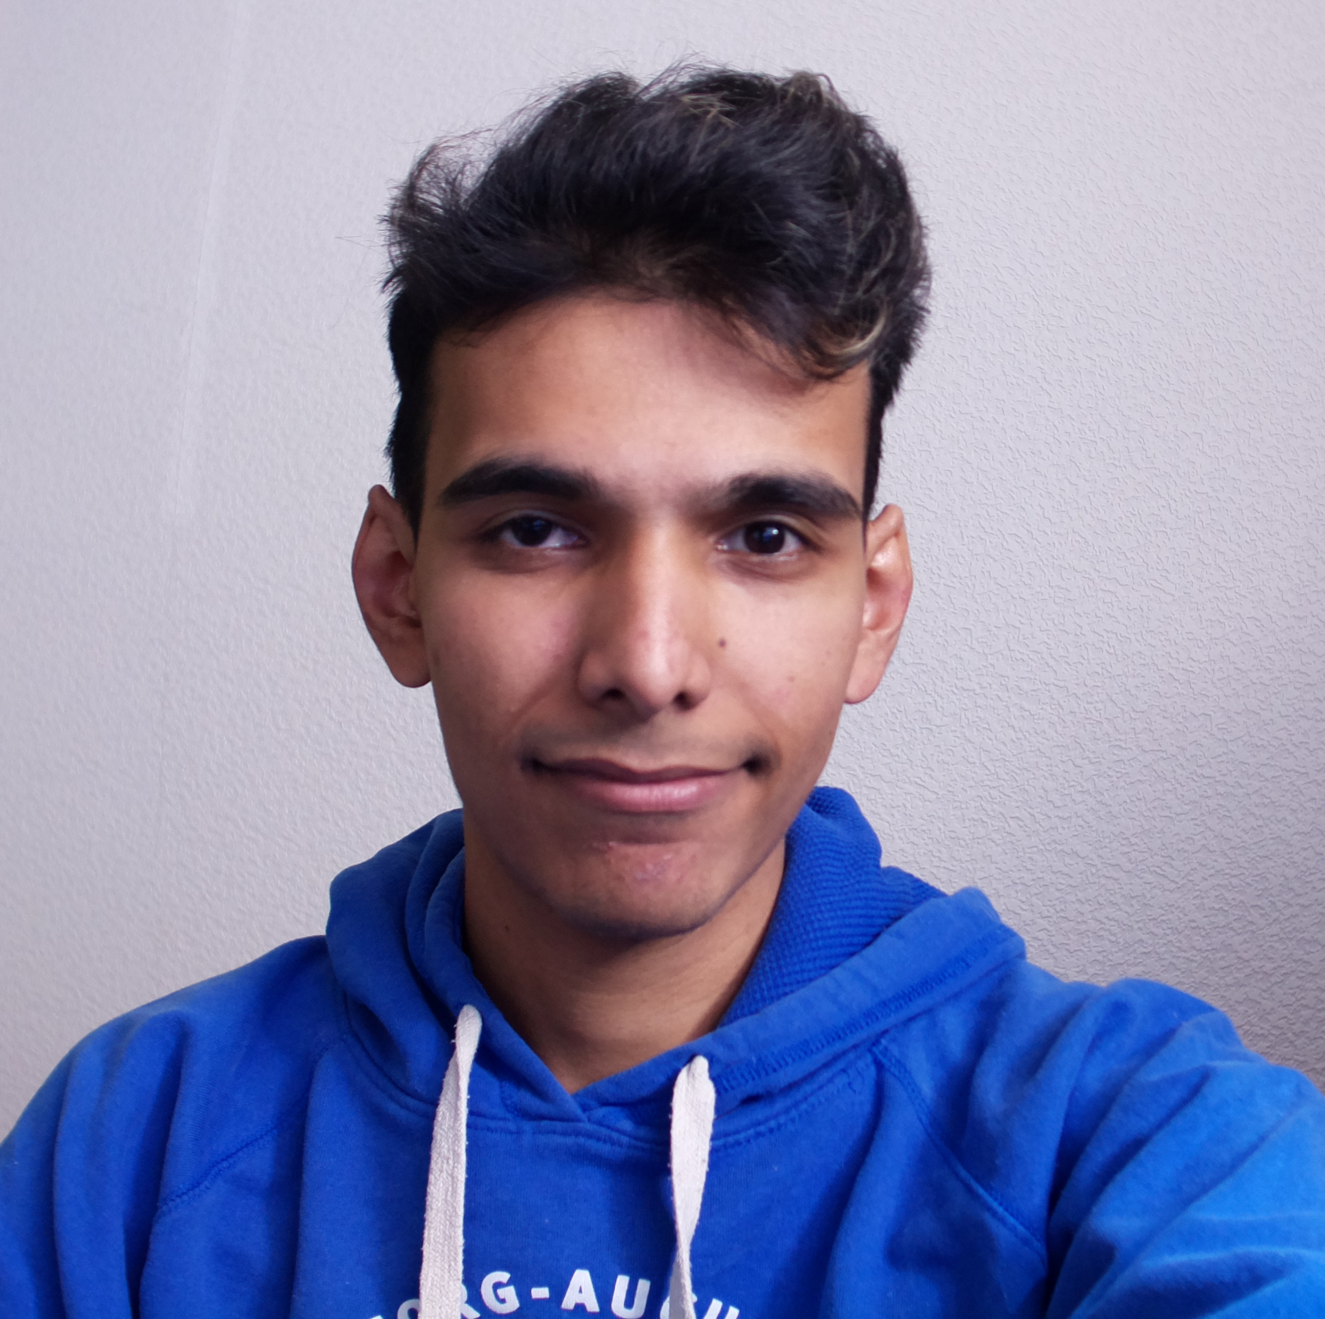
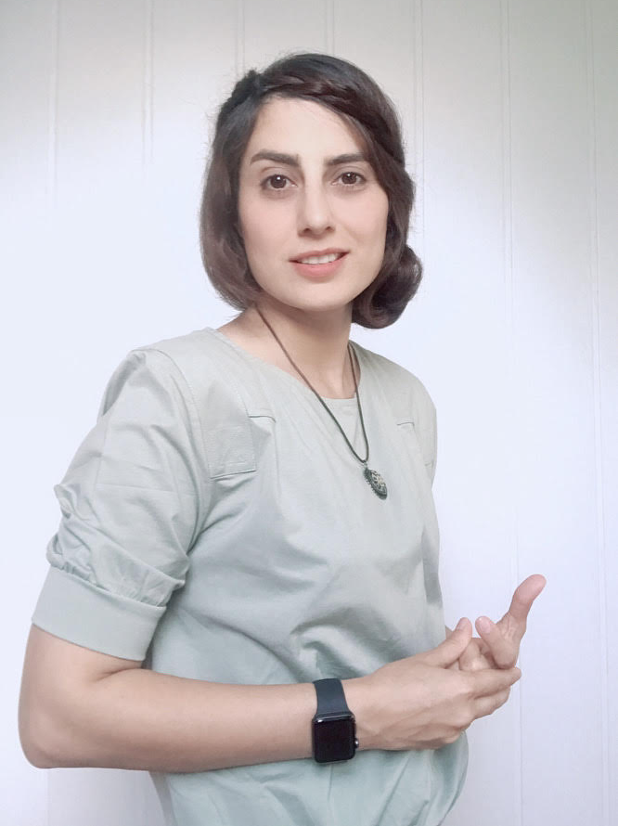
Team
Prof. Dr. Benjamin Leiding
M.Sc. Anant Sujatanagarjuna
M.Sc. Shohreh Kia

Slide 4
Research Group
Emerging Technologies for the Circular Economy → ETCE
Research focus:
Intersection of IT and sustainability
Circular Economy and Circular Societies
Self-organized, decentralized and distributed systems
Localized and resilient food production → Watch our mushrooms! (Link)
Other courses:
Requirements Engineering (WS – M.Sc.)
Emerging Technologies for the Circular Economy (SS – M.Sc.)
The Limits to Growth – Sustainability and the Circular Economy (SS/WS – open for everyone)
Notes:
<number>

Slide 5
Research Group
ETCE Website – Link
Course material
Theses/project topics
Our research in action:
ZDF documentary (German) – Link
Klartext Preis 2020 (German) – Link
You want join us? Write us an email!
→ benjamin.leiding@tu-clausthal.de
Notes:
<number>

Slide 6
Learning Outcome
Understanding the concept of a circular economy, sustainability, and related concepts (biocapacity, etc.).
Gain a basic understanding of causes, dimensions, and the characterization of climate change, environmental pollution, and dwindling non-renewable resources.
Introduction to IoT and cyberphysical systems in the circular economy
Sensors and actuators for IoT, control and process systems of the circular economy
Experience in prototyping IoT applications and systems
The ability to critically assess upcoming technological solutions enabling/facilitating sustainability and the circular economy.
Notes:
<number>

Slide 7
Lectures
24.10.2022 → No lecture
31.10.2022 → No lecture
07.11.2022 → Organization (L00) + Introduction I (L01)
14.11.2022 → Introduction II (L02)
21.11.2022 → Introduction III (L03)
28.11.2022 → What Happened So Far? (L04)
05.12.2022 → Life-Cycle Assessment – LCA (L05)
12.12.2022 → World3 (L06)
19.12.2022 → Circular Economy (L07)
09.01.2023 → Circular Society (L08)
16.01.2023 → Introduction to the Internet of Things (L09)
23.01.2023 → IoT Communication (L10) + IoT Security & Privacy (L11)
30.01.2023 → IoT Data Processing & Big Data (L12)
06.02.2023 → Technology (L13)
13.02.2023 → Exam Q&A

Slide 8
Lectures
17.04.2023 → Organization (L00) + Introduction (L01)
24.04.2023 → Circular Economy (L02)
08.05.2023 → Lifecycle Assessment – LCA (L03)
15.05.2023 → Introduction to the Internet of Things (L04)
22.05.2023 → Internet of Things – Communication + Security and Privacy (L05)
05.06.2023 → Internet of Things – Data Processing and BigData (L06)
→ Extra MOOC - Foodsharing
12.06.2023 → Industrial Internet of Things (L07)
19.06.2023 → Introduction to Blockchain Technology (L08)
26.06.2023 → Blockchain Technology – Consensus (L09)
03.07.2023 → Blockchain Technology – Ethereum and Smart Contracts (L10)
10.07.2023 → Blockchain Technology and Sustainability (L11)
17.07.2023 → Invited Lecture XOR The Machine-to-Everything Economy – A step towards the CE 2.0? (L12)

Slide 9
Exercises
14.11.2022 → Exercise 01 – Carbon Footprint
21.11.2022 → Exercise 02 – Household Waste
28.11.2022 → Exercise 03 – Your Favourite Fruit or Vegetable
05.12.2022 → Exercise 04 – LCA of Your Favourite Fruit or Vegetable
12.12.2022 → Exercise 05 – World3
19.12.2022 → Exercise 06 – Performance Economy
09.01.2023 → Exercise 07 – Circular Society
06.02.2023 → Exercise 08 – Technology

Slide 10
Course Organization
News and updates → StudIP
Slides → StudIP
Lecture recordings → StudIP
Further notes:
Recordings might contain irrelevant information (made for previous semesters) → Please ignore those.
Lecture/exercise numbers in the videos might not match your lecture/exercise number → Don’t worry.
Course news for this semester (WS22/23) and this course will be communicated via StudIP.

Slide 11
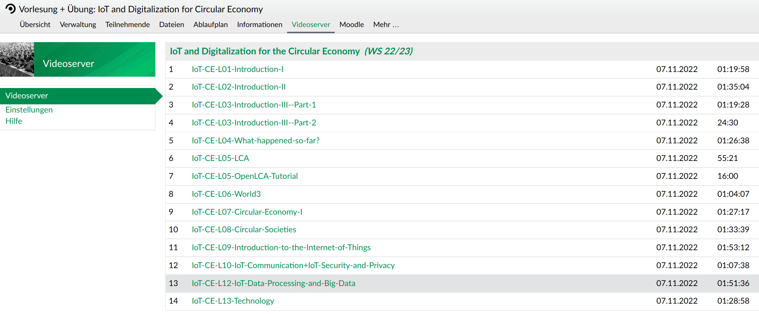
Course Organization

Slide 12
Dates/Times/Locations
Lecture:
Monday 1:15 pm to 2:45 pm (Berlin time) – 07.11.2022 to 13.02.2023
Location: BigBlueButton (Link) OR video recordings
Exercise / Q&A:
Monday 3 pm to 3:30 pm (Berlin time) – 07.11.2022 to 13.03.2023
Location: BigBlueButton (Link)
Practical Workshop in Goslar/CLZ:
When: 15.02.2023 (Wednesday) 9 am – 4pm (Berlin time)
Location: Goslar (DIGIT) or CLZ

Slide 13
Exercises and Practical Workshop
Individual work → no group submissions
Submission of each exercise is mandatory
You pass by submitting an exercise – even if it is an empty page
You will receive feedback on your submission (during Q&A session)
Exercise = learning feedback
Practical workshop → You pass the workshop if you score 50% (or more)
More info on points, percentages, etc. follow on the next slides (Examination)

Slide 14
Examination
Prerequisite for admission to the final exam (all criteria have to be fulfilled):
Submit all exercises
Pass the practical workshop
Final exam:
Most likely 23.02.2023
Oral examination (20min)
Online

Slide 15
Self-Study Star
Slides with the self-study star indicate optional/additional study material that is not mandatory but could be helpful or interesting
Self-Study Star →

Slide 16
Literature
This course is not based on a single book and you do not need to buy a book to pass the exam.
Donella H. Meadows, Jorgen Randers, and Dennis L. Meadows. The Limits to Growth (1972).
Donella H. Meadows, Jorgen Randers, and Dennis L. Meadows. Limits To Growth: The 30-Year Update (2004).
Baccini et al. Metabolism of the Anthroposphere: Analysis, Evaluation, Design (2012).
Walter R. Stahel. The Circular Economy: A User's Guide (2019).
W. Brian Arthur. The Nature of Technology: What It Is and How it Evolves (2011)

Slide 17
Literature
Perry Lea. Internet of Things for Architects: Architecting IoT solutions by implementing sensors, communication infrastructure, edge computing, analytics, and security (2018).
M.A. Khan, M.T. Quasim, F. Algarni, A. Alharthi. Decentralised Internet of Things (2020).
Dimitrios Serpanos und Marilyn Claire Wolf. Internet-of-Things (IoT) Systems Architectures, Algorithms, Methodologies (2018).

Slide 18
Questions?

