Slide 1
The Limits to Growth: Sustainability and the Circular Economy
Lecture 0: Organization
Prof. Dr. Benjamin Leiding
M.A. Theresa Sommer

Slide 2
License
This work is licensed under a Creative Commons Attribution-ShareAlike 4.0 International License. To view a copy of this license, please refer to https://creativecommons.org/licenses/by-sa/4.0/ .
Updated versions of these slides will be available in our Github repository.

Slide 3
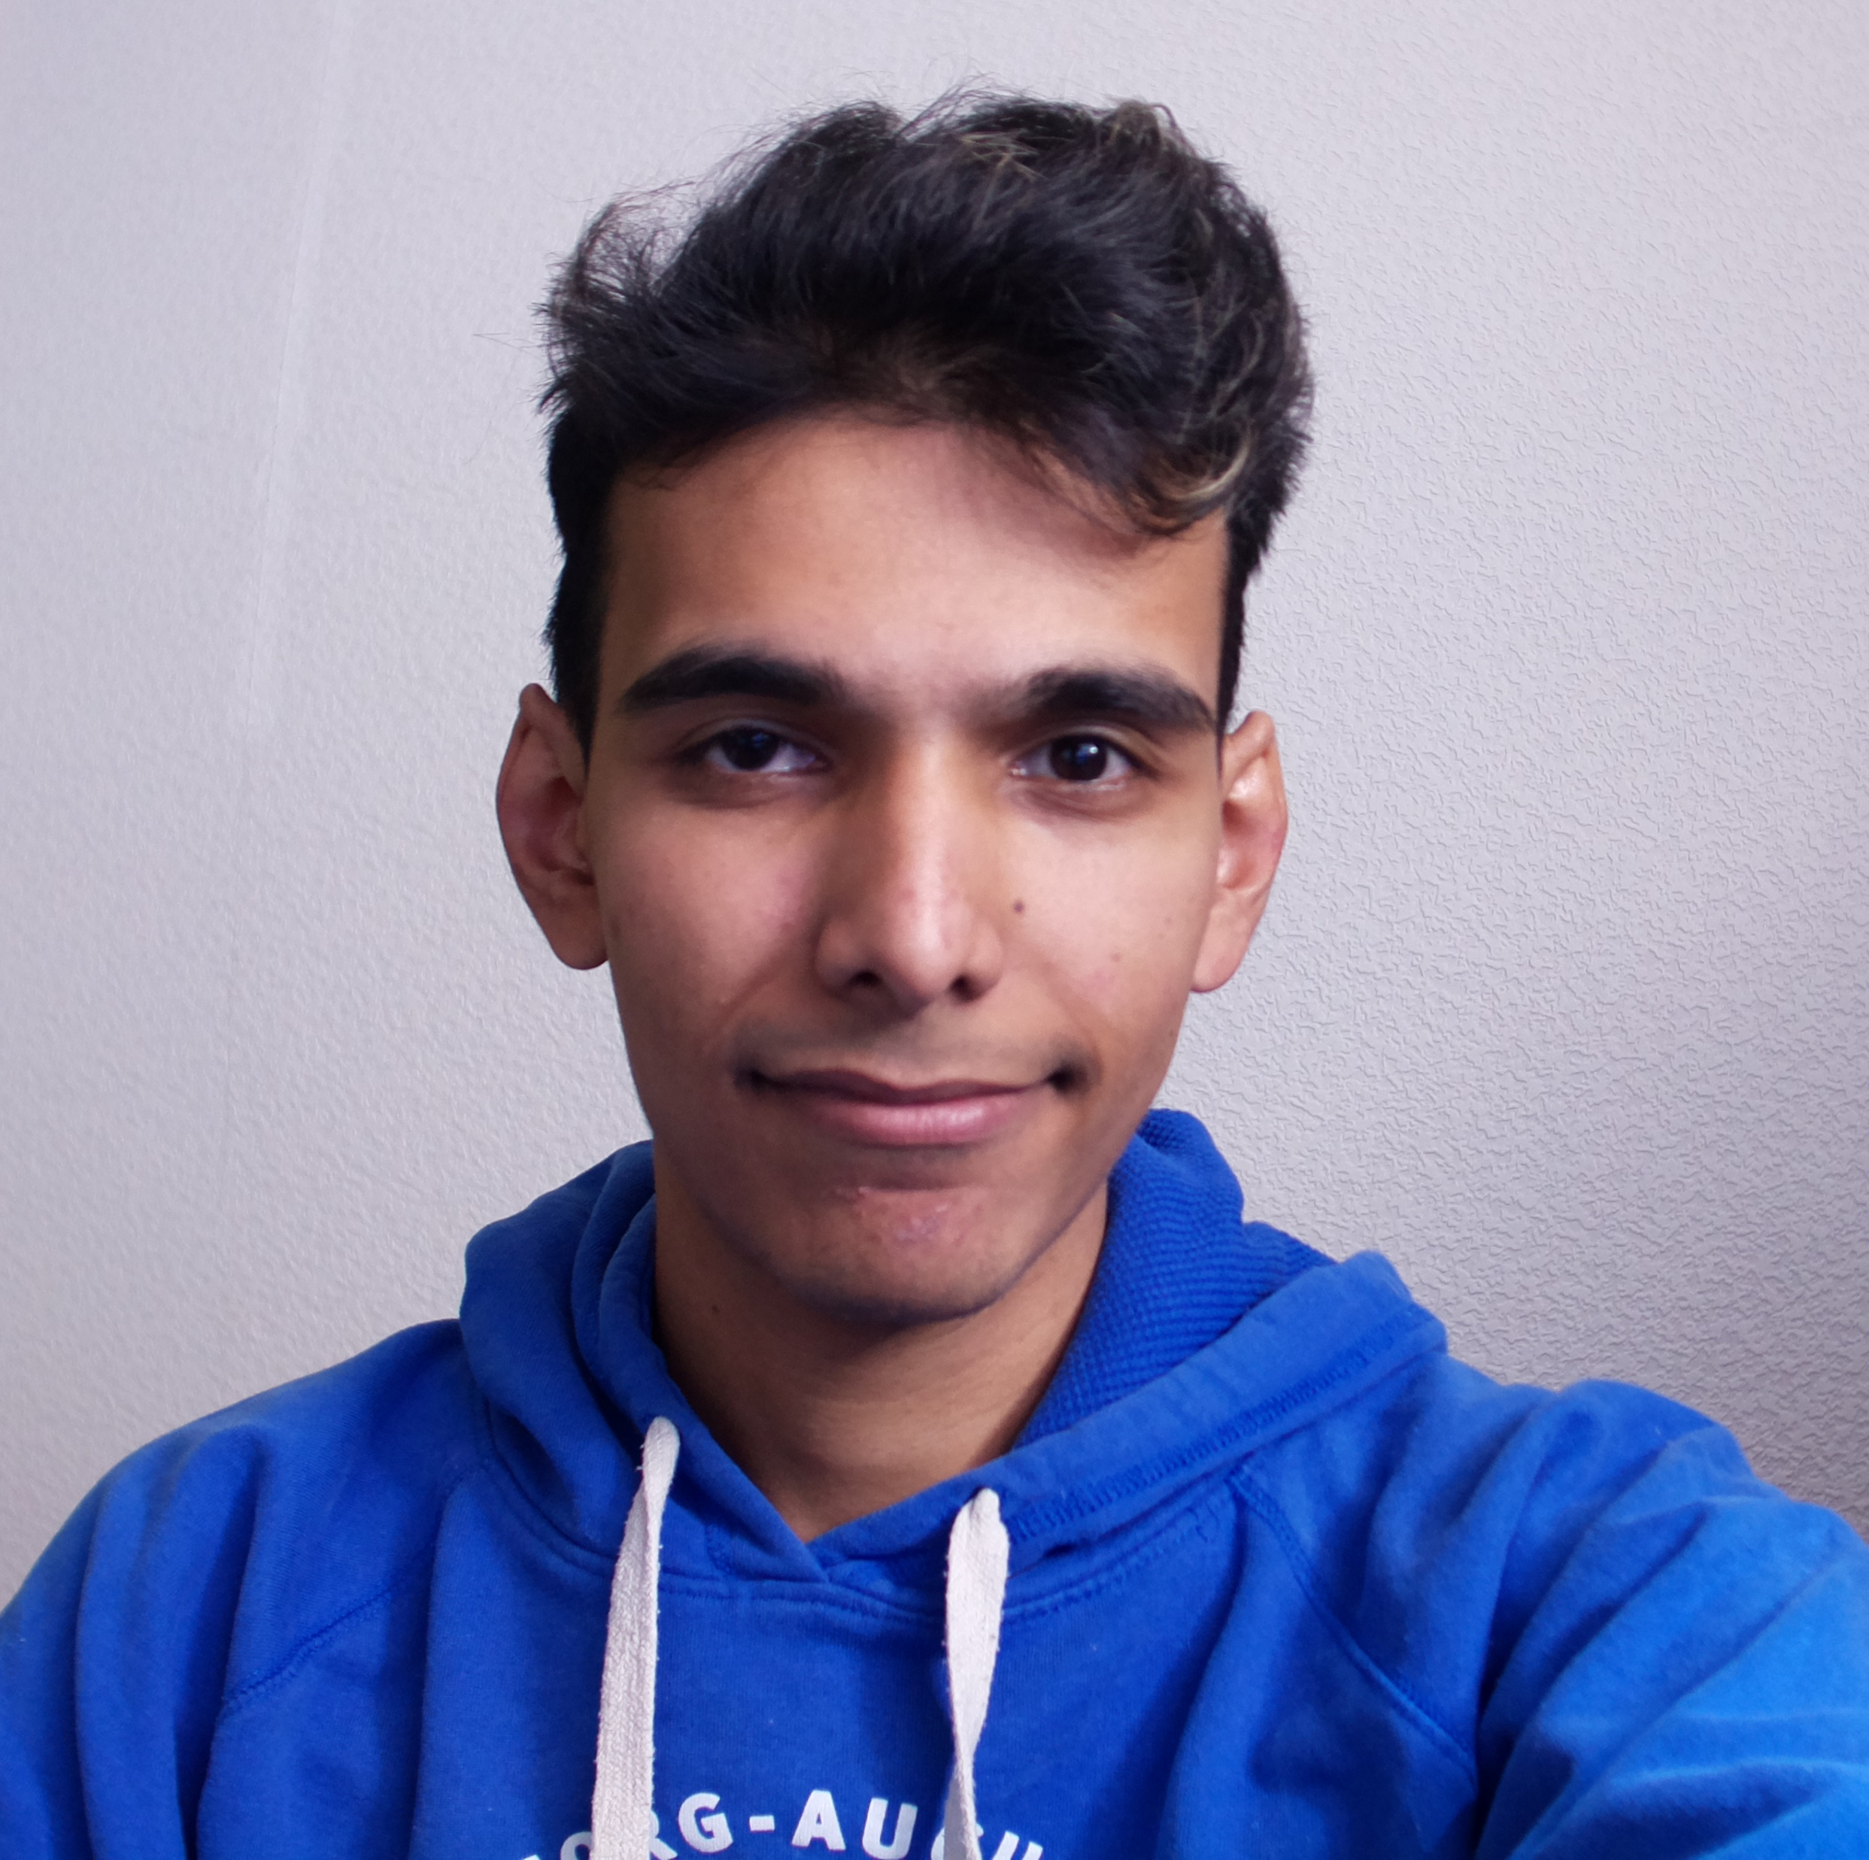
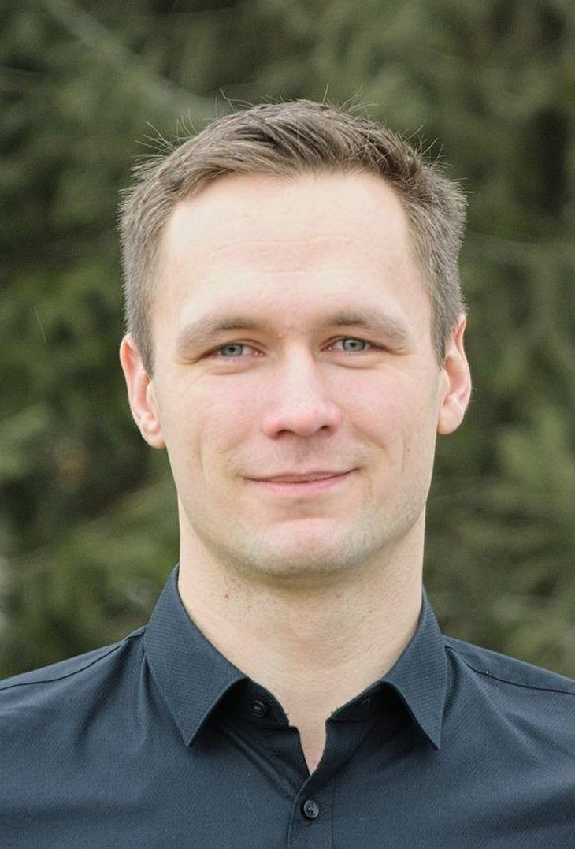
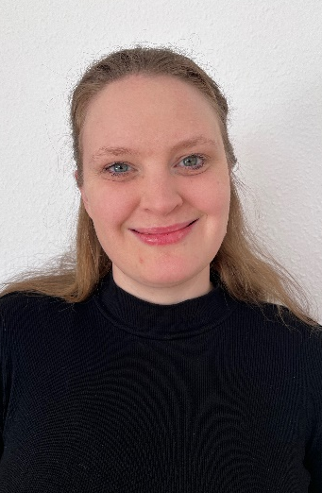
Team
M.Sc. Anant Sujatanagarjuna
anant.sujatanagarjuna@tu-clausthal.de
Prof. Dr. Benjamin Leiding
benjamin.leiding@tu-clausthal.de
M.A. Theresa Sommer
theresa.sommer@tu-clausthal.de

Slide 4
Research Group
Emerging Technologies for the Circular Economy → ETCE
Research focus:
Intersection of IT and sustainability
Circular Economy
Self-organized, decentralized and distributed systems
Machine-to-Everything Economy (M2X Economy)
Other courses:
Emerging Technologies for the Circular Economy (SS – M.Sc.)
Requirements Engineering (WS – M.Sc.)
Notes:
4

Slide 5
Research Group
ETCE Website – Link
Course material
Theses/project topics
Our research in action:
ZDF documentary (German) – Link
Klartext Preis 2020 (German) – Link
You want join us? Write us an email!
→ benjamin.leiding@tu-clausthal.de
Notes:
5

Slide 6
Research Group
ETCE Website – Link
Course material
Theses/project topics
Our research in action:
ZDF documentary (German) – Link
Klartext Preis 2020 (German) – Link
You want join us? Write us an email!
→ benjamin.leiding@tu-clausthal.de
Notes:
6

Slide 7
Course Content
Basics of climate change, environmental pollution, and dwindling non-renewable resources
Introduction to the circular economy, sustainability, and related concepts (biocapacity, etc.)
Sustainability goals
Feedback loops and tipping points
Implications of closed systems with a finite supply of resources
Technology-focused and technology-critical approaches towards sustainability
Circular Societies
Notes:
7

Slide 8
Learning Outcome
Understanding the concept of a circular economy, sustainability, and related concepts (biocapacity, etc.).
Gain a basic understanding of causes, dimensions, and the characterization of climate change, environmental pollution, and dwindling non-renewable resources.
Being able to make high-level, transdisciplinary assessments of decisions and measures in a social, economic, and political context.
The ability to critically assess upcoming technological solutions enabling/facilitating sustainability and the circular economy.
Notes:
8

Slide 9
Lecture Plan
19.04.2023 → Organization (L00) + Introduction (L01)
26.04.2023 → Challenges I: Climate Change (L02)
03.05.2023 → Challenges II: Pollution and Natural Resources (L03)
10.05.2023 → Sustainability and Political (In-)Action (L04)
17.05.2023 → Limits to Growth and Planetary Boundaries (L05)
24.05.2023 → From Cradle to the Grave: (Over-) Consumption, Environmental Impacts and the Life Cycle of Products (L06)
31.05.2023 → Circular Economy (L07)
07.06.2023 → Beyond the Circular Economy (L08)
14.06.2023 → Towards a Circular Society (L09)
21.06.2023 → Technologies And What They Can (Not) Do (L10)
28.06.2023 → Critical Thinking and Sustainable Everyday Practices (L11)
05.07.2023 → Invited Lecture (L11)
12.07.2023 → Invited Lecture (L12)
19.07.2023 → Now What? (L13)

Slide 10
Course Organization – UPDATE NECESSARY – MOODLE + MOOC
Course website – Link
News and updates:
CLZ students + DigiTec: StudIP (Link)
Everyone else: Mailing list (Link)
Slides will be uploaded to StudIP (Link) and to Github (Link)
Please report bugs ;)
Lecture recordings will be available on StudIP and on Github
Questions? Write us an email: etce-ltg@tu-clausthal.de ← We will only respond to emails written to this specific email address!

Slide 11
Dates/Times/Locations UPDATE NECESSARY
Please note:
The Gotec in Goslar is limited to ca. 15-20 seats due to the current COVID restrictions. Thus, only DigiTec students may join us in Goslar.
We kindly ask everyone else to use the BBB rooms (links below).
Lecture:
Wednesday 2.15 pm to 3.45 pm (Berlin time) – 19.04.2023 to 19.07.2023
Location: Goslar Gotec (Am Stollen 19 C, 38640 Goslar, Germany) or via BigBlueButton (Link)
Exercise / Q&A:
Monday 4 pm to 5 pm (Berlin time) – 19.04.2023 to 19.07.2023
Location: Goslar Gotec (Am Stollen 19 C, 38640 Goslar, Germany) or via BigBlueButton (Link)

Slide 12
Exercises
Individual work → no group submissions
Submission of each exercise is mandatory
You pass by submitting an exercise – even if it is an empty page
You will receive feedback on your submission
Exercise = learning feedback
s task:
orm groups of 5 people
ome up with a great idea that evolves around sustainability in general
Push the idea as far as possible throughout the semester
Record a 60s video explaining your idea and what you did throughout the semester
Selection of the 5 best ideas → bonus points for the exam (e.g., better grade – instead of 2.0 → 1.7 or something similar)
More info on points, percentages, etc. follow on the next slides (Examination)

Slide 13
Exercises UPDATE NECESSARY
Individual work → no group submissions
Submission of each exercise is mandatory
You pass by submitting an exercise – even if it is an empty page
You will receive feedback on your submission
Exercise = learning feedback
Bonus task:
Form groups of 2 or more people
Come up with a great idea that revolves around sustainability in general
Push the idea as far as possible throughout the semester
Record a 60s video explaining your idea and what you did throughout the semester
Selection of the 5 best ideas → bonus points for the exam (e.g., better grade – instead of 2.0 → 1.7 or something similar)
More info on points, percentages, etc. follow on the next slides (Examination)

Slide 14
Examination
Prerequisite for admission to the final exam (all criteria have to be fulfilled):
Submit all exercises
Final exam:
No Specific date yet
Either written exam (120min) or oral examination (20-25min)
Online vs. lecture room examination → depends on the pandemic and the number of students

Slide 15
Self-Study Star
Slides with the self-study star indicate optional/additional study material that is not mandatory but could be helpful or interesting
Self-Study Star →

Slide 16
Literature
This course is not based on a single book and you do not need to buy a book to pass the exam.
Donella H. Meadows, Jorgen Randers, and Dennis L. Meadows. The Limits to Growth (1972).
Donella H. Meadows, Jorgen Randers, and Dennis L. Meadows. Limits To Growth: The 30-Year Update (2004).
Baccini et al. Metabolism of the Anthroposphere: Analysis, Evaluation, Design (2012).
Walter R. Stahel. The Circular Economy: A User's Guide (2019).
XR. This is not a Drill (2019)
W. Brian Arthur. The Nature of Technology: What It Is and How it Evolves (2011).
David Wallace-Wells. The Uninhabitable Earth, Annotated Edition (2017).
James Lawrence Powell. The 2084 Report: An Oral History of the Great Warming (2020).
Rutger Bregman. Utopia for Realists (2017).

Slide 17
Literature
(German) Stefan Rahmstorf, Hans Joachim Schellnhuber. Der Klimawandel (2019).
David Archer, Stefan Rahmstorf. The Climate Crisis (2010).
Gabrielle Walker, David King. The Hot Topic: How to Tackle Global Warming and Still Keep the Lights on (2008).

Slide 18
Further Resources
Climate University – Teaching and learning for a sustainable future – Link
Circular Societies (German) – Link
Server Infrastructure for a Global Rebellion – Link
Podcasts:
Drilled (Link)
How to Save a Planet (Link)
1,5 Grad – der Klima-Podcast mit Luisa Neubauer (German) (Link)

Slide 19
Questions?

