Slide 1
The Limits to Growth: Sustainability and the Circular Economy
Lecture 8: Circular Society
Prof. Dr. Benjamin Leiding
M.Sc. Anant Sujatanagarjuna

Slide 2
License
This work is licensed under a Creative Commons Attribution-ShareAlike 4.0 International License. To view a copy of this license, please refer to https://creativecommons.org/licenses/by-sa/4.0/ .
Updated versions of these slides will be available in our Github repository.

Slide 3
News/Updates

Slide 4

Course Evaluation
QR Code and Link
Link: Click Me

Slide 5
Exercise E05

Slide 6
Exercise E05
Feedback
Proposals:
“Massively reduce consumption of (fossil) resources and associated pollution; build a circular economy, reduce consumption accompanied by a change in behavior (way of living, working, producing, even thinking . . . )”
Reduce footprint + reduce pollution
Invest in healthcare and education
Management of remaining resources (e.g., arable land, etc.)
Population control, e.g., birth rate == mortality rate

Slide 7
Exercise E05
Feedback
Proposals:
“Global withdrawal from export-oriented market economy”
“Capping the workweek at 20 hours whilst increasing real wages”
“Shift from planned obsolescence to planned longevity”

Slide 8
Exercise E05
Question
“I noticed a quite steep increase in the Human Welfare Index in the World3-Model from 1940-1941. As this is during WW2, I am wondering about the reason. Do you have an explanation for this?”

Slide 9
Exercise E06

Slide 10
Exercise E06
Feedback

Slide 11
Exercise E06
Feedback
Consumer products:
Slackline
Clothes (fancy shoes)
Books
Household appliances
Iron & ironing board
Washing machine
Vacuum cleaner
(Refrigerator) + (Microwave)
Electric toothbrush → ???
Tools → Tool box, drilling machine, fan/cooler, etc.
Electronics → Computer, camera, printer
Bicycle & air pump
Cars
Food → Canteen/mensa instead of your own kitchen + scalability + avoid food waste

Slide 12
Exercise E06
Feedback
Consumer products:
Slackline
Clothes (fancy shoes)
Books
Household appliances
Iron & ironing board
Washing machine
Vacuum cleaner
(Refrigerator) + (Microwave)
Electric toothbrush → ???
Tools → Tool box, drilling machine, fan/cooler, etc.
Electronics → Computer, camera, printer
Bicycle & air pump
Cars
Food → Canteen/mensa instead of your own kitchen + scalability + avoid food waste

Slide 13
Exercise E06
Feedback
Consumer products:
Slackline
Clothes (fancy shoes)
Books
Household appliances
Iron & ironing board
Washing machine
Vacuum cleaner
(Refrigerator) + (Microwave)
Electric toothbrush → ???
Tools → Tool box, drilling machine, fan/cooler, etc.
Electronics → Computer, camera, printer
Bicycle & air pump
Cars
Food → Canteen/mensa instead of your own kitchen + scalability + avoid food waste

Slide 14
Exercise E06
Feedback
Consumer products:
Slackline
Clothes (fancy shoes)
Books
Household appliances
Iron & ironing board
Washing machine
Vacuum cleaner
(Refrigerator) + (Microwave)
Electric toothbrush → ???
Tools → Tool box, drilling machine, fan/cooler, etc.
Electronics → Computer, camera, printer
Bicycle & air pump → most sport equipment
Cars
Food → Canteen/mensa instead of your own kitchen + scalability + avoid food waste

Slide 15
Exercise E06
Feedback
Consumer products:
Slackline
Clothes (fancy shoes)
Books
Household appliances
Iron & ironing board
Washing machine
Vacuum cleaner
(Refrigerator) + (Microwave)
Electric toothbrush → ???
Tools → Tool box, drilling machine, fan/cooler, etc.
Electronics → Computer, camera, printer
Bicycle & air pump → most sport equipment
Cars
Food → Canteen/mensa instead of your own kitchen + scalability + avoid food waste

Slide 16
Circular Economy vs. Circular Society

Slide 17
Circular Society
CE Recap
Goals of the CE:
Maintain natural resources and minimize the discharge of substances that are harmful to health and nature
Ecological modernization of the economy to increase resource efficiency, e.g., by technical innovation and digital solutions
Products/services designed and constructed in such a way, that they can be returned to the economic and material flows at any time with little financial and energetic effort
Increase/maximize utilization of resources, e.g., Performance Economy
Partially based on: F. Hofmann, J. Zwiers (2018) – Circular Society – Eine pluralistische und emanzipatorische Alternative zur Circular Economy? – Link.
.

Slide 18
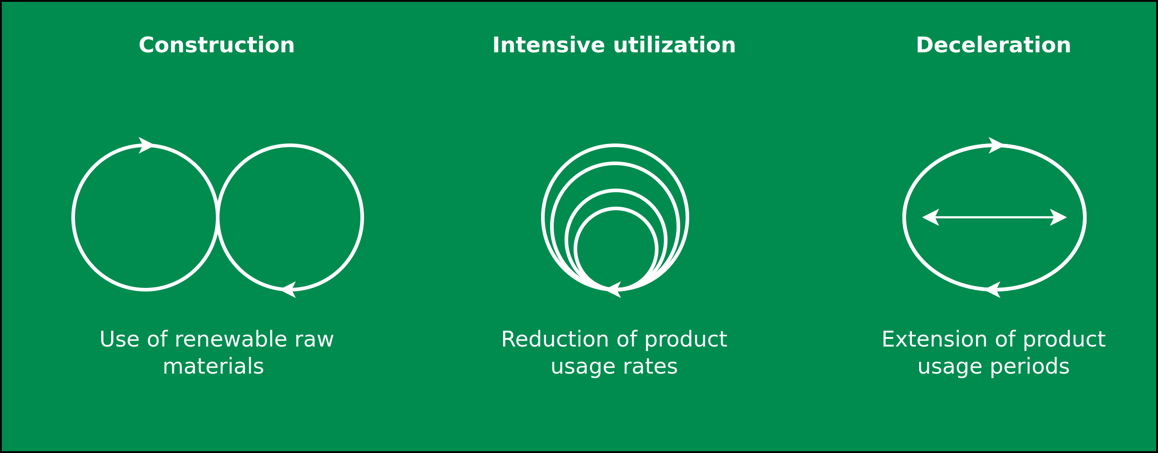
Circular Society
CE Recap
Image adapted from: M. Jaeger-Erben, F. Hofmann (2019) – Kreislaufwirtschaft - Ein Ausweg aus der sozial-ökologischen Krise? – Link.

Slide 19
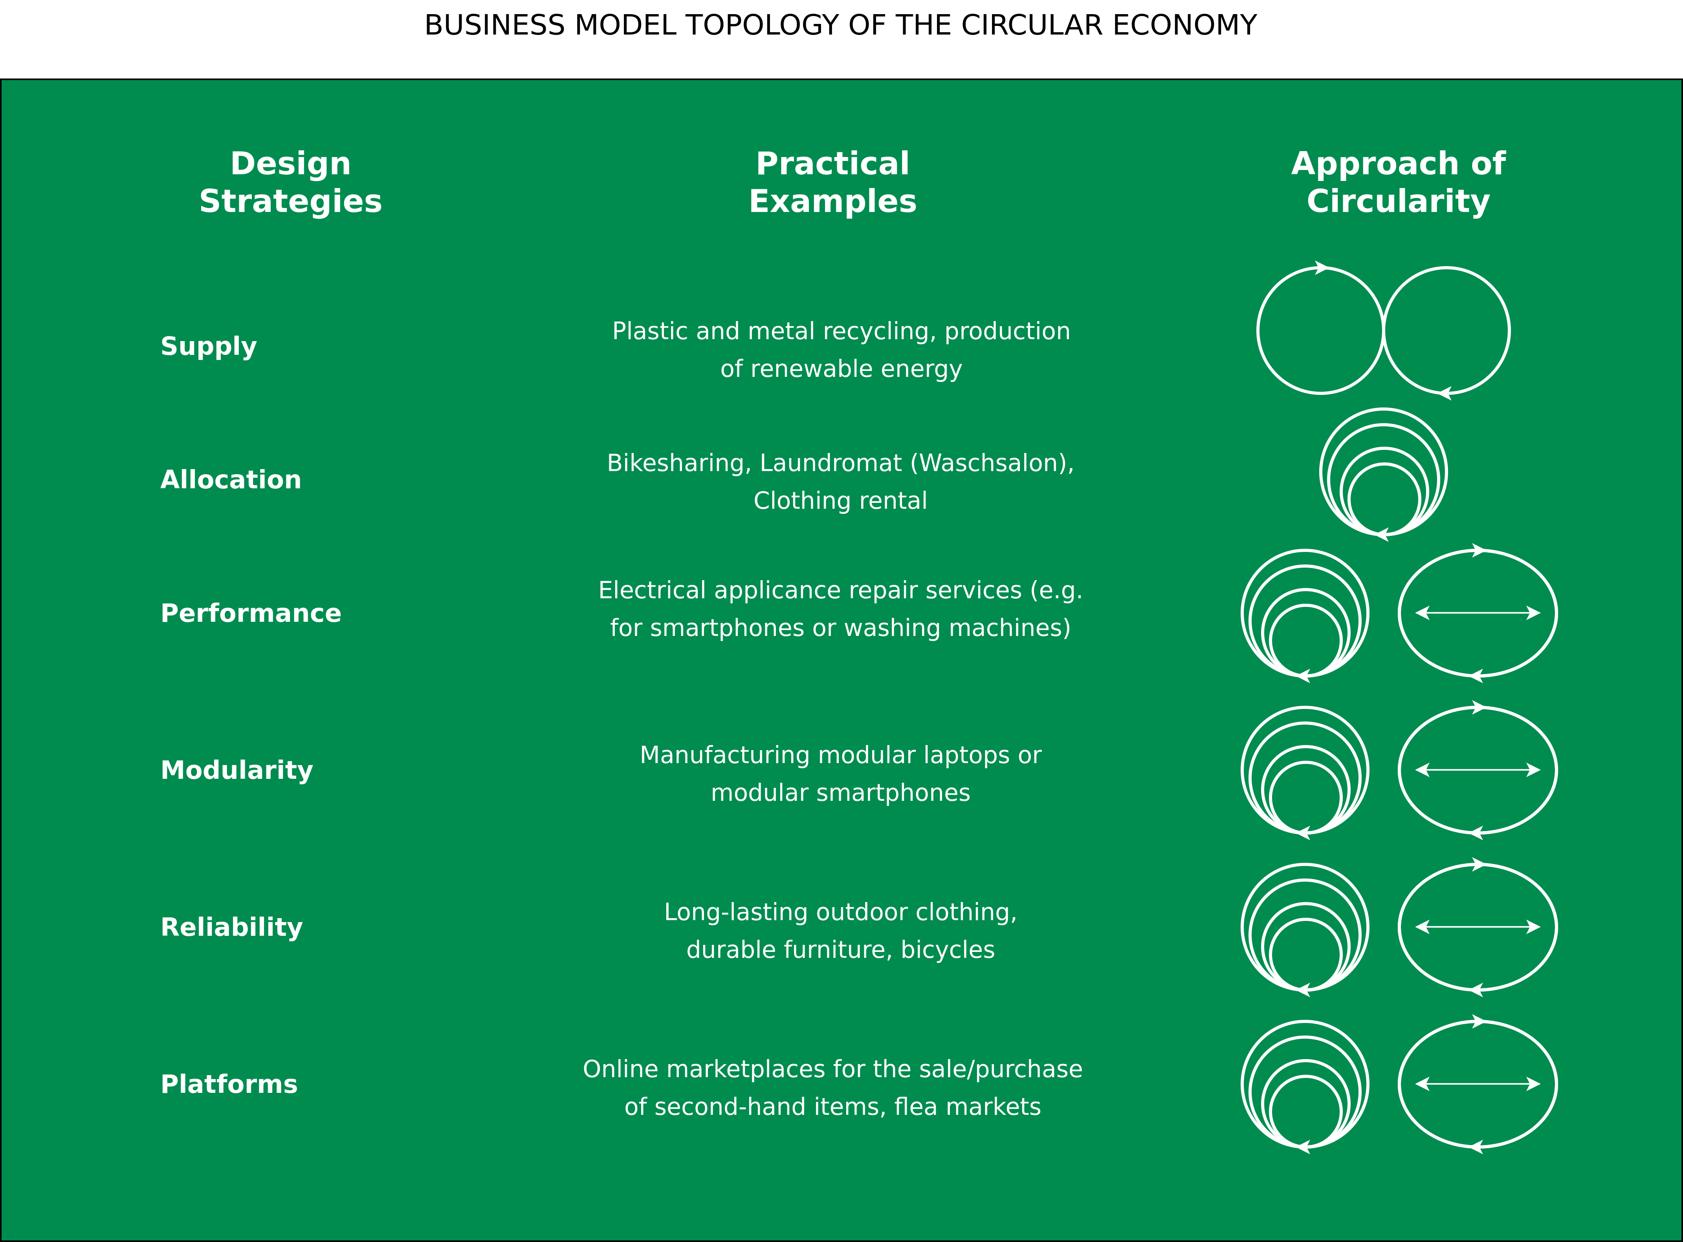
Circular Society
CE Recap
Image adapted from: M. Jaeger-Erben, F. Hofmann (2019) – Kreislaufwirtschaft - Ein Ausweg aus der sozial-ökologischen Krise? – Link.

Slide 20
Circular Society
CE Criticism
Replace the LE with circularly oriented forms of consumption and production
CE focus mostly on earned value management (“Wertschöpfungsmanagement”), product-service systems, product/business model innovations within existing power asymmetries
Decouple economic growth and consumption of natural resources
→ But why do we need neverending economic growth and why is it good to consume as many goods and services as possible?
Alternatives:
Sufficiency strategies and lifestyle changes
Question the prevailing entrepreneurial orientation towards the shareholder concept
Deconstruction of existing power and hegemonic relations
Partially based on: F. Hofmann, J. Zwiers (2018) – Circular Society – Eine pluralistische und emanzipatorische Alternative zur Circular Economy? – Link.
.

Slide 21
Circular Society
CE Criticism
Replace the LE with circularly oriented forms of consumption and production
CE focus mostly on earned value management (“Wertschöpfungsmanagement”), product-service systems, product/business model innovations within existing power asymmetries
Decouple economic growth and consumption of natural resources
→ But why do we need never ending economic growth and why is it good to consume as many goods and services as possible?
Alternatives:
Sufficiency strategies and lifestyle changes
Question the prevailing entrepreneurial orientation towards the shareholder concept
Deconstruction of existing power and hegemonic relations
Partially based on: F. Hofmann, J. Zwiers (2018) – Circular Society – Eine pluralistische und emanzipatorische Alternative zur Circular Economy? – Link.
.

Slide 22
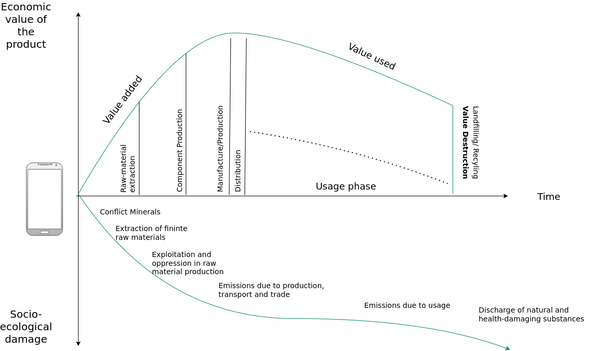
Circular Society
CE Criticism
Image adapted from: M. Jaeger-Erben, F. Hofmann (2019) – Kreislaufwirtschaft - Ein Ausweg aus der sozial-ökologischen Krise? – Link.

Slide 23
Circular Society
CE Criticism
Replace the LE with circularly oriented forms of consumption and production
CE focus mostly on earned value management (“Wertschöpfungsmanagement”), product-service systems, product/business model innovations within existing power asymmetries
Decouple economic growth and consumption of natural resources
→ But why do we need never ending economic growth and why is it good to consume as many goods and services as possible?
Alternatives:
Sufficiency strategies and lifestyle changes
Question the prevailing entrepreneurial orientation towards the shareholder concept
Deconstruction of existing power and hegemonic relations
Partially based on: F. Hofmann, J. Zwiers (2018) – Circular Society – Eine pluralistische und emanzipatorische Alternative zur Circular Economy? – Link.
.

Slide 24
Circular Society
Overview
Circular Society → CS
Goals of the CS:
Not just “CE + social”
Socio-political transformation and reorganization
Replace intransparent and inequity-based value chains of the LE with democratic, transparent and cooperatively organized value chains
Also → preserve the environment/ressources for present and future generations and enable social participation and quality of life
All-encompassing change necessary if the CE is to be the subject of a socio-ecological transformation
Democratisation of value creation processes and strategies for the activation and emancipation of different stakeholder groups
Partially based on: F. Hofmann, J. Zwiers (2018) – Circular Society – Eine pluralistische und emanzipatorische Alternative zur Circular Economy? – Link.
.

Slide 25
Circular Society
Overview
Circular Society → CS
Goals of the CS:
Not just “CE + social”
Socio-political transformation and reorganization
Replace intransparent and inequity-based value chains of the LE with democratic, transparent and cooperatively organized value chains
Also → preserve the environment/resources for present and future generations and enable social participation and quality of life
All-encompassing change necessary if the CE is to be the subject of a socio-ecological transformation
Democratisation of value creation processes and strategies for the activation and emancipation of different stakeholder groups
Partially based on: F. Hofmann, J. Zwiers (2018) – Circular Society – Eine pluralistische und emanzipatorische Alternative zur Circular Economy? – Link.
.

Slide 26
Circular Society
Overview
Circular Society → CS
Goals of the CS:
Not just “CE + social”
Socio-political transformation and reorganization
Replace intransparent and inequity-based value chains of the LE with democratic, transparent and cooperatively organized value chains
Also → preserve the environment/resources for present and future generations and enable social participation and quality of life
All-encompassing change necessary if the CE is to be the subject of a socio-ecological transformation
Democratization of value creation processes and strategies for the activation and emancipation of different stakeholder groups
Partially based on: F. Hofmann, J. Zwiers (2018) – Circular Society – Eine pluralistische und emanzipatorische Alternative zur Circular Economy? – Link.
.

Slide 27
Circular Society
Definition
„A circular society defines discourses with a vision of circularity where not only resources are circulated in sustainable loops, but also wealth, knowledge, technology and power is
circulated and redistributed throughout society”
M. C. Friant, R. Salomone, W. J. V. Vermeulen (2020) – A Typology of Circular Economy Discourses: Navigating the Diverse Visions of a Contested Paradigm – Link

Slide 28
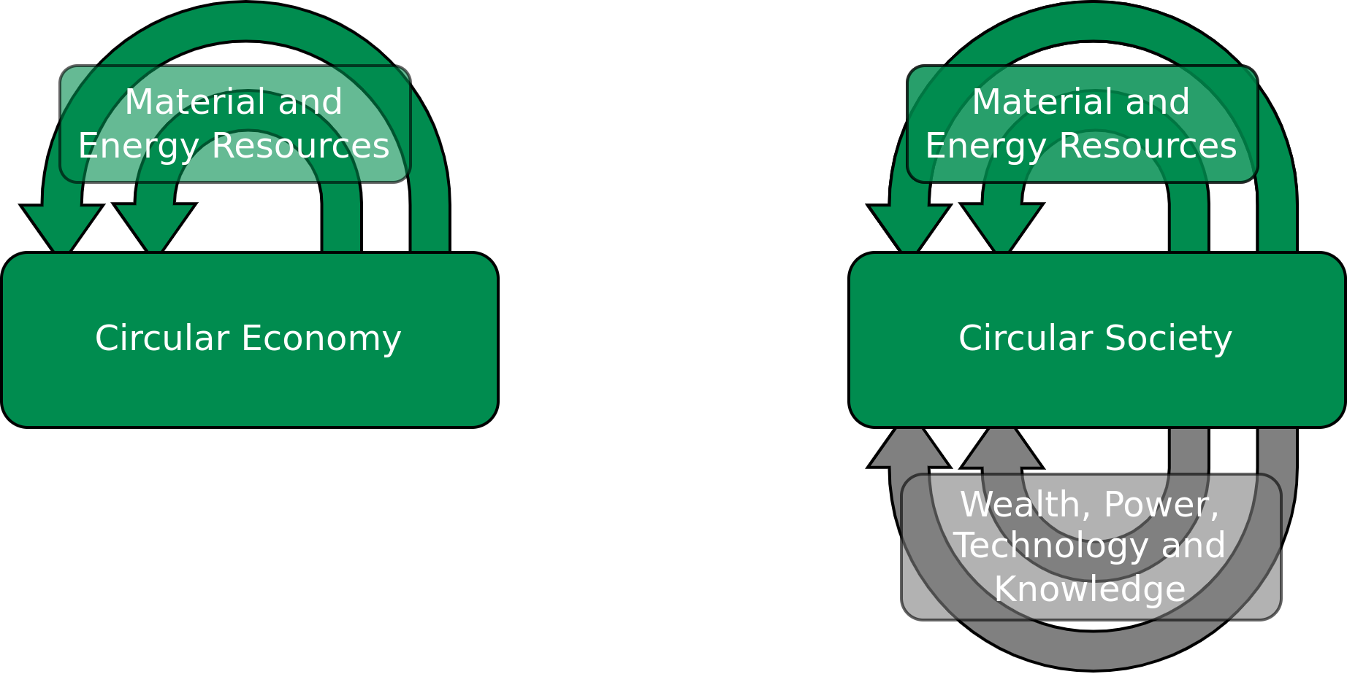
Circular Society
Definition
„ A circular society defines discourses with a vision of circularity where not only resources are circulated in sustainable loops, but also wealth, knowledge, technology and power is
circulated and redistributed throughout society”
Image licensed under CC BY-SA 4.0, sourced from M. C. Friant, R. Salomone, W. J. V. Vermeulen (2020) – A Typology of Circular Economy Discourses: Navigating the Diverse Visions of a Contested Paradigm – Link

Slide 29
Circular Society
CE vs. CS
CE = market-based solutions and economic considerations
CS = Circularity as a holistic social transformation
M. C. Friant, R. Salomone, W. J. V. Vermeulen (2020) – A Typology of Circular Economy Discourses: Navigating the Diverse Visions of a Contested Paradigm – Link

Slide 30
Circular Society
CE vs. CS
Circularity vision | Temporal scale | Spatial scale | Sustainability factors included | Perspective on the resource nexus | Views on capitalism and decoupling | Main goal/objective | Narrative
Circular Society | Very long term: multiple generations (beyond 50 years) | Macro-scale: planet Earth | People, Planet, Prosperity | Changing consumption and production patterns to keep energy, biodiversity and aterial resources within safe planetary limits. | Sceptical regarding the possiblity of decoupling and the sustainability of capitalism. | Maintaining socio-ecological health and wellbield for present and future generations of human and non-human life. | The earth is borrowed from future generations of living beingd, humans must preserve, respect, restore and share it in a fair maner, even if that entails changing lifestyles and consumption patterns.
 | Long term: 1 to 2 generations (20-50 years) | Macro-scale: planet Earth | People, Planet, Prosperity | Balancing trade-offs and synergies to keep energy, biodiversity and material resources within safe planetary limits. | Believe in the possibility of decoupling and the sustainability of capitalism. | Preserving social well-being and the biophysical health of the Earch system in line with the SDGs. | Humans must ensure justice, fairness and participation in the sustainable stewardship of the Earth, even if that entails redistributing and changing consumption patterns.
Table adapted from M. C. Friant, R. Salomone, W. J. V. Vermeulen (2020) – A Typology of Circular Economy Discourses: Navigating the Diverse Visions of a Contested Paradigm – Link

Slide 31
Circular Society
CE vs. CS
Circularity vision | Temporal scale | Spatial scale | Sustainability factors included | Perspective on the resource nexus | Views on capitalism and decoupling | Main goal/objective | Narrative
Circular Economy | Long term: one generation (19-25 years) | Macro-scale: planet Earth | Planet, Prosperity | Balancing trade-offs and synergies to keep energy, biodiversity and material resources within safe planetary limits. | Believe in the possibility of decoupling and the sustainability of capitalism. | Maintaining the biophysical health of the Earth system. | Reducing humanity’s overall ecological footprint and balancing resource limits and constraints is key to ensure the stability of the biosphere and long-term economic prosperity.
 | Mid-term: 1 to 2 government planning cycles (5-10 years) | Meso-scale (country, region, industrial park, city) | Planet, Prosperity | Optimizing and securing material, natural and energy resources, especially for critical raw materials. | Believe in the possibility of decoupling and the sustainability of capitalism. | Securing and preserving critical resources and materials. | Strategically maximising sco-efficiency and balancing resource use is necessary to maintain resource security and ensure geopolitical stability.
 | Short-term: single product life-cycle(1 to 2 years) | Micro-scale (single product, service, or firm) | Planet, Prosperity | Optimizing material and energy resource flows in product design. | Believe in the possibility of decoupling and the sustainability of capitalism. | Capturing oppostunities to lower both environmental impacts and economic costs. | Ensuring optimium resource efficiency through eco-innovation leads to win-win solutions that reduce ecological harm and increase economic value.
Table adapted from M. C. Friant, R. Salomone, W. J. V. Vermeulen (2020) – A Typology of Circular Economy Discourses: Navigating the Diverse Visions of a Contested Paradigm – Link

Slide 32
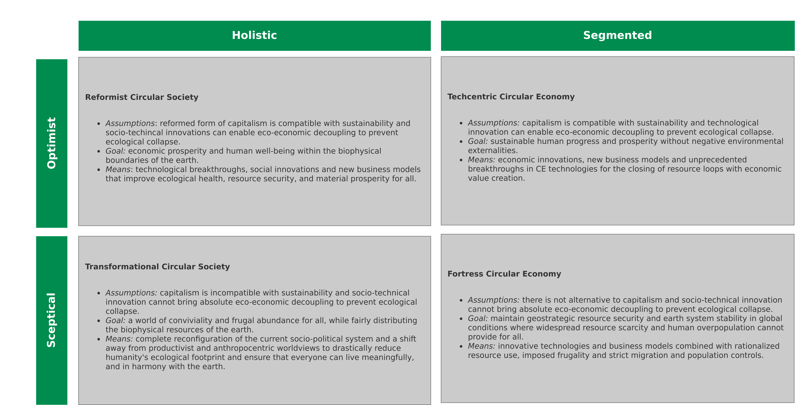
Circular Society
CE vs. CS – Typology
Image recreated from: M. C. Friant, R. Salomone, W. J. V. Vermeulen (2020) – A Typology of Circular Economy Discourses: Navigating the Diverse Visions of a Contested Paradigm – Link

Slide 33
Conclusion

Slide 34
Conclusion
Circular Economy (CE):
Maintain natural resources and minimize the discharge of substances that are harmful to health and nature → Increase/maximize utilization of resources, e.g., Performance Economy
Ecological modernization of the economy to increase resource efficiency, e.g., by technical innovation and digital solutions
Circular Society (CS):
Not just “CE + social” instead socio-political transformation and reorganization
Replace intransparent and inequity-based value chains of the LE with democratic, transparent and cooperatively organized value chains
Democratization of value creation processes and strategies for the activation and emancipation of different stakeholder groups

Slide 35
Conclusion
Circular Economy (CE):
Maintain natural resources and minimize the discharge of substances that are harmful to health and nature → Increase/maximize utilization of resources, e.g., Performance Economy
Ecological modernization of the economy to increase resource efficiency, e.g., by technical innovation and digital solutions
Circular Society (CS):
Not just “CE + social” instead socio-political transformation and reorganization
Replace intransparent and inequity-based value chains of the LE with democratic, transparent and cooperatively organized value chains
Democratization of value creation processes and strategies for the activation and emancipation of different stakeholder groups

Slide 36
Detour

Slide 37
Detour
Exercise 05 – Feedback
Proposals:
“Global withdrawal from export-oriented market economy”
“Capping the workweek at 20 hours whilst increasing real wages”
“Shift from planned obsolescence to planned longevity”
→ John Maynard Keynes predicted a 15h work week in his 1930 essay “Economic Possibilities for our Grandchildren”

Slide 38
Detour
Exercise 05 – Feedback
Proposals:
“Global withdrawal from export-oriented market economy”
“Capping the workweek at 20 hours whilst increasing real wages”
“Shift from planned obsolescence to planned longevity”
→ John Maynard Keynes predicted a 15h work week in his 1930 essay “Economic Possibilities for our Grandchildren”

Slide 39
Detour
SS23 note → elaborate why we did not get a 15h work week yet
Exercise 05 – Feedback

Slide 40
Detour
Bullshit Job – Definition

Slide 41
Detour
Bullshit Job – Definition
„Form of paid employment that is so completely pointless, unnecessary, or pernicious that even the employee cannot justify its existence even though, as part of the conditions of employment, the employee feels obliged to pretend that this is not the case.”
D. Graeber (2013) – On the Phenomenon of Bullshit Jobs – Essay – Link
D. Graeber (2018) – Bullshit Jobs: A Theory

Slide 42
Detour
Bullshit Job – Definition
„Form of paid employment that is so completely pointless, unnecessary, or pernicious that even the employee cannot justify its existence even though, as part of the conditions of employment, the employee feels obliged to pretend that this is not the case.”
→ Inefficiencies in capitalism?
D. Graeber (2013) – On the Phenomenon of Bullshit Jobs – Essay – Link
D. Graeber (2018) – Bullshit Jobs: A Theory

Slide 43
Detour
Bullshit Jobs – Categories
D. Graeber (2013) – On the Phenomenon of Bullshit Jobs – Essay – Link
D. Graeber (2018) – Bullshit Jobs: A Theory

Slide 44
Detour
Bullshit Jobs – Categories
Flunkies: Serve to make their superiors feel important, e.g., receptionists, administrative assistants, door attendants, store greeters, makers of websites whose sites neglect ease of use and speed for looks
Goons: Act to harm or deceive others on behalf of their employer, e.g., lobbyists, corporate lawyers, telemarketers, public relations specialists, community managers;
Duct tapers: Temporarily fix problems that could be fixed permanently, e.g., programmers repairing bloated code, airline desk staff who calm passengers whose bags do not arrive;
Box tickers: Create the appearance that something useful is being done when it is not, e.g., survey administrators, in-house magazine journalists, corporate compliance officers, quality service managers;
Taskmasters: Create extra work for those who do not need it, e.g., middle management, leadership professionals.
D. Graeber (2013) – On the Phenomenon of Bullshit Jobs – Essay – Link
D. Graeber (2018) – Bullshit Jobs: A Theory

Slide 45
Detour
Bullshit Jobs – Categories
Flunkies: Serve to make their superiors feel important, e.g., receptionists, administrative assistants, door attendants, store greeters, makers of websites whose sites neglect ease of use and speed for looks
Goons: Act to harm or deceive others on behalf of their employer, e.g., lobbyists, corporate lawyers, telemarketers, public relations specialists, community managers
Duct tapers: Temporarily fix problems that could be fixed permanently, e.g., programmers repairing bloated code, airline desk staff who calm passengers whose bags do not arrive;
Box tickers: Create the appearance that something useful is being done when it is not, e.g., survey administrators, in-house magazine journalists, corporate compliance officers, quality service managers;
Taskmasters: Create extra work for those who do not need it, e.g., middle management, leadership professionals.
D. Graeber (2013) – On the Phenomenon of Bullshit Jobs – Essay – Link
D. Graeber (2018) – Bullshit Jobs: A Theory

Slide 46
Detour
Bullshit Jobs – Categories
Flunkies: Serve to make their superiors feel important, e.g., receptionists, administrative assistants, door attendants, store greeters, makers of websites whose sites neglect ease of use and speed for looks
Goons: Act to harm or deceive others on behalf of their employer, e.g., lobbyists, corporate lawyers, telemarketers, public relations specialists, community managers
Duct tapers: Temporarily fix problems that could be fixed permanently, e.g., programmers repairing bloated code, airline desk staff who calm passengers whose bags do not arrive
Box tickers: Create the appearance that something useful is being done when it is not, e.g., survey administrators, in-house magazine journalists, corporate compliance officers, quality service managers;
Taskmasters: Create extra work for those who do not need it, e.g., middle management, leadership professionals.
D. Graeber (2013) – On the Phenomenon of Bullshit Jobs – Essay – Link
D. Graeber (2018) – Bullshit Jobs: A Theory

Slide 47
Detour
Bullshit Jobs – Categories
Flunkies: Serve to make their superiors feel important, e.g., receptionists, administrative assistants, door attendants, store greeters, makers of websites whose sites neglect ease of use and speed for looks
Goons: Act to harm or deceive others on behalf of their employer, e.g., lobbyists, corporate lawyers, telemarketers, public relations specialists, community managers
Duct tapers: Temporarily fix problems that could be fixed permanently, e.g., programmers repairing bloated code, airline desk staff who calm passengers whose bags do not arrive
Box tickers: Create the appearance that something useful is being done when it is not, e.g., survey administrators, in-house magazine journalists, corporate compliance officers, quality service managers
Taskmasters: Create extra work for those who do not need it, e.g., middle management, leadership professionals.
D. Graeber (2013) – On the Phenomenon of Bullshit Jobs – Essay – Link
D. Graeber (2018) – Bullshit Jobs: A Theory

Slide 48
Detour
Bullshit Jobs – Categories
Flunkies: Serve to make their superiors feel important, e.g., receptionists, administrative assistants, door attendants, store greeters, makers of websites whose sites neglect ease of use and speed for looks
Goons: Act to harm or deceive others on behalf of their employer, e.g., lobbyists, corporate lawyers, telemarketers, public relations specialists, community managers
Duct tapers: Temporarily fix problems that could be fixed permanently, e.g., programmers repairing bloated code, airline desk staff who calm passengers whose bags do not arrive
Box tickers: Create the appearance that something useful is being done when it is not, e.g., survey administrators, in-house magazine journalists, corporate compliance officers, quality service managers
Taskmasters: Create extra work for those who do not need it, e.g., middle management, leadership professionals
D. Graeber (2013) – On the Phenomenon of Bullshit Jobs – Essay – Link
D. Graeber (2018) – Bullshit Jobs: A Theory

Slide 49
Detour
Bullshit Jobs – Why?
Assumption → Capitalism does not allow for inefficiencies
Hypothesis → "Managerial feudalism" instead of capitalism
The pains of dull work as a justification for the ability to fulfill consumer desires
Fulfilling those desires → reward for suffering through pointless work
Prosperity from technological advances (e.g., emerging technologies which were supposed to give us a 15h work week) has been reinvested into industry and consumer growth instead of leisure time
Bullshit jobs also serve political ends, in which political parties are more concerned about having jobs than whether the jobs are fulfilling. In addition, he contends, populations occupied with busy work have less time to revolt
Graeber’s solution → Universal Basic Income (UBI) → Livable benefit paid to all, thus letting people work at their leisure
D. Graeber (2013) – On the Phenomenon of Bullshit Jobs – Essay – Link
D. Graeber (2018) – Bullshit Jobs: A Theory

Slide 50
Detour
Bullshit Jobs – Why?
Assumption → Capitalism does not allow for inefficiencies
Hypothesis → "Managerial feudalism" instead of capitalism
The pains of dull work as a justification for the ability to fulfill consumer desires
Fulfilling those desires → reward for suffering through pointless work
Prosperity from technological advances (e.g., emerging technologies which were supposed to give us a 15h work week) has been reinvested into industry and consumer growth instead of leisure time
Bullshit jobs also serve political ends, in which political parties are more concerned about having jobs than whether the jobs are fulfilling. In addition, he contends, populations occupied with busy work have less time to revolt
Graeber’s solution → Universal Basic Income (UBI) → Livable benefit paid to all, thus letting people work at their leisure
D. Graeber (2013) – On the Phenomenon of Bullshit Jobs – Essay – Link
D. Graeber (2018) – Bullshit Jobs: A Theory

Slide 51
Detour
Bullshit Jobs – Why?
Assumption → Capitalism does not allow for inefficiencies
Hypothesis → "Managerial feudalism" instead of capitalism
The pains of dull work as a justification for the ability to fulfill consumer desires
Fulfilling those desires → reward for suffering through pointless work
Prosperity from technological advances (e.g., emerging technologies which were supposed to give us a 15h work week) has been reinvested into industry and consumer growth instead of leisure time
Bullshit jobs also serve political ends, in which political parties are more concerned about having jobs than whether the jobs are fulfilling. In addition, he contends, populations occupied with busy work have less time to revolt
Graeber’s solution → Universal Basic Income (UBI) → Livable benefit paid to all, thus letting people work at their leisure
D. Graeber (2013) – On the Phenomenon of Bullshit Jobs – Essay – Link
D. Graeber (2018) – Bullshit Jobs: A Theory

Slide 52
Detour
Bullshit Jobs – Why?
Assumption → Capitalism does not allow for inefficiencies
Hypothesis → "Managerial feudalism" instead of capitalism
The pains of dull work as a justification for the ability to fulfill consumer desires
Fulfilling those desires → reward for suffering through pointless work
Prosperity from technological advances (e.g., emerging technologies which were supposed to give us a 15h work week) has been reinvested into industry and consumer growth instead of leisure time
Bullshit jobs also serve political ends, in which political parties are more concerned about having jobs than whether the jobs are fulfilling. In addition, he contends, populations occupied with busy work have less time to revolt
Graeber’s solution → Universal Basic Income (UBI) → Livable benefit paid to all, thus letting people work at their leisure
D. Graeber (2013) – On the Phenomenon of Bullshit Jobs – Essay – Link
D. Graeber (2018) – Bullshit Jobs: A Theory

Slide 53
Detour
SS23 note → stretch this slide over various slids -< to compact/to much info
Bullshit Jobs – Why?
Assumption → Capitalism does not allow for inefficiencies
Hypothesis → "Managerial feudalism" instead of capitalism
The pains of dull work as a justification for the ability to fulfill consumer desires
Fulfilling those desires → reward for suffering through pointless work
Prosperity from technological advances (e.g., emerging technologies which were supposed to give us a 15h work week) has been reinvested into industry and consumer growth instead of leisure time
Bullshit jobs also serve political ends, in which political parties are more concerned about having jobs than whether the jobs are fulfilling. In addition, he contends, populations occupied with busy work have less time to revolt
Graeber’s solution → Universal Basic Income (UBI) → Livable benefit paid to all, thus letting people work at their leisure
D. Graeber (2013) – On the Phenomenon of Bullshit Jobs – Essay – Link
D. Graeber (2018) – Bullshit Jobs: A Theory

Slide 54
Detour
SS23 note → UBI section (lecture?)
Exercise 05 – Feedback

Slide 55
Exercise E07

Slide 56
Exercise E07
Circular Economy vs. Circular Society
L08 slide 31 details the circularity discourse typology (CE vs. CS). Which of the four categories do you prefer and/or deem to be more likely and why?
Submit your submission according to the instructions in the exercise sheet.

Slide 57
Additional Resources
Circular Societies (German) – Link
David Graeber. Debt: The First 5000 Years (2011).
David Graeber. On the Phenomenon of Bullshit Jobs – Essay (2013) – Link.
David Graeber. Bullshit Jobs – Book (2018).

Slide 58
Questions?

