Slide 1
Emerging Technologies for the Circular Economy
Lecture 5a: Internet of Things Communications
Prof. Dr. Benjamin Leiding (Clausthal)
M.Sc. Arne Bochem (Göttingen)
M.Sc. Anant Sujatanagarjuna (Clausthal)

Slide 2
License
This work is licensed under a Creative Commons Attribution-ShareAlike 4.0 International License. To view a copy of this license, please refer to https://creativecommons.org/licenses/by-sa/4.0/ .
Updated versions of these slides will be available in our Github repository.

Slide 3
Updated Bonus Task Registration
2 projects registered
The project “Value-Based Recovery Design for End of Life Products” is still looking for team members → please get in touch with us and we will establish contact with the team
What stopped everyone else from proposing projects?
a) no team
b) no project
c) no time
d) not interested

Slide 4
Updated Bonus Task Registration
2 projects registered
The project “Value-Based Recovery Design for End of Life Products” is still looking for team members → please get in touch with us and we will establish contact with the team
What stopped everyone else from proposing projects?
a) no team
b) no project
c) no time
d) not interested

Slide 5
Updated Lecture Plan
20.04.2022 → Organization + Introduction
27.04.2022 → Emerging Technologies for the Circular Economy I
04.05.2022 → Emerging Technologies for the Circular Economy II
11.05.2022 → Introduction to the Internet of Things
18.05.2022 → Internet of Things – Communication + Privacy and Security
25.05.2022 → Internet of Things – Cloud and BigData
01.06.2022 → Introduction to Blockchain Technology
15.06.2022 → Blockchain Technology – Consensus
22.06.2022 → Blockchain Technology – Ethereum and Smart Contracts Part 1
29.06.2022 → Blockchain Technology – Ethereum and Smart Contracts Part 2
06.07.2022 → Invited speaker → Dr. Uli Gallersdörfer (TU Munich)
13.07.2022 → Invited speaker → Prof. Dr. Steffen Herbold (TU Clausthal)
20.07.2022 → Blockchain Technology and Sustainability
27.07.2022 → The Machine-to-Everything Economy – A step towards the CE 2.0?

Slide 6
COMMUNICATIONS

Slide 7
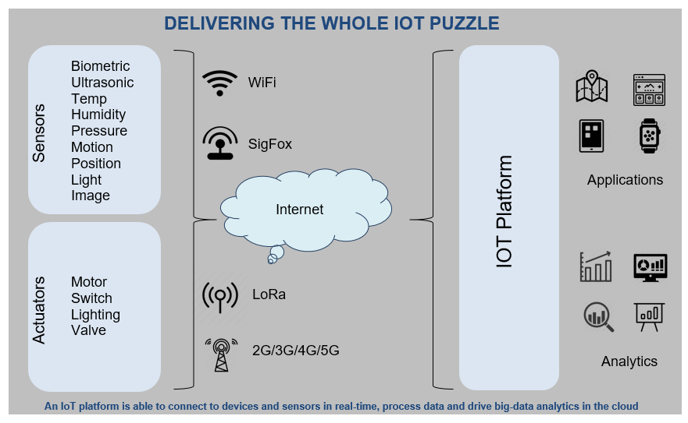
Overview

Slide 8
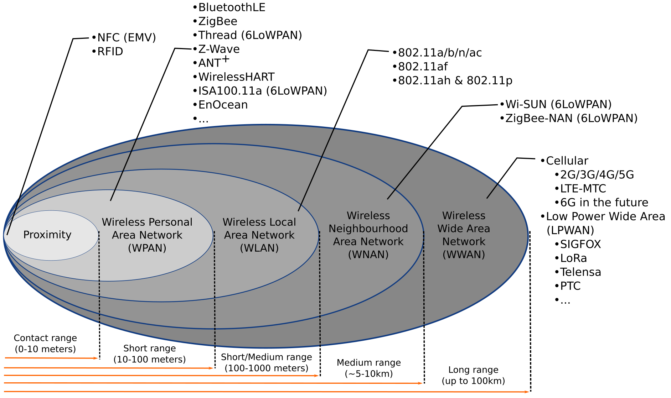
Different ranges, different standards
Source: M.S. Mahmoud, A. Mohamad, “A Study of Efficient Power Consumption Wireless Communication Techniques/ Modules for Internet of Things (IoT) Applications”, January 2016, Advances in Internet of Things 06(02):19-29, DOI:10.4236/ait.2016.62002

Slide 9
WPAN

Slide 10
Wireless Personal Area Network
IP based
6LoWPAN (IPv6 over Low-Power Wireless Personal Area Networks)
IEEE 802.11p (V2V)
RuBee (IEEE standard 1902.1)
Not IP based
Bluetooth
ZigBee (IEEE 802.15.4-based)
IrDA (Infrared Data Association)
Z-Wave
And more.

Slide 11
Bluetooth
Pros
Low power requirements
Resilient against interference
Cons
Low bandwidth
Limited range
Limited number of participants in network
Applications
Beacons
Fitness trackers, smart watches
Medical applications
Smart homes
Smart cars
Earbuds, headsets etc.
Classes for different applications with different ranges/power usages.

Slide 12
Zigbee
Pros
Low power requirements
Scales to large network sizes (~6500 nodes)
Cons
Low range
Low bandwidth
Security issues (fixed, known fallback keys in at least one profile)
Applications
Wireless sensor networks (WSN)
Industrial automation
Smart homes

Slide 13
6LoWPAN
Pros
IPv6 based
Built-in security
Scalability
Interoperability
Cons
Higher minimum requirements due to IPv6 minimum complexity
Not as popular as ZigBee
Applications
Wireless sensor networks (WSN)
Internet of Things
Industrial Internet of Things

Slide 14
IEEE 802.11p
Vehicular network optimized
Vehicle to vehicle (V2V)
Vehicle to infrastructure (V2I) such as road side units (RSU)
Built in time synchronization
Applications
Vehicular networks

Slide 15
WAN

Slide 16
Wide Area Network
Service/subscription model based
Service provider runs infrastructure such as base stations and radio towers
Examples:
Cellular networks (UMTS/LTE/5G)
LoRa (Long Range, physical layer), LoRaWAN (MAC layer)
Sigfox

Slide 17
Cellular network architecture
Grid of cell towers
Overlapping cells
Requires handover for mobile stations between cells
Network planning
Space division multiple access
Minimize interference
Avoid allocating overlapping spectrum on nearby cells

Slide 18
5G
New radio communication techniques and spectrum
Support for device to device communications (D2D)
Improved performance
Theoretical latency in single digit ms
Bandwidth in gbps range
Ability to provide connectivity in fast moving vehicles
Enables more dense connectivity and scalability (more devices)

Slide 19
LoRa/LoRaWAN
Uses unlicensed spectrum
Low number of base stations (Gateways) covers wide area
7 are enough to cover Belgium
Only produced by a single company (Simtech)
High latency, no realtime applications
Subscription based
Misses some common features from LTE networks
Only physical and MAC layers are covered => Higher OSI layers have to be implemented on top

Slide 20
Sigfox
Uses unlicensed spectrum
Uplink
100bps
12B payloads
Maximum of 6 messages per device and hour (140 per day)
Downlink
600bps
8B payloads
Maximum of 4 messages per day
Open hardware
Network subscription based

Slide 21
Router and gateways

Slide 22
Router and Gateways
Router
Bridges two networks
Can translate between protocols
Routes data
Port forwarding and network address translation (mainly end user or carrier grade)
VNETs
Gateways (not in the routing sense)
Bridges wireless network and internet
Can translate between protocols
Edge/Fog computing capabilities (see next lecture)
Routers can be gateways

Slide 23
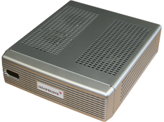
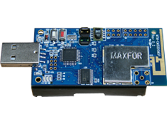
Gateway example
Wireless sensor nodes running Contiki RPL with Ipv6
Node attached to gateway over USB acts as gateway
IPv6 connectivity between networks provided through SLIP (Serial Line Internet Protocol)

Slide 24
Questions?

