Slide 1
Requirement Engineering
Lecture 1: Introduction
Prof. Dr. Benjamin Leiding
M.Sc. Anant Sujatanagarjuna
M.Sc. Chintan Patel

Slide 2
Lecture 1: Introduction
Content
Motivation for Requirements Engineering
Requirements Engineering Overview
Requirements Engineering Process

Slide 3
Motivation of Requirements Engineering

Slide 4
Motivation for Requirements Engineering
Why Requirements Engineering
Someone needs software for a professional activity or as part of a product
Most people cannot create this software!
Option 1: Buy a fitting software product
Option 2: Pay for the development of a new software
For both options the requirements must be known!

Slide 5
Motivation for Requirements Engineering
Requirements Vital for Project Success
 |  | % of Responses
1. | Incomplete Requirements | 13.1%
2. | Lack of User Involvement | 12.4%
3. | Lack of Ressources | 10.6%
4. | Unrealistic Expectations | 9.9%
5. | Lack of Executive Support | 9.3%
6. | Changing Requirements & Specifications | 8.7%
7. | Lack of Planning | 8.1%
8. | Didn‘t Need It Any Longer | 7.5%
9. | Lack of IT Management | 6.2%
10. | Technology Illiteracy | 4.3%
 | Other | 9.9%
The Standish Group (1995) – Chaos Report –https://personal.utdallas.edu/~chung/SYSM6309/chaos_report.pdf

Slide 6
Motivation for Requirements Engineering
Effects of Inadequate RE – Airbus
Requirement: „Reverse thrust may only be used, when the airplane is landed.“
Translation: „Reverse thrust may only be used while the wheels are rotating.“
Implementation: „Reverse thrust may only be used while the wheels are rotating fast enough.“
Situation: Rainstorm – aquaplaning
Result: Crash due to overshooting the runway!
Problem: Erroneous modeling in the requirement phase

Slide 7
Motivation for Requirements Engineering
Effects of Inadequate RE – General Examples
Missing requirements
“Of course, we need to print reports…”
Inadequate requirements
“Provide an optimal delivery route for each truck within 1 msec”
Implicit requirements which are not explicitly available
“Only one train may be in a specific railway segment at the same time”
Inconsistent requirements
“only approved personal may be allowed to menu level 2” but
“in order to get approval one needs to use level-2 function request approval”
Ambiguous requirements
“After inserting the card and the PIN provide access to the menu within 2 sec.”

Slide 8
Motivation for Requirements Engineering
Tasks of Requirements
Show what results the stakeholders want
A stakeholder of a system is a person or organization that has an (direct or indirect) influence on the requirements of a system.
Represent different viewpoints
Accept products against precise criteria
Requests for proposals and contract structuring
Communication between stakeholders and developers
Common understanding of desired product

Slide 9
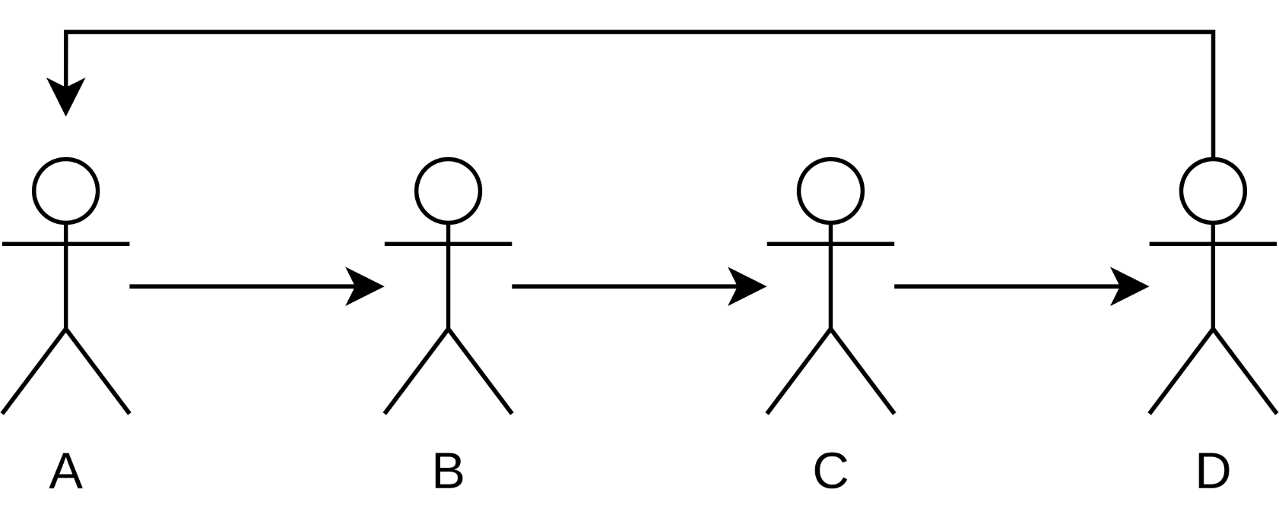
Motivation for Requirements Engineering
Getting the Right Information is Tricky – Telephone Game
Youtube → Link

Slide 10
Motivation for Requirements Engineering
Challenges for the System Analysis
Unclear objectives
Often multiple stakeholders
Bad coordination between stakeholders
Low imagination
High complexity
No individual knows every detail of the desired product
Complex business processes, boundaries, rules, and wishes
Language barriers
Native speakers vs. foreign language
Professional jargon vs. computer science jargon

Slide 11
Motivation for Requirements Engineering
Challenges for the System Analysis
Changing requirements
Vague requirements get more detailed during the development
Business process changes
Bad quality of the requirements
Imprecise, ambiguous, inconsistent
Unnecessary features
Gold plating: functions and features that are not required are part of the system definition
Imprecise planning
Results from the problems above

Slide 12
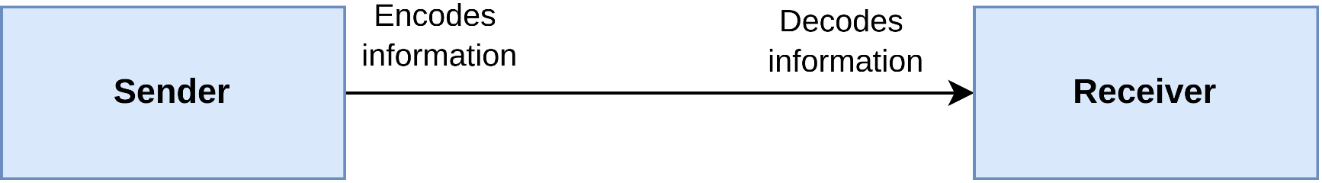
Motivation for Requirements Engineering
Fundamentals of Communication Theory
Requirements must be communicated
Mostly natural language
What a person (sender) says or writes (encodes) is not necessarily the same as what another person (receiver) understands (decodes)

Slide 13
Motivation for Requirements Engineering
Fundamentals of Communication Theory
Communication in natural language depends on several factors
Cultural background
Educational background
Area of expertise
Everyday work life
Communication medium
...

Slide 14
Motivation for Requirements Engineering
Fundamentals of Communication Theory
Different communication media have different properties
Verbal communication
Relies heavily on redundancy, e.g., language, gestures or intonation
Immediate feedback possible
Written communication
Minimum of redundancy and feedback

Slide 15
Motivation for Requirements Engineering
Fundamentals of Communication Theory
Sometimes required information is not transferred at all
Focusing
Certain information is left out due to a wrong/misguided focus
Simplification
Complex parts of the information are excluded
Oversimplified language use
Wrong expectation of existing knowledge
Agreed upon common language usage improves communication
Usually achieved through a glossary

Slide 16
Motivation for Requirements Engineering
Why are Software Requirements Special?
Software is different than hardware/materials!
Universal: almost no restrictions of the area of application
Requirements also have almost no bounds
Same means for many areas of application
Many things are taken for granted
Amorphous: software has no shape, cannot be visualized
Not monotone: Problems can always occur
If 3 and 5 work, 4 can still fail
Users and customers think anything is possible
Partially true
More possibilities means that requirements need to be detailed!

Slide 17
Requirements Engineering Overview

Slide 18
Requirements Engineering Overview
Definition – Software
Software is a collection of computer programs, procedures, directives, associated documentation and data.
IEEE 729-1983 (1983) –https://standards.ieee.org/ieee/729/967/

Slide 19
Requirements Engineering Overview
Definition – Requirements
The IEEE defines requirements as follows (IEEE Std. 610.12-1990):
A condition or capability needed by a user to solve a problem or achieve an objective.
A condition or capability that must be met or possessed by a system or system component to satisfy a contract, standard, specification, or other formally imposed documents.
A documented representation of a condition or capability as in 1) or 2).
https://ieeexplore.ieee.org/document/159342

Slide 20
Requirements Engineering Overview
Definition – Requirements Engineering
“Requirements engineering is a systematic and disciplined approach to the specification and management of requirements with the following goals:
Knowing the relevant requirements, achieving a consensus among the stakeholders about these requirements, documenting them according to given standards, and managing them systematically.
Understanding and documenting the stakeholders’ desires and needs, specifying and managing requirements to minimize the risk of delivering a system that does not meet the stakeholders’ desires and needs.”
K. Pohl, C. Rupp (2011) – Requirements Engineering Fundamentals: A study guide for Requirements Engineering Foundation Level

Slide 21
Requirements Engineering Overview
Four Core Activities of Requirements Engineering
Elicitation
Obtain requirements from stakeholders and other sources
Refinement of the requirements
Documentation
Adequate descriptions of elicited requirements.
Different techniques, e.g., natural language or conceptual models
Validation and negotiation
Validation of documented requirements and possibly their negotiation
Happens as early as possible

Slide 22
Requirements Engineering Overview
Four Core Activities of Requirements Engineering
Management
Orthogonal to the other activities
Consists of measures for
structuring requirements
preparing them for use in different roles
maintaining consistency after changes
ensuring their implementation

Slide 23
Requirements Engineering Overview
Requirement Types
Different types of requirements
Example:
Consider a calculator that should be able to perform basic arithmetic operations.
Which operations should be supported (e.g., add, subtract, multiply)?
How fast should the calculations be (e.g., 10 milliseconds, 1 second)?
What kinds of numbers should be supported (e.g., integer, floats)?

Slide 24
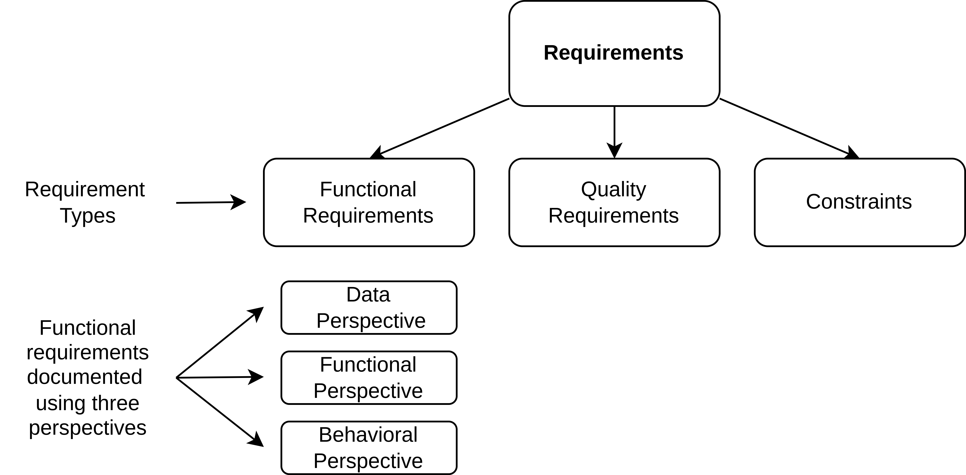
Requirements Engineering Overview
Requirement Types

Slide 25
Requirements Engineering Overview
Requirement Types – Functional Requirements
Functional requirements
A functional requirement is a requirement concerning a result of behavior that shall be provided by a function of the system
Often has many perspectives
Functional perspectives
Behavioral perspectives
Data perspectives
Example:
The calculator must be able to read numbers as input.
The calculator must be able to add two numbers and display the result.

Slide 26
Requirements Engineering Overview
Requirement Types – Quality Requirements
Quality requirements
A quality requirement is a requirement that pertains to a quality concern that is not covered by functional requirements
Typically about performance, availability, dependability, scalability, or portability of a system
Often called “non-functional requirements”
Example:
The result of any calculation must be provided within 10 milliseconds.
In average, the calculator must not crash more often than every 10,000 arithmetical operations.

Slide 27
Requirements Engineering Overview
Requirement Types – Quality Requirements
Further categorization of quality requirements
For example, ISO Standard 9126
Quality of system functions
Appropriateness, security and safety, accurateness of calculations, interoperability, conformity to standards, ...
Dependability of functionalities
Robustness, fault tolerance, recoverability, ...
Usability of a system
Understandability, learnability, ease of use, ...
System efficiency
Time behavior, consumption behavior, ...

Slide 28
Requirements Engineering Overview
Requirement Types – Quality Requirements
Changeability of a system
Analyzability, changeability, stability, testability, ...
Portability of a system
Adaptability, installability, replaceability, ...
Quality requirements often related to multiple functional requirements
Should not be mixed
Relationships should be well documented

Slide 29
Requirements Engineering Overview
Requirement Types – Constraints
Constraints
A constraint is a requirement that limits the solution space beyond what is necessary for meeting the given functional requirements and quality requirements.
Cannot be influenced by the development team
Constraints are not implemented; they are adhered to
The constraint is not part of the solution, it simply limits how the solution will look like.
Example:
The calculator shall be implemented on hardware that allows double-precision floating point operations.
The calculator shall be available on the market in June 2023.

Slide 30
Requirements Engineering Overview
Definition – Stakeholder
“A stakeholder is either a person or an organisation that has a potential interest in the system to be developed.
A stakeholder typically has their own requirements for the system.
A person can represent the interest of different stakeholders (people and/or organisations), i.e a stakeholder can have more than one role and represent more than one stakeholder.”
K. Pohl (2010) – Requirements Engineering – Fundamentals, Principles and Techniques

Slide 31
Requirements Engineering Overview
Stakeholder – Examples
Customers
System/software developers
System users
Architects
Domain experts
Testers
Maintenance staff
Etc.

Slide 32
Requirements Engineering Process

Slide 33
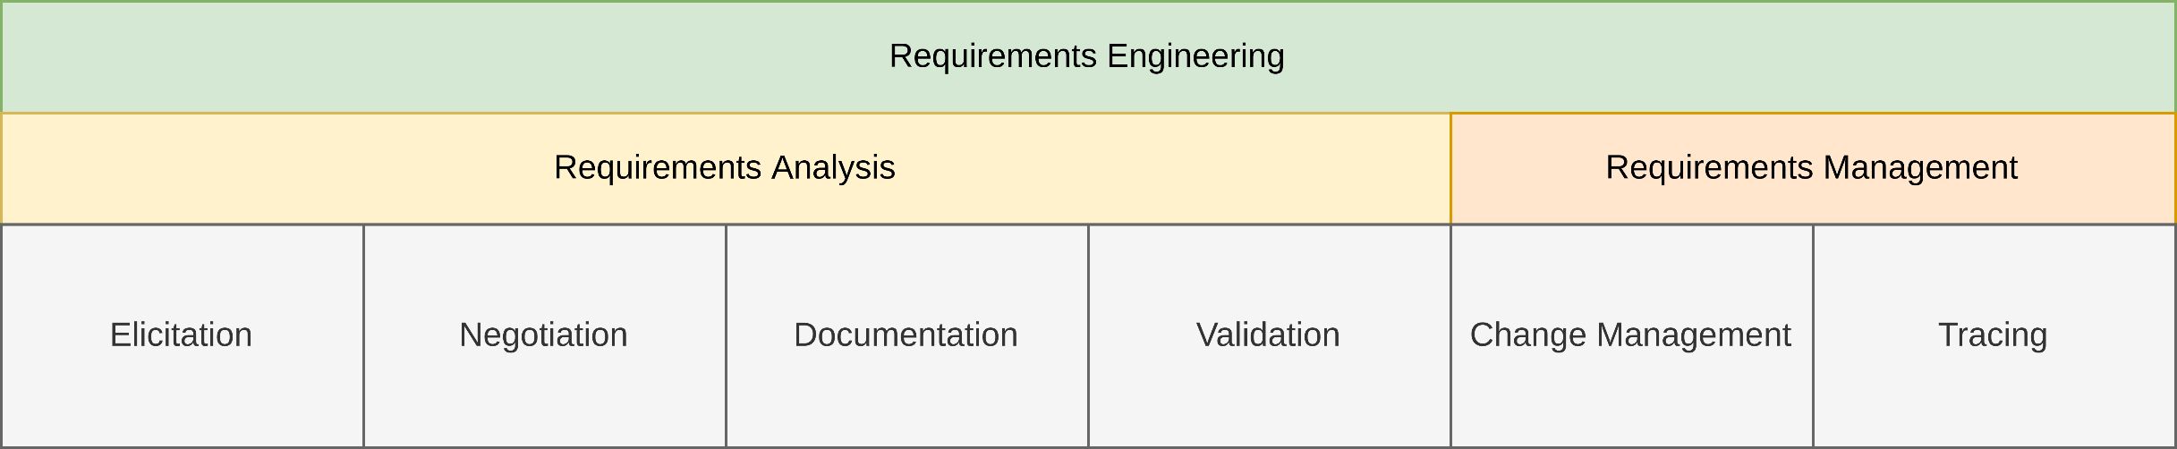
Requirements Engineering Process
Overview

Slide 34
Requirements Engineering Process
Elicitation
Start of a project
Content roughly known
Tasks:
Identification of stakeholders
Identification of additional sources of requirements
For example, existing systems, standards, etc.
Gathering of raw requirements
Need further refinement, but already capture the “core” of the requirements

Slide 35
Requirements Engineering Process
Elicitation
Approach:
Visit and interview customer
Only few people involved
Documents and important names are retrieved
Evaluate results and determine open questions
Ask targeted questions in interviews
Customer or other stakeholders are asked
Possibly in form of a workshop

Slide 36
Requirements Engineering Process
Analysis & Negotiation
Tasks:
Identification of the concrete requirements
Structuring of the requirements
Identification of relationships
Classification of requirements (e.g., functional requirement)
Merging of similar requirements
Grouping of requirements
Based on relationships
Based on requirement type (e.g., functional requirements, quality requirements)
Refinement of the requirements
From raw requirements to detailed requirements sufficient that can be the basis of an acceptance test
Identification of dependencies
Detection of inconsistencies
Resolution of inconsistencies
Prioritization of requirements
For example, in must-have requirements and optional requirements

Slide 37
Requirements Engineering Process
Analysis & Negotiation
Approach:
Study records of meeting with customer and additional available material
Ask questions if needed (back to elicitation)
Resolve ambiguities off-line
For example, through a phone call
In case of contradictions → Negotiation
Parallel: Writing of the Specification (→ Documentation)
Called “Draft” while it is a work-in-progress
Distribution of specification draft
Workshop with all “important” people
Stakeholders, project management, software architects
Often people who can actually make decisions absent
Presentation of the obtained requirements
Slides, mock-ups
Interactive prioritization and concretization
In case of disagreement, direct mediation is possible
Intensive record keeping required

Slide 38
Requirements Engineering Process
Documentation
Tasks:
Specification of requirements
Through the documentation, the requirements are fixed
Documentation of intermediate results and assumptions
Documentation of reasoning for requirements
Assignment of attributes to requirements
Approach:
Writing driven by employees
Usually iterative and often incremental process
Multiple drafts, each with more information and details
A lot of copy-and-paste between drafts
Uses the results of the workshops and interviews with customers
In practice often a mix of natural language, tables, use cases and UML
Documents have long appendixes
Requirements Specification V1.0 a lot longer than the drafts
Better style, more technical
Reasoning behind requirements almost completely removed

Slide 39
Requirements Engineering Process
Documentation
Tasks:
Specification of requirements
Through the documentation, the requirements are fixed
Documentation of intermediate results and assumptions
Documentation of reasoning for requirements
Assignment of attributes to requirements

Slide 40
Requirements Engineering Process
Documentation
Approach:
Writing driven by employees
Usually iterative and often incremental process
Multiple drafts, each with more information and details
A lot of copy-and-paste between drafts
Uses the results of the workshops and interviews with customers
In practice often a mix of natural language, tables, use cases and UML
Documents have long appendixes
Requirements Specification V1.0 a lot longer than the drafts
Better style, more technical
Reasoning behind requirements almost completely removed

Slide 41
Requirements Engineering Process
Validation
Tasks:
Validation of the content of the specification documents
If possible, a formal verification of the documents
Verification and validation against previously existing documents (e.g., request for proposals, documentation of a legacy system) and customer wishes
Approach:
Documents are reviewed by experienced employees
Often less experienced people involved in writing the requirements
Checking of formal guidelines through templates
Checking if the customers wishes are met by the document
Based on the memory of the participants in workshops/interviews
Especially check for wishes that seem very important
Sometimes: Produce a prototype

Slide 42
Requirements Engineering Process
Validation
Tasks:
Validation of the content of the specification documents
If possible, a formal verification of the documents
Verification and validation against previously existing documents (e.g., request for proposals, documentation of a legacy system) and customer wishes

Slide 43
Requirements Engineering Process
Validation
Approach:
Documents are reviewed by experienced employees
Often less experienced people involved in writing the requirements
Checking of formal guidelines through templates
Checking if the customers wishes are met by the document
Based on the memory of the participants in workshops/interviews
Especially check for wishes that seem very important
Sometimes: Produce a prototype

Slide 44
Requirements Engineering Process
Change Management
Tasks:
Management of change requests
Management of different versions of requirements
Each change to a requirement yields a new version
Well organized propagation of changes
Approach:
Informed and competent decision about change requests
Change request → Change Control Board → Decision → Assign change task (costs money)
Often, this is done rather informally
No change control board, no clear decision making process
In case a RE tool is used:
Change and version control automatically → the change requests and changes themselves become traceable objects within the system
Propagation depends on the organization
In case no RE tool is used:
Changes are introduced manually
Changes are usually no traceable objects themselves

Slide 45
Requirements Engineering Process
Change Management
Tasks:
Management of change requests
Management of different versions of requirements
Each change to a requirement yields a new version
Well organized propagation of changes

Slide 46
Requirements Engineering Process
Change Management
Approach:
Informed and competent decision about change requests
Change request → Change Control Board → Decision → Assign change task (costs money)
Often, this is done rather informally
No change control board, no clear decision making process
In case a RE tool is used:
Change and version control automatically → the change requests and changes themselves become traceable objects within the system
Propagation depends on the organization
In case no RE tool is used:
Changes are introduced manually
Changes are usually no traceable objects themselves

Slide 47
Requirements Engineering Process
Tracing
Tasks:
Record assumptions
Record decisions
Record which assumptions lead to which decisions and how the requirements were influenced
Approach:
Requires RE tool to be effective
Usually not available!
Manual tracing is a lot of work
Requires searching in documents and protocols
“In the meeting XYZ, Mr. Smith said that we should ...”

Slide 48
Requirements Engineering Process
Tracing
Tasks:
Record assumptions
Record decisions
Record which assumptions lead to which decisions and how the requirements were influenced

Slide 49
Requirements Engineering Process
Tracing
Approach:
Requires RE tool to be effective
Usually not available!
Manual tracing is a lot of work
Requires searching in documents and protocols
“In the meeting XYZ, Mr. Smith said that we should ...”

Slide 50
Summary

Slide 51
Summary
System analysis has many challenges
Requirements engineering is a complex task
Requirements are the foundation of projects
Without good requirements, projects are in trouble
Requirements engineering is more than just “getting the requirements and writing them down”
Tasks include elicitation, documentation, but also validation of requirements, change management and tracing of requirements

Slide 52
Questions?

Slide 53
References

