Slide 1
IoT and Digitalization for the Circular Economy
Lecture 0: Organization
Prof. Dr. Benjamin Leiding
M.Sc. Anant Sujatanagarjuna
M.Sc Chintan Patel

Slide 2
License
This work is licensed under a Creative Commons Attribution-ShareAlike 4.0 International License. To view a copy of this license, please refer to https://creativecommons.org/licenses/by-sa/4.0/ .
Updated versions of these slides will be available in our Github repository.

Slide 3
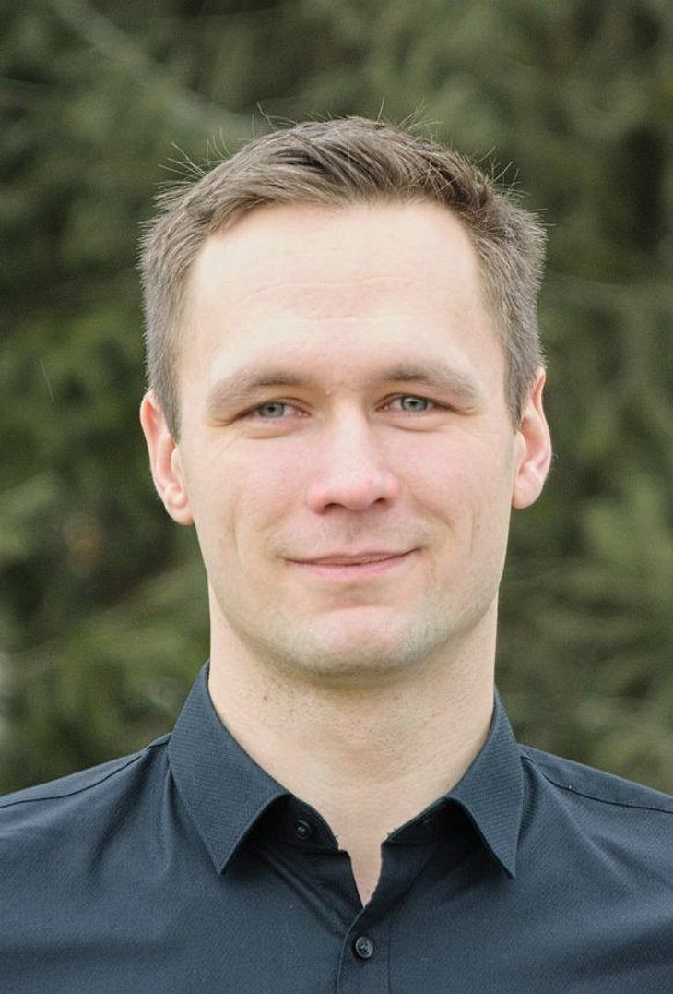

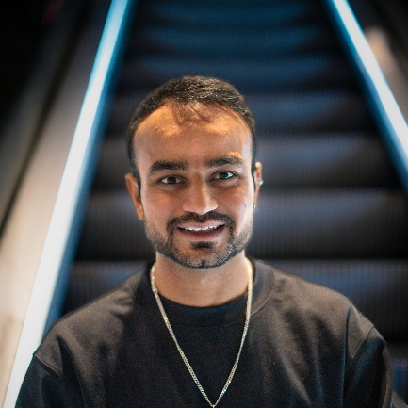
Team
Prof. Dr. Benjamin Leiding
M.Sc. Anant Sujatanagarjuna
M.Sc. Chintan Patel

Slide 4
Research Group
Emerging Technologies for the Circular Economy → ETCE
Research focus:
Intersection of IT and sustainability
Circular Economy and Circular Societies
Self-organized, decentralized and distributed systems
Sustainable and resilient food production
Other courses:
Requirements Engineering (WS – M.Sc.)
The Limits to Growth – Sustainability and the Circular Economy (WS – open for everyone)
Notes:
<number>

Slide 5
Research Group
ETCE Website – Link
Course material
Theses/project topics
You want join us? Write us an email!
→ benjamin.leiding@tu-clausthal.de
Notes:
<number>

Slide 6
Learning Outcome
Understanding the concept of a circular economy, sustainability, and related concepts (biocapacity, etc.).
Gain a basic understanding of causes, dimensions, and the characterization of climate change, environmental pollution, and dwindling non-renewable resources.
Introduction to IoT and cyberphysical systems in the circular economy
Sensors and actuators for IoT, control and process systems of the circular economy
Experience in prototyping IoT applications and systems
The ability to critically assess upcoming technological solutions enabling/facilitating sustainability and the circular economy.
Notes:
<number>

Slide 7
Lectures
27.04.2026 → Organization (L00)
04.05.2026 → Introduction (L01)
11.05.2026 → Circular Economy (L02)
18.05.2026 → Lifecycle Assessment – LCA I (L03)
01.06.2026 → Lifecycle Assessment – LCA II (L04)
08.06.2026 → Introduction to the Internet of Things (L05)
15.06.2026 → Internet of Things – Communication (L06) + Security and Privacy (L07)
22.06.2026 → Internet of Things – Data Processing and Big Data (L08)
29.06.2026 → IoT in Mining I (L09)
06.07.2026 → IoT in Mining II (L10)
13.07.2026 → Digital Technologies and Greenwashing (L11)
23.07.2026 → Coding Workshop I (Goslar)
24.07.2026 → Coding Workshop II (Goslar)
27.07.2026 → Exam Q&A

Slide 8
Exercises (Deadlines)
18.05.2026 → Exercise 01 – Circular Economy (MC)
01.06.2026 → Exercise 02 – Lifecycle Assessment (LCA) – Part 1
08.06.2026 → Exercise 03 – Lifecycle Assessment (LCA) – Part 2
13.07.2026 → Exercise 04 – IoT in Mining
20.07.2026 → Exercise 05 – TBA

Slide 9
Course Organization
News and updates → StudIP
Organization of the lecture:
Slides are available on Github (Link)
Please report bugs!
Lectures and exercises as live stream (BBB – next slide)
Lecture recordings will be available on StudIP and on Github
Exercise time slots = Time for questions and eventual tutorials related to the exercises
Questions? Write us an email: etce-iot@tu-clausthal.de ← We will only respond to
emails written to this specific email address!

Slide 10
Dates/Times/Locations
Lecture:
Monday 2:15 pm to 3:45 pm (Berlin time) – 27.04.2026 to 13.07.2026
Location: Goslar Gotec (Am Stollen 19 C, 38640 Goslar, Germany) or via BigBlueButton (Link) OR video recordings
Exercise / Q&A:
Monday 4 pm to 4:45 pm (Berlin time) – 27.04.2026 to 13.07.2026
Location: Goslar Gotec (Am Stollen 19 C, 38640 Goslar, Germany) or via BigBlueButton (Link)
Practical Coding Workshop:
When: 23.07.2026 and 24.07.2026 from 10 am – 5 pm (Berlin time)
Location: Goslar (DIGIT – Wallstr. 6, 38640 Goslar)

Slide 11
Exercises and Practical Workshop
Individual work → no group submissions
Multiple-Choice or written exercises
Multiple-Choice exercises are considered “self-evaluations” and are not submitted
Submission of each written exercise is mandatory
You pass by receiving a grade greater than 0.
You will receive feedback on your submission (during Q&A session)
Exercise = learning feedback
Practical workshop → You pass the workshop if you score 50% (or more)
More info on points, percentages, etc. follow on the next slides (Examination)

Slide 12
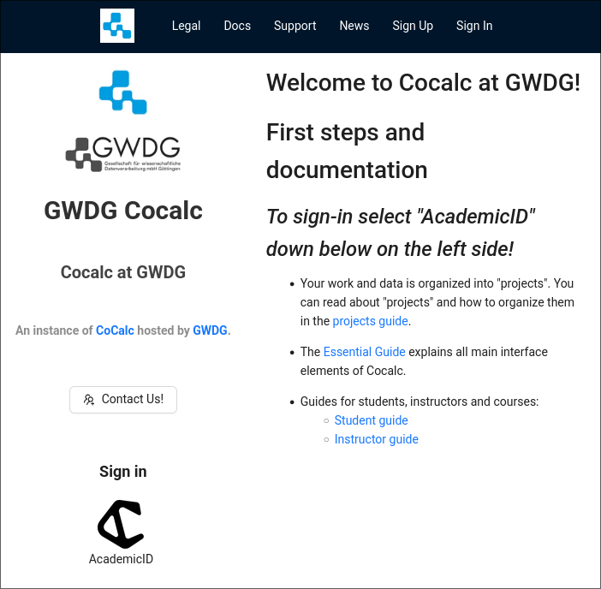
Exercise Submission and Grading
Exercises are graded semi-automatically. Due to this it is highly important that you follow the required submission format. Otherwise the grading process will fail and you will receive 0 points.
Exercises will be provided to you via Cocalc https://cocalc.gwdg.de/ with additional instructions provided via GitHub.

Slide 13
Coding Exercise Submission and Grading
Sign-in using your university credentials.
Click on the “Academic ID” Logo

Slide 14
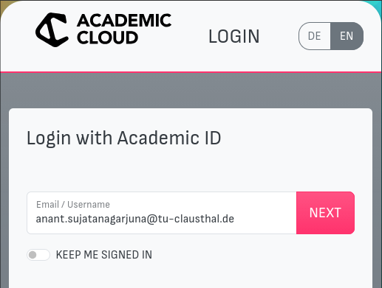
Coding Exercise Submission and Grading
Sign-in using your university credentials.
Click on the “Academic ID” Logo
Enter your university email address.

Slide 15

Coding Exercise Submission and Grading
Sign-in using your university credentials.
Click on the “Academic ID” Logo
Enter your university email address.
Choose “Technische Universität Clausthal” from the drop-down box.

Slide 16

Coding Exercise Submission and Grading
Sign-in using your university credentials.
Click on the “Academic ID” Logo
Enter your university email address.
Choose “Technische Universität Clausthal” from the drop-down box.
Login with your usual TU-Clausthal credentials.

Slide 17
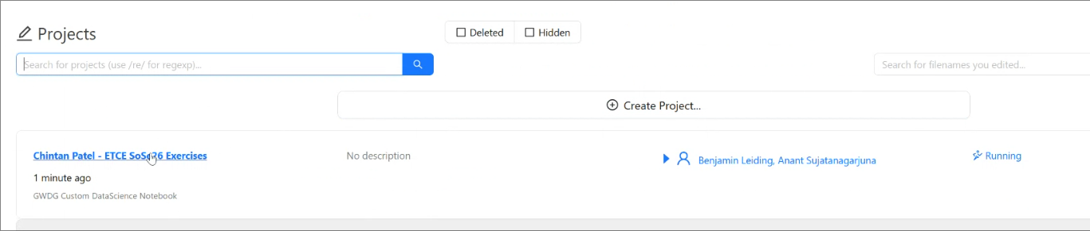
Coding Exercise Submission and Grading
Submitting Assignments
Click on “IoT Mining SoSe26”

Slide 18
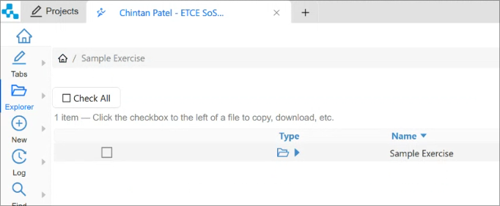
Coding Exercise Submission and Grading
Submitting Assignments
Click on “IoT Mining SoSe26”
Open the folder of the exercise you want to work on.

Slide 19
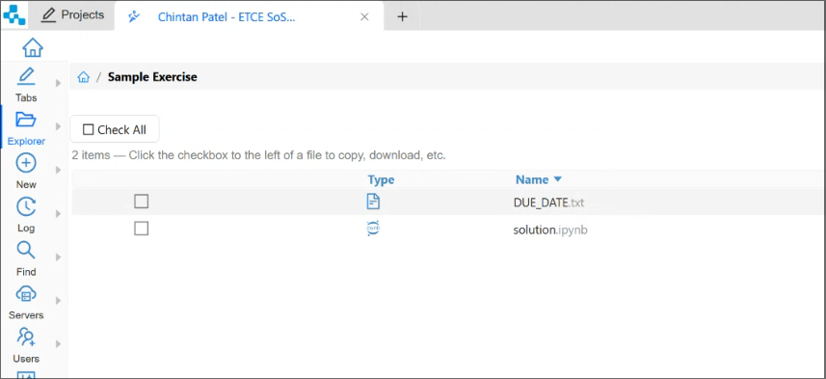
Coding Exercise Submission and Grading
Submitting Assignments
Click on “IoT Mining SoSe26”
Open the folder of the exercise you want to work on.
Edit the file in the exercise folder as indicated in the exercise handout PDFs.

Slide 20
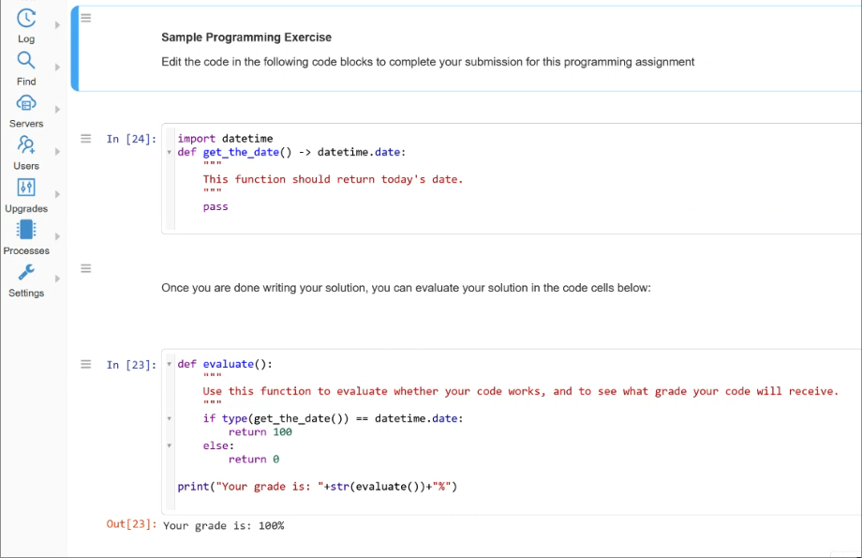
Coding Exercise Submission and Grading
Submitting Assignments
Click on “IoT Mining SoSe26”
Open the folder of the exercise you want to work on.
Edit the file in the exercise folder as indicated in the exercise handout PDFs.

Slide 21
Coding Exercise Submission and Grading
Exercise Grades
We will collect your exercises after the deadline has elapsed.
Please ensure to save all changes to the exercise folder BEFORE the deadline.
DO NOT submit your assignments via email/other means.

Slide 22
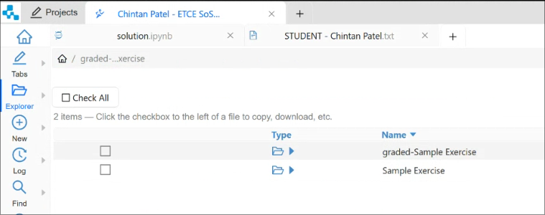
Coding Exercise Submission and Grading
Exercise Grades
We will collect your exercises after the deadline has elapsed.
Please ensure to save all changes to the exercise folder BEFORE the deadline.
DO NOT submit your assignments via email/other means.
Exercises, once graded will be released back to you.

Slide 23
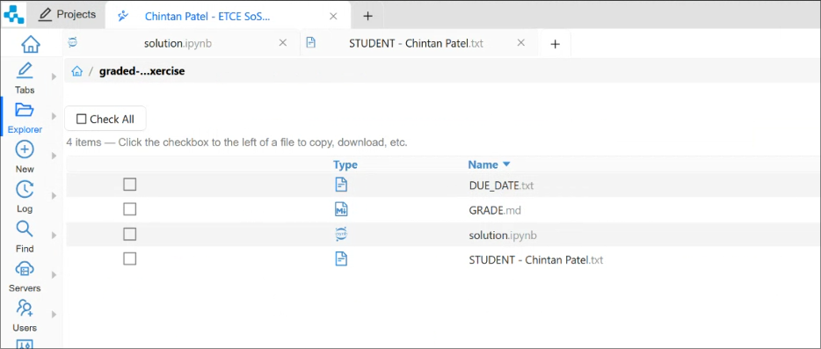
Coding Exercise Submission and Grading
Exercise Grades
We will collect your exercises after the deadline has elapsed.
Please ensure to save all changes to the exercise folder BEFORE the deadline.
DO NOT submit your assignments via email/other means.
Exercises, once graded will be released back to you.
Your grade is provided inside the “GRADE.md” file.

Slide 24
Coding Exercise Submission and Grading
Exercise Grades
We will collect your exercises after the deadline has elapsed.
Please ensure to save all changes to the exercise folder BEFORE the deadline.
DO NOT submit your assignments via email/other means.
Exercises, once graded will be released back to you.
Your grade is provided inside the “GRADE.md” file.
Receiving a grade of 0 = FAIL.

Slide 25
Multiple-Choice Exercises
Every student enrolled in this course is advised to take the knowledge quiz in the second week of the course.
Goal of the test:
To check the knowledge level of the student that is relevant to this course of study.
Preparation:
A review of basic concepts of the Circular Economy is recommended for Week 2.
THE TEST IS JUST FOR YOU → WE CANNOT CHECK THE TEST RESULTS

Slide 26
Multiple-Choice Exercises
Every student enrolled in this course is advised to take the knowledge quiz in the second week of the course.
Goal of the test:
To check the knowledge level of the student that is relevant to this course of study.
Preparation:
A review of basic concepts of the Circular Economy is recommended for Week 2.
THE TEST IS JUST FOR YOU → WE CANNOT CHECK THE TEST RESULTS
Link for all multiple-choice exercises → etce.etce-lab.de

Slide 27

Multiple-Choice Exercises

Slide 28
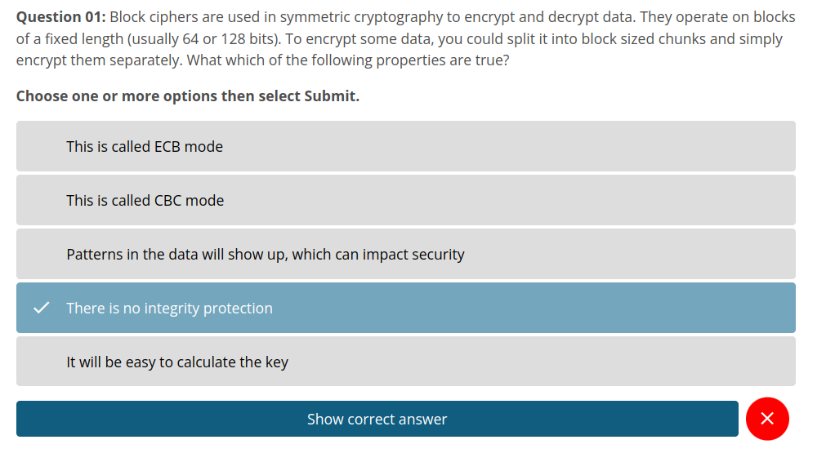
Multiple-Choice Exercises

Slide 29
Examination
Prerequisite for admission to the final exam (all criteria have to be fulfilled):
Submit all exercises
Pass the practical workshop
Final exam:
Most likely 12.08.2026 and 13.08.2026
Oral examination (20min)
Online

Slide 30
Self-Study Star
Slides with the self-study star indicate optional/additional study material that is not mandatory but could be helpful or interesting
Self-Study Star →

Slide 31
Literature
This course is not based on a single book and you do not need to buy a book to pass the exam.
Donella H. Meadows, Jorgen Randers, and Dennis L. Meadows. The Limits to Growth (1972).
Donella H. Meadows, Jorgen Randers, and Dennis L. Meadows. Limits To Growth: The 30-Year Update (2004).
Baccini et al. Metabolism of the Anthroposphere: Analysis, Evaluation, Design (2012).
Walter R. Stahel. The Circular Economy: A User's Guide (2019).
W. Brian Arthur. The Nature of Technology: What It Is and How it Evolves (2011)
David Wallace-Wells. The Uninhabitable Earth, Annotated Edition (2017).
(German) Stefan Rahmstorf, Hans Joachim Schellnhuber. Der Klimawandel (2019).

Slide 32
Literature
Perry Lea. Internet of Things for Architects: Architecting IoT solutions by implementing sensors, communication infrastructure, edge computing, analytics, and security (2018).
M.A. Khan, M.T. Quasim, F. Algarni, A. Alharthi. Decentralised Internet of Things (2020).
Dimitrios Serpanos und Marilyn Claire Wolf. Internet-of-Things (IoT) Systems Architectures, Algorithms, Methodologies (2018).

Slide 33
Questions?

