Slide 1
Requirement Engineering
Lecture 2: System Context Boundaries
and
Types of Requirements
Prof. Dr. Benjamin Leiding
M.Sc. Anant Sujatanagarjuna

Slide 2
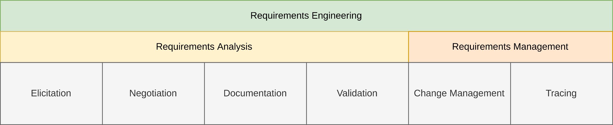
General Requirements Engineering Process
Overview

Slide 3
Lecture 2: System Context Boundaries
Content
System Context
System Boundary
Context Boundary
Types of Requirements

Slide 4
System Context

Slide 5
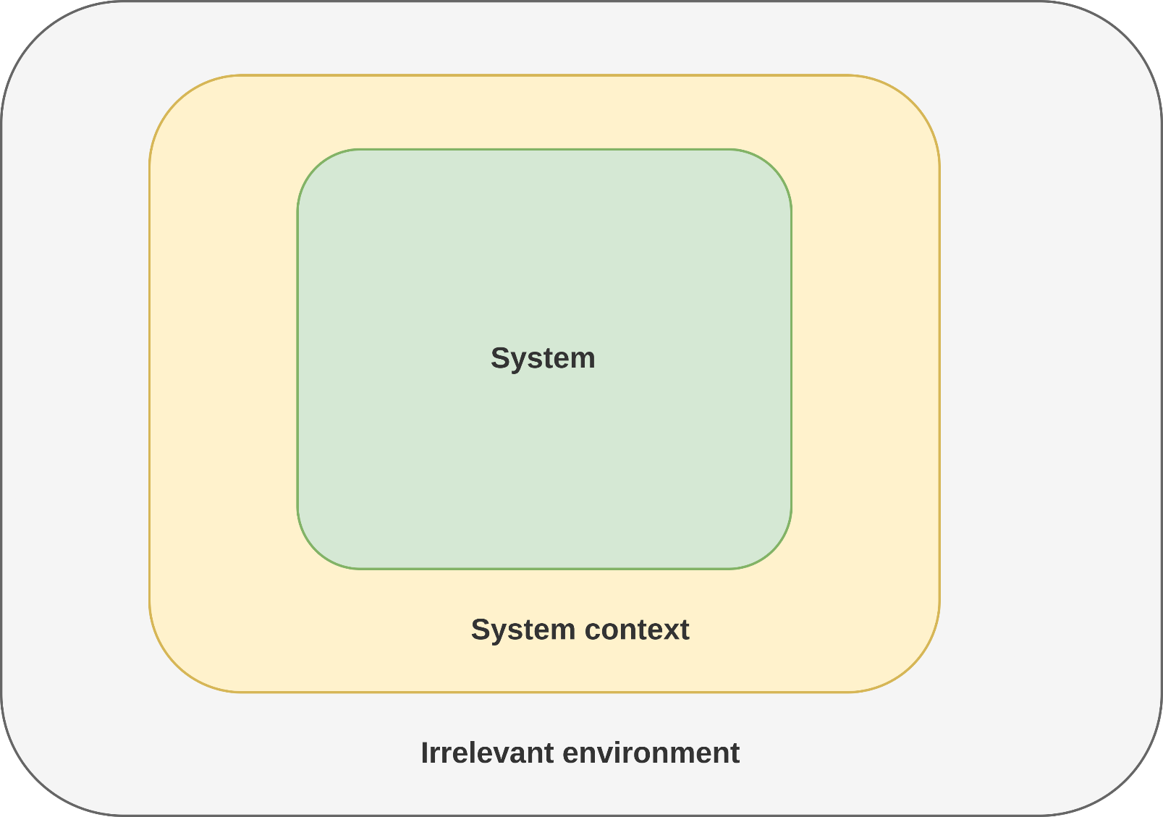
System Context
System Boundary
Context Boundary
Based on K. Pohl, C. Rupp (2011) – Requirements Engineering Fundamentals: A study guide for Requirements Engineering Foundation Level

Slide 6
System Context
Why?
Software system is always embedded in an environment
Environment influences definition of requirements
Environment might consist of, e.g., (im)material objects ((non-)technical systems), people, technologies, business processes, laws, sensors, existing software components, etc.
→ Ignoring the environment will most likely lead to defects in the requirement specification

Slide 7
System Context
Some Examples for Limiting Factors
Developers only trained in Java
Excludes other language options
Input data comes from a publicly available database
Excludes arbitrary input formats
eXtreme Programming should be used
Can only use technologies for which the required tooling is available, e.g., automated unit tests
An existing library should be re-used
Excludes other libraries that provide similar features
Requires development that is compatible to the available library

Slide 8
System Context
Wrong Context – so what?
In extreme cases:
Critical bugs that prevent the system execution
System may not be deployable
The implementation may be impossible
Less extreme cases:
Late changes to requirements increase costs
Removal of features
Uncritical bugs
Users just don’t like the software

Slide 9
System Context
Wrong Context – so what?
In extreme cases:
Critical bugs that prevent the system execution
System may not be deployable
The implementation may be impossible
Less extreme cases:
Late changes to requirements increase costs
Removal of features
Uncritical bugs
Users just don’t like the software
Wrong Context → Wrong Requirements

Slide 10
System Context
Definition
“The system context is the part of the system environment relevant for defining, understanding, and interpreting the system requirements. The system context consists of four context facets: the subject facet, the usage facet, the IT system facet, and the development facet.”
K. Pohl, C. Rupp (2011) – Requirements Engineering Fundamentals: A study guide for Requirements Engineering Foundation Level

Slide 11
System Context
Context as Origin of Requirements
Without knowing the context, requirements cannot be defined properly
Otherwise, requirements may be outside of the context
Example:
Medical applications require the fulfillment of medical software standards
The standards are part of the context
The standards may prohibit certain requirements, that contradict the standard
e.g., publish data
The standards may lead to requirements, in order to fulfill it
e.g., pseudonymize data

Slide 12
System Context
Understanding the Context is Important
Understanding the context leads to understanding the requirements
Some requirements cannot be understood without the context
Example:
The sending of E-Mails must be according to RFC 821. ← Defines SMTP
Without knowledge about RFC 821 not understandable
The “why” of requirements often originates from the context
Example:
All documents must be encrypted with AES-256.
Usually this is unreasonable
If the documents are classified and you know that AES-256 is NSA approved, this makes sense

Slide 13
System Context
Defining the System and Context Boundaries
Responsibility of the requirements engineer
Both system boundary and context boundary must be defined
System boundary:
Which aspects belong to the system and which aspects belong to the system context?
Context boundary:
Which aspects belong to the system context and which aspects are irrelevant (i.e., not in the system context)?

Slide 14
System Boundary

Slide 15
System Boundary
System Boundary
Context Boundary
Based on K. Pohl, C. Rupp (2011) – Requirements Engineering Fundamentals: A study guide for Requirements Engineering Foundation Level

Slide 16
System Boundary
Overview
The system boundary defines the scope of the development
Example:
If a credit card payment system is developed as part of the system, it is within the system boundary
If an existing credit card payment system is reused, it is outside of the system boundary

Slide 17
System Boundary
Definition
“The system boundary separates the system to be developed from the system context. The system boundary separates the parts that belong to the system and can hence be changed during the development process from the parts of the system context that cannot be changed during the development process.”
K. Pohl, C. Rupp (2011) – Requirements Engineering Fundamentals: A study guide for Requirements Engineering Foundation Level

Slide 18
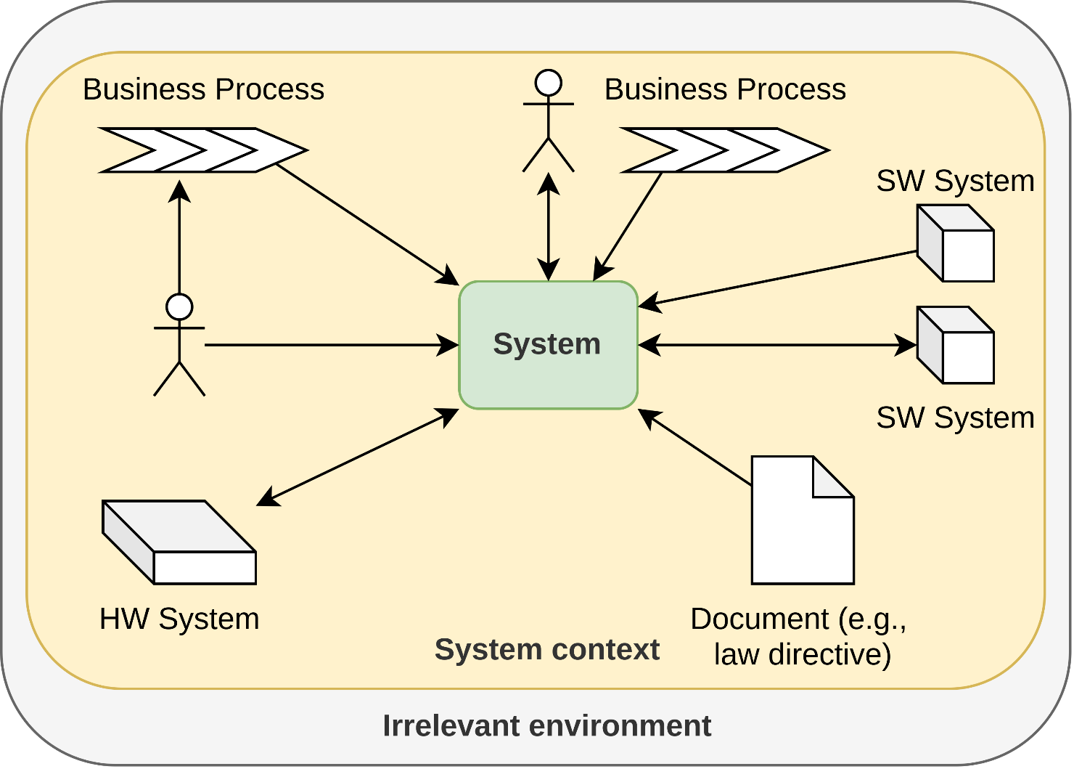
System Boundary
Influences on the System Boundary
Based on K. Pohl, C. Rupp (2011) – Requirements Engineering Fundamentals: A study guide for Requirements Engineering Foundation Level

Slide 19
System Boundary
Interfaces of the System
Two types of interfaces
Sources provide inputs for the system
Sinks receive output from the system
Possible sources and sinks:
(Groups of) Stakeholders
Existing Systems
Interfaces are used ...
for monitoring the environment
to provide functionalities to the environment
to influence parameters of the environment
to control operations of the environment

Slide 20
System Boundary
Interface Types
Sources and Sinks require various interfaces
Depends on the functionality of the source/sink
Common examples:
Human-machine interfaces
Mouse, keyboard, touchscreen, emergency off switch
Hardware interface
SD card slot, USB port
Software interface
Library, Web service
The interfaces may impose constraints
The interfaces may be sources of requirements

Slide 21
System Boundary
Development of the Boundary
Not all elements of the system boundary are known at the beginning of a project
Interfaces unknown, desired functionalities unknown, ...
System boundary often not defined until the end of the requirements engineering process
Leads to a “gray zone” between the system and the context
System boundary may shift within the gray zone
Gray zone itself may shift
At the end of the requirements engineering, no gray zone left

Slide 22
Context Boundary

Slide 23
Context Boundary
System Boundary
Context Boundary
Based on K. Pohl, C. Rupp (2011) – Requirements Engineering Fundamentals: A study guide for Requirements Engineering Foundation Level

Slide 24
Context Boundary
Overview
Distinguishes between what is relevant for the requirements engineering and what is not.
Similar to the system boundary: may shift and have a gray zone

Slide 25
Context Boundary
Definition
“The context boundary separates the relevant part of the system environment from the irrelevant environment which contains all those aspects that do not need to be considered during the system development.”
K. Pohl, C. Rupp (2011) – Requirements Engineering Fundamentals: A study guide for Requirements Engineering Foundation Level

Slide 26
Context Boundary
Completeness of the Context Boundary
Complete definition of the context boundary virtually impossible
Sometimes unclear, whether an aspect belongs to the system context or not
Cannot always be resolved during the requirements engineering
It is possible that after the requirements engineering, there is still a gray zone in the context
Different from the system context, where the gray zone is resolved

Slide 27
Context Boundary
Documenting the System Context
Often through natural language
Diagrams also very useful
Use case diagrams
Actors (people, other systems) and their usage relationship to the system
Data flow diagrams
Flow of data between the sources and sinks
Typically, a mixture of several documentation forms

Slide 28
Types of Requirements

Slide 29
Types of Requirements
Motivation
Different types of requirements must be documented for a complete requirements documentation.
These requirements types differ with respect to:
adequate specification techniques
their importance for different types of systems
Notes:
49

Slide 30
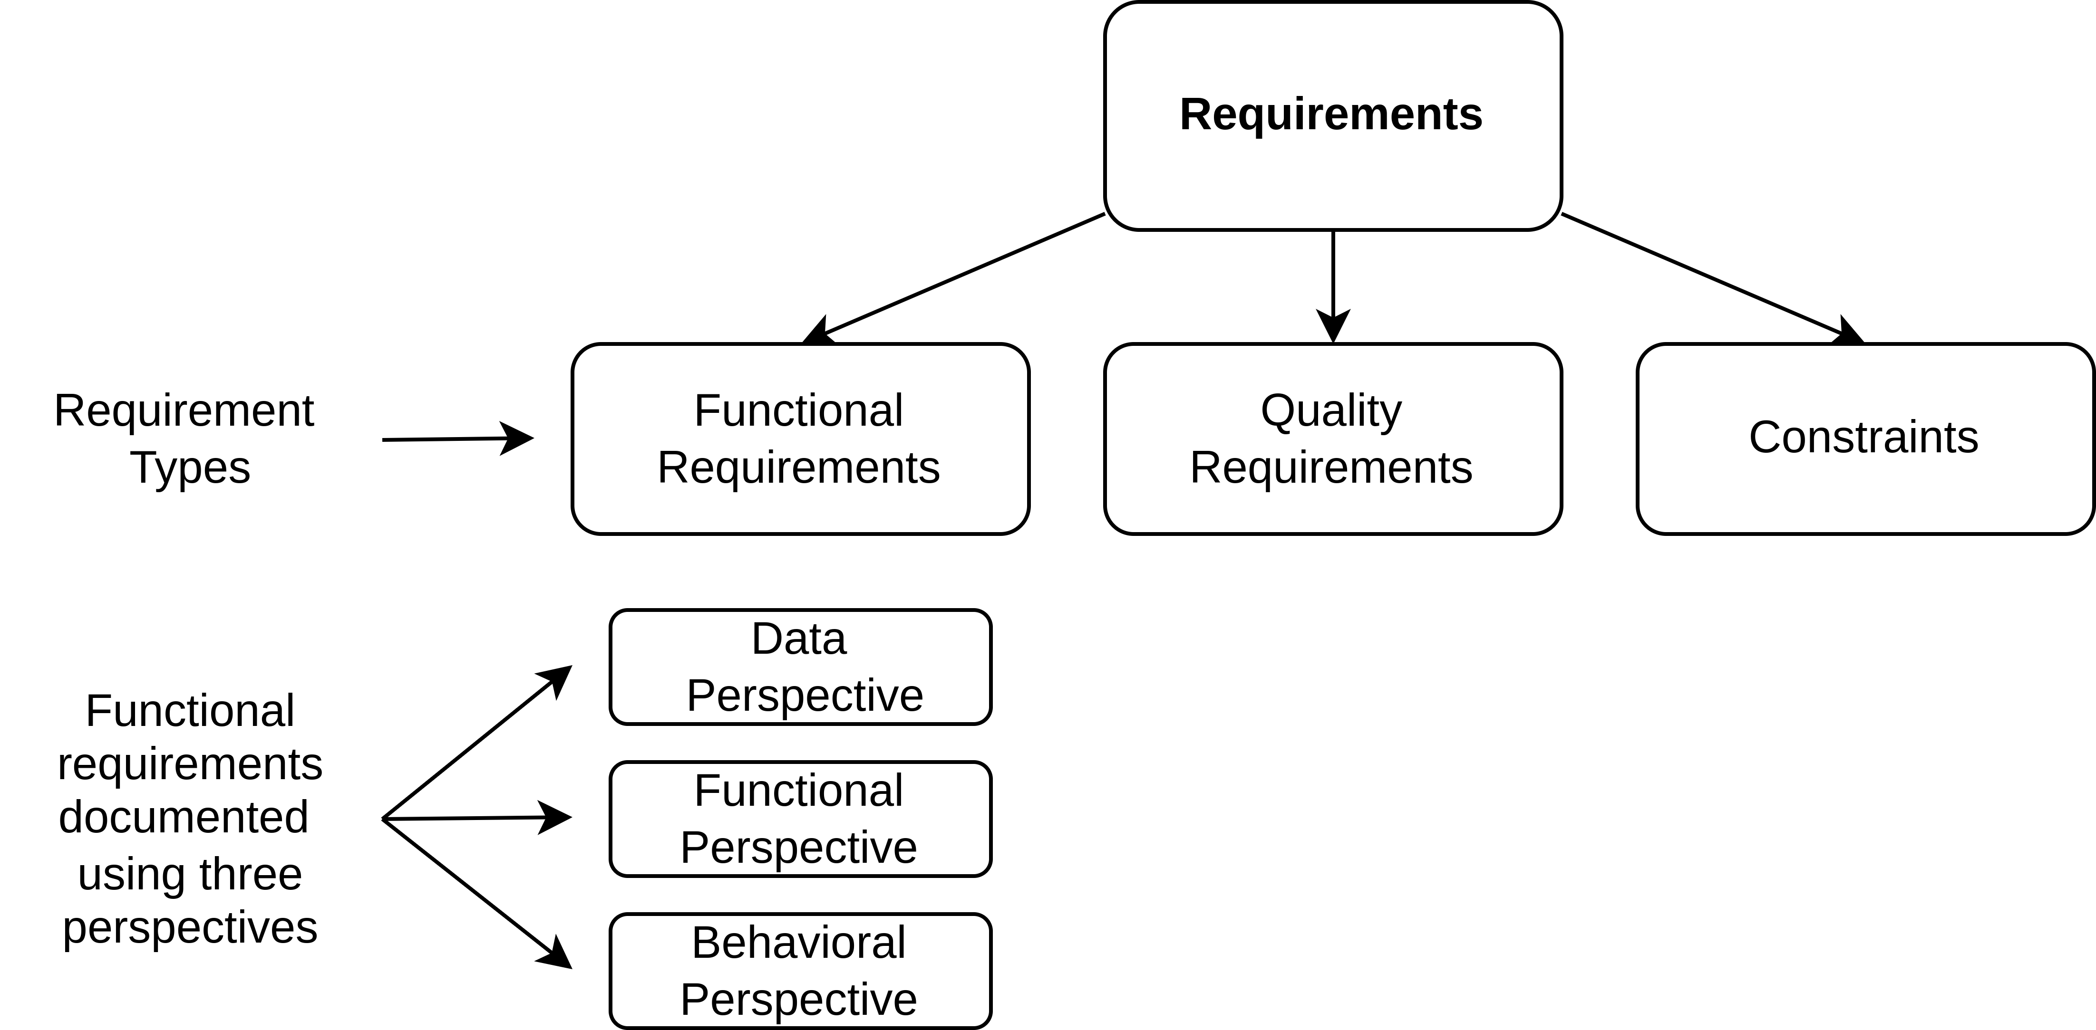
Types of Requirements
Functional Requirements
Notes:
49

Slide 31
Types of Requirements / Functional Requirements
Data Perspective
All systems need to deal with data
Data on customers, articles, etc.
Multimedia, e.g., videos, songs, etc.
…
Information must be adequately structured and represented:
Which information / data items are relevant to the system?
Which information / data items are at the boundary of the system?
Notes:
49

Slide 32
Types of Requirements / Functional Requirements
Data Perspective – Representing Data
UML class diagrams
Context diagrams
Data dictionary
Note:
the data specified in the requirements need not be directly related to the implementation
same information, but different structure possible
e.g. attributes versus classes may change strongly
In information systems understanding the data is a key driver !
Notes:
49

Slide 33
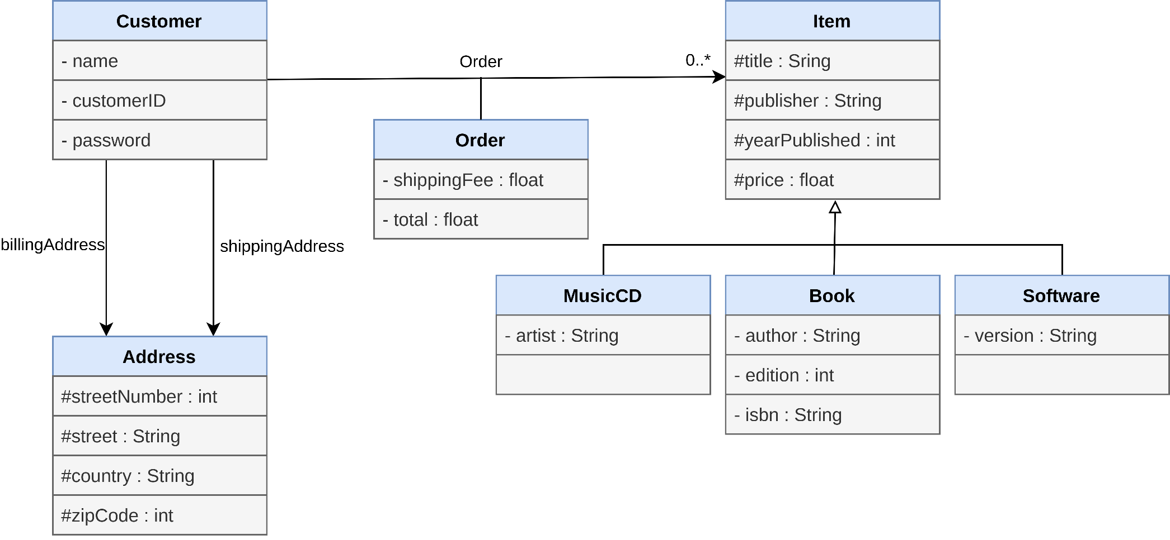
Types of Requirements / Functional Requirements
Data Perspective – Book Shop UML Example
Notes:
49

Slide 34
Types of Requirements / Functional Requirements
Data Perspective – Context Diagram Example
instructor
customer
manage
courses and
customers
courses
clerk
customer clerk
accounting
Notes:
49

Slide 35
Types of Requirements / Functional Requirements
Behavioral Perspective
Behavioral requirements describe what a system will do (with the data):
how input information is transformed into state information and output information
sequences of interaction of the software system with its environment (people, software, hardware)
System behavior is important on various levels:
Business processes - describe the fundamental flow of activities in an enterprise
Task level - describe the interaction of people with a software system on a coarse grained level (e.g., define new customer)
Stimulus / response - describe interactions
Notes:
49

Slide 36
Types of Requirements / Functional Requirements
Behavioral Perspective – Specification Techniques
Many different techniques were developed for specifying this:
Textual Use Cases
Business Process Modeling Languages
Scenario-Based Modeling Approaches
Event-Based Modeling Techniques
The techniques can be categorized along the following dimensions:
data-flow (-transformation) vs. stimulus-/response
complete description vs. prototypical description
Notes:
49

Slide 37
Types of Requirements / Functional Requirements
Behavioral Perspective – Specification Techniques
The UML provides different approaches:
Use Case Diagram
State Machine Diagram
Activity Diagram
Notes:
49

Slide 38
Types of Requirements / Functional Requirements
Interface Requirements
The interface takes apart interior and exterior
Interfaces are defined by the project context
Different types of interfaces:
User interfaces (Human-Machine Interface)
Software Interfaces
Hardware-related interfaces
Notes:
49
Genau in der Systemgrenze, vergleiche Kapitel 2

Slide 39
Types of Requirements / Functional Requirements
Interface Requirements – User Interface
Interface Description must describe
Layout
Look & Feel
Category of Interface (WIMP, ASCII-based, tactile, …)
Interaction sequences
..
Usability aspects are specific to this type of interface
Person (e.g., impairements, knowledge)
Situation
Task
…
Notes:
49
WIMP steht meist für „Windows“, „Icons“, „Menus“ und „Pointer“ ➔ GUI

Slide 40
Types of Requirements / Functional Requirements
Interface Requirements – Software Interface
Interfaces to other software interfaces are defined based on
Identification of service, i.e., how to find it
The protocol (how to interact)
The data format(s), e.g., how to exchange data
Typically use of standard protocols, like
Web-Service
HTTP
…
But also possible → Data file is written to a specific location and read by another program
Notes:
49
Auffinden von fremden Diensten
Identifikation von Services, Protokoll, Datenformat gegeben → gleich zu HW Interface

Slide 41
Types of Requirements / Functional Requirements
Interface Requirements – Hardware Interface
Hardware interfaces are often:
Time critical
Protocol specification must include timing information
Specified close to hardware (e.g. addressing)
Hardware-based → service identification may be given in bits and bytes
Other than that, usually hardware interfaces are like a software interface
Mapping software information to the physical world is done by hardware!
Notes:
<number>
Wenn ich A mache muss ich min 5 Sekunden warten und max 7 Sekunden warten bis ich Aktion B mache
Nachdem ich Ventil geöffnet habe muss ich x Sekunden warten, bis ich korrekten Druckwert ablesen kann
Embbeded Systeme/Register, wenn ich folgende Daten in Speicherzelle 3700 ablege, wie werden diese interpretiert
Hardware Adressen nehmen mir RAM Adressen weg
Beispiel: http://en.wikipedia.org/wiki/Memory-mapped_I/O

Slide 42
Types of Requirements
Non-Functional & Quality Requirements – Definition
Quality requirements define qualitative attributes of the whole system, a single function or a group of functions, i.e. how good a system shall do the things it is supposed to do.
Non-functional requirements are used to encompass all kinds of not functional requirements for a system:
quality requirements should be related to the functional requirement or group of requirements they are relevant to
development constraints should be captured separately
project aspects should be clearly separated from product aspects
he term
Notes:
<number>

Slide 43
Types of Requirements
Non-Functional & Quality Requirements – Definition
Quality requirements define qualitative attributes of the whole system, a single function or a group of functions, i.e. how good a system shall do the things it is supposed to do.
Non-functional requirements are used to encompass all kinds of not functional requirements for a system:
quality requirements should be related to the functional requirement or group of requirements they are relevant to
development constraints should be captured separately
project aspects should be clearly separated from product aspects
The term non-functional requirements is depreciated (according to IEEE)
Notes:
<number>

Slide 44
Types of Requirements
Non-Functional & Quality Requirements – Kinds of Requirements
Requirements
Functional requirements
Non-functional requirements
Constraints
Functional attributes
Development attributes
Maintainability, portablility, ...
Local attributes (QoS)
Non-local attributes
Performance, reliability, ...
Security, usability
Notes:
<number>

Slide 45
Types of Requirements
Non-Functional & Quality Requirements – Product Quality (ISO 9126 / DIN 66272)
Functionality
Adequacy
Security
Precision of calculation
Interoperability
Conformity with standards
Reliability
Maturation
Fault tolerance
Recovery
Usability
Comprehensibility
Learnability
Operability
Notes:
<number>

Slide 46
Types of Requirements
Non-Functional & Quality Requirements – Product Quality (ISO 9126 / DIN 66272)
Efficiency
Time response
Resource Consumption
Changeability
Analyzability
Modifiability
Stability
Verifiability
Portability
Adaptivity
Installability
Conformity with standards
Replaceability
Notes:
<number>

Slide 47
Types of Requirements
Non-Functional & Quality Requirements – Example „Performance“
User level → The user can create accounts with only two interactions
System task level → The creation of an account (pressing of the „system availability“ button) takes max. 0.5 seconds
→ Derived non-functional requirement result from the interplay between both levels.
Notes:
<number>

Slide 48
Summary

Slide 49
Summary
The system context defines what is relevant for the system and what can be ignored
Stakeholder, data sources and sinks, standards, ...
The system boundary defines the scope of the system
E.g., which functionalities are provided by the system in comparison to what is provided by the system context
A wrong system context leads to erroneous requirements
Possibly fatal for a project

Slide 50
Summary
Notes:
<number>

Slide 51
Questions?

Slide 52
References

