Slide 1
Emerging Technologies for the Circular Economy
Lecture 0: Organization
Prof. Dr. Benjamin Leiding
M.Sc. Anant Sujatanagarjuna
M.Sc. Chintan Patel

Slide 2
License
This work is licensed under a Creative Commons Attribution-ShareAlike 4.0 International License. To view a copy of this license, please refer to https://creativecommons.org/licenses/by-sa/4.0/ .
Updated versions of these slides will be available in our Github repository.

Slide 3
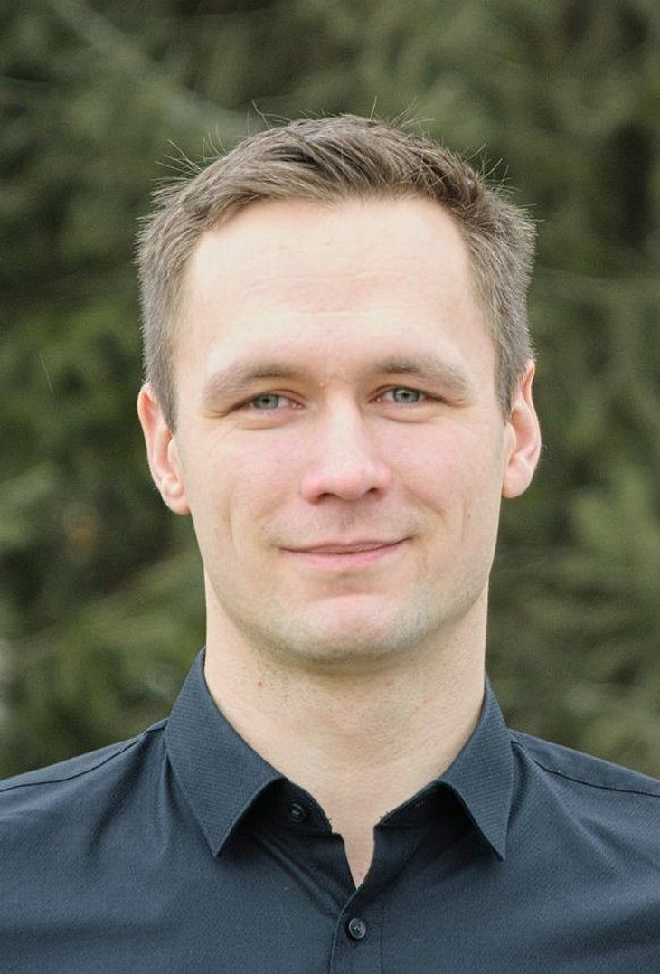

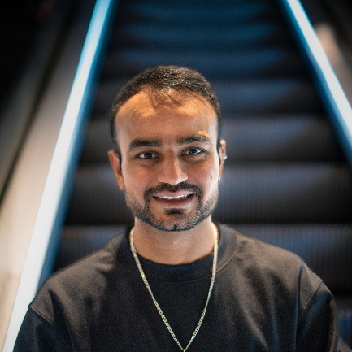
Team
Prof. Dr. Benjamin Leiding
M.Sc. Anant Sujatanagarjuna
M.Sc. Chintan Patel

Slide 4
ETCE Research Group
Emerging Technologies for the Circular Economy → ETCE
Research focus:
Intersection of IT and sustainability
Circular Economy
Self-organized, decentralized and distributed systems
Sustainable and resilient food production
Other courses:
The Limits to Growth – Sustainability and the Circular Economy (WS – open for everyone)
Requirements Engineering (WS – M.Sc.)
Notes:
<number>

Slide 5
ETCE Research Group
ETCE Website – Link
Course material
Theses/project topics
You want join us? Write us an email!
→ benjamin.leiding@tu-clausthal.de
Notes:
<number>

Slide 6
ETCE Research Group
ETCE Website – Link
Course material
Theses/project topics
You want join us? Write us an email!
→ benjamin.leiding@tu-clausthal.de
Notes:
<number>

Slide 7
Learning Outcome
Basic understanding of the concept of the circular economy
Basic understanding of emerging technologies at the intersection of digital technologies and sustainability
Understanding and overview of the Internet of Things and related concepts
Ability to design smart systems and applications in the context of connected sensor systems and other stakeholders.
Experience in prototyping applications and systems

Slide 8
Lectures
27.04.2026 → Organization (L00)
04.05.2026 → Introduction (L01)
11.05.2026 → Circular Economy (L02)
18.05.2026 → Lifecycle Assessment – LCA I (L03)
01.06.2026 → Lifecycle Assessment – LCA 2 (L04)
08.06.2026 → Introduction to the Internet of Things (L05)
15.06.2026 → Internet of Things – Communication (L06) + Security and Privacy (L07)
22.06.2026 → Internet of Things – Data Processing and Big Data (L08)
06.07.2026 → IoT Applications I – Resilient and Sustainable Food Production (L09)
13.07.2026 → Digital Technologies and Greenwashing (L10)
20.07.2026 → Exam Q&A

Slide 9
Exercises (Deadlines)
11.05.2026 → Exercise 01 – Knowledge Test (MC)
18.05.2026 → Exercise 02 – Circular Economy (MC)
01.06.2026 → Exercise 03 – Lifecycle Assessment (LCA) – Part 1
08.06.2026 → Exercise 04 – Lifecycle Assessment (LCA) – Part 2
15.06.2026 → Exercise 05 – IoT Sensing and Gathering Data
22.06.2026 → Exercise 06 – IoT Data Processing
29.06.2026 → Exercise 07 – IoT Security
06.07.2026 → Exercise 08 – IoT and Food Production

Slide 10
Course Organization
Organization of the lecture:
Slides are available on Github (Link)
Please report bugs!
Lectures and exercises as live stream (BBB – next slide)
Lecture recordings will be available on StudIP and on Github
Exercise time slots = Time for questions and eventual tutorials related to the exercises
Questions? Write us an email: etce-etce@tu-clausthal.de ← We will only respond to
emails written to this specific email address!

Slide 11
Dates/Times/Locations
Lecture:
Monday 2:15 pm to 3:45 pm (Berlin time) – 27.04.2026 to 13.07.2026
Location: Goslar Gotec (Am Stollen 19 C, 38640 Goslar, Germany) or via BigBlueButton (Link)
Exercise / Q&A:
Monday 4 pm to 4:45 pm (Berlin time) – 27.04.2026 to 13.07.2026
Location: Goslar Gotec (Am Stollen 19 C, 38640 Goslar, Germany) or via BigBlueButton (Link)

Slide 12
Exercises
Individual work → no group submissions
Multiple-Choice or coding exercises
Multiple-Choice exercises are considered “self-evaluations” and are not submitted
7-14 days to submit (depending on the task)
Submission deadline (coding exercises) is always Monday at 1:59pm (right before the next lecture)
Submission of each coding exercise is mandatory
You pass by receiving a grade greater than 0.
You will receive feedback on your submission
Exercise = learning feedback

Slide 13
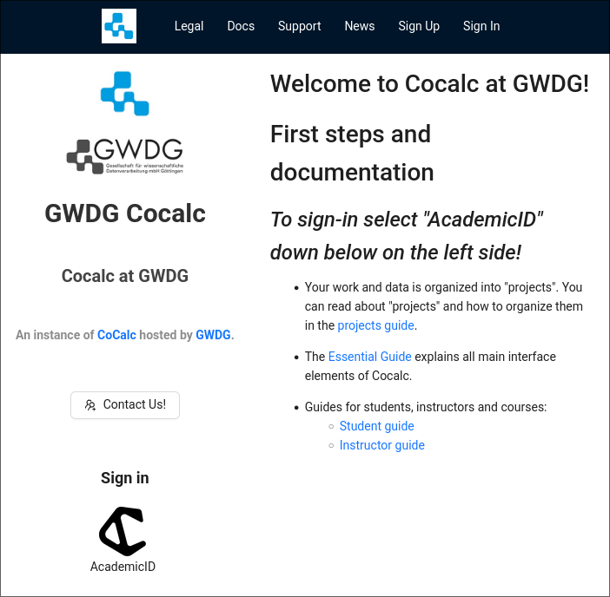
Coding Exercise Submission and Grading
Coding exercises are graded semi-automatically. Due to this it is highly important that you follow the required submission format. Otherwise the grading process will fail and you will receive 0 points.
Coding exercises will be provided in the form of Jupyter Notebooks, and provided to you via Cocalc https://cocalc.gwdg.de/, with additional instructions provided via GitHub.

Slide 14
Coding Exercise Submission and Grading
Sign-in using your university credentials.
Click on the “Academic ID” Logo

Slide 15
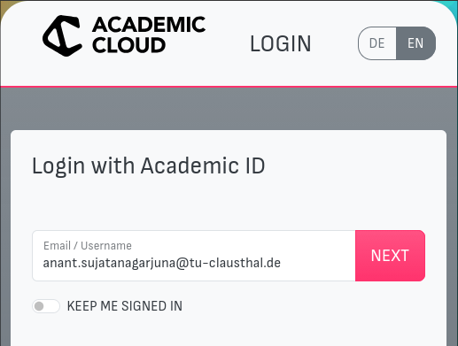
Coding Exercise Submission and Grading
Sign-in using your university credentials.
Click on the “Academic ID” Logo
Enter your university email address.

Slide 16
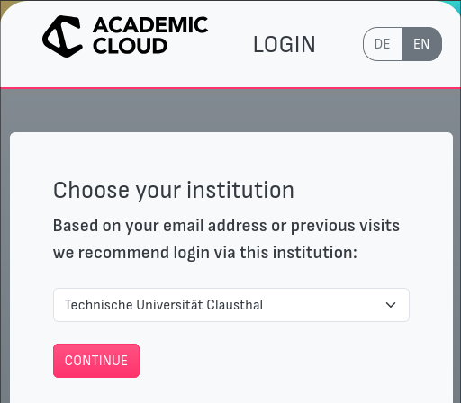
Coding Exercise Submission and Grading
Sign-in using your university credentials.
Click on the “Academic ID” Logo
Enter your university email address.
Choose “Technische Universität Clausthal” from the drop-down box.

Slide 17

Coding Exercise Submission and Grading
Sign-in using your university credentials.
Click on the “Academic ID” Logo
Enter your university email address.
Choose “Technische Universität Clausthal” from the drop-down box.
Login with your usual TU-Clausthal credentials.

Slide 18
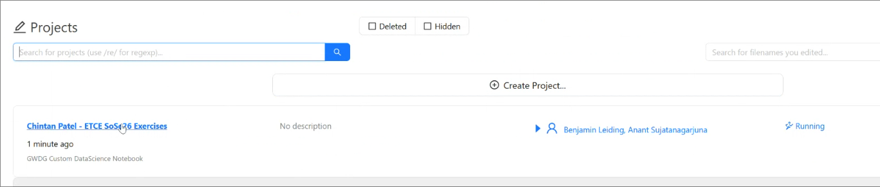
Coding Exercise Submission and Grading
Submitting Assignments
Click on “ETCE SoSe26 Exercsies”

Slide 19
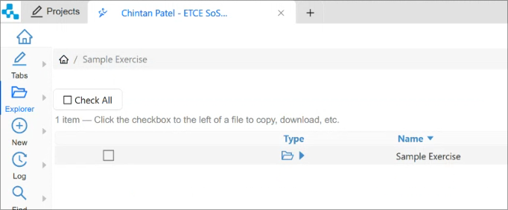
Coding Exercise Submission and Grading
Submitting Assignments
Click on “ETCE SoSe26 Exercsies”
Open the folder of the exercise you want to work on.

Slide 20
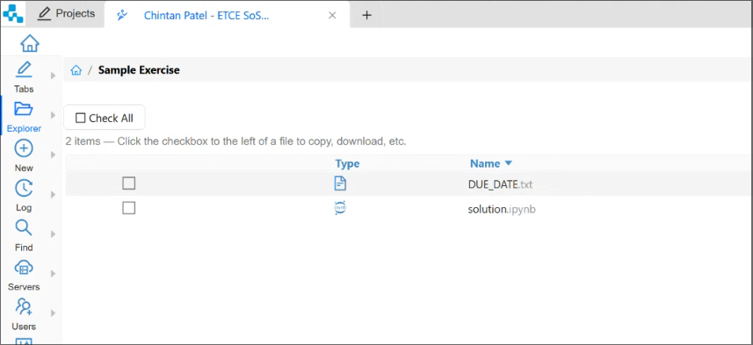
Coding Exercise Submission and Grading
Submitting Assignments
Click on “ETCE SoSe26 Exercsies”
Open the folder of the exercise you want to work on.
Edit the file in the exercise folder as indicated in the exercise handout PDFs.

Slide 21
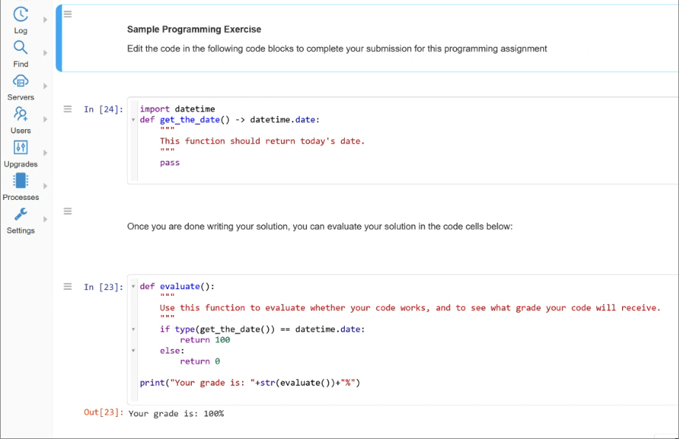
Coding Exercise Submission and Grading
Submitting Assignments
Click on “ETCE SoSe26 Exercsies”
Open the folder of the exercise you want to work on.
Edit the file in the exercise folder as indicated in the exercise handout PDFs.

Slide 22
Coding Exercise Submission and Grading
Exercise Grades
We will collect your exercises after the deadline has elapsed.
Please ensure to save all changes to the exercise folder BEFORE the deadline.
DO NOT submit your assignments via email/other means.

Slide 23
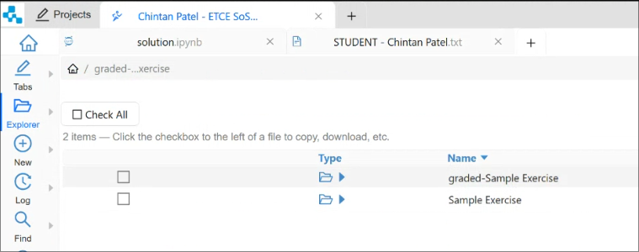
Coding Exercise Submission and Grading
Exercise Grades
We will collect your exercises after the deadline has elapsed.
Please ensure to save all changes to the exercise folder BEFORE the deadline.
DO NOT submit your assignments via email/other means.
Exercises, once graded will be released back to you.

Slide 24
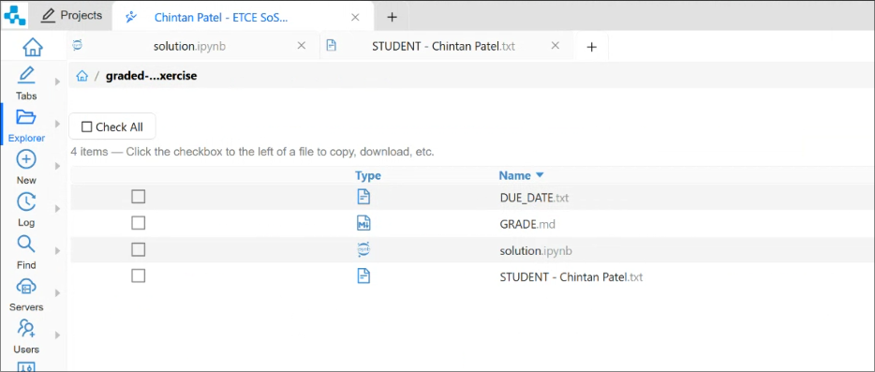
Coding Exercise Submission and Grading
Exercise Grades
We will collect your exercises after the deadline has elapsed.
Please ensure to save all changes to the exercise folder BEFORE the deadline.
DO NOT submit your assignments via email/other means.
Exercises, once graded will be released back to you.
Your grade is provided inside the “GRADE.md” file.

Slide 25
Coding Exercise Submission and Grading
Exercise Grades
We will collect your exercises after the deadline has elapsed.
Please ensure to save all changes to the exercise folder BEFORE the deadline.
DO NOT submit your assignments via email/other means.
Exercises, once graded will be released back to you.
Your grade is provided inside the “GRADE.md” file.
Receiving a grade of 0 = FAIL.

Slide 26
Multiple-Choice Exercises
Every student enrolled in this course is advised to take the knowledge quiz in first two weeks of the course.
Goal of the test:
To check the knowledge level of the student that is relevant to this course of study.
Preparation:
A review of basic concepts of Cryptography and Circular Economy is recommended for Week 1 and Week 2 respectively
Knowledge quiz for Week 1 only tests your existing knowledge.
THE TEST IS JUST FOR YOU → WE CANNOT CHECK THE TEST RESULTS

Slide 27
Multiple-Choice Exercises
Every student enrolled in this course is advised to take the knowledge quiz in first two weeks of the course.
Goal of the test:
To check the knowledge level of the student that is relevant to this course of study.
Preparation:
A review of basic concepts of Cryptography and Circular Economy is recommended for Week 1 and Week 2 respectively
Knowledge quiz for Week 1 only tests your existing knowledge.
THE TEST IS JUST FOR YOU → WE CANNOT CHECK THE TEST RESULTS
Link for all multiple-choice exercises → etce.etce-lab.de

Slide 28

Multiple-Choice Exercises

Slide 29
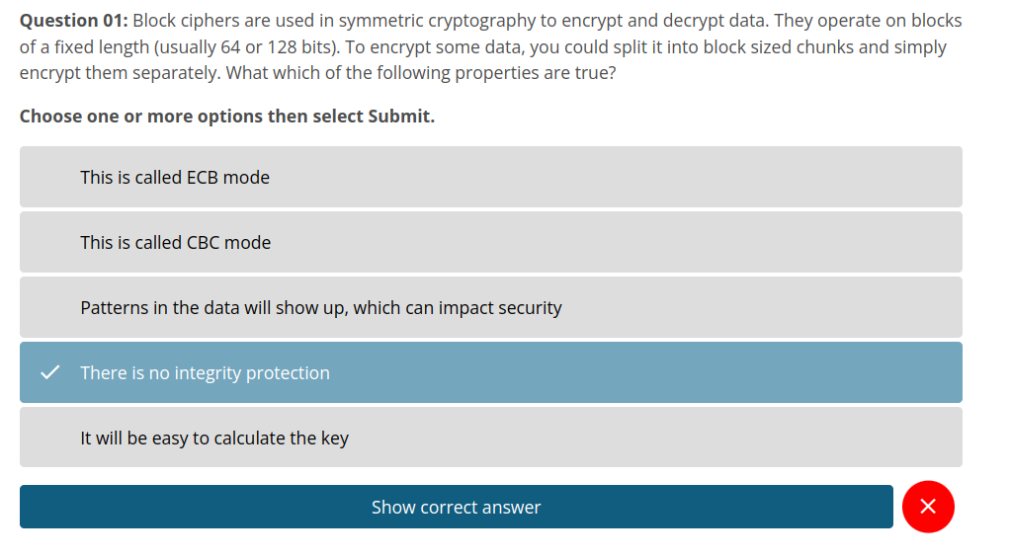
Multiple-Choice Exercises

Slide 30
Examination
Prerequisite for admission to the final exam (all criteria have to be fulfilled):
Submit all exercises (except for the MC exercises).
Final exam:
Written exam (120min) via Moodle
Date → Most likely 03.08.2026 from 2 pm – 4 pm

Slide 31
Self-Study Star
Slides with the self-study star indicate optional/additional study material that is not mandatory but could be helpful or interesting
Self-Study Star →

Slide 32
Literature
This course is not based on a single book and you do not need to buy a book to pass the exam.
Donella H. Meadows, Jorgen Randers, and Dennis L. Meadows. The Limits to Growth (1972).
Donella H. Meadows, Jorgen Randers, and Dennis L. Meadows. Limits To Growth: The 30-Year Update (2004).
Baccini et al. Metabolism of the Anthroposphere: Analysis, Evaluation, Design (2012).
Walter R. Stahel. The Circular Economy: A User's Guide (2019).
W. Brian Arthur. The Nature of Technology: What It Is and How it Evolves (2011).
David Wallace-Wells. The Uninhabitable Earth, Annotated Edition (2017).
(German) Stefan Rahmstorf, Hans Joachim Schellnhuber. Der Klimawandel (2019).

Slide 33
Literature
M.A. Khan, M.T. Quasim, F. Algarni, A. Alharthi. Decentralised Internet of Things (2020).
Dimitrios Serpanos und Marilyn Claire Wolf. Internet-of-Things (IoT) Systems Architectures, Algorithms, Methodologies (2018).
Perry Lea. Internet of Things for Architects: Architecting IoT solutions by implementing sensors, communication infrastructure, edge computing, analytics, and security (2018).
Dan Boneh, Amit Sahai und Brent Waters. Functional Encryption: Definitions and Challenges (2010).

Slide 34
Questions?

