Slide 1
MedTwin-IDS
AI-driven intrusion detection and device risk scoring for a medical IoT digital twin
ICT3214 Security Analytics · Coursework 2 · Group [Group ID]
[Member 1] · [Member 2] · [Member 3] · [Member 4] · [Member 5]
Notes:
Introduce the team and the project in one sentence: we built a digital twin of a hospital ward, used it to generate labelled medical IoT traffic, and trained machine learning models that detect attacks in real time and score every device's risk.

Slide 2




Attacks on ward devices are patient-safety events
Spoofed monitor
Altered vitals
Rogue pump command
An impostor publishes normal vitals while the patient deteriorates.
A man-in-the-middle changes heart rate or SpO2 on the way to the nurse station.
Guessed credentials let an attacker change an infusion rate.
The data gap
Public IoMT datasets (e.g. WUSTL-EHMS-2020, about 16,000 records) are small and fixed: attack type, intensity and timing cannot be varied, so unseen attacks and real-time behaviour cannot be tested.
Notes:
Motivation. Medical devices are hard to patch and an attack can directly harm a patient. Research is held back by small, fixed datasets. That is why we generate our own data with a digital twin.

Slide 3

Five research questions
RQ1
Can a ward digital twin generate realistic, exactly labelled IoMT data?
RQ2
Which of Random Forest, XGBoost and an MLP balances accuracy and speed best?
Project scope
Idea 1: AI-driven IDS for medical IoT digital twins
Idea 7: per-device risk score
Idea 12: explainable alerts
Bonus: simulated data, real time
RQ3
Do twin-only features improve detection of integrity attacks?
RQ4
How well do detectors handle attack families never seen in training?
RQ5
Can the model run in real time with explainable device risk scores?
Notes:
These five questions structure the rest of the talk. Each result slide answers one of them.

Slide 4


A digital twin of an eight-bed ward
Physiology
Benign look-alikes (hard negatives)
Vitals per patient follow an Ornstein-Uhlenbeck process; clinical episodes ramp in and out
Clinical episodes (tachycardia, desaturation, fever...)
Network congestion
2 to 6 MB firmware updates
Device reboots
Nurse pump changes and pauses
Wearable motion artefacts
Capture glitches for the cleaner
Devices
8 monitors (1 Hz), 8 infusion pumps (5 s), 8 wearables (2 s), gateway, nurse station, EHR
Network
MQTT, HL7, HTTPS and ARP packet events with real timing, sizes, flags and sequence numbers
Notes:
The twin has three synchronised layers. Monitors and wearables sample the same simulated patient, which later lets us check that the two sensors agree. We deliberately add benign events that look suspicious so models cannot rely on 'anything unusual is an attack'.

Slide 5
Six attack families, each at three intensities
Attack | Footprint | Low / medium / high
DoS flood | SYN or MQTT PUBLISH flood on the gateway | 25 / 80 / 250 pkt/s
Spoofing | Client-ID takeover or IP/MAC clone with false vitals | 1x / 2x / 4x rate
Data alteration | ARP poisoning; vitals changed in transit | 0.2 / 1 / 3 rounds/s
Unauthorised access | Credential guessing, then rogue pump command | 0.5 / 2 / 8 tries/s
Reconnaissance | Host and port scanning of the ward | 0.5 / 4 / 20 probes/s
Exfiltration | EHR records staged, then uploaded externally | 15 / 120 / 400 kB/s
Sources vary: rogue host, compromised workstation or compromised device. Every packet carries ground truth.
Notes:
Each campaign lasts 60 to 240 seconds and uses a random source, so the same attack family appears with different footprints. Low-intensity campaigns are deliberately subtle.

Slide 6
Two independent, exactly labelled runs
1,504,111
packets, training run (6 h, seed 7)
650,522
packets, test run (3 h, seed 2026)
191,345
flow windows with 55 features
Notes:
The two runs differ in seed, patients, time of day and attack timing, so the test run is genuinely unseen. Normal traffic dominates, as in a real ward, which is why we report macro F1 as well as accuracy.

Slide 7
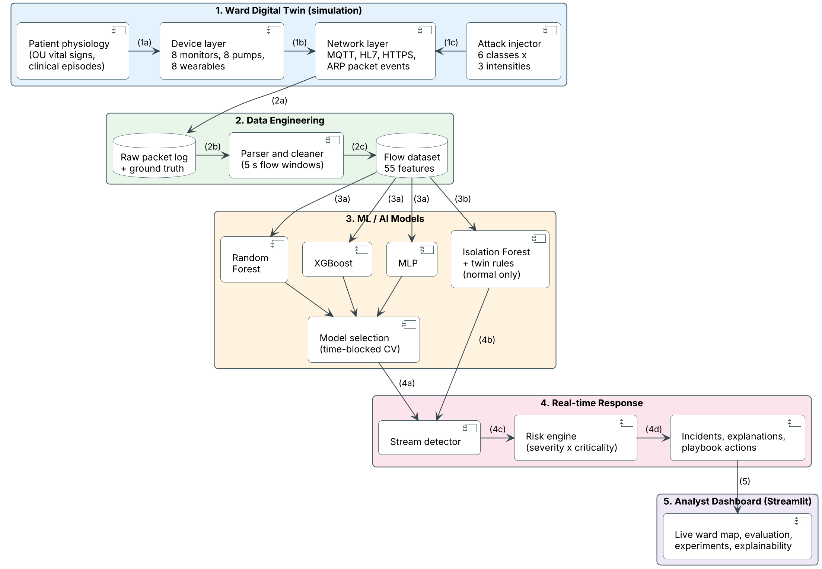
End-to-end pipeline
Notes:
Walk through the numbers: (1) the twin generates packets, (2) the parser cleans them and builds flow windows, (3) three models are trained and one is selected by cross-validation, (4) the live detector and risk engine score devices, (5) the dashboard shows it all.

Slide 8

55 features in three groups
Network (34)
Biometric (10)
Digital twin (11)
Packets, bytes, loads, rates
Packet sizes, inter-arrival, jitter
SYN, RST, FIN, ARP counts
MQTT CONNECT, refused, PUBLISH, CMD
Host fan-out and port spread
Temperature, SpO2, pulse
Blood pressure, heart rate
Respiration rate, ST segment
Infusion rate
Telemetry present
Unknown source, MAC or TTL mismatch
Duplicated or missing sequence numbers
Monitor vs wearable residual (HR, SpO2)
Vitals change and spread
Requested pump-rate change
5 s service-level bidirectional flow windows, oriented by the TCP SYN. No addresses, ports or time stamps are used as features.
Notes:
Network and biometric features mirror WUSTL-EHMS-2020. The twin features are new: they compare traffic with what the twin expects, for example whether the monitor and the wearable on the same patient agree.

Slide 9
Three models, one leakage-aware protocol
Random Forest
XGBoost
MLP (deep network)
Bagged trees; robust, little tuning; class weights
Boosted trees fix earlier errors; suits rare, hard classes
256-128-64 ReLU layers; scaled features; oversampling
+ Isolation Forest and label-free twin rules, both built from normal traffic only, as safety nets for unseen attacks
Tune on temporal hold-out (last 25%)
5-fold CV with 30-min time blocks
Select on CV macro F1 only
Test once on the independent run
Follows Arp et al. (USENIX Security 2022) to avoid data snooping and temporal leakage.
Notes:
The three models cover bagging, boosting and deep learning. The protocol is the important part: the test run is touched once, after the model has been chosen on cross-validation alone.

Slide 10
XGBoost is the most accurate and fast
Model | Accuracy | Binary F1 | Macro F1 | 95% interval | CV macro F1 | Extra wards | Latency (ms)
Random Forest | 0.9982 | 0.9938 | 0.965 | 0.947 to 0.978 | 0.953 | 0.979 | 24.04
XGBoost | 0.9990 | 0.9966 | 0.981 | 0.970 to 0.987 | 0.974 | 0.993 | 2.28
MLP | 0.9980 | 0.9933 | 0.973 | 0.960 to 0.982 | 0.947 | 0.982 | 0.32
0.981
99.90%
2.28 ms
macro F1 over 7 classes (XGBoost)
accuracy on the unseen test run
to score one flow (one thread)
All three exceed 99.8% accuracy, so accuracy hides the difference; macro F1 does not. XGBoost was chosen on cross-validation (the highest). On the test run it ties with the MLP (paired bootstrap) and beats Random Forest; on three extra unseen wards it is best 3 times out of 3.
Notes:
Selection used cross-validation only. The 95% cluster-bootstrap interval of the macro-F1 difference is 0.004 to 0.031 against Random Forest (a real lead) and 0.000 to 0.018 against the MLP (a tie). On the extra wards XGBoost averages 0.993, the MLP 0.982 and Random Forest 0.979. XGBoost trains in 32 s and needs 2.28 ms per flow; Random Forest is 11x slower per flow and weaker on spoofing.

Slide 11
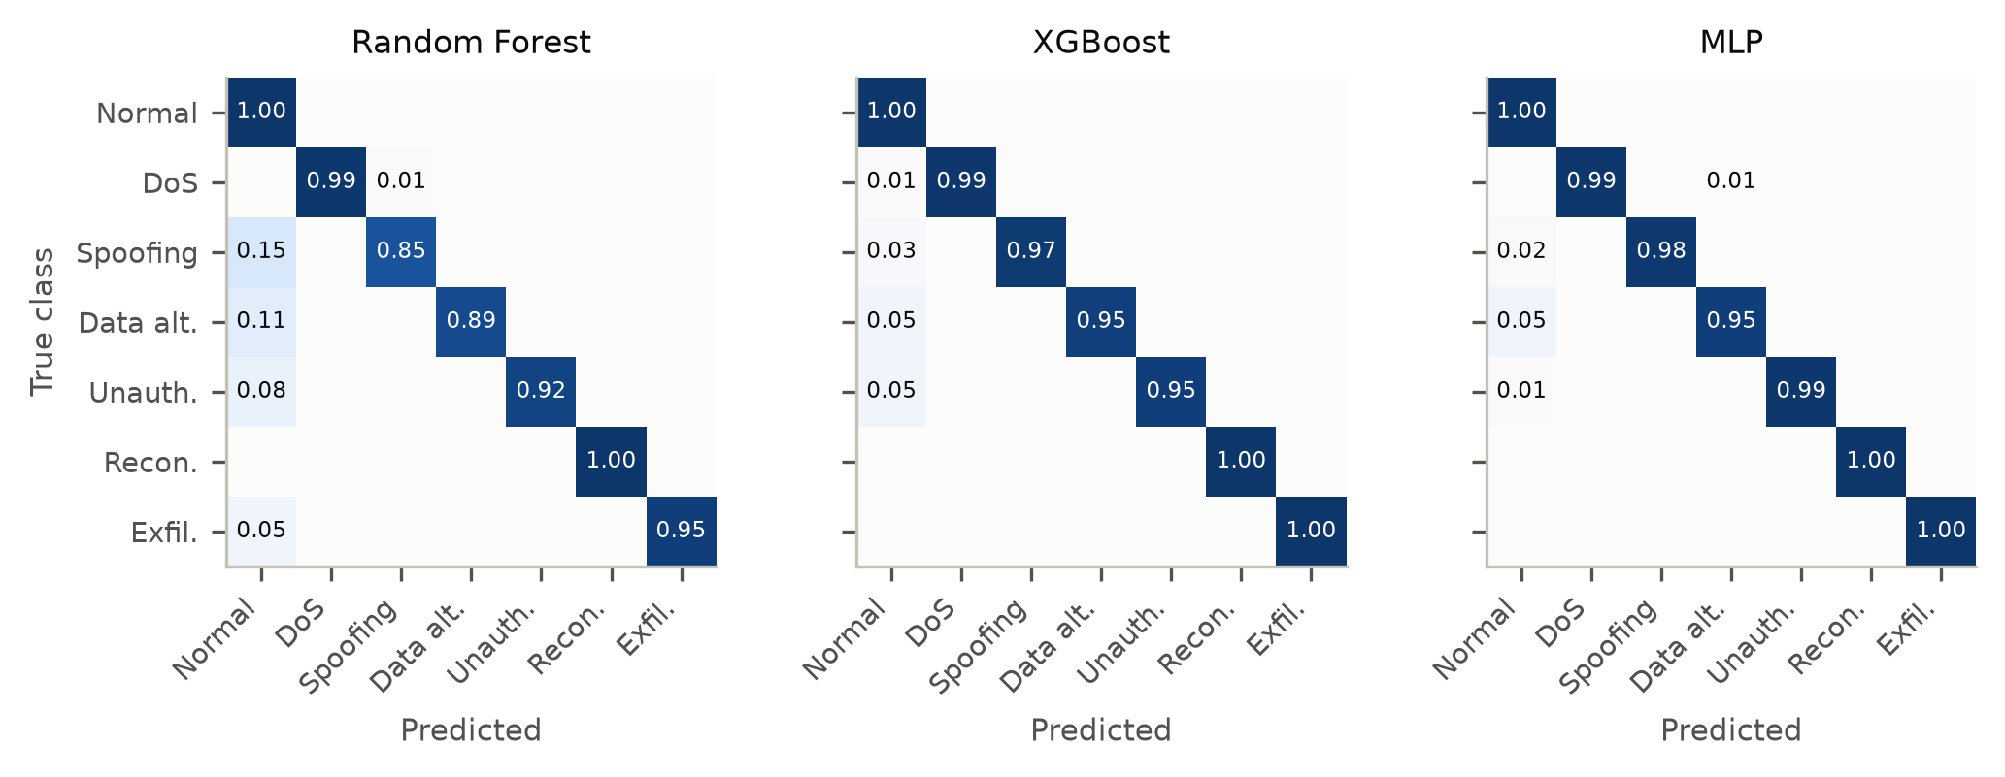
The difference is in the integrity attacks
Random Forest calls 10% of impostor spoofing flows normal; XGBoost and the MLP catch 98% and 99%. The evidence is a few weak twin signals that bagging outvotes and boosting focuses on.
Notes:
Rows are true classes, columns predictions, normalised per row. Loud attacks are easy for all models. The impostor publishes under a victim's identity; only sequence numbers, the cross-sensor residual and the sender's registry status give it away.

Slide 12
Twin features make integrity attacks visible
What the model relies on (SHAP)
27%
65%
twin features
network features
Adding the 11 twin features lifts XGBoost from 0.835 to 0.981 and spoofing recall from 28% to 97%. Raw vitals alone add little: consistency is what matters.
Notes:
Biometric features alone are nearly useless because the fake vitals are plausible. Network plus biometric, the WUSTL-EHMS-2020 design, is no better than network alone here. The twin features (sequence integrity, monitor versus wearable residual, registry checks) make the difference. Twin features are 20% of the inputs but carry about a quarter of the SHAP attribution.

Slide 13
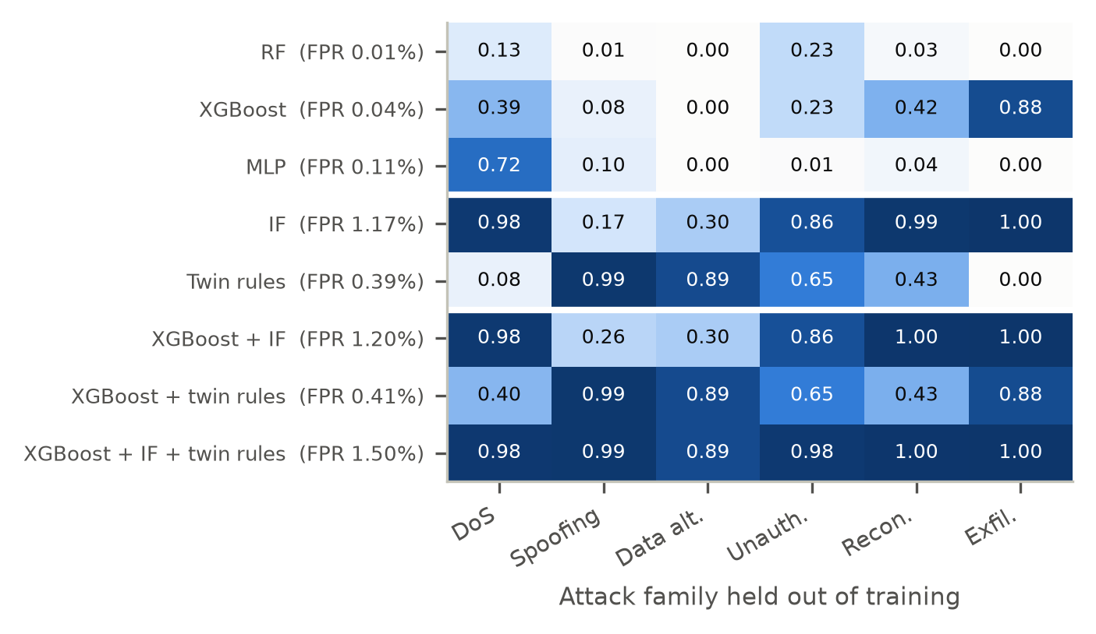
Unseen attacks: three layers close the gap
Closed-world models miss the unknown
Trained without one family, supervised recall on it averages only 0.33 (XGBoost). The Isolation Forest reaches 0.72: strong on DoS, scans and exfiltration, weak on spoofing (0.17) and data alteration (0.30). Adding the twin rules closes that gap: all three layers together reach 0.97.
Notes:
Each row is a detector, each column an attack family that was removed from training. The hybrid of XGBoost and the Isolation Forest reaches 0.73 at 1.20% FPR; adding the twin rules gives 0.97 at 1.50%. The next slide explains the rules.

Slide 14
Designed fix: twin consistency rules
99%
89%
R1
Sender is in the asset registry
of unseen spoofing caught
of unseen data alteration caught
R2
MAC address and TTL match the registry
R3
Sequence numbers neither duplicated nor missing
0.73 → 0.97
R4
Monitor and wearable on one patient agree
mean recall on unseen families (XGBoost + Isolation Forest, then + rules)
R5
Pump rate does not change unexpectedly
36 → 91
Thresholds: 99.9th percentile of normal training traffic. No attack labels needed.
false alerts in the live run: the cost, so the rules are an option
Notes:
The rules need no attack labels: each threshold is the 99.9th percentile of its signal in normal training traffic. They are strongest exactly where the learners are weakest, on unseen spoofing (0.99) and data alteration (0.89). The cost is more false alerts: in the live run 36 became 91, so the rules are an option (--twin-rules). At the 99.99th percentile their false positive rate falls to 0.12% but unseen-spoofing recall falls to 0.84.

Slide 15
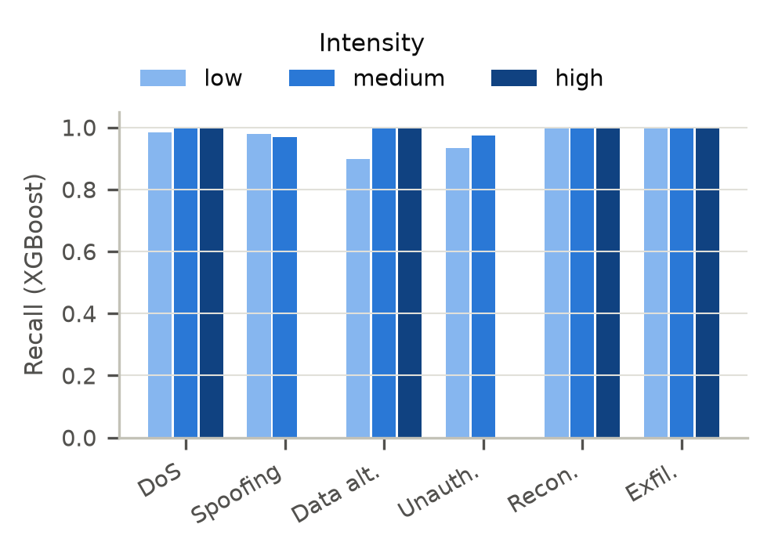
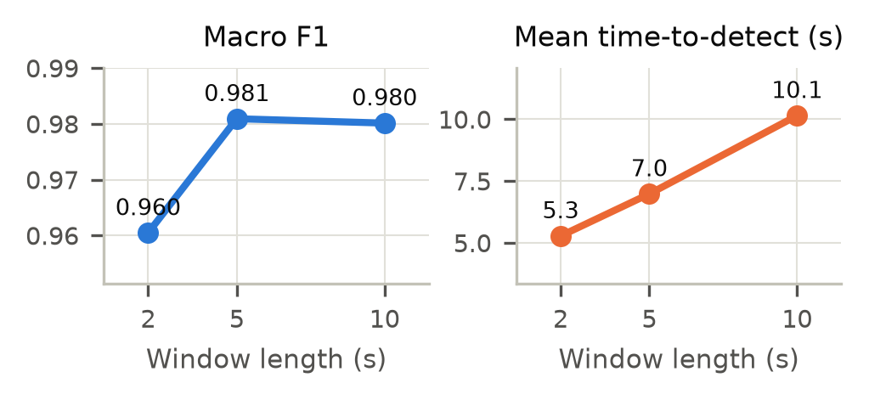
Sensitivity to attack intensity and window length
Low-intensity data alteration is the hardest case (XGBoost recall 0.90). Shorter windows detect sooner: mean time-to-detect 10.1 s at 10 s, 7.0 s at 5 s and 5.3 s at 2 s, with macro F1 0.980, 0.981 and 0.960. We keep 5 s.
Notes:
The test run contains no high-intensity spoofing or unauthorised-access campaign, so those bars are missing. Exfiltration raises the mean delay because it is only visible once the upload starts.

Slide 16
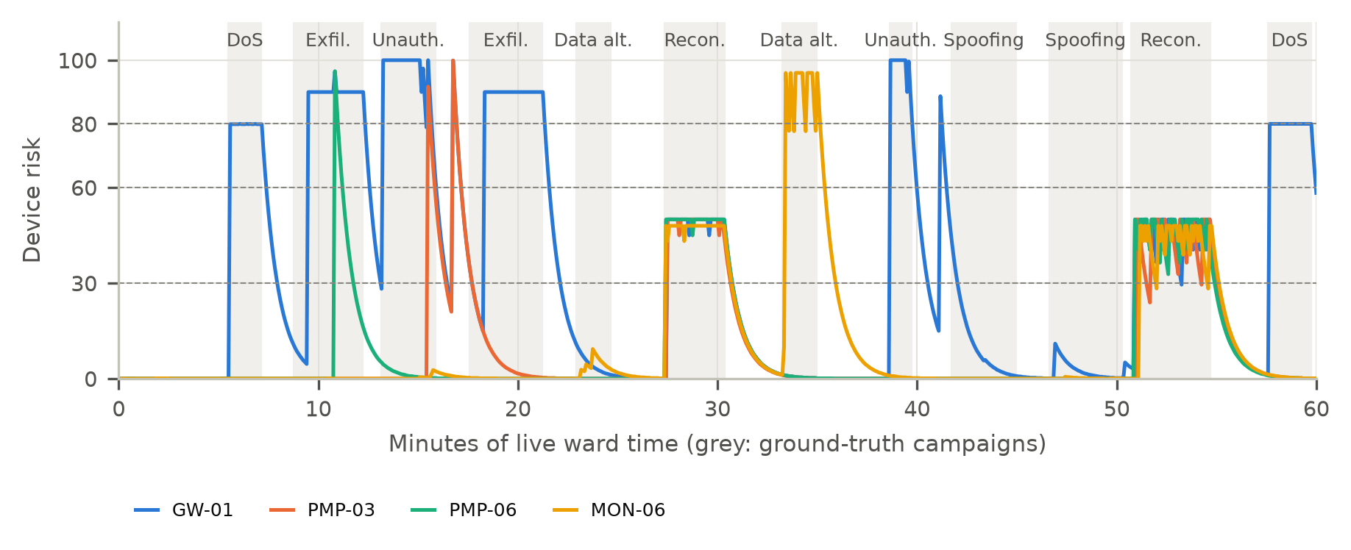
Real-time detection on a live twin
30/30
12/12
3.7 s
128 ms
test-run campaigns detected (streamed)
campaigns on a new live twin
median time-to-detect
processing per 5 s window
Notes:
Replay of the test run: 30/30 campaigns, median 3.7 s. New live twin: 12/12, median 3.5 s. 4,782 alerts collapse into 34 incidents. Most 'false' alerts are the Isolation Forest, nurse pump pauses, or the healthy wearable of a patient whose monitor is spoofed, which still points at the right bed.

Slide 17
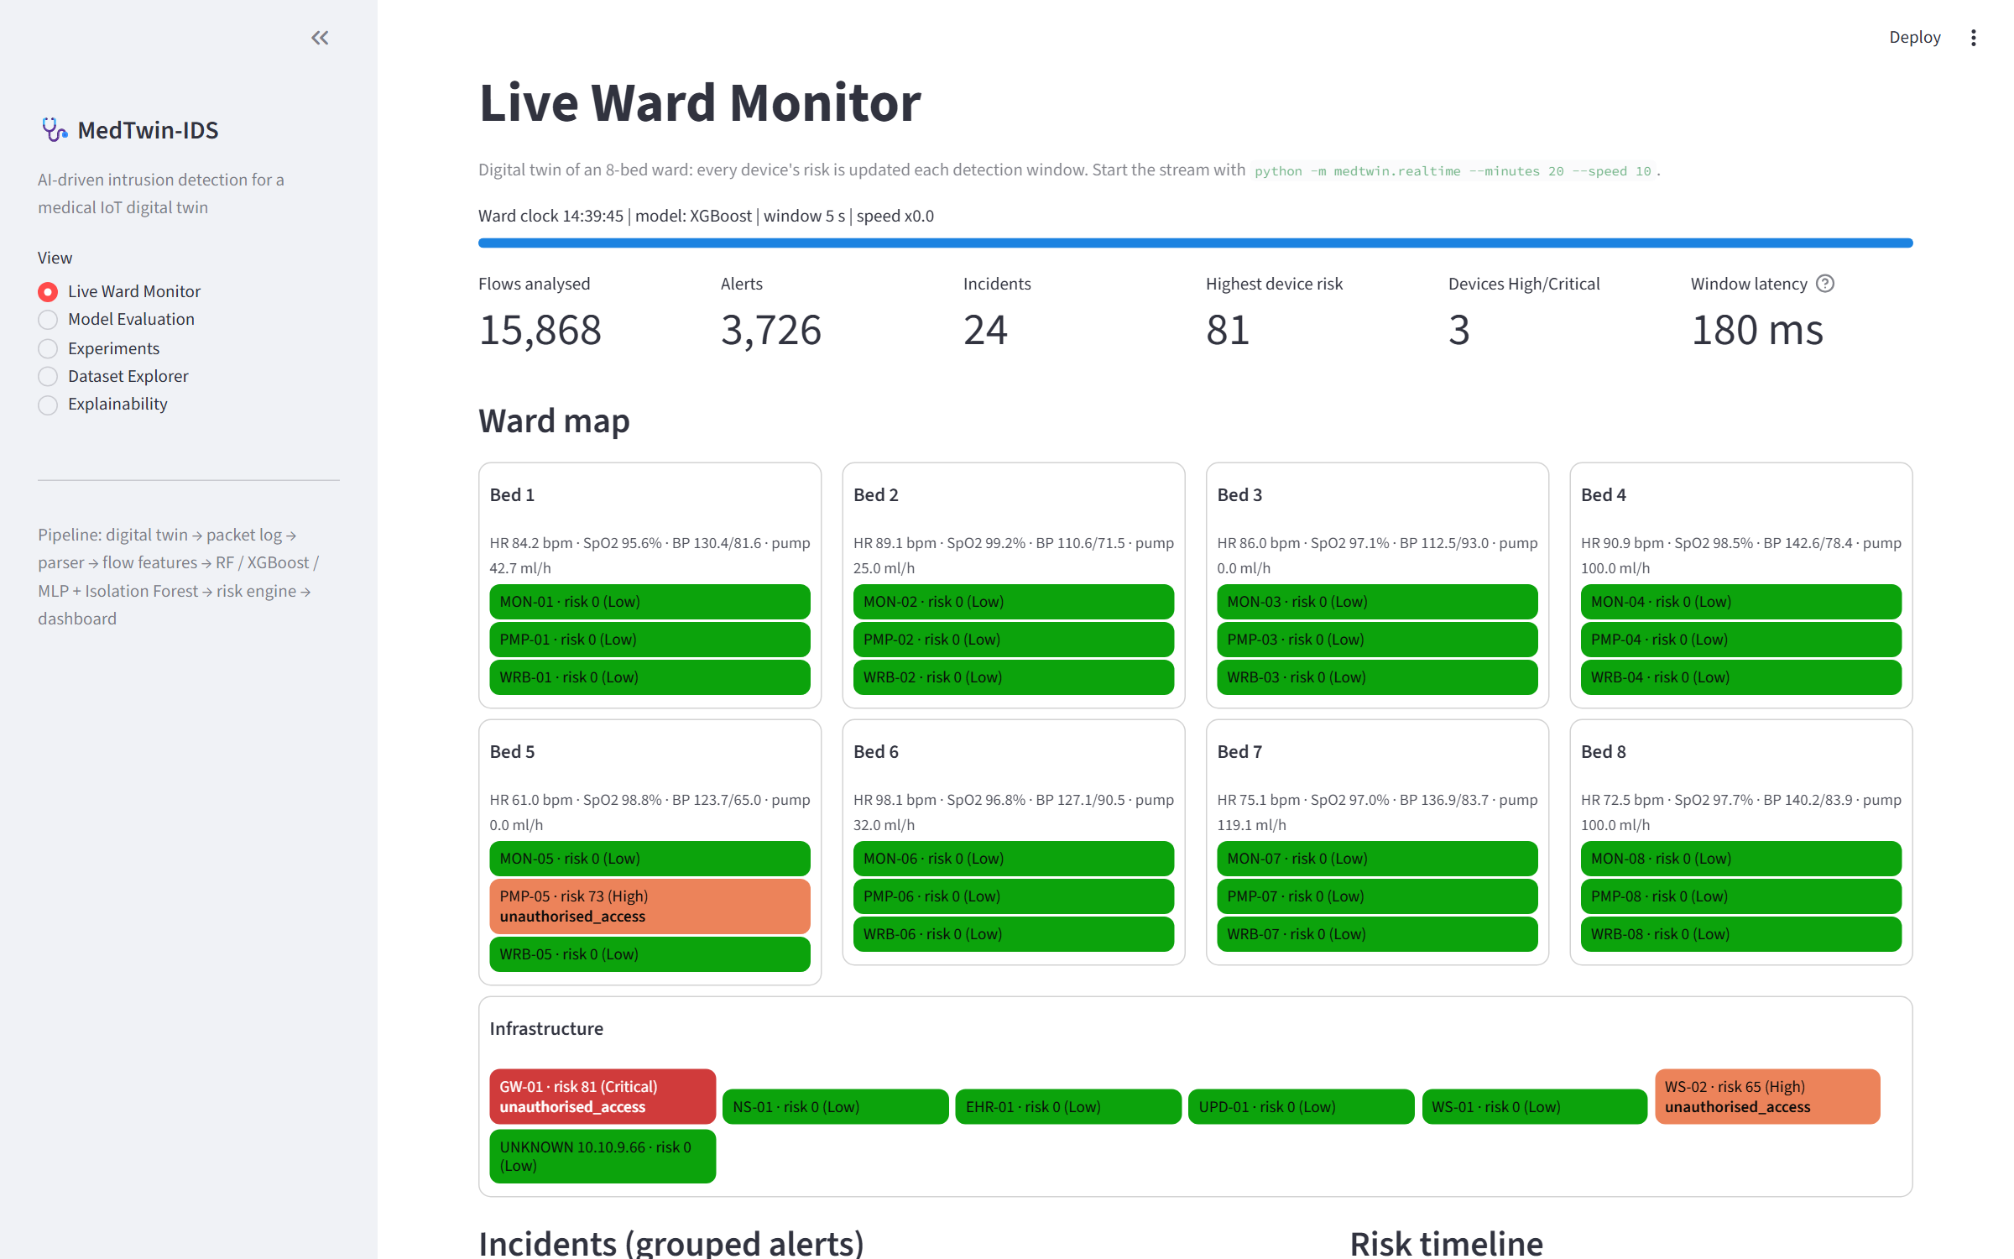
Analyst dashboard (live demo)
Notes:
Live demo: start 'python -m medtwin.realtime --minutes 20 --speed 10' and the dashboard. Point out the ward map, a device turning red, the incident with its explanation and recommended action, and the risk timeline. Then show the Model Evaluation and Experiments pages.

Slide 18
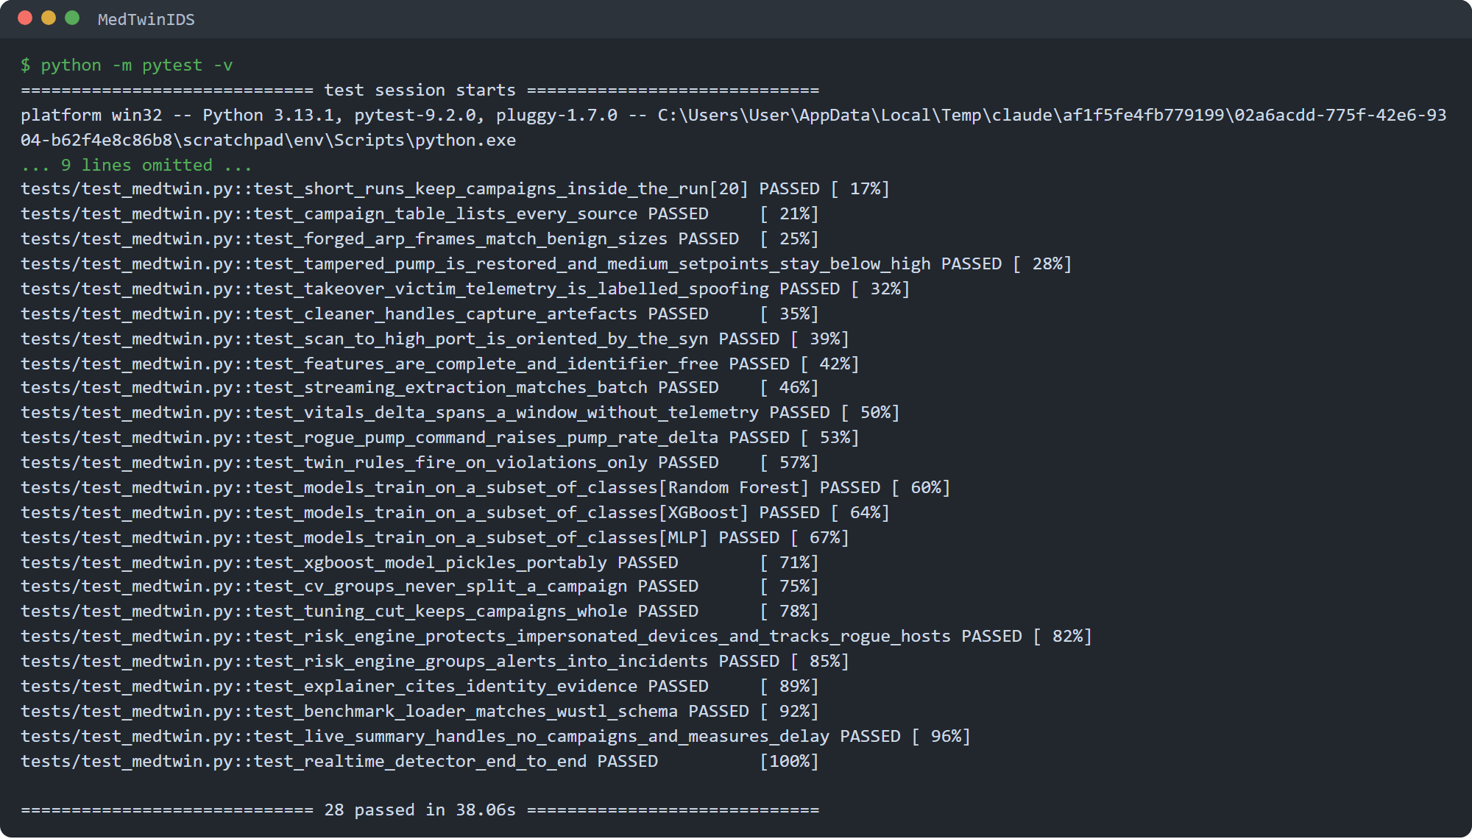

Tested and reproducible
28 automated tests pass
Live, window-by-window features equal offline features for all 55
Twin is deterministic; every attack family is labelled
Each twin rule fires only on its violation
Risk engine protects impersonated devices
Real-time detector runs end to end
Seeded runs: re-running gives the same data and results
Notes:
Run 'python -m pytest -v' from the MedTwinIDS folder. The most important test checks that the live detector sees exactly the same 55 feature values as the offline training data, so the deployed model gets the inputs it was trained on. The user manual reproduces every table and figure in the report.

Slide 19


Limitations and next steps
Limitations
Next steps
Simulated data: real devices and attackers vary more, so absolute scores are optimistic
Twin rules catch unseen integrity attacks but add false alerts
Nurse pump commands, including restores after an attack, can look like rogue commands
Flow labels can disagree with bed-level reality
WUSTL-EHMS-2020 benchmark script ready but not yet run
Validate on real captures and WUSTL-EHMS-2020
Calibrate twin rules per device to cut false alerts
Feed command source and clinical orders into pump features
Online sequence models (autoencoder ensembles)
Clinician-approved automatic isolation of high-risk devices
Notes:
Be honest about limitations: the data is simulated, so the next step is validation on real captures and the public WUSTL-EHMS-2020 benchmark.

Slide 20
Conclusion
RQ1: the ward twin generates exactly labelled, controllable IoMT data
RQ2: XGBoost gives the best balance (macro F1 0.981, 2.28 ms per flow)
RQ3: twin features lift spoofing recall from 28% to 97%
RQ4: Isolation Forest plus twin rules lift unseen-attack recall from 0.33 to 0.97
RQ5: all 30 test campaigns detected in real time, median 3.7 s
Notes:
Answer the five research questions in one line each, then invite questions.

Slide 21
Key references
A. A. Hady et al., "Intrusion detection system for healthcare systems using medical and network data," IEEE Access, 2020.
D. Arp et al., "Dos and don'ts of machine learning in computer security," USENIX Security, 2022.
T. Chen and C. Guestrin, "XGBoost: A scalable tree boosting system," ACM SIGKDD, 2016.
L. Breiman, "Random forests," Machine Learning, 2001.
F. T. Liu, K. M. Ting and Z.-H. Zhou, "Isolation forest," IEEE ICDM, 2008.
S. M. Lundberg and S.-I. Lee, "A unified approach to interpreting model predictions," NIPS, 2017.
Y. Mirsky et al., "Kitsune: An ensemble of autoencoders for online network intrusion detection," NDSS, 2018.
The full reference list is in the final report.
Notes:
References for the slides; the report has the complete list.

